Slide 1

2012 Commercial Building Energy Consumption Survey (CBECS)
Stakeholder Meeting
Tom Leckey, Joelle Michaels, Alan Swenson
May 15, 2012 | Washington, DC

Slide 2
Agenda
Welcome
CBECS background
2012 CBECS general changes
2012 CBECS changes and new questions by questionnaire section
Potential new questions for audits
Future CBECS considerations
How you can still help us on the 2012 CBECS

Slide 3
EIA CBECS Team Members
Core CBECS Team: Survey Operations, Sampling, Data Processing, Editing, Imputation, Analysis…
  Joelle Michaels, Survey Manager
  Katie Lewis
  Jay Olsen
  Alan Swenson
  Marilyn Worthy
  Vincent LeMoine
Management
  Tom Leckey, Director, Office of Consumption and Efficiency Statistics
  Eileen O’Brien, Team Lead, Buildings Surveys Statistics
  Hiro Minato, Team Lead, End Use Consumption Statistics

Slide 4
Welcome
CBECS Stakeholder Input
EIA action
Benefits to EIA of this interaction
Constraints
  Length of survey, cost
  Instrument reliability
  OMB approval
  Scope of survey
  Respondent capability
  New technologies

Slide 5
What is CBECS?
Commercial Buildings Energy Consumption Survey (CBECS)
  the only national level source of data on the characteristics and energy use of commercial buildings
  conducted every 3 or 4 years since 1979
  mandated by the Department of Energy (DOE) Organization Act of 1977, Public Law 95-91

Slide 6
What is CBECS?
CBECS interviews…
  conducted by professional interviewers using a computerized survey instrument, usually in-person – average interview lasts 30 minutes
  advance package of materials (including worksheets) is provided to the building a few days before the interview
  sample size historically 5,000-7,000 buildings
  building interview covers many topics – building size and use; ownership and occupancy; energy sources, uses, and equipment; energy consumption and cost
  building survey is followed by an energy supplier survey – if useable energy usage information is not available from the building respondent
  the 2012 CBECS interviews will be conducted between April 2013 and Sept 2013, with the energy supplier survey following

Slide 7
CBECS Sample Overview
Multistage area probability sample
  statistically select from increasingly smaller geographic areas
    “field listers” walk each block in selected areas and list every commercial building within the segments
    CBECS area sample is selected from that list
Supplemented with additional list samples
  use several special lists in order to efficiently sample enough large buildings
    Federal buildings (GSA)
    hospitals
    colleges/universities
    airports (FAA)
    other large buildings

Slide 8
2012 CBECS: General Changes
Sample update using proven methodology
Sample size increased 150% - target of 8,400 buildings for 2012
Subset of buildings will be re-interviewed/verified using energy audit techniques
Some interviews to be conducted by telephone (ability to locate more knowledgeable respondents)
Streamlined editing procedures

Slide 9
2012 CBECS Changes and New Questions By Questionnaire Section
Overview of planned substantive changes for each questionnaire section
Following each section, we would like to hear your questions and comments

Slide 10
Section A: Building Size, Structural Characteristics, and Age
Square footage
  clarifying questions about total/gross square footage
    does the reported square footage include parking?
      completely enclosed and physically connected to the building (e.g. underground parking levels)
      partially open garages or garages separate from the building
    does it include “non-leasable” areas (e.g. lobbies, hallways, stairways)?
NEW: Floor-to-ceiling height
NEW: “Cool roof” materials
Escalators
  specify that moving walkways should be counted as escalators

Slide 11
Section A: Building Size, Structural Characteristics, and Age
Renovations
  remove the word “major” from the filter question
    list of renovation types may be overly inclusive, but we can exclude minor improvements when we report the data
  NEW CATEGORIES
    “exterior replacement” split into “exterior roof replacement” and “exterior wall replacement or renovation”
    building automation/management system
    electrical upgrade
    fire/safety/security upgrade
  we ask about renovations done “since 1980”
    is this still a meaningful reference date?
Questions/comments on Section A?

Slide 12
Section B: Building Activity
A few points of clarification:
  we purposely duplicate activity subcategories within the main activity categories
    the survey instrument automatically reclassifies the activity to the correct CBECS principal building activity so that we can ask the appropriate follow-up questions
    example: libraries are “public assembly” by CBECS definition but are also available as an option within office, education, service, and other
  if a building is not 75% or more of a single activity, we ask for the top three activities and collect the percent of floorspace used for each
  military bases are not included in the CBECS sample
  laboratories have always been classified separately in the CBECS, but are combined into “other” for reporting because of sample size constraints
    increase in sample size may allow reporting for laboratories
New details on specialized uses of space – Section E
Questions/comments on Section B?

Slide 13
Section C: Ownership, Occupancy, Operating Hours, Employment
Building ownership
  NEW: ask if the building is owned as an investment (i.e. for leasing) or for occupancy
  NEW CATEGORY: add “Real estate investment trust (REIT)” as a building owner category
Ask whether the building is leased by a government agency?
  would this be useful information?
Purchasing power
  NEW: ask who pays the energy bills?
Hours of operation
  better alignment with Energy Star definitions (e.g. for offices, define as the time when 75% or more of the people are in the building)

Slide 14
Section C: Ownership, Occupancy, Operating Hours, Employment
Number of building occupants
  NEW: collect information to better define usage levels in building types that are public/customer oriented (e.g. average meals served in restaurants, room- nights at a hotel, number of visitors to a museum)
Vacancy rates
  NEW: ask for the average yearly occupancy rates for certain building types
Fire station staffing levels
  NEW: is the staffing at the station usually constant, highly variable, or is the building usually unoccupied (e.g. volunteer station)
Questions/comments on Section C?

Slide 15
Section D: Energy Sources, Uses, Equipment
Heating equipment types
  furnace type
    add “Individual room high efficiency condensing furnace”
  boiler and district system distribution types
    add “Radiant panels in walls/floors”
  heat pump type
    add “Dual source” and “Dual fuel” (clarify)
  individual heater type
    add “High temperature infrared radiant heater”
    add “Low temperature electrical radiant panels”
  add “Chiller heater”

Slide 16
Section D: Energy Sources, Uses, Equipment
Heating (and cooling) ventilation types
  add “Underfloor air distribution”
  add “natural ventilation” to “No mechanical ventilation”
Reduce heating (and cooling)
  add “Manual operation”
Cooling equipment types
  chiller type
    add “Absorption chiller”
  chiller/district chilled water distribution type
    add “Chilled beam”
  heat pump type
    add “Dual source”

Slide 17
Section D: Energy Sources, Uses, Equipment
Other energy sources/HVAC equipment items under consideration
  use of air- and waterside economizers
  use of demand controlled ventilation
  energy recovery and energy storage systems
  cogeneration
  dual fuel sources for heating
  solar thermal
  age of HVAC equipment
  variable air-volume system (heating components)

Slide 18
Section D: Energy Sources, Uses, Equipment
Regular HVAC maintenance
  add follow-up question to characterize the maintenance program
Water heating sources/equipment
  add “Heat recovery”
Separate question for building automation system (BAS)

Slide 19
Section D: Energy Sources, Uses, Equipment
Generation technologies
  add “Small wind turbines”
  add “Reciprocating (gas/diesel) engines”
  add “Gas turbines”
Use of generated electricity
  capture amount generated in Section F (Electricity)
New question to characterize how excess generated electricity is used
  sold to the local utility or another electricity supplier
  stored onsite for later use by the building

Slide 20
Section D: Energy Sources, Uses, Equipment
How purchase electricity
  add “Amalgamated contract purchase”
Questions/comments on Section D?

Slide 21
Section E: Miscellaneous Space Uses and Equipment
Food preparation or serving areas
  in addition to simply the presence of these types of areas, collect the percent of floorspace (NEW)
    snack bar/concession stand
    fast food/small restaurant
    cafeteria/large restaurant
    large kitchen/commercial kitchen/other large food preparation area
Medical-related
  NEW: for health care buildings, collect the number of MRI, X-ray, CT, linear accelerators
  NEW: for hospitals, collect the percent of the building used for outpatient care
  NEW: for outpatient health care, ask if there is an ambulatory surgery center, and if so, the number of operating rooms

Slide 22
Section E: Miscellaneous Space Uses and Equipment
Lodging-related
  NEW: percent of building used for conferences/special events
Refrigeration equipment
  NEW: ask lodging buildings if there is a small refrigerator in each guest room
Fire station use
  NEW: percent of building used for non-fire department activities (e.g. hall rental, police station, local government offices)
  NEW: are there living quarters in the station?

Slide 23
Section E: Miscellaneous Space Uses and Equipment
Computer-related
  currently collect the number of: computers, laptops, servers
    clarify to exclude any tablet PCs
  high-density computing areas
    collect presence and percent of square footage (NEW) for each:
      data center/server farm
      NEW: trading floor
      computer-based training room
      student or public access computer center

Slide 24
Section E: Miscellaneous Space Uses and Equipment
Other equipment
  NEW: ask for the number of video displays (e.g. televisions, flat panel displays)
  NEW: for schools, collect the number of interactive whiteboards (e.g. SMART boards)
Plug load controls
  NEW CATEGORY: add “sleep mode” or Energy Star setting as a method to turn off computers
  NEW: controlled receptacles (i.e. power outlets) that automatically turn equipment off at certain times or when the space is vacant?

Slide 25
Section E: Miscellaneous Space Uses and Equipment
Lighting
  add “induction lighting” as a type of lamp?
  instead of just “daylighting features” ask two sets of lighting feature questions:
    lighting controls
      scheduling, occupancy sensors, multi-level lighting or dimming, high-end trim or tuning, personal light control, demand responsive lighting
    daylighting features
      tinted window glass, reflective window glass, external overhangs or awnings, skylights or atriums, automatic controls that increase or reduce lighting in response to natural light, automated or motorized window shades
  remove question about “specular reflectors”?
    is it outdated?

Slide 26
Section E: Miscellaneous Space Uses and Equipment
NEW: ask about building certification
  Energy Star, LEED, Green Globes, Other
NEW: ask whether the building has an AMI meter
Questions/comments on Section E?

Slide 27
Sections F-J: Consumption and Expenditures
Enclosed malls
  collect information on how electricity/HVAC responsibilities are divided between the landlord and the tenants
  clarify which portions of the mall are included in the consumption data that we obtain: common area, tenants, anchor stores
On-site generation
  NEW: for buildings with on-site generation, ask for the amount of electricity produced
Better accounting of whether non-building uses are included in the consumption figures
  parking lot lights (added in 2007)
  other exterior lighting
  outdoor swimming pools
Questions/comments on Sections F-J?

Slide 28
Section K: Water
Water consumption
  collect information on the units (gallons, cubic feet, etc.)
  in Section D, for buildings with central chillers, heat pumps or packaged units as their cooling systems, ask if there is a cooling tower
  determine whether water is metered separately for cooling towers and/or irrigation
    if so, collect the volume used for each separate use

Slide 29
Potential Questions for the Audit Subsample
Building orientation
Building footprint and the site footprint
Building codes/energy codes
Wall construction
  number of layers and associated insulation values
Information on pumps (how many, motor sizes)
Peak electricity/energy loads
Exhaust hoods/fume hoods, including size
Linear feet of open and closed refrigeration units

Slide 30
Future CBECS Considerations
Additional reporting for units of analysis other than the building
  campuses
  establishments within strip shopping centers (e.g. grocery stores)
Multifamily residential buildings

Slide 31
We still need your help on the 2012 CBECS
Endorsement insert/letters
  for inclusion with the advance packet of materials provided to respondents
  please let EIA know if you would like your organization listed in association with the following statement:
    The following organizations recognize that the Commercial Buildings Energy Consumption Survey (CBECS) provides critically important information to support programs that promote energy efficiency in commercial buildings in the U.S. These organizations strongly encourage participation in the 2012 CBECS.
  we would also welcome individual endorsement letters that the interviewer would use as a tool for gaining respondent cooperation
Trade magazines/journals
  increase awareness that CBECS is in the field (April 2013-Sept 2013)

Slide 32
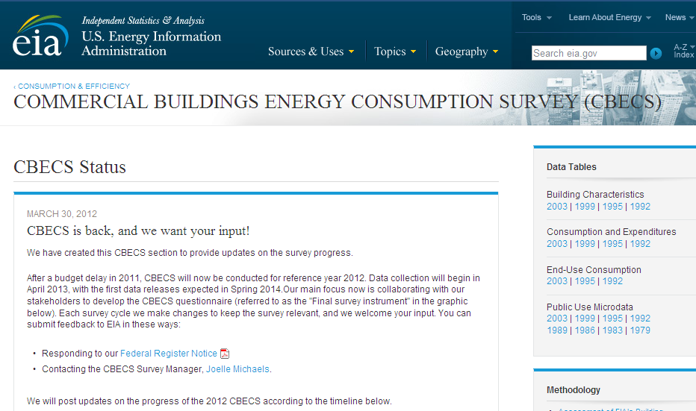
The new CBECS “blog”
Periodic updates on 2012 CBECS progress will be posted at www.eia.gov/consumption/cbecs

Slide 33
For more information:
CBECS home page | www.eia.gov/consumption/commercial
Tom Leckey, Director, Office of Energy Consumption and Efficiency Statistics | thomas.leckey@eia.gov
Joelle Michaels, Survey Manager | joelle.michaels@eia.gov

