Slide 1
The National Survey on Drug Use and Health: 2019
Elinore F. McCance-Katz, MD, PhD
Assistant Secretary for Mental Health and Substance Use
Substance Abuse and Mental Health Services Administration
U.S. Department of Health and Human Services
September 2020

Slide 2
National Survey on Drug Use and Health (NSDUH)
NSDUH is a comprehensive household interview survey of substance use, substance use disorders, mental health, and the receipt of treatment services for these disorders in the United States.
NSDUH is collected face-to-face by field interviewers who read less sensitive questions to respondents and transition respondents to audio computer assisted self‑interviewing for sensitive items.
NSDUH covers the civilian, noninstitutionalized population, aged 12 or older:
Includes: Households, college dorms, homeless in shelters, civilians on military bases
Excludes: Active military, long-term hospital residents, prison populations, homeless not in shelters
Sample includes all 50 states and DC
Approximately 67,500 persons are interviewed annually
Data collected from January to December

Slide 3
How Do We Use NSDUH?
Provides a window into the state of substance use and mental health issues in the United States
Helps to guide policy directions in addressing:
problem substances
prevalence of mental illness
intersection of substance use and mental health issues
provides insights that can be studied in the context of data from other agencies to help in decision-making about what types of resources are needed and where resources should be directed

Slide 4
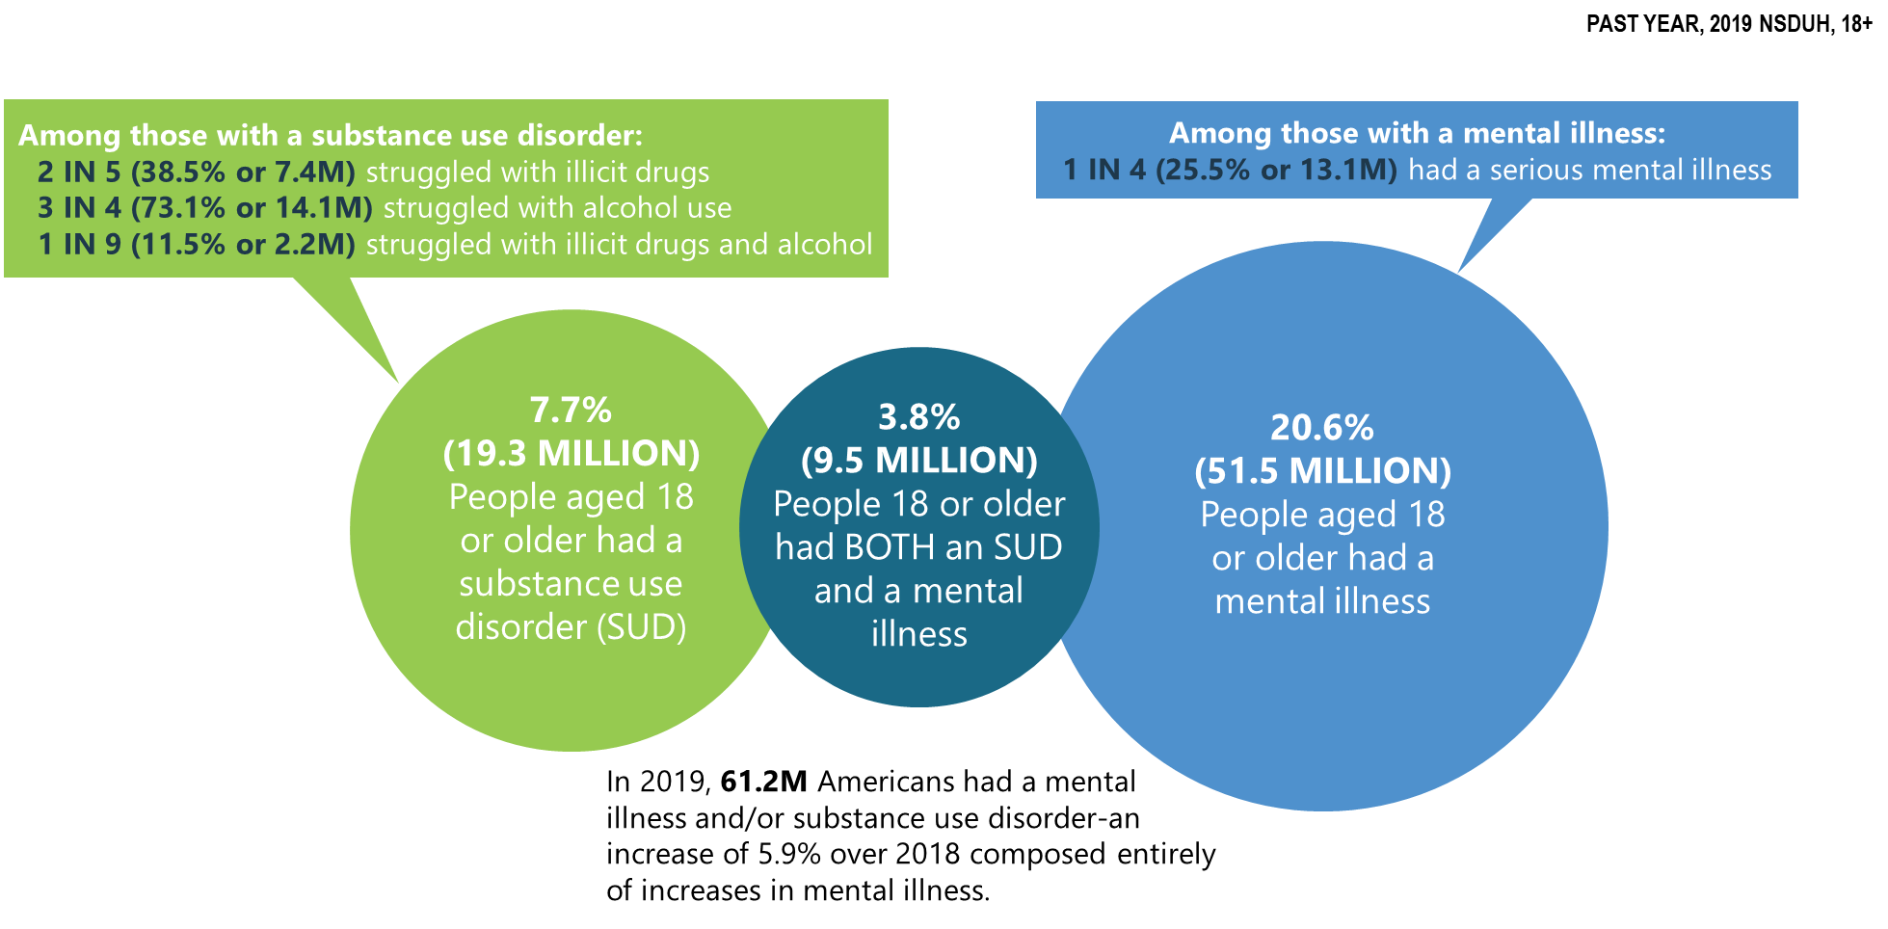
Mental Illness and Substance Use Disorders in America
Notes:
Slide ID: Nat19-4
Source: 2019 DT 5.1, 8.1, 8.4, and 8.47

Slide 5
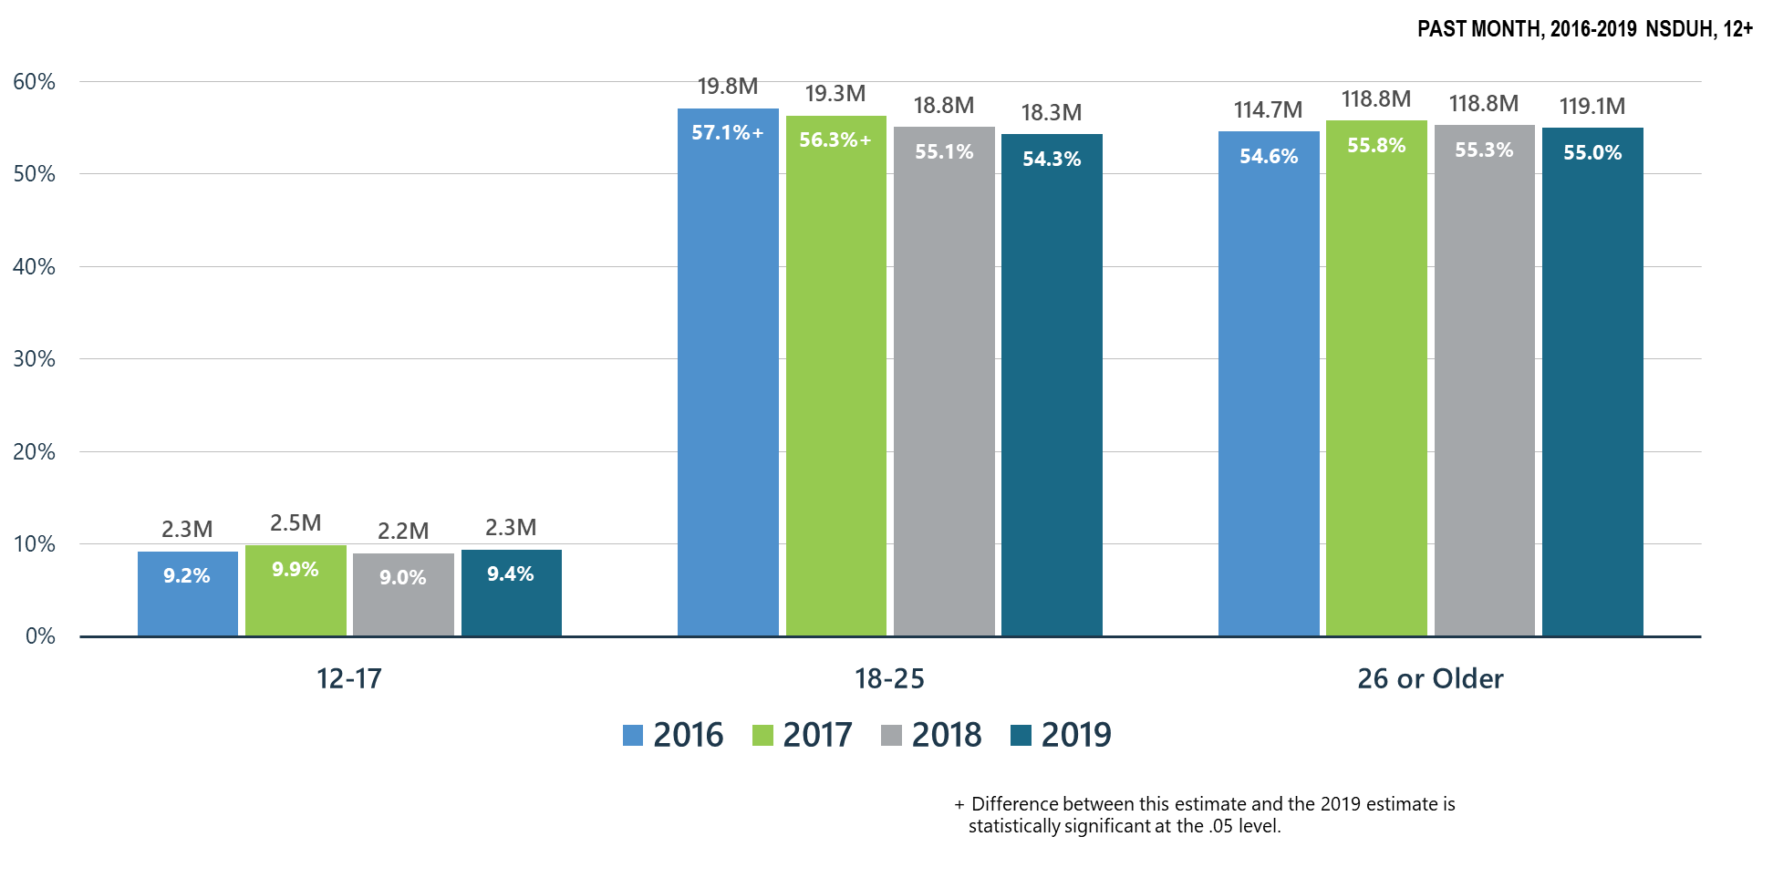
Alcohol Use
Notes:
Slide ID: Nat19-5
SOURCE: 2019 DT 7.6, 7.12, and 7.15

Slide 6
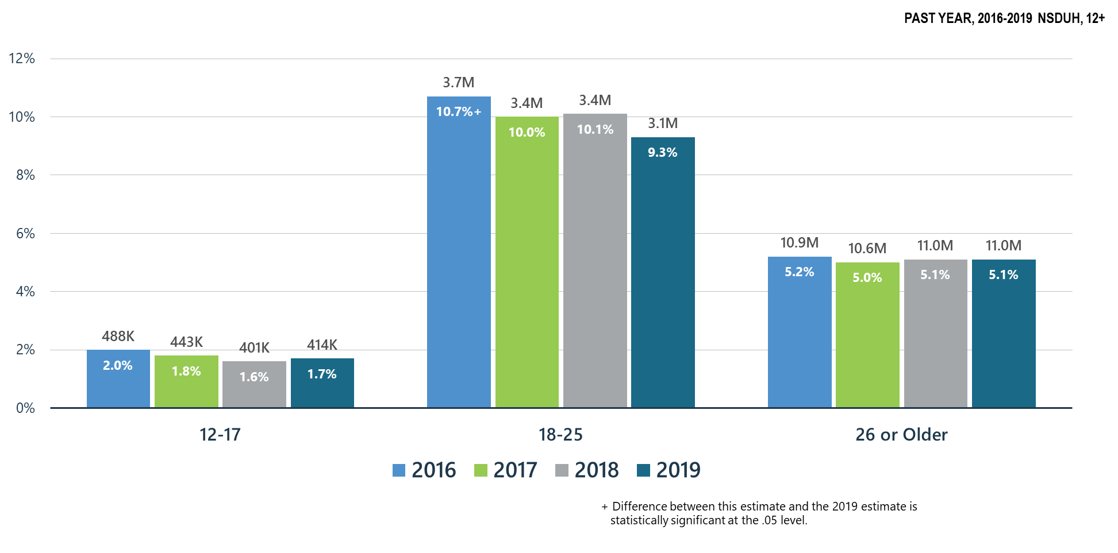
Alcohol Use Disorder
Notes:
Slide ID: Nat19-6
SOURCE: 2019 DT 7.47, 7.49, and 7.50

Slide 7
Summary: Alcohol Use in 2019
Past month alcohol use and past year alcohol use disorder remained stable in all age groups during 2018-2019
Alcohol use and Alcohol Use Disorder declined significantly in young adults from 2016 to 2019.
SAMHSA will continue its prevention programs:
SAMHSA Prevention Technology Transfer Centers produce resources and materials related to alcohol misuse prevention
CSAP ‘Talk They Hear You’ focuses on underage drinking
CSAP requires Partnerships for Success grantees to emphasize underage drinking prevention
CSAT has promoted SBIRT for alcohol use in all programs including CJ, PPW, adolescent treatment, HIV and homeless programs
CSAT has funded SBIRT training in medical residencies and other healthcare practitioner programs which screen for hazardous alcohol use and use disorders

Slide 8
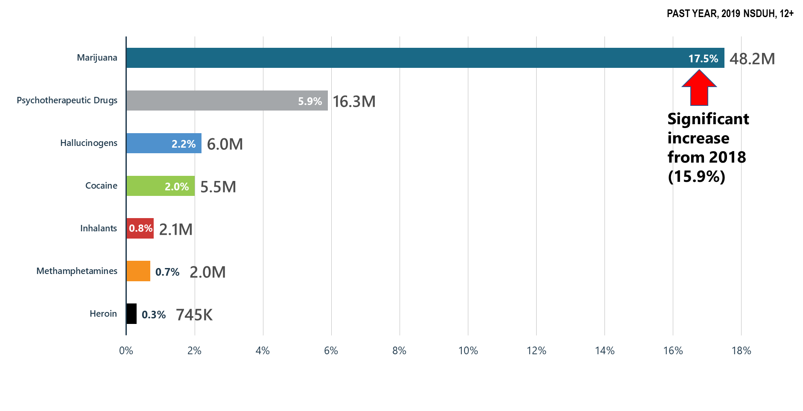
Illicit Drug Use: Major Concerns: Opioids, Marijuana, Methamphetamines
Notes:
Slide ID: Nat19-8
SOURCE: 2019 DT 7.2

Slide 9
Progress on the Opioid Epidemic: Prescription Pain Reliever Misuse
Notes:
Slide ID: Nat19-9
Source: Special analysis.

Slide 10
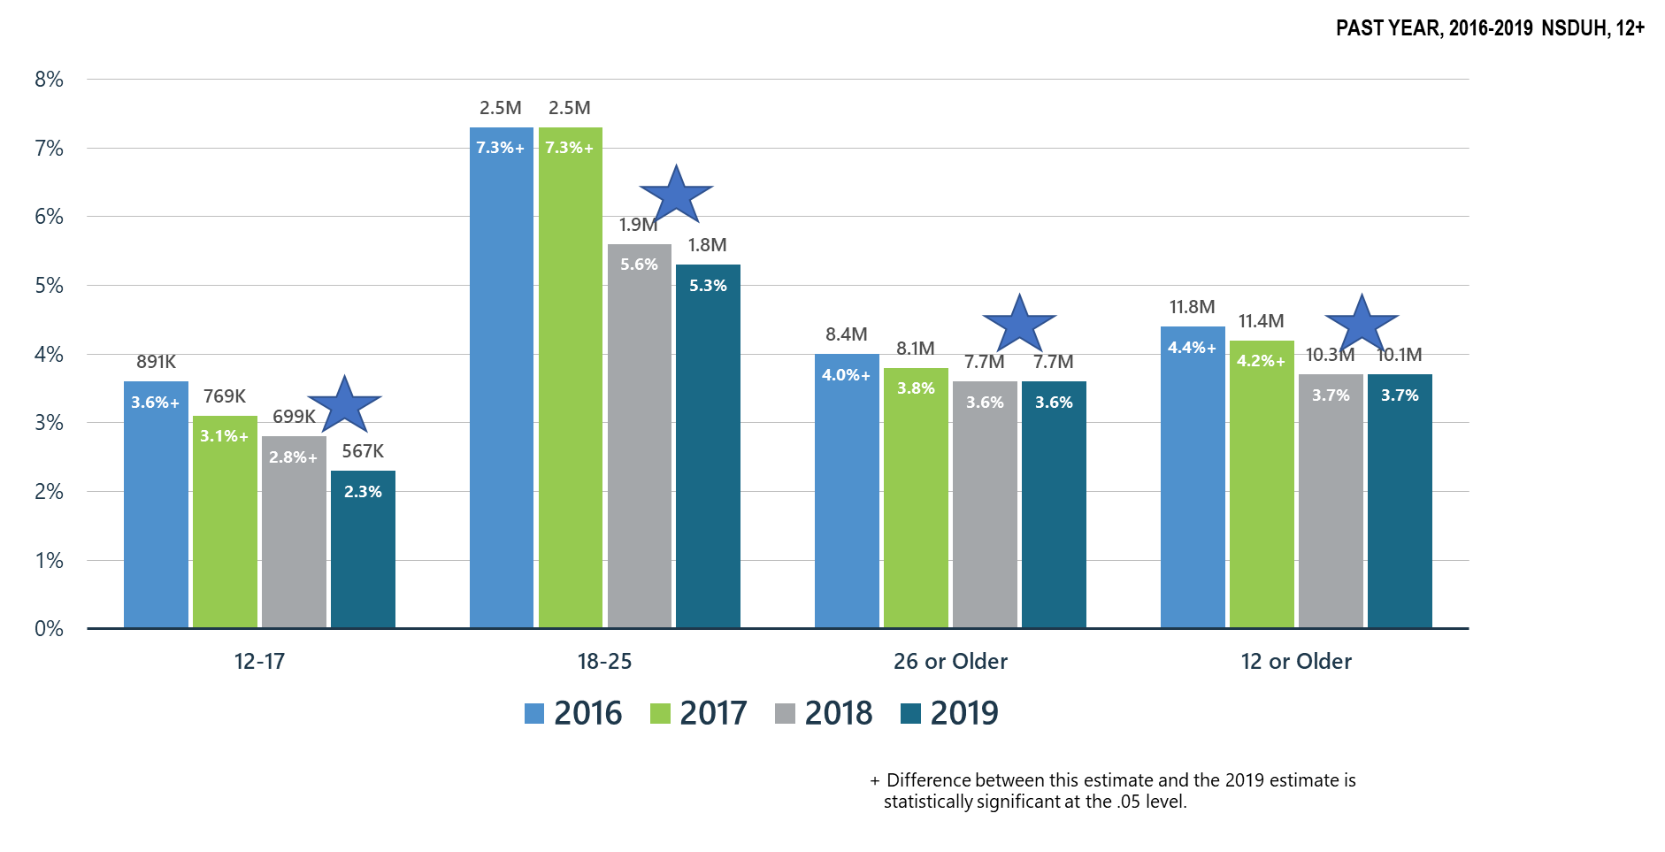
Opioid Misuse
Notes:
Slide ID: Nat19-10
SOURCE: 2019 DT 7.2, 7.5, 7.11, and 7.14

Slide 11
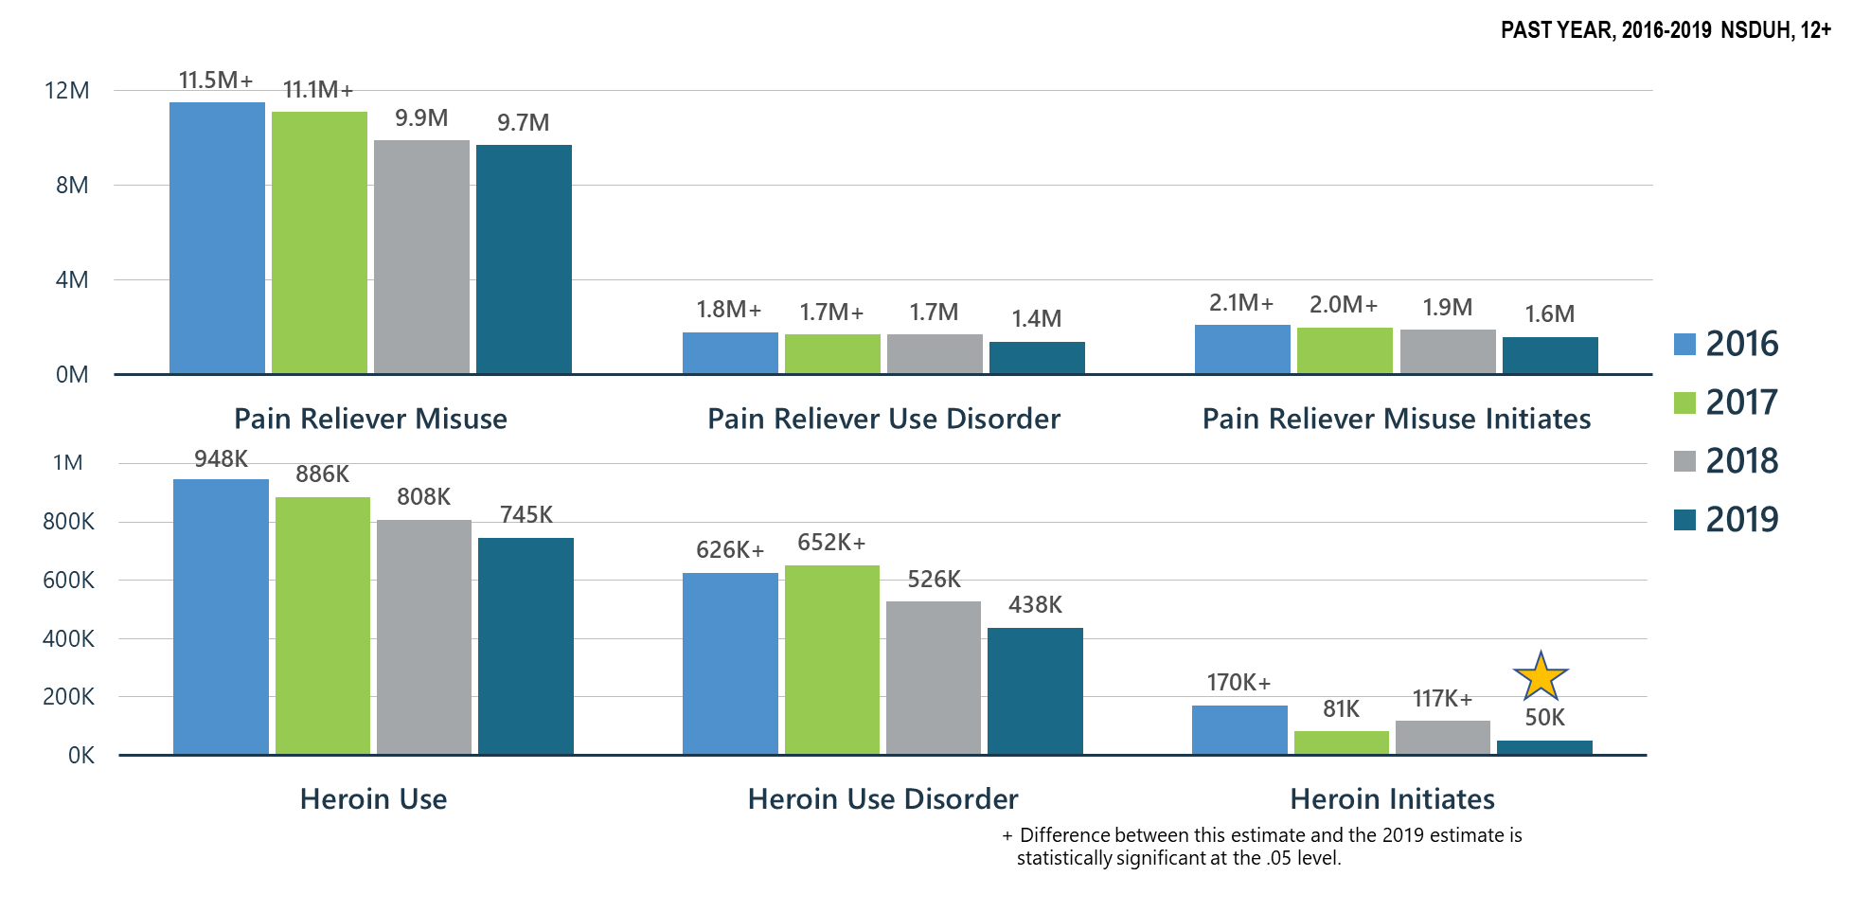
Prescription Pain Reliever Misuse and Heroin Use
Notes:
Slide ID: Nat19-11
SOURCE: 2019 DT 7.2, 7.40, and 7.46

Slide 12
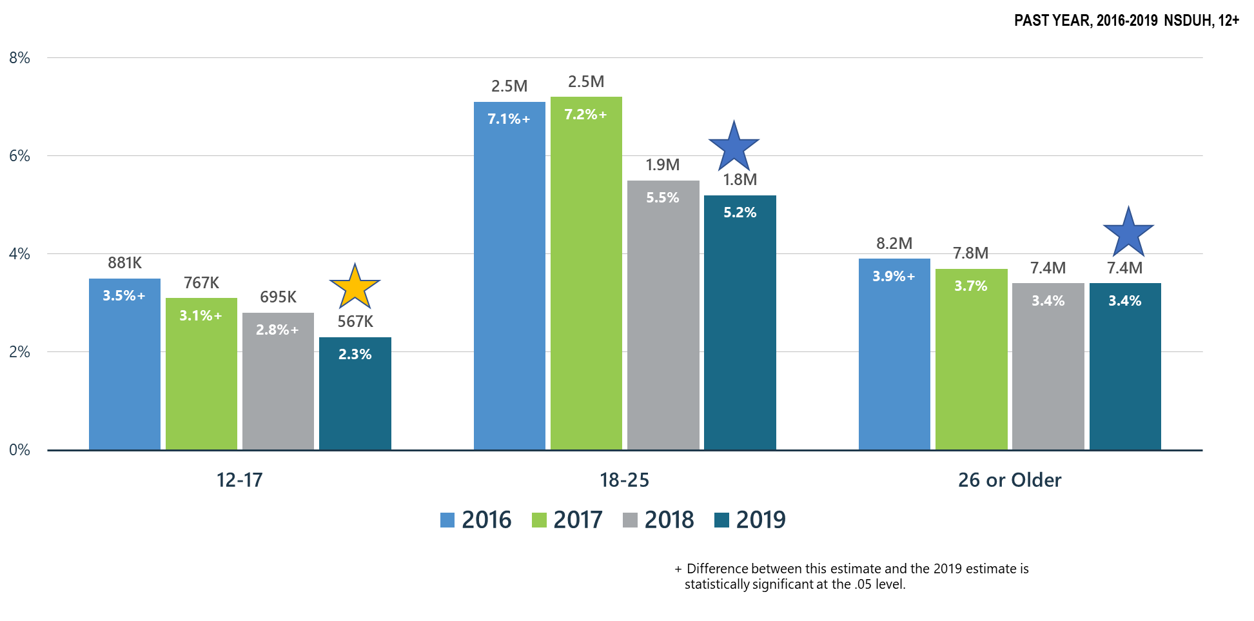
Prescription Pain Reliever Misuse
Notes:
Slide ID: Nat19-12
SOURCE: 2019 DT 7.5, 7.11, and 7.14

Slide 13
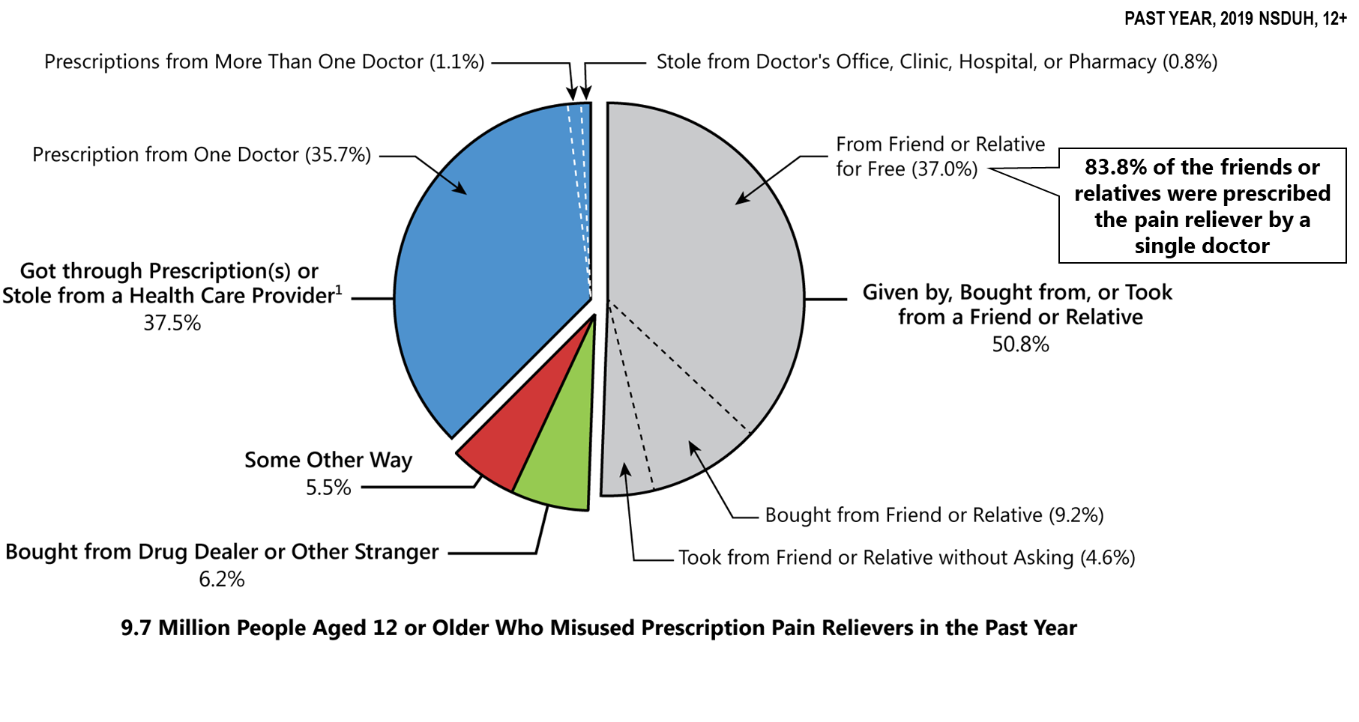
Sources Where Pain Relievers Were Obtained for Most Recent Misuse among People Who Misused Prescription Pain Relievers
Notes:
Slide ID: Nat19-13
Source: 2019 DT 6.5 and 6.6

Slide 14
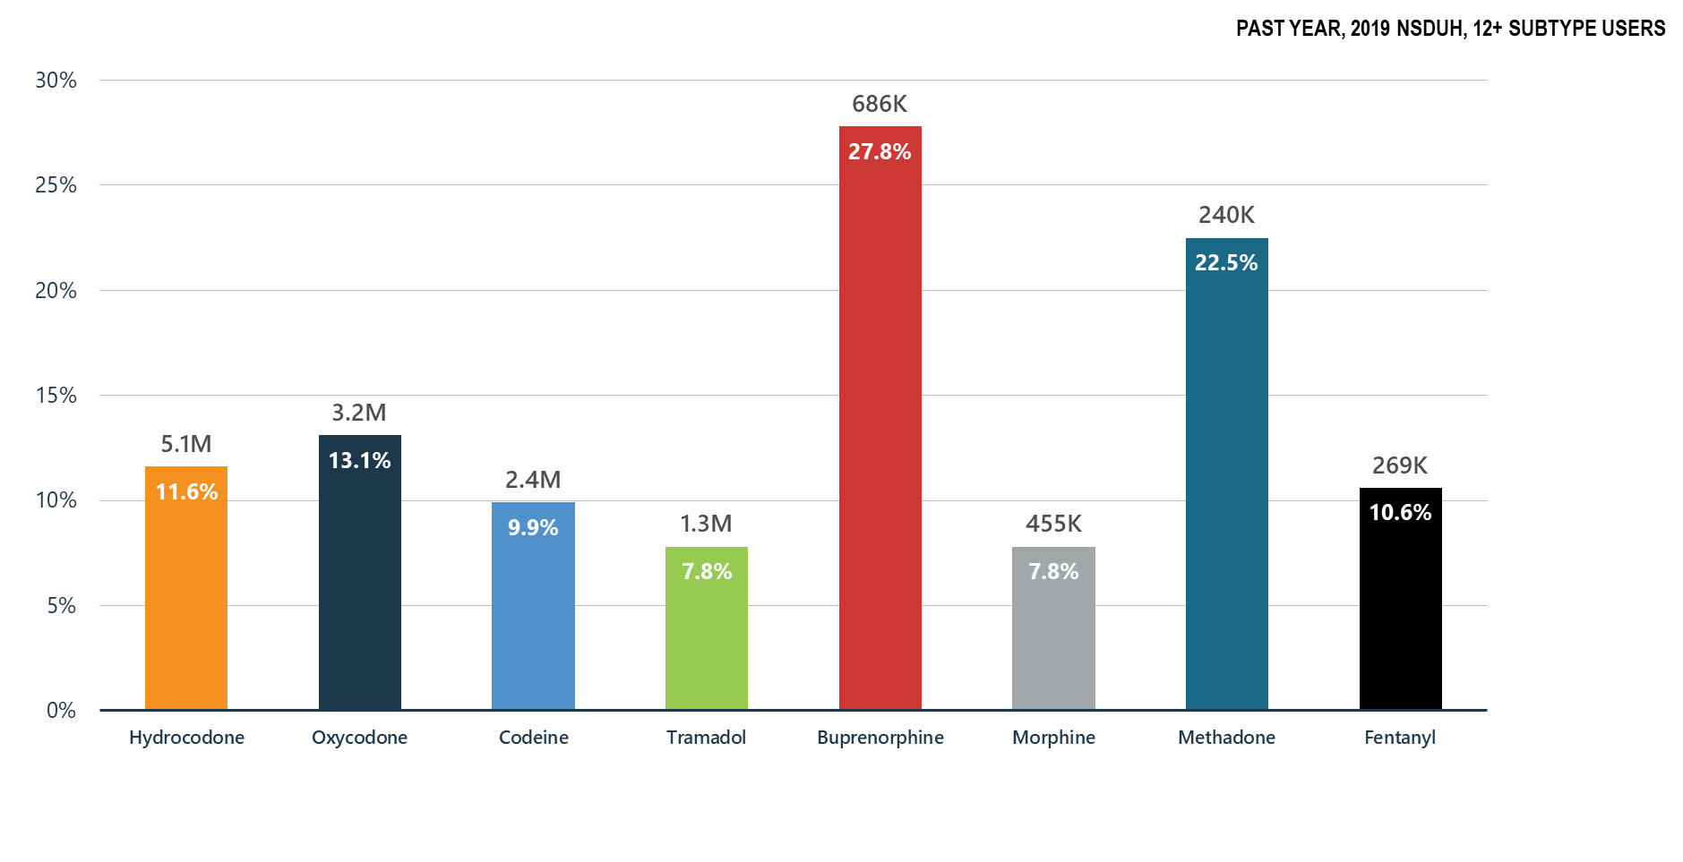
Misuse of Prescription Opioid Subtypes
Notes:
Slide ID: Nat19-14
SOURCE: 2019 DT 1.98

Slide 15
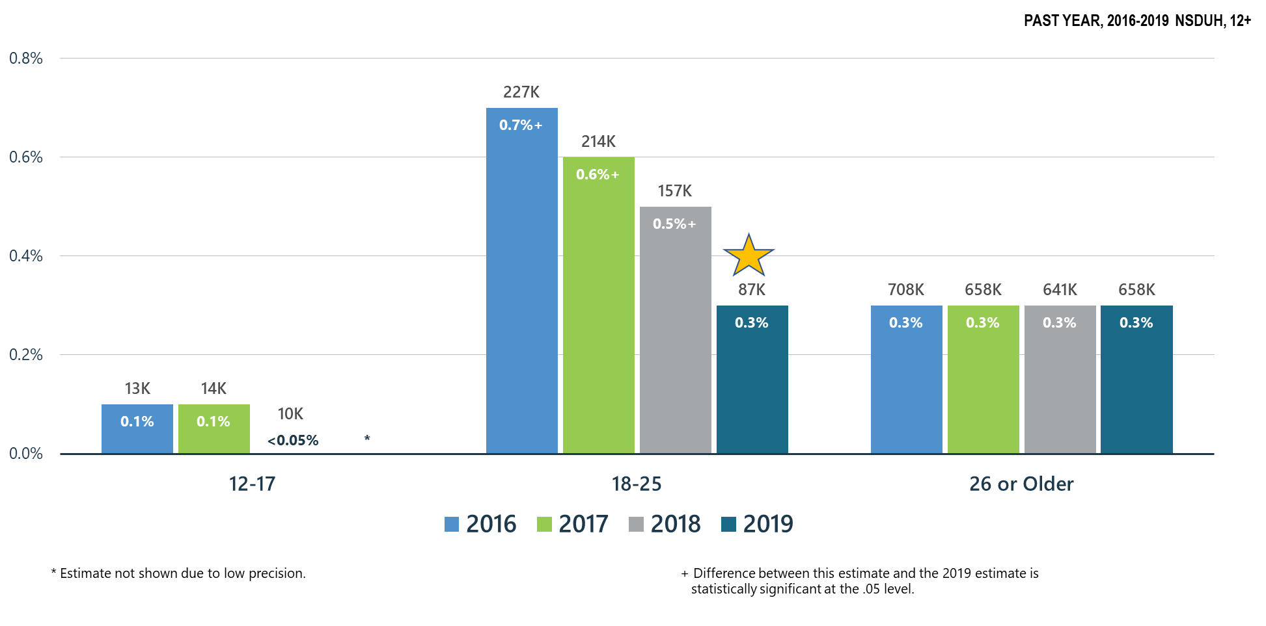
Heroin Use: Continuing to Decline in 18-25 y.o.
Notes:
Slide ID: Nat19-15
SOURCE: 2019 DT 7.5, 7.11, and 7.14

Slide 16
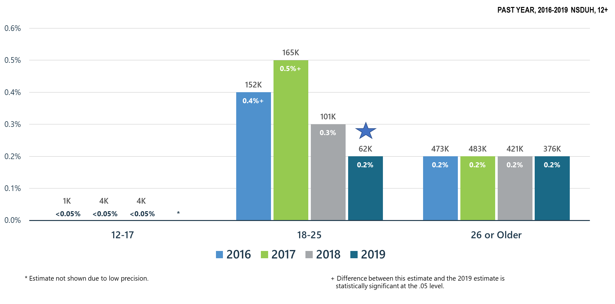
Heroin-Related Opioid Use Disorder
Notes:
Slide ID: Nat19-16
SOURCE: 2019 DT 7.47, 7.49, and 7.50

Slide 17
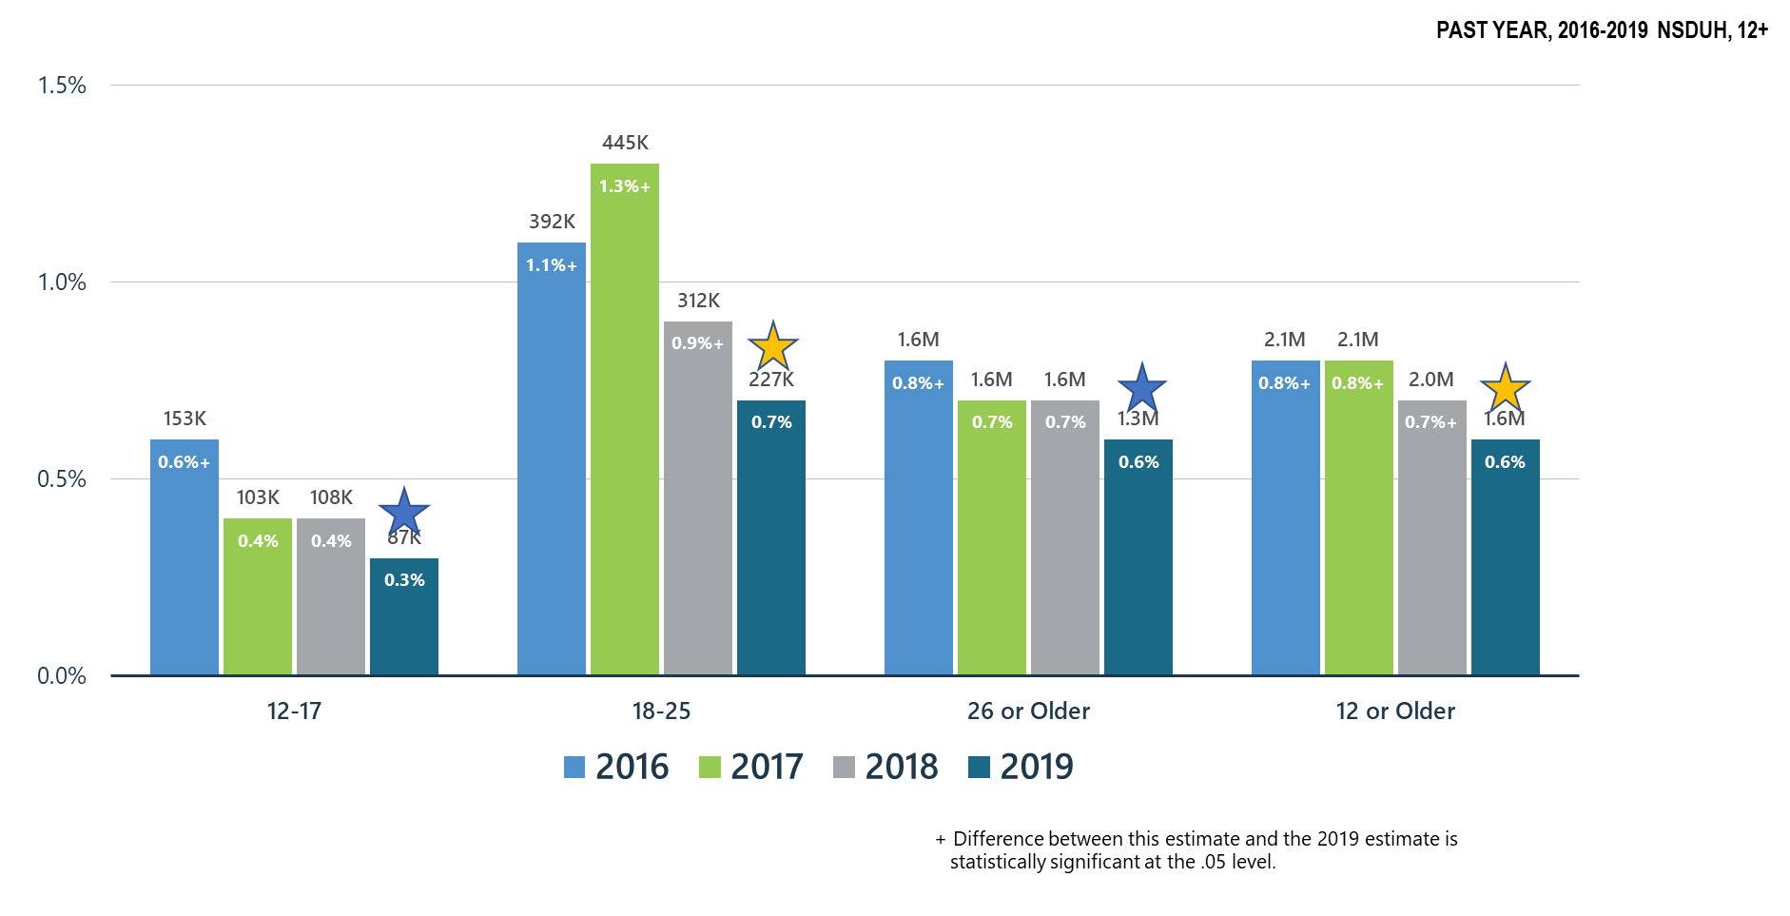
Opioid Use Disorder
Notes:
Slide ID: Nat19-17
SOURCE: 2019 DT 7.46, 7.47, 7.49, and 7.50

Slide 18
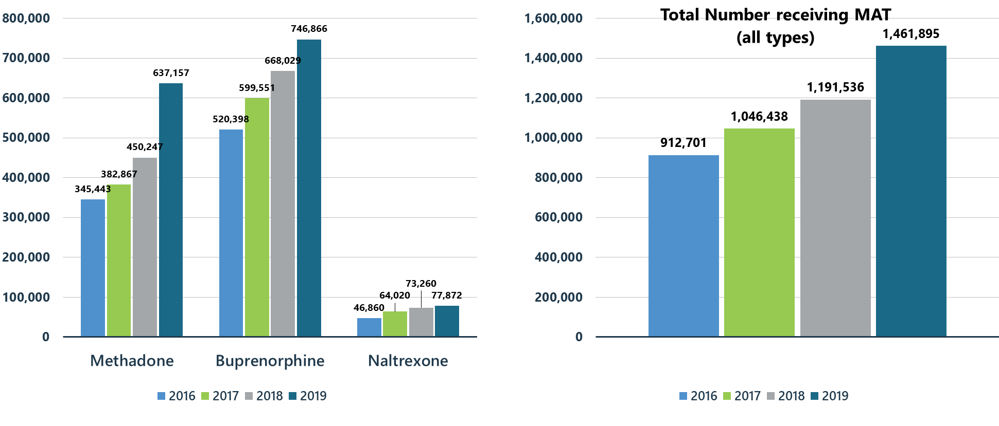
Treatment Gains: Number of Individuals Receiving Pharmacotherapy for Opioid Use Disorder (MAT)

Slide 19
Summary: Opioid Misuse in the United States in 2019 Compared to 2018
Opioid use disorder decreased significantly from 2.0M to 1.6M. Efforts to increase access to Medication-Assisted Treatment, psychosocial and community recovery supports have had a positive effect.
Among those aged 12+, opioid misuse decreased significantly from 2017 and for those 12-17, opioid misuse decreased significantly from 2018.
Pain reliever misuse decreased significantly from 2018 for those 12-17 years of age and continues trending downward for 18-25 year olds.
Heroin initiation decreased significantly with a 57% decline from 2018.
Heroin use among 18-25 year olds decreased significantly from 2018.
Despite gains opioid overdose deaths increased in 2019 by approximately 4.6% underscoring the risks of potent illicit synthetic opioids and need to continue to engage people in treatment/recovery services.
Buprenorphine continues to be the opioid with the highest percentage of users acknowledging misuse of the medication.

Slide 20
Other Illicit Substances

Slide 21
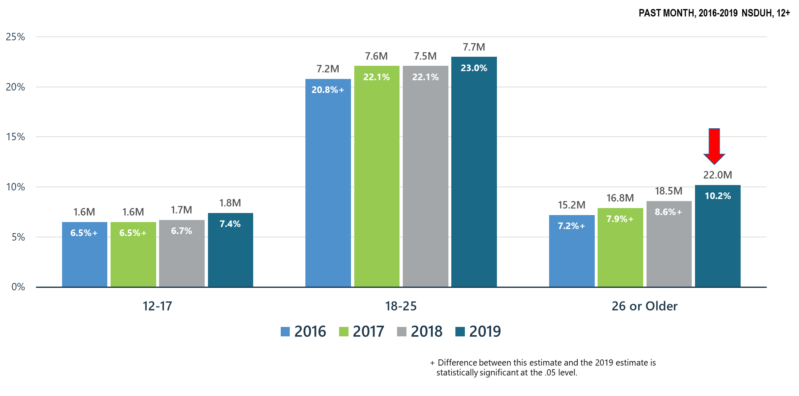
Past Month Marijuana Use for All Age Groups
Notes:
Slide ID: Nat19-21
SOURCE: 2019 DT 7.6, 7.12, and 7.15

Slide 22
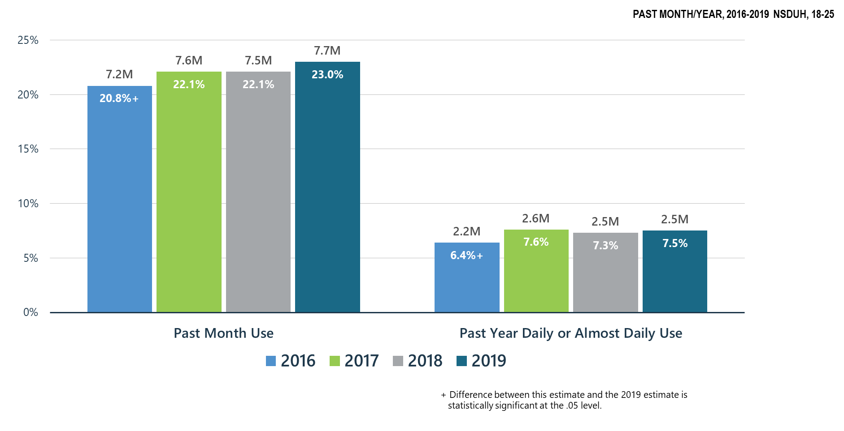
Marijuana Use among Young Adults (18-25 y.o.)
Notes:
Slide ID: Nat19-22
SOURCE: 2019 DT 7.12 and 7.22

Slide 23
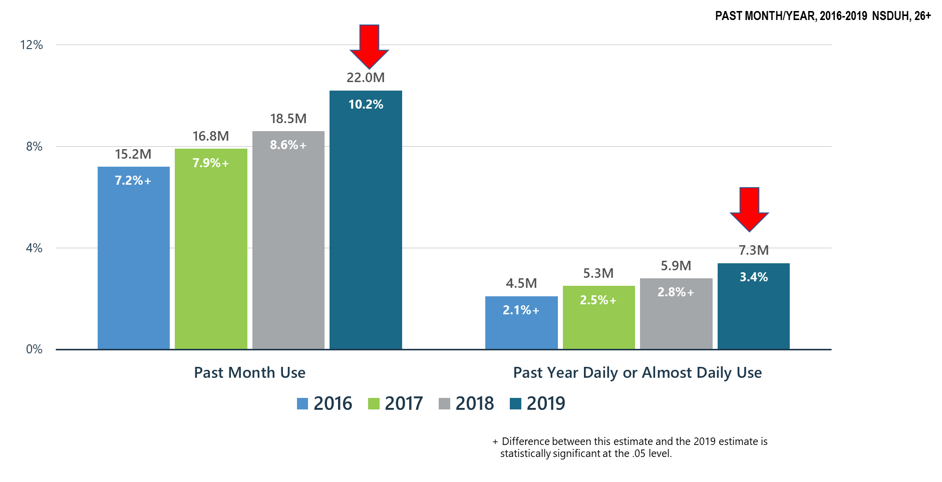
Significant Increase in Marijuana Use among Adults 26+
Notes:
Slide ID: Nat19-23
SOURCE: 2019 DT 7.15 and 7.23

Slide 24
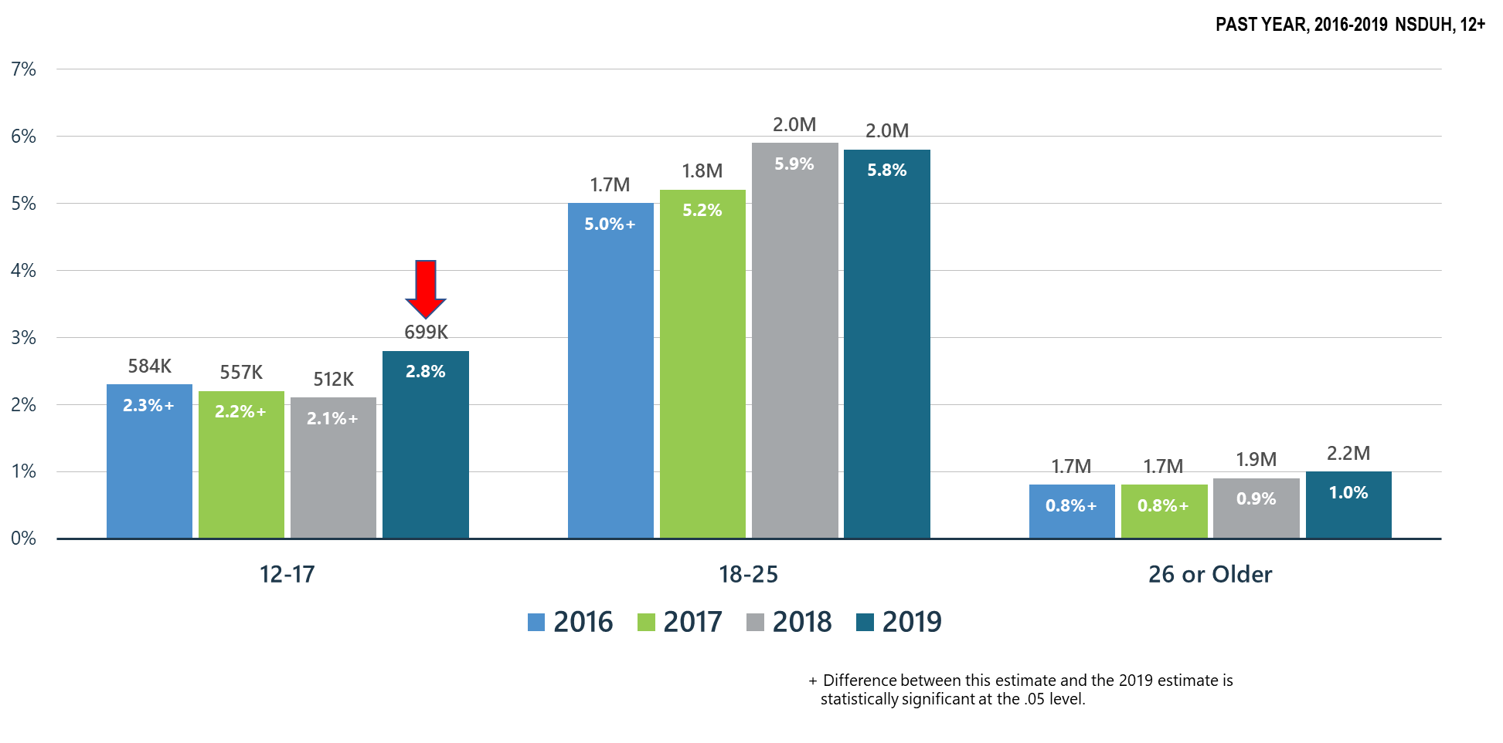
Marijuana Use Disorder: Significant Increase for 12-17 y.o.
Notes:
Slide ID: Nat19-24
SOURCE: 2019 DT 7.47, 7.49, and 7.50

Slide 25
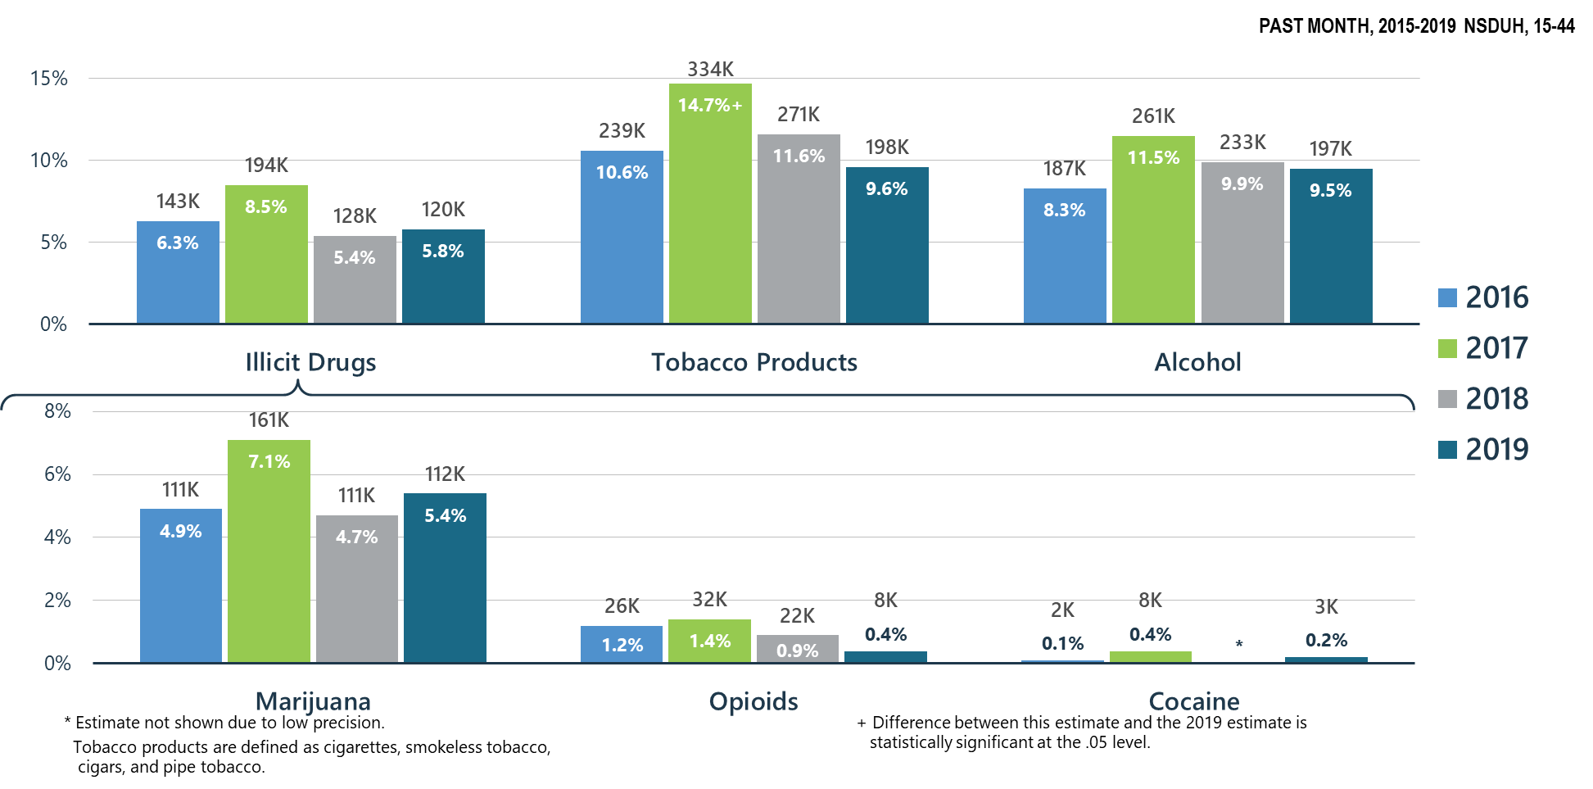
Past Month Substance Use among Pregnant Women
Notes:
Slide ID: Nat19-25
SOURCE: Special analysis

Slide 26
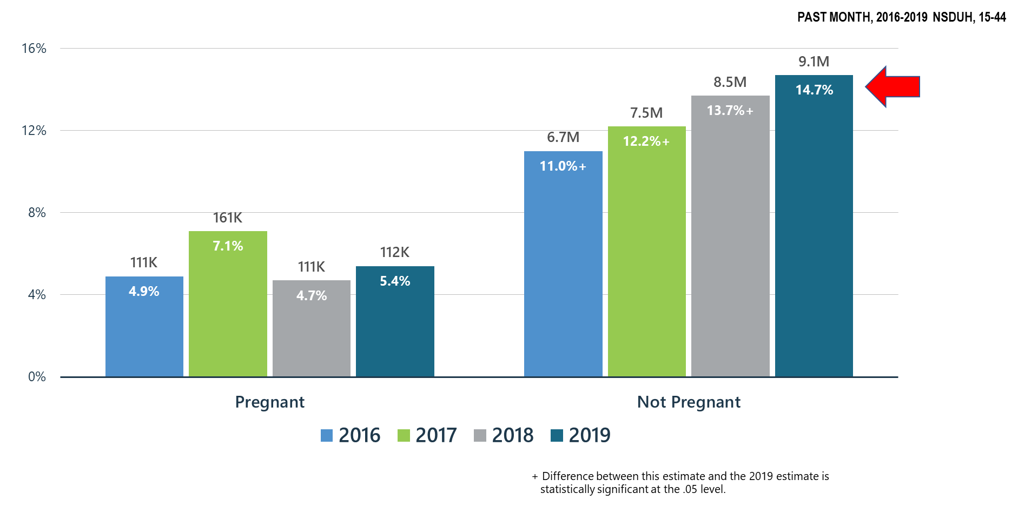
Marijuana Use among Women by Pregnancy Status
Notes:
Slide ID: Nat19-26
SOURCE: Special analysis

Slide 27
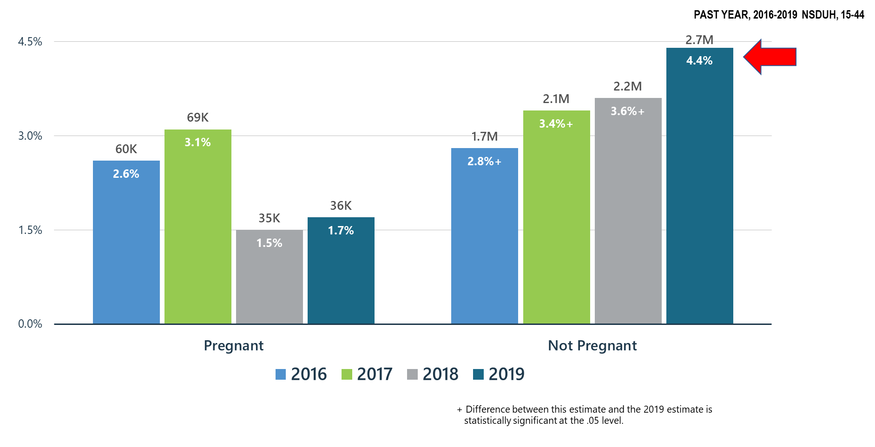
Daily or Almost Daily Marijuana Use among Women by Pregnancy Status
Notes:
Slide ID: Nat19-27
SOURCE: Special analysis

Slide 28
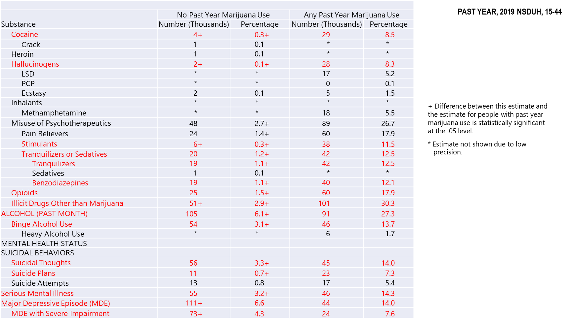
Past Year Substance Use and Mental Health Issues among Pregnant Women Aged 15 to 44 by Marijuana Use Status
Notes:
Slide ID: Nat19-28
SOURCE: Special analysis

Slide 29
Marijuana Use: Health Concerns
Use during pregnancy may be associated with fetal growth restriction, stillbirth, preterm birth, and neonatal intensive care unit admission (Metz and Borgelt, 2018; Stickrath, 2019).
Use linked to depression/suicide: adolescents (Roberts BA, 2019), veterans (Kimbrel et al., 2018)
Use in adolescence is associated with increased risk for psychotic disorders in adulthood and is linked with suicidal ideation or behavior (D’Souza et al, 2016; McHugh et al, 2017).
The risk for psychotic disorders increases with frequency of use, potency of the marijuana product, and as the age at first use decreases (NASEM, 2017).
Use among adolescents is linked to a decline in IQ and is associated with educational drop out (Meier, 2012).
Use has been linked to the development of drug use disorders including alcohol, tobacco and other illicit drugs (NASEM, 2017).
Marijuana intoxication is an important cause of MVAs associated with injury and death—it is wrong to say that marijuana use never killed anyone (NASEM, 2017).
Association between state laws allowing medical marijuana and opioid overdose mortality reversed direction from -21% (1999-2010) to +23% (1999-2017). (Shover, et al., 2019)
Risk of subsequent prescription opioid misuse and use disorder was increased among people who reported marijuana use 5 years earlier (Olfson et al., 2017)

Slide 30
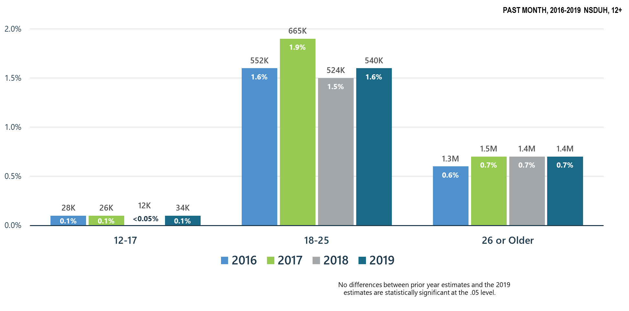
Cocaine Use
Notes:
Slide ID: Nat19-30
SOURCE: 2019 DT 7.6, 7.12, and 7.15

Slide 31
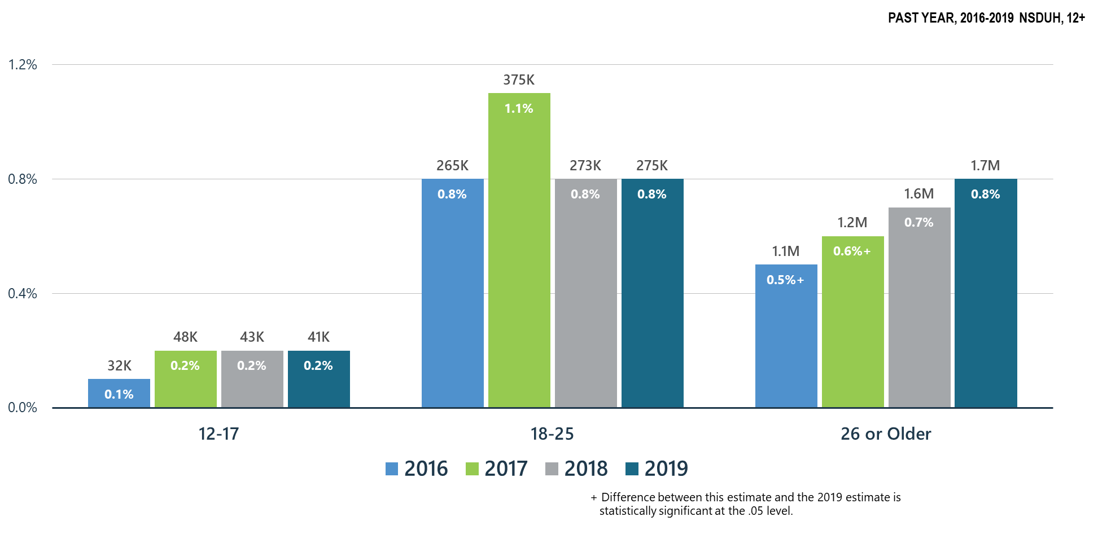
Methamphetamine Use
Notes:
Slide ID: Nat19-31
SOURCE: 2019 DT 7.5, 7.11, and 7.14

Slide 32
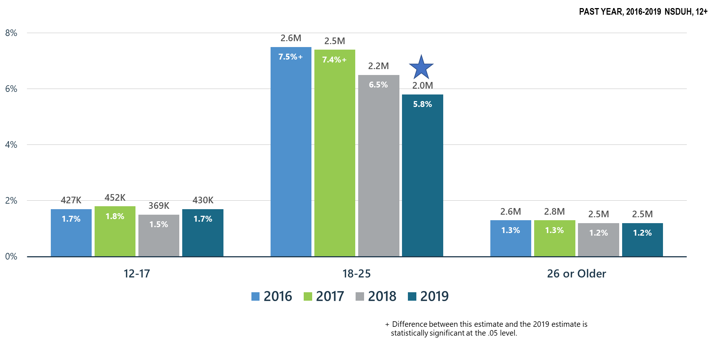
Misuse of Prescription Stimulants
Notes:
Slide ID: Nat19-32
SOURCE: 2019 DT 7.5, 7.11, and 7.14

Slide 33
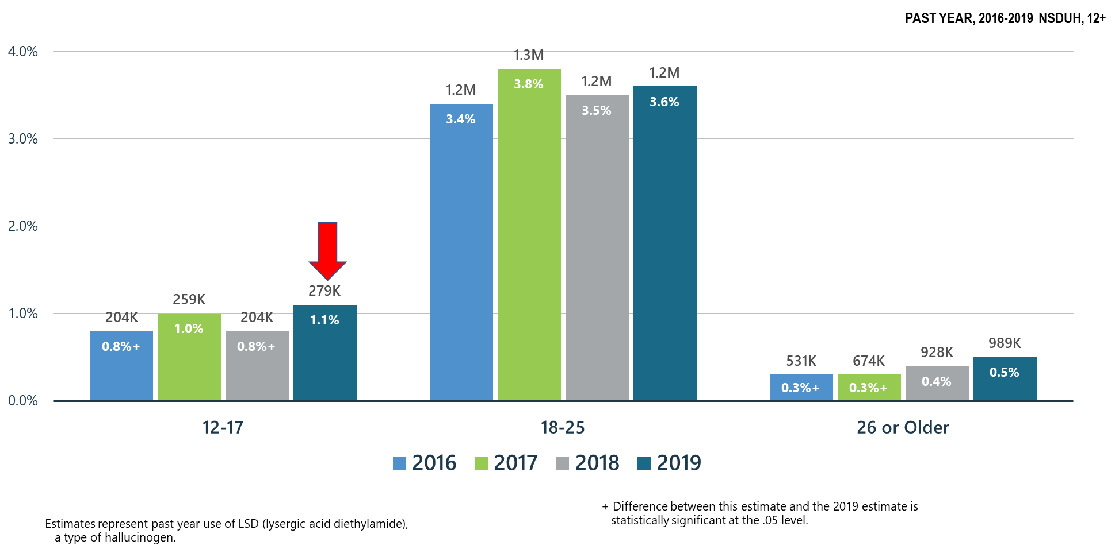
LSD Use Among All Age Groups
Notes:
Slide ID: Nat19-33
SOURCE: 2019 DT 7.5, 7.11, and 7.14

Slide 34
Summary: Other Substance Use in the United States in 2019 Compared to 2018
Past month marijuana use and past year daily or almost daily marijuana use significantly increased in adults aged 26+
Past year marijuana use disorder significantly increased in adolescents
Non-significant increase in marijuana use by pregnant women; significant increases in marijuana use by women 15-44
Alcohol and tobacco use trending downward in pregnant women; but any alcohol or tobacco use is hazardous in pregnancy
No change in cocaine use in all age groups
Upward trend in methamphetamine use and significantly increased over 2016-17 in adults 26 and older
Prescription stimulant misuse trending downward in those 18-25 years old
Past year LSD use significantly increased in adolescents; non-significant increases in LSD use in young adults and adults

Slide 35
Polysubstance Use and Mental Illness

Slide 36
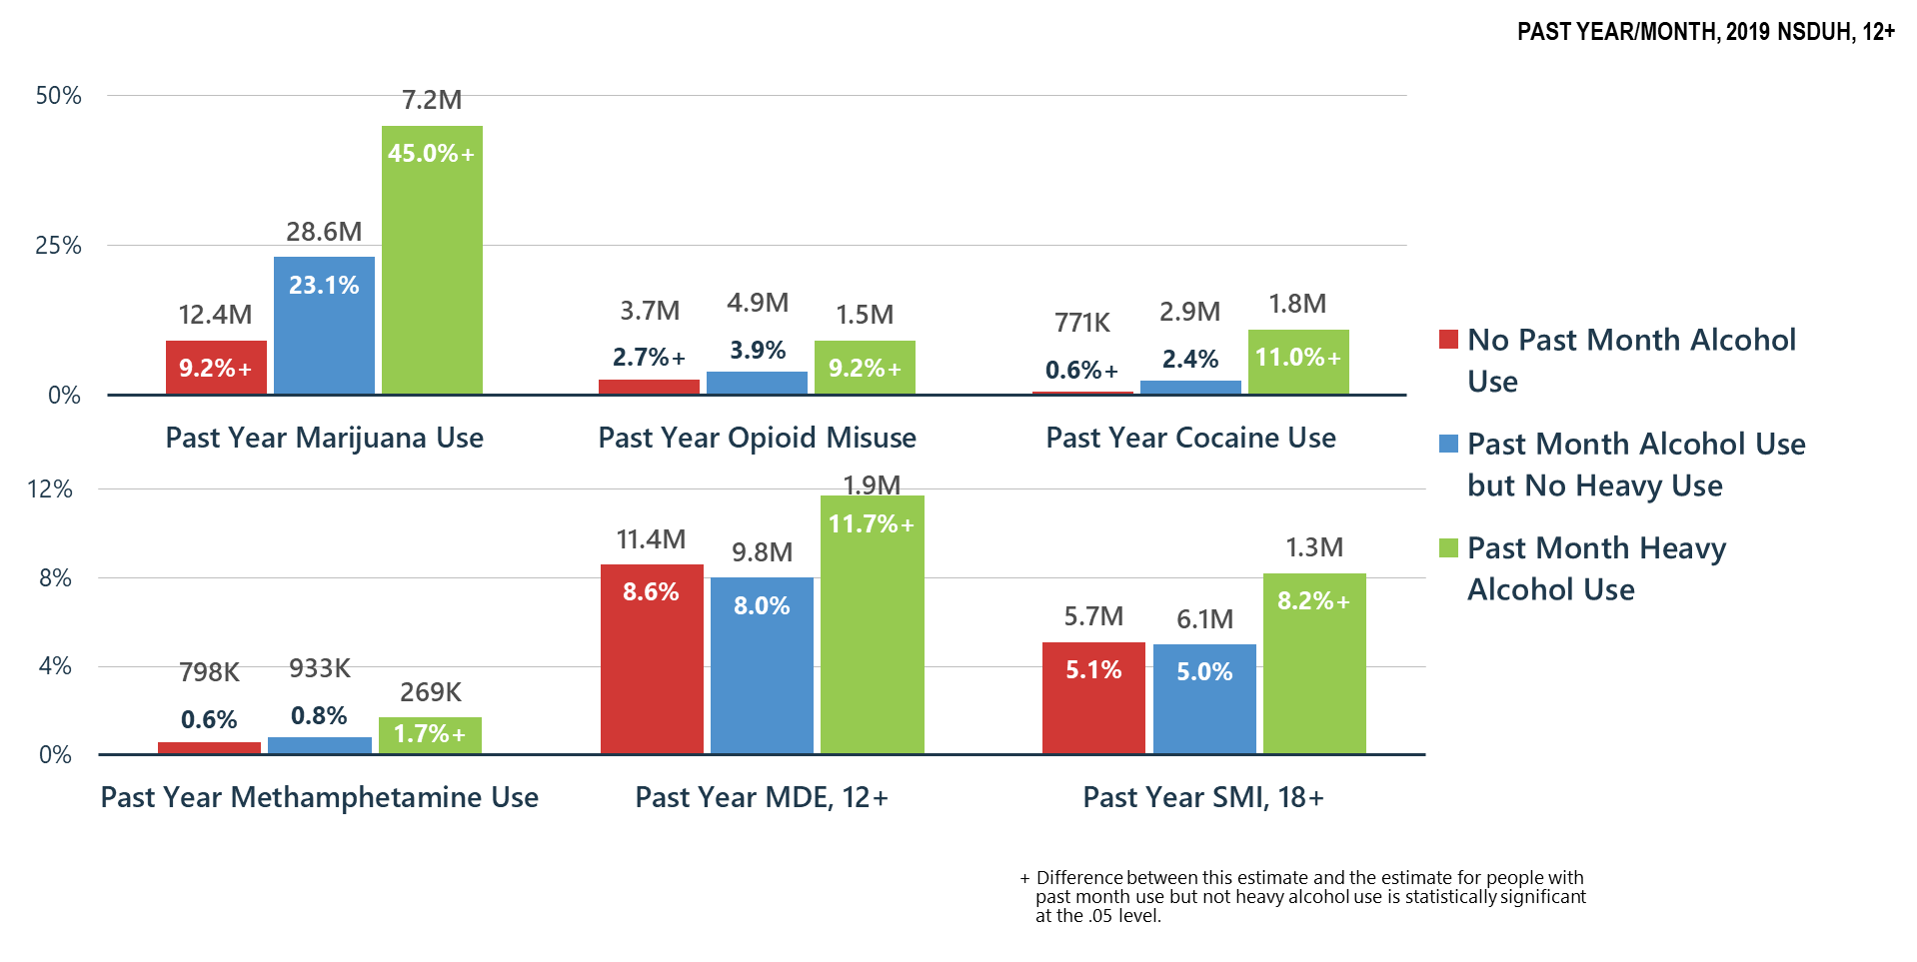
Alcohol Use Related to Other Substance Use, MDE and SMI
Notes:
Slide ID: Nat19-36
SOURCE: Special analysis

Slide 37
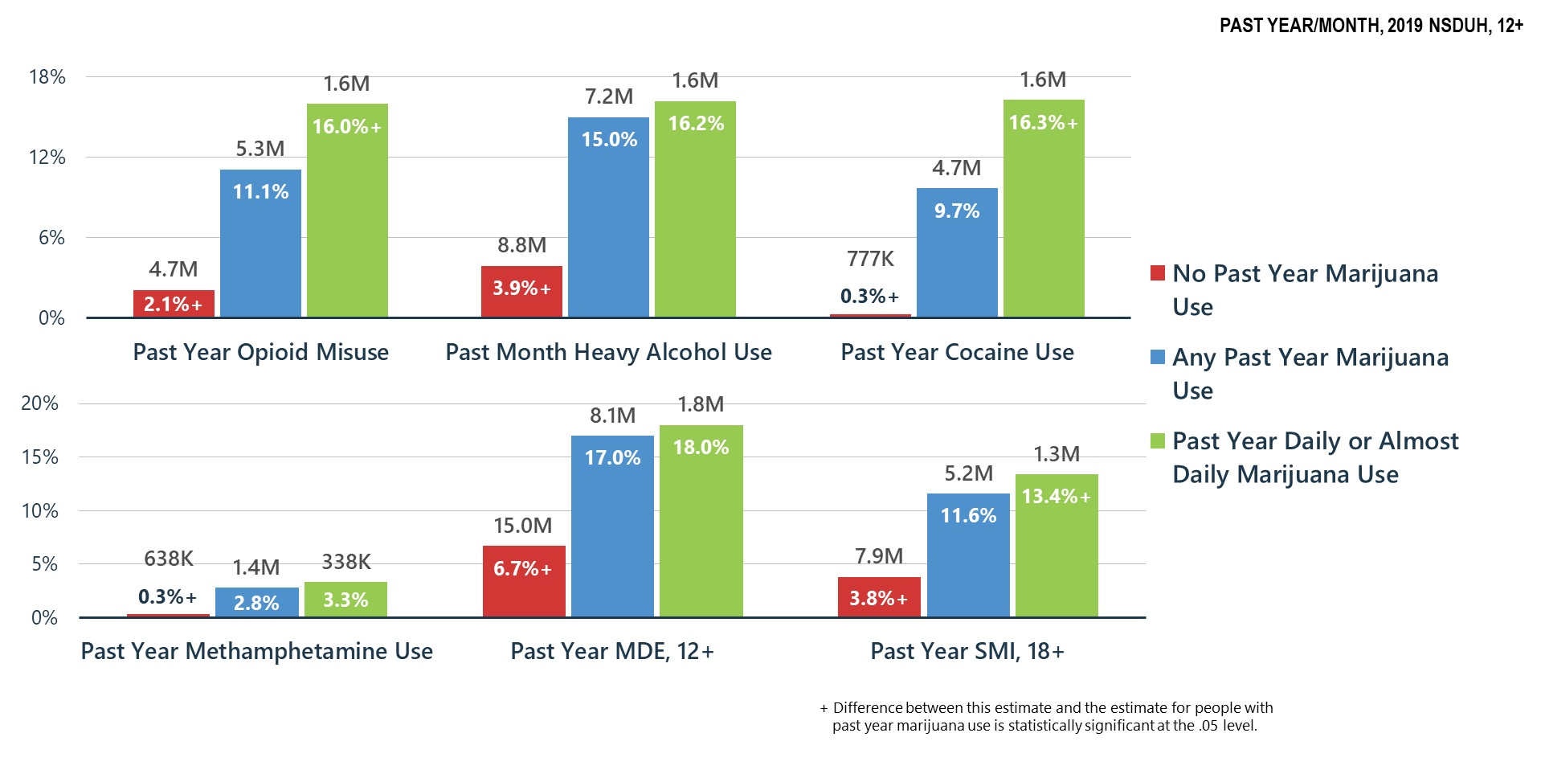
Marijuana Use Related to Other Substance Use, MDE and SMI
Notes:
Slide ID: Nat19-37
SOURCE: Special analysis

Slide 38
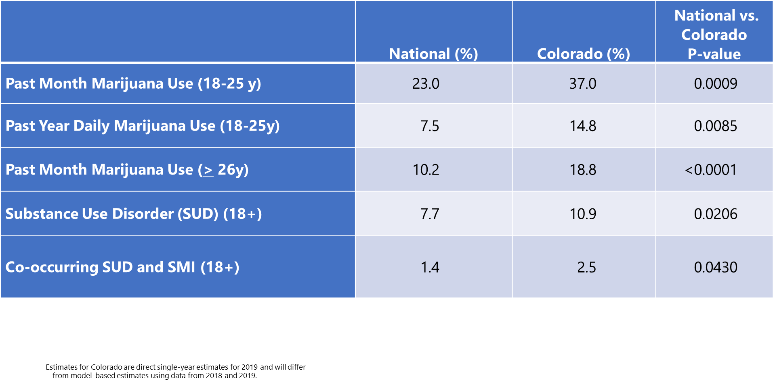
Comparison of Rates of Mental/Substance Use Disorders Associated with Marijuana Use: National vs. Colorado Data from the National Survey on Drug Use and Health (2019)
Notes:
Slide ID: Nat19-38
SOURCE: Special analysis

Slide 39
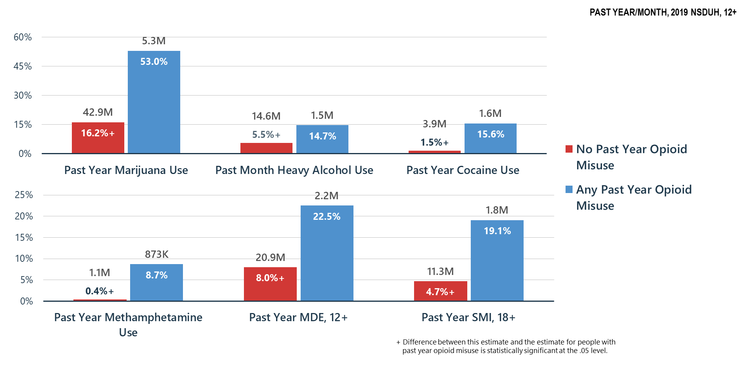
Opioid Misuse Related to Other Substance Use, MDE and SMI
Notes:
Slide ID: Nat19-39
SOURCE: Special analysis

Slide 40
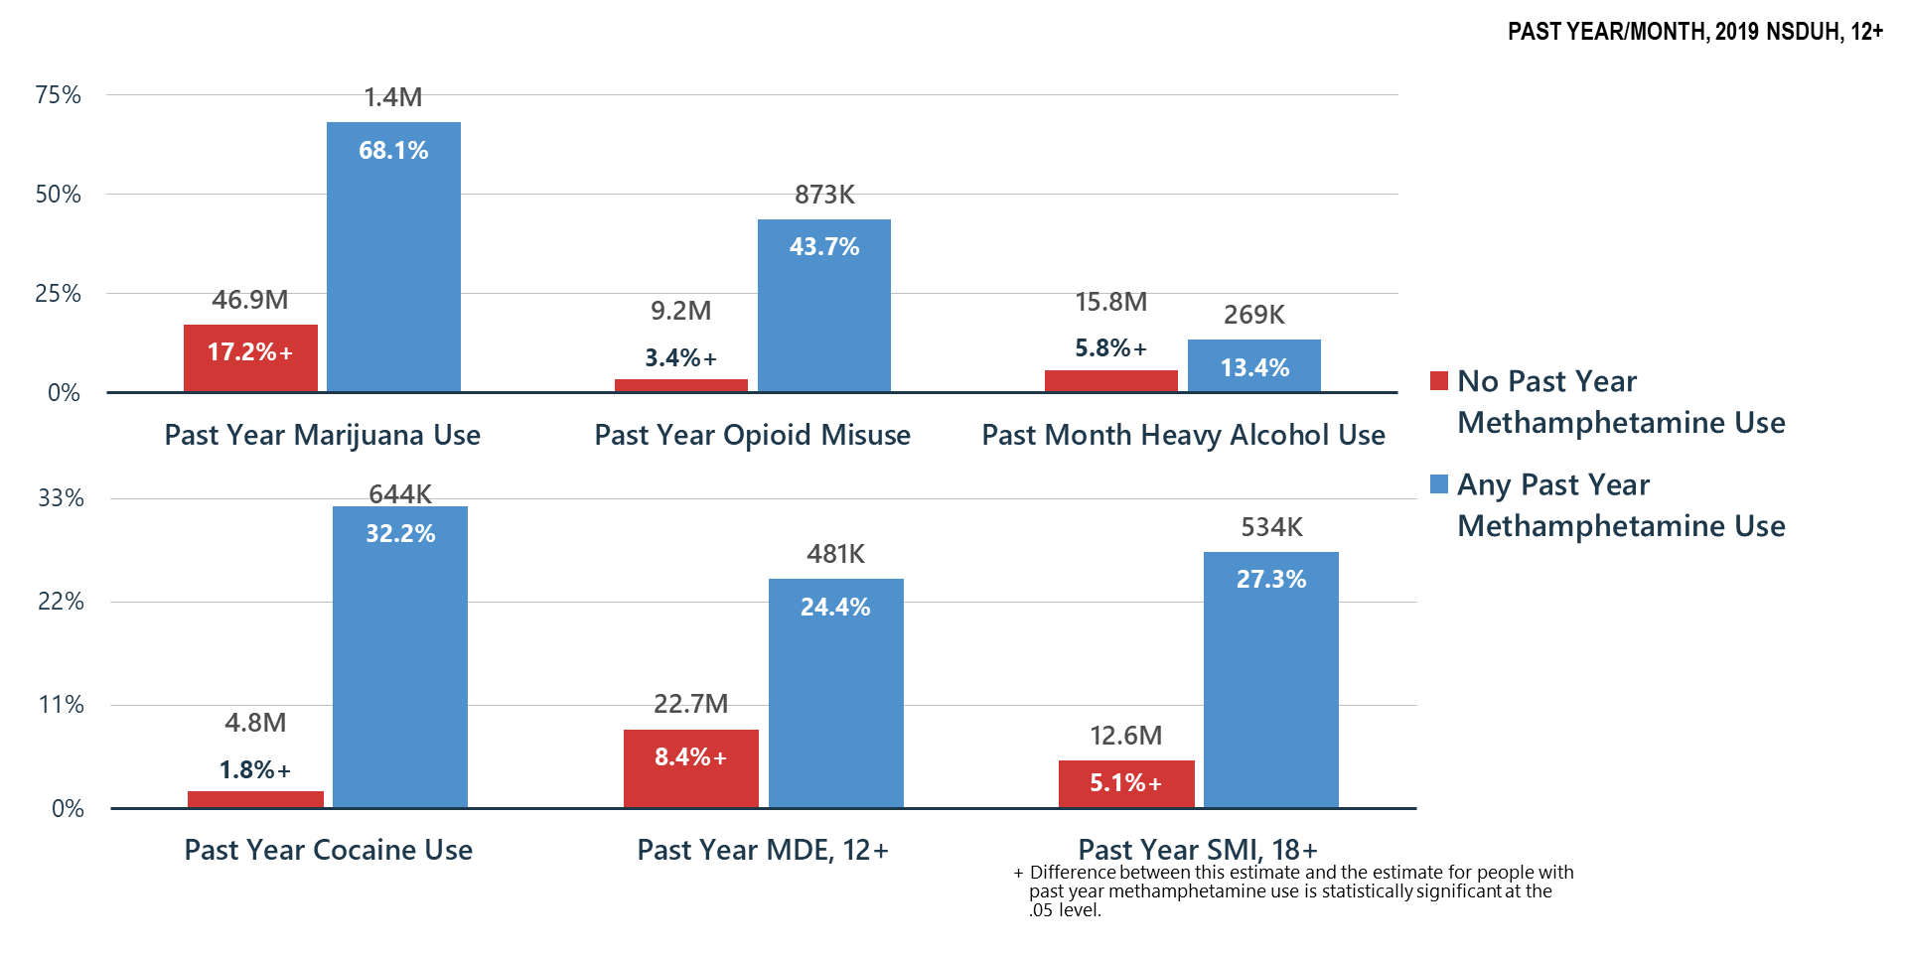
Methamphetamine Use Related to Other Substance Use, MDE and SMI
Notes:
Slide ID: Nat19-40
SOURCE: Special analysis

Slide 41
Summary
Polysubstance use is common—if a person is having problems with one substance, they are likely using and may be having problems with other substances
Treatment providers must screen for and treat all substance use disorders and problem substance use
Association of substance misuse and mental illness is clear—we must all do a better job of helping Americans understand these relationships and risks

Slide 42
Mental Health

Slide 43
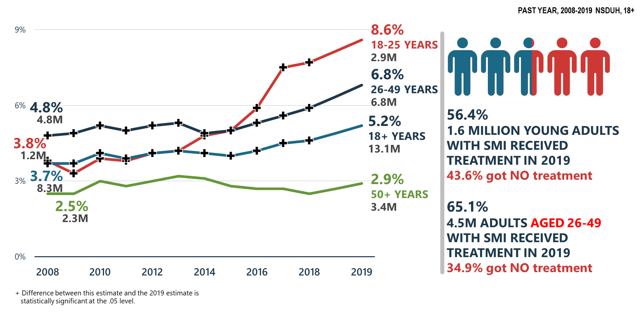
Serious Mental Illness (SMI) Increasing
Notes:
Slide ID: Nat19-43
SOURCE: 2019 DT 10.3 and 10.11

Slide 44
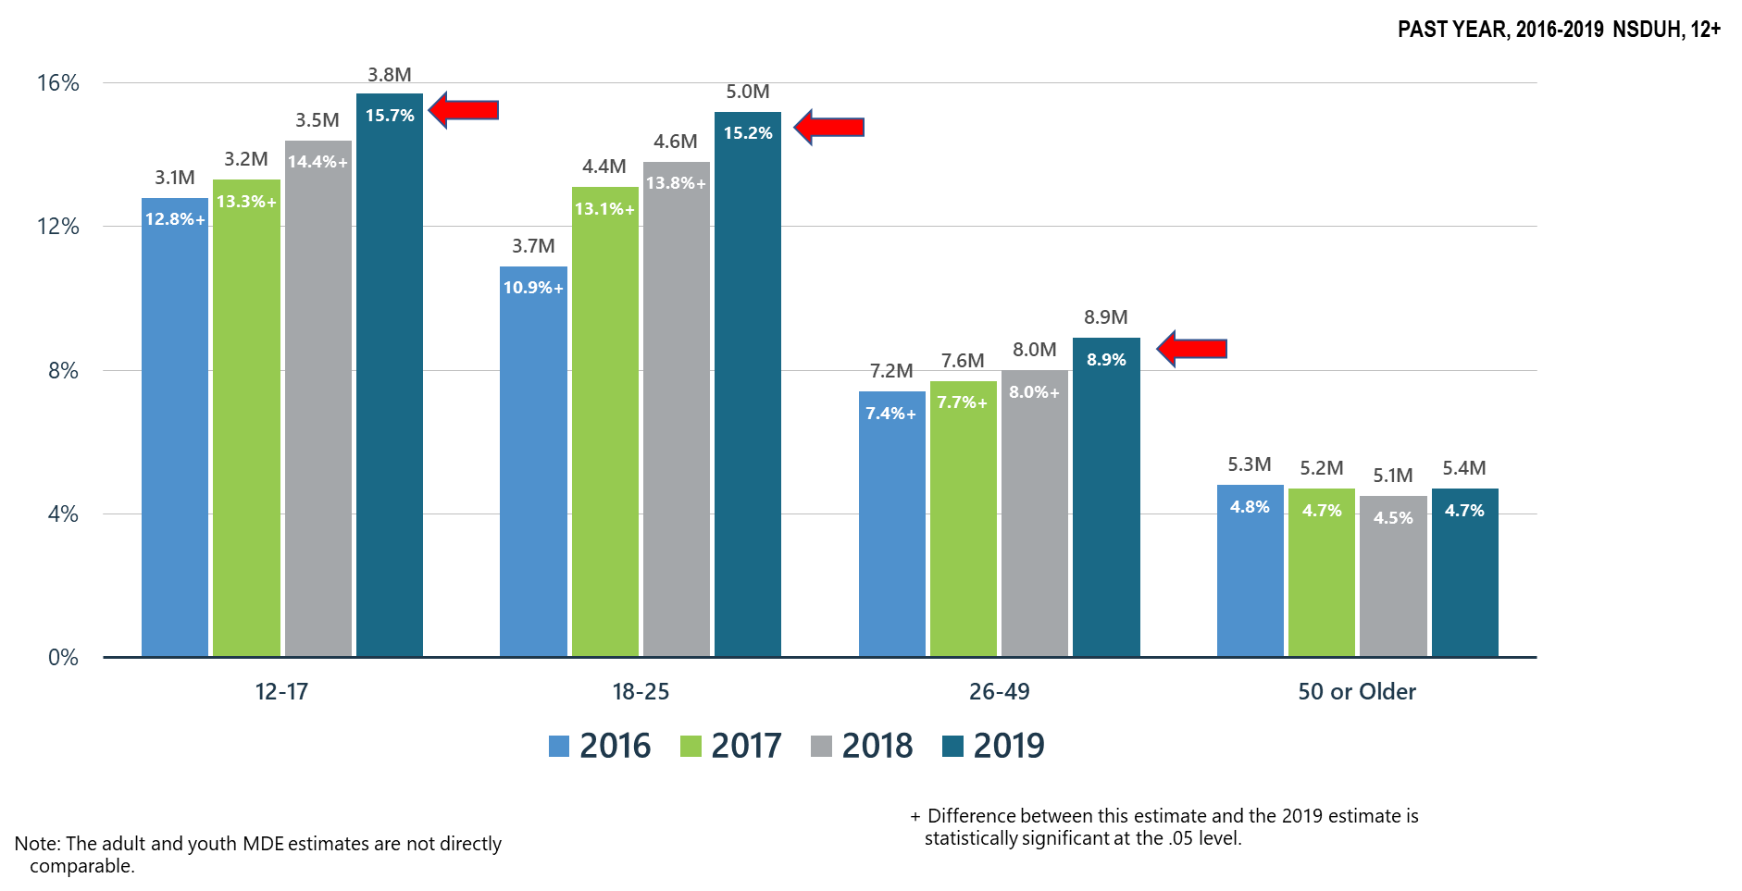
Major Depressive Episodes Increased for Those Under Age 50
Notes:
Slide ID: Nat19-44
SOURCE: 2019 DT 10.32 and 11.2

Slide 45
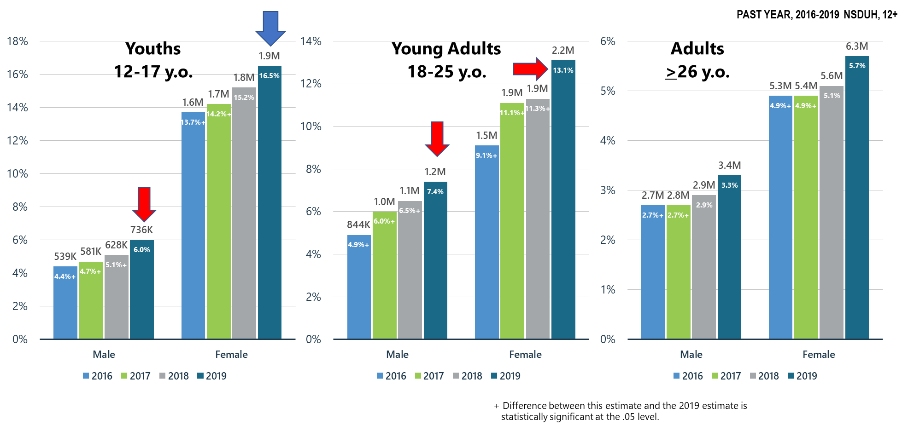
Major Depressive Episodes with Severe Impairment
Notes:
Slide ID: Nat19-45
SOURCE: Special analysis

Slide 46
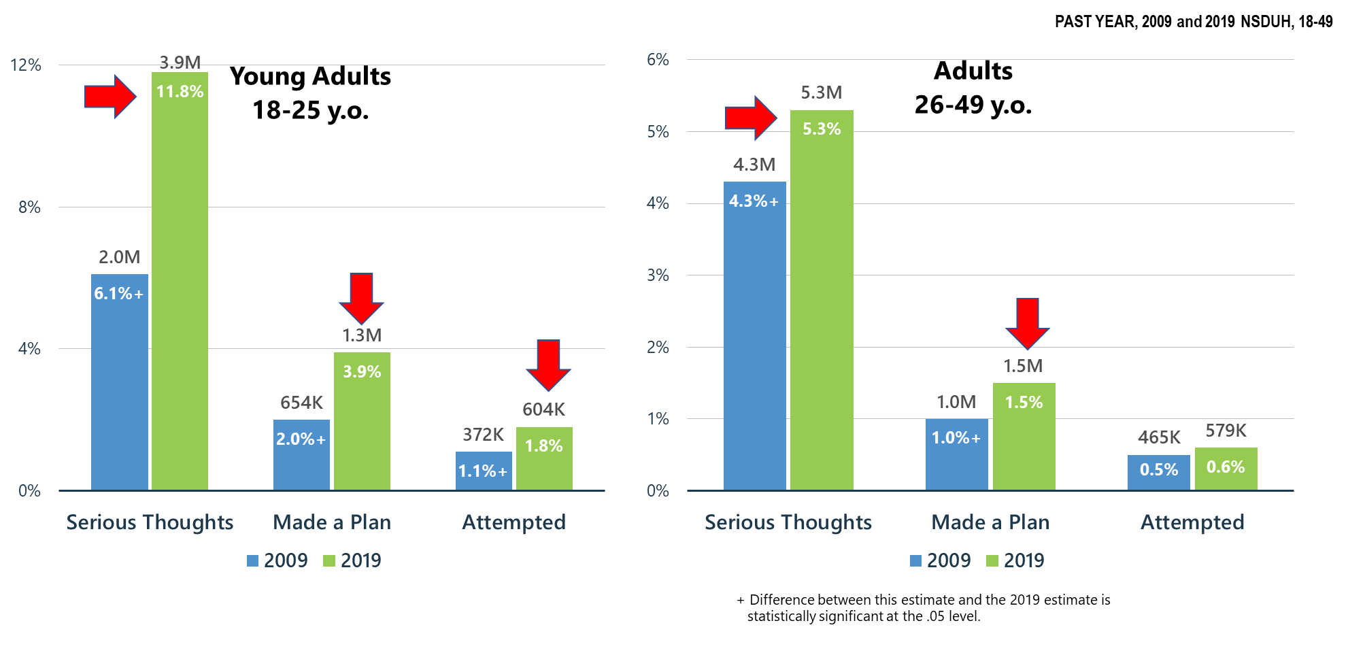
Suicidal Thoughts, Plans, and Attempts Increase for Young Adults (18-25 y.o.) and Adults (26-49 y.o.)
Notes:
Slide ID: Nat19-46
SOURCE: Special Analysis

Slide 47
Co-Occurring
Mental and Substance Use Disorders

Slide 48
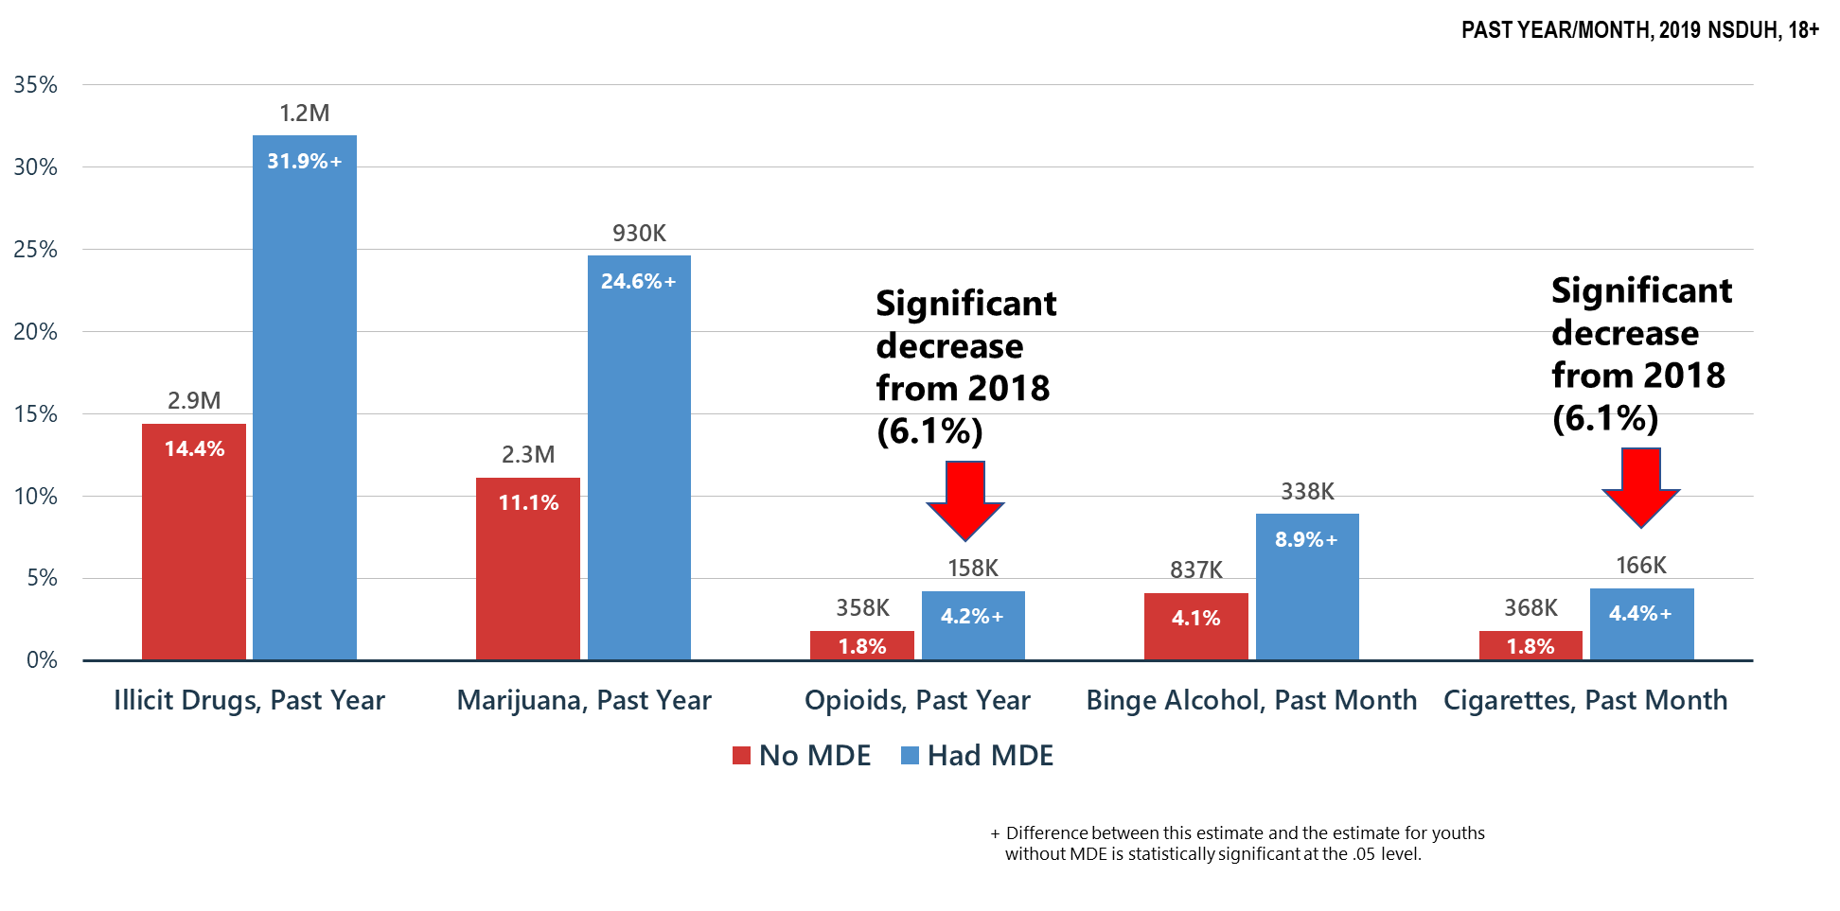
Substance Use among Youths (12-17 y.o.) by Past Year Major Depressive Episode (MDE) status
Notes:
Slide ID: Nat19-48
SOURCE: 2019 DT 11.6 and 11.8

Slide 49
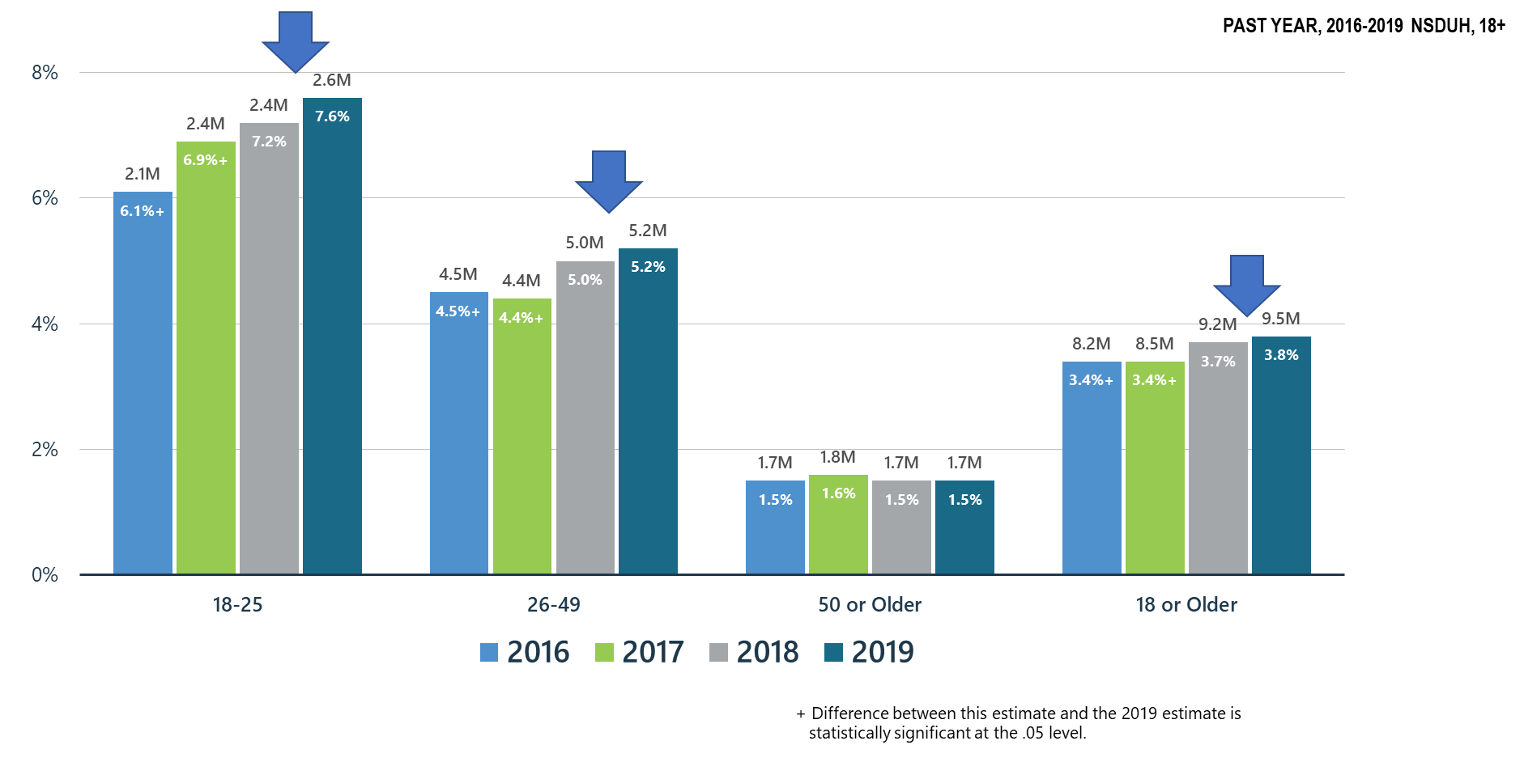
Co-Occurring Substance Use Disorder and Any Mental Illness in Adults
Notes:
Slide ID: Nat19-49
SOURCE: 2019 DT 10.6

Slide 50
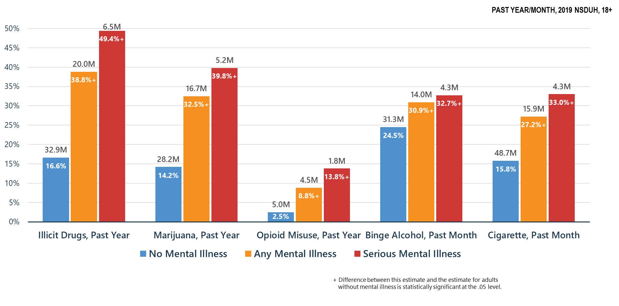
Co-Occurring Issues: Substance Use and Mental Illness among Adults
Notes:
Slide ID: Nat19-50
SOURCE: 2019 DT 8.42

Slide 51
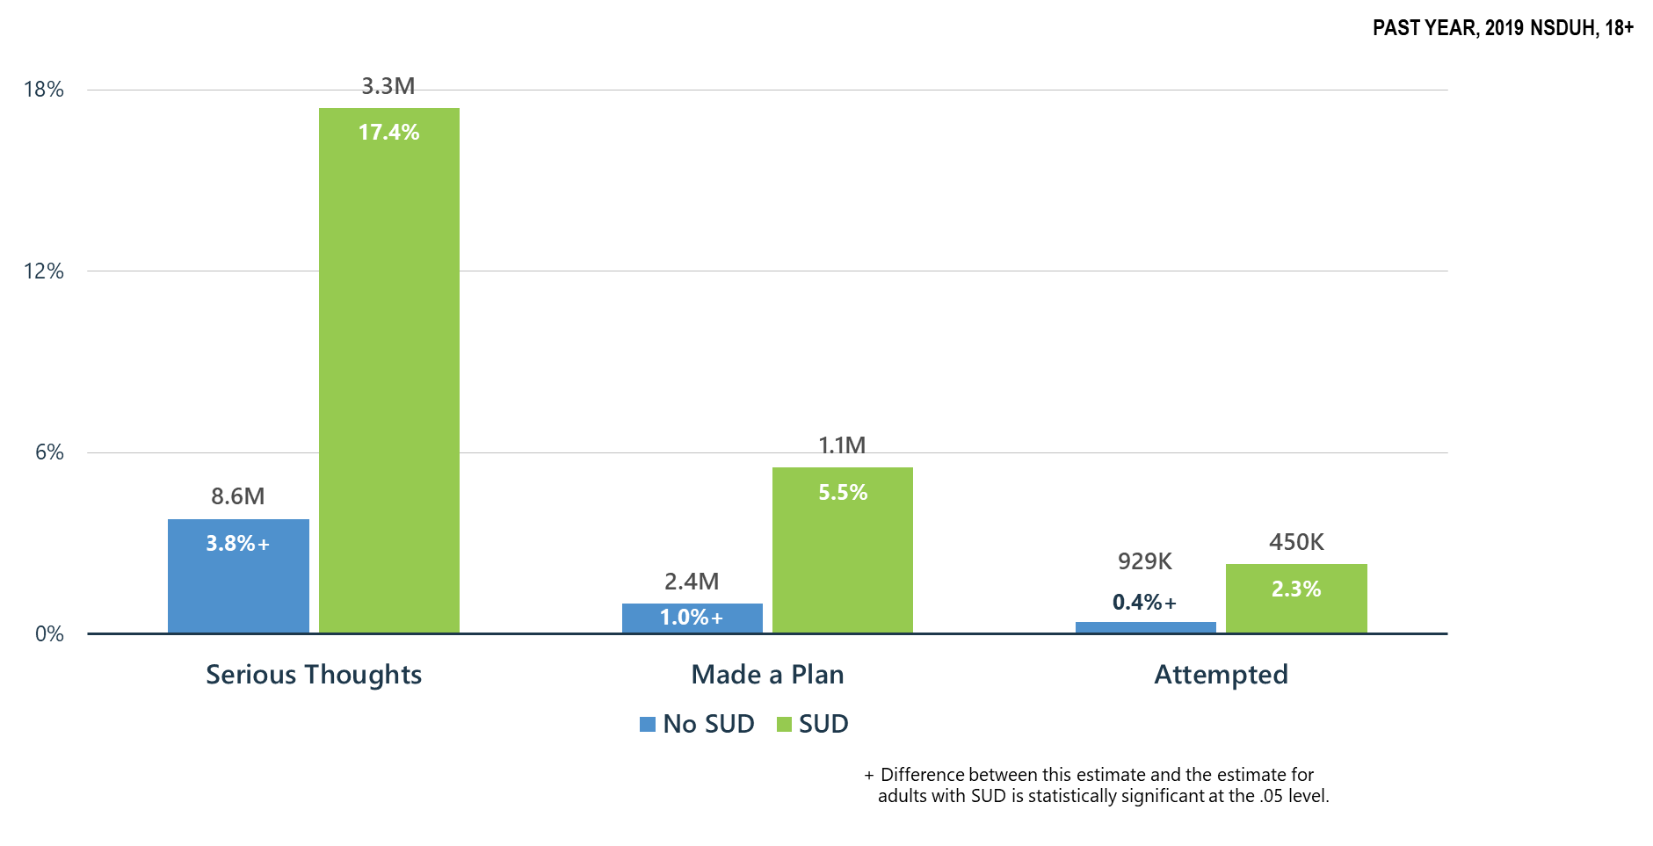
Substance Use Disorder (SUD) is Associated with Suicidal Thoughts, Plans, and Attempts among Adults >18 y.o.
Notes:
Slide ID: Nat19-51
SOURCE: 2019 DT 8.61

Slide 52
Mental and Substance Use Disorders: High Prevalence/Huge Treatment Gaps
Notes:
Slide ID: Nat19-52
Source: Special analysis

Slide 53
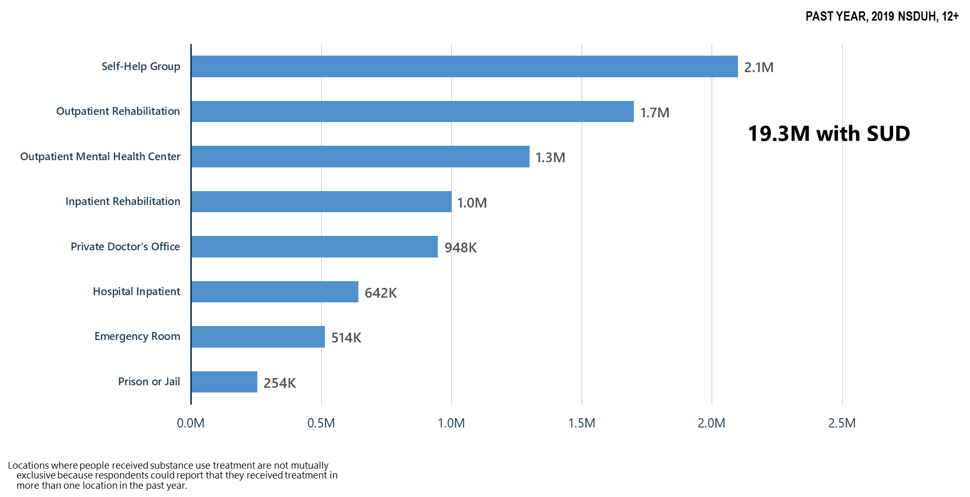
Locations Where Substance Use Treatment Was Received
Notes:
Slide ID: Nat19-53
SOURCE: 2019 DT 5.17

Slide 54
Receipt of Substance Use Treatment at a Specialty Facility and Mental Health Services in the Past Year among Adults Aged 18 or Older with Past Year Substance Use Disorder and Serious Mental Illness: 2015-2019
Notes:
Slide ID: Nat19-53
SOURCE: 2019 DT 10.27

Slide 55
Summary: Mental Health/Co-Occurring Issues in the United States in 2019
Serious mental illness significantly increased in adults aged 18-49 y.o. between 2018 and 2019
Major depressive episode significantly increased in all age groups (except for those aged 50+) between 2018 and 2019
Major depressive episode with severe impairment significantly increased in adolescents and young adults (18-25 y.o.) between 2018 and 2019
Suicidal thoughts and behaviors significantly increased in adults 18-49 y.o. between 2009 and 2019
Co-occurring substance use and mental disorders are common. Adolescents have significantly increased rates of MDE/substance use and significant increases in mental disorders/SUDs are observed in adults 18-49 y.o.
Adults with substance use disorders have significantly higher rates of suicidal thoughts and behaviors than those without such conditions
Despite modest gains, the large gap in treatment need continues
Those who do get treatment are not getting treatment for co-occurring disorders and most with co-occurring disorders get treatment for one disorder or no treatment at all

Slide 56
2019: A Year of Some Progress, Major Concerns
NSDUH reveals areas where we need to focus resources:
Continuing need to address ongoing opioid epidemic to increase the gains seen
Marijuana use significantly increased in adults aged 26+
Marijuana use disorder significantly increased in adolescents
LSD use significantly increased in adolescents
Rising year over year serious mental illness in adults aged 18-49 y.o.
Rising year over year major depression in all age groups with increased suicidality
Polysubstance use is pervasive among substance users
Substance use and mental disorders are closely linked
Severe mental illness is a risk factor for hazardous alcohol use and illicit substance use
Needs in behavioral health are underscored: ongoing efforts in prevention of substance use disorders, improvement in substance use treatment rates and treatment for youth and adults with mental illness—and this needs to be in the context of treatment for co-occurring disorders

Slide 57
How Does NSDUH Fit With Behavioral Health Needs Nationwide?
NSDUH is a household survey
Does not capture other populations with great mental health/substance use needs:
Institutionalized populations:
Incarcerated
Hospitalized
Nursing homes
Homeless populations
Children under age 12

Slide 58
COVID-19 Effect
2019 data is all pre-COVID-19
COVID-19 has brought:
Great fear of illness/death from the virus
Fear of resuming normal life activities for fear of infection
Neglect of one’s own health/mental health needs for fear of infection
Loss of familiar daily structure
Isolation
New expectations: children at home 24/7, parents expected to become at home teachers
Unemployment—for millions this is expected to be permanent loss of a job as businesses fail and close
Stress of trying to find employment
Financial stress
Inability to get medical care and follow up because such care is deemed ‘non-essential’
Increases in domestic violence and child abuse/neglect—home is not safe for millions
Expect substantial increases in substance use disorders, mental illness, and suicidality in all age groups

Slide 59
We Are Already Seeing the Negative Mental Health Effects of COVID-19
1000% increase in calls to the Disaster Distress Helpline relative to same period in 2019
Increases in proportion of ED visits related to suicide attempts in April and May relative to same time period in 2019—decreased in June as stay at home orders lifted and America began to open up again
Increases in calls to domestic violence hotlines
Reports of child abuse/increases in infant deaths attributed to injuries related to child abuse
Increases in suicides in some areas
Increases in opioid overdose deaths in some areas—as much as 25-50% increases over comparison 2019 time period—first responders in some areas concerned about administering nasal naloxone related to COVID-19
Emergency housing for those leaving psychiatric hospitalization converted to COVID-quarantine space in some areas increasing homelessness for those with SMI
Layoff of behavioral health staff/providers without financial reserves to survive long-term and unable to generate enough revenue to survive
All of this portends major increases in mental/substance use disorder treatment and recovery service needs and potential loss of the staff and services to assist Americans experiencing these issues

Slide 60
Costs of Untreated Mental/Substance Use Disorders
Cost of untreated SMI: $300B/yr (NAMI); cost of drug/alcohol abuse: $600B/yr (NIDA, 2018)
Nearly $1 Trillion in yearly costs in addition to the devastation of lives
Loss of productivity
Unemployment
Disability
Health Care Costs
Criminal Justice Costs
All of these burdens will only increase with the addition of the stresses of COVID-19

Slide 61
What Can We Do Now?
SAMHSA must use its resources to benefit as many as possible:
Community based treatment and recovery services
Build on the Certified Community Behavioral Health Clinic model
Crisis intervention services/suicide prevention resources
Integrated mental health, substance use, general medical services
Children’s mental health services-linkages with schools
Keep telemedicine/telehealth in place including use of telephone where audio/visual is not possible and pay for these services at same rate as face-to-face—no reduction in reimbursement because it is telemedicine
Continue and expand as possible technical assistance and training to behavioral health providers—clinicians and peers

Slide 62
Address Safety Issues in BH Settings Related to COVID-19
We must think outside the box:
This means making treatment settings/community settings safe:
Observe social distancing
Masks need to become the norm
Providers should be ordering/storing PPE: masks/gloves/disinfectants/hand sanitizers
Bring back behavioral health staff for face-to-face service provision and expand hours—evenings and weekends may need to become the norm so that smaller groups who can social distance can get needed in-person care
Our patients and their families must feel confident that their loved ones can get necessary services safely—for the individual and for those they will come in contact with at home

Slide 63
It’s Up to Us Now
Let’s work as hard as we can to make decision-makers understand mental health and substance use needs in America—pre and post-COVID-19
Let’s keep the virus in mind in planning and implementing our services so that we can safely deliver care, but we cannot ignore the overall health needs of the American people—that is not an option
Let’s work to meet the mental health/substance use needs of our people:
Restore our systems—mental health and substance use disorder services are ‘essential services’
Expand our treatment and community recovery support systems permanently
Every American life is precious and every American death—regardless of the cause is a terrible loss

