Slide 1
FASAB Update
AGA
Baltimore Chapter
September 27, 2017
Robin Gilliam, FASAB Assistant Director

Slide 2
Disclaimer
Views expressed are those of the speaker.

Slide 3
Overview
Recently Completed
Open Requests for Comment
Risk Assumed
Land
Leases
Reporting Model
Disclosures
Classified Activities
Three-Year Plan

Slide 4
Recently Completed
Opening Balances – for “first-time” adopters (SFFAS 50)
Flexibility afforded - implementation guidance
Insurance Programs (SFFAS 51)
Strengthens definitions, measurement and recognition as well as streamlines disclosures
Tax Expenditures (SFFAS 52)
Creates awareness and understanding
Budget and Accrual Reconciliation (SFFAS 53, pending)

Slide 5
Open Requests for Comment
Intragovernmental Exchange Transactions
Assigning Assets to Components
Inter-entity Costing

Slide 6
Risk Assumed Project
Two Phases:
Insurance Programs
(SFFAS 51 Issued)
Risk Assumed Phase II

Slide 7
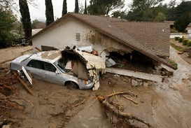
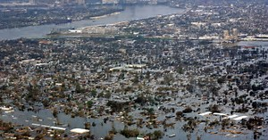
Risk Assumed II (RAII)
Will study significant risk shocks
such as
Photo by SPRC.org
to determine accounting standards that provide concise, meaningful, and transparent information regarding the potential impact to the fiscal health of the federal government.

Slide 8
RAII Status & Challenges
Status
Two roundtables
USAFacts Report
Ongoing gap analysis – meeting with practitioners
Challenges
Model for Reporting RA
Balance of Information
Unique Risk Definitions
Measure Risks Assumed

Slide 9
Land
Undertaken as a result of SFFAS 50 on Opening Balances.
Land reporting should be:
Consistent
Comparable
Useful
Hope for a proposal this calendar year

Slide 10
How Do We Account for Land Now? 2 Buckets:
SFFAS 6: General PP&E land and land rights
Capitalize
SFFAS 29: Stewardship land
Note disclosures
No asset dollar amount shown on balance sheet

Slide 11
Stewardship vs. GPP&E Federal Land by Acreage (in Millions)

Slide 12
What is the Board Considering?
Goal – Consistency and Accountability
Removing capitalized amounts (expensing new land acquisitions)
Requiring Disclosures
Key amendments to SFFAS 6 & 29 would include:
clarifying the categorization and reporting of land use,
broad acreage disclosure of acreage held-for-disposal
Rescinding Stewardship Land guidance in Technical Release 9.

Slide 13
Proposed Land Use Categories
Notes:
Dept. of Interior entities = BLM - Bureau of land Management, NPS - National Park Service, FS Fish and Wildlife Service
U. S. Dept. of Agriculture = Forest Service

Slide 14
Leases
FASAB collaborated with GASB to develop standards for governmental organizations.
Lease proposal issued late last year and comments received.
Board is deliberating on
comments.
Notes:
Leases
The objective for the August meeting was for the Board to review the draft Leases Statement and give staff feedback on any technical issues so that a pre-ballot draft can be provided to the Board by the October meeting.
Staff made the necessary edits to the Leases Exposure Draft (ED) to convert the document from an ED to a draft Statement based on
Board discussions related to responses to the 2016 Leases Exposure Draft (ED)
Board discussions with representatives from five federal entities at the April 2017 meeting on their views on the ED
Staff editorial changes for understandability and readability of the standard, including revisions adapted from GASB’s final Leases standard.
At the August meeting staff discussed the following three issues with the Board:
Definition of a lease
Service contracts
Lease term determination

Slide 15
Leases
Proposal
Single Model Approach
short-term exception - 24 months
Leases create “right of use” assets (resources)
Leases create liabilities (obligation)
Treatment should help identify the interest cost associated with leases.

Slide 16
Leases
Intragovernmental Exceptions:
Leases between two consolidation entities
(as defined in SFFAS 47)
Expensed by lessee when due and payable
Minimal disclosure requirements
Notes:
Effective date of standard
Other revisions to the standard
Possibility of re-exposure
The Board agreed to revise the standard to include the narrower lease definition to, “a contract or agreement that conveys the right to control the use of another entity’s identified property, plant, or equipment (an identified asset) for a period of time in exchange for consideration”. The Board agreed to include the definition of service contracts in the Leases standard. The Board agreed to add language that would clarify the “noncancelable period” and agreed that both the lessee and the lessor’s options to extend or terminate the lease contract or agreement, if probable, should be included in the lease term at its commencement. The Board agreed that when the lessee or lessor was assessing its own options to extend or terminate the contract or agreement the level of probability is at the probable threshold, whereas when the lessee or lessor was assessing the other party’s options to extend or terminate the contract or agreement the level of probability is at a higher threshold, like reasonably certain which requires significant evidence. The Board agreed to change the effective date of the Leases standard to reporting periods beginning after September 30, 2020 (FY 2021). The Board agreed to several editorial changes. The Board unanimously agreed that re-exposure of the Leases standard was not necessary based on the substance of the revisions.
Next Steps: Staff will make the necessary revisions to the draft standard based on all Board discussions since the exposure draft and present a pre-ballot draft to the Board by the October meeting.
Point of Contact: Monica Valentine, 202-512-7362, valentinem@fasab.gov

Slide 17
Leases
Areas under Deliberation
Clarify the nature of “right to use”
Scope (limit to PP&E and exclude IUS)
Weighing benefit vs cost
Need for implementation guidance
Implementation date

Slide 18
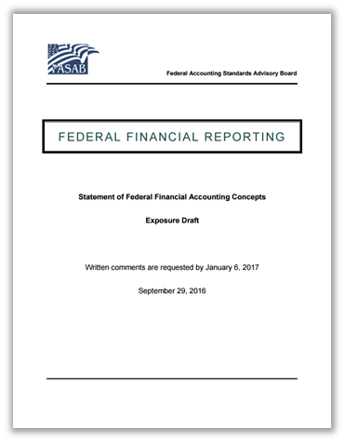
Reporting Model
Proposed conceptual guidance
Notes:
role of financial statements and required supplementary information (RSI)
content of financial statements and RSI
presentation of budgetary information
presentation of performance information
summary-level information

Slide 19
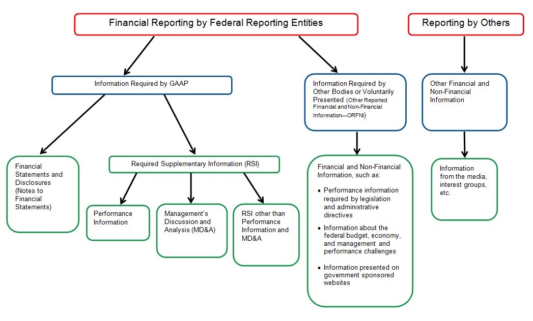
Reporting Model

Slide 20
Reporting Model
GAAP
Meet Reporting Objectives
Required by FASAB
ORFNI
Meet Reporting Objectives
Voluntary or
Administrative
Directive
Limitations
Qualitative Characteristics
Notes:
Relationship between financial statements and RSI (GAAP) and other reported financial and non-financial information (ORFNI)
GAAP
Based on common understanding of terms
Meets qualitative characteristics
ORFNI
Contribute to reporting objectives
May accompany GAAP
May have limitations
Lack exposure to same level of internal controls
Not subject to certain procedures required by GAGAS

Slide 21
Reporting Model
Next Steps
Near term – Improve User Access
Streamline User needs Clarity
Notes:
Streamline reporting and increase user access
Reduce excessive information
Reduce redundant information
Reduce boilerplate information
Use visual representations
ASAB discusses proposals for streamlining management’s discussion and analysis (MD&A) and required supplementary stewardship information (RSSI). During its August 2017 meeting, FASAB staff presented a proposal to require reporting entities to inform readers on where to obtain the entity’s annual performance report (APR) rather than providing detailed performance information in MD&A. The Board supported the proposal and noted that conditions have changed since FASAB developed the MD&A reporting standards in the early 1990s. Component reporting entities currently issue separate financial and performance reports and issue the reports at different times. In addition, the Board’s concepts acknowledge that information that users need may not reside in a single report. Consequently, the Board plans to develop an exposure draft (ED) to amend the existing MD&A reporting standards, explain the rationale for the proposal, and obtain comments from users, preparers, and auditors.
The Board also discussed an initial draft ED proposing to rescind RSSI reporting requirements. The draft ED noted that users do not review the RSSI provided in financial reports. Users can access the information from other sources, such as the Budget of the United States and APRs. However, the Board discussed the history and complexities of the RSSI topic and noted that the draft ED needed to include a comprehensive discussion of the rationale for rescinding RSSI. Thus, FAAB staff will present a revised draft ED during the October 2017 meeting.
Point of Contact: Ross Simms, 202-512-2512, simmsr@fasab.gov

Slide 22
Reporting Model – Potential for the Long Term
Electronic, internet based Access to detail Customization
Notes:
Potential Features for the Long Term
Electronic, internet-based presentation
Topic areas - separate required information (management’s discussion and analyses (MD&A), financial statements, and required supplementary information (RSI)) for each topic
ability to review highly aggregated and disaggregated data
ability to customize data for analysis

Slide 23
Two Streamlining Proposals
Management’s Discussion and Analysis
Make the summary of performance information optional
Integrate performance reporting by permitting links to performance reports
Stewardship Investments
Reviewing the usefulness of the RSSI requirements
Potential to provide guidance regarding relevancy of information

Slide 24
Disclosures

Slide 25
Classified Activities

Slide 26
Annual Input on Board Agenda
Conducted a survey in late 2016
Planning for an improved survey in 2017
Your opportunity to provide input!

Slide 27
Contact Information
Robin Gilliam, CPA, PMP
gilliamr@fasab.gov
www.fasab.gov
202.512.7350

