Slide 1
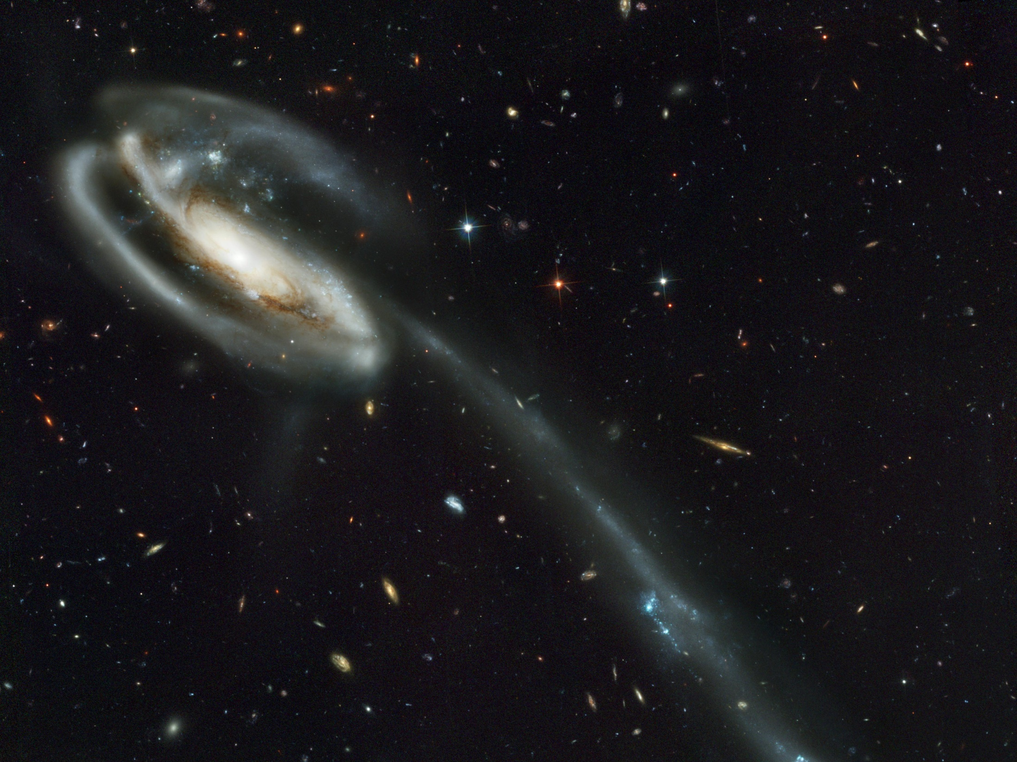
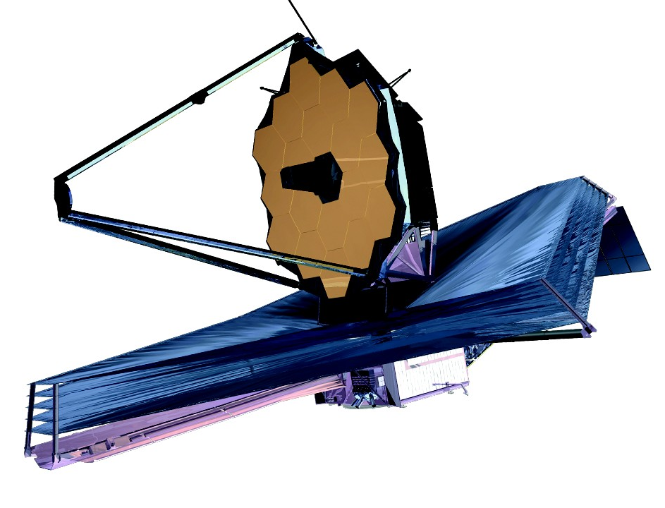

The James Webb Space Telescope
Extending the Science
Jonathan P. Gardner
NASA’s Goddard Space Flight Center
http://jwst.nasa.gov Space Science Reviews, 2006, 123/4, 485

Slide 2
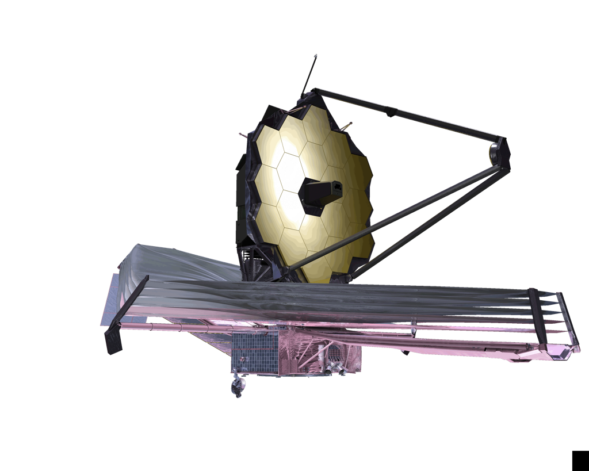
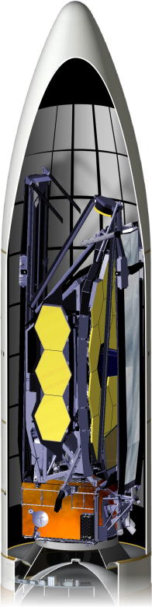
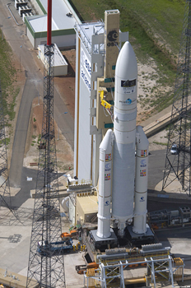
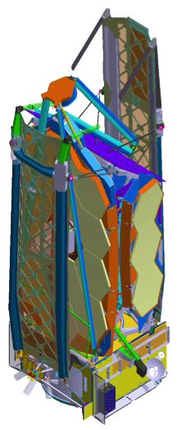
James Webb Space Telescope
Integrated Science
Instrument Module (ISIM)
Primary Mirror
6.6m Telescope
Successor to Hubble & Spitzer.
Demonstrator of deployed optics.
4 instruments: 0.6 to 28.5 μm
Passively cooled to < 50 K.
Named for 2nd NASA Administrator
Secondary
Mirror
5 Layer Sunshield
Spacecraft Bus
Complementary to WFIRST, ELT, ALMA, etc
NASA + ESA + CSA: 14 countries
Lead: Goddard Space Flight Center
Prime: Northrop Grumman
Operations: STScI
Senior Project Scientist:
Nobel Laureate John Mather
Notes:
Webb was succeeded by Thomas Paine.

Slide 3
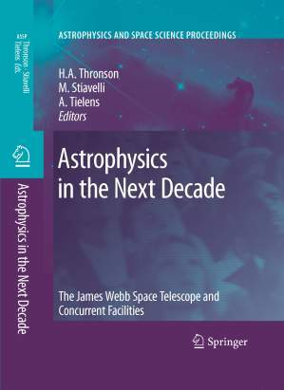
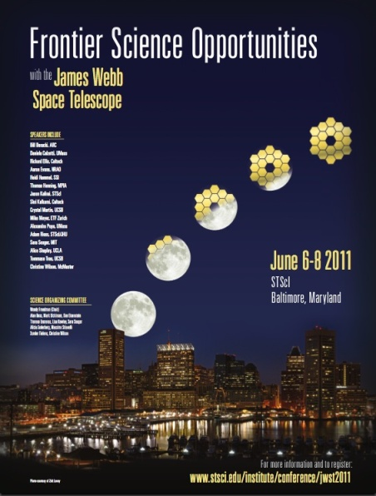
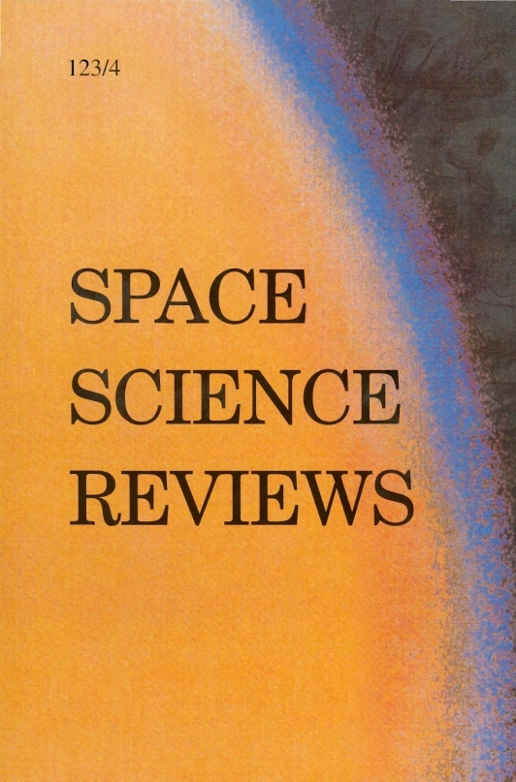
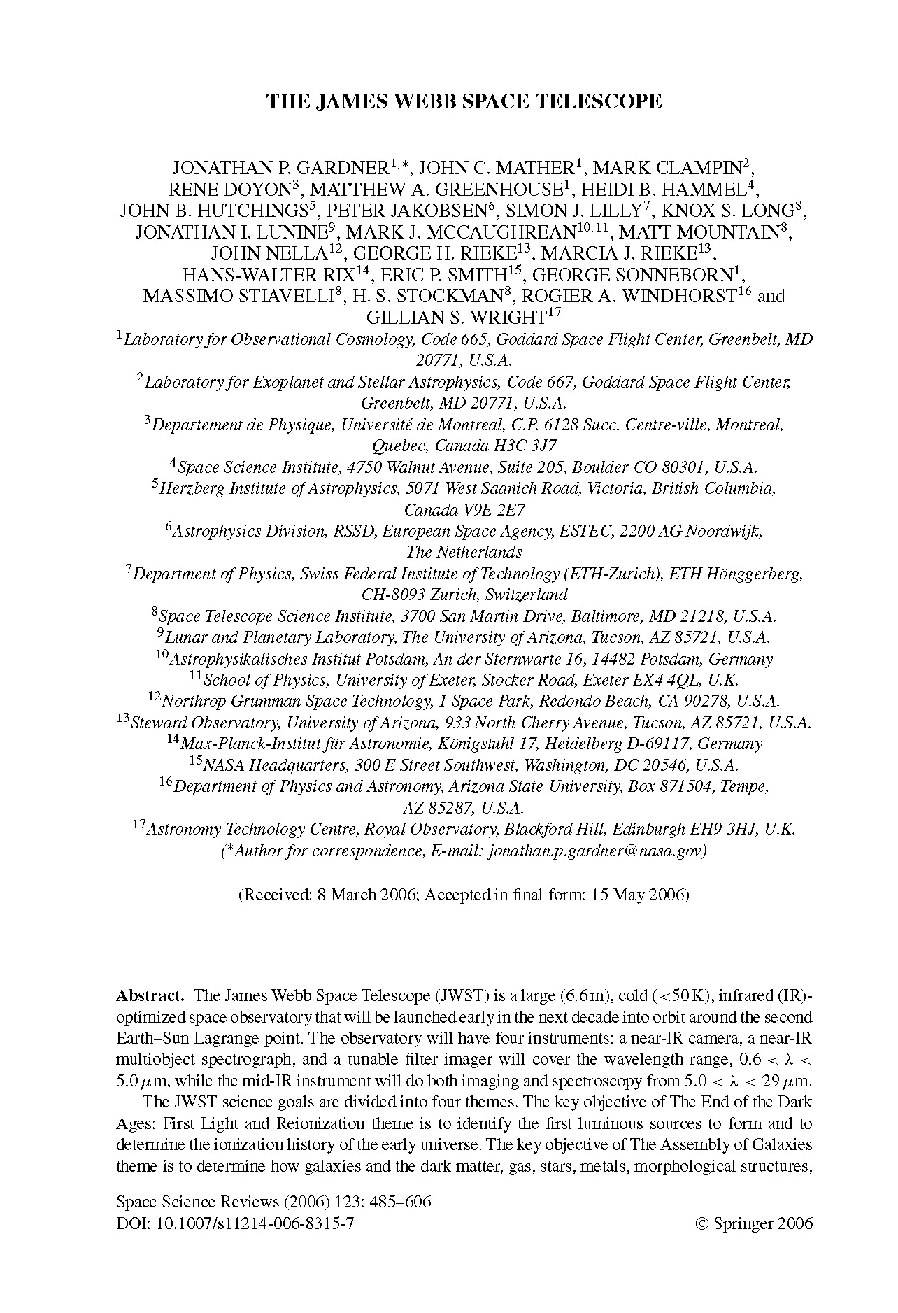
JWST Science Goals
White Papers:
JWST in Decadal Survey
Solar System Objects
Dark Energy
Transiting Planets
Coronagraphy
Planetary Systems
Stellar Pops
Star Formation
Galaxy Assembly
First Light
Astrobiology
Scientific Capabilities
Observation Planning
2007 Conference
Proceedings
Read on-line at Springer
2011 Conference
Webcast and Charts
http://webcast.stsci.edu
“Webcast Archives”
Gardner et al. 2006,
Space Science Reviews, 123/4, 485 http://jwst.nasa.gov/scientists.html
Science White Papers
http://www.stsci.edu/jwst/science/whitepapers/
JWST FAQ for Scientists & Engineers: http://jwst.gsfc.nasa.gov/faq_scientists.html

Slide 4
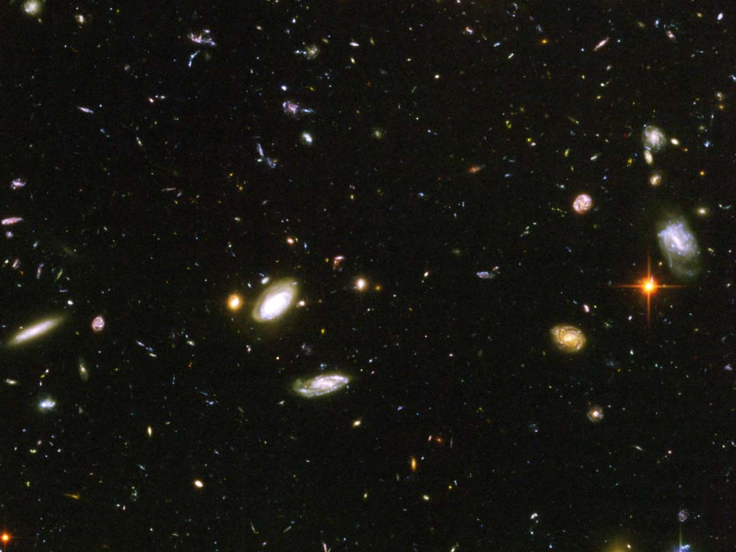
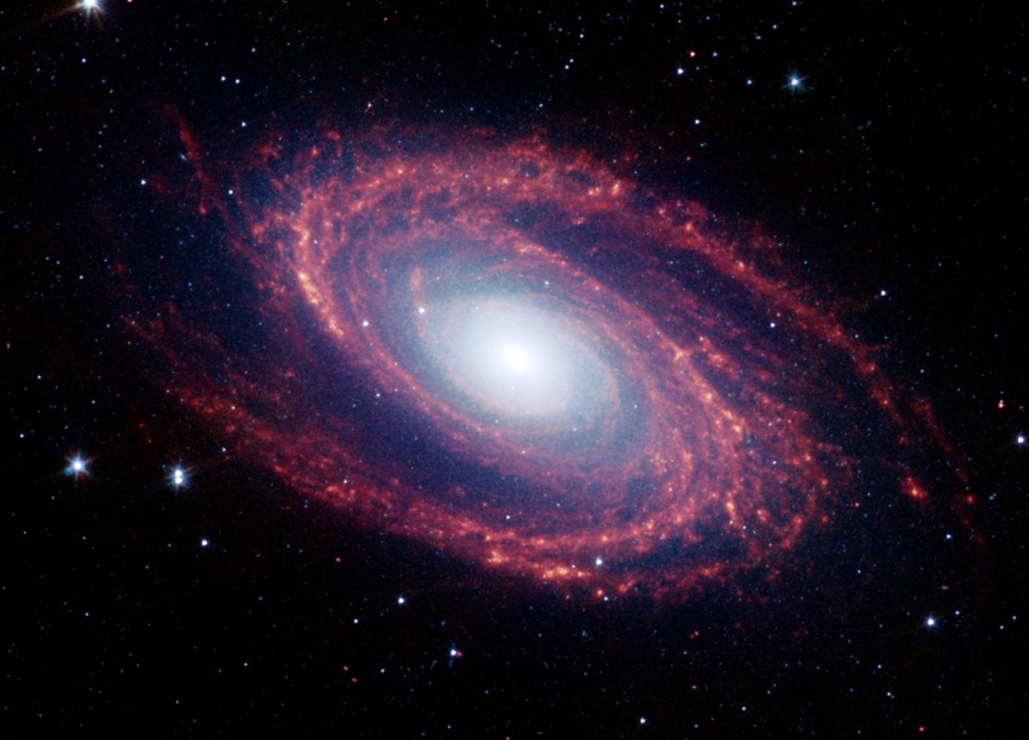
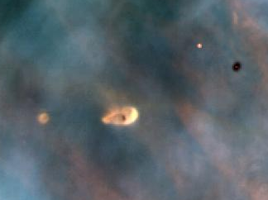
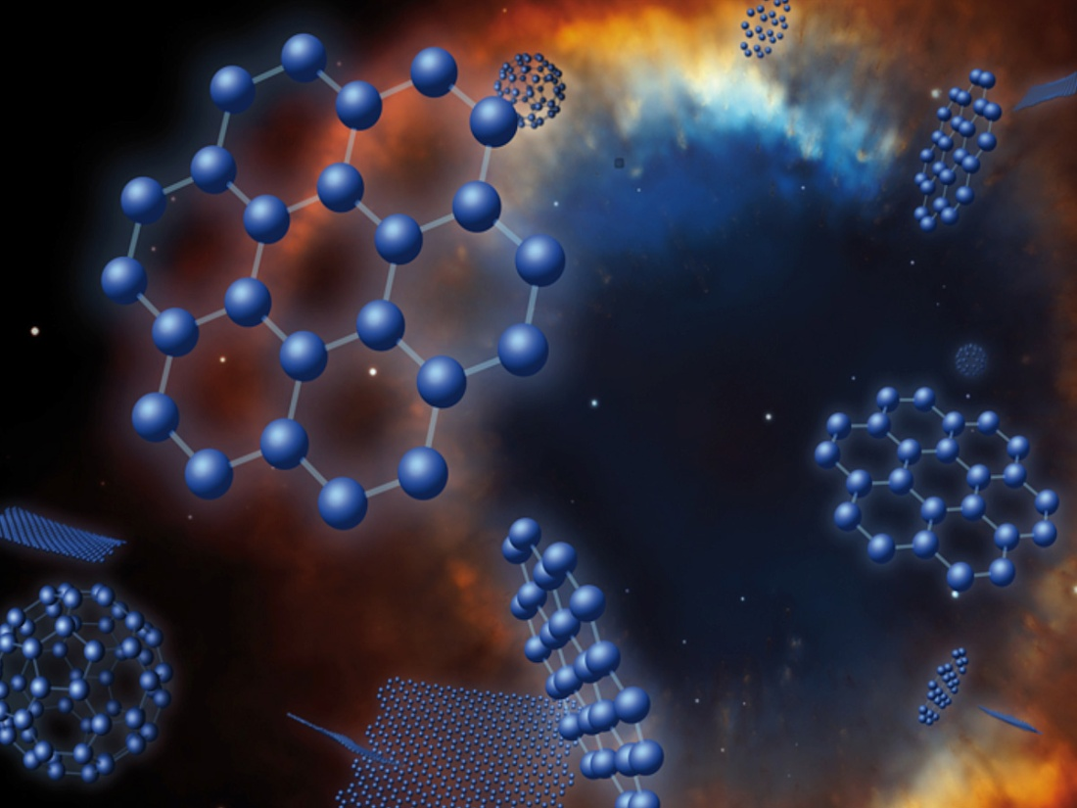
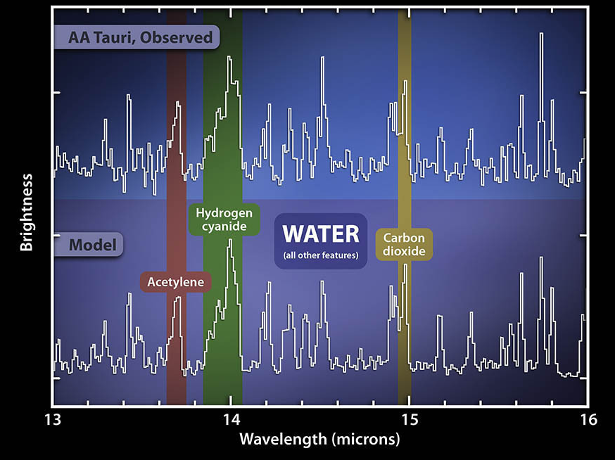
End of the dark ages:
first light and reionization
The Assembly of Galaxies
The Birth of Stars and Protoplanetary Systems
Planetary Systems and the Origins of Life

Slide 5
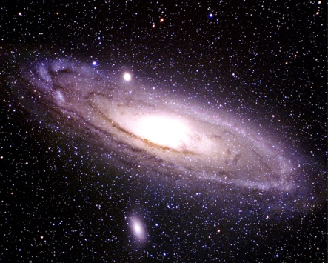
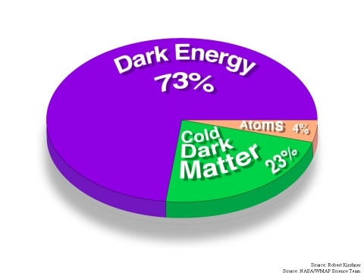
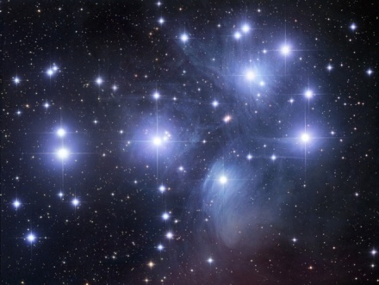
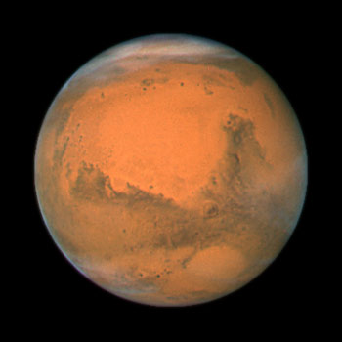
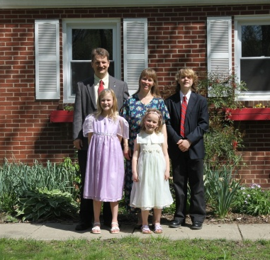
Extending JWST Science: The Dark Universe
Light Matter

Slide 6
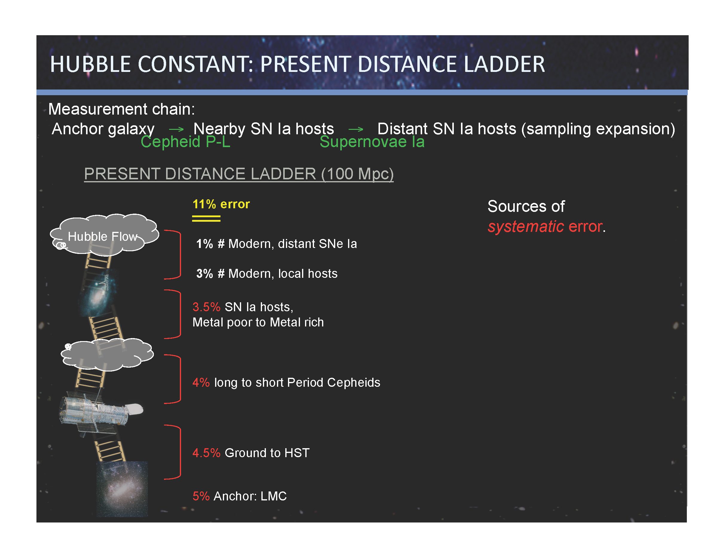
Riess Frontiers talk
Notes:
In order to measure the effects of dark energy on the expansion history,

Slide 7
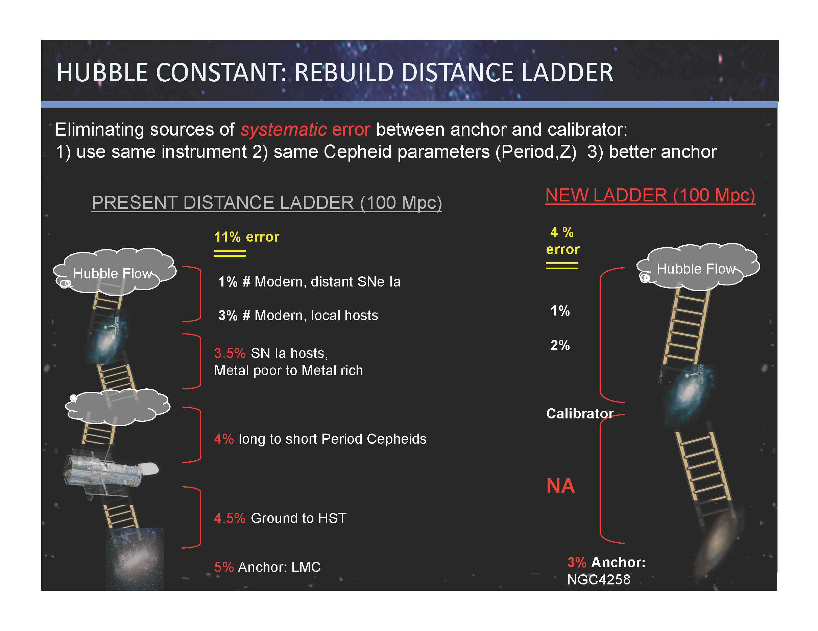
Riess Frontiers talk

Slide 8
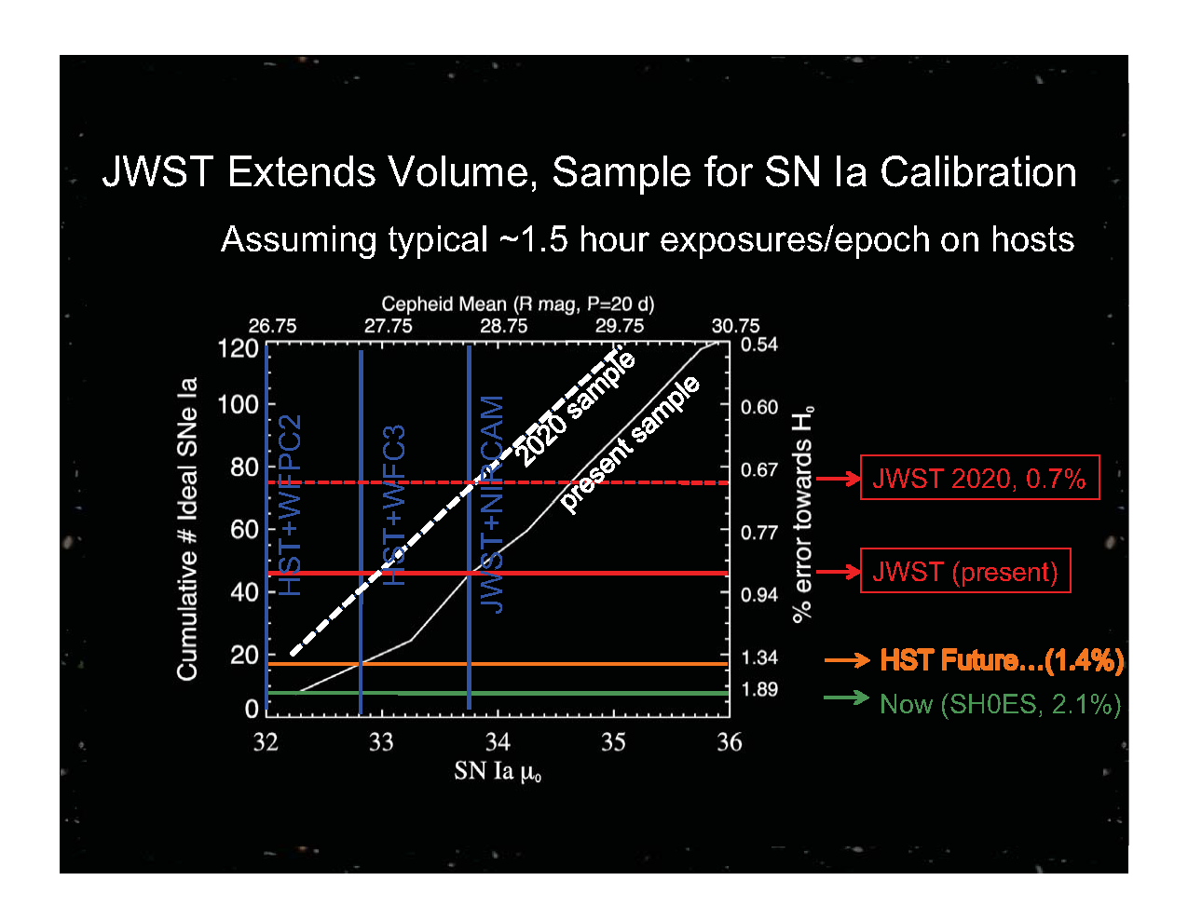
Riess Frontiers talk

Slide 9
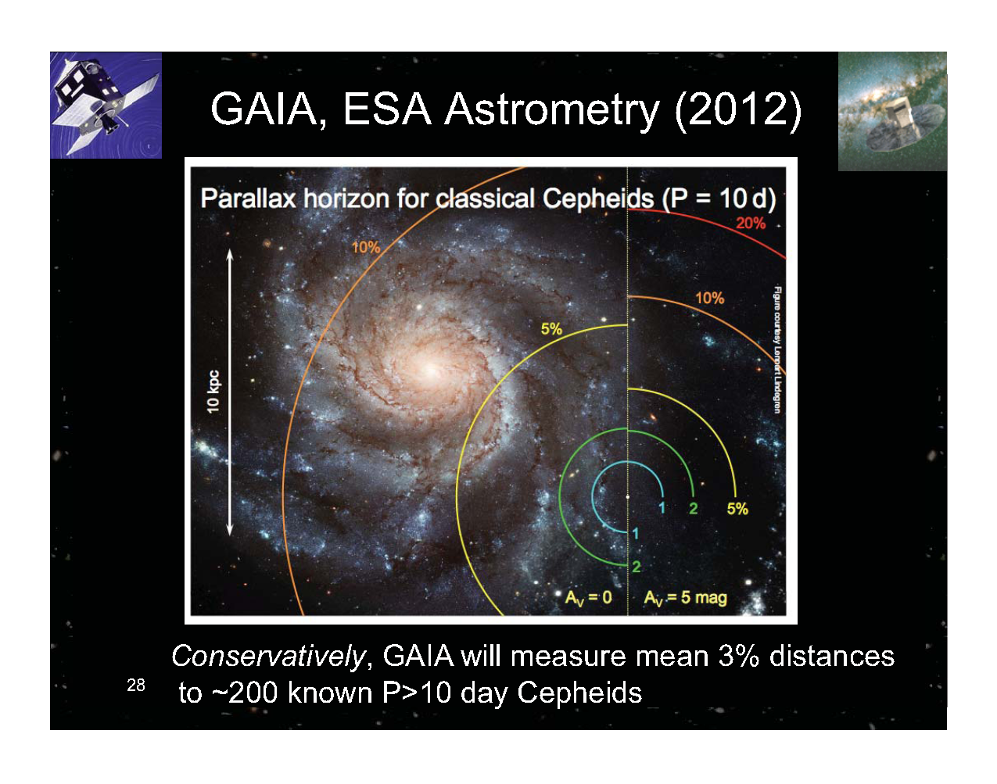
Riess Frontiers talk

Slide 10
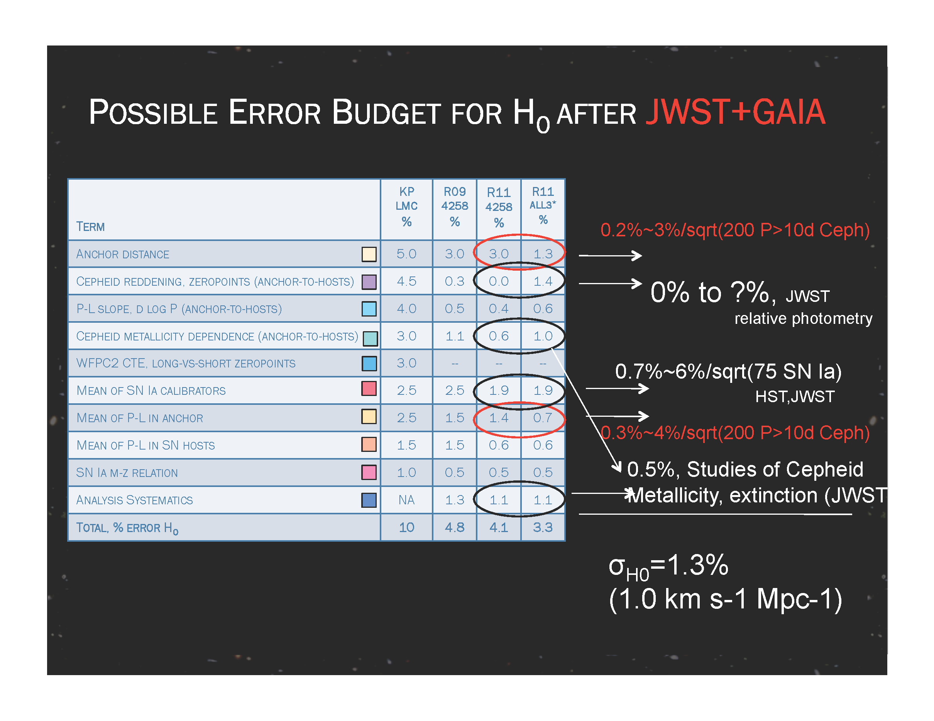
Riess Frontiers talk

Slide 11
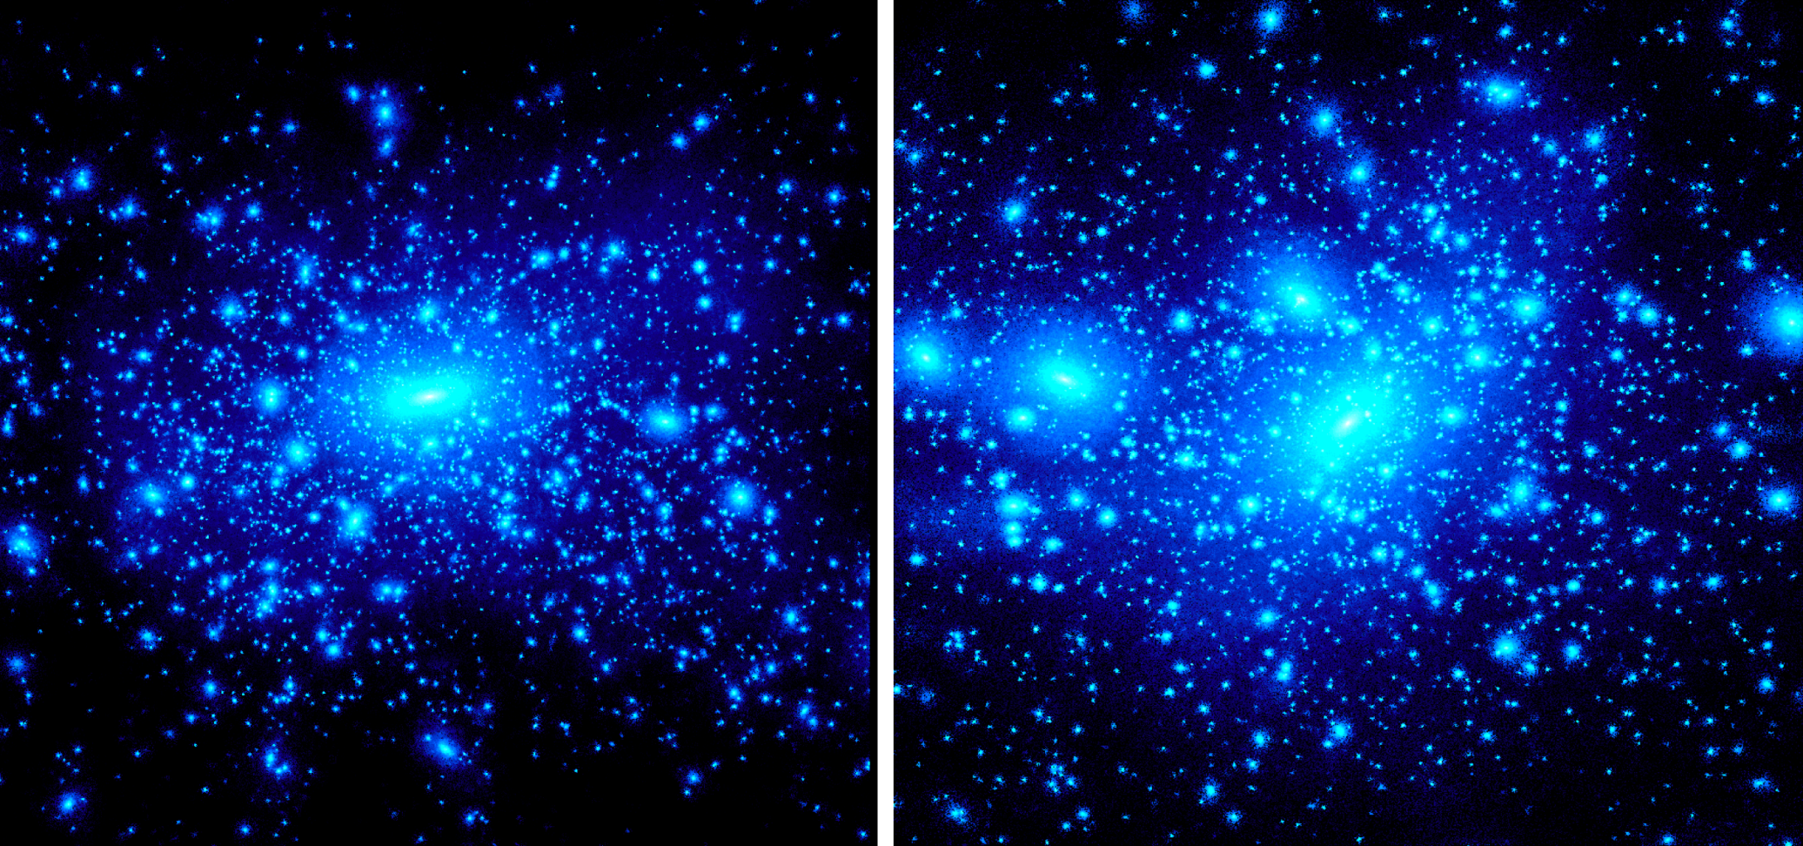
Dark Matter: Theory
Cluster
Galaxy
Kravtsov 2010
Treu Frontiers talk
Notes:
11

Slide 12
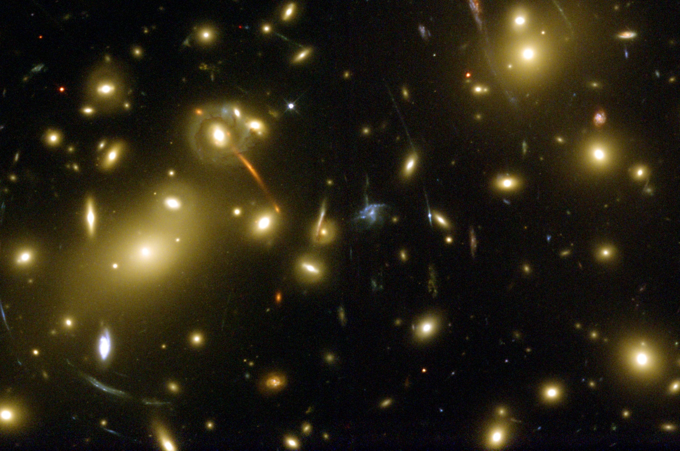
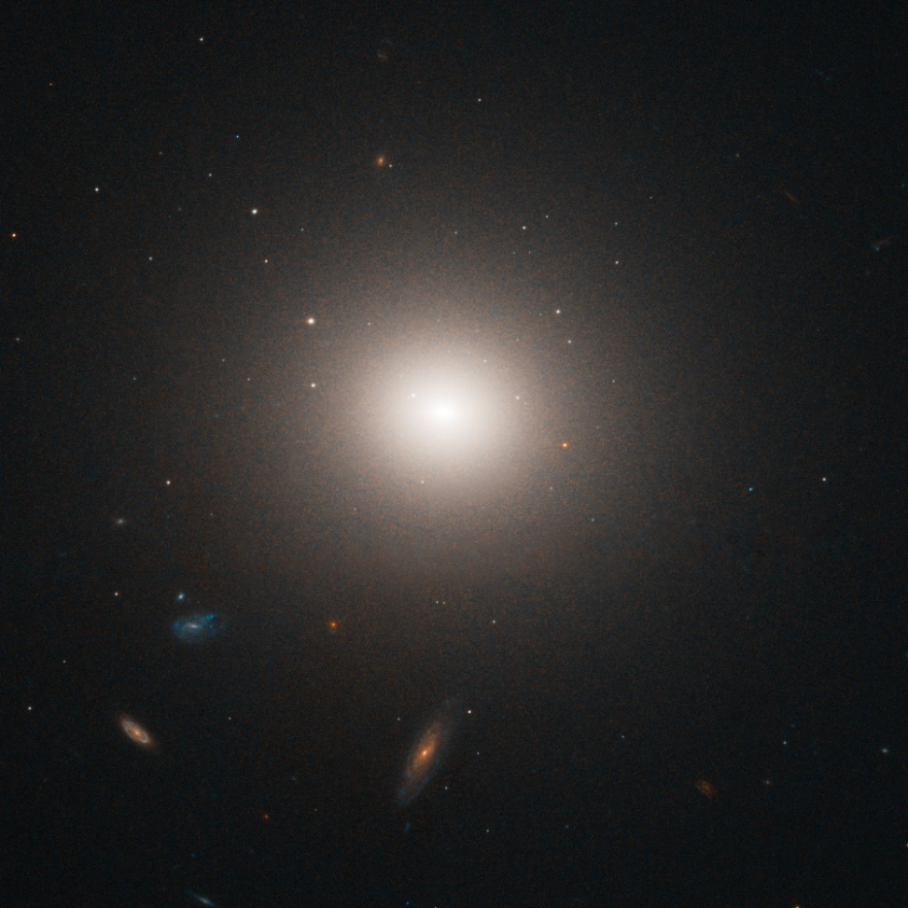
Light Matter: Observations
Cluster
Galaxy
Treu Frontiers talk
Notes:
12

Slide 13
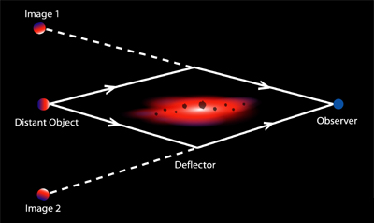
Strong gravitational Lensing
Image separation is a direct measurement of mass, luminous or dark!
Treu Frontiers talk

Slide 14
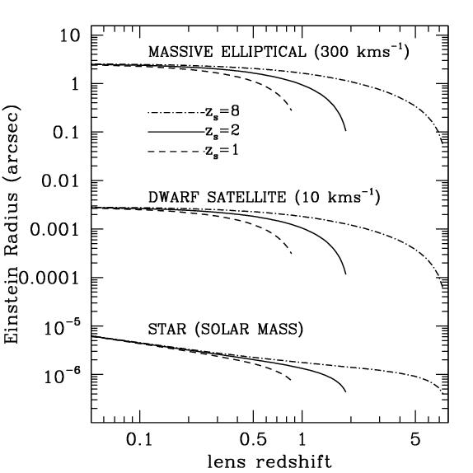
“Missing satellites” and strong lensing
Strong lensing detects satellites based on mass
Satellites are detected as “anomalies” in the gravitational potential ψ
  ψ’’ = magnification
  ψ’ = astrometry
  ψ = time delay
Three scales within lens:
  Arcsec: galaxies
  0.01’’: satellites
  micro-as: stars
1”
0.01”
micro”
Treu Frontiers talk
Treu 2010
Notes:
14

Slide 15
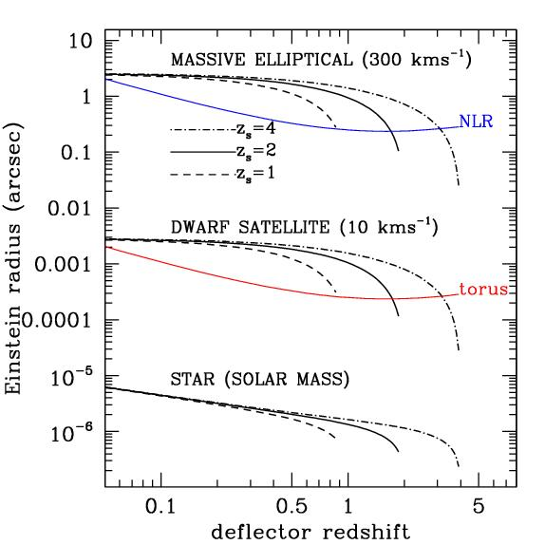
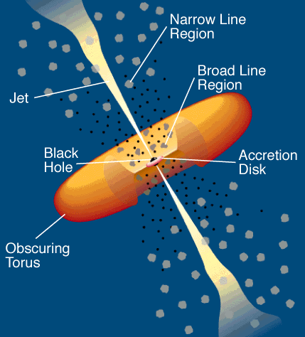
Dusty Torus and Narrow Line Region
Are not affected by microlensing
Treu Frontiers talk
Notes:
15

Slide 16
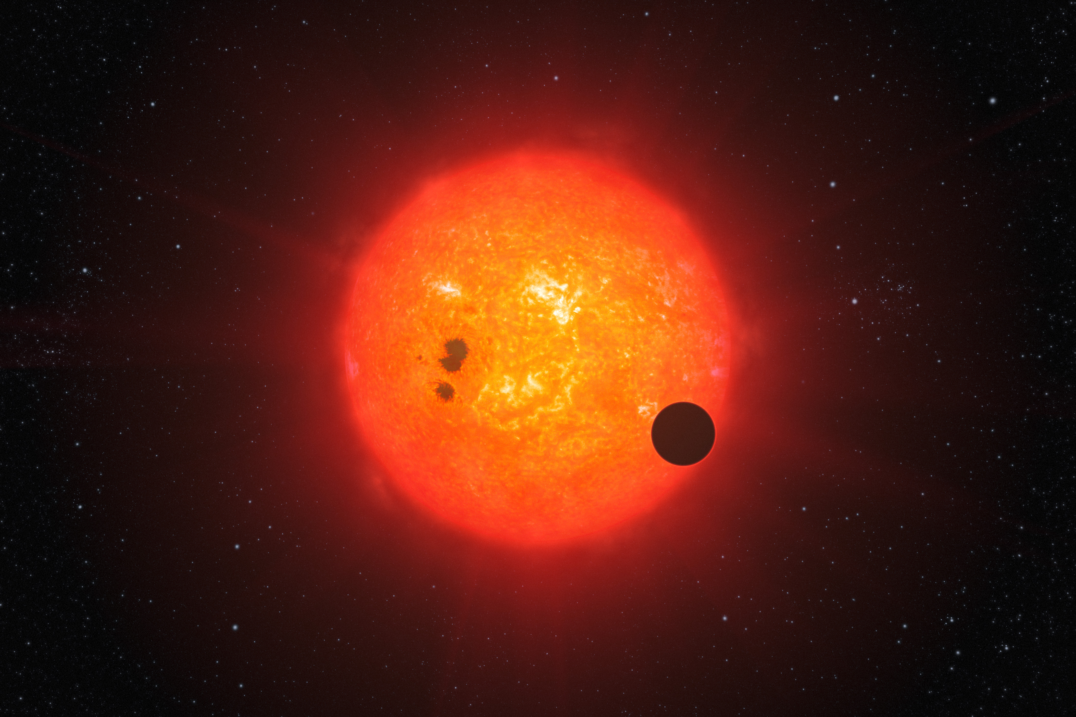
The Fast Track to Finding an Inhabited Planet
Exoplanets

Slide 17
Transits Allows Studies of the Atmospheres That Are Not Possible for Non-Transiting Planets
Secondary Eclipse
See thermal radiation and reflected light from planet disappear and
reappear
Transit
Detection of:
-Atoms & Molecules
-Stratospheres
-Clouds
-Winds
See radiation from star transmitted through the planet’s atmosphere
Charbonneau AAS January 2012

Slide 18
Gas Giants: HD189733b
NIRISS
Courtesy T. Greene and D. Charbonneau, as shown in Clampin et al 2009.

Slide 19
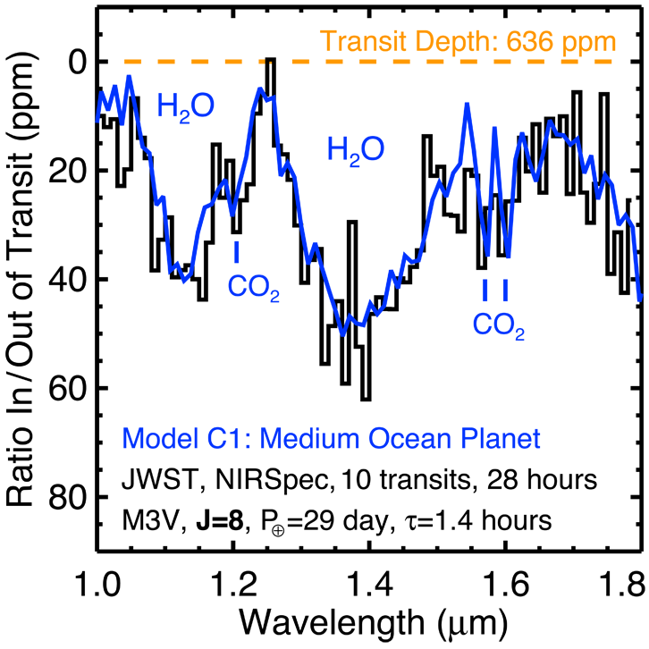
Transit Spectrum of Habitable-Zone
Earth-size Ocean Planet (1 R_{Earth}, 0.5 M_{Earth})
Notes:
Now we move on to terrestrial, but not yet Earth-like planets, looking only at absorption during planetary transit.
Blue curve is a model from Ehrenreich et al. (2006) for an Earth-sized “ocean planet” transiting an M3V.
The small radius of the M dwarf, relative to G dwarfs, increases the depth of transit features.
The water vapor features have a depth of 50 parts per million, comparable to the slit loss variations we calculated earlier.
I’ve picked J=8, which is faint enough that such a transiting planet should exist, if eta_Earth is anything near unity.
Discovering small planets that transit M dwarfs is another matter.
The simulation assumes 10 transits observations, covering 0.7 hours before and after each 1.4 hour transit.

Slide 20
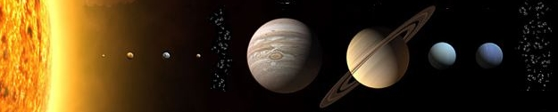
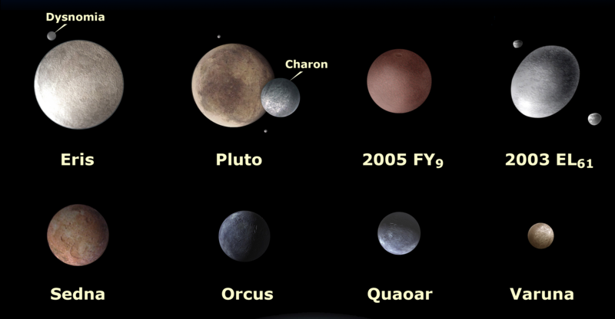
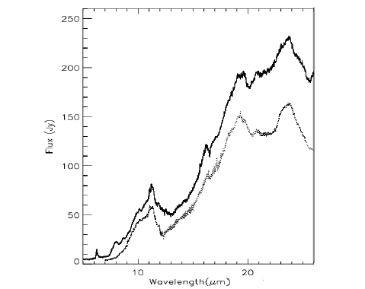
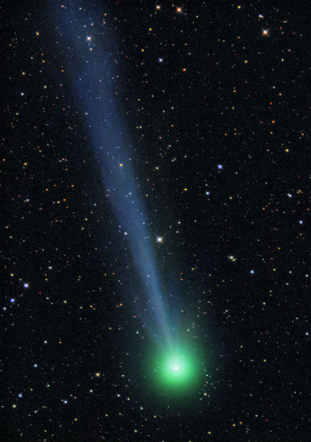
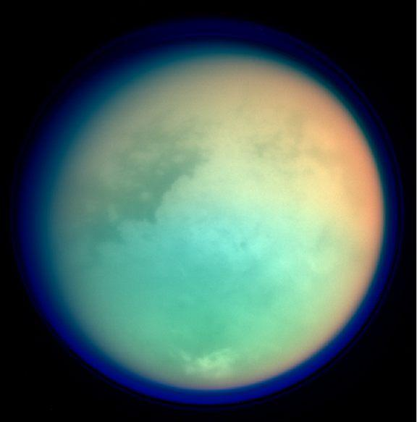
Within our Solar System: The Planets
Within our Solar System:
HD100546
KBOs
Hale-Bopp
Titan

Slide 21
Mercury, Venus, Earth: no
Mars, Jupiter, Saturn: some modes
Uranus, Neptune: yes
Can JWST observe:

Slide 22
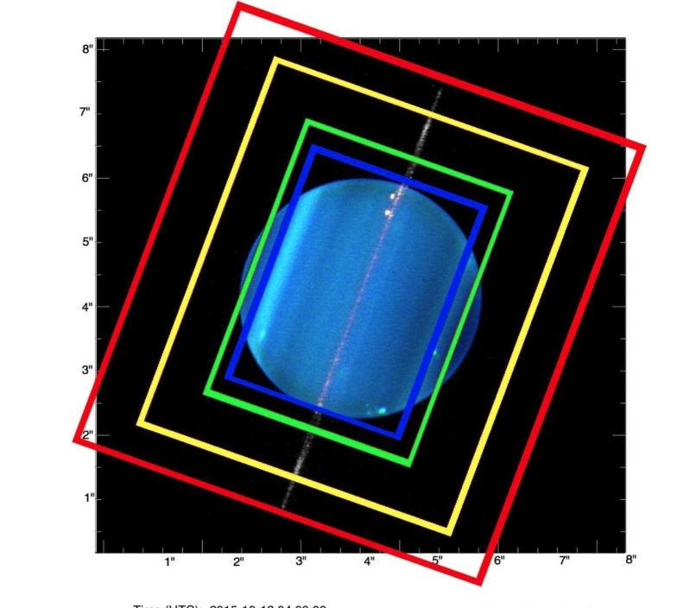
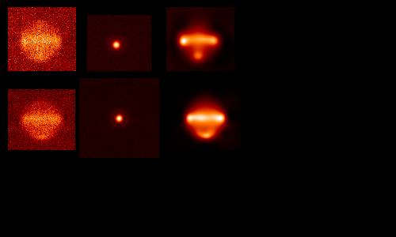

MIRI IFU & Uranus
20-year evolution of atmospheric temperatures on Uranus
Comparison with simulated image based on Voyager IRIS T(p,lat.)
VLT/VISIR 18.7-μm image
← cold pole
← warm pole
Uranus deconvolved Uranus simulation based on Voyager
(PIXON) IRIS results, c. 1986
O MIRI resolution
Hammel Frontiers talk

Slide 23

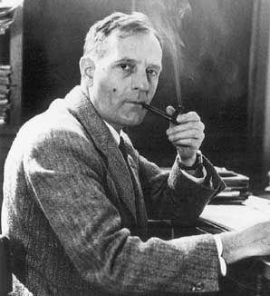
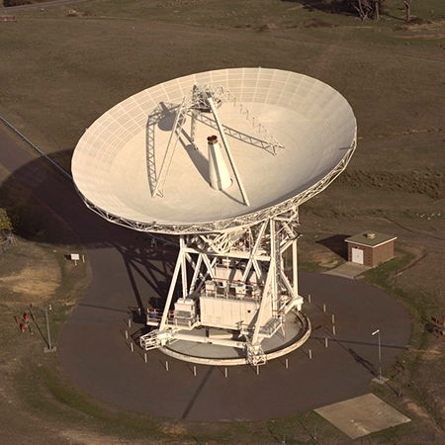
Operations
STScI will be the JWST
Science Operations Center
GO, Treasury and GTO programs similar to HST
JWST at L2
Astronomer
Ka
S
STScI
TAC
DSN

Slide 24
The James Webb Space Telescope
Extending the Science
Jonathan P. Gardner
NASA’s Goddard Space Flight Center
http://jwst.nasa.gov Space Science Reviews, 2006, 123/4, 485

Slide 26
The James Webb Space Telescope
Jonathan P. Gardner
NASA’s Goddard Space Flight Center
http://jwst.gsfc.nasa.gov Space Science Reviews, 2006, 123/4, 485

