Slide 1

ENGAGE & SAVE !
Resident Engagement Toolkit for
Housing Authorities
Ruchi Shah- Energy Associate
Stewards of Affordable Housing for the Future (SAHF)
October 22, 2015

Slide 2
Webinar Agenda
SAHF Overview
Need for Resident Engagement
Resident Engagement Toolkit Background
Resident Engagement Toolkit Components (Handout)
Next Steps

Slide 3

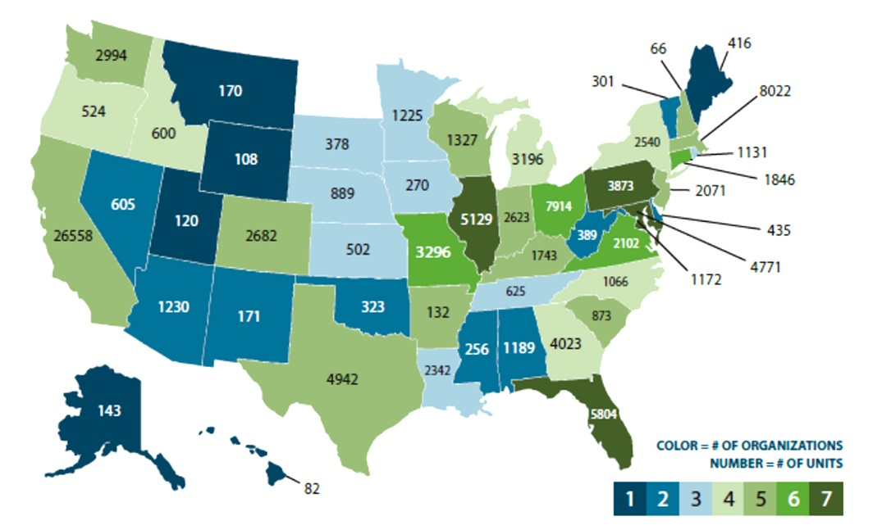
Stewards of Affordable Housing for the Future (SAHF)
  A collaborative of 11 exemplary multi-state non-profits.
  Over 115,000 units of affordable housing across the U.S.

Slide 4
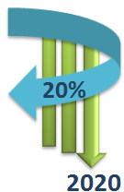
Buildings Don’t Use Energy And Water…
RESIDENTS DO !
Physical improvements/Capital investments
Changing the behavior of building staff and residents.
  Studies show that up to 20% of building efficiency outcomes depend upon resident behavior (Dietz et al.2009).
  Big Reach Goal
Notes:
Under a grant from the U.S. Department of Energy to test strategies for funding energy retrofits in private multi‐family housing, SAHF and its contractor, GreenRoots Strategies, undertook the design of the Resident Engagement Toolkit to complement the energy and water retrofits being made in the properties of participating SAHF members. The Toolkit enables owners and staff to maximize consumption reductions and to further reduce both owner and resident utility costs.

Slide 5


Where To Go?
SAHF Resident Engagement Toolkit
http://sahfnet.org/residentengagement.html
Specific to Affordable Multifamily Housing
Practical engagement tools, guidance, delivery tips:
  Enterprise - Resident Training in a Box & Green Leader training program
  Green Roots
  British Columbia Housing

Slide 6
What Are Your Goals?
Poll 1 – Why do you want to engage your RESIDENTS?
Reduce Utility Cost and Consumption
Increase Community Engagement and Awareness
My Peers are Doing It
Promote Resident Health and Comfort
Other

Slide 7
One-Size Fits All
Building Efficiency
Community Engagement
Resident Health
Utility Consumption
Utility Costs
Operating Costs
INCREASE
DECREASE

Slide 8

TOPIC AREAS
OTHER ITEMS
Resident Communications
Program Kick Off
Close Out & Evaluation
Choose What You Want !!

Slide 9
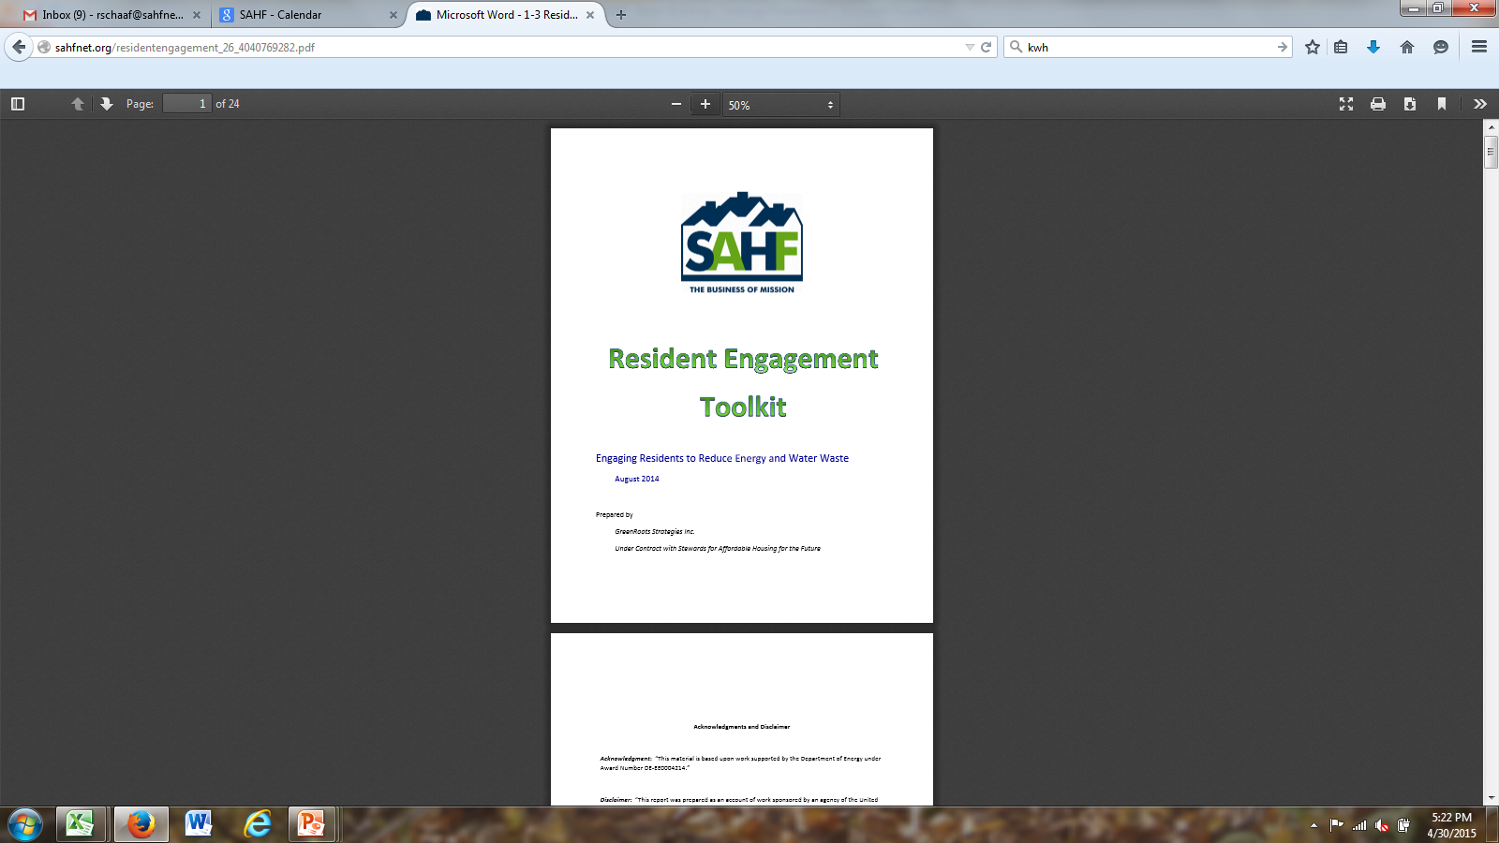
TOOLKIT COMPONENTS
Overview of Resident Engagement Modules
Before Getting Started
Gathering Information About Your Housing Community
Module A: Build a Conservation Foundation
Module B: Promote a Conservation Culture
Module C: Create Resident Green Leaders
Additional Resources
Refer to the handout attached.

Slide 10
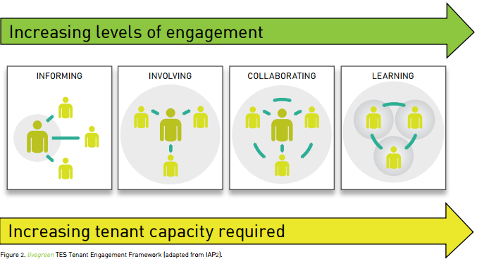
Ch1. Overview of Resident Engagement Modules
Notes:
Change the box colors

Slide 11
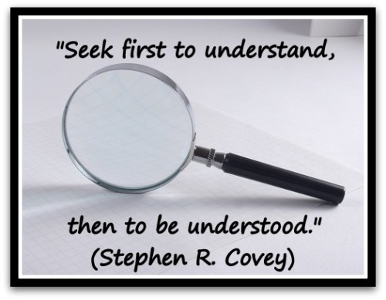
Ch2. Before Getting Started
Background Information:
Residential Energy and Water Use
The Role of Resident Behavior
Types of Behavior Programs
Factors: Program Design and Delivery
Resident Engagement Best Practices
Building in Feedback Opportunities

Slide 12

Types of Behavior Programs
1.Cognition – Education
2.Calculus – Incentive
3.Community-Based Social Marketing (CBSM) – Peer Pressure
  Build awareness
  Barriers & benefits to adopting conservation practices
  Emphasize only a few and meaningful conservation behaviors
  Commitments to conservation & point‐of‐use behavior reminders
  Provide staff and residents feedback on program outcomes

Slide 13
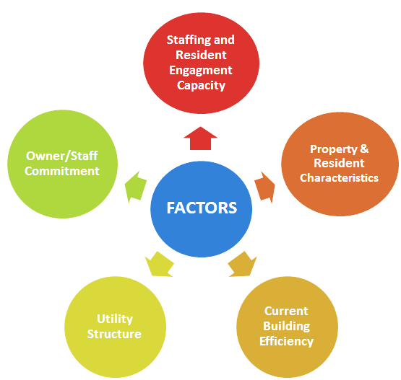
Program Design & Delivery
THINK THROUGH !!

Slide 14
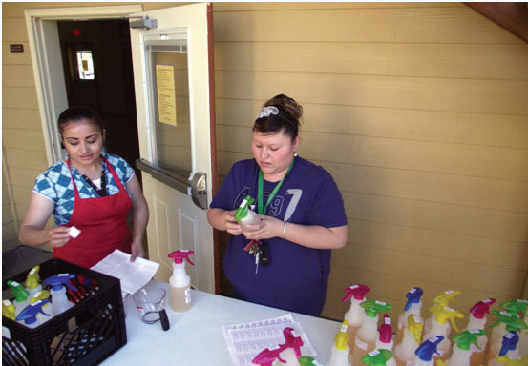
Best Practices
Listen to residents
Staff buy-in
Simple is better
Repetition is key
Recognize & Reward
Farmworker Housing Development Corporation taught residents to make and use their own green cleaners.

Slide 15
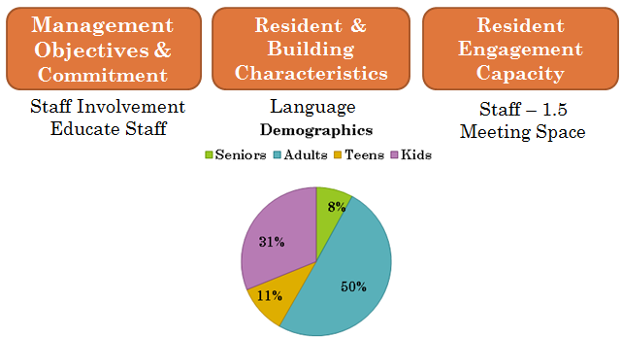
Ch3. Gathering Information and Planning
Planning Tool- Engagement Opportunities Questionnaire
Notes:
Once you have selected influencing factors gather some information
Assist in selecting modules that best match owner resources and resident capacity
Collect information to tailor messages and activities to residents/properties
If completed by the Housing Manager or another person knowledgeable about both residents and your
apartment buildings, the questionnaire can be completed in less than an hour.

Slide 16


Ch4. Module A: Build a Conservation Foundation
Staff Commitment and Resident Awareness
Informational + Interactive
Minimum staff time
Activities and Tools
Notes:
For each activity: pictures of materials, instructions, and estimate of staff time
Special section – Strategies and tips on engaging residents during retrofits

Slide 17
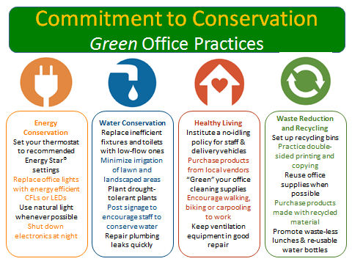
Housing Operations
1 hour workshops with learning activities for staff

Slide 18
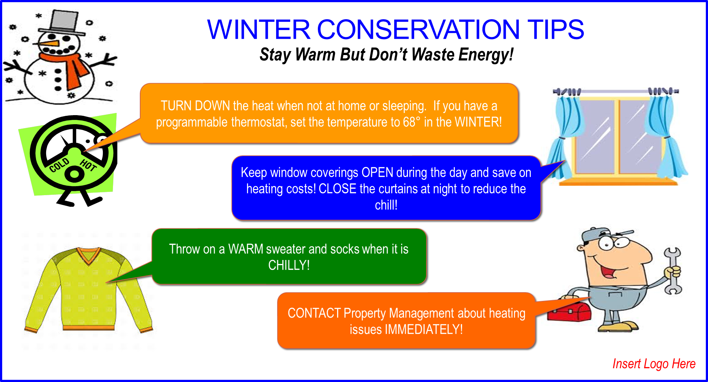
Resident Communications

Slide 19
Resident Intercept Survey
When you have little time to conduct research to uncover the barriers and benefits to resident participation, set up intercept surveys. This intercept survey involves asking two simple questions of residents as they pass through an area (lobby, rec room, or management office).
What makes it difficult or challenging for you to cut energy or water waste?
What do you see as beneficial or rewarding about cutting energy or water waste?
Make sure to go to locations where residents congregate!

Slide 20


Slide 21
Seasonal Conservation Message Campaigns
Conservation Corner/Postcards
Useful Activities:
        Read Your Utility Bill !
        How Much Electricity do I Use?
        “Switch‐a‐bulb" during annual unit inspections
Point‐of‐use prompt stickers and door hangers
Conservation‐themed coloring sheets for children

Slide 22



Point-of-Use Prompts
Electricity Use

Slide 23

Color It !!

Slide 24
Ch5. Module B: Promote a Conservation Culture
Increasingly interactive – greater staff and resident involvement
Activities and Tools:
  Program kick-off
  Energy : Energy Bingo game, Plug Load Conservation
  Water : Water Trivia and Water Log Challenge
  Healthy living: Green Cleaning Lobby Display
  Waste reduction and recycling
  Close out and evaluation: Poster Competition
Optional children’s program – Green Sprouts !
Notes:
Activities conducted by staff alone or in coordination with community partners and consultants
Works best if residents already participate in group activities

Slide 25

Resident Advisory Group
Agenda – Meeting One
Welcome and Introductions
A description of the Resident Engagement Program
Review Program 1 or Program 2 - Schedule of Activities
Discussion on Engagement Barriers
Campaign Kick-Off Event (Switch-a-Bulb) Planning
Question & Answer Period
Next Steps
Notes:
Resident Advisory Group – Meeting #1 Agenda. The attached agenda provides an outline of topics to discuss/explore with the newly appointed Resident Advisor Group.

Slide 26
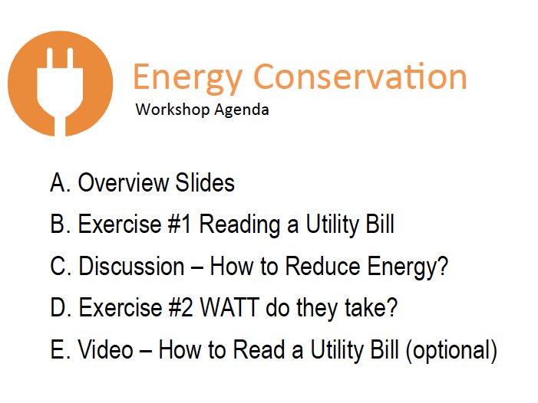
Notes:
Video Link?

Slide 27
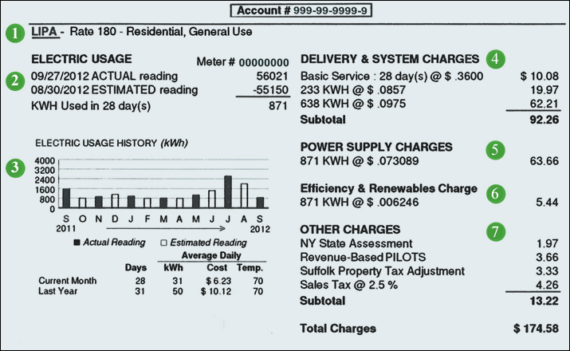
Reading a Utility Bill

Slide 28
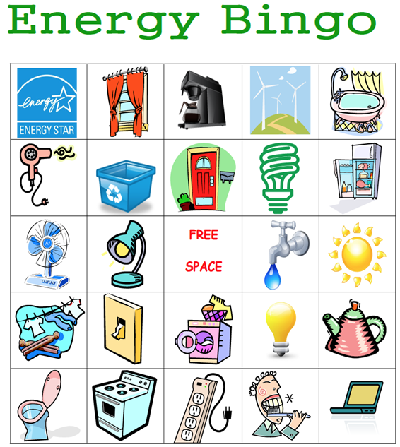
FUN !!

Slide 29



Movie Night
Come Learn About...
Water Conservation!
Tracking your Water Use
Watch “Ice Age – the Meltdown”
Tuesday April 22, 2016
2:00 p.m.
Meet in the Community Room
Notes:
Optional Activity – Green Sprouts Program
The Green Sprouts - Movie Night Poster should be used to advertise for a fun night of entertainment and education. Children will learn about water use and conservation and take home a Water Log Challenge.
Note: the Green Sprouts Movie Night is an optional activity. Remember to insert the proper logo, date, time and location of the event. Posters are more noticeable when printed on tabloid size paper (11x17) and posted at least one week prior to an event.

Slide 30
Ch6. Module C: Create Resident Green Leaders
Highest level of staff and resident engagement
Residents as co‐trainers with staff
Activities and Tools:
  Resident recruitment
  Resident training toolkit
  Sharing best practices

Slide 31

We are looking for residents - just like you - who are willing to join us by becoming a Green Leader to address energy, water, recycling and healthy living in our building.
It won’t take much time and it will
be fun (really!). The goal of this program is to encourage our building to take action towards living a more sustainable lifestyle and saving money.
To learn more contact:
Insert your name and contact information here

Slide 32
Ch7. Additional Resources
Listing of sources, briefings, and publications:
  Community-Based Social Marketing (CBSM)
  Low Income Housing Facts
  Resident Engagement, Conservation & Multifamily Housing
  Resident Engagements as part of Retrofit Programs

Slide 33
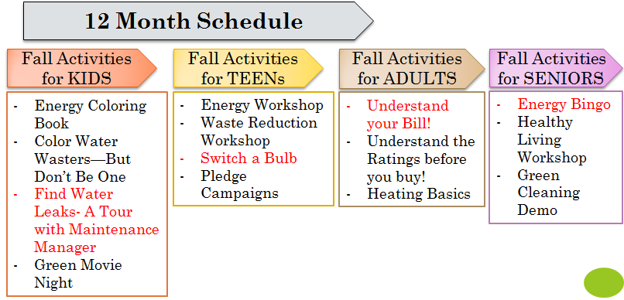
It’s Comprehensive !!

Slide 34
What’s Next?
Get familiar with the Resident Engagement Toolkit
Consider how to implement at your properties
Determine staff leadership involvement
Questions on training/support– Contact Us!!

Slide 35
How can we serve better?
Post-Webinar Survey

Slide 36
THANK YOU!!
Resident Engagement Toolkit
http://sahfnet.org/residentengagement.html
Ruchi Shah- Energy Associate
Stewards of Affordable Housing for the Future (SAHF)
rshah@sahfnet.org

