Slide 1

NSF Grants Writing and Management Workshop
Directorate for Education and Human Resources
Division of Undergraduate Education
Division of Human Resource Development
Division of Research on Learning in Formal and Informal Settings
Division of Grants and Agreements
2017-2018
Notes:
Good Morning. Thank you all for joining us today to learn about grant writing, review of proposals and managing grant awards at NSF. I am joined by my colleagues from the Directorate of Education and Human Resources and the Division of Grants and Agreements. Please do not worry about taking notes, we will be sharing the slides with you. Also, please hold any questions until the end of the presentations.

Slide 2



NSF by the Numbers
11,900
awards funded
$7.5
billion FY 2016
All STEM disciplines
Research, education and related activities
1,826
NSF-funded
Institutions
STEM
Education Research
96%
49,300
proposals
320,900
NSF-supported researchers
214 Nobel Prize winners
Notes:
Let me begin with a brief review of NSF’s scope of operation. In Fiscal Year 2016, NSF’s budget was $7.5 billion and 96% of this money funded research in the STEM disciplines, STEM education and related activities. In FY2016, NSF received 49,300 proposals and made 11,900 awards, overall a 23% success rate. In this same fiscal year, NSF supported 1,826 different institutions and ~300K individual researchers.

Slide 3


Education & Human Resource Directorate
Office of the Assistant
Director
Division of Research on Learning (DRL)
Division of Graduate Education (DGE)
Dr. Jim Lewis
EHR Assistant Director
Dr. France Córdova
NSF Director
Division of Undergraduate Education (DUE)
Division of Human Resource Development (HRD)
Notes:
The National Science Foundation is an independent federal agency whose head is appointed by the President of the United States. The current director, Dr. France Cordova was appointed by President Barack Obama. NSF comprises 7 directorates, including ours—the Directorate for Education and Human Resources (EHR). EHR is led by an Assistant Director, currently Dr. Jim Lewis. EHR has four divisions, Division of Research on Formal and Informal Settings (DRL), Division of Graduate Education (DGE), Division of Undergraduate Education (DUE), and Division of Human Resource Development (HRD). The HSI program is managed jointly by DUE and HRD, with help from DRL. Today’s workshop is being conducted by representatives from HRD, DUE, and DRL. WE also have staff from the Division of Grants and Agreement who will provide guidance in awards and grants management.

Slide 4
Education & Human Resources (EHR) Goals
Prepare the next generation of STEM professionals and attract/retain more Americans to STEM careers
Develop a robust research community that can conduct rigorous research and evaluation to support excellence in STEM education
Increase the technological, scientific and quantitative literacy of all Americans
Broaden participation and close achievement gaps in all STEM fields.
Notes:
EHR’s goals are to prepare the next generation of STEM professionals, develop a robust research community, increase the technological, scientific and quantitative literacy of all Americans, and close achievements gaps in all STEM fields through broadening participation. The HSI program is being established to ensure the participation of Hispanic Serving Institutions in STEM.

Slide 5
Workshop Structure
Presentations/discussions
  Proposal and Award Timeline
  Proposal Preparation and Submission
  Proposal Review and Processing
  Award Process
2. Break out sessions:
  Review Panel Simulation
  Q & A with Division of Grants & Agreements
Report Out and Debrief
Q&A
Notes:
The Purpose of this workshop is to familiarize potential PIs and their grant administrators with the process of developing and submitting an NSF proposal using NSF’s merit review criteria.
The workshop will be divided into two parts:
General information session focused on the proposal cycle- including the timeline for critical events such as: publication of a program solicitation, writing and submitting a proposal, NSF’s proposal review process, and finally, the award process.
This general information session will be followed by a breakout session that involves simulating a panel review, using ‘cleaned’ proposals. Our goal is transparency about how we ask reviewers to review a proposal, write a review and discuss a review. We hope this session will inform you about how to write a competitive NSF proposal and encourage you to become a reviewer for NSF. Following a period of discussion as a “mock review” format, we will have open questions and debriefing on the breakout experience.
The workshop will end with the Q &A.

Slide 6
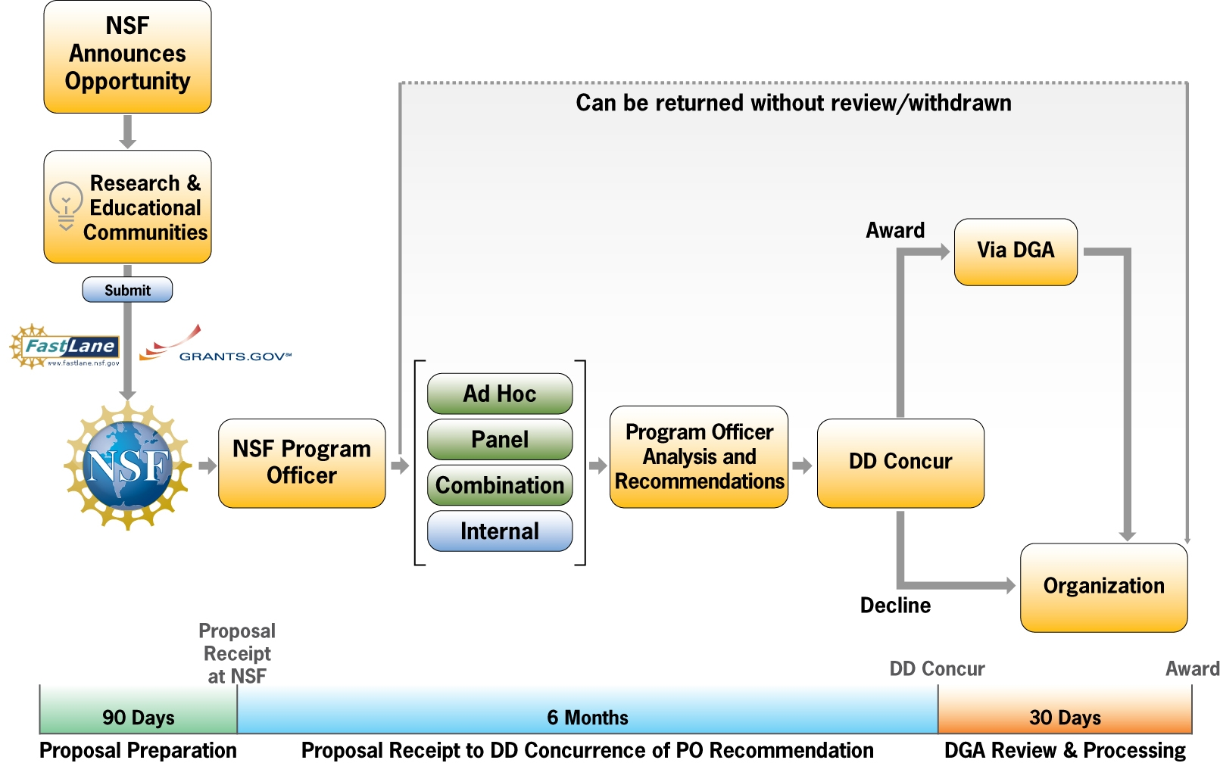
NSF Proposal & Award Process Timeline
Notes:
This diagram represents the NSF proposal & award process timeline. We’re going to step through it one section at a time starting with the publication of a funding opportunity. The funding opportunity announcements may be in the form of program announcements, program solicitations or “Dear Colleague Letter”. In most cases, once a program solicitation is announced, you have about 90 days to write and submit your proposals, so always check the submission deadlines. Some programs have multiple tracks so make sure that you are following the correct submission deadline. Also note that some program tracks may not have a deadline, while others have target dates, which simply means that proposals may be submitted any time as long as the solicitation is active, but will be reviewed on the next organized panel review, so it is best if you have questions about submission dates, to check with the cognizant program officers.
Investigators will work with their Offices of Sponsored Research to submit proposals via FastLane or Grants.gov. Proposals are routed to the National Science Foundation who sends them to the relevant Program Office.
Reference: https://nsf.gov/about/how.jsp

Slide 7
How to Find Out About Funding Opportunities
Subscribe to National Science Foundation Update https://public.govdelivery.com/accounts/USNSF/subscriber/new?qsp=823
  Choose your subscription topics
  Change your topics at any time
  Program announcements and solicitations no less than 90 days before target date/deadline
  Watch for Dear Colleague Letters in areas of interest
Notes:
To keep abreast of current opportunities, sign up for updates at the website below. On the website, you can choose your subscription topics, change topics any time, receive program announcements and watch for DCLs in areas of interest to you. You will automatically receive updates about NSF programs.

Slide 8
Reminders: Preparing Proposals
Read the funding opportunity; ask a Program Officer for clarifications if needed.
Remember to address NSF’s two merit review criteria.
  Intellectual Merit and Broader Impacts
Address all program- & solicitation-specific criteria.
Avoid omissions and mistakes
Check your proposal to verify that it is complete!
Notes:
In addition to the reminders on this slide, you can refer to Chapter 2 of NSF’s Proposal & Award Policies and Procedures Guide, or PAPPG. You can find a link to the PAPPG by going here: https://www.nsf.gov/funding/preparing/. Use the PAPPG and the funding opportunity announcement to verify that your proposal is complete. Again, you can also reach out to a Program Officer.

Slide 9
Address these Fundamental Questions
} Goals
} Rationale
} Evaluation
} Dissemination
What are you trying to accomplish? What will be the outcomes?
Why do you believe that you have a good idea?
Why is the problem important?
How does your idea tie into previous efforts?
Why is your approach promising?
How will you manage the project to ensure success?
How will you know if you succeed?
How will others find out about your work?
How will you interest / excite them?
DIRECTORATE FOR EDUCATION
AND Human resources
Notes:
When writing your proposal, be sure to address these fundamental questions. First, what are the GOALS of your proposal. What are you trying to accomplish? What will be the outcomes?
Second, your proposal should have a RATIONALE. Why do you believe that you have a good idea? Why is the problem important? How does it tie into previous literature/efforts? Why is your approach promising?
Third, your proposal should have an EVALUATION component. How will you manage the project to ensure success? How will you know if you succeed?
Finally, explain your DISSEMINATION plan. How will others find out about your work? How will you interest / excite them?

Slide 10
Writing the 1-Page Project Summary
1st descriptive paragraph
What will you do?
Why is it important?
What has already been done?
How are you going to do it and how is your approach special (innovative, creative)?
2nd paragraph
Intellectual Merit (technical, scientific contributions)
3rd paragraph
Broader Impacts (benefit to society)
Notes:
The proposal must contain a one-page summary of the proposed activity suitable for publication. It is not an abstract of the proposal, but rather a self-contained description of the activity that would result if the proposal is funded. The summary should be written in the third person and include a statement of objectives and methods to be employed. The summary should be informative to other persons working in the same or related fields and, insofar as possible, understandable to a scientifically or technically literate lay reader.
Summaries contain 3 paragraphs: A description of the proposed work, its intellectual merit and broader impacts.
To write the first paragraph, you might consider using these questions: What will you do? Why is it important? What has already been done? How are you going to do it and how is your approach special (innovative, creative)?
The second paragraph should address the intellectual merit or technical / scientific contributions. How does the work advance the field?
The third paragraph should address the Broader Impacts. How will society benefit from the proposed work?
**Proposals that do not separately address both merit review criteria within the one-page Project Summary will be returned without review.**
See Chapter II Proposal Preparation Instructions, Part C. Proposal Contents: https://www.nsf.gov/pubs/gpg/nsf04_23/2.jsp

Slide 11
Proposal Review and Processing
Notes:
Following submission of proposals and routing to the relevant program officer, there are three processes where the proposal can go:
Return without review- we will discuss this further later
Proposals can be withdrawn by the PI for a variety of reasons, similar to return without review, but instead the PI does the action, while return without review will be done by the program office.
Send out for review
From the time of submission up to review, program officer recommendation, and concurrence by the Division Director will take approximately 6 months.

Slide 12
Program Officer Review
Upon receipt at NSF, proposals are routed to the appropriate program officer.
NSF staff conducts a preliminary review to ensure they are:
  Complete;
  Timely; and
  Conform to proposal preparation requirements.
NSF may not accept a proposal or may return it without review if it does not meet the requirements above.
Notes:
What happens when the proposal is routed to program office? NSF staff conduct preliminary review to ensure the proposals are: Complete; Timely; and Conform to proposal preparation requirements. NSF may not accept a proposal or may return it without review if it does not meet the requirements above. The return without review process will be discussed in greater detail later in the session.

Slide 13
Proposals Not Accepted or Returned Without Review
Project Summary:
  Proposals that do not contain the Project Summary, including an overview and separate statements on intellectual merit and broader impacts will not be accepted by FastLane or will be returned without review
Postdoctoral Researcher Mentoring Plan (If applicable):
  Proposals that include postdoctoral researchers must include, as a supplementary document, a description of the mentoring activities that will be provided for such individuals.
  The mentoring plan must not exceed one page per project.
Data management plan :
  A plan for the security of the project data and how it will be shared with others must be included as a supplementary document.
Notes:
Why are proposals not accepted or returned without review? The NSF Proposal & Award Policies & Procedures Guide (PAPPG) is the primary policy document that applies to the submission and review of proposals, and will provide a complete explanation of this process. https://www.nsf.gov/pubs/policydocs/pappg18_1/index.jsp
Work closely with your colleagues in your Sponsored Programs Office to ensure that your proposal meets these requirements. In some cases FastLane will not even accept your proposal if certain elements are missing.
https://www.nsf.gov/pubs/policydocs/pappg17_1/pappg_4.jsp
Some of the reasons for proposals not accepted or returned without review are shown in this slide.

Slide 14
Reasons for Return of Proposals Without Review
It is inappropriate for funding by the National Science Foundation.
It is submitted with insufficient lead time before the activity is scheduled to begin.
It is a full proposal that was submitted by a proposer that has received a “not invited” response to the submission of a preliminary proposal.
It is a duplicate of, or substantially similar to, a proposal already under consideration by NSF from the same submitter.
NSF’s Automated Compliance Checking Page
Notes:
These slide provides other reasons for proposals being returned without review. Note that many programs at NSF use a Program Solicitation or Program Announcement to call for proposals and may also include additional requirements or review criteria on proposals beyond those in the PAPPG.
The meta-message here is to “Read the Solicitation (Program Announcement, Program Description) carefully!” For example, see bullet #2.
FastLane now has the deadlines (5pm local time) hardcoded and will deny submission after the deadline has passed.

Slide 15
Reasons for Return of Proposals Without Review
Continued
It does not meet NSF proposal preparation requirements, such as page limitations, formatting instructions, and electronic submission, as specified in the PAPPG or program solicitation.
It is not responsive to the PAPPG or program announcement/solicitation.
It does not meet an announced proposal deadline date (and time, where specified).
It was previously reviewed and declined and has not been substantially revised.
It duplicates another proposal that was already awarded.
Notes:
And yet more reasons why a proposal will be returned without review.
Note that bullet #1 reiterates the advice to “Read the Solicitation.” If you have a question about appropriateness, you can always contact a program officer.
See the PAPPG at: https://www.nsf.gov/pubs/policydocs/pappg17_1/pappg_4.jsp for more information on proposals returned without review.

Slide 16
The Merit Review Process
Proposal & Award Policies & Procedures Guide (PAPPG)
NSF 18-001
https://www.nsf.gov/pubs/policydocs/pappg18_1/index.jsp
Notes:
Let’s take a look at the Merit Review Process. A complete guide is available at https://www.nsf.gov/pubs/policydocs/pappg18_1/index.jsp, which is the most recent revised version of the Proposal & Award Policies & Procedures Guide. The new PAPPG will be effective for proposals submitted or due on or after January 29, 2018, which may be applicable for the HSI Program. While this version of the PAPPG becomes effective on January 29, 2018, in the interim, the guidelines contained in the current PAPPG (NSF 17-1) continue to apply.

Slide 17
Proposal Review and Processing
Notes:
Here is the same flow chart that we saw before but now we are focusing on the middle part of the timeline. Once a proposal is routed to the relevant Program Officer, the review process begins. The next several slides will explain 4 options for review (ad hoc, plane, combination of ad hoc ad panel and internal). Once reviews are completed, the managing or cognizant Program Officer also reviews the proposal and analyzes the input received from the reviewers.
See: Phase II: Proposal Review and Processing https://www.nsf.gov/bfa/dias/policy/merit_review/phase2.jsp

Slide 18
NSF has TWO Merit Review Criteria
Intellectual Merit
  What will we learn?
  How will it advance knowledge?
Broader Impacts
  What will the impact be on society?
  How will it make the nation a better place?
Educationally-focused projects often have a hard time disentangling these, but you need to separate them in your proposal.
Notes:
The two NSF merit review criteria remain unchanged - Intellectual Merit and Broader Impacts
The Intellectual merit criterion -- encompasses the potential to advance knowledge.
Typical questions reviewers will ask under this criterion are:
What will we learn?
How will it advance knowledge?
The Broader impacts criterion -- encompasses the potential to benefit society and contribute to the achievement of specific, desired societal outcomes.
Typical questions reviewers will ask under this criterion are:
What will the impact be on society?
How will it make the nation a better place?

Slide 19
Elements of the Merit Review Criteria
What is the potential for the proposed activity to make a difference?
IM: By advancing knowledge and understanding within its own field or across different fields; and
BI: By benefitting society or advancing desired societal outcomes?
To what extent do the proposed activities suggest and explore
creative, original, or potentially transformative concepts?
Is the plan for carrying out the proposed activities well-reasoned, well organized, and based on a sound rationale? Does the plan incorporate a mechanism to assess success?
How qualified is the individual, team, or institution to conduct the proposed activities?
Are there adequate resources available to the PI (either at the home institution or through collaborations) to carry out the proposed activities?
Notes:
Elements considered in the review for both criteria include:
The extent to which the proposed activities suggest and explore creative, original, or potentially transformative concepts.
Is the plan for carrying out the proposed activities well-reasoned, well-organized, and based on a sound rationale?
Does the plan incorporate a mechanism to assess success? What is your definition of success, and how will you measure that.
How well qualified is the individual, team, or organization to conduct the proposed activities?
The Merit Review Principles, Criteria and Elements are described in the Proposal and Award Policies and Procedures Guide

Slide 20
Types of Reviews
Panel: Face-to-face sessions conducted by reviewers mainly at NSF but also in other settings (or virtual/hybrid panels)
  Panel reviewers usually have a broader scientific knowledge.
  Some proposals may undergo only a panel review.
  Some proposals may undergo reviews by multiple panels (especially for those proposals with cross-cutting themes).
Ad hoc: proposals sent out for review
  Ad hoc reviewers usually have specific expertise in a field related to the proposal.
  Some proposals may undergo ad hoc review only.
  Combination: some proposals may undergo supplemental ad hoc reviews before or after a panel review.
Notes:
NSF programs use a wide variety of reviewing processes. What is constant are the two criteria: IM and BI. How NSF program officers obtain advice on a proposal’s IM and BI can vary. This flexibility is a strength of NSF’s merit review system.
Note to presenter: Should it come up, it is fine to say that virtual panels may also be used, or hybrid (F2F and virtual).

Slide 21
Types of Reviews Continued
Internal: review by NSF Program Officers only
  Examples of internally reviewed proposals:
    Proposals submitted to Rapid Response Research Grants (RAPID)
    Proposals submitted to EArly-concept Grants for Exploratory Research (EAGER)
    Proposals for conferences or workshops
      Budget ($50 K-$100 K)
Notes:
Internal reviews by program officers may be done by the cognizant program officer and may ask for other program officers whose expertise is within the area of the proposed project. These proposals may be submitted anytime, most do not have deadlines but funding will depend at the time of receipt as well as availability of funds.
Some conference proposals are reviewed internally, especially for those budgeting at $100 K or less.

Slide 22
Typical Format of a Review
General summary of project (2-3 sentences)
Intellectual merit
  Strengths
  Weaknesses/concerns
Broader impacts
  Strengths
  Weaknesses/concerns
Summary statement (2-3 sentences)
Overall Rating (Excellent to Poor)
Notes:
When your proposal is reviewed you will receive individual reviews from either panel or ad hoc reviewers, as well as a panel summary, which provides additional information that may not be apparent in the individual reviews. These reviews will usually include an overall summary of the proposed project, then the two merit review criteria are addressed by identifying the strengths and weaknesses of each criterion. A summary statement provides the overall assessment of the project and all these narratives are expected to reflect the rating given by the reviewers. For the Panel Summary, a recommendation may also be included, but this is not required.

Slide 23
Proposal Review and Processing
Notes:
Based on the scientific, technical and programmatic review, the NSF Program Officer develops a recommendation to the cognizant Division Director either for an award or declination for funding. The review and consideration process can take up to six months.

Slide 24
Funding Decisions
The merit review panel summary provides:
  Review of the proposal and a recommendation on funding.
  Feedback (strengths and weaknesses) to the proposers.
NSF Program Officers make funding recommendations guided by program goals and portfolio considerations.
NSF Division Directors either concur or reject the Program Officer’s funding recommendations.
Notes:
The Panel Summary is the justification of the panel’s recommendation to the Program and to the PI. It is the most important document the PI receives. It acts as a bridge between the reviews and the panel’s recommendation, helping the PI to understand how and why the panel came to its decision.
The POs funding recommendations are guided by the review results, program goals and portfolio considerations (e.g. current and previously funded projects).
Final programmatic approval for a proposal is generally completed at the Division level, but final action for award is done by the Division on Grants and Agreements.

Slide 25
Feedback from Merit Review
Reviewer ratings (such as: E, VG, G, F, P)
Analysis of how well proposal addresses both review criteria: Intellectual Merit and Broader Impacts
Proposal strengths and weaknesses
Reasons for a declination (if applicable)
If you have any questions, contact the cognizant Program Officer.
Notes:
PIs receive results of the review of their proposals whether they get an award or not. The feedback includes the individuals reviews with individual ratings, and will focus on how the two merit criteria were addressed or not and the Principal Investigator could see these through FastLane.
PIs are encouraged to contact the cognizant PO for any questions they may have regarding the review outcomes of their proposals.

Slide 26
Documentation from Merit Review
Verbatim copies of individual reviews, excluding reviewer identities
Context Statement (usually)
Panel Summary or Summaries (if panel review was used)
PO to PI comments (formal or informal, written, email or verbal) as necessary to explain a decision
Notes:
When a decision has been made (whether an award or a declination), the following information is released electronically to the Principal Investigator (PI) through FastLane: 1) copies of all reviews used in the decision (panelists and ad hoc reviewers), 2) a context statement describing the program and review process employed, 3) copy of the panel summary (if reviewed by a panel), and/or 4) a Program Officer comment explaining the program decision.

Slide 27
Examples of Reasons for Declines
The proposal was not considered to be competitive based on the merit review criteria and the program office concurred.
The proposal had flaws or issues identified by the program office.
The program funds were not adequate to fund all competitive proposals.
Notes:
These are a few general reasons why some proposals are declined. Some of these are listed in this slide.

Slide 28
Award Processing
Notes:
If the decision is made to decline the award, the organization is notified and review information is available to the PI in the FastLane System. If the decision is to award, the recommendation is submitted to a Grants & Agreements Officer in the Division of Grants and Agreements (DGA). DGA review and processing takes approx. 30 days.

Slide 29
Issuing the Award
NSF’s Division of Grants and Agreements (DGA) reviews the recommendation from the program office for business, financial, and policy implications.
  DGA typically makes awards within 30 days of receiving a recommendation.
NSF’s grants and agreements officers make the official award as long as:
  The institution has an adequate grants management capacity.
  The PI/Co-PIs do not have overdue annual or final reports.
  There are no other outstanding issues with the institution or PI.
Notes:
The Grants and Agreements Officer in DGA conducts a review of business, financial, and policy implications. Generally, DGA makes awards within 30 days after the program office makes its recommendation. Additional processing time may be required if: the organization has not received prior funding (New Performer); if the award is a cooperative agreement; or it involves special situations (such as coordination with another Federal agency or a private funding source).
Additional information will be provided during the session conducted by DGA.

Slide 30

Grants Administration
Keys to Success

Slide 31

The Division of Grants and Agreements (DGA)
The Division of Grants and Agreements (DGA) is a division within the Office of Budget, Finance and Award Management.
DGA is responsible for the award of NSF grants and agreements recommended for support by NSF program offices.
As a customer-service oriented organization, DGA's team of dedicated grants officers, which is divided into three operational branches, are assigned an award portfolio under each of the Foundation's science Directorates and Offices.
Notes:
DGA processes all the assistance awards for the Foundation. There are several types of awards: grants, cooperative agreements and fellowships.
From pre-award through closeout, DGA conducts a variety of business, financial, and award administrative reviews to ensure compliance with award terms and conditions, NSF policies and procedures, and Federal rules and regulations.

Slide 32
NSF AWARD PROCESS
Awards Issued by DGA
Assistance Awards - the principal purpose of which is to transfer anything of value from NSF to the grantee for them to carry out a public purpose; and not to acquire property or services for NSF’s direct benefit or use.
  Grants (Standard and Continuing)
  Cooperative Agreements
  Fellowships
DGA typically approves approximately 17,000 funded actions, and 4,000 non-funded actions each year.
Notes:
DGA processes all the assistance awards for the Foundation. There are several types of awards: grants, cooperative agreements and fellowships.
In Fiscal year 2016, DGA reviewed approximately 21,000 recommendations from NSF Program Officers. This included funded and non-funded (no dollar) actions.

Slide 33
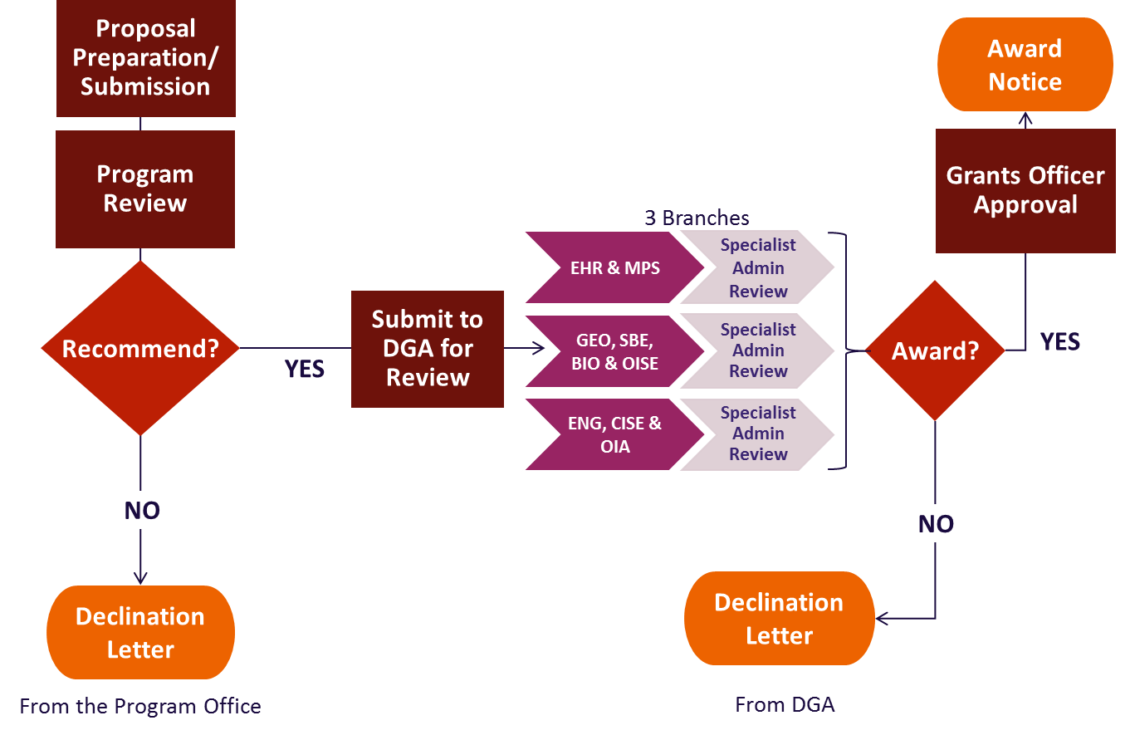
SCHEMATIC NSF AWARD PROCESS
Notes:
An earlier slide discussed the NSF Proposal and Award Process timeline. This is an example of a general NSF award process after a recommendation from the NSF Program Office.

Slide 34
GRANTEE RESPONSIBILITES
NSF’s legal relationship is with the grantee institution.
The grantee institution is responsible for proposals submitted to NSF.
The grantee institution is also responsible for adhering to the terms and conditions of an NSF award.
This includes establishing appropriate policies and procedures, oversight, internal controls, and training to ensure that award expenditures are allowable, allocable, reasonable, and necessary.
This also includes complying with all relevant federal regulations and national policy requirements.
Notes:
The Grantee is the awardee institution generally the University/College that submitted the proposal.
NSF may interchangeably use grantee/awardee.
The Grantee has full rights to most NSF proposals/awards.
Grantees are free to accept or reject the grant as awarded. Normally, a request to drawdown NSF funds constitutes acceptance, however, in limited circumstances, NSF may require formal acceptance of a grant. If the grantee chooses not to accept the award, then a written request should be sent to the cognizant NSF Program Officer to withdraw (or terminate) the grant.

Slide 35
PI RESPONSIBILITES
Adheres to all terms and conditions of award.
Submits any technical/annual reports required.
Submits all annual reports in a timely manner.
Lines of Communication.
Notes:
The PI is also known as Principal Investigator/Project Director (PI/PD) means the individual(s) designated by the proposer, and approved by NSF, who will be responsible for the scientific or technical direction of the project.
The PI is responsible for several reports including the Annual and Final Project Reports and the Program Outcomes Report.
The PI’s should always contact the SRO for any administrative questions prior to contacting NSF.

Slide 36
Technical Reporting Requirements
Annual Reports are due no later than 90 days prior to end of the current budget period to allow adequate time for cognizant Program Officer to review and approve the report.
Final Project Reports are due no later than 120 days following the end of the grant.
Project Outcomes Reports are due no later than 120 days following the expiration of the grant.
Failure to submit any report can delay funding and administrative actions for approval.
Notes:
The PI should always know the report deadlines. Late or no reports can hinder future award actions for PI and any associated PI’s. PIs are encouraged to submit these reports within the deadline to avoid any delay for them to receive another award, or a colleague who has an award for which this PI is a co-PI. The colleague’s award will not be released if there are pending reports from co-PIs.
These reports are not the only requirements. Please read your award letters for other requirements.

Slide 37
FASTLANE / RESEARCH.GOV
All grantee requests must be submitted through Fastlane or Research.gov unless otherwise stated.
Proposed Grantee Organizations
  Register with Fastlane
  Work on Fastlane Demonstration site
As a Principal Investigator
  Prepare a Letter of Intent in response to NSF Solicitation
  Prepare, edit and submit proposals to Office of Sponsored Programs
  Check on proposal status
Post-Award Activities
  Post-Award Requests and Notifications
  Annual and Final Project Reports
Notes:
NSF generally uses two systems to submit proposals and post award requests.

Slide 38
Collaborative Proposal Submissions
  Submission of a collaborative proposal from one organization
    The single proposal method allows investigators from two or more organizations who have developed an integrated research project to submit a single, focused proposal.
  Submission of a collaborative proposal from multiple organizations
    Simultaneous submission of proposals allows multiple organizations to submit a unified set of certain proposal sections, as well as information unique to each organization.
Notes:
One organization - A single investigator bears primary responsibility for the administration of the grant and discussions with NSF, and, at the discretion of the organizations involved, investigators from any of the participating organizations may be designated as co-PIs. Note, however, that if awarded, a single award would be made to the submitting organization, with any collaborators listed as subawards. (See Chapter II.C.2.g(vi)(e) for additional instructions on preparation of this type of proposal.)
Multiple organizations - . All collaborative proposals arranged as separate submissions from multiple organizations must be submitted via FastLane. For these proposals, the project title must begin with the words "Collaborative Research:” If funded, each organization bears responsibility for a separate award.
Awardee is the organization to which the grant has been awarded
The primary place of performance could be separate place where the research will be conducted

Slide 39
New Performers
New Performer: Any grantee organization that has never received any funding from NSF.
Updated Performer: Any grantee that has not had an active NSF award within the last five years.
Process of New Awardee Package
  Program Officer Roles
  Grants Officer Roles
  Grantee Institution Roles
Notes:
Each proposing organization that is new to NSF or has not had an active NSF assistance award within the previous five years should be prepared to submit basic organization and management information and certifications, when requested, to the applicable award-making division within the Office of Budget, Finance & Award Management (BFA).
This information is only requested based on an intention to recommend by the NSF Program Officer to DGA.

Slide 40
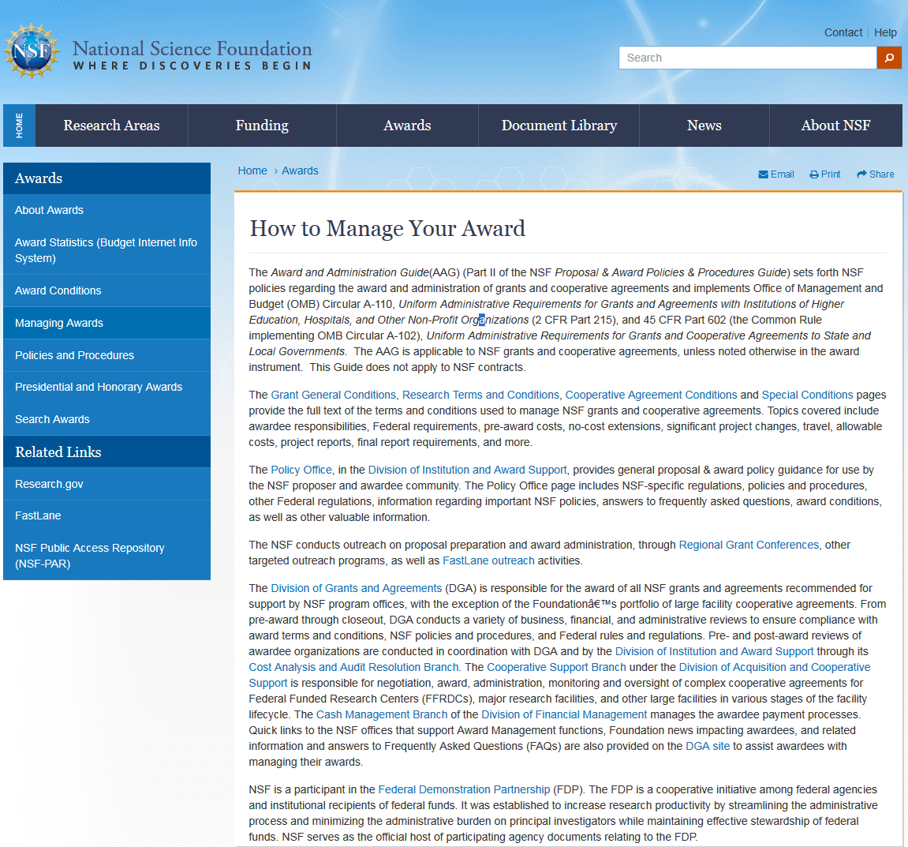
Other Resources
nsf.gov/awards/managing/
Links to the Award & Administration Guide( AAG)
Find Award Conditions
Find how to get assistance with your award from the Division of Grants & Agreements
Notes:
For more information on grants administration please see the website in this slide.

Slide 41

Questions?
Ask Early, Ask Often!
https://www.nsf.gov/bfa/dga
Notes:
We are here to help you.

Slide 42

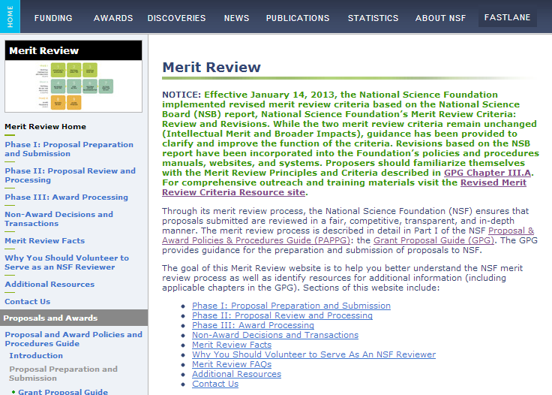
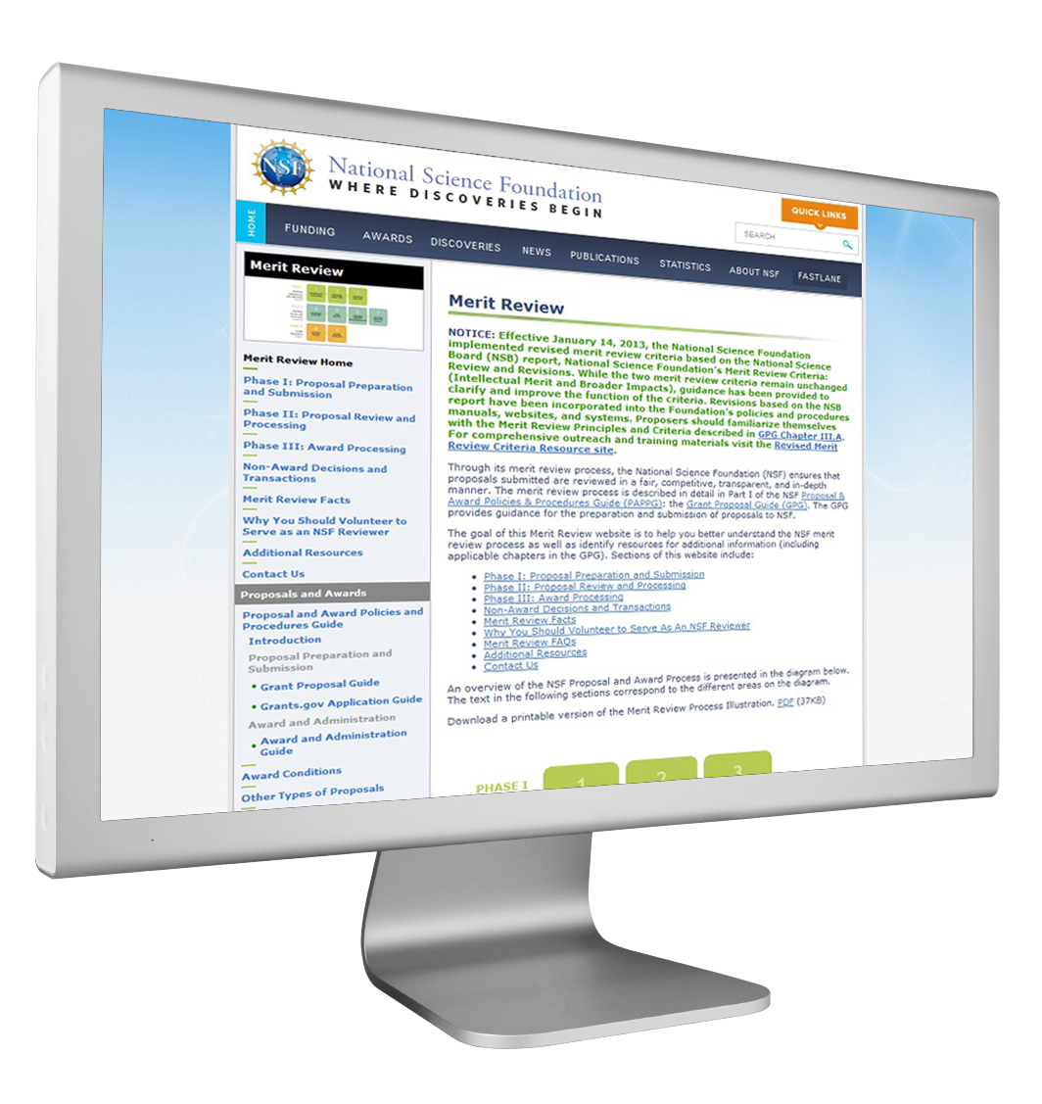
For More Information
Go to NSF’s Home Page (http://www.nsf.gov)

Slide 43
Become and Stay Connected
Contact NSF Program Officers if you have questions about a program
Submit proposals – don’t give up after the first decline
Be active as workshop participants and organizers
Serve as ad hoc reviewers and panelists
Consider being a rotator
http://www.nsf.gov/about/career_opps/rotators/index.jsp
Go to NSF’s Home Page (http://www.nsf.gov)
Notes:
One of the ways to stay connected is to do what you are all doing here…participating in workshops, asking questions; staying in contact with your program officers. To get a better understanding of how the review process works, please consider volunteering as an ad hoc reviewer of panelist. And of course, if you can, consider being a rotator.
A rotator is someone from another organization outside of NSF who is invited to work at NSF through the Intergovernmental Personnel Act (IPA). The individual is on loan from his/her organization for 1-3 years, depending on the arrangement between NSF and the organization.

Slide 44
Useful Resources
NSF: www.nsf.gov
PAPPG: www.nsf.gov/pubs/policydocs/pappguide/nsf13001/index.jsp
Guide to Programs:
www.nsf.gov/funding/browse_all_funding.jsp
Award Information: www.nsf.gov/awardsearch
FastLane: www.fastlane.nsf.gov
Broader Impacts: www.nsf.gov/pubs/gpg/broaderimpacts.pdf
Data Management Plan: www.nsf.gov/bfa/dias/policy/dmp.jsp
Funding Opportunities: www.nsf.gov/funding
Notes:
These links provided will help you as you go through the process of writing your proposal or just looking for funding opportunities and what’s new at NSF.

Slide 45

WORKSHOP ACTIVITY: Think, Pair, Share
Think by yourself (prior to the workshop)
  Read the proposal.
  Write down your individual analysis of the Intellectual Merit & Broader Impacts, citing specific strengths and weaknesses.
  Give the proposal a rating.
Pair with your panel for 30 minutes.
  Discuss the proposal.
  Write down your collective analysis of strengths and weaknesses in the Intellectual Merit & Broader Impacts.
  Consider modifying your rating in light of the discussion.
Share with everyone for 30 minutes.
Notes:
As you prepare to go for your breakout groups, please make sure that you have read the sample proposal and write your individual analysis of the Intellectual Merit and Broader Impacts, identifying for each criterion the strengths and weaknesses.
At the breakout, please discuss your individual analysis of the proposal with 2-3 people per group, then come up with the collective analysis. This will be for 30 minutes.
We will the have an open discussion of your collective analysis for 30 minutes, if you think that the points have been raised, please add what you feel has not been discussed.

Slide 46
Intellectual Merit Debrief
Key Questions:
What will we learn?
How will it advance knowledge?
Strengths
Weaknesses
Notes:
Open discussion will follow the 30 minute sharing.
This will be followed by a debrief of the mock review process

Slide 47
Broader Impacts Debrief
Key Questions:
How will the project impact society?
How will it make the nation a better place?
Strengths
Weaknesses
Notes:
Let’s look at the strengths and weaknesses of the Intellectual Merit and Broader Impacts of the “cleaned” proposal.
Questions.

