Slide 1
Port Performance Freight Statistics Working Group
Port List Recommendations
September 23, 2016
Notes:
1

Slide 2
Session Objectives
Discuss feedback from Working Group members following first session
Discuss the pros and cons of selection criteria
Present recommended port lists for the three categories
Notes:
One of the major goals today is to finalise the methodology that we will use to develop the three port lists so that the working group can turn its attention to the next stages of this effort.
To that end, this session will focus on reaching consensus on the port definitions and data sources used in the development of the three lists. I will also discuss some of the pros and cons of the choices made in the development of this methodology, and end with the port lists themselves.

Slide 3
Key Question
Do you concur with the methodology used to develop the three port lists:
TEUs?
Tonnage?
Dry Bulk?
Notes:
3
So while I talk there is one key question to keep in mind: Do you concur with the methodology that was used to develop each of the three port lists?
While there will be some time in this session for the discussion of this question, it is one of the focal points of this afternoon’s breakout period.
With that I am going to turn to the feedback from the questions that we were displayed at the end of the first Working Group meeting. While we have already spoken about the feedback this morning, further examination within the context of the port lists and the methodologies used to create them is helpful.

Slide 4
Feedback from the First Working Group Meeting
Port Definitions
One or more facilities or terminals under the purview of an organized navigation district or port authority
Contiguous facilities under the operation of a single entity
Each individual port location that unloads and loads cargo in one specific location
Defined and categorized by terminal type and size, and not by port
Use the geographic jurisdiction of a port authority
Don’t confuse ports with terminals and facilities
Notes:
Let’s start with port definitions. As expected, we saw a wide variety of answer, ranging from the terminal level up to the regional activity area.
Some of the respondents provided definitions used in other government projects (#1)
Other responses would draw more nebulous boundaries (#2)
Finally there were suggestions to define ports as the terminals themselves (#4)

Slide 5
Feedback from the First Working Group Meeting
Data Source
Rely on the existing public sources that report on the industry and report annually
Use the Commerce Department and the Army Corps of Engineers, which use Customs Districts that are defined by statute
Notes:
Turning to data sources, a number of respondents stated that the rankings should be based on annual figures that were reported in public sources.
Others suggested that the data be drawn from the Commerce Department and the Army Corps of Engineers so that it would be tied to Customs Districts, which would or could then serve as the basis for defining port boundaries.

Slide 6
Feedback from the First Working Group Meeting
Port Selection
Focus on the top 25 ports in specified categories to be consistent with the FAST Act
Consider a minimum activity level as a cut off
Use the list of ports identified in the National Multimodal Freight Network process as a minimum
For container terminals, both loaded and empty
Should be consistency between the lists when it comes to locations like Seattle-Tacoma
Notes:
In general, most respondents agreed that the language in the FAST Act should be followed, with the focus on the Top 25 ports in each category. Others noted that they would like to see that expanded (and the language in the Act was for a minimum of 25 ports).
Some suggested using a minimum threshold of activity as a cut off, while another comment suggested using the much larger National Multimodal Freight Network list of ports.
There was consensus that for containers the focus should be on total TEUs, namely both loaded and empty containers. And most respondents stated that there should be consistency between the lists, especially when it came to making decisions about ports like Seattle and Tacoma.

Slide 7
Feedback from the First Working Group Meeting
Organization of Ports
Group by geography
Categorize by volume handled
Classify by function
Notes:
The final set of feedback that I will discuss surrounds how the data is organised, and again there were lots of differing opinions. These could be broadly defined as those that wanted to group ports by geography, categorize them by volume handled, and classify them by function.
All three options are excellent ways to think of ports within the larger transportation network, and that’s certainly something that will be addressed in the annual reports.
Now we have looked at the feedback it’s time to look at the decisions that were made. I’ll step through the choices that were made to come up with the proposed methodology.

Slide 8
Port List Methodology
Data Source
Army Corp of Engineers’ Waterborne Commerce Statistics Center
Provides consistency across all three lists
Publically available
Domestic tonnage based off of operator reports
Foreign tonnages built from PIERS, Census, and CBP
Considered alternatives
AAPA/Port Reporting, Commercial Sources
Notes:
First up is the source of the data for the lists, namely TEUs, total tonnage, and dry bulk.
All three lists will be developed using databases created by the Army Corp of Engineers’ Waterborne Commerce Statistics Center.
This is based in no small part on the fact it results in a single consistent source for all three lists and that the data is publically available for all to see.
Amy Tujague will be speaking after me to provide an overview of these databases, but for now suffice it to say that the domestic tonnage in the database is based off of operator reports while foreign tonnages are built from PIERS, the Census Bureau, and CBP entrances and clearances.
It is worth noting that a number of different data sources were considered, and that while none was perfect this is the best for the task at hand.

Slide 9
Port List Methodology
Port Definitions
Port level where possible
Ports based on the U.S. Army Corp’s definition of a port area
port limits defined by legislative enactments of state, county, or city governments
Cincinnati-Northern KY, Port of Virginia
Seattle and Tacoma, not Northwest Seaport Alliance
Notes:
As we discussed in the first Working Group Meeting, how one defines a port is open to interpretation. While some feedback called for terminal level considerations and some looked towards a more activity focused area boundary, the consensus was at the port level.
You may recall that I raised the question of where to draw boundaries, whether in the case of port authorities that stretch along the river like South Louisiana or Cincinnati-Northern Kentucky, or with ports that are in the process of adjusting their organisation, like Seattle and Tacoma or the Port of Virginia.
Well, we will be using the definitions included within the Army Corps databases, which requires legislative enactments by a state, county, or city to change the limits of a port. So as of the 2015 data release the Port of Virginia is in as a single port while Seattle and Tacoma remain separate.
The advantage of this decision is that there will be consistency across the lists and that this effort will not set a precedent for including non-legislatively passed entities. The downside is that the North West Seaport Alliance does not release TEU data at the port level, and so that is something that will have to be dealt with further down the road.

Slide 10
Port List Methodology
Units of Measurement
TEUs
Total Tonnage (short tons, excludes weight of containers)
Dry Bulk Tons based on custom queries (short tons)
Based on Vessel Type
International Classification of Ships by Type (ICST)
Notes:
The first two units were not controversial choices, specified as they were in the FAST Act. It should be pointed out that the Army Corp database does not measure empty international containers, unlike the data released by the ports themselves or by the American Association of Poth Authorities. To be clear, though, any reporting on capacity and throughput will take all loaded and empty containers into account.
The total tonnage is measured in short tons, and excludes the weight of containers.
The dry bulk numbers are a subset of the total tonnage statistics, and as such are based on short tons. I will now briefly describe the methodology used to extract the dry bulk cargo from the total.
Amy ran a number of queries on the tonnage, which were based on the type of vessel that was transporting the cargo and on the commodity classification assigned to the cargo. In both cases the Army Corps and the Maritime Administration had a hand in selecting the criteria for the filters.
Ultimately we made the decision to rely solely on the ICST codes, or International Classification of Ships by Type codes. Given the complexity of the commodities we felt it was safer to not exclude a commodity type that perhaps was transported as dry bulk. Having said that, every commodity of over 100,000 tons that was output in the vessel type query was also represented on our commodity white list.
Truth be told, the queries generated the same 25 ports regardless of whether we ran the ICST query, the dry bulk commodity query, or a combined query that required both requirements to be fulfilled. Now let’s look at the three lists.

Slide 11
Ports by TEUs
Port | Millions of TEUs
Los Angeles, CA | 5.53
Long Beach, CA | 5.30
New York, NY & NJ | 4.61
Savannah, GA | 2.82
Port of Virginia, VA | 2.07
Houston, TX | 1.79
Oakland, CA | 1.74
Tacoma, WA | 1.73
Charleston, SC | 1.55
Seattle, WA | 1.24
Honolulu, HI | 1.16
San Juan, PR | 0.88
Jacksonville, FL | 0.85
Port | Millions of TEUs
Miami, FL | 0.77
Port Everglades, FL | 0.73
Baltimore, MD | 0.63
Anchorage, AK | 0.39
Philadelphia, PA | 0.37
New Orleans, LA | 0.37
Wilmington, NC | 0.23
Wilmington, DE | 0.19
Boston, MA | 0.19
Mobile, AL | 0.18
Ketchikan, AK | 0.14
Palm Beach, FL | 0.14
Preliminary 2015, Excludes international empties
Notes:
I want to start by saying that these lists are all based on the preliminary 2015 numbers, and as such are illustrative and subject to change. The following three lists are included in your handouts if you want to take a longer look.
These are the top 25 ports by TEUs. As I previously noted, 2015 is the first year that the Port of Virginia was included as an entity within the Army Corps’ database, which is why you will see an asterisk next to the 2014 numbers in the handout package.
You will also see that Tacoma and Seattle are listed separately, in contrast to the AAPA port list. Other that that the list remains the same as the AAPA’s with one exception: the Port of Ketchikan, Alaska, versus Gulfport, Mississippi.

Slide 12
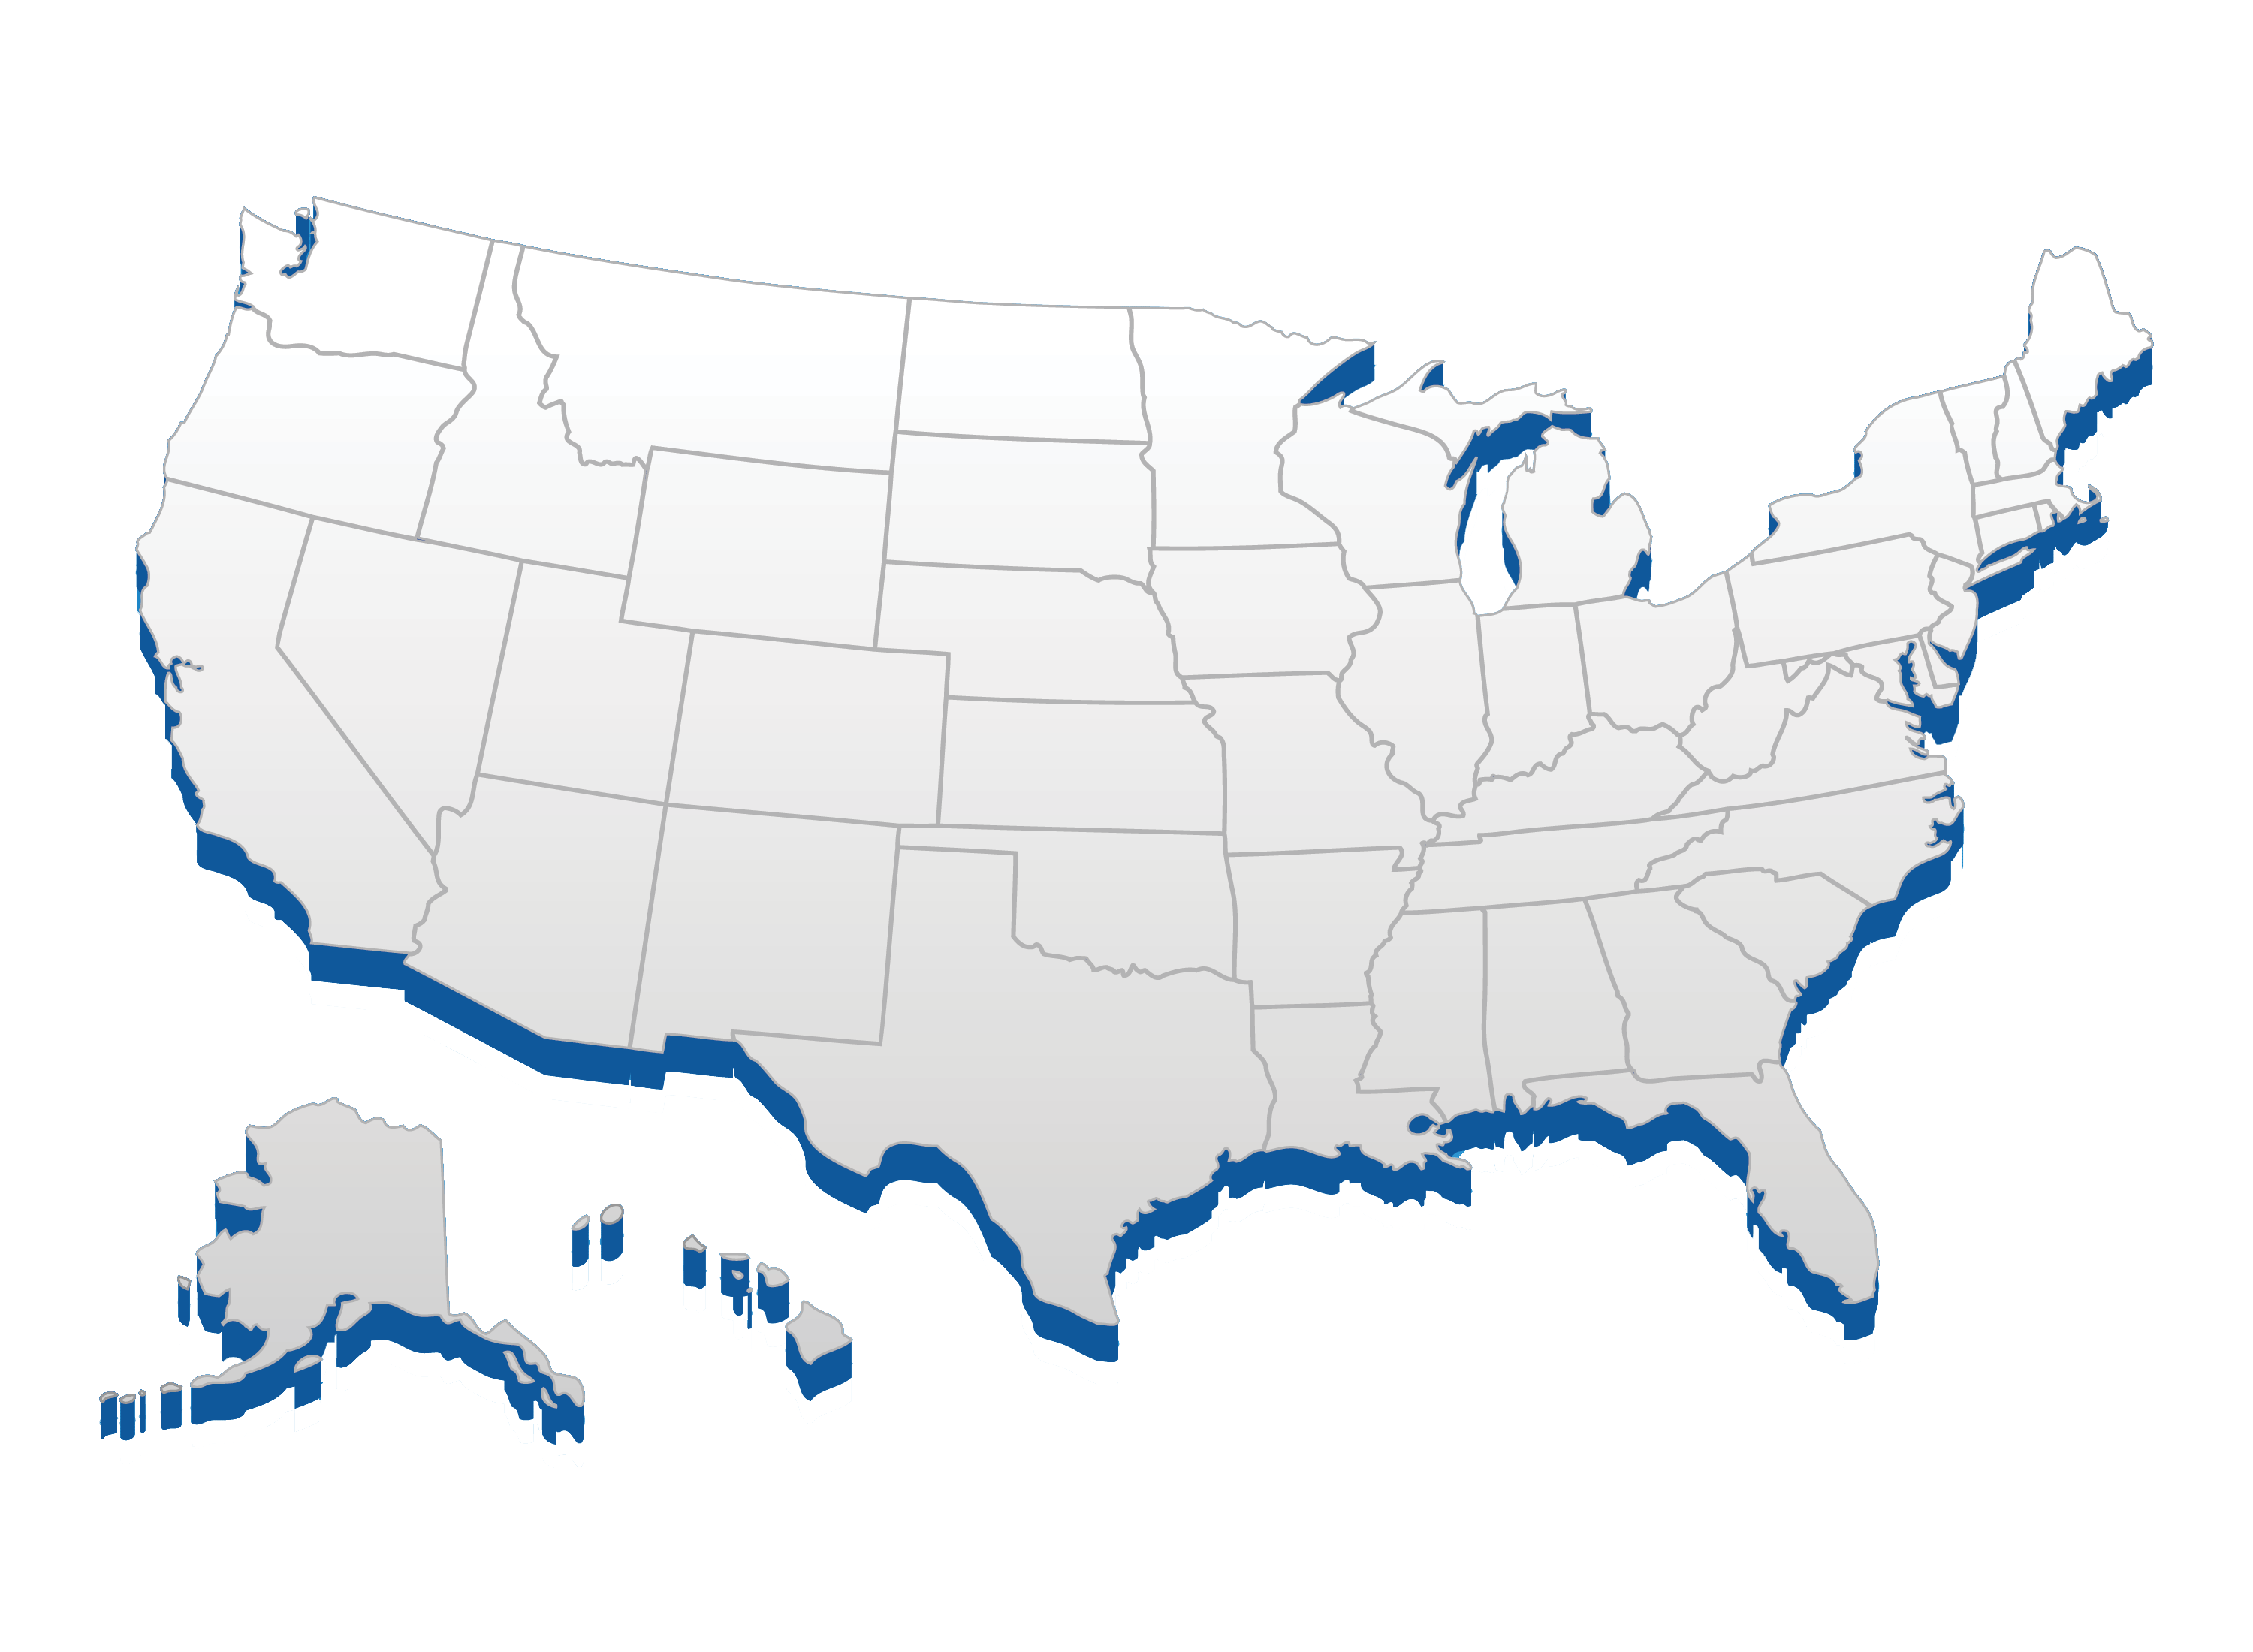
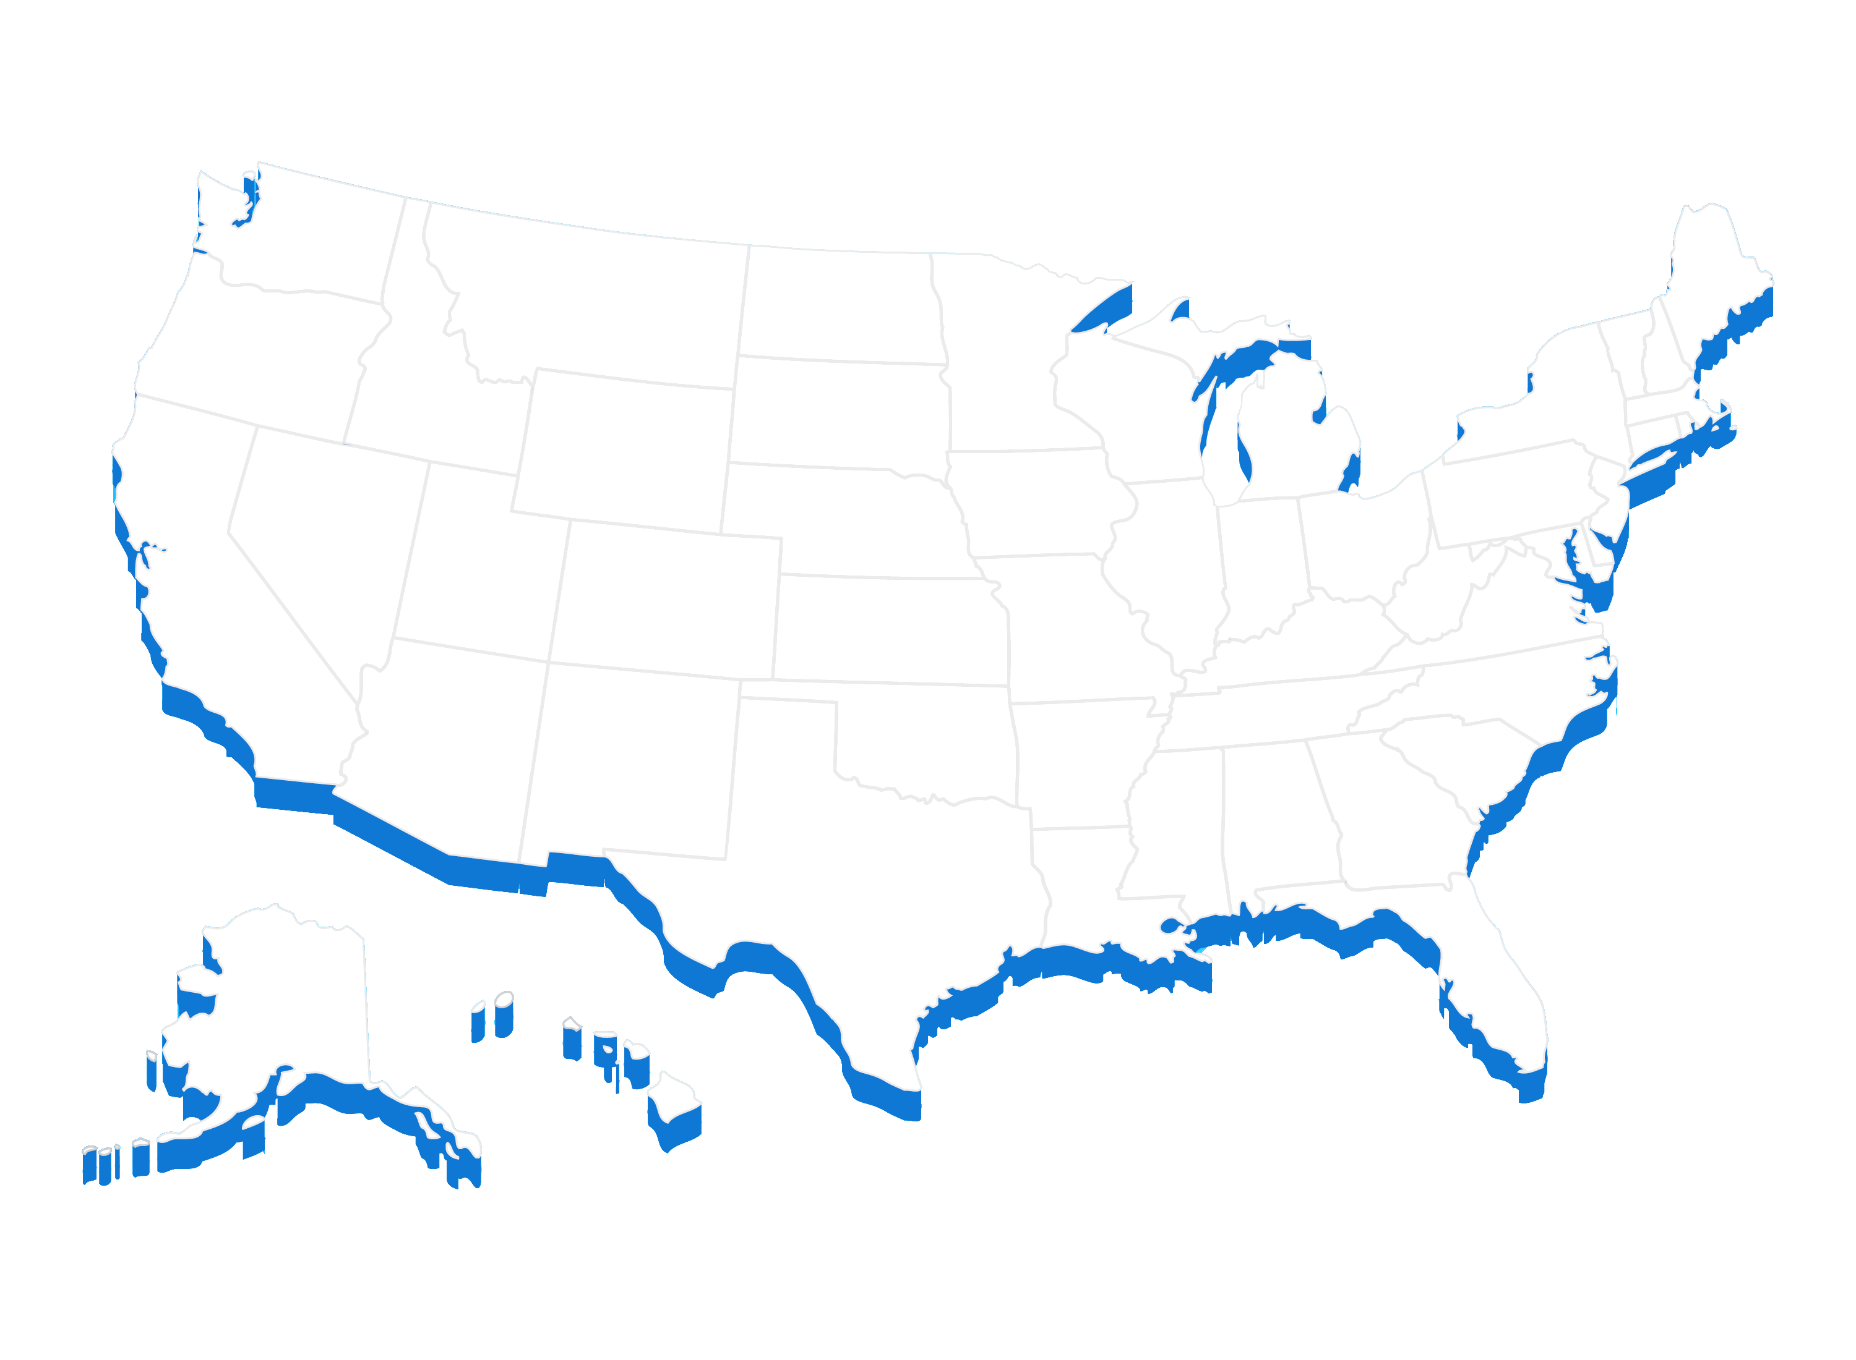
Ports by TEUs
Notes:
It is immediately obvious, and no surprise, that these are all coastal ports, with just over half on the Atlantic Ocean, with a further eight on the Pacific.

Slide 13
Ports by Tonnage
Port | Millions of Short Tons
Port of South Louisiana, LA | 259.31
Houston, TX | 241.38
New York, NY and NJ | 126.77
New Orleans, LA | 87.91
Beaumont, TX | 86.08
Corpus Christi, TX | 85.59
Long Beach, CA | 77.90
Baton Rouge, LA | 68.74
Los Angeles, CA | 60.13
Mobile, AL | 58.77
Virginia, Port of | 57.83
Lake Charles, LA | 56.76
Port of Plaquemines, LA | 53.56
Port | Millions of Short Tons
Texas City, TX | 42.88
Huntington – Tristate | 42.37
Port of Cincinnati-Northern KY | 42.21
Baltimore, MD | 39.40
Port Arthur, TX | 36.98
Tampa, FL | 35.95
Savannah, GA | 35.20
St. Louis, MO and IL | 34.96
Duluth-Superior, MN and WI | 30.54
Richmond, CA | 28.41
Valdez, AK | 26.75
Pascagoula, MS | 26.46
Preliminary 2015, excludes container weight
Notes:
Next up is the total tonnage list. Again this is based on preliminary 2015 data.

Slide 14
Ports by Tonnage
Notes:
The significance of the energy industry is clear, with 13 of the 25 ports on the Gulf Coast.
I want to point out that this pie chart could also show 4 inland ports with one fewer Gulf Coast port, as South Louisiana was classed in the database as being a coastal port, which given almost half of its cargo by weight is international in nature makes sense.

Slide 15
Dry Bulk Ports
Port | Millions of Short Tons
Port of South Louisiana, LA | 151.64
New Orleans, LA | 47.48
Port of Plaquemines, LA | 40.31
Ports of Cincinnati-Northern KY | 37.43
Port of Virginia, VA | 35.74
Mobile, AL | 34.39
Huntington - Tristate | 32.16
St. Louis, MO and IL | 29.07
Baton Rouge, LA | 28.24
Duluth-Superior, MN and WI | 27.76
Houston, TX | 27.49
Baltimore, MD | 24.35
Pittsburgh, PA | 24.31
Port | Millions of Short Tons
Two Harbors, MN | 14.32
Tampa, FL | 13.20
Kalama, WA | 13.13
Cleveland, OH | 12.93
Portland, OR | 12.72
Corpus Christi, TX | 11.46
Chicago, IL | 11.17
Seattle, WA | 11.16
New York, NY and NJ | 11.02
Longview, WA | 10.51
Detroit, MI | 10.43
Indiana Harbor, IN | 9.82
Preliminary 2015
Notes:
Finally we have the dry bulk ports, measured in short tons.

Slide 16
Dry Bulk Ports
Notes:
And as we turn to the map there are a number of clearly defined regions that are home to clusters of ports. Once again we could reassign the Port of South Louisiana to the inland pie wedge.

Slide 17
During the Break Out Groups…
Do you concur with the methodology used to develop the three port lists?
But first a look at the Army Corps of Engineers Waterborne Commerce Statistics data used to generate the lists
Notes:
So there we have it. In your packets you have those three lists along with some additional information that shows the stability of the queries compared to the actual 2014 numbers.
Before we take any questions, though, I want to turn things over to Amy Tujague. Given the reliance on the Waterborne Commerce Statistics database, we thought it would be instructive to lean what it, or they, are, how they are updated, and what they are used for. I also want to take this opportunity to thank Amy for the huge amount of time and effort she put into advising and assisting with this process.

