Slide 1
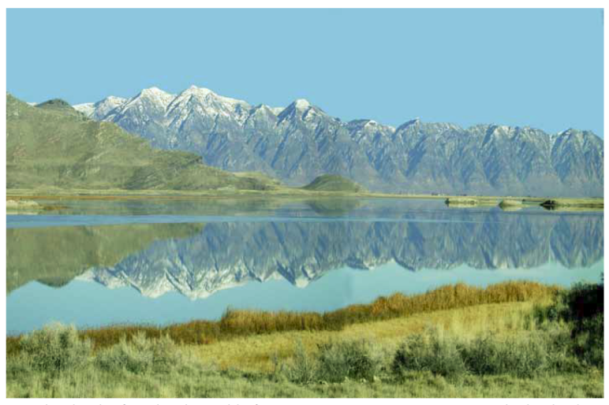
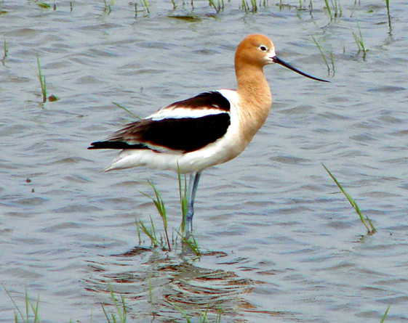
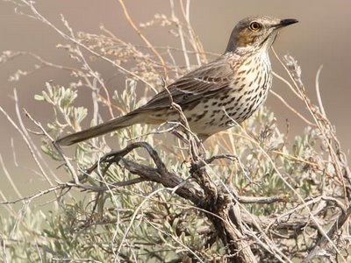
BREEDING BIRD SURVEY REGRESSION MODELS FOR THE BEAR RIVER WATERSHED CONSERVATION AREA

Slide 2
BRWCA Sage Thrasher Model
BBS Data Year: 2000
Model Type: Negative Binomial Regression (GLM)
Landscape around each BBS stop : 1200 meter radius
SATH $=EXP(β_{0}+β_{1}\left(NORTH\right)+β_{2}\left(EAST\right)−β_{3}\left(ELEV\right)−β_{4}\left(URBAN\right)+$
$$β_{5}\left(GRASS\right)+β_{6}\left(WATER\right)+β_{7}\left(CROP\right)+β_{8}\left(FOREST\right)+$$
$β_{9}\left(SHUB\right)+β_{10}\left(PATCH\right)−β_{11}\left(ROUGH\right)$)

Slide 3
Sage Thrasher
NB Regression Model
using BBS data from 2000
Sage Thrashers per 1.75 mi²
Notes:
The result of applying the model to the project area. A radius of 1200 meters around a given cell in the study area results in a 1.75 square mile window. Some predictions in the middle and lower drainage are associated with isolated shrub patches. Due to uncertainty with the landcover and model application, results will need to be verified on the ground prior to conservation action.

Slide 4
BRWCA American Avocet Model
BBS Data Years: 1997-2010 combined
Model Type: Logistic Regression (GLMM)
Landscape around each BBS stop : 800 meter radius
AMAV $= \frac{e^{x}}{1+e^{x}}$
x = $(β_{0}+β_{1}\left(NORTH\right)+β_{2}\left(EAST\right)−β_{3}\left(ELEV\right)−β_{4}\left(URBAN\right)−$
$$β_{5}\left(GRASS\right)+β_{6}\left(WATER\right)−β_{7}\left(CROP\right)−β_{8}\left(FOREST\right)−$$
$β_{9}\left(SHUB\right)−β_{10}\left(HAY\right)−β_{11}\left(ROUGH\right)$)
Notes:
The best draft AMAV model based on a competing model analysis. Elevation at the BBS stop and the proportion of urban class and roughness in the landscape around the stop were negatively associated with AMAV observations. The proportion of water in the landscape around the BBS stop had the greatest positive association with AMAV observations.

Slide 5
American Avocet
Logistic Regression Model using BBS data from 1997 – 2000
Probability of Occurrence
High
Low

