Slide 1
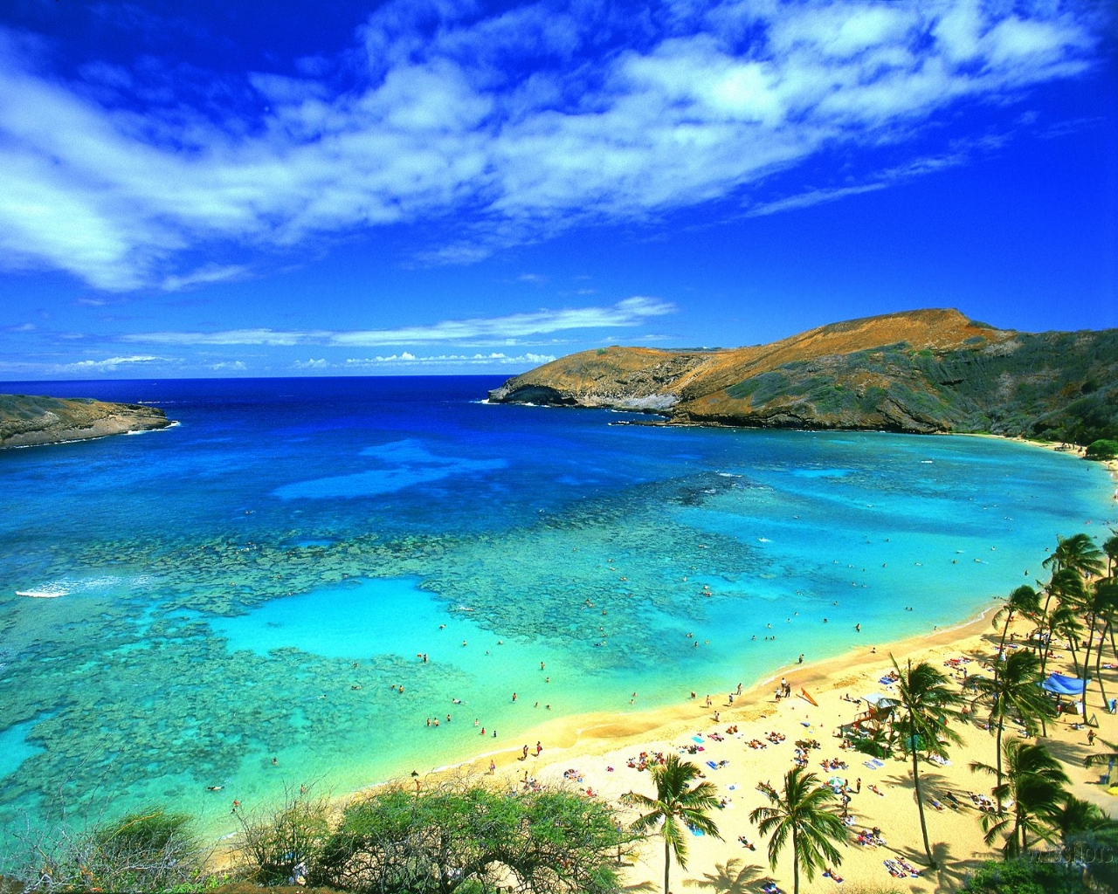
A Synopsis of Hawaiian Weather
Monday, May 31 – Monday, June 7
Jordan McLeod

Slide 2
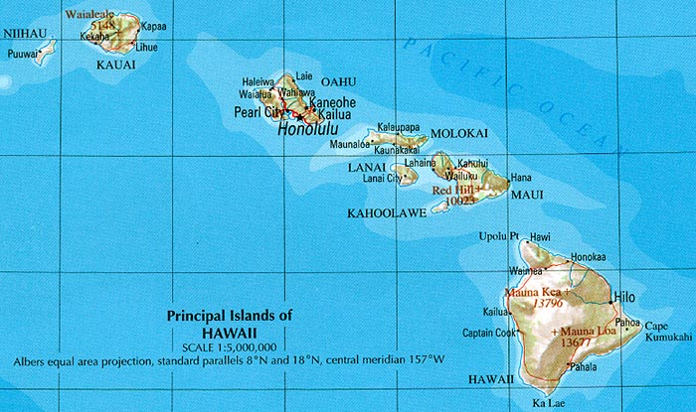
Map of the Hawaiian Islands

Slide 3
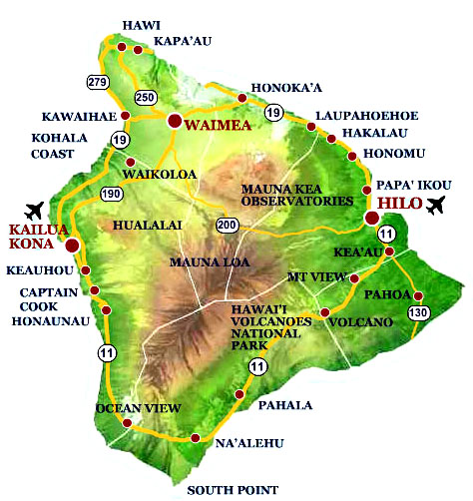
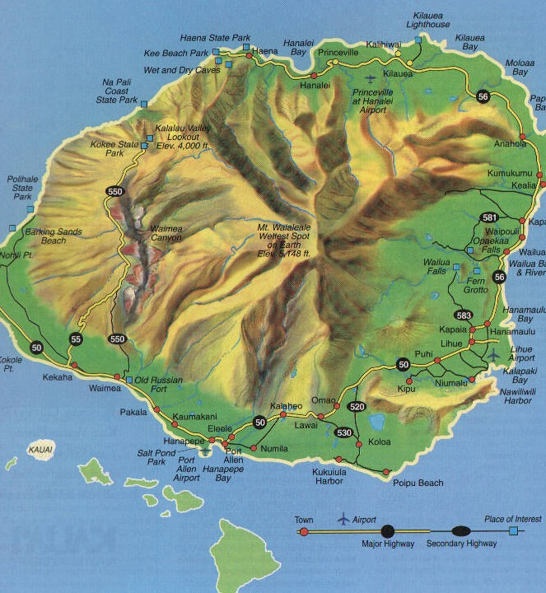
Map of The Big Island and Kauai
Hawaii (“The Big Island”)
Kauai

Slide 4
A Basic Comparison of The Big Island and Kauai
Hawaii (“The Big Island”)
Kauai
Mostly Sunny on the Coastal Periphery
Mostly Cloudy in the Central Mountains
Very Windy, Especially in the Mountains
Warm (Mid-80’s) on the Coast
Chilly in the Mountains
Quick Shower in the Mountains
Partly to Mostly Cloudy Throughout the Island
Warm Temperatures (Mid-80’s)
Breezy (Not as Windy as Hawaii)
Few Sprinkles

Slide 5
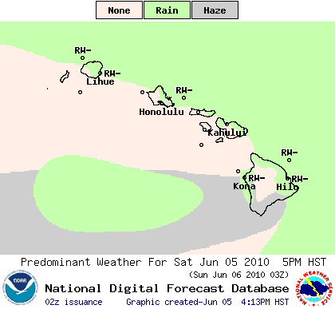
A Persistent Pattern

Slide 6
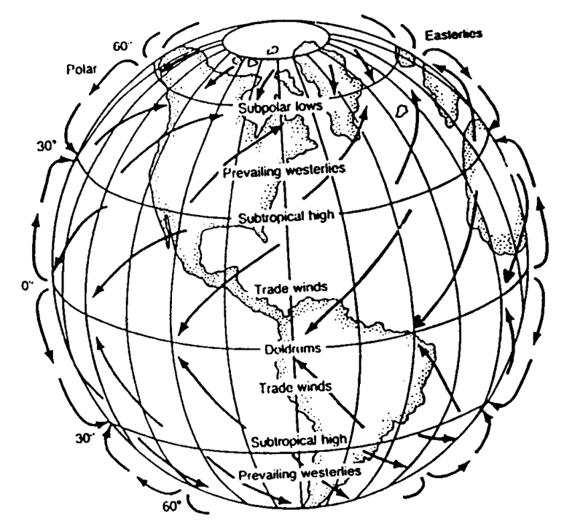
Why? Northeasterly Trade Winds

Slide 7
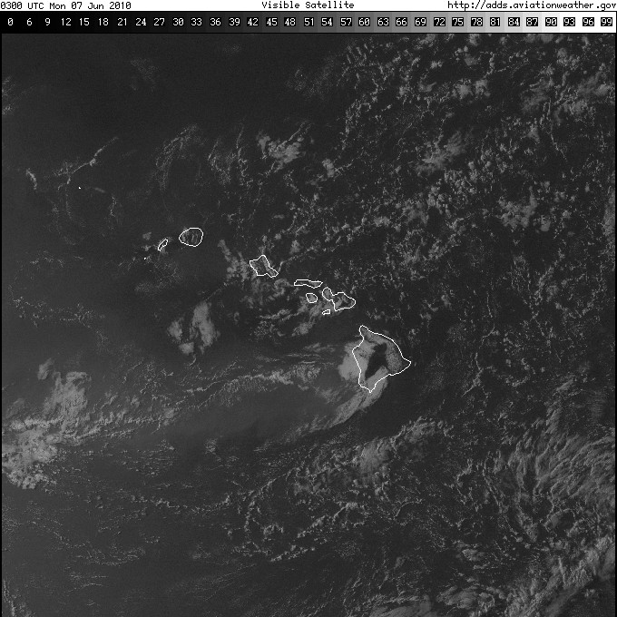
A Satellite Image Example (Sunday Evening, June 6th)

Slide 8
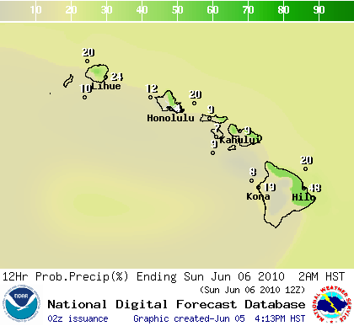
Precipitation Percentages

Slide 9
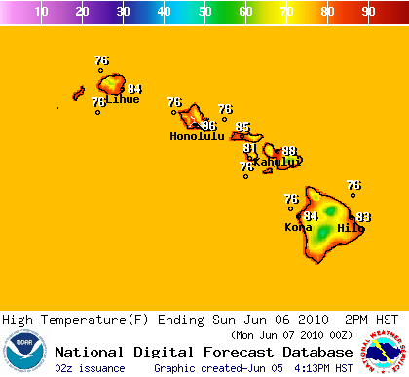
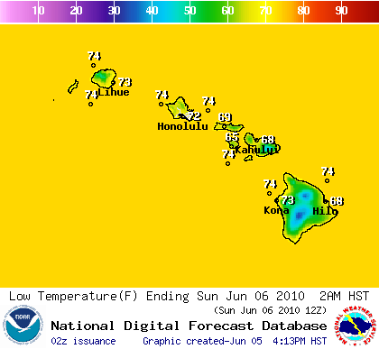
A Highly Moderated Thermal Environment
High Temperatures
Low Temperatures

Slide 10
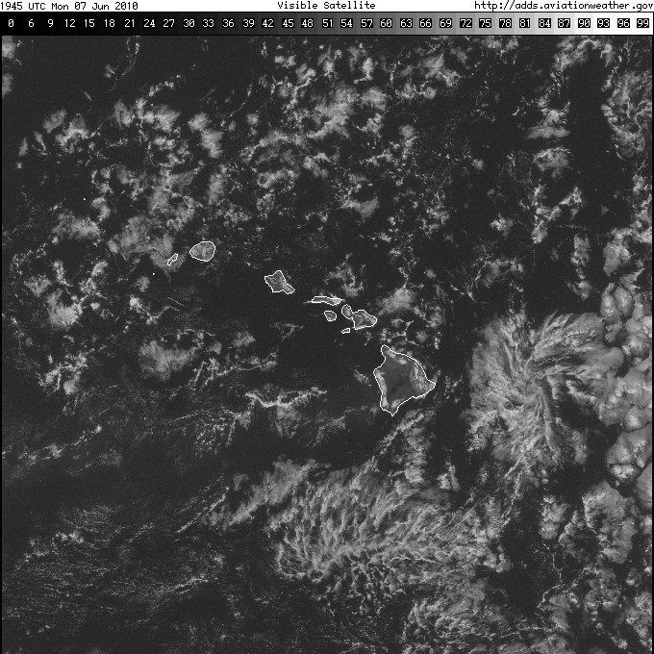
Visible Satellite Image
Monday Morning, June 7th

Slide 11
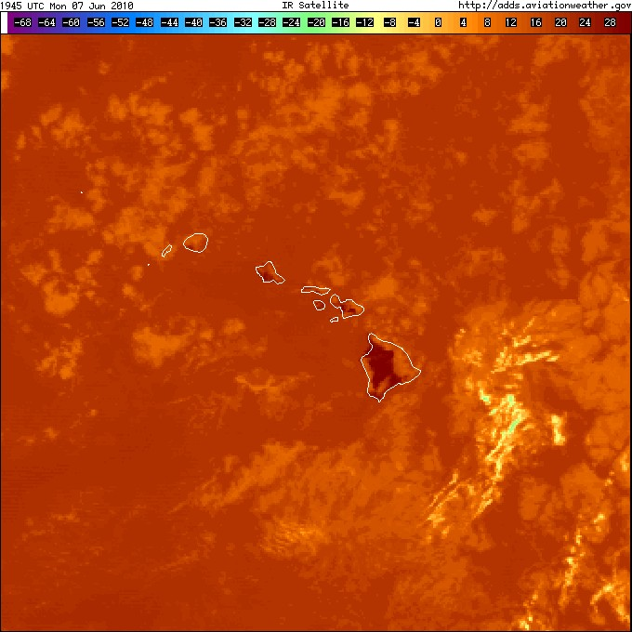
Infrared Satellite Image
Monday Morning, June 7th

Slide 12
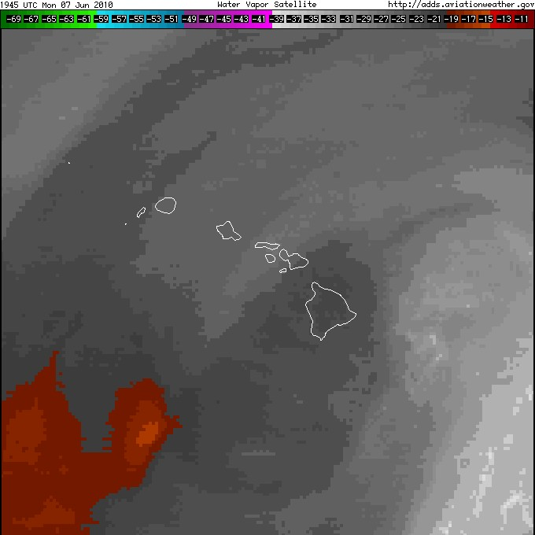
Water Vapor Image
Monday Morning, June 7th

Slide 13
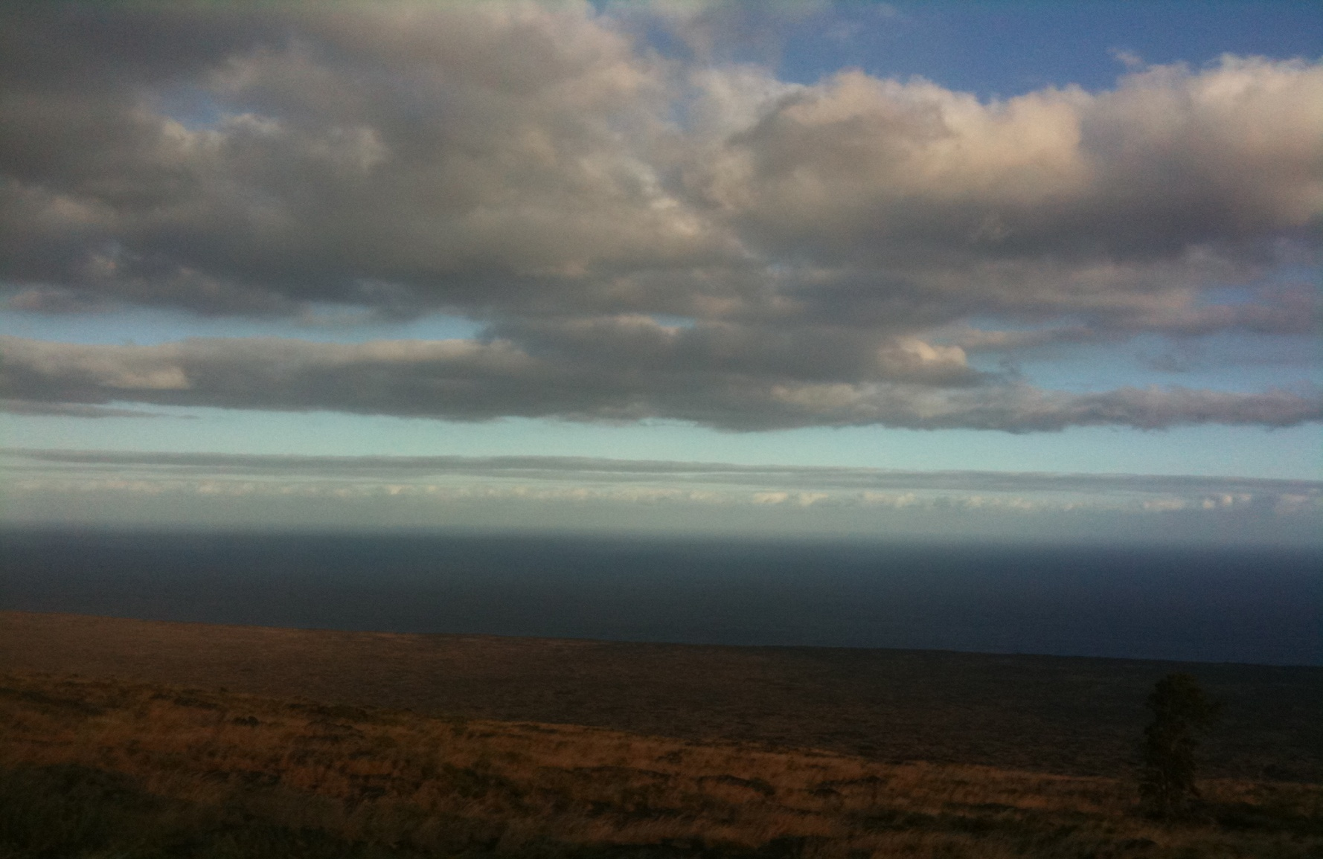
Persistent Marine Layer Situated Off the Hawaiian Coastline

Slide 14
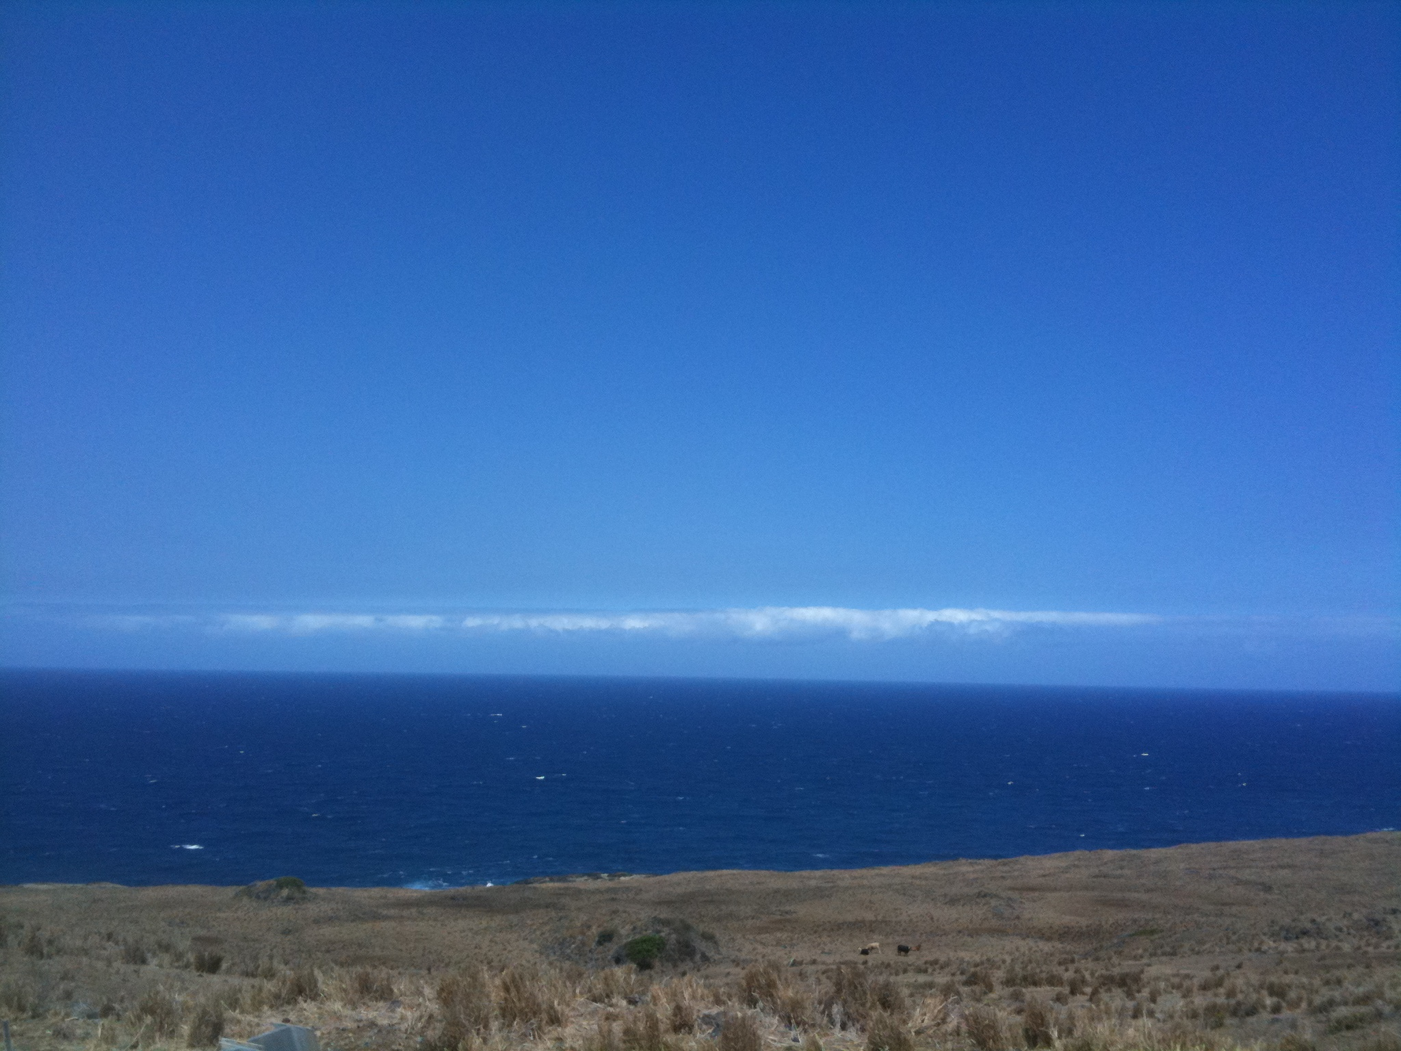

Slide 15
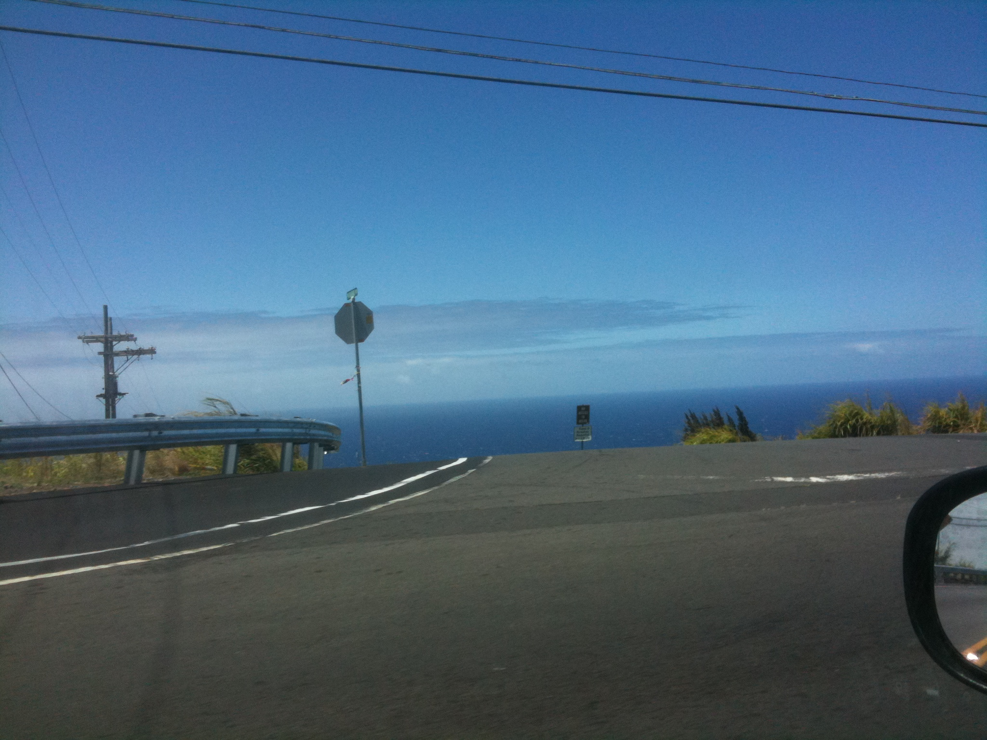

Slide 16
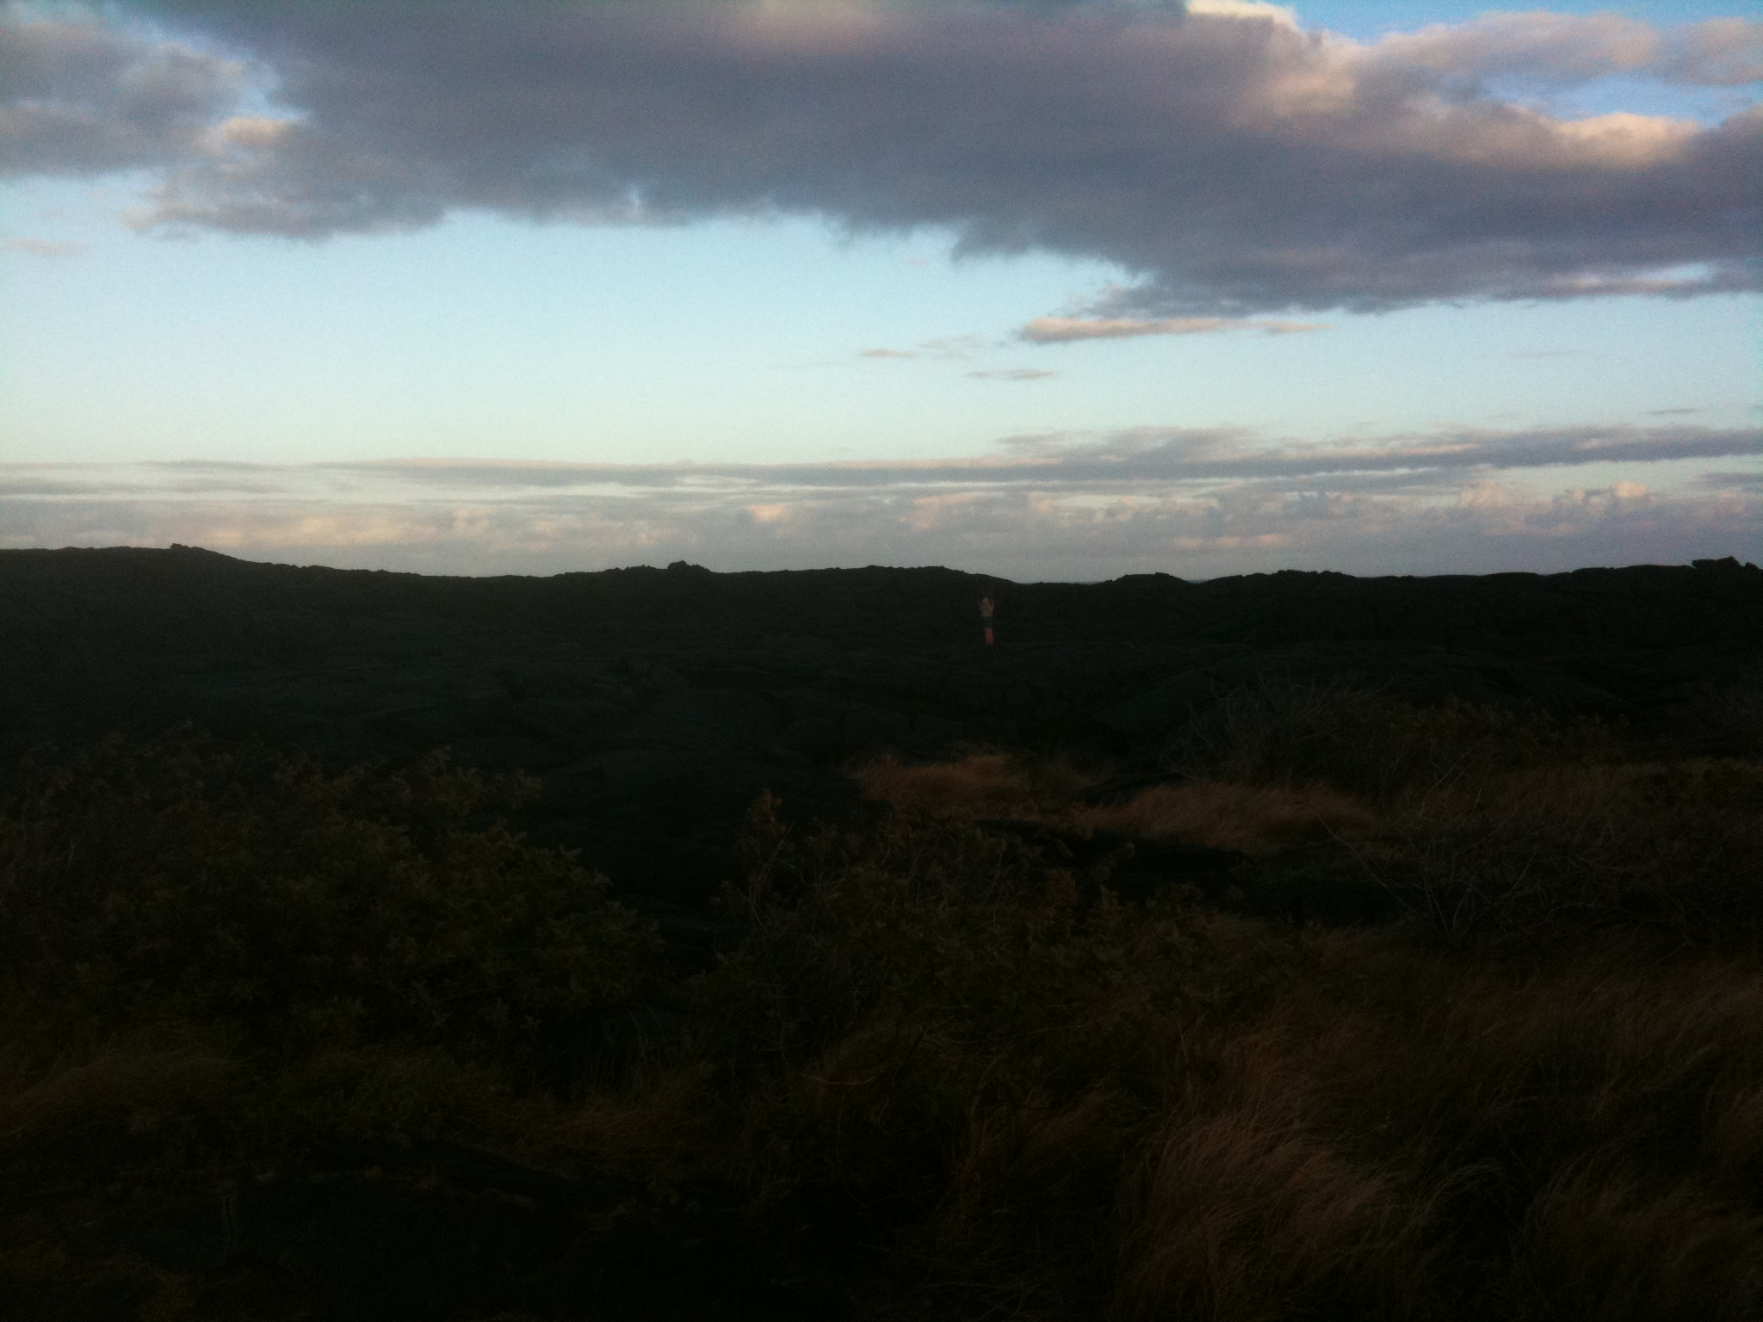

Slide 17
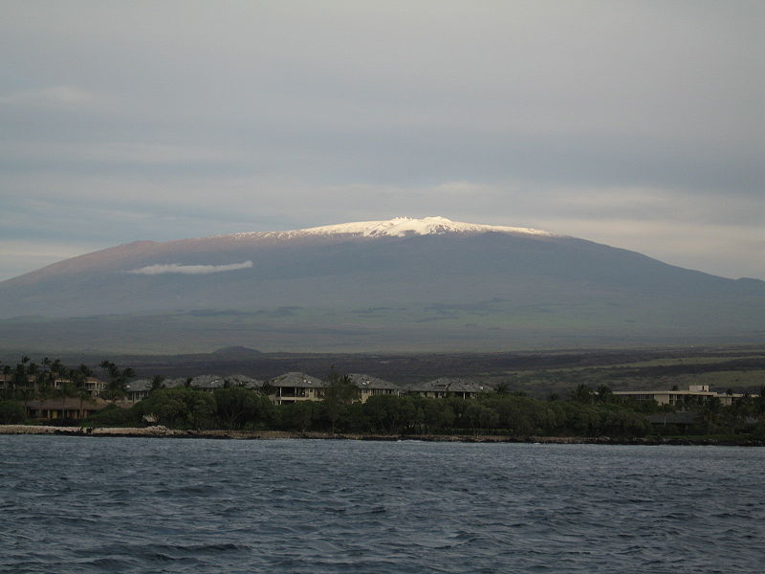
Snowcapped Mauna Kea on the Big Island

Slide 18
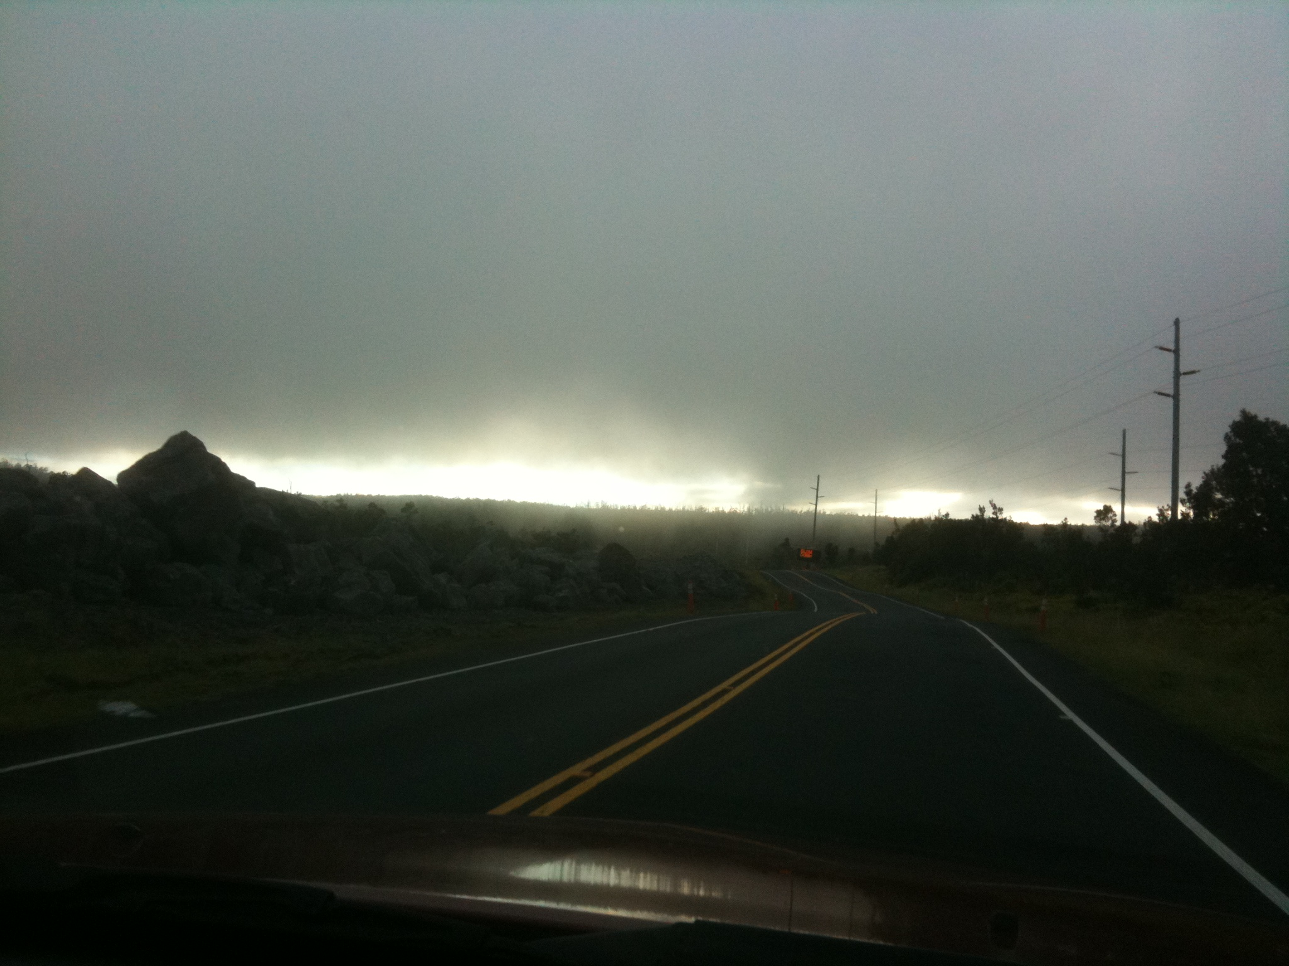

Slide 19
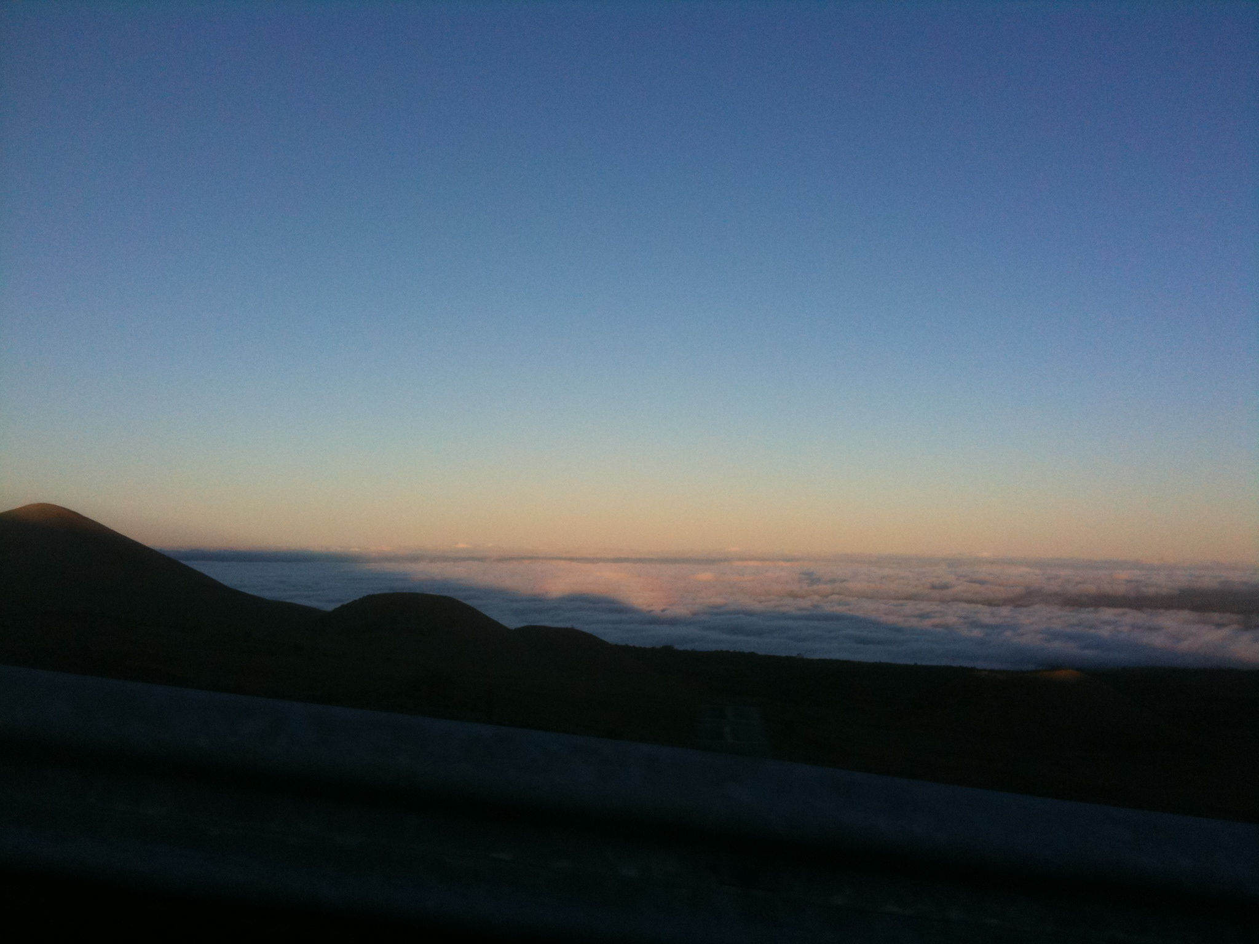

Slide 20
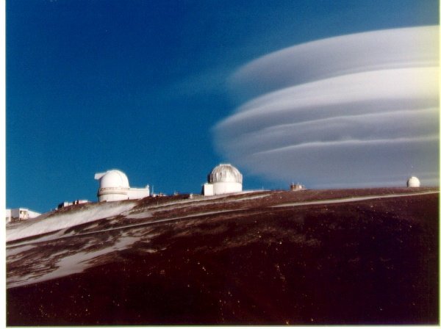

Slide 21
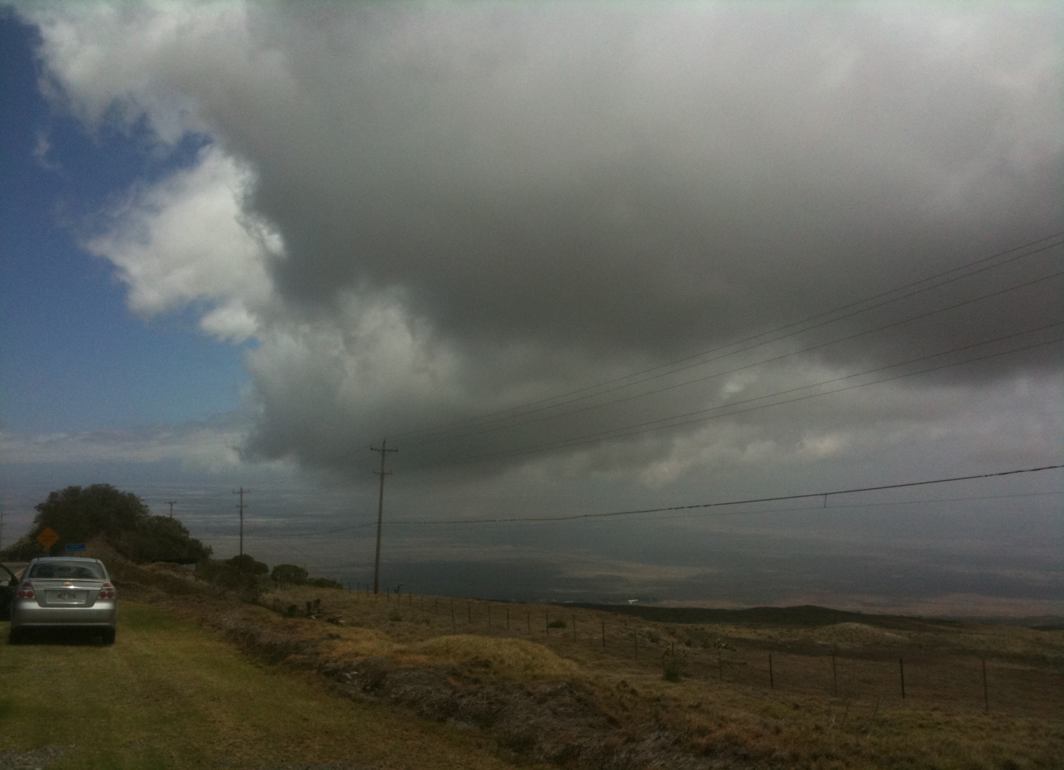
Up Close and Personal: Big Island Cumuli

Slide 22
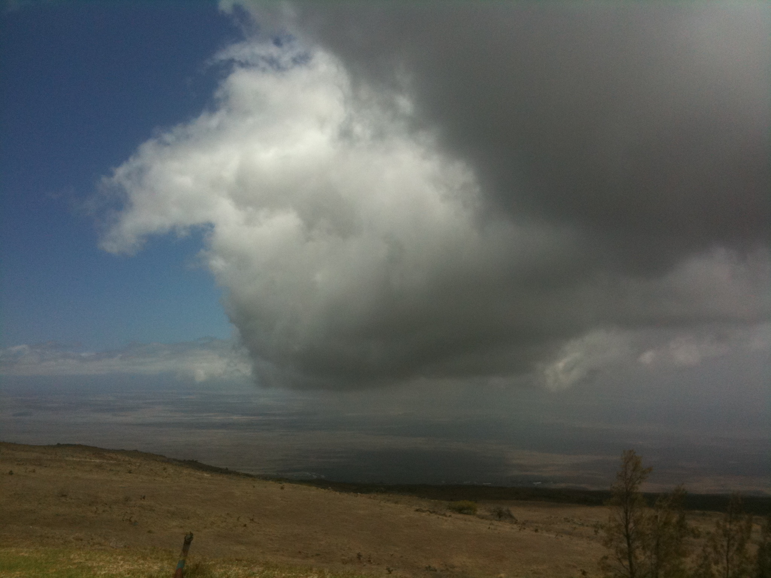

Slide 23
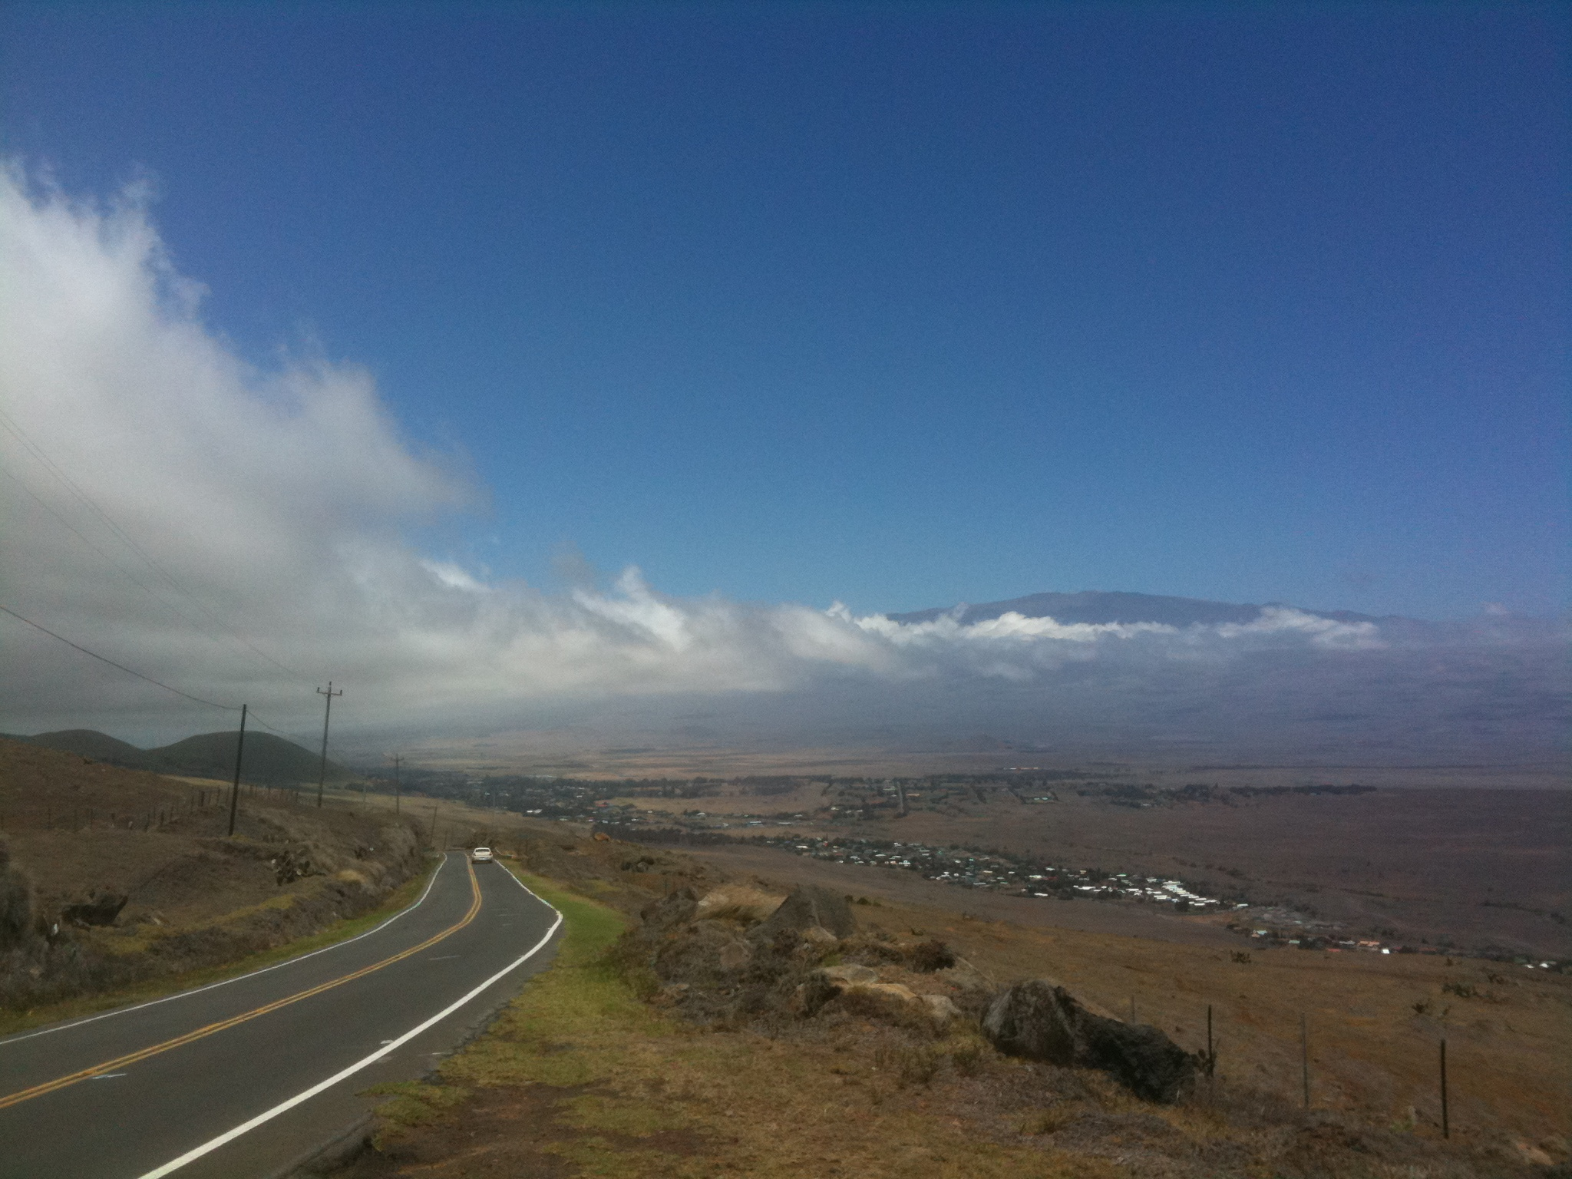

Slide 24
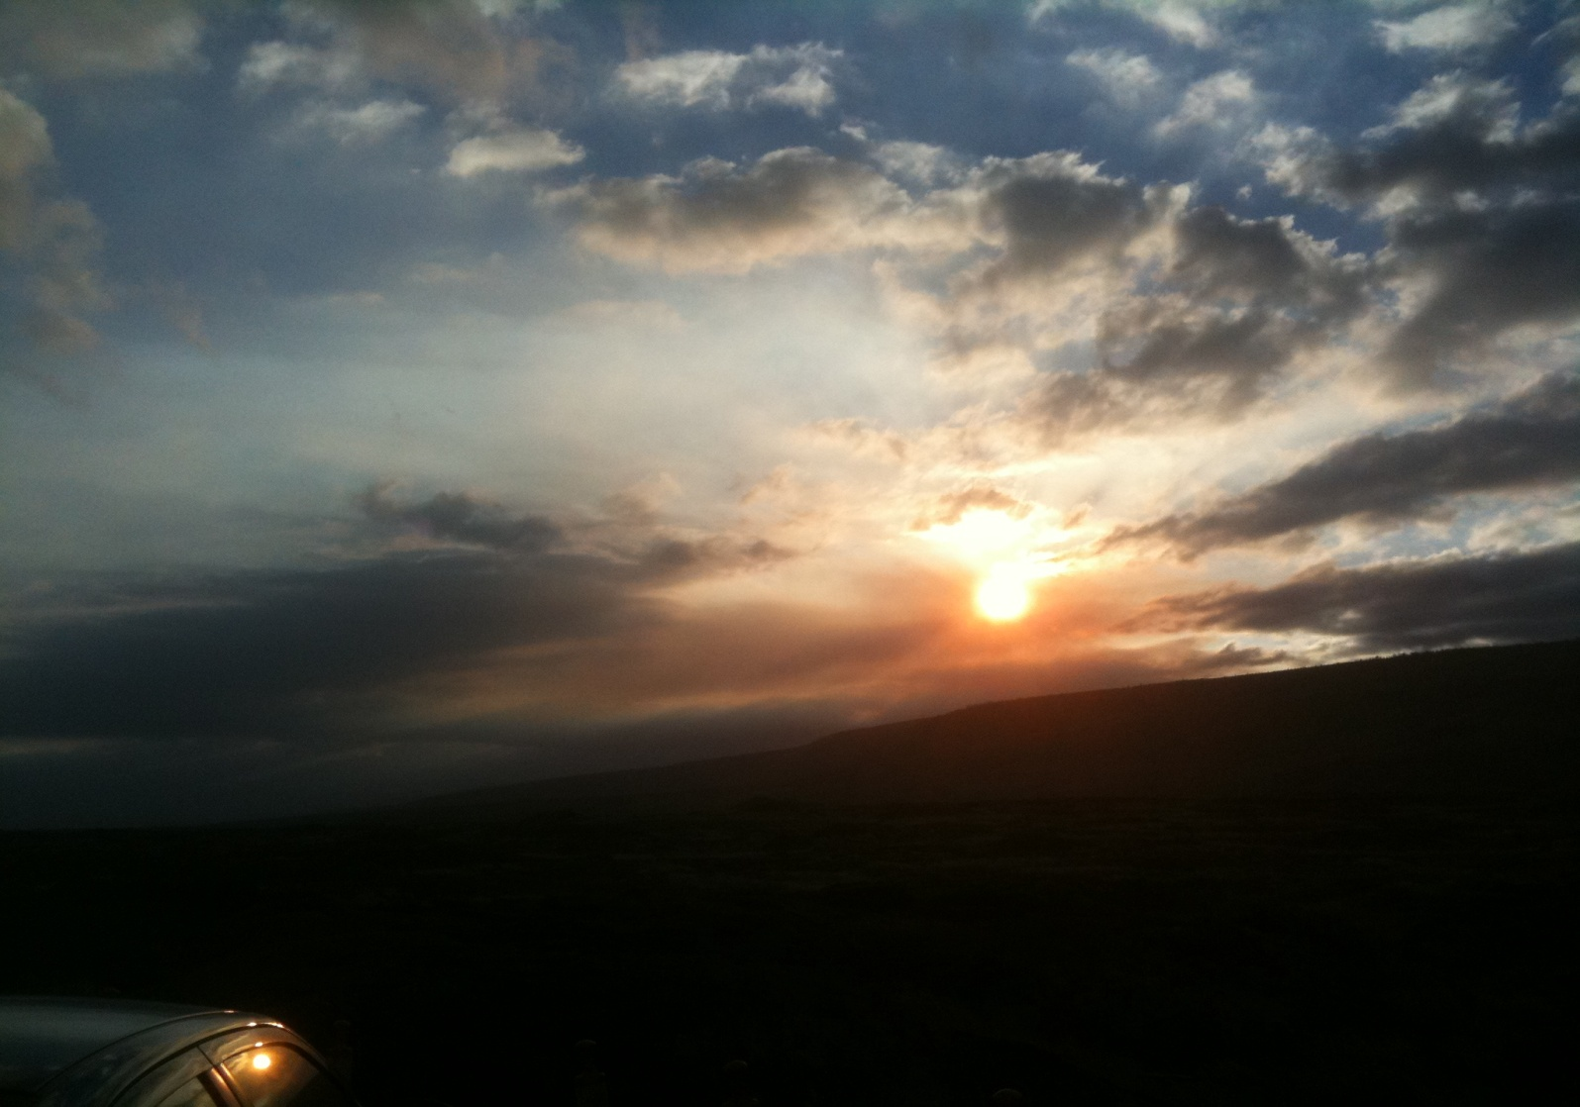
A Kilauea Sunset

Slide 25
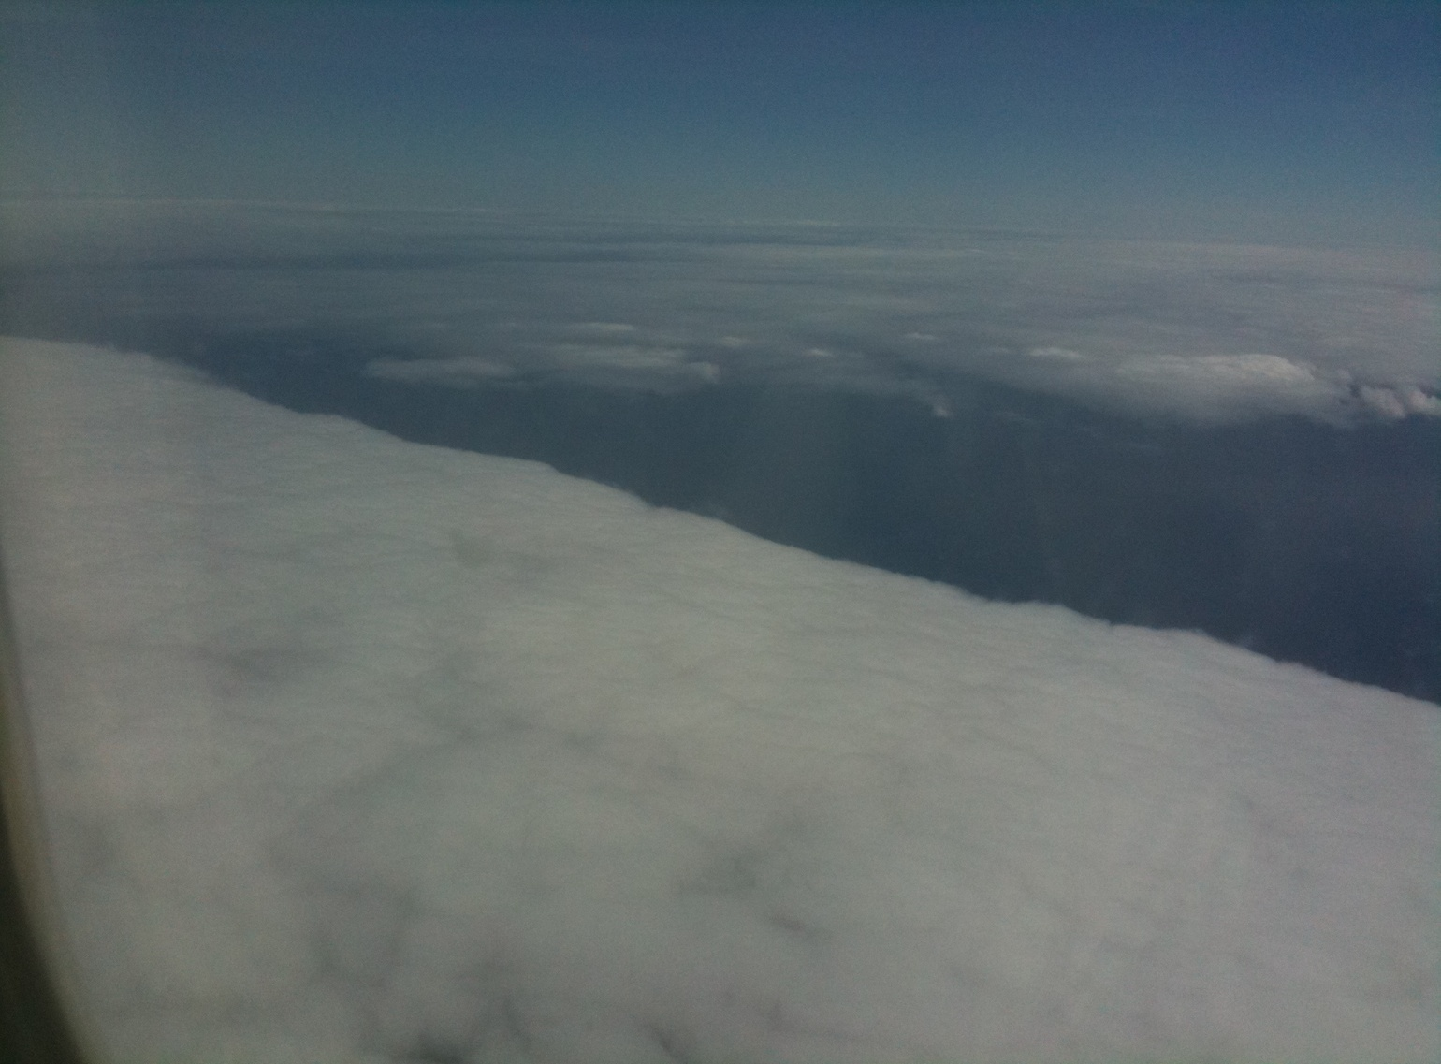
The Flight from Hawaii to Kauai

Slide 26
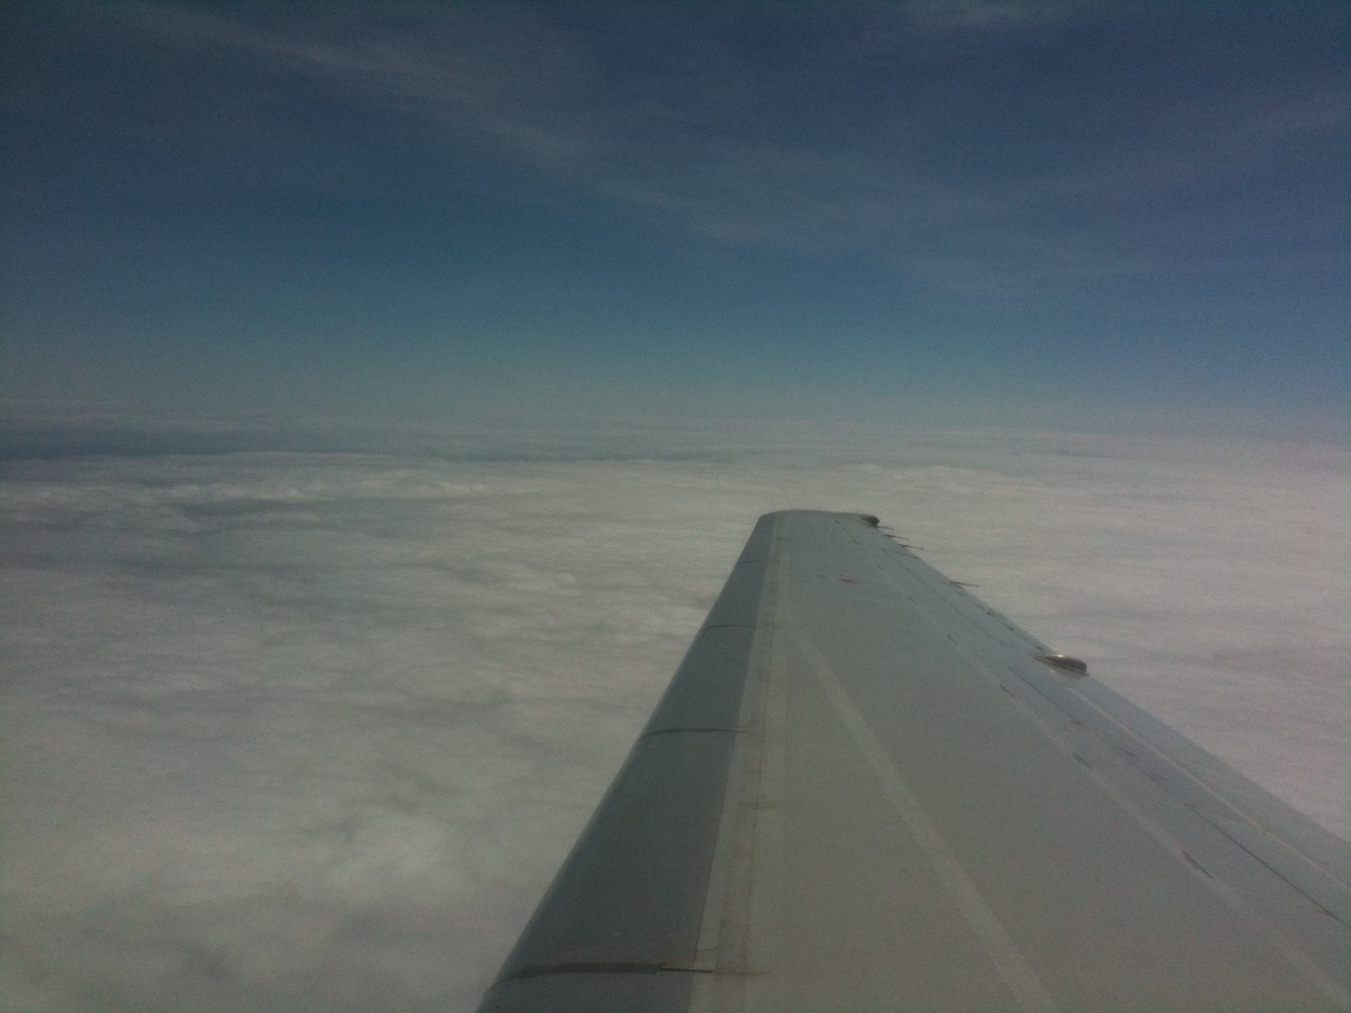

Slide 27
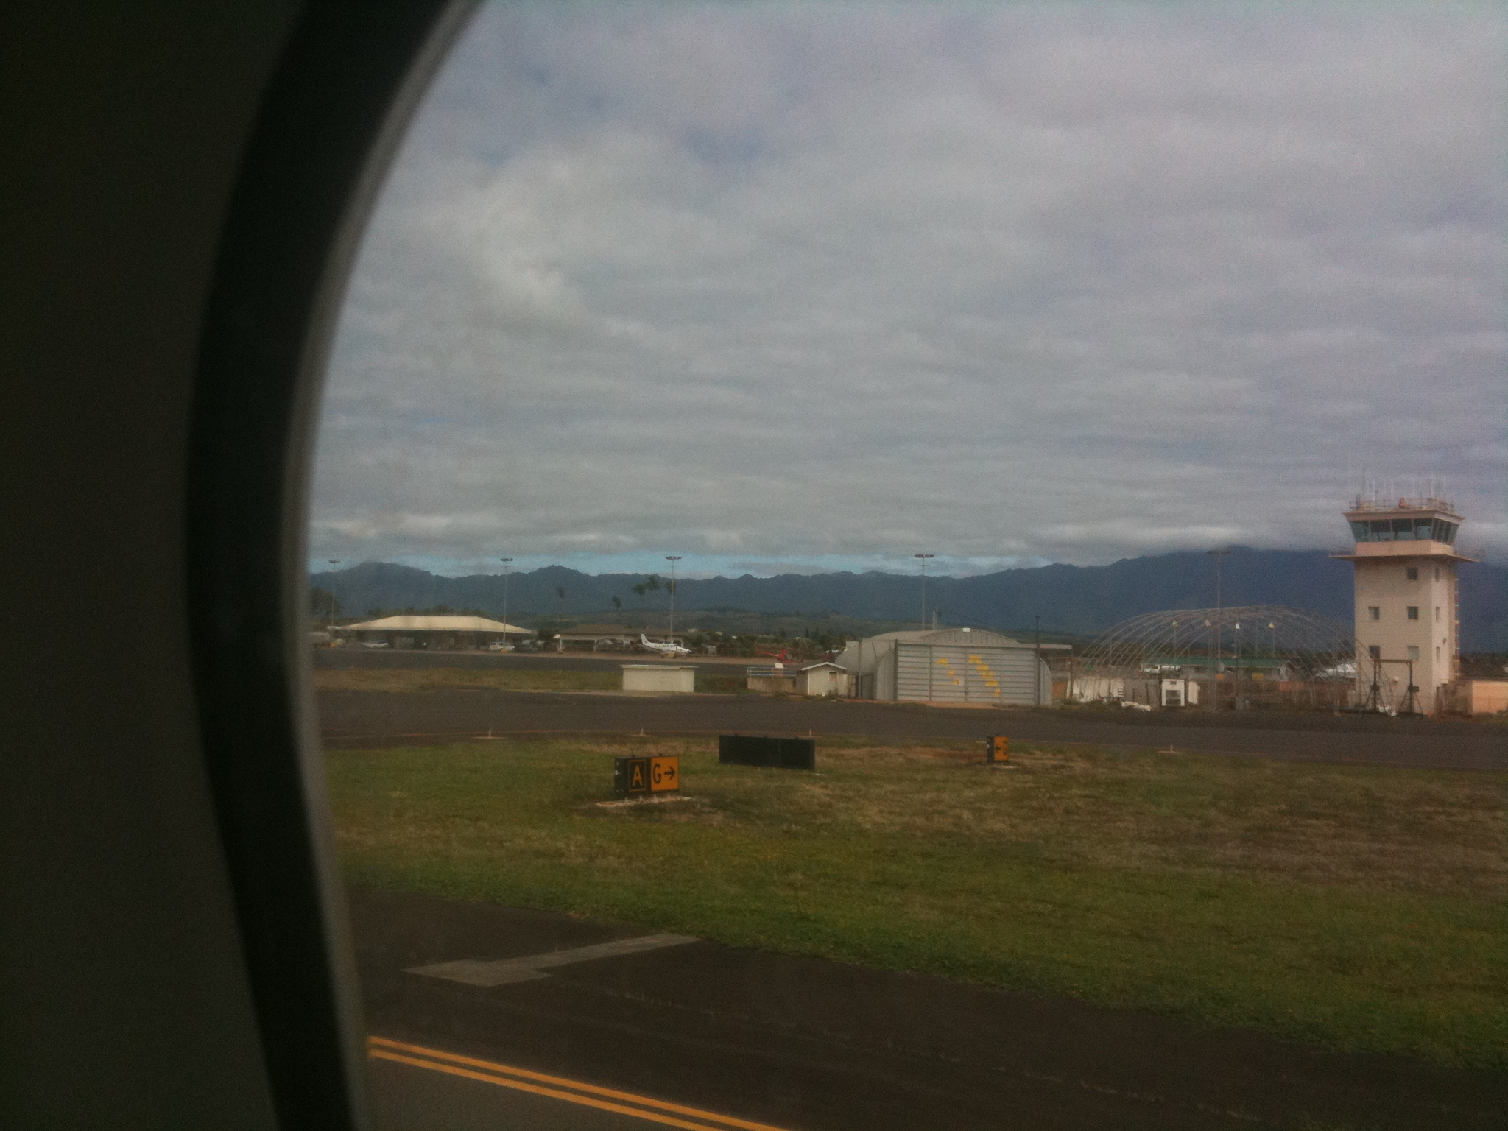

Slide 28
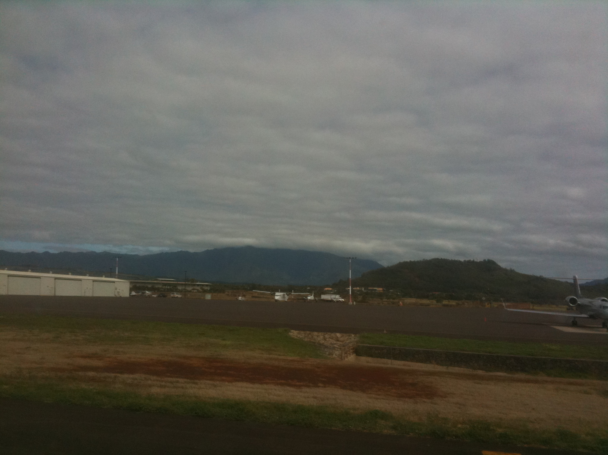

Slide 29
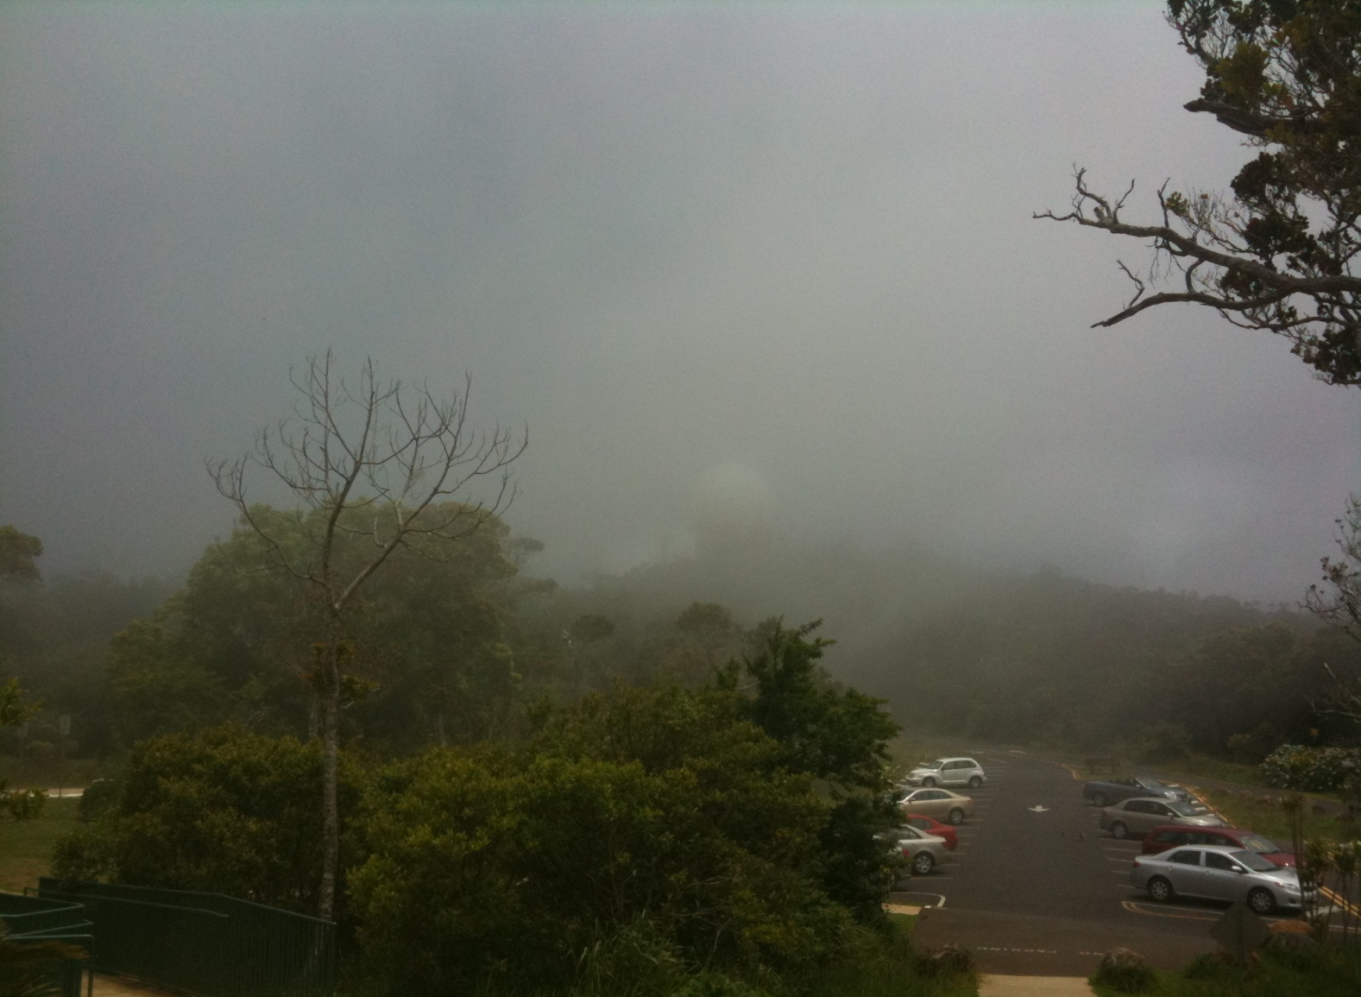
In the Clouds at Kalalau Valley Lookout

Slide 30
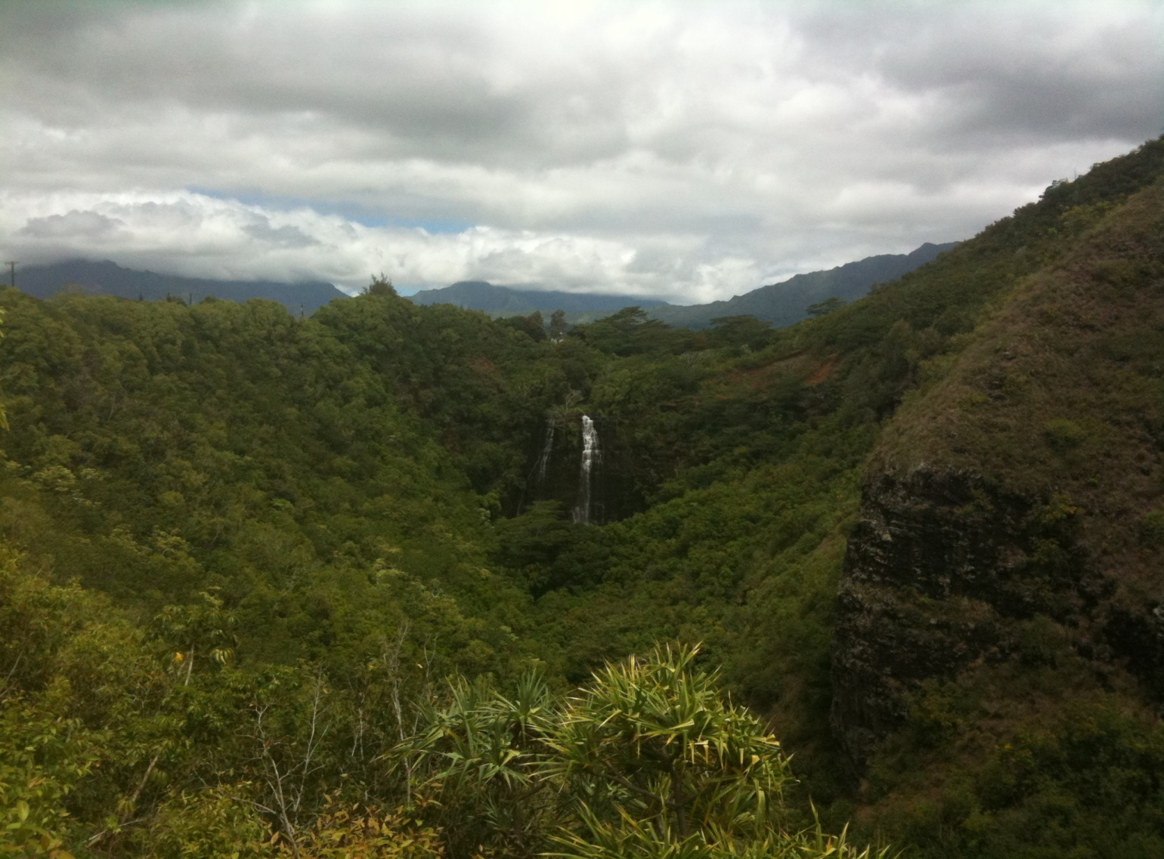
Opaekaa Falls

Slide 31
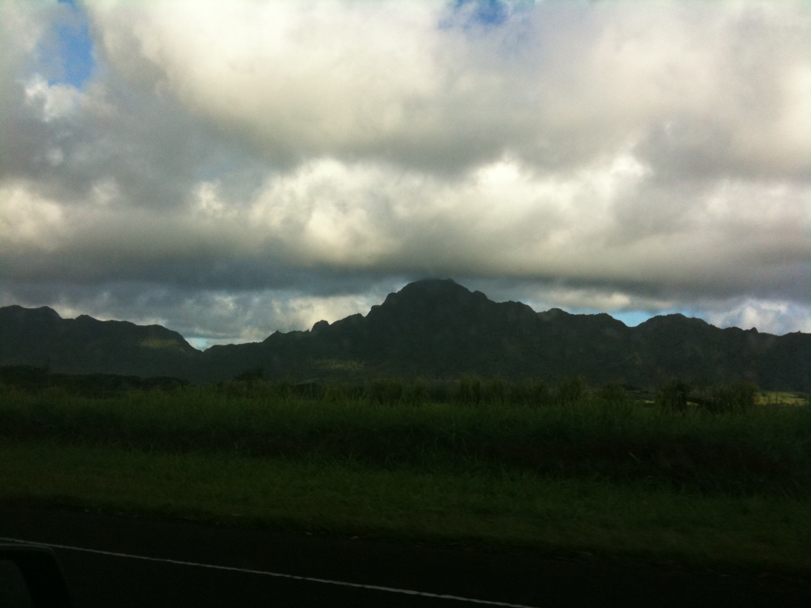
Kauai

Slide 32
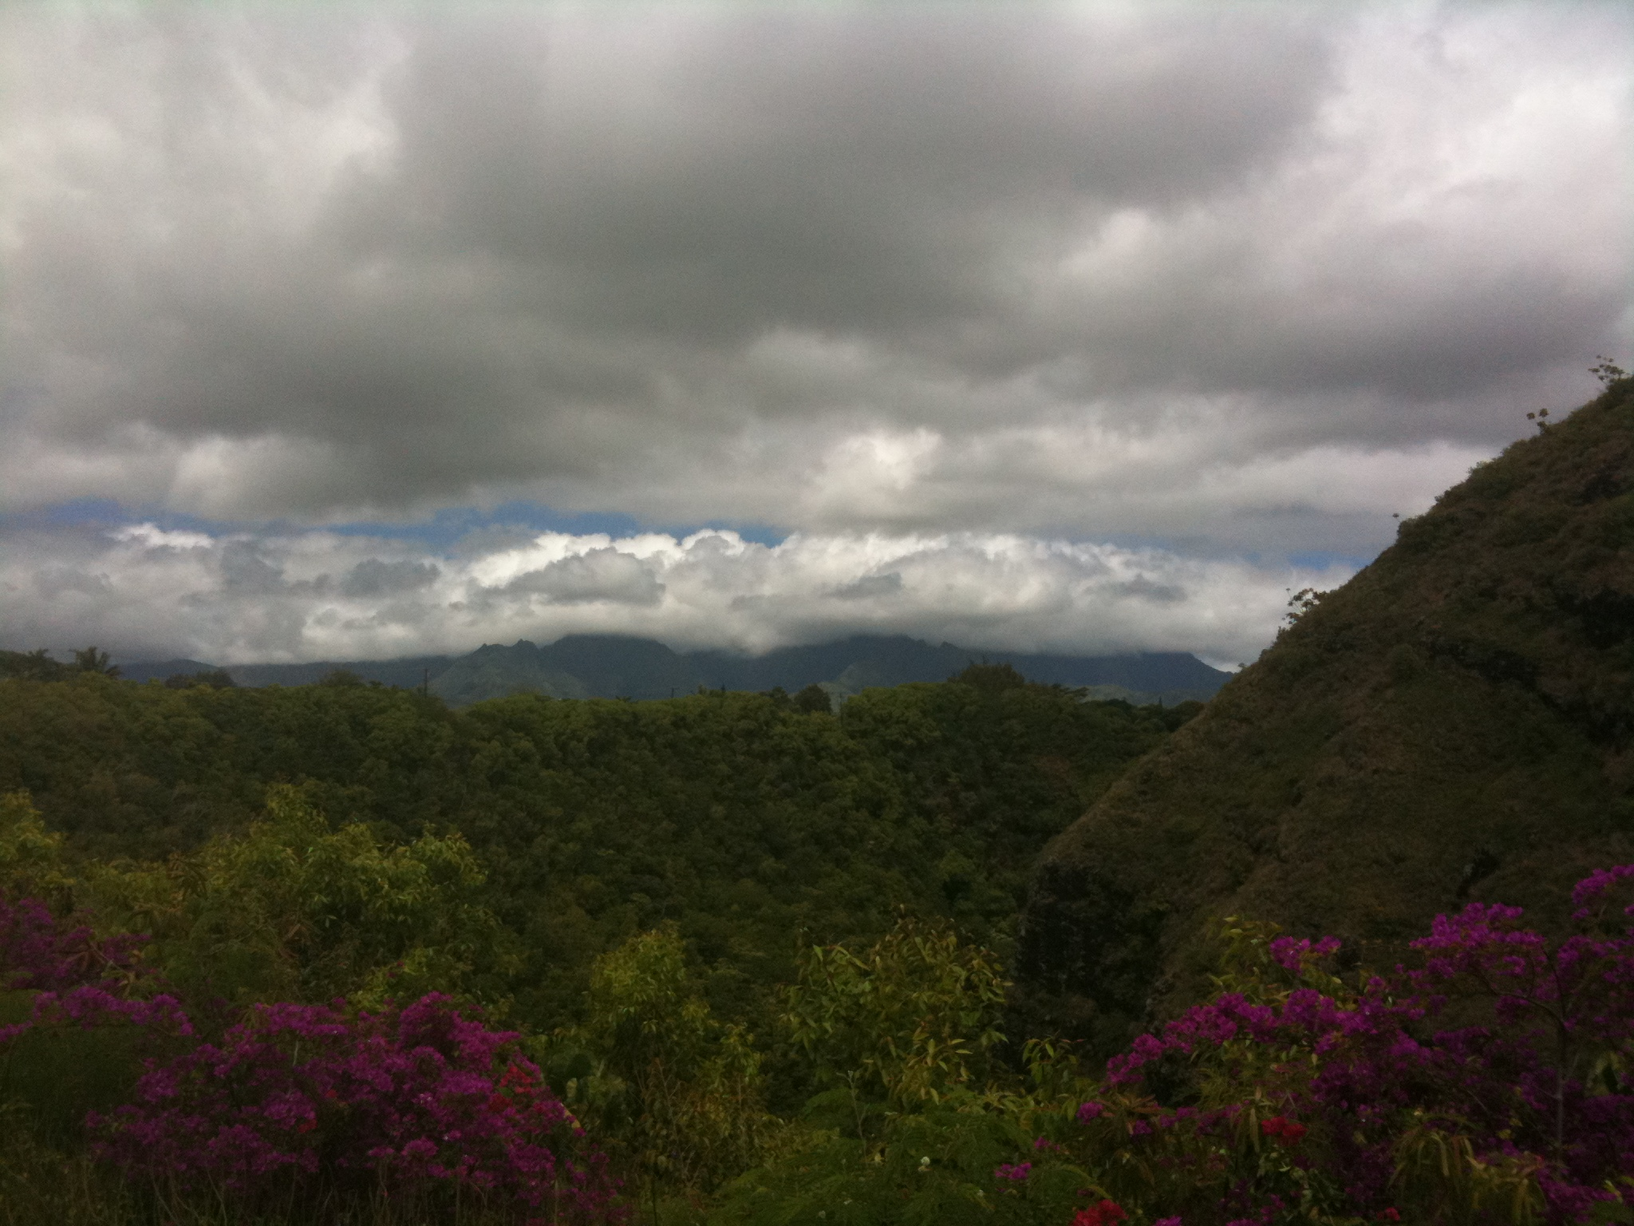

Slide 33
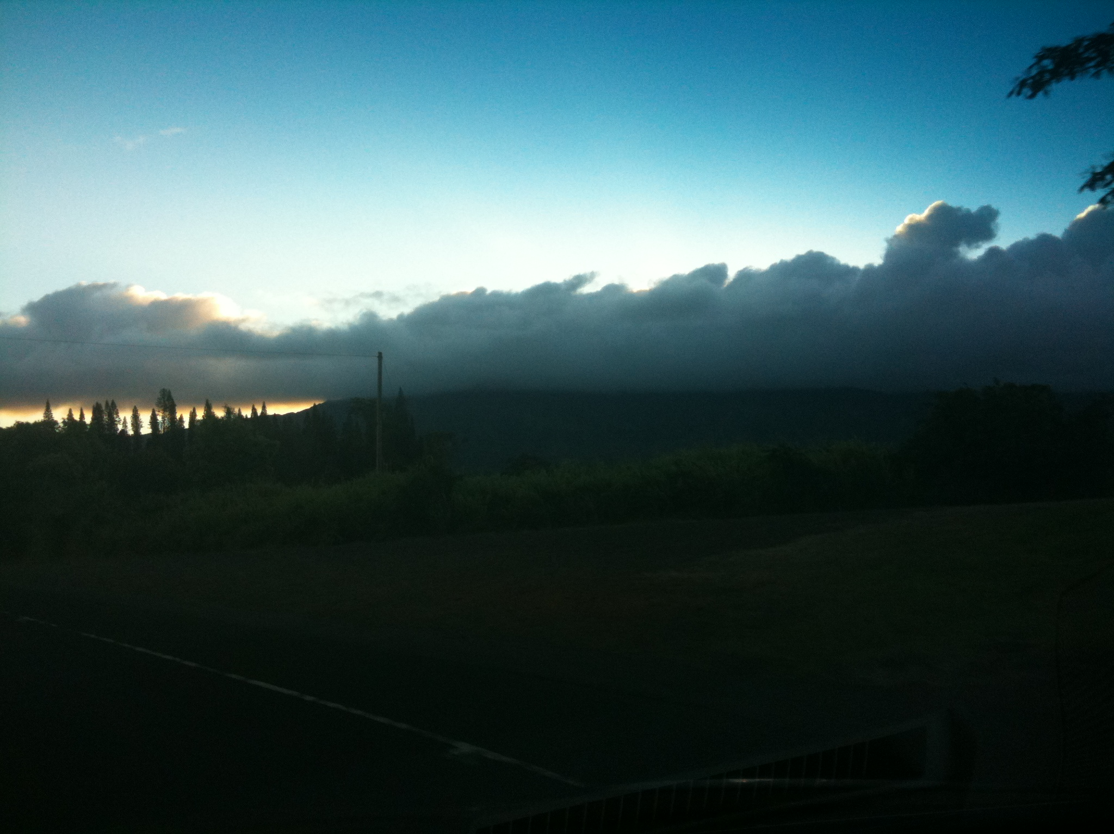

Slide 34
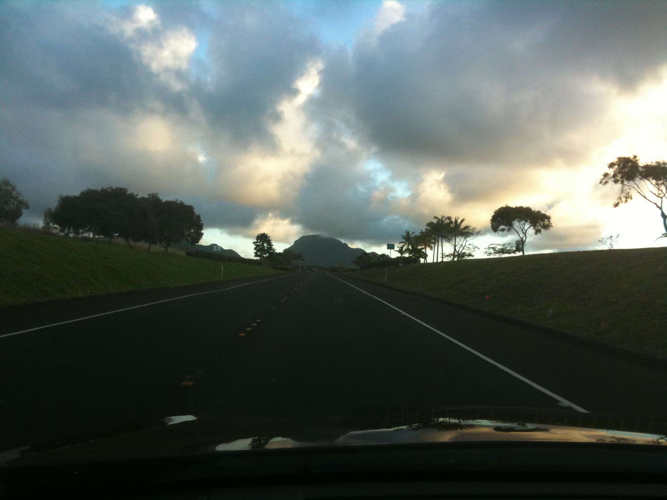

Slide 35
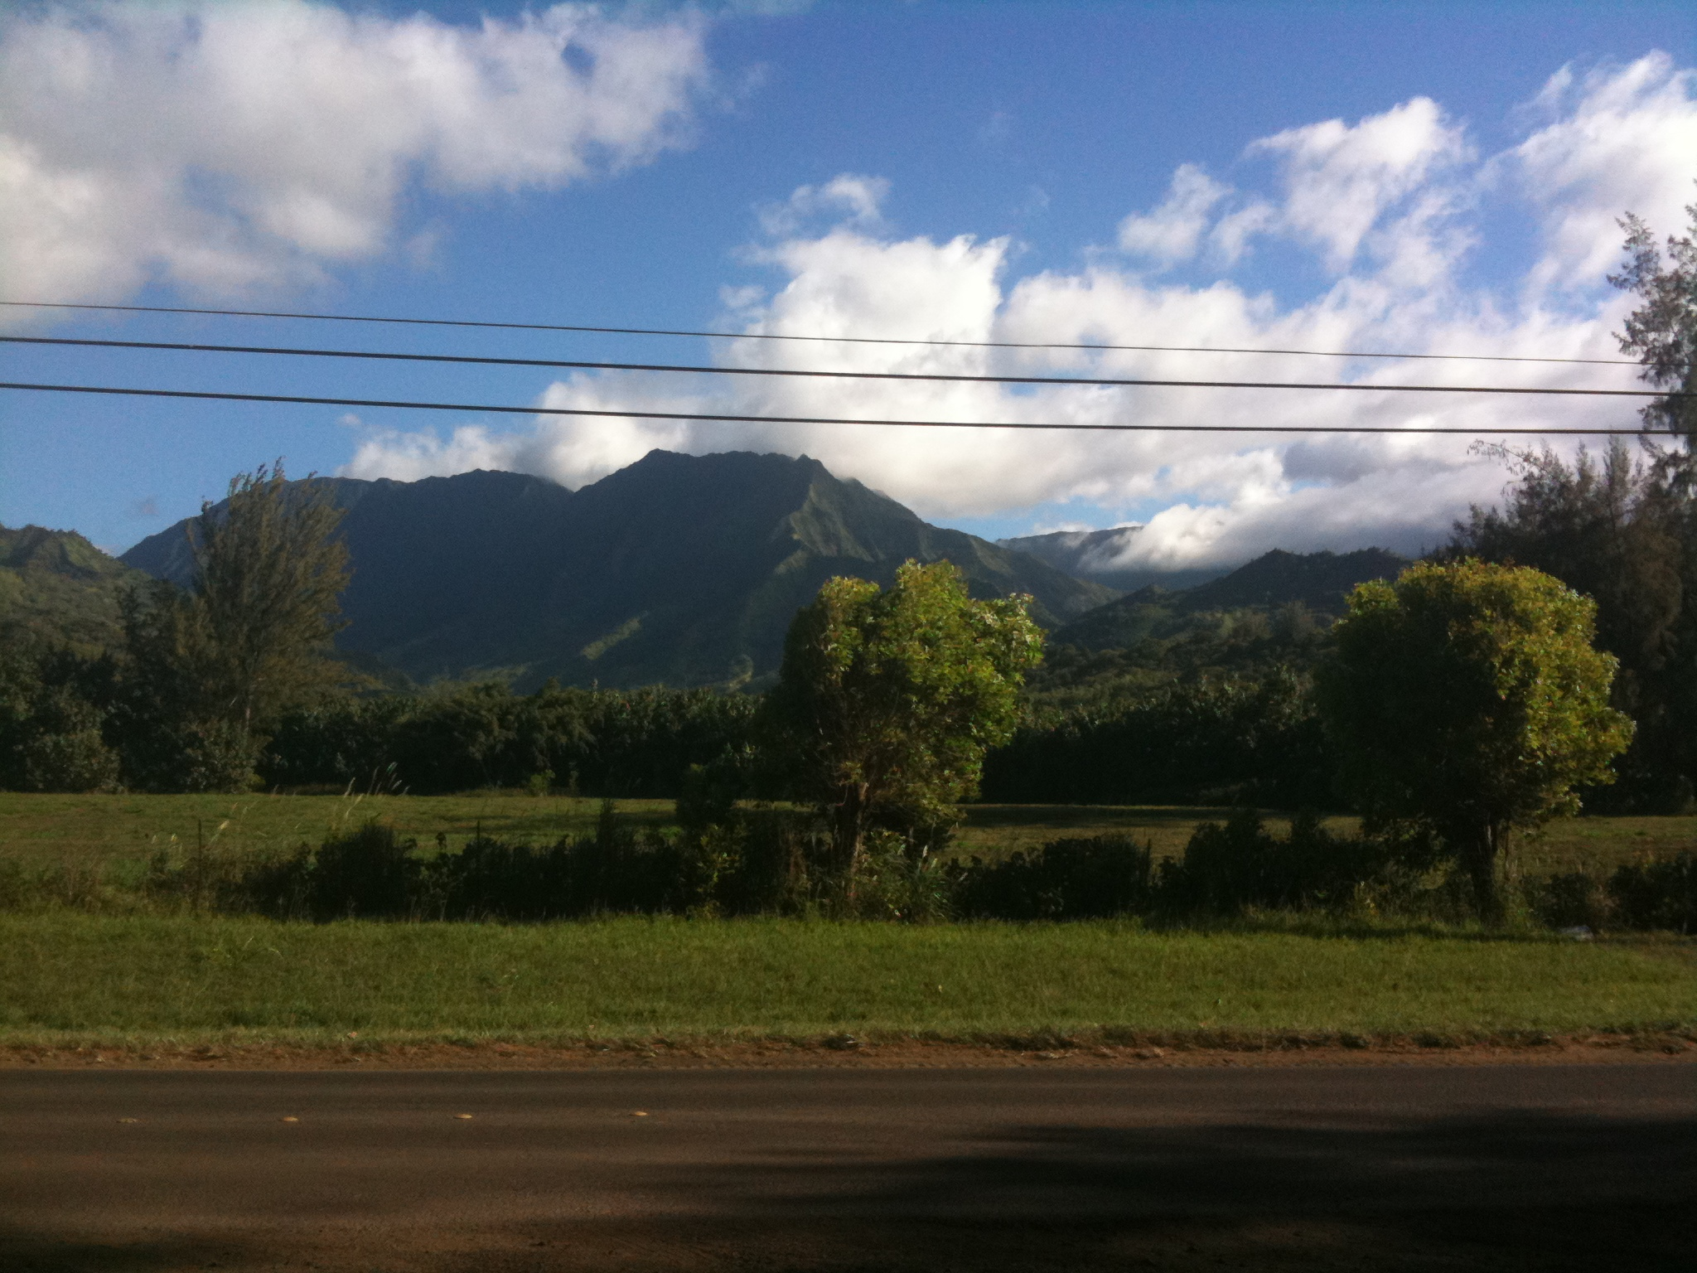

Slide 36
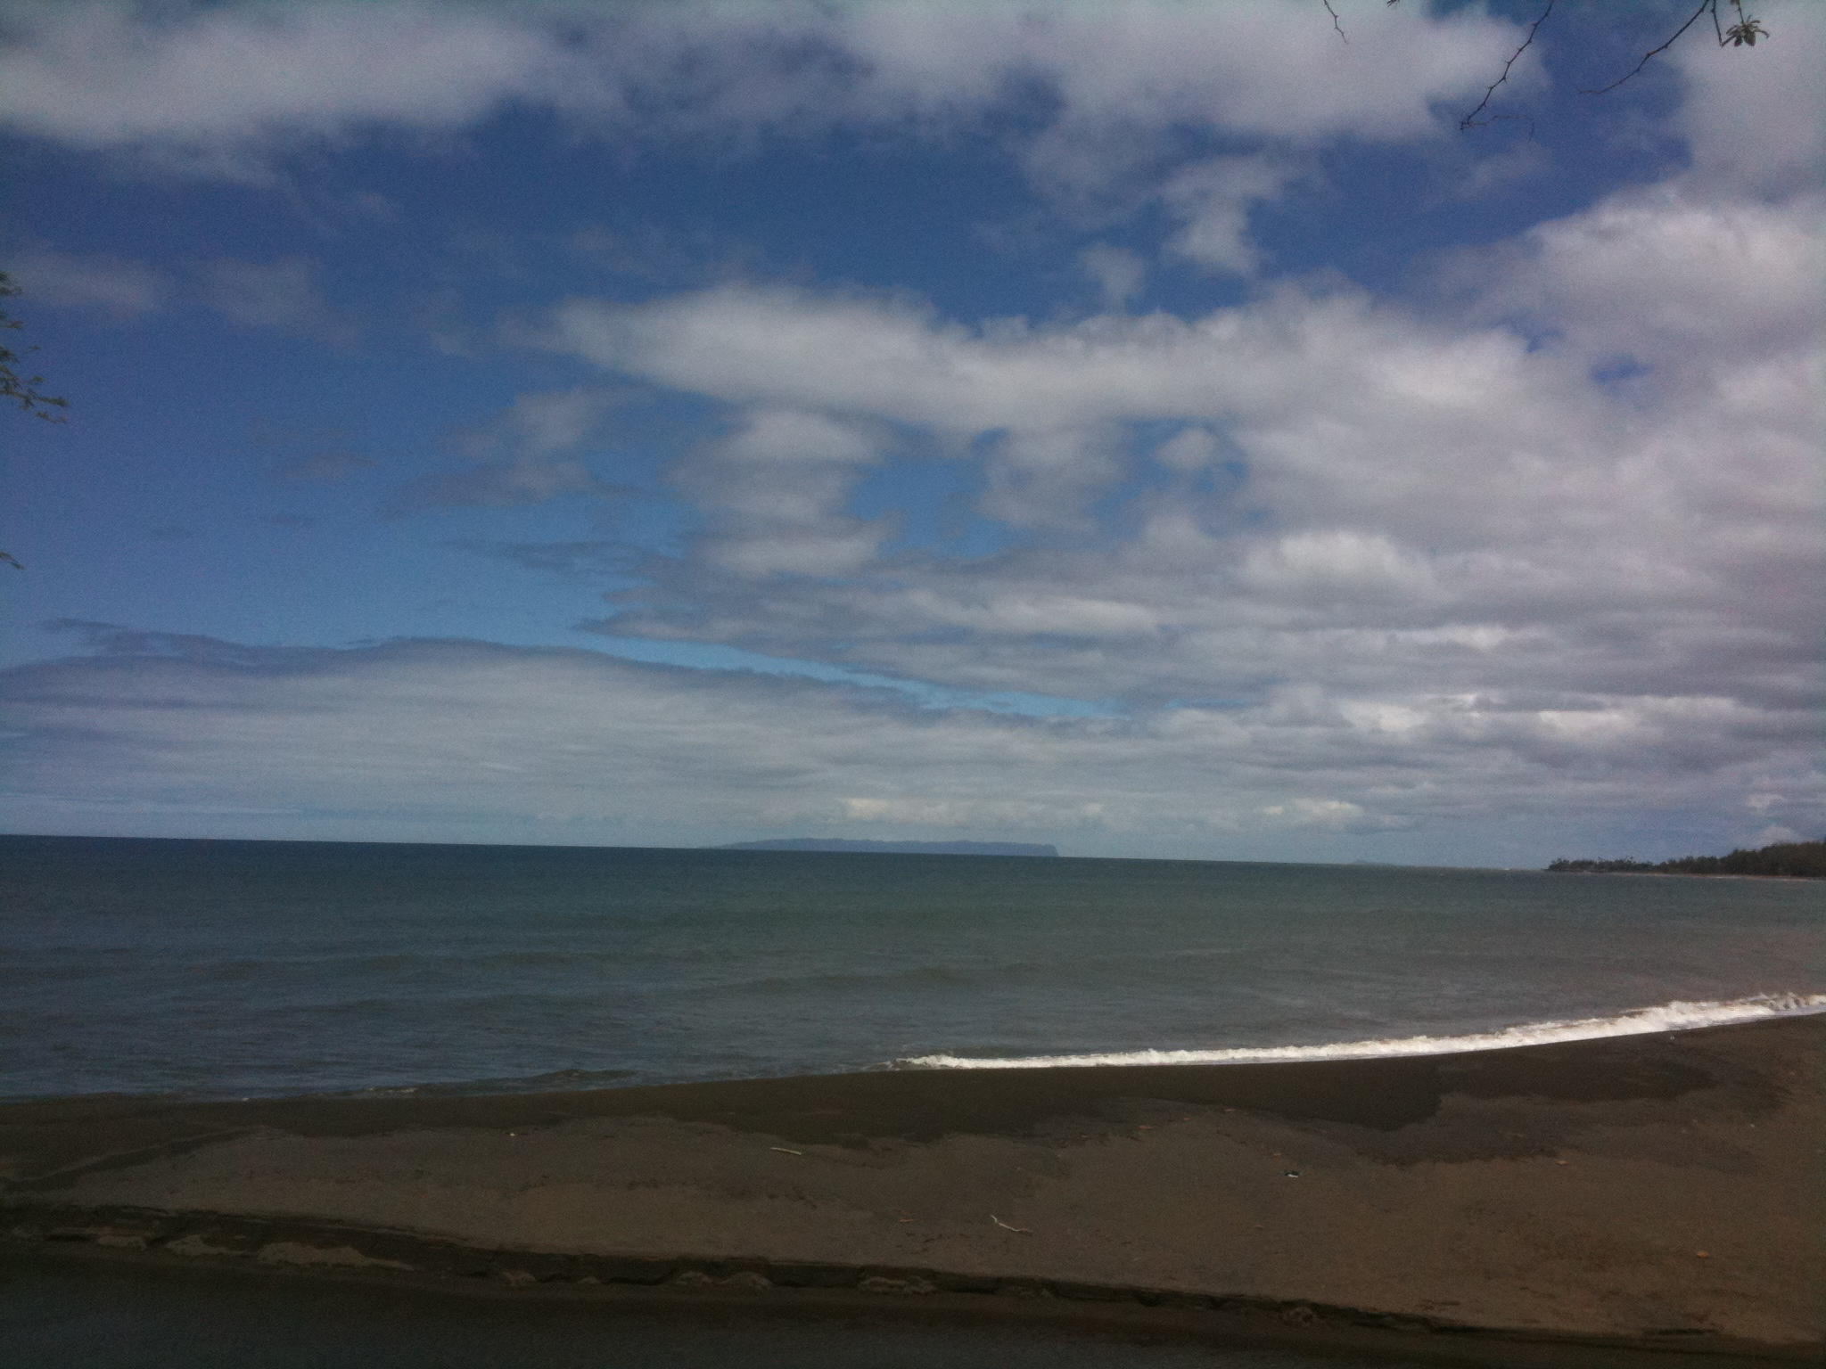

Slide 37
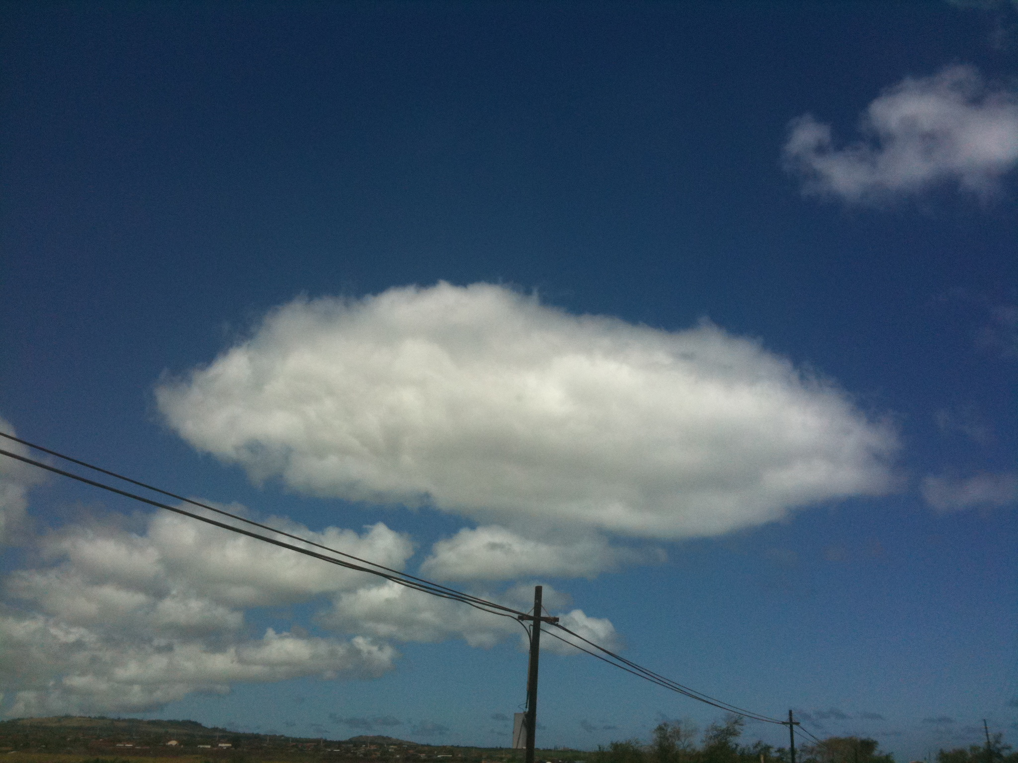

Slide 38
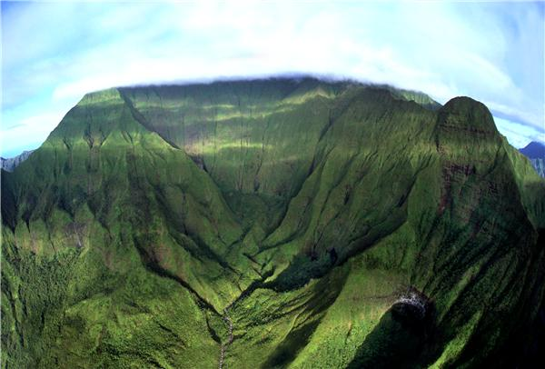
Kauai’s Mt. Wai’ale’ale: The Wettest Spot on Earth (426 inches of rain per year on average; 1982 record: 683 inches!)

Slide 39
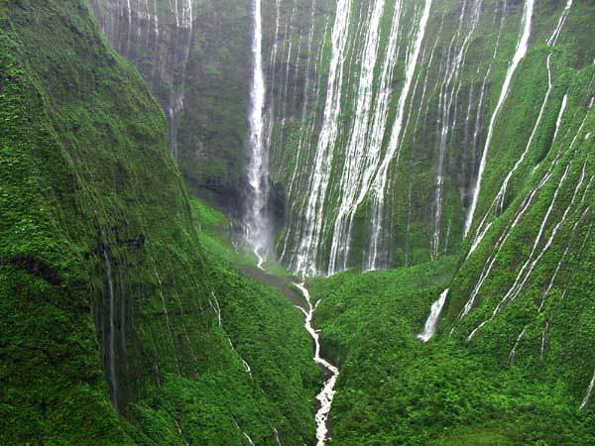
When it rains…

Slide 40
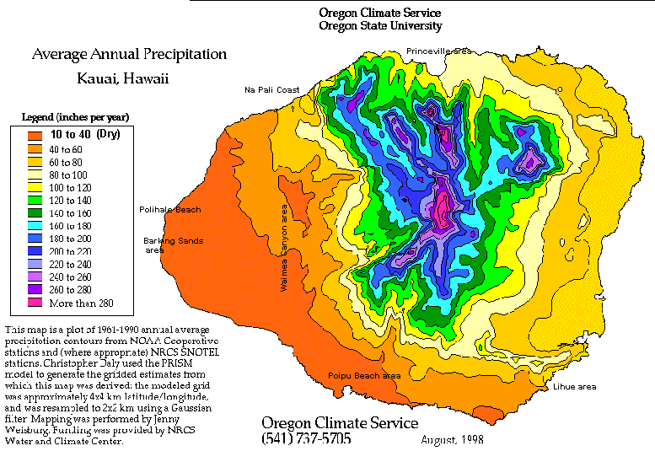
Annual Precipitation Map of Kauai

Slide 41
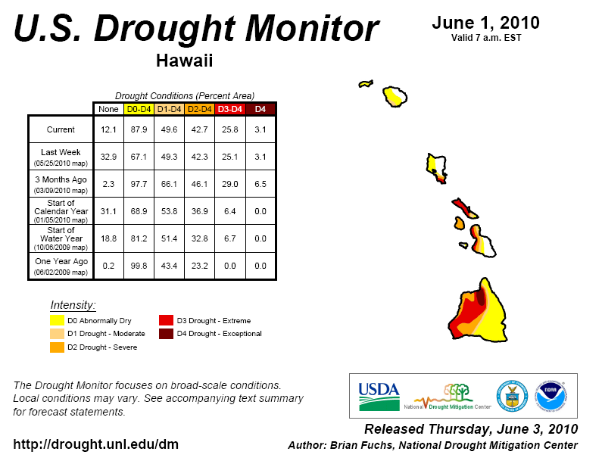
Drought in Hawaii?!

Slide 42
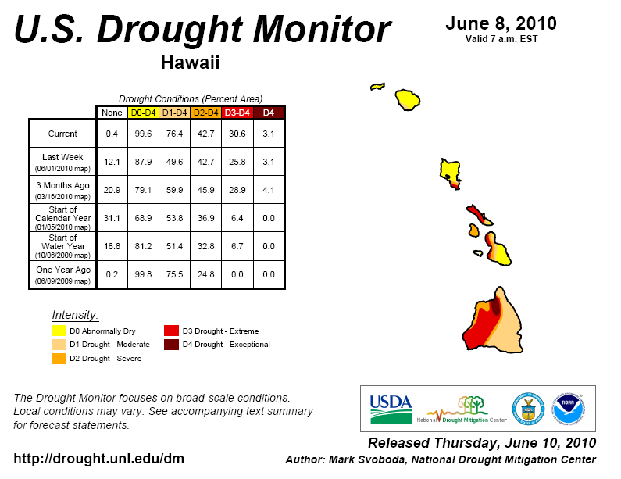
It’s Getting Worse!

