Slide 1
20120308 Update to OMPS Initial Performance Evaluation

Slide 2
Summary New Bullets
Collection of Golden Day (20120225) data sets is proceeding.
STAR data repository (scdr-files system) has begun receiving IDPS products from CLASS; ozone profile products are present in the March files received by scdr.
ICVS monitoring plots for OMPS are starting to be populated.
Surface reflectivity values for the Nadir Mapper are sometimes greater than 1. This has been traced to the climatology.
Comparisons of the observed solar to synthetic spectra show consistent biases and features.

Slide 3
Comparisons between 201201027 Solar & synthetic data. Notice the features are shared between the three. The figure on the right shows that all three have the same pattern of average bias as a function of cross-track position.

Slide 4
20120301 Update to OMPS Initial Performance Evaluation

Slide 5
Summary new Bullets
Work is proceeding to produce a provisional Day 1 Solar spectra
Offline V8 processing (TOZ and PRO) is active
NP stray light investigation will compare estimates to those from modulation transfer functions
G-ADA processing of February data has been delayed due to other priorities. The Day-of-Year error plaguing February processing does not appear to be present for March for total ozone.
There is a dark current discretization error that will be present until the next build caused by the non-linearity correction
We need to develop a screen to filter transients for the smear correction

Slide 6
Histogram of Dark Counts for TC Cal SDR
The OMPS TC Dark counts show severe discretization errors. In this histogram, there are approximately 13 empty bins between each populated one. This problem has been traced to a nonlinearity correction that uses the corrected value for the nearest table node instead of an interpolated value.
Notes:
Provided by R. Buss

Slide 7
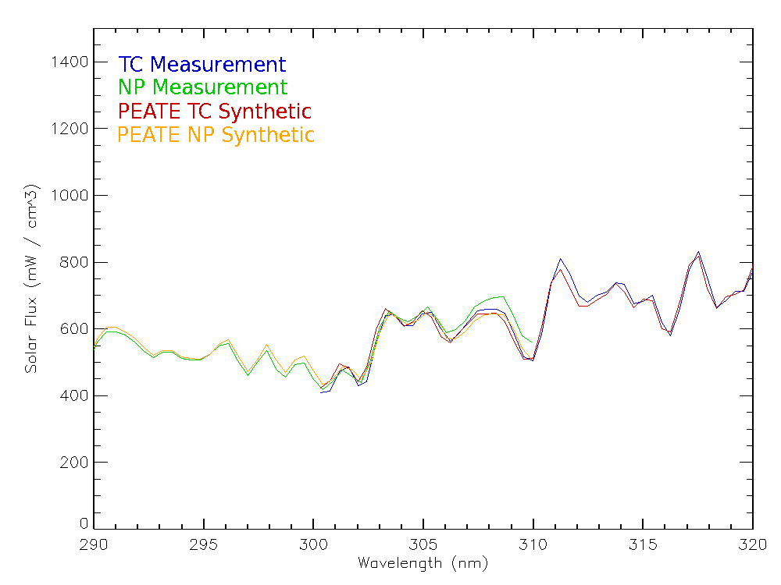
Comparison of solar measurements and synthetic spectra in the NP/NM overlap region. Further study of the radiance/ irradiance ratios will need to be conducted once a preliminary Day 1 solar is provided.
Notes:
Provide by C. Seftor.

Slide 8
OMPS Earth View SDR Status (1)
Dark Current levels and the increase in Hot Pixels are consistent with prelaunch characterization and expectations.
On-orbit Non-Linearity measurements match laboratory data very well.
Solar Spectra is consistent with synthetic spectra from instrument bandpass convolved reference spectra.
Preliminary analysis of Signal-to-Noise levels show performance above requirements.
Stray Light is present in the Nadir Profiler spectra and will need a correction. Measurements were taken in the laboratory to provide these corrections.
The Wavelength Scale shows small intra-orbit variations tracking the optical bench temperatures
Charge particle effects in the South Atlantic Anomaly are apparent in the Nadir Profiler spectra in the expected region.
Preliminary evaluation of the Geolocation Registration shows it well within specifications
The CCD array Detector Temperatures are within allowable tolerance of the design values.

Slide 9
OMPS Earth View SDR Status (2)
A good amount of Earth-View SDR data has been obtained over the last month for both Nadir instruments.
A minor code bug and a minor table bug have led to missing fields for scales and solar flux in the EV SDRs. The radiances are complete. This has prevented the creation of IPs and EDRs at IDPS since February 1. The issues will be resolved on March 1.
In the meantime, the GRAVITE-ADA has begun reprocessing February data to provide the missing information (both SDRs and IPs).
OMPS EV SDRs have been used successfully to generate total ozone and ozone profiles in offline processing (at the PEATE and STAR) with various flavors of the Version 8 Algorithms.
The process to provide new and updated SDR Calibration tables to IDPS is now working well. Fast Track Tables have been identified and can be replaced with less bureaucratic overhead.
Several DRs have been identified (both SDR and EDR related) and solutions are proceeding through the system.
The teams are awaiting the introduction of measured day one solar into the products.
Delivery and archiving of JPSS-Funded, PEATE-processed Calibration SDRs is an open concern.

Slide 10
20120223 Update to OMPS Initial Performance Evaluation and First Images

Slide 11
Summary new Bullets
NP has stray light; a two term correction using radiances at 305 nm and at 298 nm is envisioned. The mean magnitude of these corrections will affect any radiance/irradiance validation.
Pre-launch solar reference results for NM: NASA PEATE vs IDPS show ±4% wavelength dependent offsets
Increase in hot pixels as expected

Slide 12
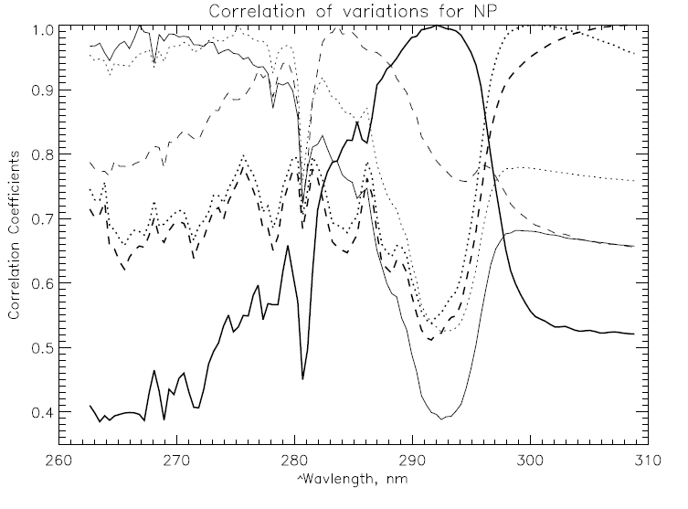
NP Stray Light Study via Correlation Matrix
A smooth polynomial fit as a function of latitude was computed for each wavelength using three orbits of NP spectra. The correlation matrix was computed for the differences between the measurements and these fits. The results for six wavelengths are presented to the left. The peaks at 1.0 identify the selected wavelengths. The high correlations between wavelengths below 290 nm with those above 300 nm is direct evidence of stray light.
E.g., the thin dotted line for 275 nm drops off as expected until 292 nm where it rises back up due to stray light contamination. Over half of the variations at this wavelength could be explained by variations at a channel between 300 and 310 nm. Similar results hold for all channels below 287 nm.
Notes:
Wavelengths are approximate. The dips at 280 (Mg II core) are unexpected. They may be related to solar cycle peak activity producing changes at the lines not shared with the continuum.

Slide 13
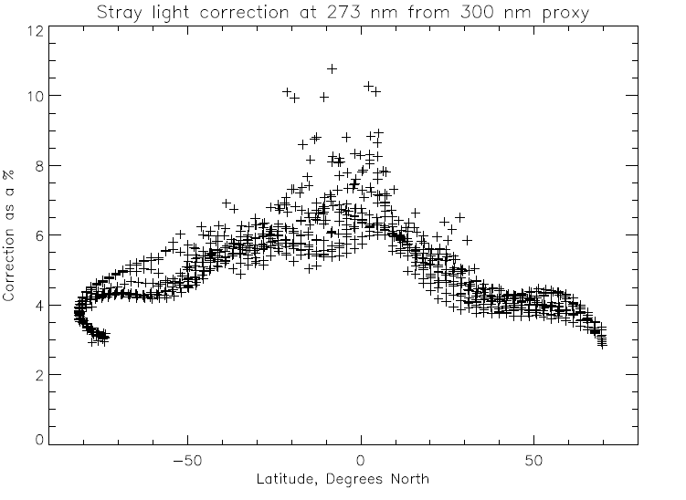
NP Stray Light Study with 300 nm Proxy
The single wavelength proxy model gives stray light ranging from 3% at high SZAs to 7% at low SZAs for the four shortest profiling wavelengths (253-288 nm) with additional variations when scene reflectivity variations are present in 300 nm.
This signal contamination will complicate any attempts to find a Radiance/Irradiance adjustment. That is, we need to come up with a first-order stray light correction, before we try to adjust the NP calibration.
Further investigation of the NP stray light in Earth View with a single wavelength proxy suggests that a weighted proxy may be needed. The relative weights can be provided by the BATC data.
Notes:
This analysis is not fully consistent with the Mg II Index results. Solar activity is complicating the use of solar lines in identifyng correlations.

Slide 14
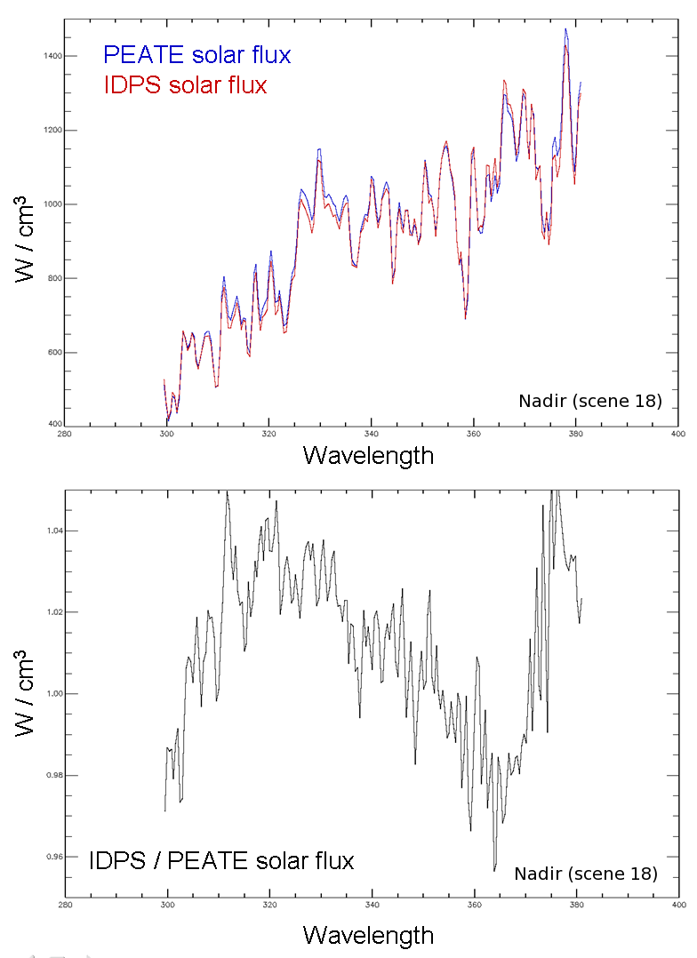
Comparisons of pre-launch solar flux.
The plot on the top shows the solar flux from the IDPS IP versus the solar flux from the PEATE product for the nadir scene (IDPS position 18; for the PEATE a simple average of scenes 18 and 19). There is a definite, wavelength-dependent difference between the IDPS and PEATE solar flux values (that is surprisingly large). The PEATE product is made from a reference solar flux that has been convolved with the appropriate OMPS BPS and CBC data.
C. Seftor, NASA/GSFC (SSAI) 1/26-27/2012
Notes:
Which reference?

Slide 15
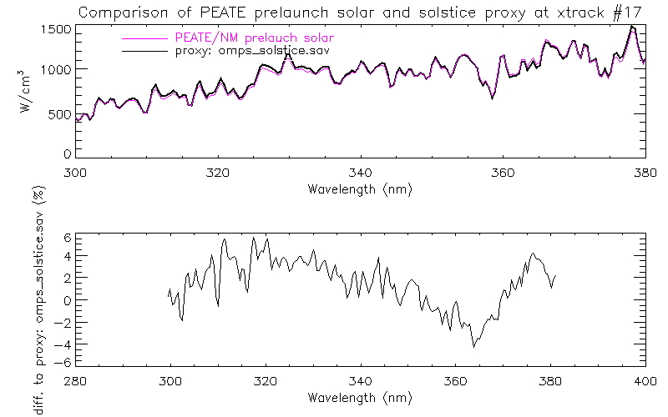
IDPS and Star Solstice proxy comparison are shown on the left. Differences are less than 3% and show high frequency features. The spectral scale have less than 0.01 nm differences in all 35 cross track position. The PEATE proxy comparisons to the STAR Solstice one are shown on the right. The differences range from ±5%.
Figure: J. Niu, NOAA/STAR (ERT)

Slide 16
Support Material for OMPS SDR to Beta Maturity Decision Performance compared to Pre-launch
Compilation of results from
JPSS and NPP OMPS Teams

Slide 17
Data Product Beta Maturity Definition

Slide 18
Outline
Dark Current
Hot Pixels
Non-linearity
Solar Spectra
Signal-to-Noise
Stray Light
Wavelength Scale
South Atlantic Anomaly – charged particle effects
Geolocation Registration
Detector Temperature

Slide 19
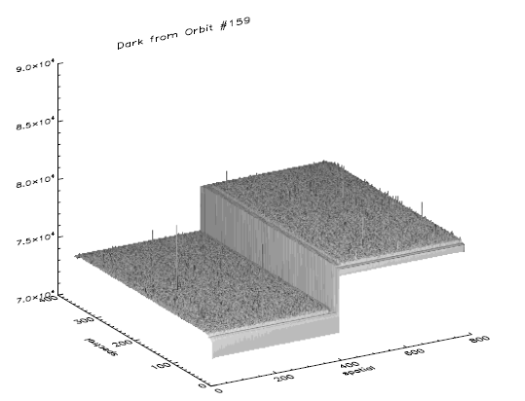
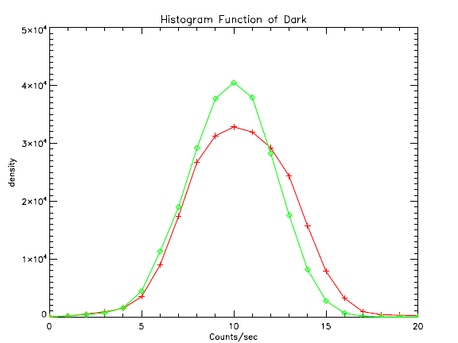
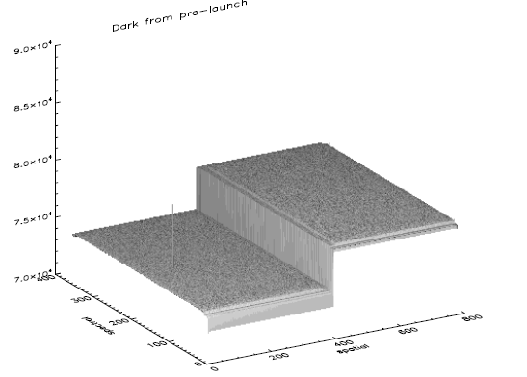
Dark Transition from Ground to Orbit
On-orbit
Raw dark image for orbit
Exposure time of 1247.1 second
The number of coadds is 100
A few potential hot pixels are observed.
Histogram function
On-orbit
Prelaunch
Gaussian distribution
Bin index
Prelaunch
Raw dark image for prelaunch
Exposure time of 1247.1 second
The number of coadds is 100
Only one hot pixel is identified
Notes:
Provided by C. Pan

Slide 20
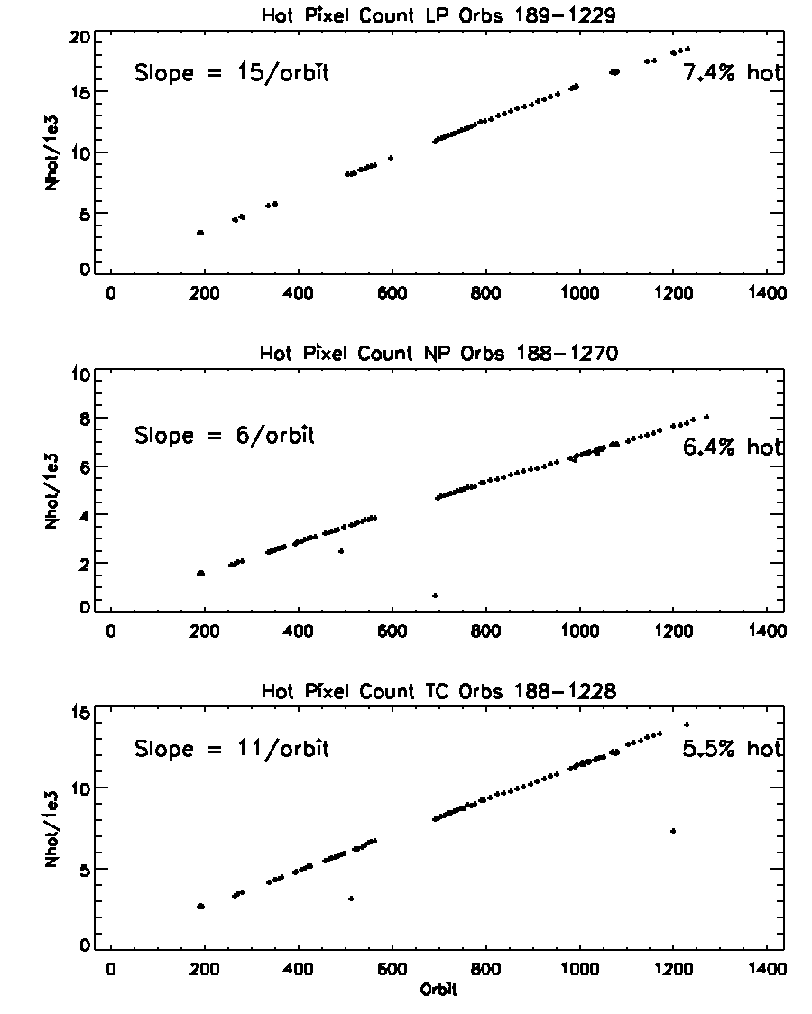
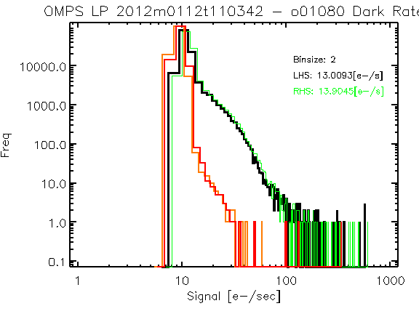
Hot pixels increasing as expected
Hot pixel defined as 8σ above pre-launch distribution
Pre-launch
Orbit 1080
Notes:
Provided by G. Jaross

Slide 21
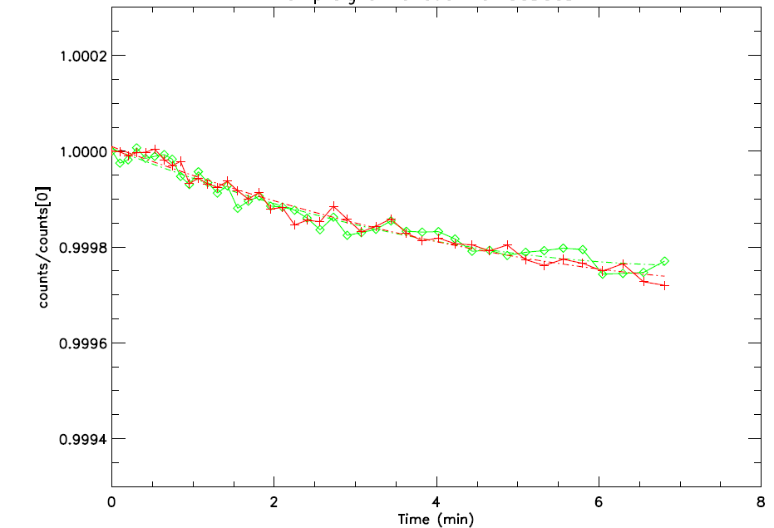
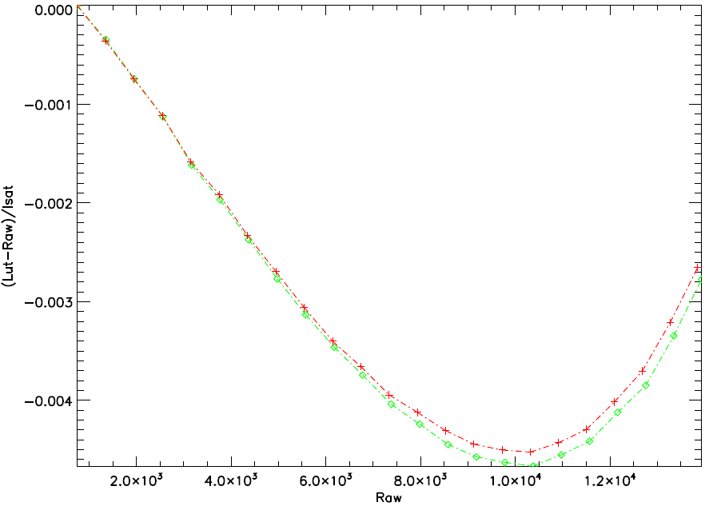
Linearity Performance Transition from Ground to Orbit
LED signal drifts
System nonlinearity
On-orbit
Prelaunch
On-orbit
Prelaunch
Observed OMPS TC LED drifts over time
meets the system requirement of < 1% per minute
Sensor nonlinearity is compliant with the specification of < 2%
Notes:
Provide by C. Pan

Slide 22
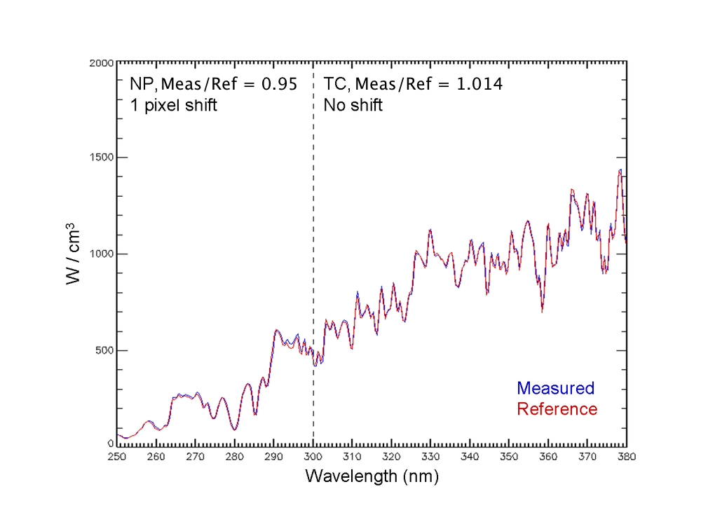
Spectral Calibration Transition from Ground to Orbit
Notes:
Provided by C. Seftor

Slide 23
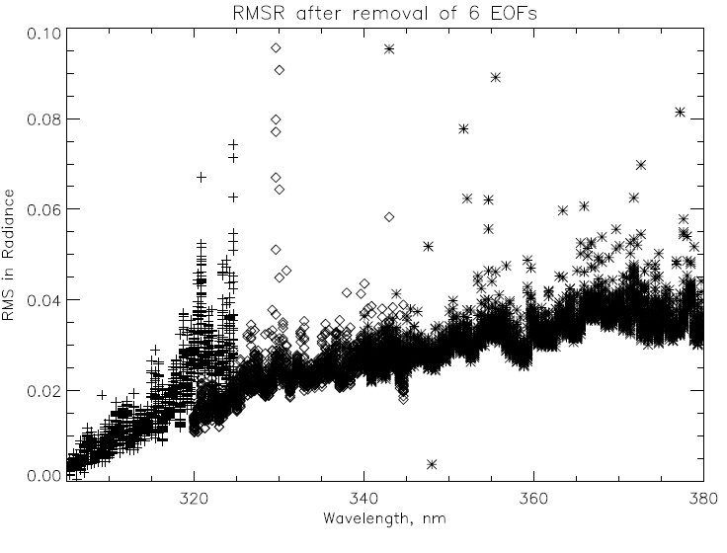
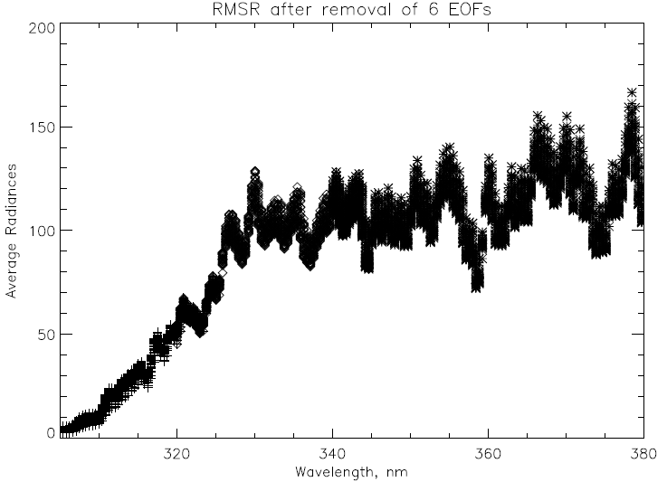
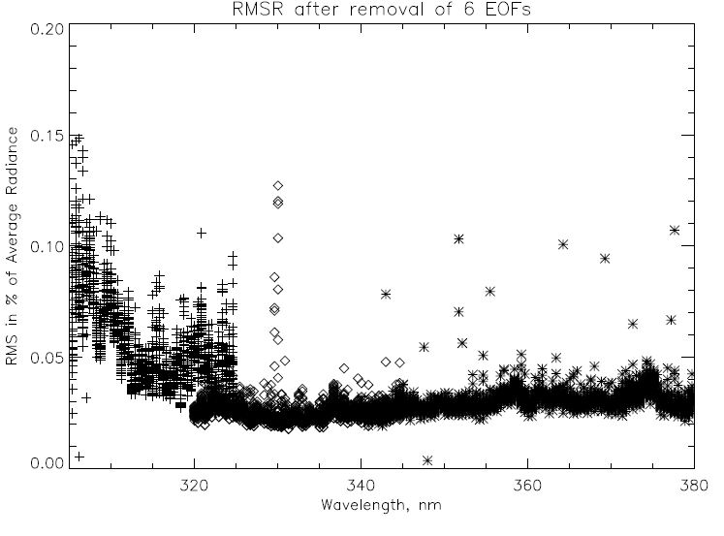
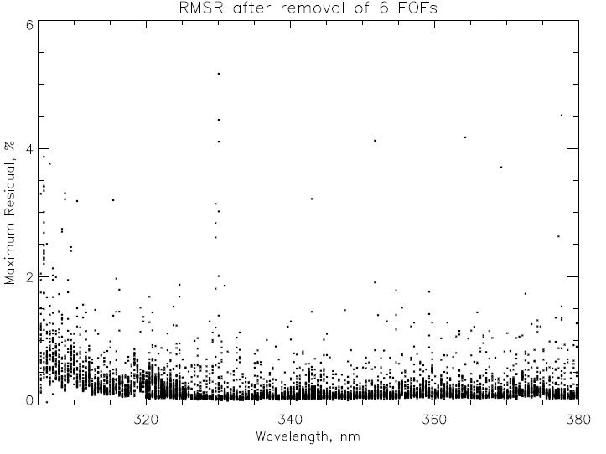
EOF/SNR analysis for six orbits (~1800 scans) OMPS NM on 1/28/2012 using three wavelength ranges (305-325, 320-345, 340-380) for 35 CT
Average Radiances
Maximum Residuals.
Spikes could be filtered.
0.1 is equivalent to SNR of 1000.
Notes:
All 35 cross-track positions. Top left shows noise in radiance units. Spikes not removed.
Provided by L. Flynn

Slide 24
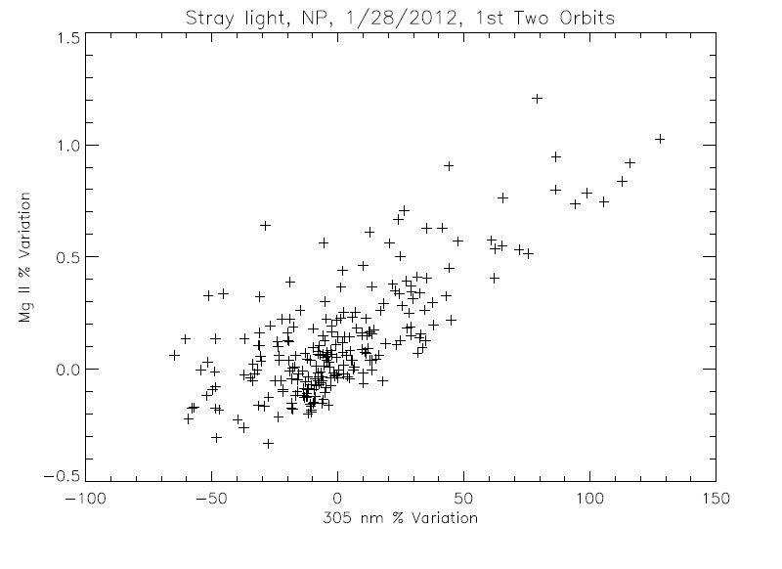
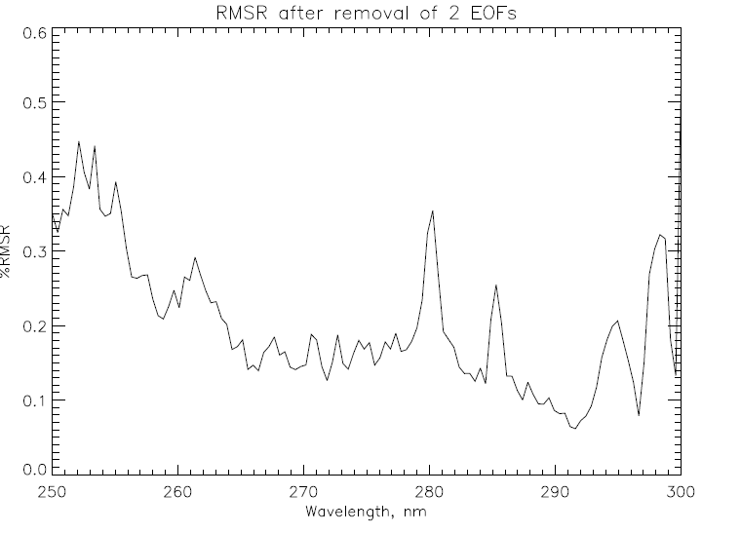
Stray Light and SNR for OMPS NP
The scatter plot on the left compares simple three-wavelength Mg II core-to-wing ratio variations (280 nm to the average of 277 nm and 282 nm) with longer wavelength variations at 305 nm. The core average is ~0.4 of wings, so this -0.5% to 1.5% variation represents (1.0/0.4 – 1 =) 1.5 times the wing variations.
The RMSR estimates on the right were done on clean data for 230 spectra. A spectral screen detected and removed one deviant value on average from each of the 120-wavelength spectra. The removal of the second EOF pattern was somewhat arbitrary as it and the third EOF may be stray light patterns. The EOF used a 6th order polynomial for normalization.
Notes:
Provided by L. Flynn

Slide 25
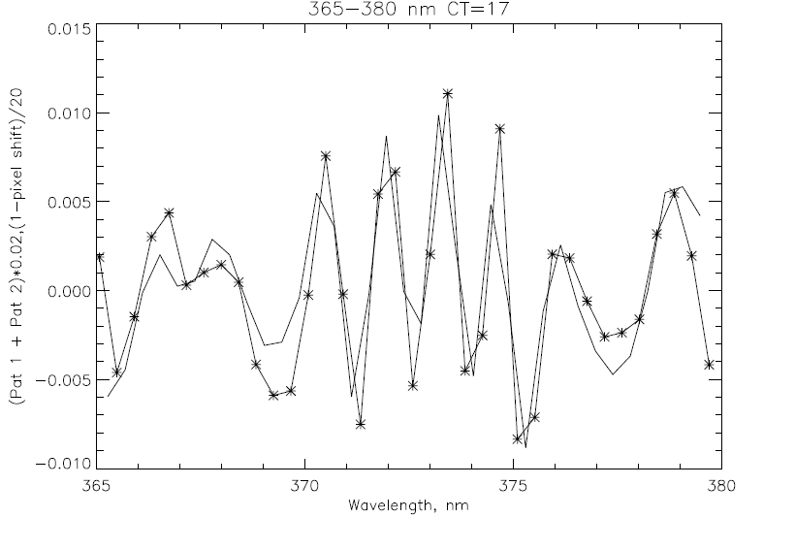
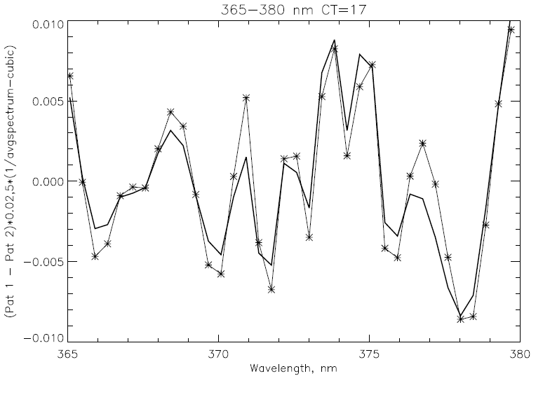
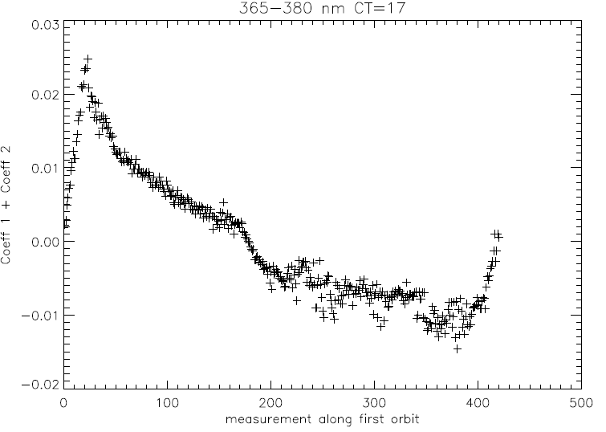
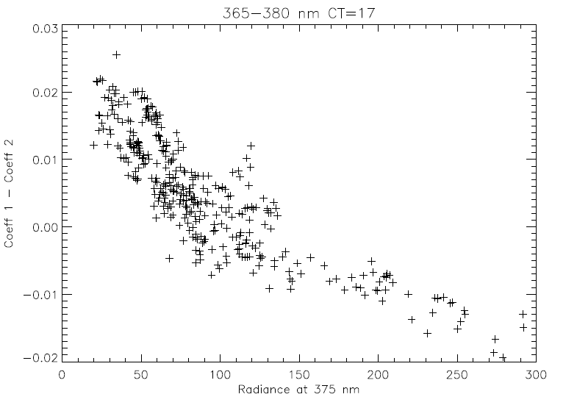
Wavelength Shift and Ring Effect/Stray Light
* EOF pattern
–– 0.02-nm shift
* EOF pattern
–– ∝ (1/Avg-poly)
EOF analysis 365 to 380 nm for parts of six orbits on 1/28/2012. The first two patterns contain 90% of the variability after removing a 3rd order polynomial from Rad/AvgRad. They are combinations of a Wavelength Scale Shift and Ring Effect/Stray Light. Given the radiance levels, a 0.01 in the figures at the top equates to approximately 1% variation.
Notes:
Provided by L. Flynn

Slide 26
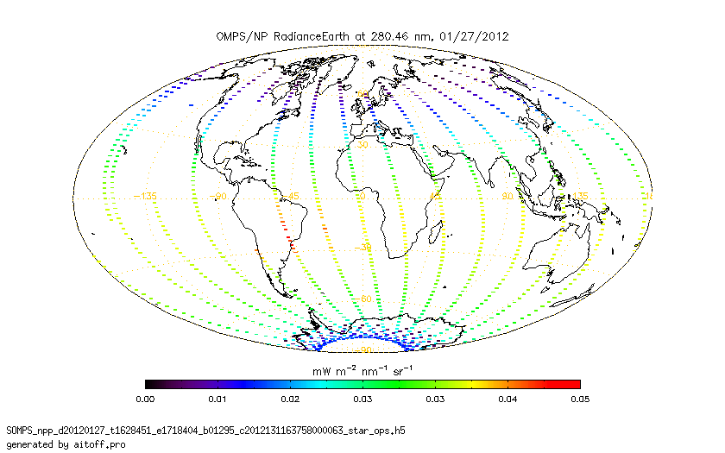
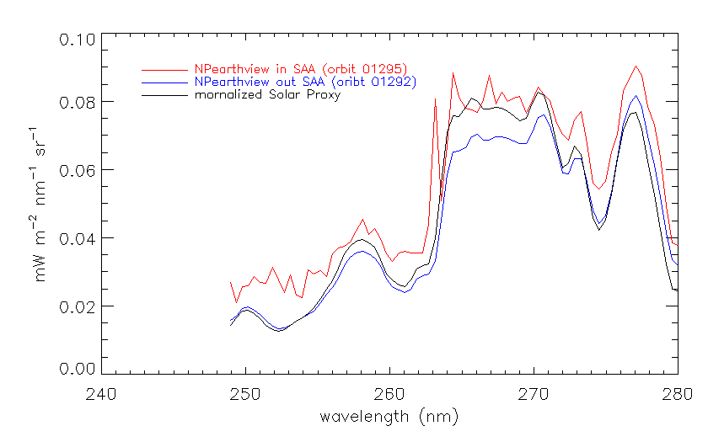
SAA Effects on NP
The noise/spikes show the expected increases when an orbital path falls with within the SAA but return to normal levels after passing through it.
Figure: J. Niu, NOAA/STAR (ERT)
Notes:
Provided by J. Niu

Slide 27
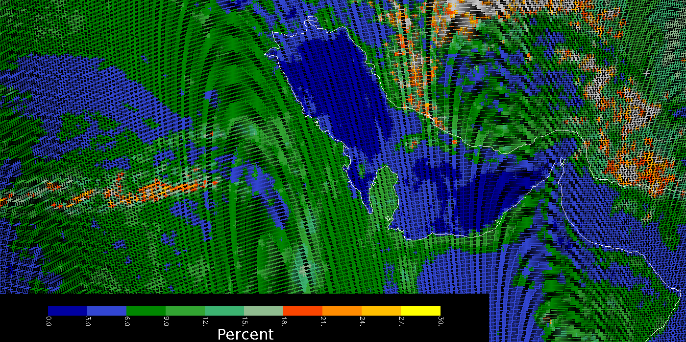
OMPS Geolocation
This image shows the effective reflectivity for the 380-nm Channel for part of an orbit of small Field-of-View (5 KM X 10 KM at Nadir) made by the OMPS Nadir Mapper in a special diagnostic mode. The Qatar peninsula sticking into the Persian Gulf in the middle of the picture lies along the nadir view of the orbital track and gives a preliminary assurance of the geolocation at better the 5 KM.
C. Seftor, NASA/GSFC (SSAI) 1/26-27/2012
Notes:
Provided by C. Seftor

Slide 28
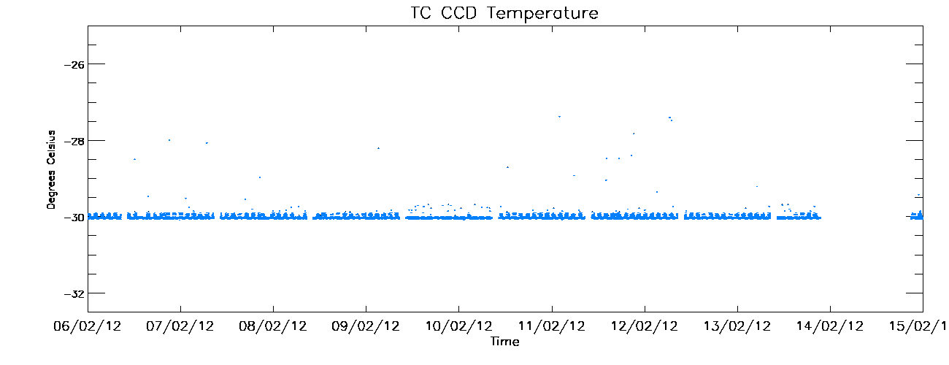
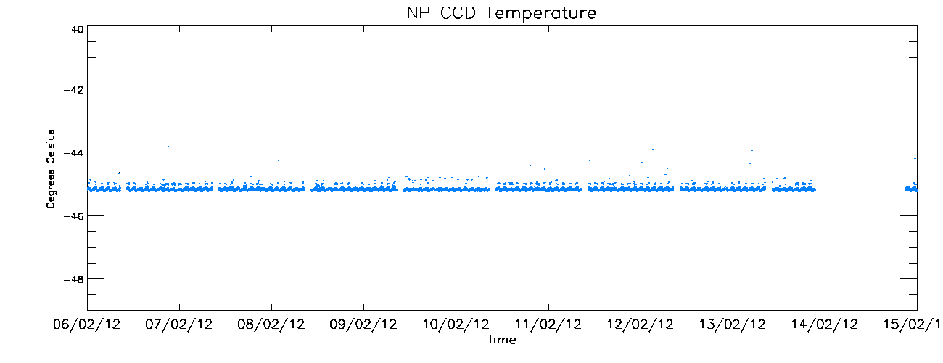
CCD Temperatures for the last ten days
Design temperature is -30∘C.
Deviations yet to be investigated.
Small intra-orbit cycle observed.
Design temperature is -45∘C.
Deviations yet to be investigated.
Small intra-orbit cycle observed.
Notes:
Provided by W. Yu

Slide 29
20120208 Update to OMPS Initial Performance Evaluation and First Images

Slide 30
Summary Bullets (Compiled by L. Flynn 2/8/2012)
OMPS NM SDRs
SNRs as expected (EOF and NN analysis)
Provide reasonable ozone and reflectivity (IDPS IP)
Geolocation is good at 5-KM level (Small FOV)
Intra-orbit Wavelength scale stability of 0.02-nm (EOF)
First Solar at 1% relative to laboratory
Solar is not in SDRs starting in February (Fill in ozone products)
Good Aerosol Index after NPP Science Team tweaking
OMPS NP SDRs
SNRs as expected (EOF and NN analysis)
No wavelength scale in product; all zeros – Fill in Profiles
Will need corrections/filtering in SAA as expected
Stray light is present (correlation of 280-nm variations with 305-nm variations gives 3%::50% response ratio)
First Solar at 5% relative to laboratory (possible 1-pixel offset in wavelength scale from expected)

Slide 31
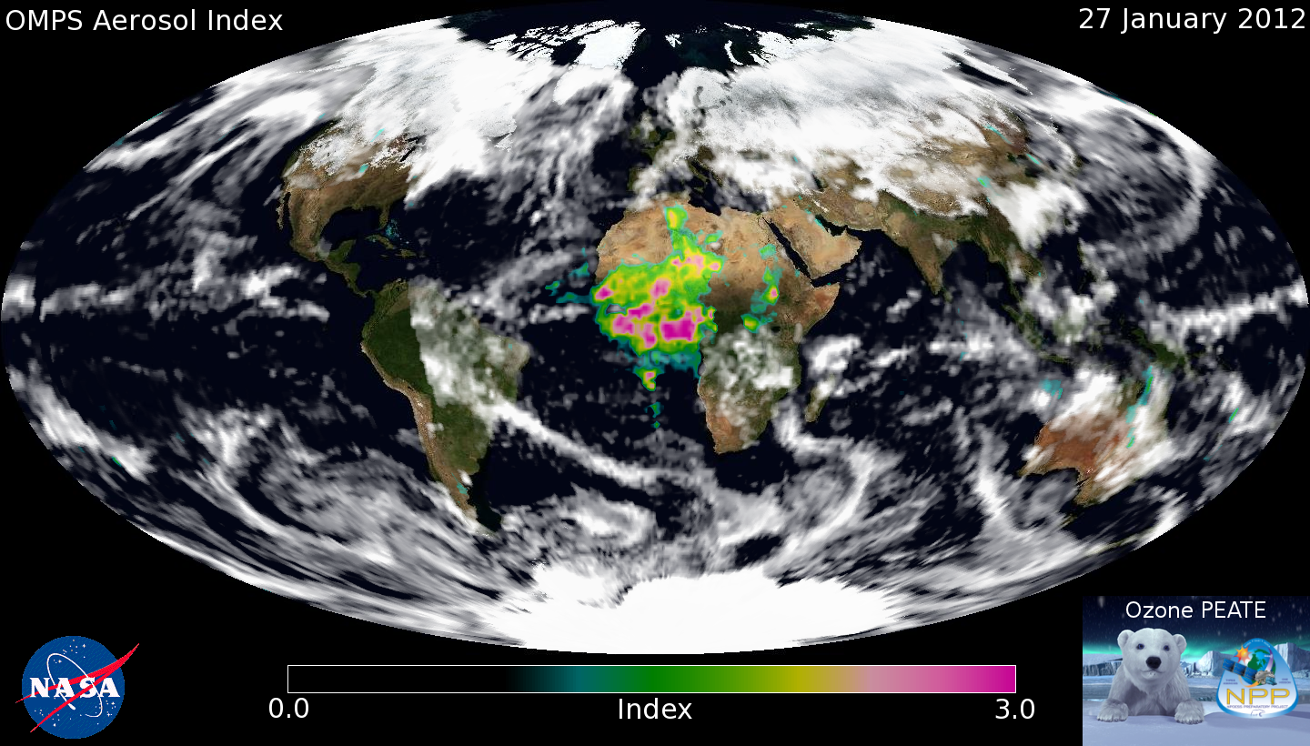
We've been working on a (very) preliminary set of soft calibration factors using the extremely limited amount of data we have so far. Using this calibration, we've generated the first daily aerosol index map from OMPS, which I'm attaching here. Sun glint has been screened out (for the most part), and clouds are represented by the OMPS reflectivity measurements. The MODIS Blue Marble image is being used for the background. Note the missing orbit over North / South America.
C. Seftor, NASA/GSFC (SSAI) 1/26-27/2012

Slide 32
Stray Light and SNR for OMPS NP
The scatter plot on the left compares simple three-wavelength Mg II core-to-wing ratio variations (280 nm to 277 and 282 nm) with longer wavelength variations at 305 nm. The core average is ~0.4 of wings, so this -0.5% to 1.5% variation represents (1.0/0.4 – 1 =) 1.5 times the wing variations.
The RMSR estimates on the right were done on clean data for 230 spectra. A spectral screen detected and removed one value on average from each of the 120-wavelength spectra. The removal of the second EOF pattern was somewhat arbitrary as it and the third EOF may be stray light patterns. The EOF used a 6th order polynomial for normalization.

Slide 33
EOF/SNR analysis for six orbits (~1800 scans) OMPS NM on 1/28/2012 using three wavelength ranges (305-325, 320-345, 340-380) for 35 CT
Notes:
All 35 cross-track positions. Top left shows noise in radiance units. Spikes not removed.

Slide 34
Wavelength Shift and Ring Effect/Stray Light
* EOF pattern
–– 0.02-nm shift
* EOF pattern
–– ∝ (1/Avg-poly)
EOF analysis 365 to 380 nm for parts of six orbits on 1/28/2012. The first two patterns contain 90% of the variability after removing a 3rd order polynomial from Rad/AvgRad. They are combinations of a Wavelength Scale Shift and Ring Effect/Stray Light. Given the radiance levels, a 0.01 in the figures at the top equates to approximately 1% variation.

Slide 35
20120202 OMPS Initial Performance Evaluation and First Images

Slide 36
Summary Bullets (Compiled by L. Flynn 2/2/2012)
OMPS NM SDRs
SNRs as expected (EOF and NN analysis)
Provide reasonable ozone and reflectivity (IDPS IP)
Geolocation is good at 5-KM level (Small FOV)
Intra-orbit Wavelength scale stability of 0.02-nm (EOF)
First Solar at 1% relative to laboratory
OMPS NP SDRs
SNRs as expected (EOF and NN analysis)
No wavelength scale in product; all zeros
Will need corrections/filtering in SAA as expected
Stray light is present (correlation of 280-nm variations with 305-nm variations gives 3%::50% response ratio)
First Solar at 5% relative to laboratory (possible 1-pixel offset in wavelength scale from expected)

Slide 37
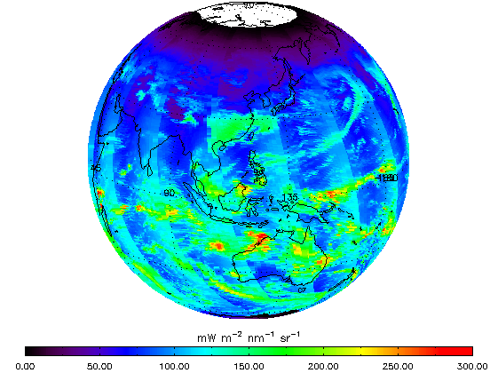
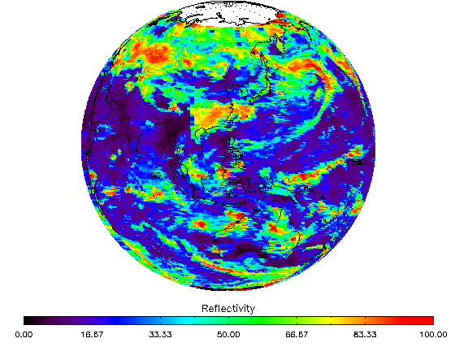
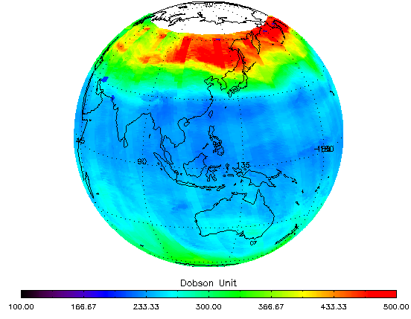
Figures: J. Niu, NOAA/STAR (ERT) 1/26-27/2012
← 331-nm Channel Radiances
for the first eight orbits of OMPS Nadir Mapper measurement (end of 1/26/2012 and start of 1/27/2012). This image shows the expected range of values and variations across the orbital track and with solar zenith angles at the times of the measurements. The white circle around the North Pole is the region of polar night during the Northern Hemisphere Winter. The OMPS needs scattered sunlight to make its measurements, so there are no data there.
Effective Reflectivity →
from the multiple triplet retrieval algorithm in IDPS for the same eight orbits. The quantity represents the UV reflectivity of the clouds and surface in each Field-of-View. Again, the range of values from bright clouds to dark open ocean scenes is as expected.
Total Ozone
from the multiple triplet retrieval algorithm in IDPS for the same eight orbits for the first pass ozone retrieval (IP product without CrIS or VIIRS information). The values show some cross track variations and are offset approximately 5% from another satellite ozone product. These uncertainty levels for preliminary products are consistent with the use of prelaunch calibration parameters and tables in the initial operational system.

Slide 38
OMPS Geolocation
This image shows the effective reflectivity for the 380-nm Channel for part of an orbit of small Field-of-View (5 KM X 10 KM at Nadir) made by the OMPS Nadir Mapper in a special diagnostic mode. The Qatar peninsula sticking into the Persian Gulf in the middle of the picture lies along the nadir view of the orbital track and gives a preliminary assurance of the geolocation at better the 5 KM.
C. Seftor, NASA/GSFC (SSAI) 1/26-27/2012

Slide 39
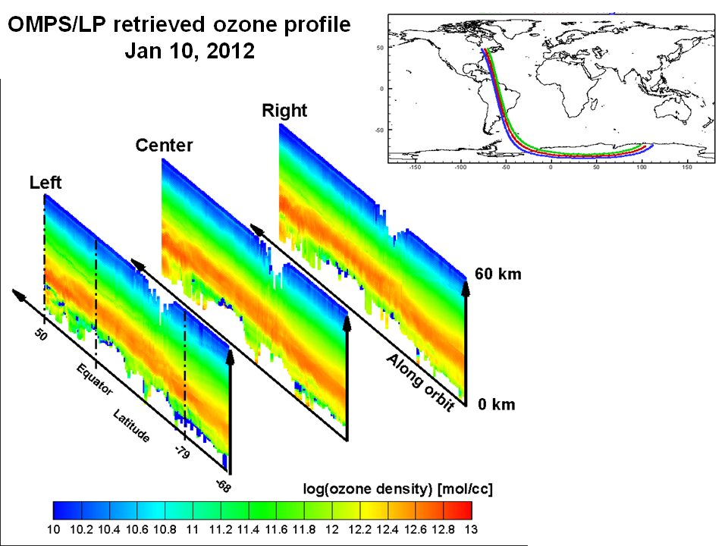
Figures: D. Rault, NASA LaRC
← OMPS Limb Profiler
These curtains represent the ozone profile in vertical slices through the atmosphere along the three paths shown above.
They demonstrate the ability of the research retrieval algorithm for the OMPS Limb Profiler in use at the NASA Ozone PEATE. The gaps at the top in the middle of the plots occur when the satellite encounters charged particles as it passes through the South Atlantic Anomaly; these are consistent with the modeled effects.
The profiles regularly extend down below 15 KM in altitude.
Notes:
Not to be outshined by Colin, I would also like to share this image of our first full-orbit retrieved ozone profiles from the OMPS Limb Profiler measurements. This image uses the PEATE processed RDRs as well as the SDR and EDR algorithms developed by the LP Science Teams. These retrievals of ozone profiles are presently being compared with MLS data to establish their quality and assess the potentials of the OMPS/LP to continue the 40-year ozone profiles record established by past NASA sensors such as SAM, SAGE, HALOE, HRDLS and MLS. These results are the fruit of team work involving NASA, SAIC (Philippe Xu) and SSAI (Tong Zhu, Nick Gorkavyi, Zhong Chen, Peter Hall, Jack Larsen) personnel. With this initial result, we can state that both the OMPS/LP sensor and the analysis team are ready for the mission. Thank you, Didier

Slide 40
OMPS Nadir Mapper and Nadir Profiler First Solar
Seftor NASA/GSFC SSAI

Slide 41
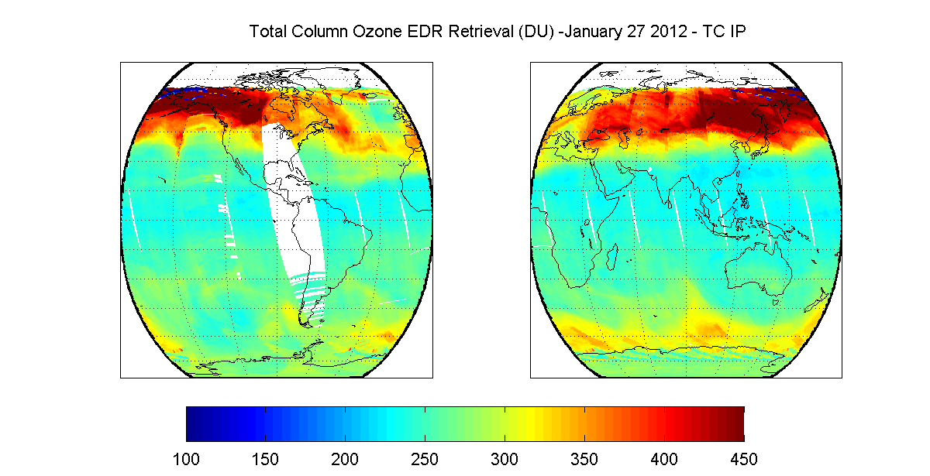
OMPS TC IP Retrieval – January 27, 2012
OMPS TC IP ozone values are plotted between 100 and 450 DU. Data as available on January 27. There are values outside of this range that need to be investigated. (M Novicki and B Sen, NGAS)

Slide 42
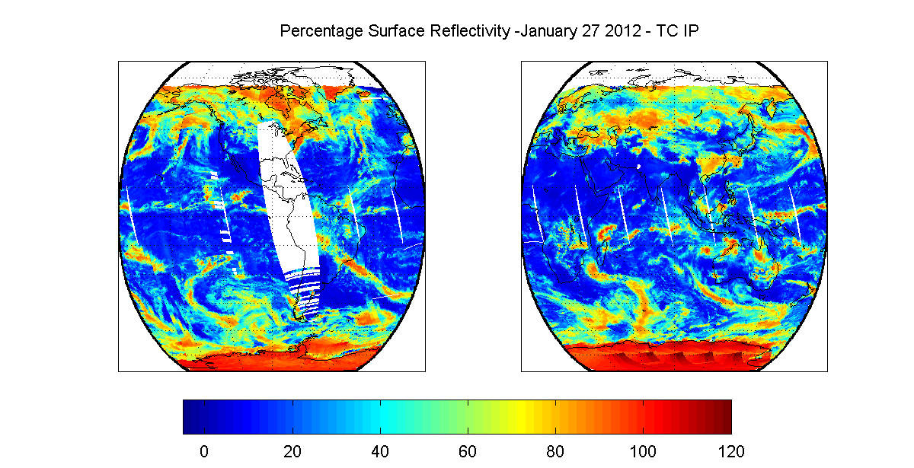
OMPS TC Surface Reflectivity – January 27, 2012
Surface reflectivity values between -5% and 120% are allowed by the OMPS TC EDR operational algorithm. Investigating ≈120% surface reflectivity values at high SZAs over Antarctic, southern Greenland and Hudson Bay. (M Novicki and B Sen, NGAS)

Slide 43
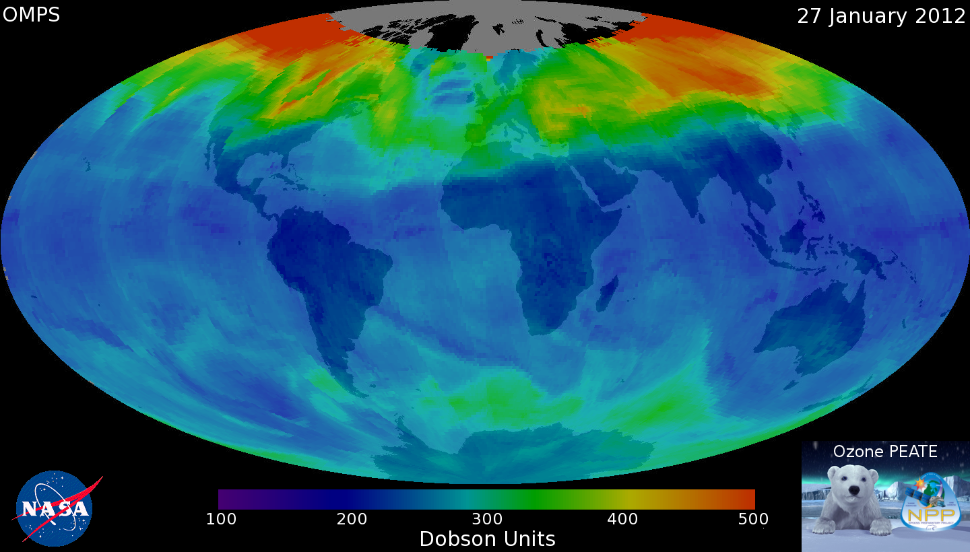
V8.6 Ozone Retrieval from NASA Ozone PEATE
Seftor NASA/GSFC SSAI

Slide 44
Backup

Slide 45
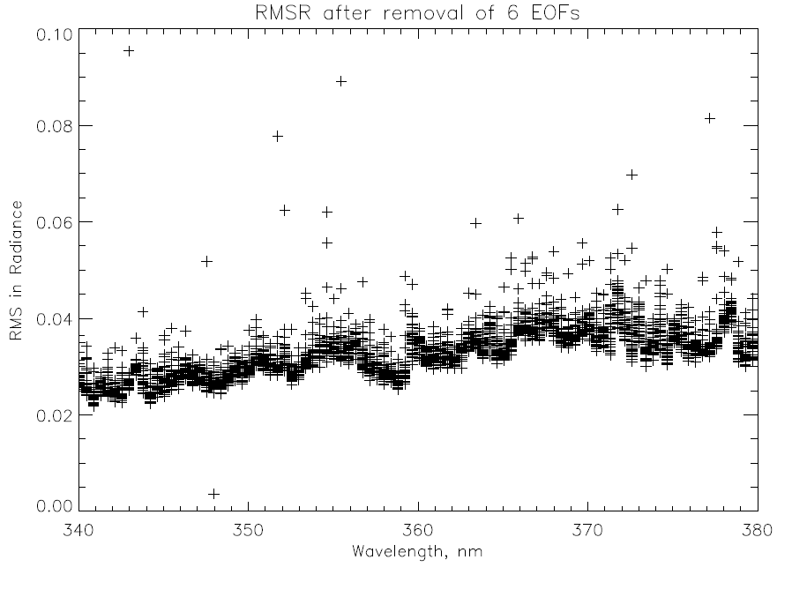
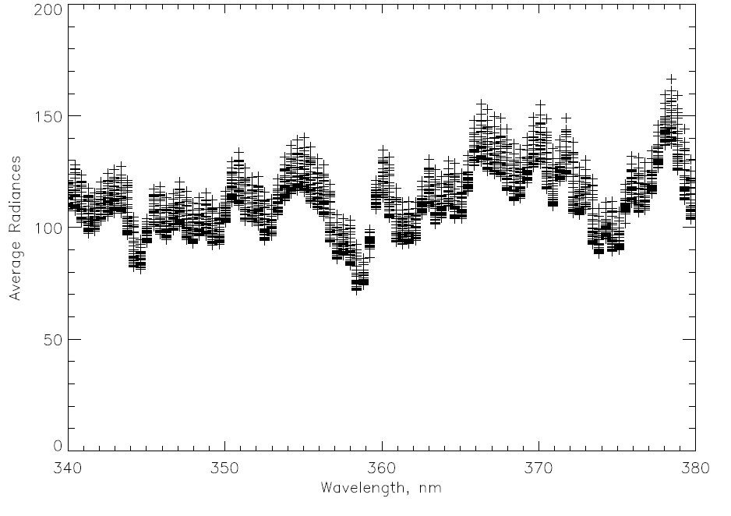
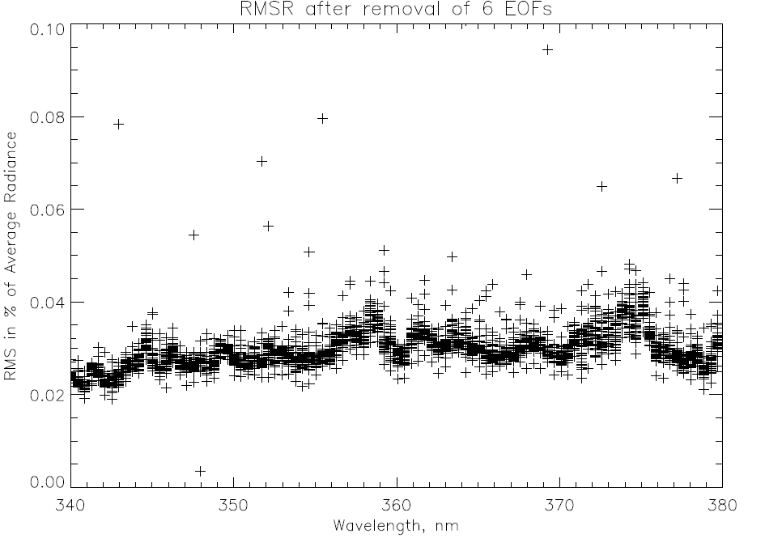
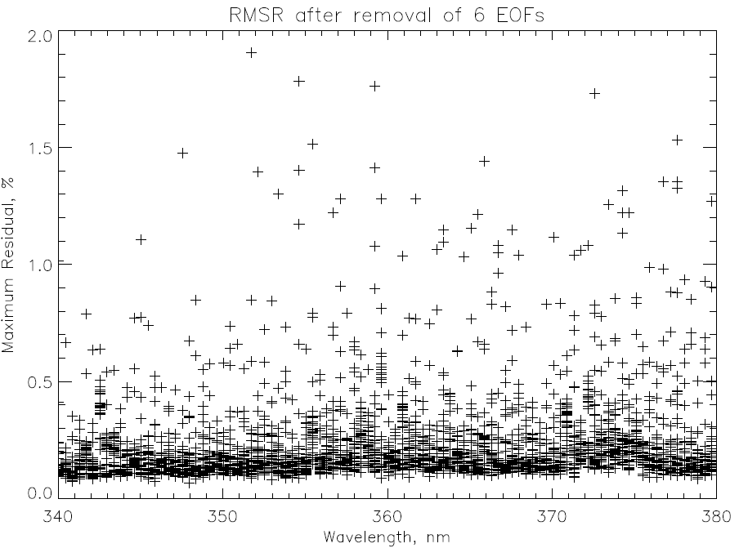
EOF/SNR analysis for six orbits OMPS NM on 1/28/2012

Slide 46
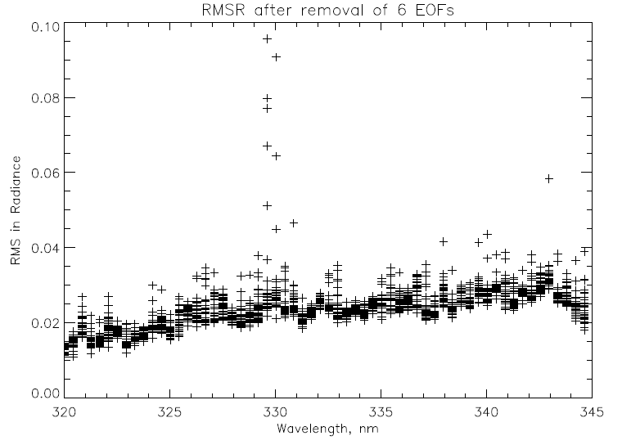
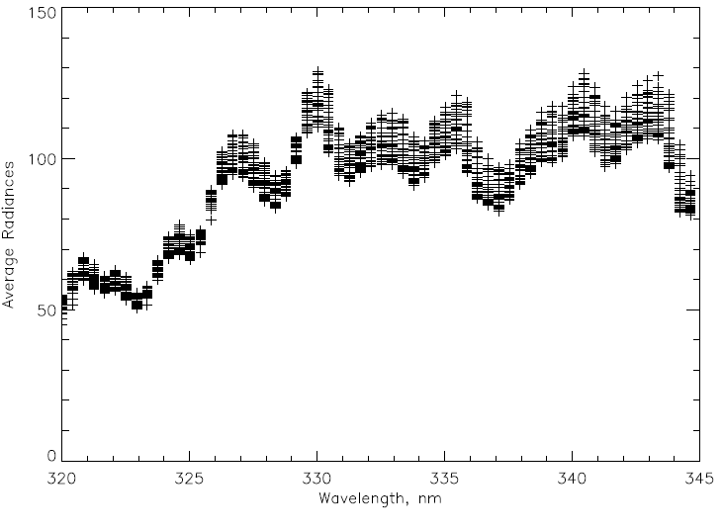
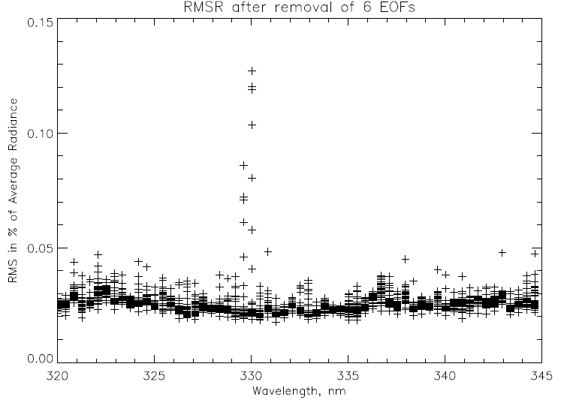
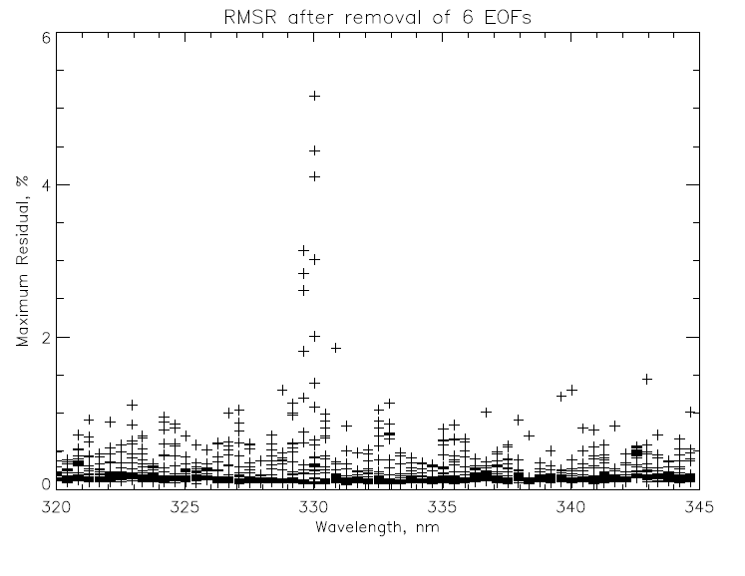
EOF/SNR analysis for six orbits OMPS NM on 1/28/2012

Slide 47
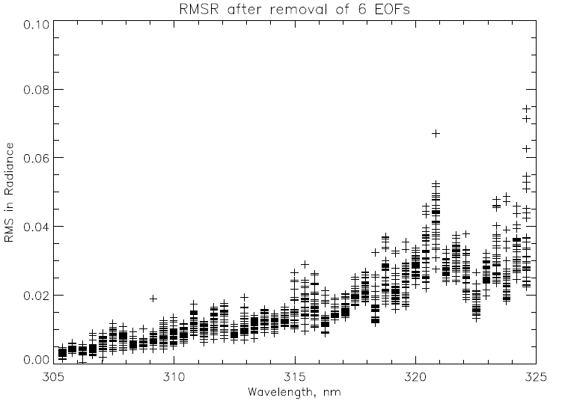
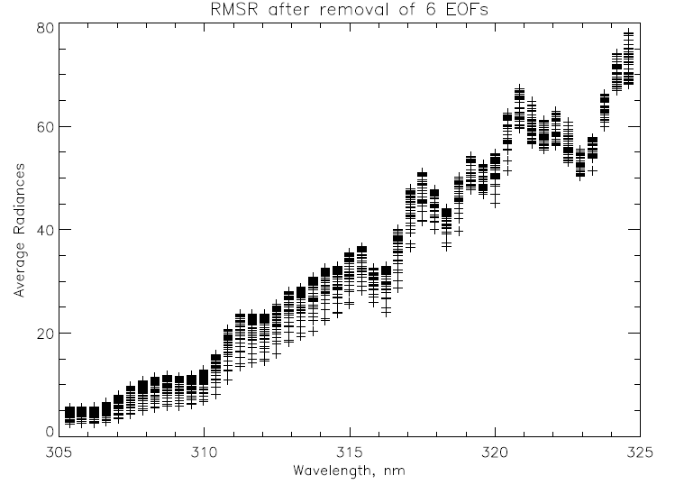
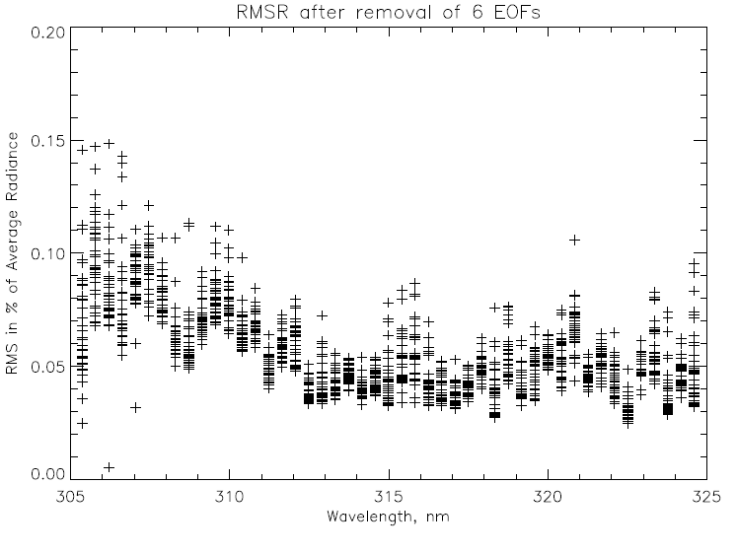
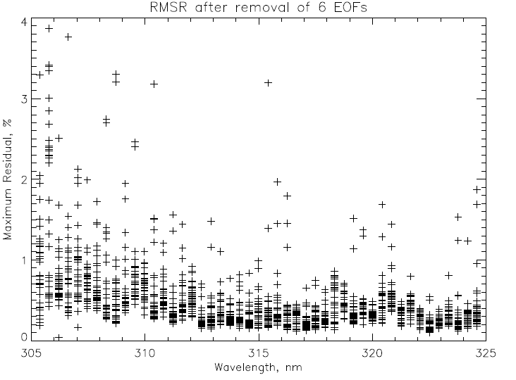
EOF/SNR analysis for six orbits OMPS NM on 1/28/2012

Slide 48
OMPS | RDR
OMPS | SDR - Ozone TC Cal/EV | Science team rewriting code to sever ties between SD and EV components of code, and that will not be done before Build Mx1.6 freeze date | DO + 1m Mar 12 | DO + 12m Feb 13 | DO + 15m May 13
OMPS | SDR - Ozone NP Cal/EV | No issues | DO + 1m Mar 12 | DO + 12m Feb 13 | DO + 15m May 13
OMPS | SDR - Ozone TC Geo | No issues | DO + 1m Mar 12 | DO + 3m May 12 | DO + 6m Aug 12
OMPS | SDR - Ozone NP Geo | No issues | DO + 1m Mar 12 | DO + 3m May 12 | DO + 6m Aug 12
OMPS | EDR - Ozone TC | Post-launch verification required; anticipate the need for post-launch adaptation of the TOMS-EP Version 8 algorithm to OMPS TC to satisfy JPSS L1RD accuracy and precision requirements | DO + 2m Apr 12 | DO + 6m Aug 12 | DO + 8m Oct 12 | DO + 10m Dec 12 | DO + 15m May 13
OMPS | EDR(IP) - Ozone NP | No heritage performance requirements; post-launch verification of operability required and anticipate the need for post-launch adaptation of the SBUV/2 Version 8 algorithm to OMPS NP to satisfy JPSS L1RD accuracy and precision requirements | DO + 2m Apr 12 | DO + 6m Aug 12 | DO + 8m Oct 12 | DO + 10m Dec 12 | DO + 15m May 13
OMPS | X-Sensor Mapping - VIIRS to OMPS | No issues
OMPS | X-Sensor Mapping - CrIMSS to OMPS | No issues
C
C
C
C
C
C
C
C
C
C
C
C
C
C
C
C
C
C
C
C
C
C
C
C
C
C
C
C
C
C
C
C
C
C
C
C
C
C
C
C
C
C
C
C
C
C
C
C
C
C
C
C
C
C
C
C

