Slide 1
Request for
VIIRS Ice Surface Temperature EDR
Provisional Maturity
Provisional Effectivity Date: 15 October 2012 (MX 6.4)
Cryosphere Products Validation Team
Jeff Key, NOAA/NESDIS/STAR, Team Lead
Paul Meade, Cryosphere Products JAM
22 August 2013

Slide 2
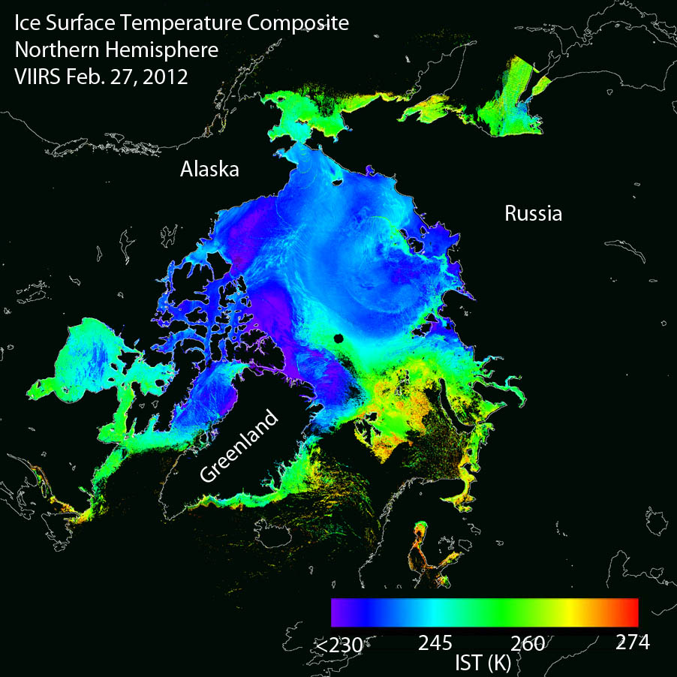
VIIRS Ice Surface Temperature

Slide 3
Outline
VIIRS IST EDR Users
Provisional EDR Maturity Definition
Summary of IST EDR
VIIRS IST EDR requirements
History of Algorithm Changes/Updates
Provisional Maturity Evaluation
Provisional Justification Summary
Caveats of Operational VIIRS IST EDR
Conclusions

Slide 4
VIIRS IST EDR Product Users
  U.S. Users
    NIC, National/Naval Ice Center
    Naval Research Laboratory
    OSPO, Office of Satellite and Product Operations
    STAR, Center for Satellite Applications and Research
    University of Washington, Polar Science Center
    GSFC, NASA/Goddard Space Flight Center Hydrological Sciences Branch
    NWS, National Weather Service, including the Alaska Ice Desk
    CLASS, Comprehensive Large Array-data Stewardship System
  User Community
    Navigation
    Emergency Management
    Operational Weather Prediction
    Climate Research
    DOD

Slide 5
Provisional EDR Maturity Definition
Product quality may not be optimal
Incremental product improvements are still occurring
Version control is in affect
General research community is encouraged to participate in the QA and validation of the product, but need to be aware that product validation and QA are ongoing
Users are urged to consult the EDR product status document prior to use of the data in publications
Ready for operational evaluation

Slide 6
Summary of the VIIRS IST EDR
The VIIRS Ice Surface Temperature (IST) EDR provides surface temperatures retrieved at VIIRS moderate resolution, for snow/ice covered oceans for both day and night.
The baseline split window algorithm statistical regression method uses two VIIRS Infrared bands, 10.76 μm (M15) and 12.01 μm (M16) for both day and night and is based on the Advanced Very High Resolution Radiometer (AVHRR) heritage IST algorithm (Yu et al., 1995).
IST EDR performance is dependent upon on the quality of the input SDR brightness temperatures, VIIRS Cloud Mask IP cloud confidence, Ice Concentration IP, Aerosol Optical Thickness IP and regression coefficients derived from matchups between the VIIRS M15 and M16 top of atmosphere (TOA) brightness temperatures and truth surface temperature sources for snow/ice covered ocean surfaces

Slide 7
Summary of the VIIRS IST EDR
Algorithm Inputs
NPPxDRs & IPs
VIIRS_ST_04
VIIRS 750m SDR
VIIRS 750m TC GEO
VIIRS Cloud Mask IP
VIIRS Ice Concentration IP
VIIRS Aerosol Optical Thickness IP
Ice Surface Temperature
Auxiliary Data
VIIRS IST Tunable parameters
VIIRS IST Regression Coefficient LUT
Output EDRs & IPs
VIIRS Ice Surface Temp. EDR
Notes:
Ancillary
GFS forecast surface pressure, lapse rate, and air temperature (for topography corrected surface pressure)
Look-up tables
DEM for surface altitude
Infrared and Microwave OSS coefficients
Local Angle Correction
IR emissivity and reflectivity covariance
MW emissivity covariance
AVTP and AVMP and Ozone covariance

Slide 8
Summary of VIIRS IST EDR
Processing Flow
For each pixel
Determine Pixel Quality
and set flags
next
pixel
T
No retrieval quality check
set IST EDR to FILL
IST split window retrieval
determine day or night mode
IST split window regression
T
IST split window if BT15 valid range
F
IST single band retrieval
determine day or night mode
IST single band regression
Check for invalid IST value range
T
set IST EDR to FILL
F
next
pixel

Slide 9
VIIRS IST EDR L1RD Requirements
Ice Surface Temperature (IST)
“IST is the radiating, or "skin", temperature at the ice surface. It includes the aggregate temperature of objects comprising the ice surface, including snow and melt water on the ice. Inland water bodies and coastal ice temperatures will be obtained from the LST EDR.
As an objective, the Ice Surface Temperature EDR shall measure the atmospheric temperature 2 m above the surface of the ice.
9

Slide 10
VIIRS IST EDR L1RD Requirements (Continued)
Ice Surface Temperature (IST) Requirements from L1RD Supplement. V2.9 (27 June 2013)
EDR Attribute | Threshold | Objective
IST Applicable Conditions 1. Clear, only
a. Sensing Depth | Ice Surface | Ice Surface
b. Horizontal Cell Size Nadir Worst Case | 1 km 1.6 km | 0.1 km 0.1 km
c. Mapping Uncertainty, 3 sigma Nadir Worst Case | 1 km 1.6 km | 0.1 km 0.1 km
d. Measure Range | 213-275 K | 213-293 K (2 m above ice)
e. Measurement Uncertainty | 1 K
f. Refresh | At least 90% coverage of the global every 24 hours (monthly average) | 12 hrs
g. Geographic Coverage | Ice-covered oceans | All ice-covered waters
RGB Image shows dense smoke (high absorption) in northwest, north central and central coastal portions of image.
10

Slide 11
Status of Upstream Products
  IST EDR performance is dependent on VIIRS SDR, VIIRS Cloud Mask IP, Ice Concentration IP, Aerosol Optical Thickness IP and IST Regression Coefficients
  VIIRS SDR Cal and Geo products reached provisional maturity in March, 2013.
  VIIRS Cloud Mask IP reached provisional maturity in February, 2013
  VIIRS Aerosol Optical Thickness reached beta maturity in September 2012 and provisional in March 2013
  VIIRS Ice Concentration IP reached beta maturity in March 2013.

Slide 12
Provisional Maturity Evaluation
Provisional Maturity Evaluation Approaches
  Visualizations and quantitative comparisons of daily global gridded VIIRS IST, comparison with MODIS IST and NCEP surface air temperature, Ice Bridge flight IST
  Time series analysis and bias analysis
    NH analysis dates: 1/29/2012, 2/1/2012, 3/14/2012
    SH analysis dates: 4/10/2012
    Beaufort Sea analysis dates: 3/14/2012 (IceBridge), 2/12/2012, 2/25/2012, 2/26/2012, 3/30/2012
    Terra Nova Bay analysis dates: 2/12/2012, 2/25/2012, 2/26/2012, 3/30/2012

Slide 13
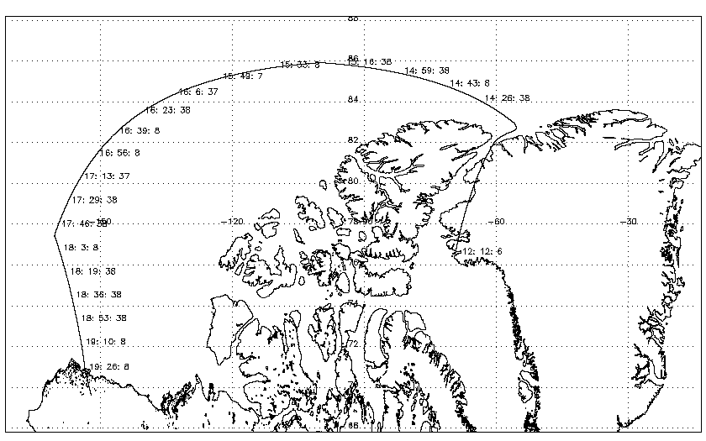
Provisional Maturity Evaluation – Comparison VIIRS IST EDR with IceBridge Flight IST
Track of the NASA P-3 aircraft for the March 14, 2012 IceBridge flight. UTC times are shown along the track. The P-3 flew at an altitude of 1000 ft over the sea ice. Among several instruments, it carried a KT-19: a downward-pointing, IR pyrometer that measures the surface temperature (in this case, the IST).

Slide 14
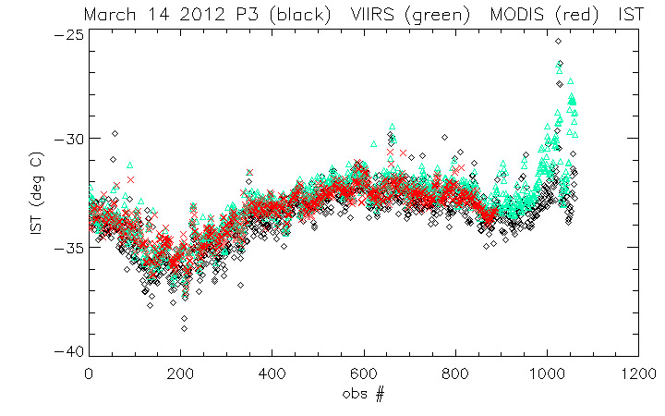
Provisional Maturity Evaluation – Comparison VIIRS IST EDR with IceBridge Flight IST
NASA's Land PEATE re-processed portions of the VIIRS IST EDR that are co-incident with IceBridge flights over sea ice during March and April 2012. The resulting VIIRS IST EDR shows much better agreement with the ice surface temperature observed by the IceBridge P-3 aircraft ‘s KT-19 instrument than the previous IST EDR data produced in March 2012.
A comparison of IST measured by the NASA P-3 aircraft's KT-19 instrument (J. Yungel, PI) and the VIIRS IST EDR
mean VIIRS = -33.2 ˚C
mean KT-19 = -33.7 ˚C
mean MODIS = -33.4 ˚C
RMS differences:
VIIRS - KT-19 = 0.6 ˚C
MODIS- KT-19 = 1.2 ˚C
VIIRS – MODIS = 1.1 ˚C
Comparison between the IST (in deg C) measured by the KT-19 (in black, smoothed over 100 points), the nearest VIIRS IST measurement (in green) and MODIS observation (red). The comparison is for the leg from 16:03:37 -19:10:08 (west of -120 lon). The VIIRS overpass occurred from 16:01 - 16:06 UTC . VIIRS, MODIS, and the KT-19 IST's show consistent good agreement along the flight track, with VIIRS close to meeting the 0.5 ˚C (or K) spec.

Slide 15
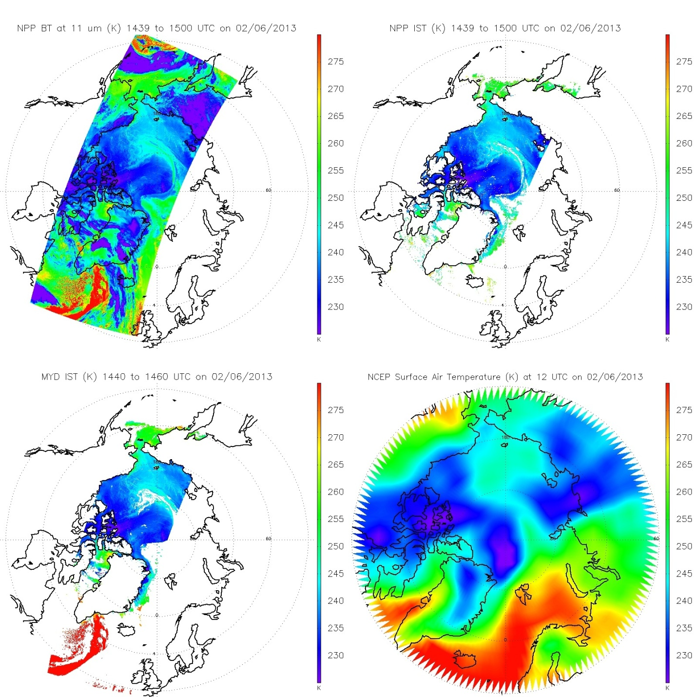
Provisional Maturity Evaluation – Comparison VIIRS IST with MODIS and NCEP
VIIRS BT(11)
VIIRS IST
Ice Surface Temperature (IST) EDR validation activities have shown that VIIRS IST has a 1-2 K cold bias relative to the MODIS Ice Surface Temperature product. The bias for VIIRS Land Surface Temperature over the ice sheet (not shown) is less than for IST.
Comparisons to NCEP and International Arctic Buoy Program (IABP) air temperatures show a similar spatial pattern but yield a VIIRS warm bias of 1 K or more, which is the opposite of the MODIS comparison. The comparison confirms the validity of the MODIS IST.
MODIS IST
NCEP Ts
Notes:
Figure: NPP VIIRS 11 micron Brightness Temperature (upper left), and ice surface temperature from NPP VIIRS EDR (upper right) and MODIS Aqua products (lower left), and NCEP surface air temperature (lower right) on February 6, 2013.

Slide 16
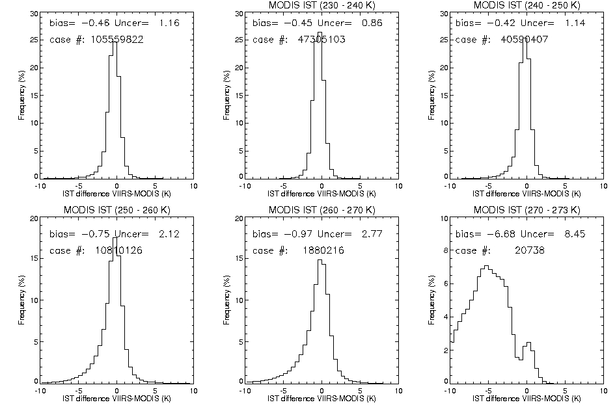
Provisional Maturity Evaluation –
VIIRS IST vs MODIS IST
VIIRS is biased low (too cold) relative to MODIS, though the bias is relatively small for most of the temperature range.
Of greater concern is the uncertainty, which is large at higher temperatures.
Histogram of ice surface temperature differences of NPP VIIRS and MODIS (Aqua and Terra) in February 2013 in the Arctic for all cases (upper left), and for cases with MODIS ice surface temperature in the ranges 230-240 K, 240-250 K, 250-260 K, 260-270 K, and 270- 273 K. Measurement bias (bias) and measurement uncertainty (Prec) are indicated for each bin.

Slide 17
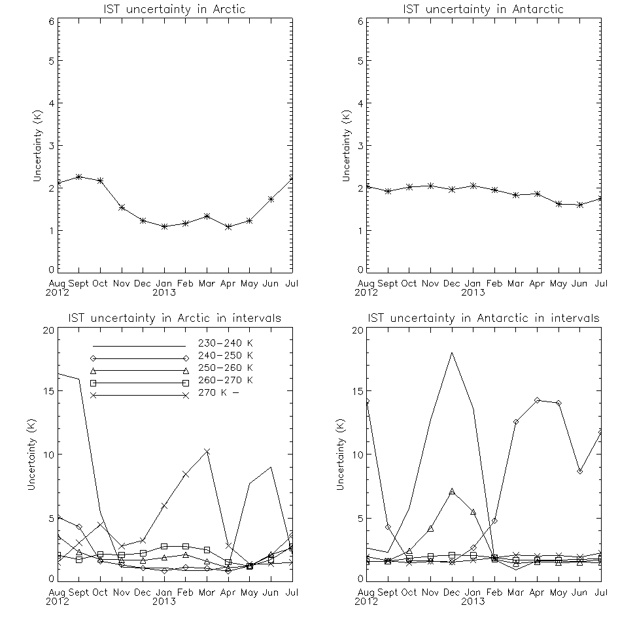
Provisional Maturity Evaluation –
VIIRS IST vs MODIS IST
Uncertainties of VIIRS ice surface temperature (IST) based on collocated VIIRS and MODIS (Terra and Aqua) from August 2012 to July 2013 for all cases in the Arctic (upper left), for all cases in the Antarctic (upper right), for cases in different MODIS IST intervals in the Arctic (lower left), and in the Antarctic (lower right).

Slide 18
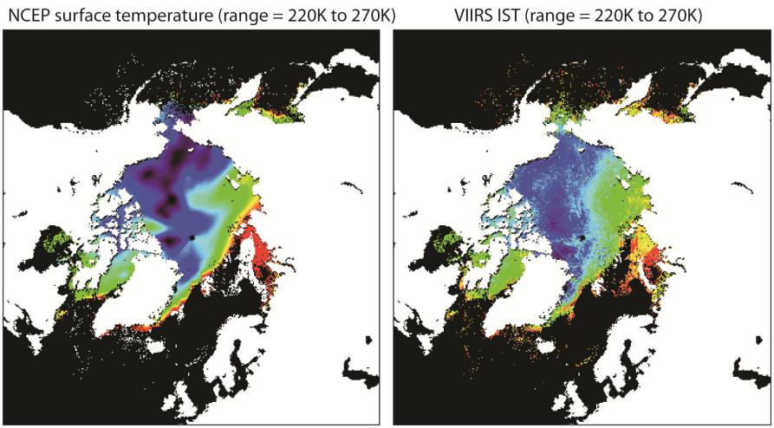
Provisional Maturity Evaluation – NH comparison
NCEP vs. VIIRS IST, Feb 27, 2012. Spatial patterns appear consistent.

Slide 19
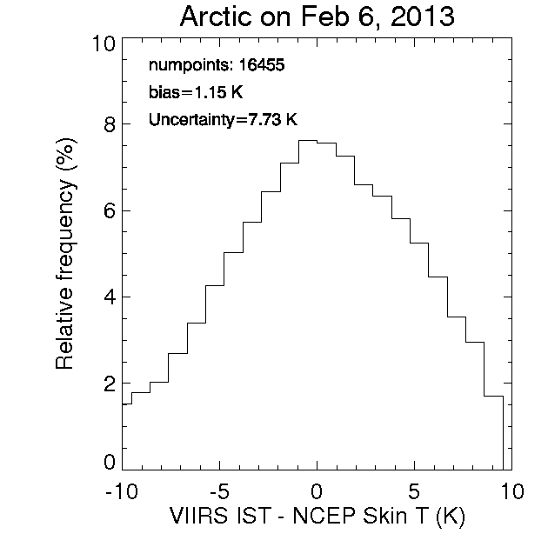
Provisional Maturity Evaluation – global comparison
VIIRS is biased high (warm) compared to NCEP reanalysis. However, the NCEP skin temperature used in this analysis is a forecast, not an analysis. This result is the opposite of the MODIS & IceBridge results.

Slide 20
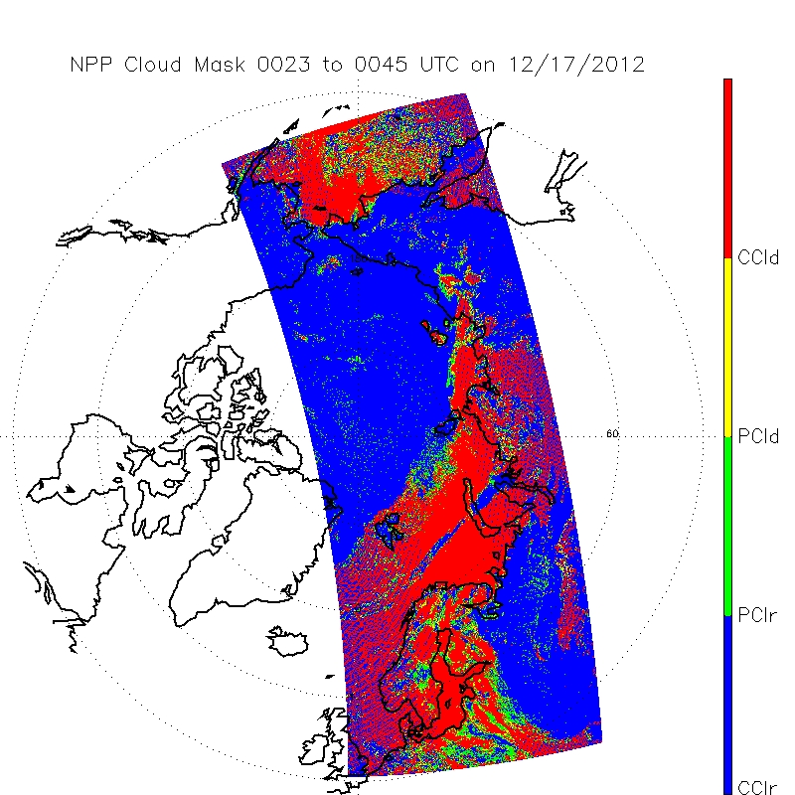
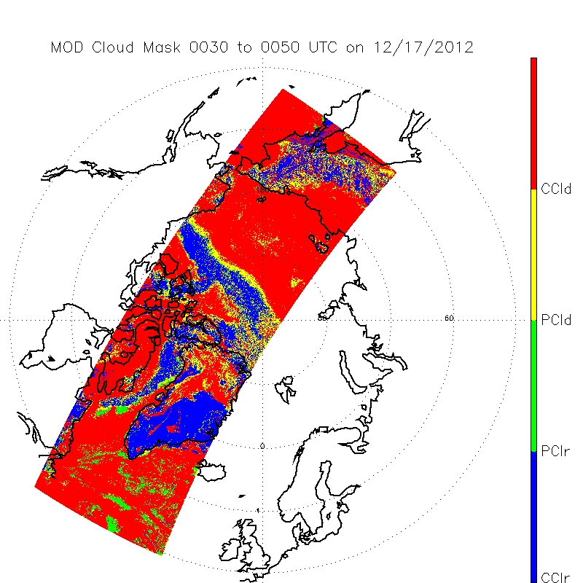
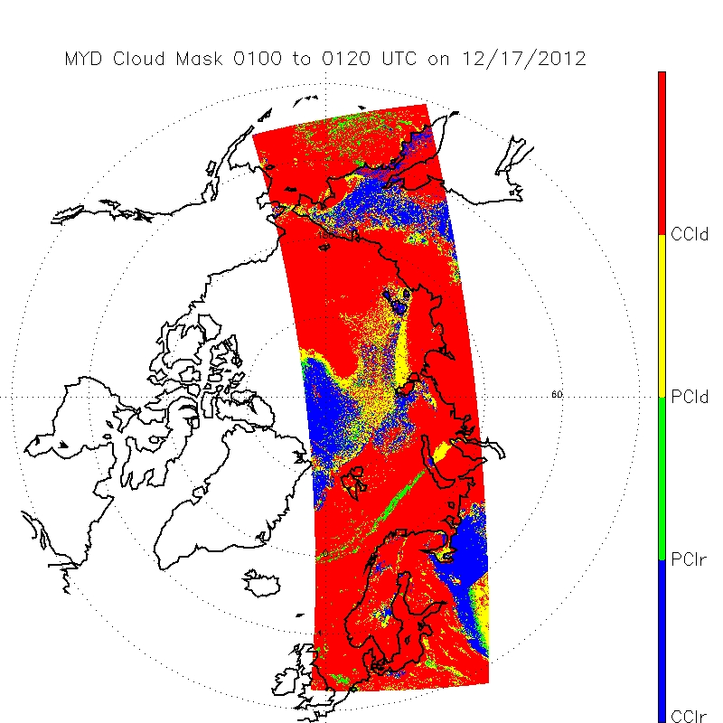
Provisional Maturity Evaluation –
Cloud Mask Impacts
Terra MODIS
Day/night boundary
(dashed green)
VCM
Region of discrepancy
Ice/No Ice boundary from snow/ice rolling tiles (IVSIC, dotted green)
Aqua MODIS
The VIIRS Cloud Mask (VCM) continues to exhibit problems in the polar regions, which can significantly impact the snow and ice products. The figure above illustrates significant differences between daytime and nighttime, as well as discontinuities along ice/no-ice boundaries.

Slide 21
Discrepancy Reports (DRs)
Date | Update/DR# | Reason | Status
04-17-2013 | 7138 | IST EDR OAD Corrections | open
04-17-2013 | 7137 | IST EDR ATBD Section 2.3 Wording Error Correction | open
11-18-2011 | 4457 | EDR PR to define mid quality criteria | open
11-18-2011 | 4456 | EDR PR update to Define the exclusion criteria for quality summations | open
11-18-2011 | 4455 | Update EDR PR to define high quality retrievals | open
12-22-2010 | 4136 | ECR A-337 Dec 10 Look Up Table drop | request closure
07-17-2009 | 2936 | Ice Surface Temp and IST use different emissivities for ice | Plan in place (next slide)

Slide 22
Path Forward Recommendation for DR 2936
Comparison of IST and Surface Temperature IP (ST IP) regression coefficients indicate that the IST coefficients currently implemented on the IDPS system are valid. However, inspection has revealed the ST IP split window coefficient value associated with view zenith angle dependence was erroneously set to 0.
The review also uncovered a sign error in the ATBD equation (second line from the top, page 34). However, the code implementation is correct.
Proposed path forward actions
Deliver updated STIP coefficients to close out DR 2936
Open DR to correct the IST ATBD equation appearing in the ATBD. The Equation should be t11 = tI + (1-f)D instead of t11 = tI - (1-f)D

Slide 23
Data Quality Threshold Tables (DQTT)
Synthesizing from the EDR PR, the CDFCB-X Vol. VI, and the IST DQTT XML file:
There are three Data Quality Flags that are linked to potential Data Quality Notifications (DQNs):
  EDR Summary Quality - The percentage of pixels within a granule with a high retrieval quality
  Exclusion Summary - The percentage of pixels within a granule with excluded conditions
  Summary Range Check - The percentage of retrieved pixels outside of the expected range (213 K to 275 K)
For each of these, the current Data Quality Threshold Table (DQTT) specifies that a DQN will occur if (and only if) the percentage in question is less than 0% AND that this has occurred a minimum of 80 times. Furthermore, the DQN "severity" in each case (if one is issued) is "Normal" (i.e., not severe).
The DQTT specifies that each of the three DQN is currently OFF (the <active> tag is "false").
This appears to be just a placeholder DQTT, as none of these can be triggered as currently specified. Therefore, the Cryosphere Team needs to develop either an internal (Cal/Val team only) or cooperative (Cal/Val team plus Raytheon OAA?) plan to define appropriate DQTTs. After doing so, we will perform analysis using two days of orbits (Dec. 17-18, 2012) to determine appropriate DQN thresholds for the three flags.
Notes:
Even if turned on, the "EDR Summary Quality" DQN would never by triggered because you are never going to have less than zero percent of the pixels retrieved with high quality. It would also be impossible to trigger the "Exclusion Summary" DQN, because it would be hard to have less than zero excluded pixels. In fact, you would want the condition for that DQN to be a Greater Than condition, because I would think that having a high percentage of excluded pixels would be an issue, not having a low percentage of excluded pixels. Similarly the "Summary Range Check" DQN - it cannot be triggered right now, even if turned on, because it's impossible to achieve the less-than-zero-percent condition, and it would seem more important to flag Greater Than some percentage of pixels out-of-range rather than Less Than some percentage of pixels out of range.

Slide 24
Provisional Justification Summary
Product quality may not be optimal
The product meets accuracy requirements under some, but not all, conditions.
  Evaluation is based on a limited number of focus days (global comparisons for retrieval products)
The product has known flaws, but these products are of sufficient quality to justify use by a broader community.
IST EDR contains retrievals over false ice retrieved by the VIIRS Sea Ice Concentration IP. Some false ice retrieved by the VIIRS Sea Ice Concentration IP has been linked to cloud leakage from a VIIRS Cloud Mask (VCM).
Incremental product improvements are still occurring
  IST EDR surface temperature performance bias exists but is expected to improve with updated regression coefficients. The bias has been observed to be reduced with more recent IDPS code, primarily due to improvements in the VCM.
  While the performance of the VCM Cloud Confidence for day continues to improve with VCM tuning, improved performance for night will be dependent on the implementation of daily NOAA Multi-sensor Snow/Ice rolling tile updates and further tuning efforts. IST EDR performance is expected to benefit from improvements to resolve the current VCM bias toward over-prediction of confidently clear regions at night in polar regions.

Slide 25
Provisional Justification Summary
Version control is in affect
(Description of the development environment, algorithm version (IDPS build number), and LUTs/PCTs versions used to generate the product validation materials.)
ATBDs are accurate, up-to-date and consistent with the product running.
General research community is encouraged to participate in the QA and validation of the product, but need to be aware that product validation and QA are ongoing
  Cryosphere IST EDR team has evaluated IDPS EDR products available from CLASS. Users can access and read the products and the product compares reasonably with the heritage satellite snow map products

Slide 26
Provisional Justification Summary
Users are urged to consult the EDR product status document prior to use of the data in publications
Examination of the VIIRS IST EDR shows temperature over false ice retrieved by the Sea Ice Concentration IP. Such errors will be reduced with MX 8.0 VIIRS Cloud Mask update and implementation additional quality checks in the Sea Ice Concentration IP for future builds beyond MX 8.0
Current IST bias should be reduced with updated IST regression coefficients based on matchup of VIIRS M15, M16 TOA brightness temperatures with surface temperature truth. Evidence of lower bias has been shown with IceBridge IST comparisons.
Ready for operational evaluation
(Key NOAA and non-NOAA end users are identified and feedback requested.)

Slide 27
Additional Supporting Documentation
TIM Meetings and Presentations
  Cal/Val Team Meeting, April 2012
Monthly/weekly reports https://groups.ssec.wisc.edu/groups/jpss/cryosphere/reports

Slide 28
Future Plans and Issues
No code changes currently planned
Detailed performance characterization requires:
  Update of IST regression coefficients based on matchup with VIIRS and truth IST sources
  Improvements, consistency, and stability in the VIIRS cloud mask
Other actions:
  Ability to check for reduced quality VIIRS Ice Concentration IP input based on quality flags with additional quality checks to be added to the Ice Concentration IP

Slide 29
Conclusion
VIIRS IST EDR has met the provisional maturity stage based on the definitions and the evidence shown
  It exceeds the definition of provisional in most cases
  Off-line EDR product performance overall is close to meeting requirements at this time and meets requirements in some cases. It continues to improve.
Some issues have been uncovered during validation and solutions are being evaluated.
  Improvements in IST EDR performance may be realized as the VIIRS Cloud Mask IP matures and additional quality flags become available in the VIIRS Ice Concentration IP to avoid IST retrievals near clouds.
The provisional effectivity date is 15 October 2012 (MX 6.4). VIIRS Cloud Mask IP improvements in this build notably improved product performance.

