Slide 1
Suomi NPP SDR Product Review
CrIMSS EDR Team
Christopher Barnet
CrIMSS EDR Lead
Oct. 23, 2012

Slide 2
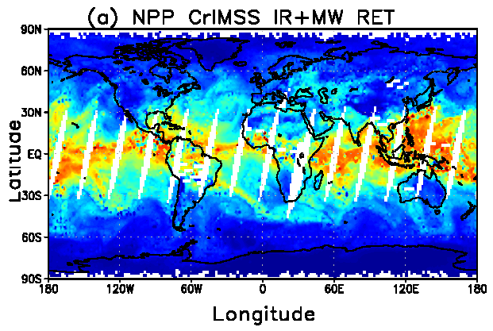
Overview of CrIMSS EDR Products
Atmospheric Vertical Moisture Profile (AVMP).
Used for initialization of high-resolution NWP models, atmospheric stability, etc.
Lower tropospheric moisture layers are Key Performance Parameters (KPPs) .
Parameter (KPP in Blue) | IORD-II, JPSS-L1RD
AVMP Partly Cloudy, surface to 600 mb | Greater of 20% or 0.2 g/kg
AVMP Partly Cloudy, 600 to 300 mb | Greater of 35% or 0.1 g/kg
AVMP Partly Cloudy, 300 to 100 mb | Greater of 35% or 0.1 g/kg
AVMP Cloudy, surface to 600 mb | Greater of 20% of 0.2 g/kg
AVMP Cloudy, 600 mb to 300 mb | Greater of 40% or 0.1 g/kg
AVMP Cloudy, 300 mb to 100 mb | Greater of 40% or 0.1 g/kg
Example of AVMP (shown as total precipitable water) on May 15, 2012 from the CrIMSS off-line EDR
Results are from the coupled algorithm without QC
RGB Image shows dense smoke (high absorption) in northwest, north central and central coastal portions of image.
Goto: outline, p.2
2

Slide 3
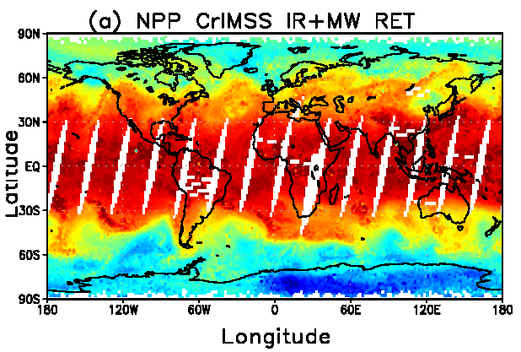
Overview of CrIMSS EDR Products
Atmospheric Vertical Temperature Profile (AVTP).
Used for initialization of high-resolution NWP models, atmospheric stability, etc.
Lower tropospheric temperature are KPPs.
Parameter (KPP in Blue) | IORD-II, JPSS-L1RD
AVTP Partly Cloudy, surface - 300 mb | 1.6 K/1-km layer
AVTP Partly Cloudy, 300 to 30 mb | 1.5 K/3-km layer
AVTP Partly Cloudy, 30 mb to 1 mb | 1.5 K/5-km layer
AVTP Partly Cloudy, 1 mb to 0.5 mb | 3.5 K/5-km layer
AVTP Cloudy, surface to 700 mb | 2.5 K/1-km layer
AVTP Cloudy, 700 mb to 300 mb | 1.5 K/1-km layer
AVTP Cloudy, 300 mb to 30 mb | 1.5 K/3-km layer
AVTP Cloudy, 30 mb to 1 mb | 1.5 K/5-km layer
AVTP Cloudy, 1 mb to 0.05 mb | 3.5 K/5-km layer
Example of AVTP at 500 hPa on May 15, 2012 from the CrIMSS off-line EDR
Results are from the coupled algorithm without QC
RGB Image shows dense smoke (high absorption) in northwest, north central and central coastal portions of image.
3

Slide 4
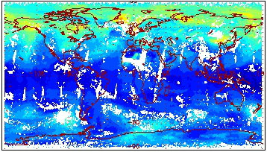
Overview of CrIMSS EDR Products
Pressure product is a EDR derived product that requires validation.
Ozone is an intermediate product (IP) used by the OMPS team.
CO, CH4 and CO2 are pre-planned product improvements(P³I)
  SOAT has recommended full-resolution RDR’s for CrIS SW and MW bands to support these products..
Example of NUCAPS total column ozone product (day+night) from CrIS for May 15, 2012.
Parameter (P³I in Blue) | IORD-II / JPSS-L1RD
Pressure Profile | 4 mb threshold, 2 mb goal
Ozone IP | 20% precision for ~5 km layers from 4 hPa to 260 hPa
CH4 (methane) column | 1% ± 5% / 1% ± 4% (precison ± accuracy)
CO (carbon monoxide) column | 3% ± 5% / 35% ± 25% (precision ± accuracy)
RGB Image shows dense smoke (high absorption) in northwest, north central and central coastal portions of image.

Slide 5
CrIS/ATMS EDR products
CrIMSS EDR: NOAA STAR is responsible for algorithm and validation support to the JPSS program for the operational CrIMSS EDR for Atmospheric Vertical Temperature Profile (AVTP), Moisture Profile (AVMP) and Pressure Profile (AVPP) products.
  This system has new forward model and new retrieval methodology.
NUCAPS EDR: The NOAA Data Exploitation (NDE) program supports the implementation of the NOAA-Unique CrIS/ATMS System (NUCAPS) .
  NUCAPS uses heritage forward models (SARTA/MIT) and retrieval code has been used operationally for 9+ years for AIRS/AMSU and 3+ years for the NOAA-IASI/AMSU/MHS instruments.
Both system utilize cloud clearing on a CrIMSS field of regard
  CrIMSS field of regard is defined by the group of 9 CrIS field of views
  Resampled ~25 ATMS field of views to the CrIMSS field of regard

Slide 6
Comparison of
CrIMSS and NUCAPS EDRs
 | CrIMSS-EDR | NUCAPS-EDR
Methodology | Simultaneous Optimal Estimation | Sequential Singular Value Decomposition
Channels used | All, except non-LTE CrIS in daytime | Selected subsets of CrIS, all ATMS
ATMS Spatial | Use remap-SDR | Use TDR and perform spatial averaging (currently 3x3 average, later B-G)
Clouds | Cloud clearing, 3-cluster approach | Cloud clearing, 9-FOV approach
Forward model | OSS for both IR and MW | Sarta for IR, MIT for MW
Apodization | Blackman-Harris | Hamming
Regularization | T/q/O3/ε covariance matrices | dR/dX for state parameters held constant + smoothing
EDRs IPs RIPs | AVTP, AVMP, AVPP O3-IP RIPs: SST, LST, emissivity | AVTP, AVMP, z(p), CCR, O3, CO, CO2, CH4, HNO3, SO2, N2O, SST, LST, emissivity, cloud fraction and pressures, convective parameters
Format | 42, 1-km AVTP layers 22, 2-km AVMP layers | All profiles on 100 levels (~0.025 km) Full state (can compute radiances).
Maturity Schedule | Beta: July 2012 Provisional: Dec. 2012 Stage.1 Validated: June 2013 Stage.2 Validated: Dec. 2013 | Beta: Apr. 2012 (internal only) Provisional: July 2012 (internal only) Stage.1 Validated: Feb. 2013 Stage.2 Validated: Apr. 2014

Slide 7
Overview of CrIMSS EDR Products
CrIS RDR
CrIS SDR
Apodization
CrIMSS EDR Processing Code
ATMS RDR
ATMS TDR
Remap SDR
ATMS SDR
GFS
Ancillary
Look-up Tables
CrIS Blackman-Harris apodized radiances and ATMS spatially convolved (i.e., Backus Gilbert) radiances are used to produce CrIMSS EDR products.
Configurable Parameters
Notes:
Ancillary
GFS forecast surface pressure, lapse rate, and air temperature (for topography corrected surface pressure)
Look-up tables
DEM for surface altitude
Infrared and Microwave OSS coefficients
Local Angle Correction
IR emissivity and reflectivity covariance
MW emissivity covariance
AVTP and AVMP and Ozone covariance

Slide 8
Overview of CrIMSS EDR Products
Preprocessed CrIS, ATMS, GFS
Initialization
Preprocessing
ATMS R’s Available?
No
NWP First Guess
Next FOR
Yes
No
2-stage ATMS-only Retrieval
Yes
All FOV finished?
EDR Post Processing
42L AVTP, 22L AVMP
100L IP
No
CrIS R’s Available?
Quality Control
Yes
ATMS + CrIS retrieval
.or.
NWP + CrIS retrieval
Scene Classification
100L IP

Slide 9
Simplified Flow Diagram of the
AIRS Science Team Algorithm
Climatological First Guess for all products
IR Physical T_{s}, ε(ν), ρ(ν)
IR Physical CO(p)
Microwave Physical for T(p), q(p), LIQ(p), ε(f)
IR Physical HNO₃(p)
IR Physical T(p)
IR Physical CH₄(p)
IR Physical q(p)
Initial Cloud Clearing, η_{j}, R_{ccr}
IR Physical CO₂(p)
MIT
IR Physical O₃(p)
IR Regression for Ts, ε(ν), T(p), q(p)
IR Physical N₂O(p)
Final Cloud Clearing, η_{j}, R_{ccr}
IR Physical T_{s}, ε(ν), ρ(ν)
RET
IR Physical T_{s}, ε(ν), ρ(ν)
FG
CCR
Note: Physical retrieval steps that are repeated always use same startup for that product, but it uses retrieval products and error estimates from all other retrievals.
Improved Cloud Clearing, η_{j}, R_{ccr}
IR Physical T(p)

Slide 10
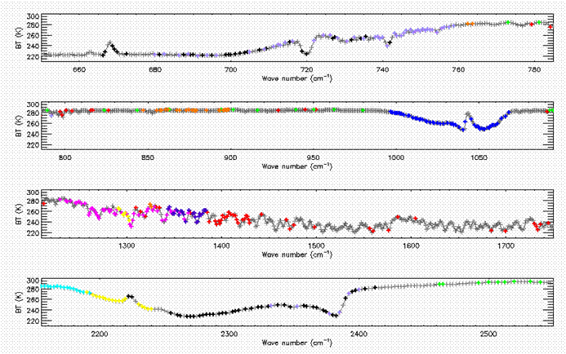
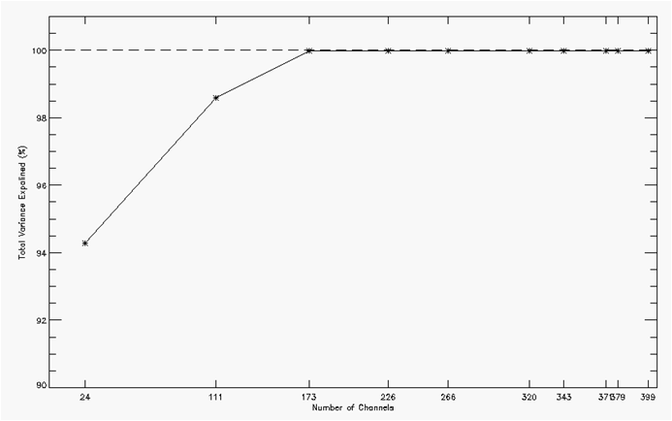
NUCAPS channel selection
Channels selected are shown at right.
  101 channels are used for AVTP (black, lt.blue)
  24 channels are used for surface (green)
  62 channels are used for AVMP (red, pink)
  53 channels are used for ozone (dk.blue)
Details, see NOAA TR-133
  Gambacorta and Barnet 2011 “Methodology and information content of the NOAA/NESDIS operational channel selection for CrIS”
>99% of information content is provided by subset selected

Slide 11
Advantage of NUCAPS:
Rapid Research to Operations and Diagnostics
Single retrieval code for AIRS, IASI, and CrIS
  Allows for direct comparison of NPP/Metop/Aqua instruments.
  Mature code with implementation of lessons-learned from AIRS and IASI systems.
Science code run through automated “filter” to create operational code
  Extremely rapid and accurate transition to operations.
    Science code fully emulates operational code: Guarantees that operational code is implemented correctly.
    Science code has an extraordinary level of diagnostic information to allow understanding of anomalies and theoretical understanding of algorithm.
  Science code can be used for validation and special scientific campaigns
IASI system is currently being upgraded to utilize AVHRR
  This was part of original IASI project plan
  This will be implicitly incorporated into NUCAPS (i.e., same code) and VIIRS scheduled to be implemented in May 2014.

Slide 12
CrIMSS EDR Team Members’
Roles and Responsibilities
Lead for Activity | Organization | Task
Chris Barnet | NOAA/NESDIS/STAR | CrIS/ATMS EDR algorithm lead (Wilson) and validation (Nallii, Xiong)
Mitch Goldberg (C. Barnet) | NOAA/NESDIS/STAR | NGAS-code analysis (Divakarla, Tan)
Anthony Reale | NOAA/NESDIS/STAR | NPROVS RAOB comparisons
Ralph Ferraro | NOAA/NESDIS/STAR | Precipitation Flag
Lead for Activity | Organization | Task
Allan Larar | NASA/LaRC | Comparisons to NAST-I EDRs
Xu Liu | NASA/LaRC | IASI proxy, Algorithm, Validation (Kizer)
Hank Revercomb | SSEC | AVMP/AVTP validation (Knuteson), AVTP/AVMP validation (Li)
Dave Tobin | SSEC | ARM-RAOBS at NWP, SGP, NSA
Larrabee Strow | UMBC | OSS validation and comparisons to SARTA
12

Slide 13
Validation Activities
Focus Days, Comparisons to AIRS and ECMWF products.
  1st focus day, Nov. 11, 2012 (ATMS-only)
    Derived ATMS tuning, check out ATMS-only parts of code
  2nd focus day, Feb. 24/25, 2012
    1st look at full retrieval system
  3nd focus day, May 15, 2012
    Characterization and optimization of algorithm
  4th focus day, Sep. 20, 2012
    Use for NUCAPS regression training (together with May 15, 2012)
Dedicated Radiosonde Launches
  Coordination with DOE/ARM to begin dedicated sonde launches at NSA, SGP, TWP (90x3 “best” estimate” overpasses will be acquired in Fall 2012)
  Coordinated with Aerospace Corp. to utilize sonde launches from Hawaii (20 in May 2012, 20 in Sep. 2012)
  Coordinated with Beltsville Center for Climate System Operation (BCCSO) to utilize sonde launches from Beltsville, MD (15 so far)
GPS-RO Comparisons (Bob Knuteson, U. Wisc)
  COSMIC GPS-RO has ~1000 soundings per day with good latitude coverage
NOTE: 2/25, 5/15, and 9/20 were chosen to have same orbit – provides optimal coincidence of NPP and Aqua

Slide 14
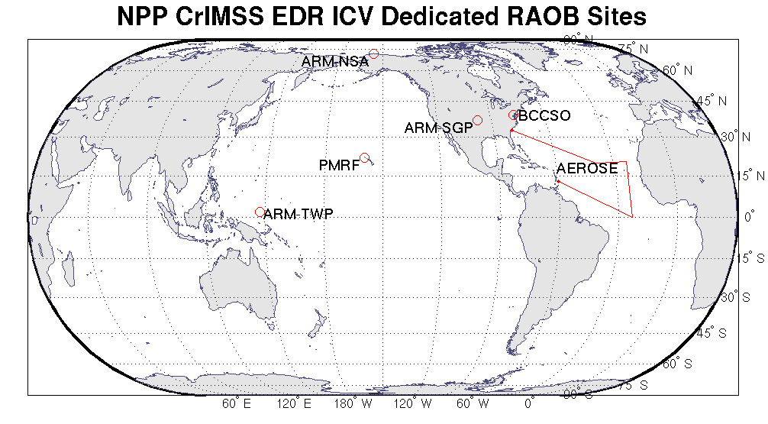
ICV Coordinated Dedicated RAOB Campaign Update
 | ARM-TWP | ARM-SGP | ARM-NSA | PMRF | BCCSO | NOAA AEROSE
Location | Manus Island, Papua New Guinea | Ponca City, Oklahoma, USA | Barrow, Alaska, USA | Kauai, Hawaii, USA | Beltsville, Maryland, USA | Tropical North Atlantic Ocean
Regime | Tropical Pacific Warm Pool, Island | Midlatitude Continent, Rural | Polar Continent | Tropical Pacific, Island | Midlatitude Continent, Urban | Tropical Atlantic, Ship
Planned N | 90 | 180 | 180 | 40 | — | ≈ 65
Launched n ₁ | 18 | 49 | 61 | 40 | 15 | 2
Launched n ₂ | — | 47 | 59 | — | — | —
Time Frame | Aug–present | Jul–present | Jul–present | May, Sep | Jun–Jul, Sep–present | Jan 2013 tentative
CrIMSS EDR matchup granules are in the process of being acquired for these RAOBs
  IDPS OPS-EDRs ≤ 500 km
  NUCAPS-EDRs
Notes:
BCCSO – Beltsville Center for Climate System Operation
PMRF – Pacific Missile Range Facility
ARM Sites (n = 450)
Tropical Western Pacific (TWP, island) (90)
Southern Great Plains (SGP) (180)
North Slope Alaska (NSA) (180)
Kauai, Hawaii (PMRF) Site (n = 40)
Tropical Central Pacific (island)
May (20)
Sep (20)
Collocated nighttime lidar
Collaborator: The Aerospace Corp.
Beltsville, MD (BCCSO) Site (n = 15+)
Urban midlatitude; lidar, MW radiometer
Jun–Jul, Sep 2012 ongoing
Collaborator: HU/NCAS
NOAA AEROSE Cruise (n ≈ 65)
Tropical Atlantic (ship)
Jan 2013 (tentative reschedule)
Collaborators: HU/NCAS, NOAA/ESRL
Sep 2012 (2) test sondes during return transit leg from Bermuda to Charleston

Slide 15
AEROSE Campaign Postponed
AEROSE Campaign was underway … but
  While in dry dock earlier this year the Ronald H. Brown had one of its two propulsion systems replaced
  Inspector showed up in Bermuda, and upon inspecting the propulsion systems, issued a formal assessment that the original one was at risk for failure within the next 30 days
  Unfortunately the entire scientific party and their equipment were already in Bermuda
  Mission was scrubbed, but 2 sondes were launched as they headed for port.
PNE cruise (and AEROSE campaign) is tentatively rescheduled for the January 2013 time frame

Slide 16
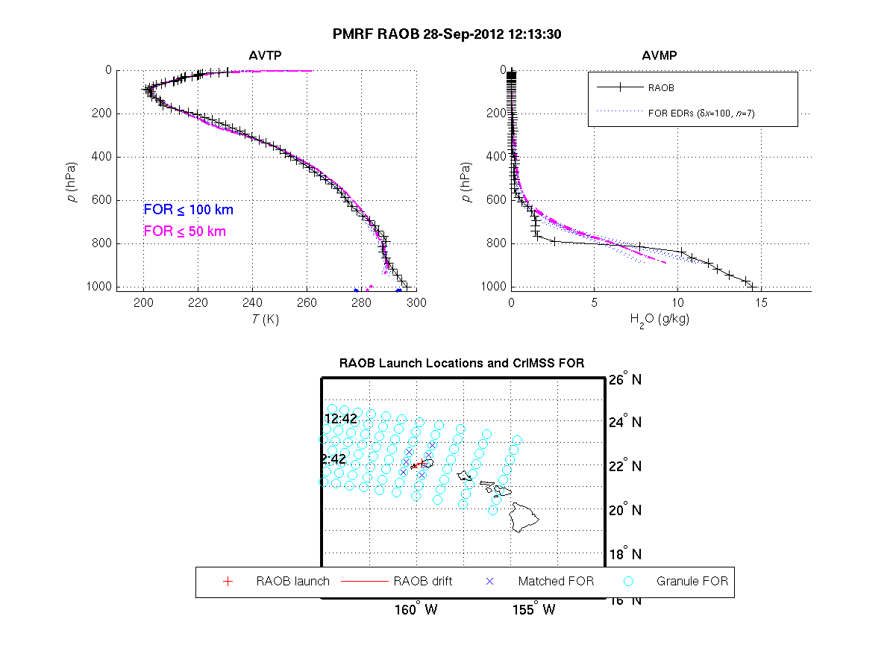
Example of PMRF comparison

Slide 17
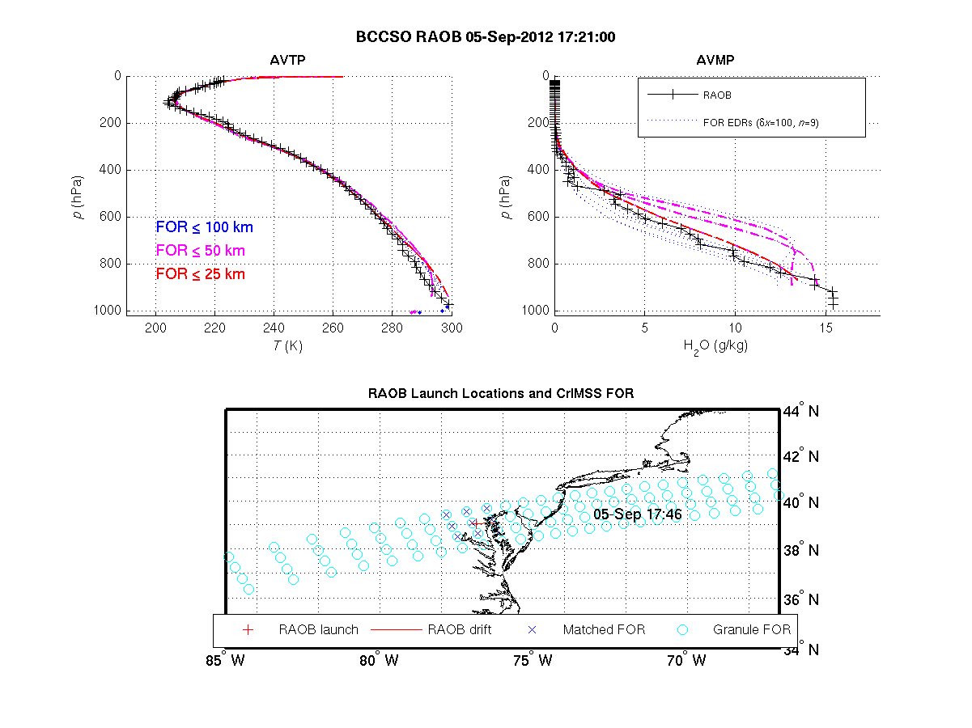
Example of Beltsville comparison

Slide 18
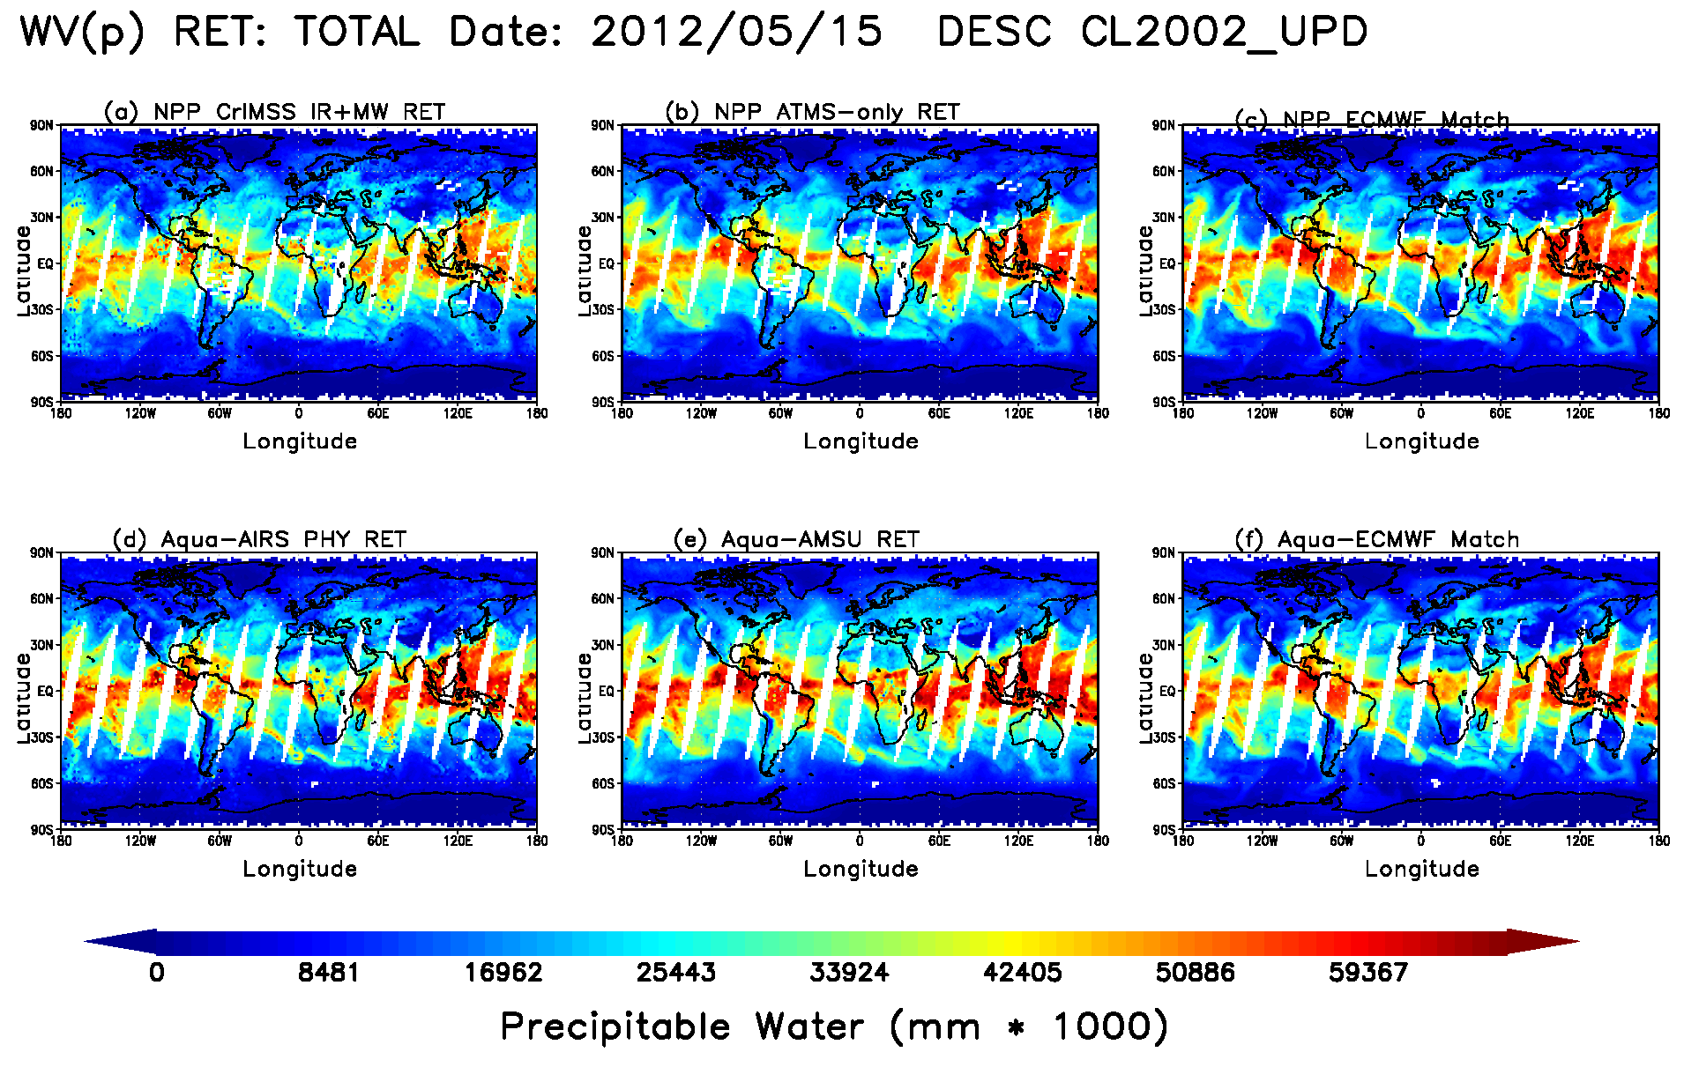
Comparison of CrIMSS EDR AVMP and
AIRS v5.9 Products
AVMP total precipitable water product for May 15, 2012
  CrIMSS IR+MW (upper left) and MW-only (upper middle)
  AIRS IR+MW (lower left) and AMSU-only (lower middle)
  Co-located ECMWF for CrIS (upper right) and AIRS (lower right)

Slide 19
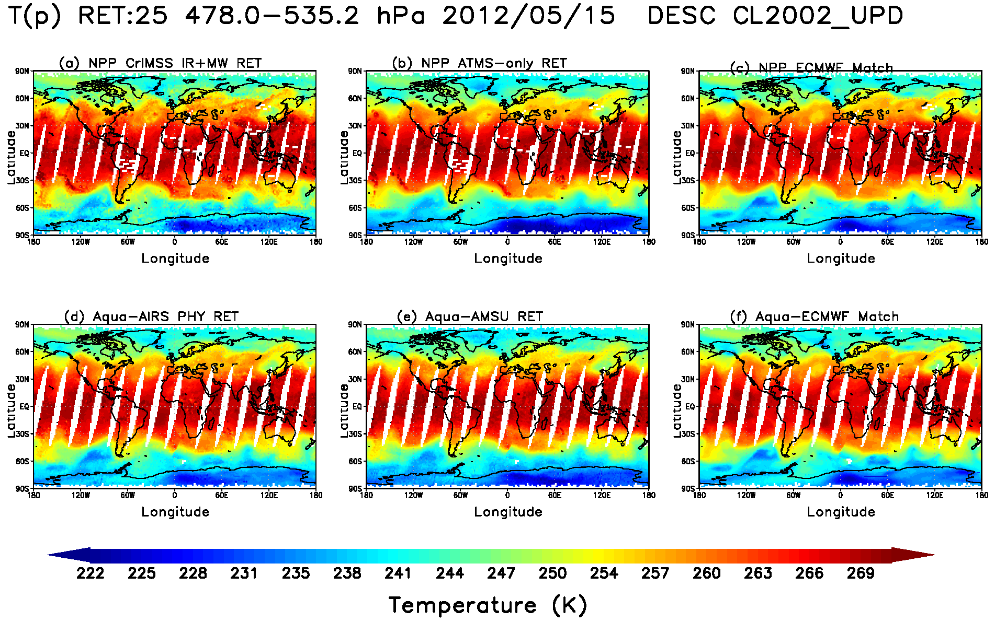
Comparison of CrIMSS EDR AVTP and
AIRS v5.9 Products
AVTP (850 hPa-surface) temperature product for May 15, 2012
  CrIMSS IR+MW (upper left) and MW-only (upper middle)
  AIRS IR+MW (lower left) and AMSU-only (lower middle)
  Co-located ECMWF for CrIS (upper right) and AIRS (lower right)

Slide 20
Caveats for Operational CrIMSS EDR (1/5)
(these changes were installed in MX6.3)
Does not have any bias correction for ATMS (DR4325)
  Causes scan angle dependent biases in AVMP and AVTP
  Causes low yield in coupled CrIS/ATMS retrieval
  Adding this bias correction to off-line code increased yield by ~6%.
Has a sub-optimal emissivity co-variance matrix (DR 4335)
  Causes poor KPP performance, especially in polar scenes
  In off-line code replacing this LUT increased yield by ~30%
Has pre-launch bias correction for CrIS (DR 4334)
  Based on IASI-proxy data, should be reasonable

Slide 21
Caveats for Operational CrIMSS EDR (2/5)
(these changes are proposed for Mx7.0)
Pre-launch values of CrIS and ATMS instrument and forward model noise LUTs is based on pre-launch, idealized performance (DR4926 & DR4943)
  Affects convergence and is causing low yields for both the microwave and coupled retrieval
  Modifying this in off-line code increased yield by ~25%
Scene stratification is not performing well (DR4946)
  Determination of “warm ocean” logic needs to be changed
Scene selection module is not performing well (DR4942)
  As a consequence of sub-optimal bias corrections and instrument noise estimates scenes are determined to be clear when they are cloudy.
  Causes poor convergence and rejection of the coupled retrieval and microwave retrieval, especially over polar regions.
  Fixed in off-line code by forcing cloud clearing for all cases.

Slide 22
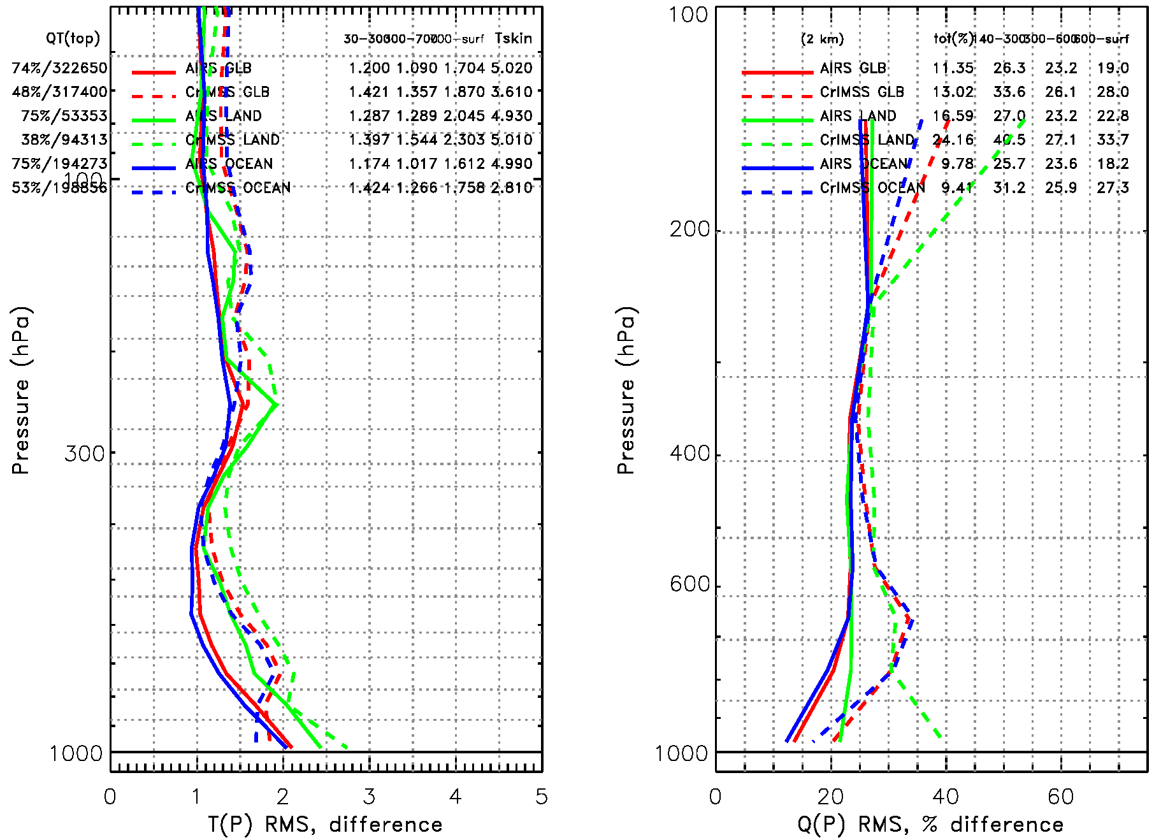
Caveats for Operational CrIMSS EDR (3/5)
Comparson of the IR+MW EDR w.r.t. ECMWF for May 15, 2012 -- if all the changes are installed (Off-line runs)
Global (red), land (green) and ocean (blue) statistics for the CrIMSS EDR (dashed) and heritage AIRS product (solid).
CrIMSS EDR has lower yield (38-53%) than AIRS (~75%) at this time
KPP performance is close to requirements (1.6K) for AVTP, but we still have work to do for AVMP (global is 28% vs. 20% requirement)
L1 Requirements
L1 Requirements
KPP
KPP

Slide 23
Caveats for Operational CrIMSS EDR (4/5)
(additional issues)
Daytime scenes have lower (~20%) yield than nighttime due to a software error in the indexing of channels affected by non-LTE (DR4922)
  Recently discovered bug and changes required are understood.
  The fix has not been implemented in any figures shown herein.
Daytime constrain for surface air/skin difference is too tight over land (DR 2945)
Precipitation flag is sub-optimal (DR4068 & 4069)
  Precipitation flag is needed for excluding cases from the performance statistics.
  Current flag is using out of date algorithm and incorrect coefficients (AMSU coefficients used)
    Appears to be producing reasonable values, most of the time but does have high failure rate (both false positives and negatives).
  We will have a report on its performance in Sep. 2012 and implementation of code/coefficient changes in Jan. 2013

Slide 24
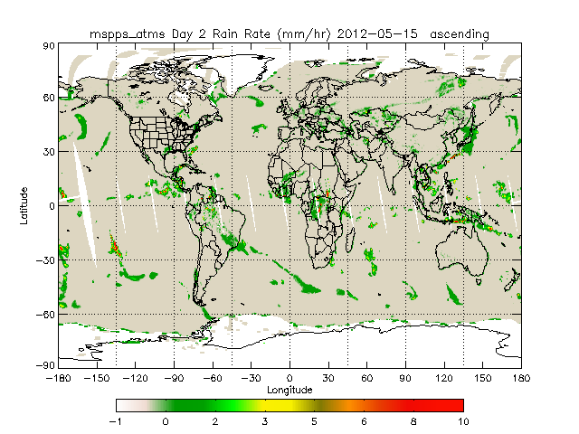
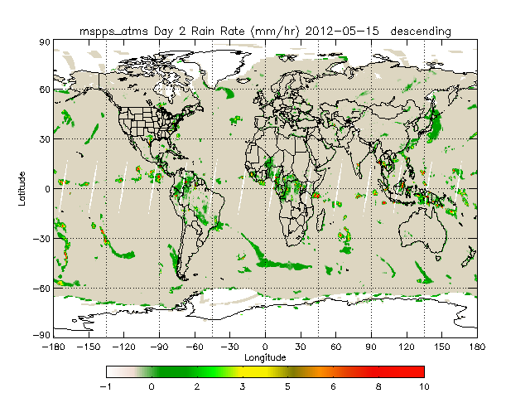
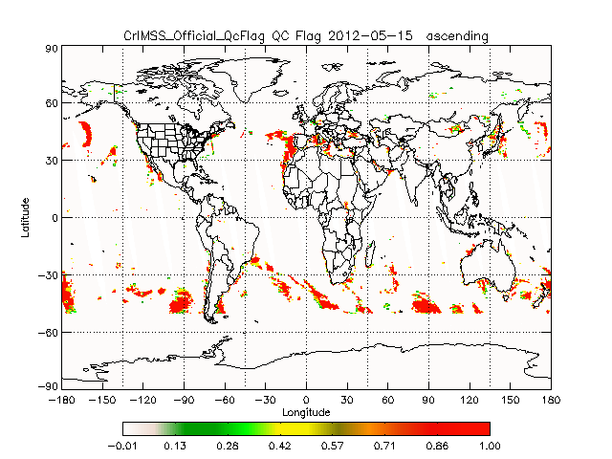
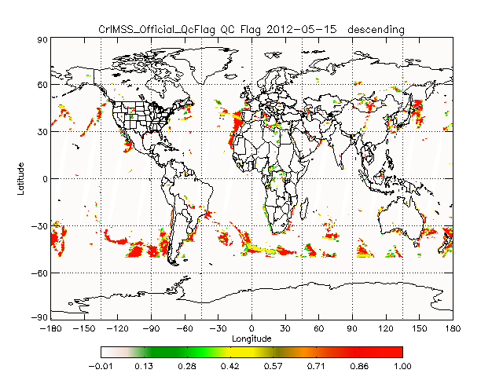
Caveats for Operational CrIMSS EDR (5/5)
(example of precip flag on May 15)
Ascending Orbit
Descending Orbit
MSPPS
CrIMSS EDR

Slide 25
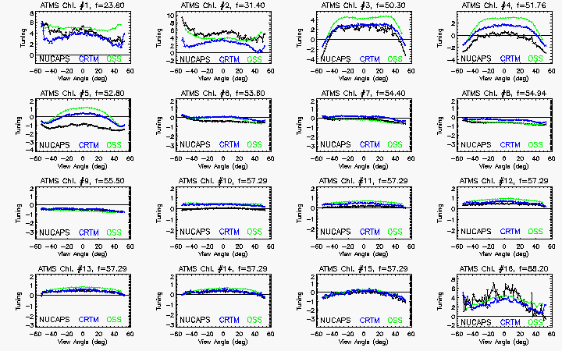
ATMS empirical bias correction
Derived ATMS bias from focus days (ocean, night, ±60 cases)
  Used Obs-Calc(ECMWF)
  Biases have not changed significantly since launch
Forward models cannot make asymmetric biases – so these must be coming from the instrument measurements.
  e.g. satellite asymmetry
Black curve (at right) was used in NUCAPS retrievals
  More work needs to be done but shape is consistent with those derived from CRTM and OSS
BLUE: bias derived from ATMS-CRTM July 9, 2012 (courtesy of Kevin Garrett)
BLACK: bias derived from ATMS-MIT for Dec. 7, 2011
Green: biases derived from ATMS-OSS for May 15, 2012

Slide 26
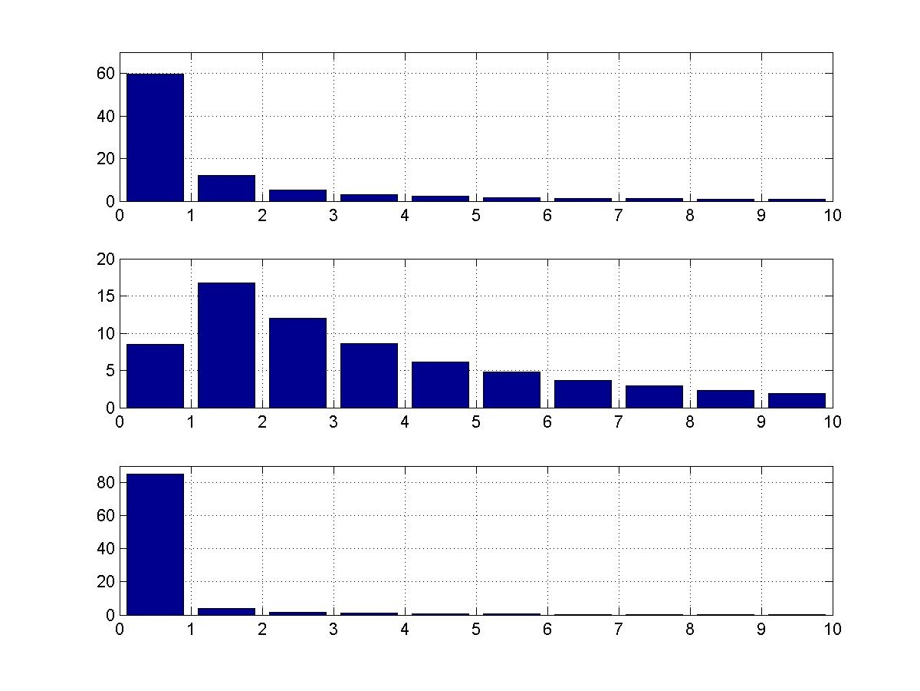
ATMS has higher residuals than CrIS
In the coupled retrieval the CrIS information dominates. Majority of cases have chi^2 < 2K (top panel).
  ATMS channels (middle panel) have a broad distribution in chi^2
In the ATMS-only retrieval (bottom) the chi^2 has narrow distribution
Similar results (not shown) from the NUCAPS system
Hypothesis: ATMS-only retrieval can find acceptable retrieval (with higher errors) but has difficulty agreeing with CrIS radiances.
Null hypothesis: CrIS cloud clearing is failing, causing disagreement with between CrIS and ATMS.
Second stage IR chi-Square
Second stage MW chi-Square
Distribution (%)
First stage MW chi-Square
Chi-Square values
Distribution of number of cases (PDF) of radiance residuals (chi^2).
Slide courtesy of Degui Gu (NGAS)

Slide 27
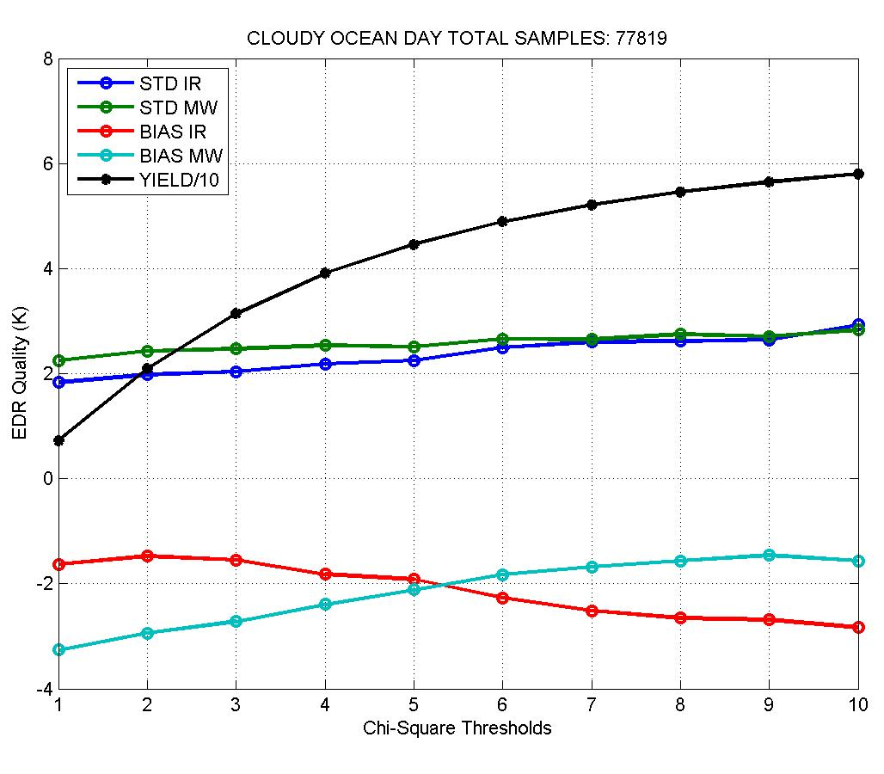
ATMS has large uncertainty
(could this be due to side-lobes?)
If we increase threshold for ATMS convergence we can get a significant increase in yield (~double).
The fact that the bias in the IR derived skin temperature and profile errors (not shown) don’t change substantially indicates these are cases where cloud clearing is working but CrIS and ATMS radiances do not agree.
Effect is much larger than striping issue.
BIAS and STD for retrieved skin temperature (w.r.t. ECMWF) for MW-only and coupled (IR) ret steps
Slide courtesy of Degui Gu (NGAS)

Slide 28
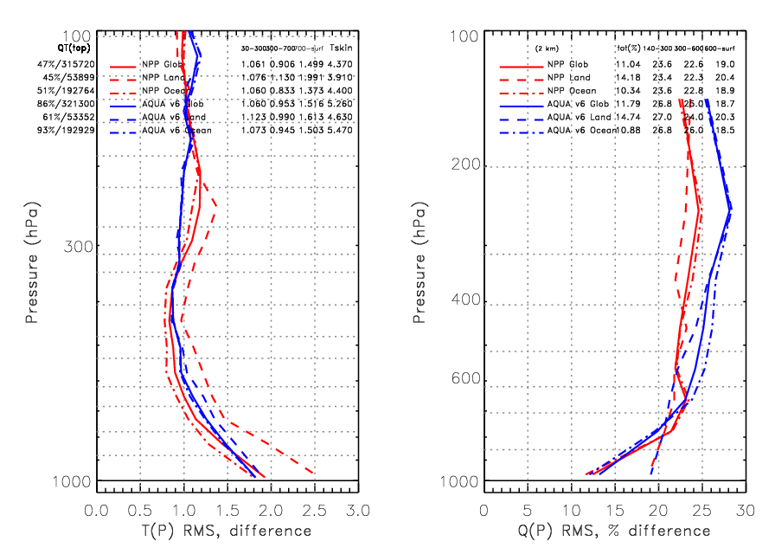
Comparison of NUCAPS and AIRS v6
AIRS/AMSU v6 (BLUE) is a mature (10+ year) algorithm.
NUCAPS CrIS/ATMS (RED) uses the same spectroscopy and retrieval methodology.
While CrIS/ATMS yield is low (~45% vs 60-90%) the performance is similar to the heritage algorithm and is meeting global requirements.
NUCAPS (RED) for Global (solid), Land (dashed) and Ocean (dash-dot) cases. This is a preliminary version with cloudy regression first guess.
AIRS (BLUE) is the official v6 product with Neural Network first guess.

Slide 29
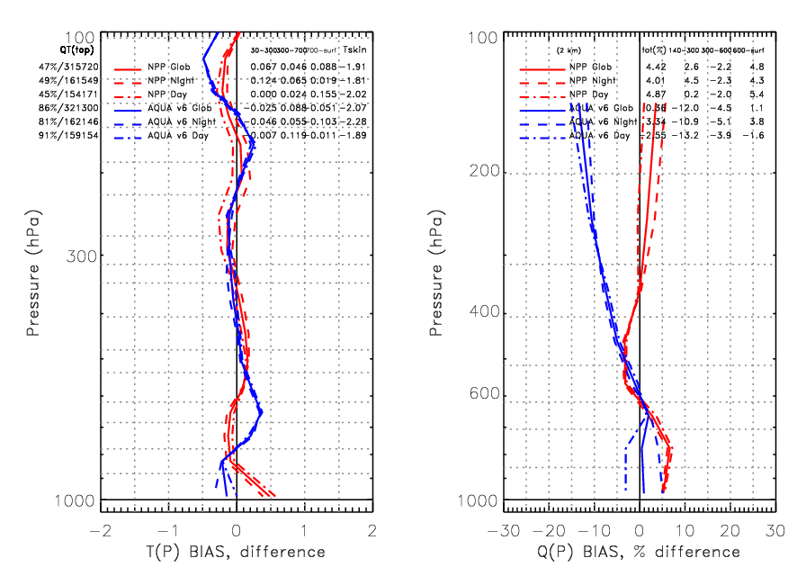
Comparison of NUCAPS and AIRS v6
Biases are small for both systems.
Unlike the CrIMSS-EDR, the NUCAPS system is a mature code.
In general, we feel that the excellent performance of the CrIS/ATMS retrievals this early in the training and optimization of the algorithm are an extremely good sign.
NUCAPS (RED) for Global (solid), Land (dashed) and Ocean (dash-dot) cases. This is a preliminary version with cloudy regression first guess.
AIRS (BLUE) is the official v6 product with Neural Network first guess.

Slide 30
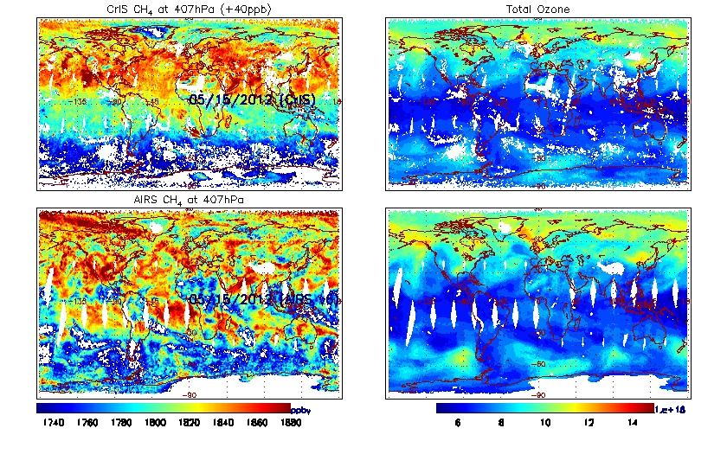
NUCAPS Ozone and Methane Retrievals
Comparison of NUCAPS and AIRS Systems
EXTREMELY PRELIMINARY
Although the CrIS/ ATMS system (top) has more rejection, the fields of methane (left) and ozone (right) have similar features when run with an identical algorithm for AIRS (bottom, here we use AIRS v5.9).
Top Panels: NPP/CrIS methane (left) and ozone products (right) from NUCAPS system
Bottom Panels: Aqua/AIRS methane (left) and ozone (right) products from v5.9 system.

Slide 31
FY-12/13 Schedule and Milestones
October to December, 2012
  Get exact match between off-line code and on-line IDPS code
  Submit CCRs for changes required for provisional maturity
  Preliminary comparison to dedicated radiosondes
  Dec. 2012 milestone: submit justification for provisional maturity.
January to June 2013
  Support AEROSE field campaign (rescheduled from Aug. 2012)
  Feb. 2013 Milestone – have stage.1 validated NUCAPS running operationally within NDE
  Detailed comparison to all dedicated radiosondes (ARM + Aerospace + Beltsville)
  Code changes for stage.1 system running in off-line code
  June 2013 Milestone – submit justification for validated stage 1 CrIMSS EDR
Summer 2013
  Support AEROSE (tentatively late-Aug) campaign to obtain RAOB’s
  Dec 2013 Milestone: submit justification for validated stage 2 CrIMSS EDR

