Slide 1
www.fueleconomy.gov the official U.S. government source for fuel economy information
Understanding the EPA Fuel Economy Label for Plug-in Vehicles
Your Name
Organization
Email
Month Day, Year

Slide 2
Understanding the Fuel Economy Label for Plug-in Vehicles
This presentation describes the EPA fuel economy labels for:
All-Electric Vehicles (EVs)
Plug-in Hybrids (PHEVs):
Series Plug-in Hybrid Vehicles (Extended Range Electric Vehicles)
Parallel (Blended) Plug-in Hybrid Vehicles
Photo: Oak Ridge National Laboratory (2011-P03692)

Slide 3
All-Electric Vehicles
The fuel economy label of an all-electric vehicle will include the text “Electric Vehicle” in the upper right hand corner
The label will also include a plug icon to identify it as a vehicle that is powered by electricity.

Slide 4
Plug-in Hybrid Electric Vehicles
The fuel economy label for a Plug-in Hybrid Vehicle will include the text “Plug-in Hybrid Vehicle” and “Electricity-Gasoline” in the upper right hand corner.
The label for a plug-in hybrid vehicle also includes a plug and a fuel pump icon to identify it as a vehicle that is powered by both electricity and gasoline.

Slide 5
Fuel Economy Estimates for All-Electric Vehicles
Fuel economy estimates for an all-electric vehicle are displayed as miles per gallon of gasoline-equivalent (MPGe).
To the right of the fuel economy numbers is text describing the best and worst fuel economy estimates for vehicles in the same class (e.g., Midsize Cars, Station Wagons, Pickup Trucks, etc.)
City, highway, and combined MPGe values are displayed on the label.
The combined fuel economy estimate assumes you drive 55% of the miles in stop and go (city) traffic and 45% of the miles in free flowing (highway) traffic. Note: The share of city/highway driving may customized on the fueleconomy.gov web site.
Notes:
MPGe represents the number of miles the vehicle can go using a quantity of fuel with the same energy content as a gallon of gasoline. Using MPGe you can compare the fuel economy of an all- electric vehicle to a similar vehicle running on gasoline.

Slide 6
Fuel Consumption Estimates for All-Electric Vehicles
The label also includes an estimate of the fuel efficiency of the vehicle in Kilowatt-hours (kW-hrs) per 100 miles.
This value tells you how many kilowatt-hours the vehicle would use to travel 100 miles.
The fuel consumption metric allows you to compare electricity consumption between electric vehicles.
The combined electricity consumption estimate assumes you drive 55% of the miles in stop and go (city) traffic and 45% of the miles in free flowing (highway) traffic. Note: The share of city/highway driving may customized on the fueleconomy.gov web site.

Slide 7
Driving Range for All-Electric Vehicles
The label for electric vehicles also includes an estimate of the driving range of the vehicle when fully charged.
This value represents the approximate number of miles that can be traveled in combined city and highway driving before the vehicle must be recharged.
Note: For tips to maximize the fuel efficiency and driving range of your EV, please visit fuelecononomy.gov.
The driving range shown on the label assumes you drive 55% of the miles in stop and go (city) traffic and 45% of the miles on the highway. Note: The share of city/highway driving may customized on the fueleconomy.gov web site.

Slide 8
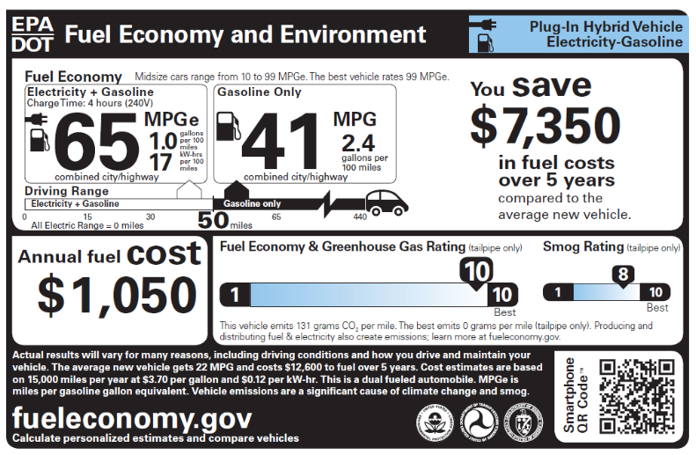
Plug-in Hybrid Electric Vehicles
Series Plug-in Hybrid Fuel Economy Label
The fuel economy numbers shown on the label for plug-in hybrid vehicles vary depending on whether the PHEV is a series plug-in hybrid or a parallel plug-in hybrid.
Parallel Plug-in Hybrid Fuel Economy Label
Notes:
Note: A series plug-in hybrid vehicle may also be called an extended range electric vehicle. A parallel plug-in hybrid may also be called a blended plug-in hybrid.

Slide 9
Plug-in Hybrid Electric Vehicles
In a series plug-in hybrid the electric motor turns the wheels
The gasoline engine is only used to generate electricity.
Series plug-ins can run solely on electricity until the battery needs to be recharged.
Some vehicles use the electric motor to drive the wheels almost all of the time, but the vehicle may operate as a parallel hybrid at highway speeds when the battery is depleted.
Vehicles that operate as a series parallel vehicle most of the time will also use the series plug-in hybrid fuel economy label
Series Plug-in Hybrid Fuel Economy Label
Notes:
General Motors (GM) uses a slightly modified version of this design in the Chevy Volt. GM refers to this design as an extended range electric vehicle (EREV). The electric motor drives the wheels almost all of the time, but the vehicle can switch to work like a parallel hybrid at highway speeds when the battery is depleted.

Slide 10
Plug-in Hybrid Electric Vehicles
Parallel Plug-in Hybrid Fuel Economy Label
In a parallel plug-in hybrid, both the engine and electric motor are mechanically connected to the wheels, and both propel the vehicle under most driving conditions.
Notes:
A parallel plug-in hybrid may also be called a blended plug-in hybrid.

Slide 11
Series PHEV Fuel Economy Estimates
The label for a series plug-in hybrid electric vehicle displays two sets of fuel economy numbers.
The left-hand set of fuel economy numbers displays the fuel economy when operating on electricity alone.
The right-hand set of fuel economy numbers displays the fuel economy when the battery is emptied and the vehicle is using gasoline.
All of these values represent the combined city and highway value.
Notes:
Fuel Economy when operating on electricity alone is described in miles per gallon of gasoline-equivalent (MPGe) and in kW-hrs per 100 miles. Fuel Economy when operating on gasoline alone is described in miles per gallon (MPG) and in gallons per 100 miles.

Slide 12
Series PHEV Fuel Economy Range Estimates
The driving range is provided below the fuel economy estimates.
For a series PHEV, the driving range on electricity represents the approximate number of miles that can be traveled in combined city and highway driving on a single charge.
The total driving range represents the electricity range plus the distance the vehicle can travel on gasoline.

Slide 13
Parallel PHEV Fuel Economy Estimates
The label for a parallel plug-in hybrid electric vehicle displays two sets of fuel economy numbers.
The left-hand set of fuel economy numbers displays the fuel economy when operating on a mix of gasoline and electricity.
The right-hand set of fuel economy numbers displays the fuel economy when the battery is emptied and the vehicle is running on gasoline.
All of these values represent the combined city and highway value.
Notes:
The electricity + gasoline fuel economy is described in miles per gallon of gasoline-equivalent (MPGe) and the fuel efficiency of the vehicle is also displayed in kW-hrs per 100 miles for electricity and gallons per 100 miles for gasoline.
The fuel economy when running on gasoline alone is described in miles per gallon (MPG) and in gallons per 100 miles.

Slide 14
Parallel PHEV Fuel Economy Range Estimates
The label for a parallel plug-in hybrid electric vehicle also displays the driving range on a mix of gasoline and electricity and the total driving range
The label also displays the distance the vehicle can travel on electricity alone.
Notes:
The driving range on electricity + gasoline represents the approximate number of miles that can be traveled in combined city and highway driving before the battery is emptied
The total driving range represents the electricity range plus the distance the vehicle can travel on gasoline alone.
In the sample label, this distance is shown as 0 miles; however, most parallel PHEV vehicles are capable of traveling a few miles on electricity alone.

Slide 15
Charge Time for EVs and PHEVs
The charge time listed on the label indicates how long it takes to charge a fully empty battery.
For the purposes of equivalent comparisons, all electric vehicles display a charge time based on use of 240 volt service
The actual time it takes to charge your vehicle will depend on the type of charger you use.
Notes:
The vehicle manufacturer should be able to provide complete information on charging times and the capabilities of their vehicles.

Slide 16
Annual Fuel Cost for EVs and PHEVs
The annual fuel cost shown on the fuel economy label is based on:
an annual mileage of 15,000 miles and projected fuel prices for the year
Visit fueleconomy.gov to personalize these fuel prices
For PHEVs, a utility factor is used to estimate the share of miles the average driver will drive on electricity vs. gasoline
Fueleconomy.gov’s “My Plug-in Hybrid Calculator” can help you estimate your annual fuel cost based on your driving habits
Notes:
The fuel prices used to calculate the annual fuel cost are shown in fine print on the label.

Slide 17
5 Year Fuel Costs or Savings
The label shows the estimated fuel cost over a five-year period for the vehicle compared to the average new vehicle of the same model year.
These five-year estimates are also based on 15,000 miles per year and projected fuel prices for the current year
The average MPG and cost to fuel an average vehicle for 5 years is shown in the fine print.

Slide 18
Fuel Economy and Greenhouse Gas Ratings for EVs and PHEVs
The EPA assigns each vehicle a rating from 1 (worst) to 10 (best) for fuel economy and greenhouse gas emissions (GHG). The rate of CO₂ emissions is also displayed on the label in grams per mile.
Since all-electric vehicles do not emit any tailpipe CO₂ their greenhouse gas rating will be a 10 and the rate of CO₂ emissions will be shown as 0 grams per mile.
Fueleconomy.gov’s Beyond Tailpipe Calculator can help you estimate greenhouse gas emissions associated with the production and distribution of the electricity used to charge an electric vehicle in your region of the country.

Slide 19
Smog Ratings for EVs and PHEVs
The EPA assigns each vehicle a rating from 1 (worst) to 10 (best) for smog emissions. This is a rating for vehicle tailpipe emissions of those pollutants that cause smog and other local air pollution.
For those vehicles that run entirely on electricity, the tailpipe emissions are zero and the smog rating will be a 10.
Smog ratings for PHEVs depend on the U.S. emission standards to which the vehicle is certified.

Slide 20
QR codes
When you are looking for a new vehicle at a dealership, you will be able to scan the QR Code® on the new label using your smartphone, provided you have downloaded a scanner app.
The QR Code® will link you to additional information about the vehicle on the www.fueleconomy.gov web site.

Slide 21
Thank you!
To look up the fuel economy of specific plug-in hybrid and all-electric vehicles, visit fueleconomy.gov.

