Slide 1
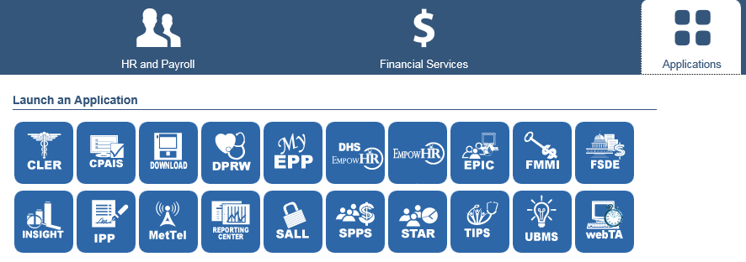
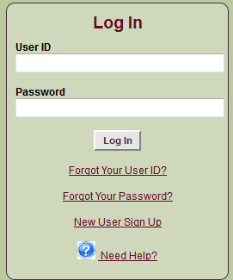
To make a change on your EPP web page: https://www.nfc.usda.gov/
1st
2nd
3rd
4th
NOAA/WFMO/WSD October 2015

Slide 2
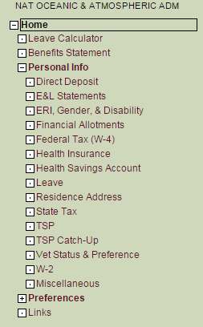
6th
Under Personal Info, select the category you want to make a change in
5th
(This may or may not pop-up!)
NOTE: There are exceptions to changes you can make in EPP:
New home address in a different state, send request to WFMO.Pay@noaa.gov so your taxes are adjusted properly
Health insurance changes are limited to “open season” each fall, unless you have a life event (listed on the Health Insurance page in EPP)
If the change is a qualifying life event, please send the request to WFMO.Benefits@noaa.gov
NEVER include your SSN or DOB in an email!
NOAA/WFMO/WSD October 2015

Slide 3
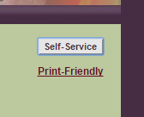
7th
When you want to make any change, you must
choose the “Self-Service” button in the right hand corner
of the page.
You will then be able to make changes.
Be sure to “SAVE” before exiting out of EPP.
If these instructions do not solve your EPP problem, please send an email to wsd.support@noaa.gov
NOAA/WFMO/WSD October 2015

