Slide 1
EIA’s Energy Outlook 2016
CFA Society of Washington
October 13, 2016 | Washington, D.C.
by
Adam Sieminski, Administrator

Slide 2
Key takeaways from AEO2016
Energy use per dollar of Gross Domestic Product declines through 2040 allowing for economic growth without upward pressure on energy consumption and related emissions
Market forces drive up oil prices throughout the projection and U.S. production increases in response
Natural gas production increases despite relatively low and stable natural gas prices
Technological improvements are key drivers of U.S. oil and gas production
Net exports of liquefied natural gas range between 3.5 Tcf and 10.6 Tcf in 2040 depending on relative prices in foreign markets
EPA’s proposed medium and heavy-duty vehicle Phase 2 standards would increase fuel economy, resulting in 18% lower diesel consumption in 2040 compared with the Reference case

Slide 3
Key takeaways from AEO2016 (continued)
EPA’s Clean Power Plan (CPP) requires states to reduce carbon dioxide emissions from existing fossil generators:
Details of the CPP implementation strategies selected by the states affect the overall generation mix, as well as consumer prices
CPP effects on coal production vary across regions
CPP, along with renewable tax credit extension and lower natural gas prices, contributes to a shift in the generation mix, with increases in generation from natural gas and renewables and reduced coal generation
Even if the CPP is not implemented, key factors combine to support a transition from coal to natural gas as the predominant fuel for electric generation
Extending or expanding existing laws and regulations, including efficiency policies for appliances and vehicles, the CPP, and EPA’s proposed Phase 2 standards for medium- and heavy-duty trucks results lower energy consumption and CO2 emissions than projected in the Reference case

Slide 4
Reductions in energy intensity largely offset impact of gross domestic product (GDP) growth, leading to slow projected growth in energy use
U.S. primary energy consumption
quadrillion Btu
AEO2016 Reference
No CPP
2015
2015
History
Projections
Projections
32% of U.S. total
33%
Natural gas
29%
8%
14%
(excluding biofuels)
12%
Renewables
36%
33%
Petroleum and other liquids
34%
1%
Liquid biofuels
9%
1%
1%
Nuclear
8%
8%
16
10%
Coal
14%
Source: EIA, Annual Energy Outlook 2016

Slide 5
U.S. net energy imports trend downward, reflecting increased oil and natural gas production coupled with slowly growing or falling demand
U.S. net imports
quadrillion Btu
History
Projections
2015
Liquids
Natural gas
Coal
Source: EIA, Annual Energy Outlook 2016

Slide 6
Electricity

Slide 7
Electricity use (including direct use) continues to grow, but the rate of growth slows as it has almost continuously over the past 60 years
U.S. electricity use and GDP
percent growth (rolling average of 3-year periods)
2015
Projections
Source: EIA, Annual Energy Outlook 2016

Slide 8
Both natural gas and renewable generation surpass coal by 2030 in the Reference case, but only natural gas does so in the No CPP case
net electricity generation
billion kilowatthours
AEO2016 Reference
No CPP
2015
2015
History
Projections
Projections
Coal
Natural gas
Nuclear
Petroleum
Renewables
Source: EIA, Annual Energy Outlook 2016

Slide 9
Changing tax and cost assumptions contribute to stronger solar growth, with the CPP providing a boost to renewables
renewable electricity generation by fuel type
billion kilowatthours
2015
AEO2016 Reference
2015
No CPP
History
Projections
Projections
Wind
Municipal waste/
landfill gas
Solar
Geothermal
Biomass
Conventional hydroelectric power
Source: EIA, Annual Energy Outlook 2016

Slide 10
Petroleum and other liquids

Slide 11
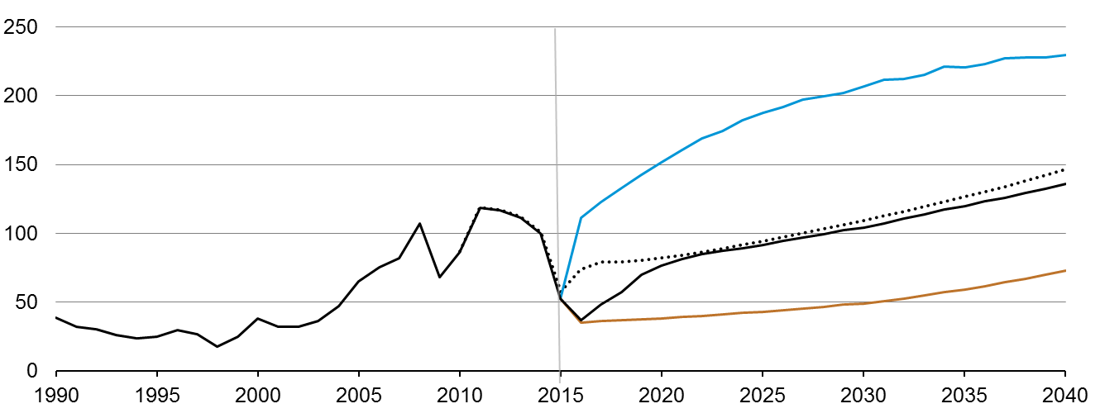
Near-term crude oil price scenario is lower in AEO2016
Brent crude oil spot price
2015 dollars per barrel
History
2015
Projections
High Oil Price
AEO2015 Reference
AEO2016 Reference
Low Oil Price
Source: EIA, Annual Energy Outlook 2016 Reference case and Annual Energy Outlook 2015 Reference case

Slide 12
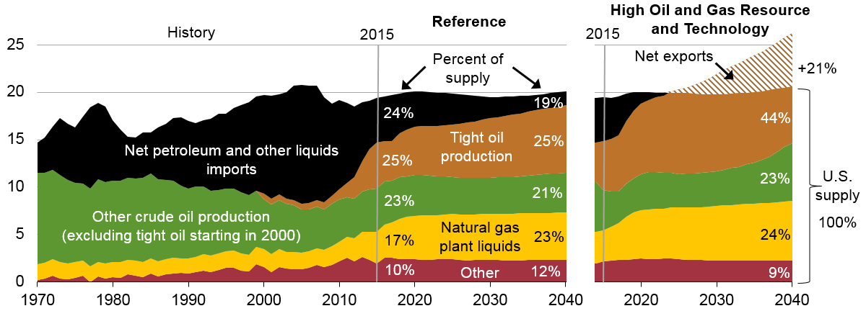
Combination of increased tight oil production and higher fuel efficiency drives projected decline in oil imports
U.S. liquid fuels supply
million barrels per day
Note: “Other” includes refinery gain, biofuels production, all stock withdrawals, and other domestic sources of liquid fuels
Source: EIA, Annual Energy Outlook 2016

Slide 13
The price relationship between crude oil and natural gas impacts producer economics and production levels for both commodities
energy spot prices under Reference case
2015 dollars per million Btu
oil-to-gas price ratio
History
2015
Projections
History
2015
Projections
High Oil and Gas Resource
and Technology
Brent crude oil
spot price
High Oil Price
Reference
Low Oil and Gas
Resource and Technology
Low Oil Price
Henry Hub spot price
Source: EIA, Annual Energy Outlook 2016

Slide 14
Future domestic natural gas plant liquids production depends on both domestic resource endowment and world crude oil prices
U.S. total natural gas plant liquids production
million barrels per day
History
Projections
2015
High Oil and Gas Resource and Technology
High Oil Price
Reference
Low Oil Price
Low Oil and Gas Resource
and Technology
Source: EIA, Annual Energy Outlook 2016

Slide 15
Natural gas

Slide 16
U.S. natural gas production dominated by shale resources; alternative price and resource /technology assumptions could be quite different
U.S. dry natural gas production
trillion cubic feet
U.S. dry natural gas production
trillion cubic feet
billion cubic feet per day
History
Projections
Projections
2015
High Oil and Gas Resource and Technology
High Oil Price
2016 Reference
Low Oil Price
2015 Reference
Shale gas and
tight oil plays
Low Oil and Gas Resource and Technology
Other lower 48
Tight gas
onshore
Coalbed methane
Alaska
Lower 48 offshore
Alaska
Source: EIA, Annual Energy Outlook 2016
Notes:
16
16

Slide 17
Natural gas consumption growth is led by electricity generation and industrial uses; natural gas use rises in all sectors except residential
U.S. dry gas consumption
trillion cubic feet
billion cubic feet per day
History
Projections
Residential
Commercial
Transportation*
Industrial**
Electric power
12.0
11.2
9.6
12.5
12.6
9.1
0.9
1.7
1.7
3.2
3.7
3.7
4.6
4.6
4.6
2020
2030
2040
*Includes pipeline fuel
Source: EIA, Annual Energy Outlook 2016
**Includes combined heat-and-power and lease, plant, and export liquefaction fuel

Slide 18
Projected U.S. natural gas exports reflect the spread between domestic natural gas prices and world energy prices
U.S. natural gas imports and exports
trillion cubic feet
billion cubic feet per day
High Oil and Gas Resource and Technology
2015
Reference
2015
2015
Low Oil Price
History
40
Lower 48 states LNG exports
30
Alaska LNG exports
Pipeline exports to Mexico
20
10
0
Pipeline exports to Canada
Pipeline imports from Canada
-10
LNG imports
-20
Source: EIA, Annual Energy Outlook 2016
Notes:
18
18

Slide 19
For more information
U.S. Energy Information Administration home page | www.eia.gov
Annual Energy Outlook | www.eia.gov/forecasts/aeo
Short-Term Energy Outlook | www.eia.gov/forecasts/steo
International Energy Outlook | www.eia.gov/forecasts/ieo
Today In Energy | www.eia.gov/todayinenergy
Monthly Energy Review | www.eia.gov/totalenergy/data/monthly
State Energy Portal | www.eia.gov/state

