Slide 1
EIA Analysis and Projections
For
Deloitte Energy Conference
June 21, 2016 | Washington, DC
By
Adam Sieminski, Administrator

Slide 2
Short-Term Energy Outlook

Slide 3
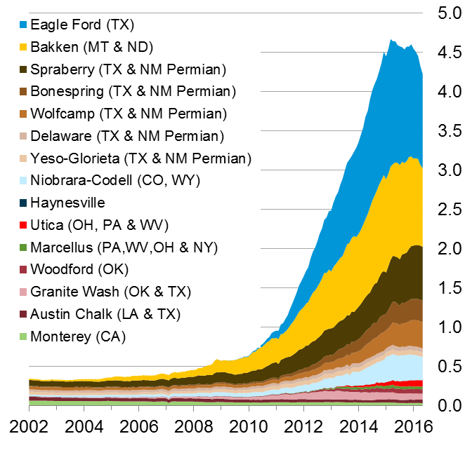
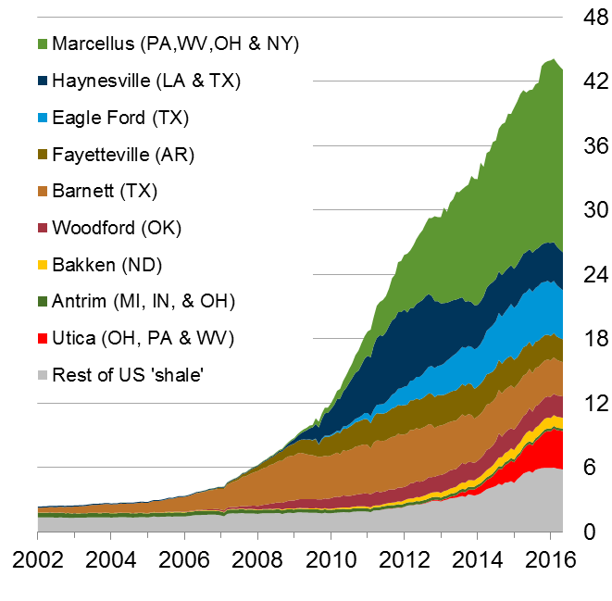
The U.S. has experienced a rapid increase in natural gas and oil production from shale and other tight resources
U.S. tight oil production
million barrels of oil per day
U.S. dry shale gas production
billion cubic feet per day
Sources: EIA derived from state administrative data collected by DrillingInfo Inc. Data are through May 2016 and represent EIA’s official tight oil & shale gas estimates, but are not survey data. State abbreviations indicate primary state(s). Note: Scales are presented at approximate barrel of oil equivalent.

Slide 4
Global supply has consistently exceeded demand since the start of 2014; EIA forecasts a return to market balance in the second half of 2017
world supply and demand
million barrels per day
implied stock change
million barrels per day
Source: EIA, Short-Term Energy Outlook, June 2016

Slide 5
EIA expects WTI oil prices to remain low compared to recent history, but the market-implied confidence band is very wide
WTI price
dollars per barrel
Source: EIA, Short-Term Energy Outlook, June 2016

Slide 6
EIA expects Henry Hub natural gas prices to rise to early 2015 levels
Henry Hub price
dollars per million Btu
Source: EIA, Short-Term Energy Outlook, June 2016

Slide 7
Annual Energy Outlook

Slide 8
Reference case crude oil prices exceed $130 in 2040
Brent crude oil spot price
2015 dollars per barrel
Source: EIA, Annual Energy Outlook 2016 Reference case

Slide 9
Natural gas prices are projected to remain below $5 per million British thermal units through most of the projection period with or without the Clean Power Plan
average Henry Hub spot prices for natural gas
2015 dollars per million Btu
Source: EIA, Annual Energy Outlook 2016

Slide 10
Clean Power Plan accelerates shift to lower-carbon options for generation, led by growth in renewables and gas-fired generation; results are likely sensitive to CPP implementation approach
electricity net generation
trillion kilowatthours
AEO2016 Reference
No CPP
History
2040
1993
2015
2040
2015
38%
34%
Natural gas
33%
13%
23%
11%
13%
27%
Renewables
53%
33%
26%
18%
Coal
19%
20%
Petroleum and other liquids
Nuclear
15%
4%
1%
16%
1%
1%
Source: EIA, Annual Energy Outlook 2016
Notes:
10
10

Slide 11
Electricity prices increase with rising fuel costs and expenditures for electric transmission and distribution infrastructure
average retail electricity prices
2015 cents per kilowatthour
Source: EIA, Annual Energy Outlook 2016

Slide 12
Technology improvements, largely driven by federal standards, help to increase energy efficiency within the end-use sectors
Buildings
lighting
space heating and cooling
refrigeration
water heating
miscellaneous electric loads (MELs) and other end uses
Industrial
electric motors
combined heat and power
Transportation
light-duty vehicles
heavy-duty vehicles

Slide 13
International Energy Outlook

Slide 14
Renewables grow fastest, coal use plateaus, natural gas surpasses coal by 2030, and oil maintains its leading share
world energy consumption
quadrillion Btu
History
2012
Projections
30%
26%
33%
22%
22%
28%
17%
23%
16%
12%
6%
4%
Source: EIA, International Energy Outlook 2016 and EIA, Analysis of the Impacts of the Clean Power Plan (May 2015)

Slide 15
As total energy consumption grows, shares by end-use sector remain relatively unchanged
world delivered energy consumption by end-use sector
quadrillion Btu
Share of total
delivered energy
53%
Industrial
54%
26%
Transportation
25%
20%
21%
Buildings
Source: EIA, International Energy Outlook 2016

Slide 16
Many global issues increase uncertainty…
Economic growth in key economies (China, Brazil, Russia, among others)
Implementation and strength of climate policies
Technology improvement rates (both supply and demand)
Future of nuclear generating capacity
Geopolitical events

Slide 17
Continuous improvement highlights at EIA
Brent crude used as marker price and revived the International Energy Outlook
U.S. Drilling Productivity Report
U.S. crude export analysis
Monthly solar PV capacity and generation
U.S. movements of crude by rail
Expanded natural gas production survey; added oil
Data browsers, application programming interface, and Excel add-in

Slide 18
For more information
U.S. Energy Information Administration home page | www.eia.gov
Short-Term Energy Outlook | www.eia.gov/steo
Annual Energy Outlook | www.eia.gov/aeo
International Energy Outlook | www.eia.gov/ieo
Monthly Energy Review | www.eia.gov/mer
Today in Energy | www.eia.gov/todayinenergy
Drilling Productivity Report | http://www.eia.gov/petroleum/drilling/
Excel Data Add-In | http://www.eia.gov/opendata/excel/

