Slide 1
Coal in the United States: Recent Developments and Outlook
for
Sabin Center for Climate Change Law
Columbia University
September 8, 2016 | New York, NY
by
Howard Gruenspecht, Deputy Administrator

Slide 2
Recent slow (or no) growth in energy use is projected to persist, with coal’s share in the energy mix continuing its recent decline
U.S. primary energy consumption
quadrillion Btu
AEO2016 Reference
No CPP
2015
2015
History
Projections
Projections
32% of U.S. total
33%
Natural gas
29%
8%
14%
(excluding biofuels)
12%
Renewables
36%
33%
Petroleum and other liquids
34%
1%
Liquid biofuels
9%
1%
1%
Nuclear
8%
8%
16
10%
Coal
14%
Source: EIA, Annual Energy Outlook 2016

Slide 3
Placing an implicit or explicit value on CO₂ emissions affects the delivered price of coal much more than the delivered prices of oil and natural gas
Fuel | CO₂ content per million Btu | Delivered Price to U.S. consumers in 2014 (all sectors, $ per million Btu) | Impact of $10 per ton CO₂ value |  | Impact of $50 per ton CO₂ value
 |  |  | $ | percent | $ | percent
Coal | 0.094 | 2.40 | 0.94 | 39.2 | 4.70 | 196
Oil | 0.074 | 28.09 | 0.74 | 2.6 | 3.70 | 13.2
Nat. Gas | 0.053 | 6.86 | 0.53 | 7.7 | 2.65 | 38.6
Note: The level of delivered fuel prices (but not their order) varies significantly from U.S. pricing across global regions.

Slide 4
Both natural gas and renewable generation surpass coal by 2030 in the Reference case, but only natural gas does so in the No CPP case
net electricity generation
billion kilowatthours
AEO2016 Reference
No CPP
2015
2015
History
Projections
Projections
Coal
Natural gas
Nuclear
Petroleum
Renewables
Source: EIA, Annual Energy Outlook 2016

Slide 5
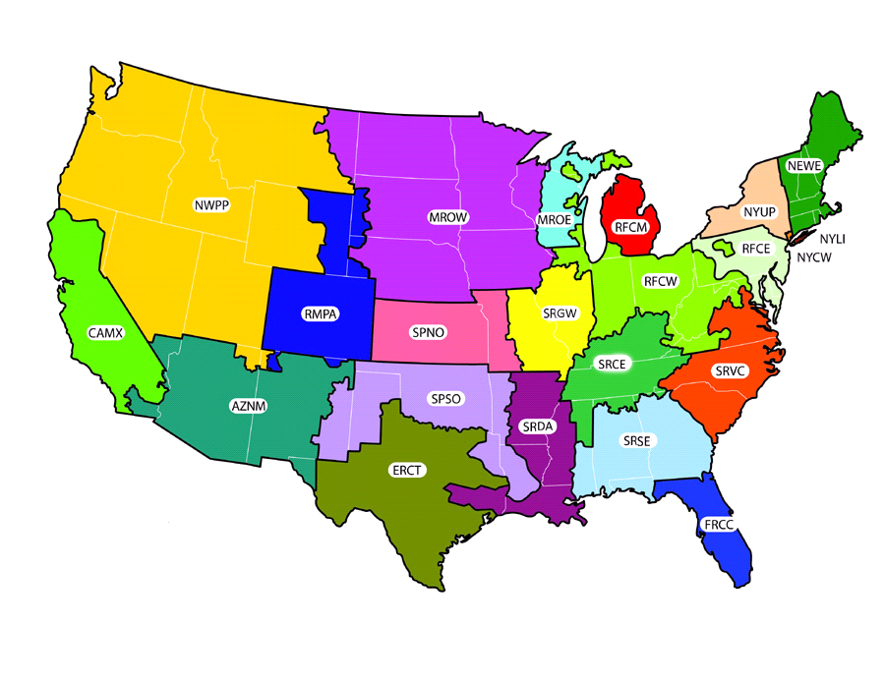
The average delivered price of coal to electricity generators varies widely across U.S. regions – transport costs are a key reason
2014 delivered coal prices, nominal $ per million Btu
$2.78
$2.27
$2.66
$2.27
N/A
$1.66
$1.81
N/A
$2.41
$2.64
$1.74
$1.94
$2.12
1.96
$2.44
$3.31
$2.28
$2.19
$2.21
$2.64
National Average | Minimum | Maximum
$2.35 | $1.66 | $3.31
$2.22
$2.82
Source: EIA, Annual Energy Outlook 2016

Slide 6
Regional coal production is 17%-32% lower in the Reference case by 2040 than in the No CPP case
U.S. coal production
million short tons
History
2015
Projections
No CPP
West
AEO2016 Reference
Appalachia
Interior
Source: EIA, Annual Energy Outlook 2016

Slide 7
Coal exports do not appear to represent a significant market opportunity for U.S. coal producers
million short tons
History
Projections
Sources: History: EIA, Quarterly Coal Report; Projections: EIA, Annual Energy Outlook 2016

Slide 8
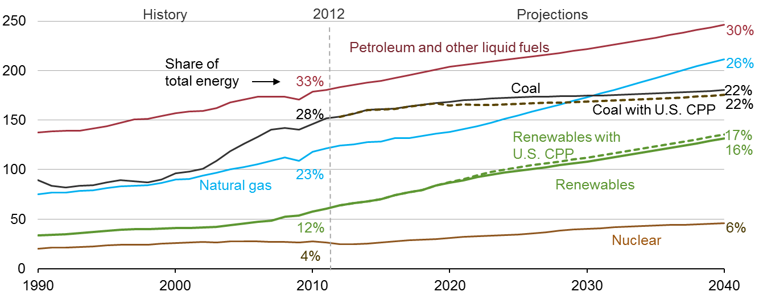
EIA’s International Energy Outlook 2016, which does not include all INDCs or assume reductions to limit warming to 2ºC, projects a plateau in global coal use
world energy consumption
quadrillion Btu
Source: EIA, International Energy Outlook 2016 and EIA, Analysis of the Impacts of the Clean Power Plan (May 2015)

Slide 9
For more information
U.S. Energy Information Administration home page | www.eia.gov
Annual Energy Outlook | www.eia.gov/forecasts/aeo
International Energy Outlook | www.eia.gov/forecasts/ieo
Short-Term Energy Outlook | www.eia.gov/forecasts/steo
Today In Energy | www.eia.gov/todayinenergy
Monthly Energy Review | www.eia.gov/totalenergy/data/monthly

