Slide 1
Oil and natural gas -- outlook and drivers
for
Committee on Earth Resources
National Academies of Science, Engineering, and Medicine
May 4, 2016 | Washington, DC
by
Howard Gruenspecht, Deputy Administrator

Slide 2
Global supply has consistently exceeded demand since the start of 2014; EIA forecasts a return to market balance in the second half of 2017
World supply and demand
million barrels per day
implied stock change
million barrels per day
Source: EIA, Short-Term Energy Outlook, April 2016

Slide 3
EIA expects WTI oil prices to remain low compared to recent history, but the market-implied confidence band is very wide
WTI price
dollars per barrel
Source: EIA, Short-Term Energy Outlook, April 2016

Slide 4
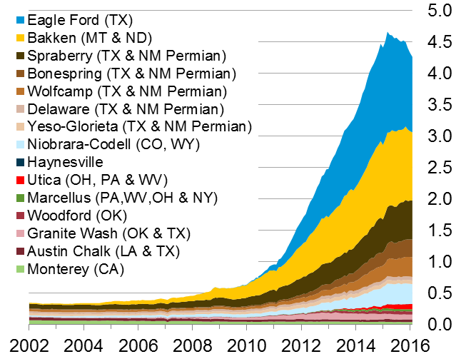
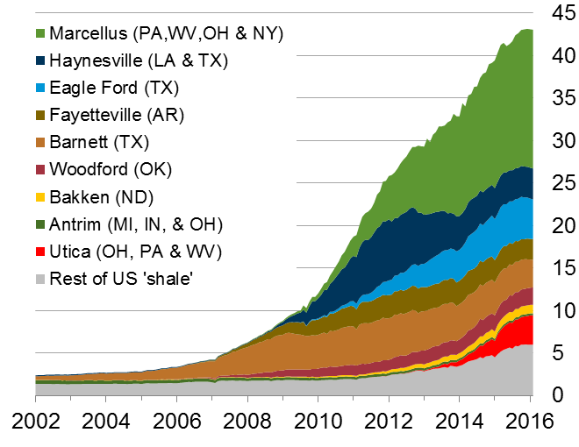
The U.S. has experienced a rapid increase in natural gas and oil production from shale and other tight resources
U.S. tight oil production
million barrels of oil per day
U.S. dry shale gas production
billion cubic feet per day
Sources: EIA derived from state administrative data collected by DrillingInfo Inc. Data are through February 2016 and represent EIA’s official tight oil & shale gas estimates, but are not survey data. State abbreviations indicate primary state(s).

Slide 5
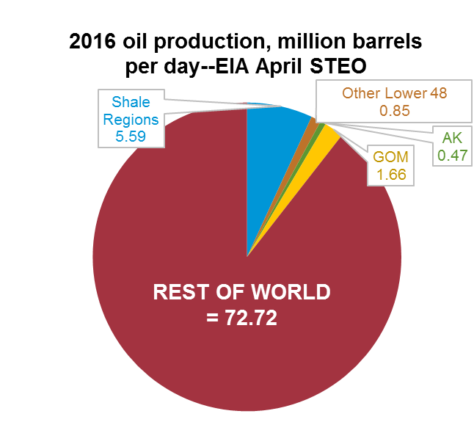
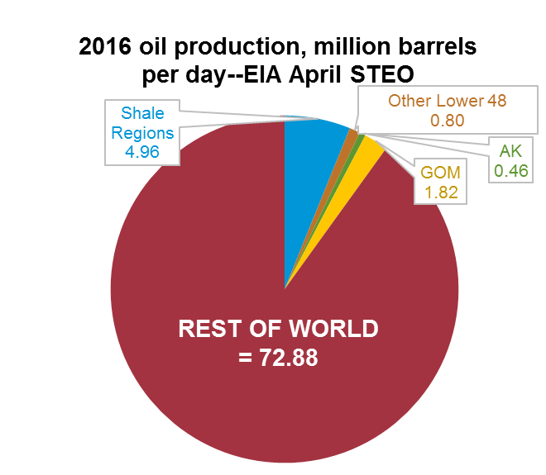
Crude supply trends outside the United States (red areas below) are key to future oil market balance: geopolitical developments, exporter decisions, and the timing and magnitude of supply effects stemming from reduced investment all matter
Source: EIA, Short-Term Energy Outlook and Drilling Productivity Report, April 2016; International Energy Agency

Slide 6
U.S. outlook

Slide 7
Increased production of tight oil and greater fuel efficiency drive decline in petroleum and other liquid imports
U.S. liquid fuels supply
million barrels per day
History
2013
Projections
2020
2040
14%
17%
33%
21%
Natural gas
plant liquids
Net petroleum and other liquids imports
21%
14%
29%
Tight oil
production
22%
17%
Other crude oil production
(excluding tight)
23%
25%
27%
Other
14%
12%
12%
Note: “Other” includes refinery gain, biofuels production, all stock withdrawals, and other domestic sources of liquid fuels
Source: EIA, Annual Energy Outlook 2015 Reference case

Slide 8
Resource and technology assumptions have major implications for projected U.S. crude oil production beyond the next few years
U.S. crude oil production
million barrels per day
2013
2013
2013
History
Reference
High Oil and Gas Resource
Low Oil Price
U.S. maximum production level of
9.6 million barrels per day in 1970
Tight oil
Lower 48 offshore
Alaska
Other lower 48 onshore
Source: EIA, Annual Energy Outlook 2015
Notes:
8
8

Slide 9
U.S. reliance on net imports of petroleum and other liquids is virtually eliminated by 2035 in High Oil and Gas Resource case
net crude oil and petroleum product imports as a percentage of total U.S. supply
percent
2013
History
Projections
Low Oil Price
Reference
High Oil Price
High Oil and Gas Resource
Source: EIA, Annual Energy Outlook 2015

Slide 10
Takeaways – Natural gas
North American natural gas production is more likely to be limited by demand than supply
U.S. natural gas demand growth is likely to be concentrated in electricity and industrial uses; natural gas exports and use in the transportation sector, where little natural gas is used today, are also likely to grow
Potential challenges to natural gas demand growth include
Slow growth in U.S. electricity demand
Competition from offshore “stranded” gas for global LNG exports and siting of gas-intensive industries.
Long-term cheap oil would be another significant challenge to LNG exports
Extent and nature of global price convergence in natural gas markets
Future policies that target particular sources or uses of energy or energy-related emissions can really matter for future natural gas demand

Slide 11
Natural gas consumption growth is concentrated in electricity generation and industry; gas use rises in all sectors except residential
U.S. dry gas consumption
trillion cubic feet
billion cubic feet per day
History
Projections
Residential
Commercial
Transportation**
Electric power
Industrial*
10.9
8.9
9.4
8.2
0.9
1.6
3.3
3.6
4.9
4.2
*Includes combined heat-and-power and lease and plant fuel
**Includes pipeline fuel
Source: EIA, Annual Energy Outlook 2015 Reference case

Slide 12
Shale resources remain the dominant source of U.S. natural gas production growth
U.S. dry natural gas production
trillion cubic feet
billion cubic feet per day
History
Projections
2013
Shale gas and tight oil plays
Other lower 48 onshore
Tight gas
Coalbed methane
Lower 48 offshore
Alaska
Source: EIA, Annual Energy Outlook 2015 Reference case
Notes:
12
12

Slide 13
Projected U.S. natural gas exports reflect the spread between domestic natural gas prices and world energy prices
U.S. natural gas imports and exports
trillion cubic feet
billion cubic feet per day
History
Projections
2013
2013
2013
40
Lower 48 states LNG exports
30
Alaska LNG exports
20
Pipeline exports to Mexico
10
0
Pipeline exports to Canada
Pipeline imports from Canada
-10
Reference
High Oil and Gas Resource
Low Oil Price
LNG imports
-20
Source: EIA, Annual Energy Outlook 2015
Notes:
13
13

Slide 14
Global outlook

Slide 15
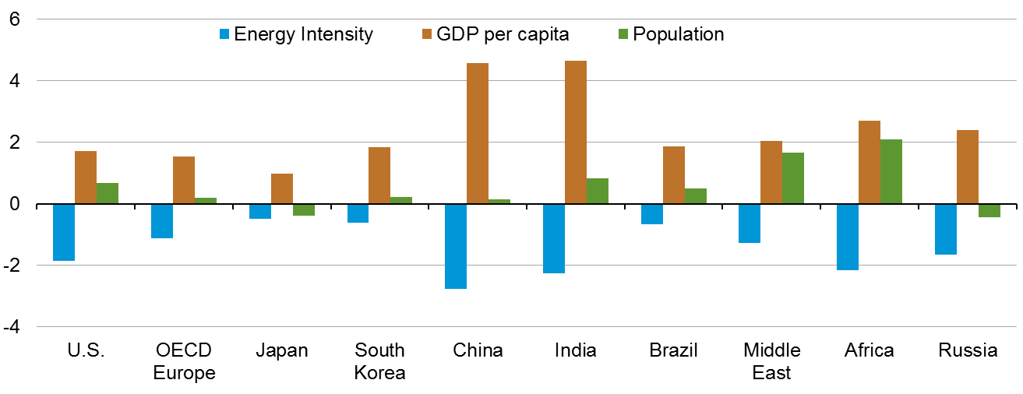
Economic activity and population drive increases in energy use; energy intensity (E/GDP) improvements moderate this trend
average annual percent change (2012–40)
percent per year
Source: Current Thinking

Slide 16
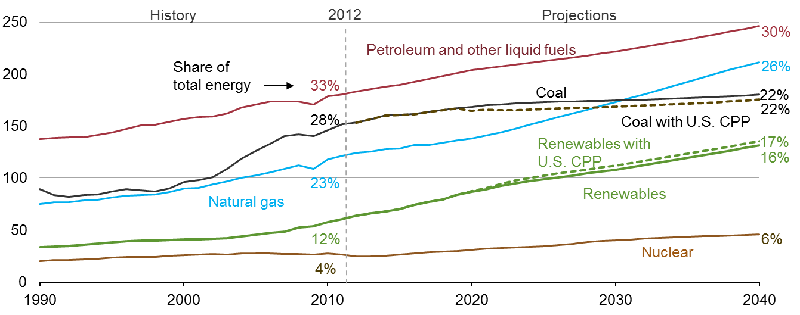
Renewables grow fastest, coal use plateaus, natural gas surpasses coal by 2030, and oil maintains its leading share
world energy consumption
quadrillion Btu
Source: Current Thinking

Slide 17
Passenger-miles per person will rise as GDP per capita grows; travel growth is largely outside the OECD
passenger-miles per capita (left-axis) and GDP per capita (horizontal-axis) for
selected country groupings 2010–40
Source: EIA, International Energy Outlook 2016

Slide 18
Most of the growth in world oil consumption occurs in the non-OECD regions — especially Asia
world petroleum and other liquid fuels consumption
million barrels per day
Source: EIA, International Energy Outlook 2016

Slide 19
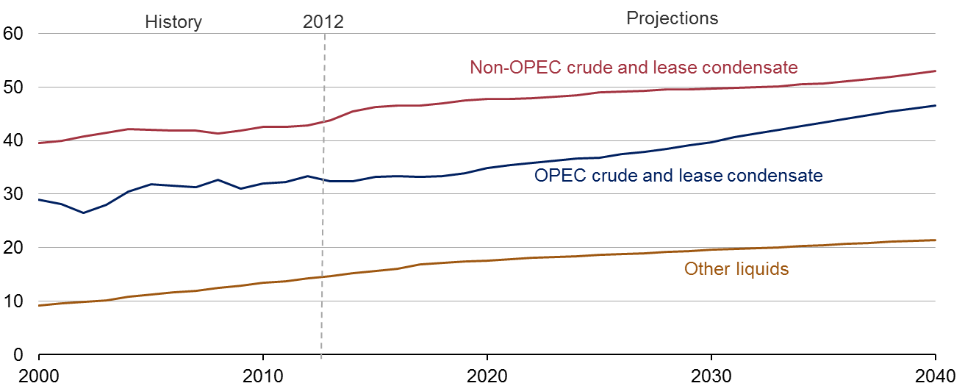
Liquid fuels supplies from both OPEC and non-OPEC producers increase through 2040
world production of petroleum and other liquid fuels
million barrels per day
Source: Current thinking

Slide 20
LONGER TERM PERSPECTIVE: Can OPEC cohere? – Change in world liquid fuel balances for two 12-year historical periods with EIA projections for 2013-25 from AEO2015 (million barrels per day)
 | Actual |  | Projected AEO 2015 Reference & HOGR Cases
 | 1973–85 | 2000–12 | 2013–25
World Liquids Demand | +3 | +12 | +12 to +13
OECD | -4 | -2 | +1
Non-OECD | +7 | +15 | +11
World Liquids Supply | -1 | +12 | +11 to +12
Non-OPEC Supply | +13 | + 6 | +10 to +15
OPEC Production | -14 | + 6 | -3 to +2
Source: EIA, Annual Energy Outlook 2015, April 2015

Slide 21
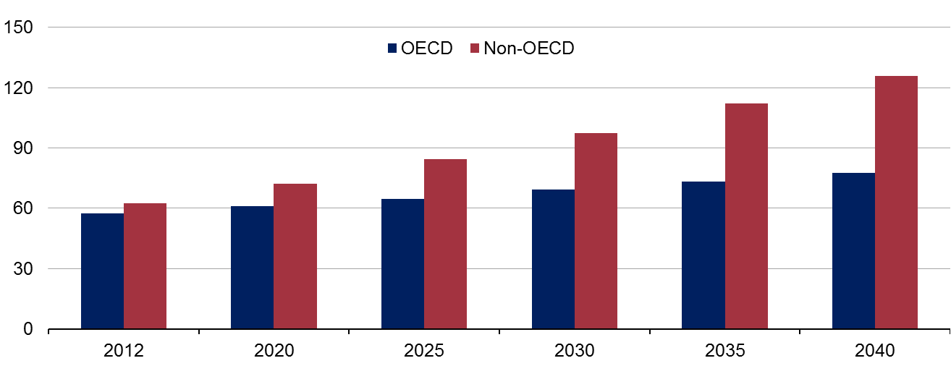
Non-OECD nations account for ¾ of projected growth in natural gas consumption
world natural gas consumption
trillion cubic feet
Source: Current Thinking

Slide 22
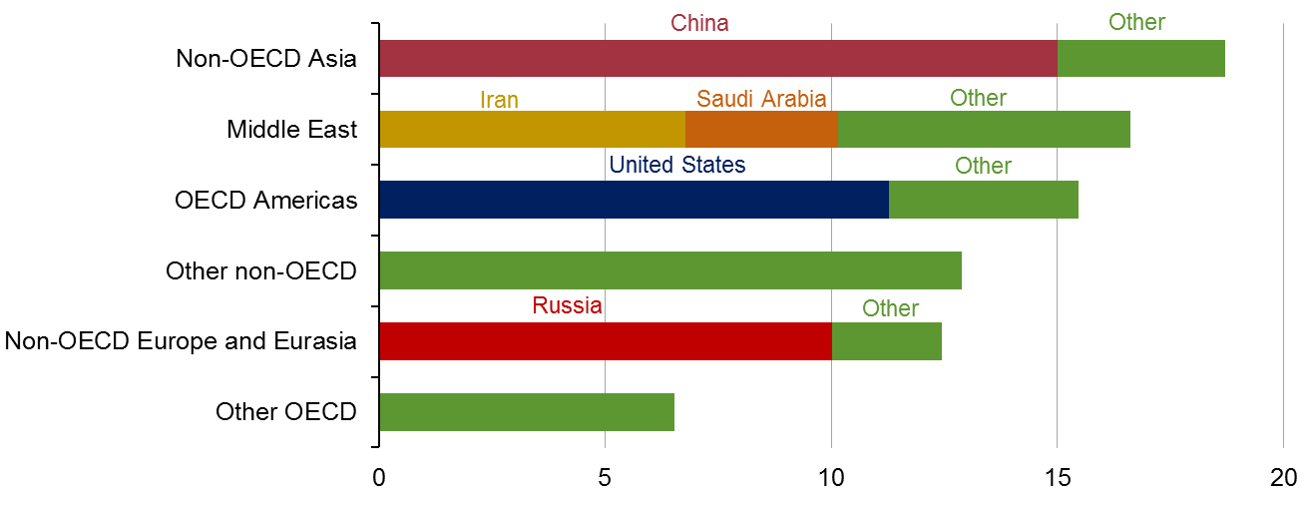
Non-OECD Asia, Middle East, and OECD Americas account for the largest increases in natural gas production
world change in natural gas production, 2012–40
trillion cubic feet
Source: Current thinking

Slide 23
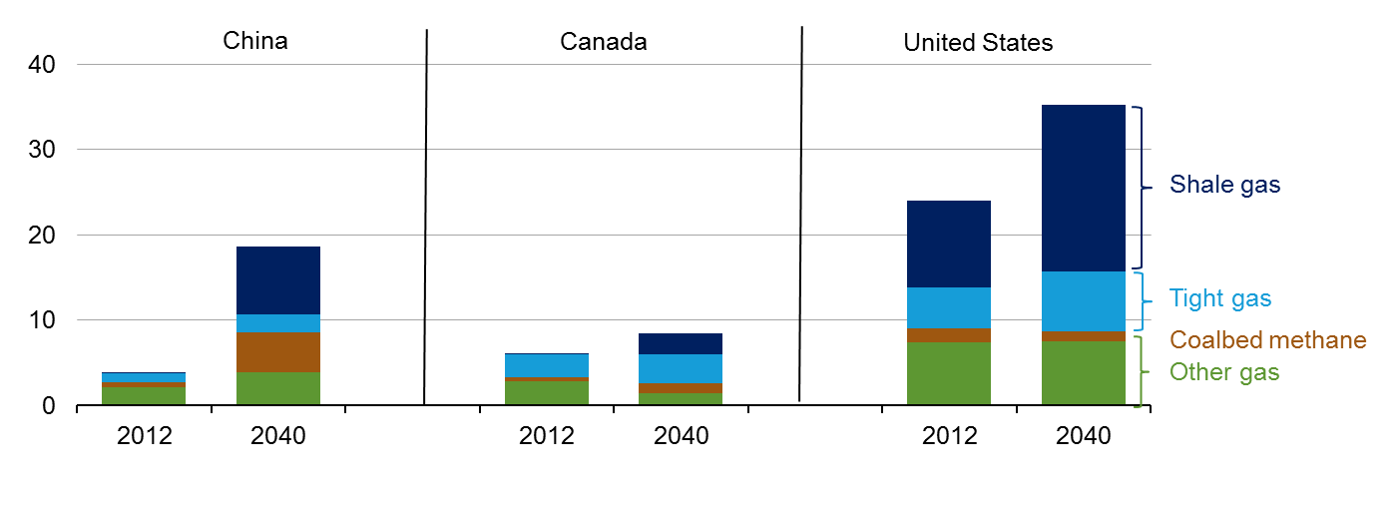
Shale gas, tight gas, and coalbed methane become increasingly important to gas supplies, not only for the U.S., but also China and Canada
natural gas production by type
trillion cubic feet
Note: Other natural gas includes natural gas produced from structural and stratigraphic traps (e.g. reservoirs), historically referred to as ‘conventional’ production.
Source: Current thinking

