Slide 1
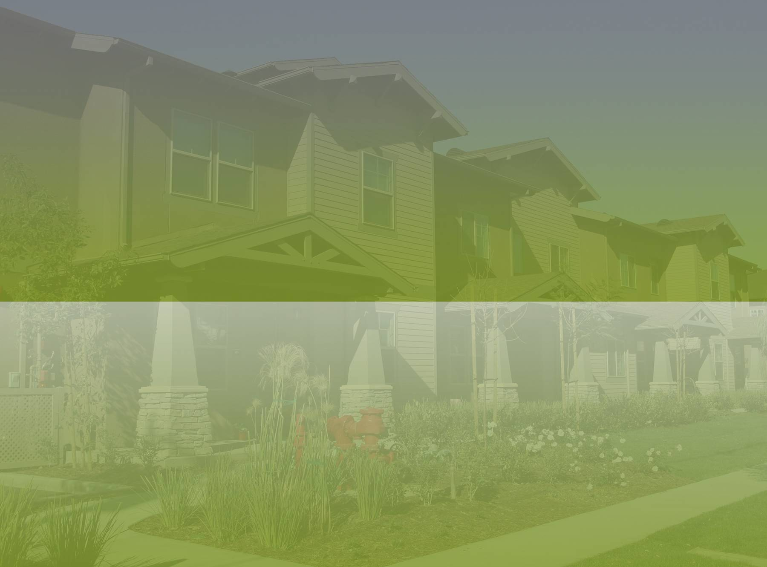
Brownfields RLF Webinar Series:
Site and Applicant Eligibility
Call In: 866-299-3188 / code 202 566 2773
November 5, 2012

Slide 2
Eligible Sites
The site must meet the brownfield definition, which is:
“...real property, the expansion, redevelopment, or reuse of which may be complicated by the presence or potential presence of a hazardous substance, pollutant, or contaminant.”
Abandoned, idled, or underused industrial or commercial properties
Reuse/redevelopment is complicated by real or perceived environmental contamination
Site and Applicant Eligibility
Notes:
Eligible Sites
With respect to eligible sites, the first thing that you are going to need to look at is whether it meets the brownfields definition, which was established in early 2002 with the passage of the Brownfields law. I’m sure you’re all familiar so I won’t repeat but the key point is that there is contamination on the site that is inhibiting the reuse.

Slide 3
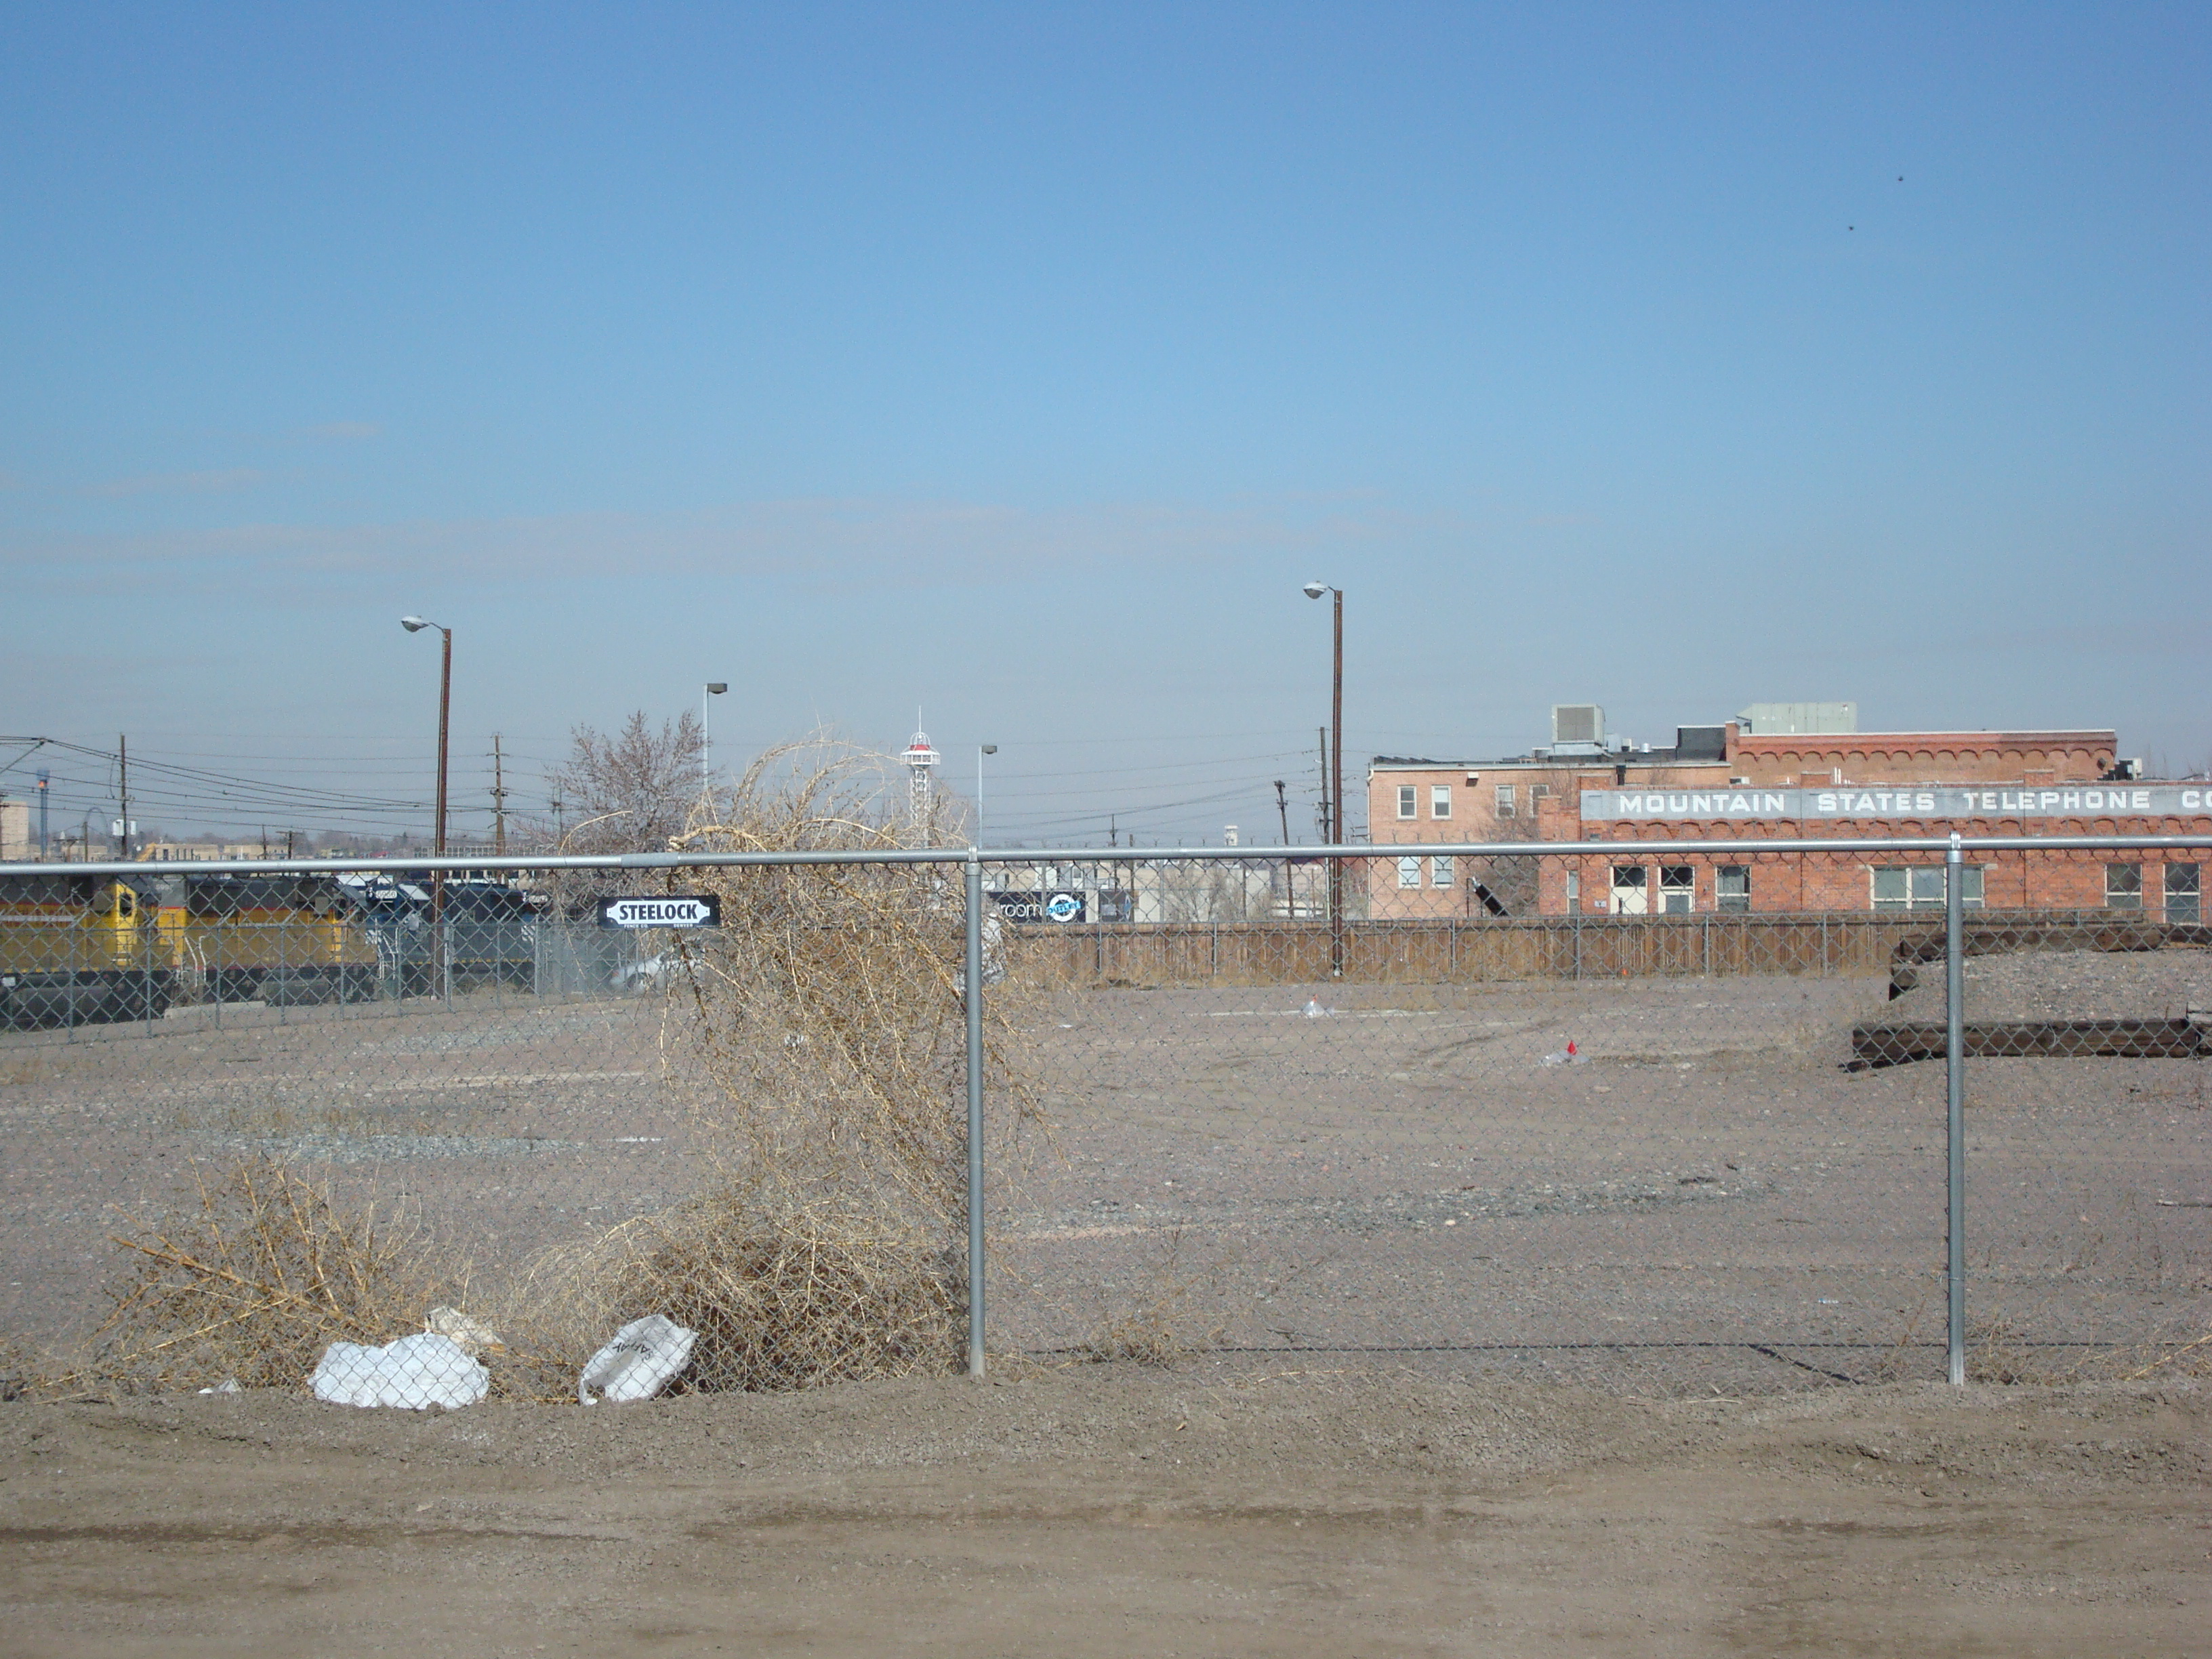
Eligible Sites
Before After
Notes:
A key aspect of meeting the brownfields definition is that the site you intend to cleanup will have a reuse. What we want to avoid is that you start with a dirt field and a chain link fence, and after the cleanup you end up with a dirt field and a chain link fence. Even though the site is clean, the community doesn’t perceive a lot of benefits of that process. So in order to fully meet the definition, there needs to be a reuse component.

Slide 4
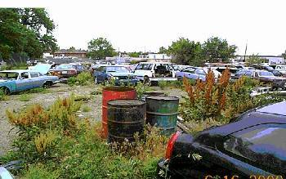
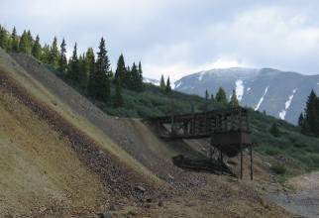
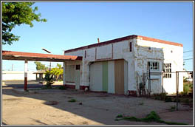
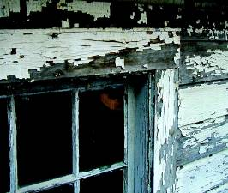
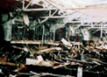
Eligible Sites
Sites with the following contaminants can be eligible for RLF loans and sub-grants:
Hazardous substances
Petroleum contamination
Asbestos & lead based paint
Controlled substances (e.g., meth labs)
Mine-scarred lands
Other contaminants
Site and Applicant Eligibility
Notes:
Eligible Sites
There are many different types of sites that are eligible for loans and subgrant, and this is not really any different than the brownfields grants, and these can include, but are not limited to
Sites contaminated by various hazardous substances
Sites contaminated by petroleum or petroleum products
Sites contaminated by controlled substances
Mine scared lands
Sites contaminated with asbestos (common question. As long as there has not been a release to the environment that triggers CERCLA.)
Sites contaminated with lead based paint
Among others – really the definition is pretty broad and it’s not just limited to narrow list of contaminants.

Slide 5
Petroleum Sites
State review based on statutory requirements to
determine whether the site is:
  Relative low risk
  No viable responsible party
  Applicant not responsible party
  No RCRA order
Site and Applicant Eligibility
Notes:
Petroleum Sites
If anyone has used brownfields funding for sites contaminated with petroleum, you probably know that eligibility is a bit more tricky than for sites with hazardous substances contamination or comingled petroleum and hazardous substances. Generally, petroleum site eligibility will be determined by the state, and when the state cannot do this, then EPA will make the determination. Briefly the statutory requirements that need to met include in order to use brownfields funds on a petroleum site include…
“relatively low risk” compared to other sites in the state,
there is no viable responsible party,
and the applicant cannot be potentially liable for cleaning up the site,
and no RCRA order – which is the resource conservation and recovery act…

Slide 6
Properties not considered
Brownfields by EPA
Listed sites or sites proposed for listing on the National Priorities List (NPL);
Sites subject to CERCLA orders or consent decrees; or,
Federal properties (except land held in trust for an Indian tribe)
Site and Applicant Eligibility
Notes:
Sites excluded from the brownfields definition and thus are not eligible are sites:
The brownfields law excluded some sites from the definition, and these are not eligible for subgrants or loans. This includes…
Listed or proposed for listing on NPL or that’s also known as a superfund site.
Subject to unilateral administrative orders, court orders, administrative orders on consent,
or judicial consent decrees issued or entered into under CERCLA
Federal property is not eligible.

Slide 7
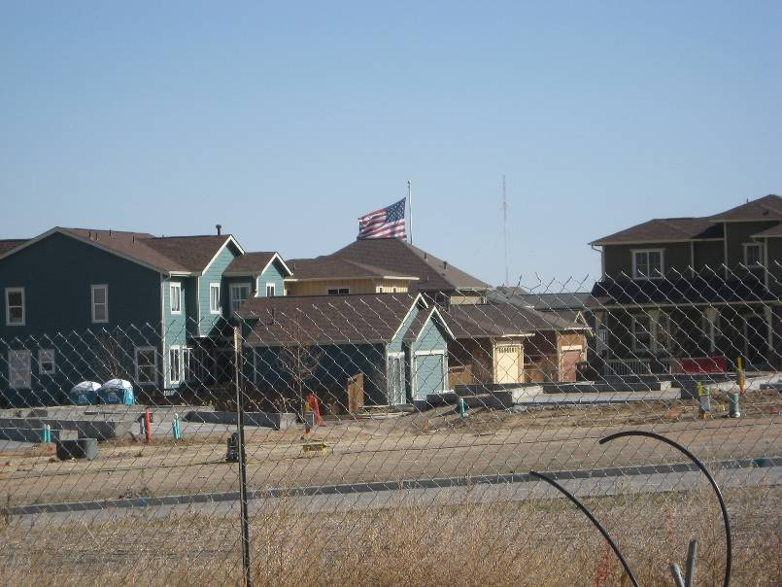
Eligible Borrowers and Sub-grantees
Eligible Borrowers
Any public or private entity with control or access of the brownfields site
Eligible Sub-grantees
States
Local governments
Tribes
Non-profit organizations
Redevelopment agencies
Land clearance authorities
Other quasi-governmental entities created by state or local governments
Gold Hill Mesa Redevelopment, Colorado Springs, Colorado
Site and Applicant Eligibility
Site and Applicant Eligibility
Notes:
Moving from eligible sites, to eligible borrowers and Subgrantees.
Eligible Borrowers
Eligible borrowers can be any public or private entity with control or access of the brownfields site.
The borrower does not need to own the site they intend to cleanup.
The grantee can give a loan to itself if that is what you want to do.
Eligible Subgrantees
Eligible sub grantees are limited to cities, states, tribes and other government entities, plus non-profits, as well as quasi governmental redevelopment authorities
Similar folks who are eligible to receive other types Brownfields grants.

Slide 8
Sub-grantee Eligibility Restrictions
Cannot sub-grant to yourself
Sub-grantee must own the land
For profit organizations are not eligible for sub-grants
Max of $200,000 sub-granted per site, and up to 50% of your grant
It is ok to pair a $200k cleanup grant and a $200k RLF sub-grant or multiple $200k RLF sub-grants from different RLF grants
Site and Applicant Eligibility
Notes:
Sub-grantee Restrictions –
Cannot give subgrant to yourself. But you can subgrant to a coalition member. So whoever the primary grantee cannot get a subgrant, but another coalition member can.
Unlike loans, Must have ownership of the land at the time the subgrant is awarded and through the end of the project being funded by the sub-grant.
For profit organizations are not eligible for subgrants.
Also with subgrants, you can only subgrant $200,000 per site, and a max of 50% of your grant can go towards subgrant and the other 50% has to go towards loans. While subgranting can fill in an important niche in your financial toolbox, if you give away your money your overall ability to make future loans is diminished.
Cannot pair two subgrants from separate RLFs for work on one site.
It is ok to pair a $200k cleanup grant and a $200k RLF subgrant
Probably way more than you ever wanted to know about subgrants.

Slide 9
Eligible Borrower/Sub-grantee
The borrower/sub-grantee cannot be a potentially liable party under CERCLA 107:
Past owner or operator during release of contamination
Cause or contributor to contamination
Generator or transporter of contamination
Voluntary acquisition without All Appropriate Inquiry (AAI)
Site and Applicant Eligibility
Notes:
CERCLA 107 - Comprehensive Environmental Response, Compensation, and Liability Act
An important factor with eligibility is that the borrower/subgrantee cannot be considered liable for the contamination they intend to cleanup. So in other words, you cannot give a loan or a subgrant to a responsible party, which could include:
Past owner or operator of the site during release of contamination
The person who caused or contributed to the contamination
The Generator or transporter of contamination
Those first three are fairly standard, but the last bullet is key to the brownfields world, which says that if the potential borrower or subgrantee voluntarily acquires a contaminated property without doing your All Appropriate Inquiry (AAI) or prior due diligence, you could be considered liable as well and thus not eligible for brownfields funding. More on AAI here…

Slide 10
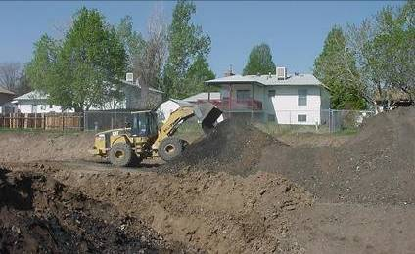
All Appropriate Inquiries (AAI)
AAI is the process of evaluating a property for:
  Potential environmental contamination
  Potential liability for environmental contamination
Requires Phase I environmental site assessment within 6 months (180 days) prior to voluntary acquisition.
Also known as: “Environmental due diligence”
and “Environmental site assessment
standards”
ASTM Standard E1527 - 05
AAI Rule available at:
www.epa.gov/brownfields.regneg.htm
Idalia Court RLF Cleanup, Aurora Colorado
Site and Applicant Eligibility
Notes:
All Appropriate Inquiry
AAI is a way for a party to voluntary take ownership without assuming liability or becoming responsible for the contamination. There are steps to meet the AAI requirements and I won’t get into all of these, but briefly they include:
conducting your Phase 1 environmental assessment within 6 months (180 days) prior to voluntarily acquiring the property. The timeframe is very important and Phase 1’s have a limited shelf-life, need to be updated if the acquisition will take longer than a year.
Once you buy it, you also have the responsibility of taking (or have taken) reasonable steps to control any release once you voluntarily take ownership.
This is very important because if a prospective borrower acquired a contaminated property and didn’t do its phase 1 prior to purchase or control the release afterwards, they may not be eligible for your loan. So if you are getting calls from prospective borrowers who bought a contaminated site, one of the first things you are going to check is if they did they their AAI.
Just know that this has been done many times in this country and its a fairly common process in real estate transactions and with RLFs. See PDF "Common Elements" and All Appropriate Inquiry Website.

Slide 11
Eligible Uses of RLF Funds
  Site eligibility per CERCLA 104(k)
  Installation of fences, warning signs, or other security or site control precautions
  Preparing an Analysis of Brownfields Cleanup Alternatives (ABCA)
  Ensuring public participation requirements are met including Community Relations Plan
  Establishing an administrative record for each site
  Removal of drums, barrels, tanks etc that contain/may contain hazardous substance or petroleum
  Sampling as related to design/implementation of selected cleanup plan (Confirmatory sampling)

Slide 12
Eligible Uses of RLF Funds
Developing a Quality Assurance Project Plan (QAPP)
Ensuring adequacy of cleanup and overseeing activities to ensure compliance with Federal & State requirements
Ensuring site is secure if borrower/subrantee is unable or unwilling to complete cleanup
Purchasing environmental insurance
Other eligible programmatic costs
Subgrantee progress reporting
*Others. Always check with your EPA Project Officer!

Slide 13
Ineligible Uses of RLF Funds
Funds cannot be used for:
  Pre-cleanup assessment activities (Phase I & II)
  Monitoring and data collection for permits under federal or state laws unless required by cleanup
  Non-cleanup related construction, demolition, development and addressing deteriorated drinking water supplies
  Job training unrelated to site cleanup
  Paying a penalty or fine
  Meeting a federal cost share requirement unless allowed by statutory authority
  Paying a response cost at a site where the recipient of a loan or subgrant is liable under CERCLA 107
  Paying a cost of compliance with any federal law not applicable to the cleanup

Slide 14
Ineligible Use of RLF Funds
  Administrative costs and all indirect costs under OMB Circulars
  are prohibited
    Ineligible administrative costs are salaries, benefits, contractual costs, supplies and data processing charges incurred to comply with Uniform Administrative Requirements for Grants in 40 CFR Part 30 or Part 31 and direct costs for grant and subgrant administration not identified in eligible costs
    See T&C for list of ineligible grant or subgrant administration costs
Notes:
Ineligible admin costs – proposal preparations, record retention, preparing revisions/changes to budgets, scopes of work; maintaining/operating financial systems etc

Slide 15
Eligibility Exercises
Scenario #1
10 acre former 1920s papermill site, no NHPA designation
The site is contaminated w/ a mixture of cinders, ash, sludge residue, heavy metals and PCBs
Cleanup plan calls for on-site consolidation and management of materials through a combination of engineering controls (road ROWs and greenspace)
Planned end use of the site is single family homes.
Groundwater, though impacted, will not impede the reuse of the site as homes will be connected to city municipal system
Cleanup costs are estimated at approximately $850,000 and the RLF grantee executes a hazardous substance loan with the developer as the borrower
Are the following activities authorized by the grantee eligible?
1. Loan funds are used to finalize the cleanup plan for review and approval by the State’s Voluntary Cleanup Program (VCP). The VCP requires additional sampling to fill in data gaps and one additional round of groundwater sampling to confirm that previously documented releases to groundwater have not significantly changed. The borrower uses loan funds to undertake the additional sampling required by the VCP. ANSWER: if a few additional samples needed than it is an eligible expense.
Notes:
1. If a few additional samples needed than it is an eligible expense.

Slide 16
Eligibility Exercises
Scenario #1 (contd) - Are the following activities authorized by the grantee eligible?
Several “hot spots” were identified during the assessment work located outside the main area requiring cleanup. These hot spots also require excavation. The borrower authorizes the use of loan funds to undertake some limited “step out” sampling of each hot spot to more fully delineate theses areas. This will better enable the borrower’s consultant to develop more detailed bid specifications. ANSWER: this is cleanup planning. It was already assessed, we just need to delineate what it was to make proper parameters for the bid.
During preparation of the bid specifications for cleanup, and upon reviewing additional historical information on the site, the borrower’s consultant identifies an area of concern on a portion of the site that had not previously been characterized. The borrower authorizes its consultant to use loan funds to characterize soil and groundwater in this additional area of concern. ANSWER: Ineligible – it would be assessment and would not be allowed. Key is “has not previously been characterized.”
Cleanup has started and is ongoing. Soil confirmation sampling is showing that the area requiring excavation is larger than originally defined. Contamination extends beneath the outbuildings that remain from the historical industrial operations. The contractor consults with the borrower and authorization is given to use loan funds to remove the buildings. ANSWER: Eligible - if there’s enough $$ to cover extra costs they have to remove the buildings to get to contaminated soil.
The VCP charges fees for document review including: 1) the draft cleanup plan and cleanup completion report; 2) cleanup oversight; and 3) issuance of a Certificate of Completion, No Further Action Letter, Covenant Not To Sue, or whatever the VCP does to certify that the cleanup is complete. The borrower uses loan funds to pay these fees. ANSWER: Eligible – yes all of these would be eligible expenses because not outside the cleanup. Required fees are part of the cleanup. All are allowable fees.
Notes:
2. Eligible – this is cleanup planning. It was already assessed, we just need to delineate what it was to make proper parameters for the bid.
3. Ineligible – it would be assessment and would not be allowed. Key is “has not previously been characterized.”
4. Eligible - if there’s enough $$ to cover extra costs they have to remove the buildings to get to contaminated soil.
5. Eligible – yes all of these would be eligible expenses because not outside the cleanup. Required fees are part of the cleanup. All are allowable fees.

Slide 17
Eligibility Exercises
Scenario #2
The City of Rivertown, South Dakota was awarded a $1,000,000 ($600,000 hazardous substance and $400,000 petroleum) EPA RLF grant in 2011 and has not yet made a loan.
A local non-profit called Rivertown Stewards wants to cleanup a scrap yard site along the Missouri river and convert into a park with recreational trails.
The site is owned by Recyclers Inc, which operated the scrap yard for 25 years. The company just filed for bankruptcy and has agreed to allow Rivertown Stewards to cleanup the site and convert it to parks and trails.
The company would sell the land to Rivertown Stewards, but the non-profit is uncertain about taking ownership of a dirty site.
A year and a half ago, Rivertown Stewards used a Targeted Brownfields Assessment (TBA) to conduct a Phase 1 and 2 assessment and the results showed elevated levels of PCE contamination on the site. There is no state or federal enforcement action and the site is not on the National Priorities List (NPL). Estimated cleanup costs are at $700,000.
John Helphand, RLF fund manager from the City, thinks he could use the City’s RLF and give a $700,000 subgrant to the non-profit for the entire cleanup.
Is he right? Why/why not? If not, what could John or the non-profit do to get the site cleaned up? ANSWERS ON NEXT SLIDE
Notes:
The City cannot give a subgrant to the city for $700,000 – this amount exceeds the subgrant limit of $200,000, and a grantee can only subgrant 50% of its budget. Furthermore, the City only has $600,000 of hazardous substance funds (no petroleum on this site). To get the site cleaned, one option is for the non-profit to update its phase 1 to purchase the property (and meet AAI requirements) and then they would be eligible for a loan for the cleanup, providing it has adequate financial resources to payback the loan. Or they could get a $200,000 subgrant and combine it with a loan for the remaining portion. For the subgrant to work, the non-profit would need to take ownership and do AAI to acquire the property and assert BFFP status. Alternatively, the City could acquire the property and conduct the cleanup (and loan to itself). The City also should know that by sugranting, it is depleting its RLF and diminishing the long term ability to make loans and cleanup sites. The City should also call its EPA PO to discuss the site and applicant eligibility.
Could consider a subgrant/loan split and then a loan for the rest. Could also apply for a cleanup grant.

Slide 18
Eligibility Exercises
Possible answers for Scenario #2
The City cannot give a subgrant to the city for $700,000 – this amount exceeds the subgrant limit of $200,000, and a grantee can only subgrant 50% of its budget.
The City only has $600,000 of hazardous substance funds (no petroleum on this site).
To get the site cleaned, one option is for the non-profit to update its phase 1 to purchase the property (and meet AAI requirements) and then they would be eligible for a loan for the cleanup, providing it has adequate financial resources to payback the loan.
Or they could get a $200,000 subgrant and combine it with a loan for the remaining portion. For the subgrant to work, the non-profit would need to take ownership and do AAI to acquire the property and assert BFFP status.
Alternatively, the City could acquire the property and conduct the cleanup (and loan to itself). The City also should know that by sugranting, it is depleting its RLF and diminishing the long term ability to make loans and cleanup sites.
Could consider a subgrant/loan split and then a loan for the rest.
Could also apply for a cleanup grant.
The City should also call its EPA PO to discuss the site and applicant eligibility.

Slide 19
Eligibility Exercises
Scenario #3
Sustainable Ventures, LLC is a redevelopment company based in Nice City, Utah. Linda Green, the company’s Acquisitions Director recently purchased a brownfield site on the North end of Nice City that is contaminated with arsenic, lead and petroleum.
Sustainable Ventures would like to cleanup the contamination and then construct a LEED certified mixed commercial, residential and open space redevelopment.
Linda Green heard that Nice City has a fund available to make low-interest loans or subgrants for cleanup projects and she decides to call to learn more.
As the RLF Manager for Nice City, what are you going to ask to determine if the site and potential applicant are eligible? ANSWERS ON NEXT SLIDE
Notes:
Answer (not provided to participants): As an RLF manager, it’s common to get a call from someone who says “I’ve heard about your fund and I have a possible cleanup project, and let’s talk to see if this could work.”
So, as RLF manager you need to get some more information and you want to ask:
Has a phase 1 or phase 2 been established?
Is the site part of the State Voluntary Cleanup Program?
Is the site on a CERCLA list or a National Priorities List or is there a state or federal enforcement action”?
Did you conduct your AAI within 180 days prior to purchase?
When did they buy it?
Is Sustainable Ventures affiliated with the responsible party?
Is the petroleum commingled with the hazardous substances?
If petroleum is present, has the state determined the site to be eligible?
What do they want to use the RLF funds for? (i.e., make sure it’s cleanup related)
Is there an interested private developer? (Just need to have control of the site, don’t have to own it)
Davis-Bacon – will you use prevailing wage on the project?
Others?
Once you get this information, a good next step for the RLF Manager is to call your PO to discuss eligibility and then meet with the potential borrower to discuss the application process.

Slide 20
Eligibility Exercises
Possible answers for Scenario #3
As an RLF manager, it’s common to get a call from someone who says “I’ve heard about your fund and I have a possible cleanup project, and let’s talk to see if this could work.”
So, as RLF manager you need to get some more information and you want to ask:
Has a phase 1 or phase 2 been established?
Is the site part of the State Voluntary Cleanup Program?
Is the site on a CERCLA list or a National Priorities List or is there a state or federal enforcement action”?
Did you conduct your AAI within 180 days prior to purchase?
When did they buy it?
Is Sustainable Ventures affiliated with the responsible party?
Is the petroleum commingled with the hazardous substances?
If petroleum is present, has the state determined the site to be eligible?
What do they want to use the RLF funds for? (i.e., make sure it’s cleanup related)
Is there an interested private developer? (Just need to have control of the site, don’t have to own it)
Davis-Bacon – will you use prevailing wage on the project?
Once you get this information, a good next step for the RLF Manager is to call your PO to discuss eligibility and then meet with the potential borrower to discuss the application process.

Slide 21
“Stump The EPA”
Real Life Eligibility Questions from Grantees
Q: A non-profit CDC forms a Limited Dividend Housing Association Limited Partnership (LDHALP), the members of which are the non-profit CDC, a non-profit housing organization and a tax credit investor. The LDHALP is a for profit entity. The project includes low/moderate income housing and the funding mechanisms are Low-Income Housing Tax Credits and New Markets Tax Credits, thus the need for the tax credit investor partner. Would this scenario be eligible for a sub-grant? If the LDHALP is not eligible, could we make a sub-grant to one of the non-profits who have an interest in the property and are eligible to receive a sub-grant? ANSWER: The nonprofit incorporated themselves so they are a for-profit agency and wouldn’t be eligible. Suggestion to update a Phase I, transfer site to nonprofit and then once cleanup is done transfer back to for-profit group to ensure they retain their credits.
Notes:
1. Nonprofit incorporates themselves so they are a for-profit agency and wouldn’t be eligible.
Suggestion to update a Phase I, transfer site to nonprofit and then once cleanup is done transfer back to for-profit group to ensure they retain their credits.
Could the New Market Tax Credits repay the loan? [Megan checking w/ Charlie]

Slide 22
“Stump The EPA”
Real Life Eligibility Questions from Grantees
Q: Say the City of Bozeman built its City Hall in 1920 with asbestos and lead-based paint. Can the City receive a loan for cleanup so they can expand and renovate the building? ANSWER: The answer is yes as long as long as the asbestos and lead-based paint haven't been released to the outside environment. The windows, doors, walls and roof need to be fully intact to show the contaminants have no way of being released. When there is no release to the outside environment, CERCLA liability hasn't been triggered. So, in this case we're able to lend/grant funds even though the borrower is responsible for having the asbestos installed in the first place.
Q: Can a site which has been contaminated with PCBs as a result of a cutting/coating oil operation qualify for a RLF petroleum subgrant or loan? The remediation would consist of institutional controls. ANSWER: It depends. If there is trace amounts of PCB associated with the oily residue of a cutting/coating operation than this could be an eligible petroleum site. The state will be a big factor here on whether the state thinks it’s a petroleum site. Is it a low-priority for the state? Will they make EPA make the determination? This is information you’ll need to factor into your decision.
Notes:
2. The answer is yes as long as long as the asbestos and lead-based paint haven't been released to the outside environment. The windows, doors, walls and roof need to be fully intact to show the contaminants have no way of being released. When there is no release to the outside environment, CERCLA liability hasn't been triggered. So, in this case we're able to lend/grant funds even though the borrower is responsible for having the asbestos installed in the first place.
3. It depends. If there is trace amounts of PCB associated with the oily residue of a cutting/coating operation than this could be an eligible petroleum site. The state will be a big factor here on whether the state thinks it’s a petroleum site. Is it a low-priority for the state? Will they make EPA make the determination? \

Slide 23
“Stump The EPA”
Real Life Eligibility Questions from Grantees
Q: What is an intragovernmental loan? What are the requirements that a recipient must meet to be eligible for an intragovernmental loan? ANSWER: An intragovernmental loan is when an RLF grantee loans to another arm of the city or state. the recipient is the same entity, so they can’t be a PRP and would have had to acquire the property appropriately. Don’t have to own property if loan, just need access to it. So at state level could go to an arm of the state such as Transportation Department. Cities may go to housing authority or parks department.
Notes:
4. (Megan) Reqts – the recipient is the same entity, so they can’t be a PRP and would have had to acquire the property appropriately. Don’t have to own property if loan, just need access to it. So at state level could go to an arm of the state such as DOT. Cities may go to housing authority or parks department. Common with Brownfields Redevelopment Authorities in MI.

Slide 24
Brownfields Conference 2013
Please join us at the 2013 Brownfields Conference in Atlanta, May 15-17!
This training conference is an eligible cost under your RLF grant and will feature additional RLF sessions

Slide 25
Contacts
For questions about this webinar please contact your RLF Project Officer
This webinar will be posted here: http://www.epa.gov/brownfields/rlflst.htm

