Slide 1
Workplace Charging Management Policies
April 23, 2015
Sarah Olexsak, U.S. Department of Energy
Frank Marino, Raytheon
Zane Lichtneger, SAS Institute
Rajit Gadh, UCLA Smart Grid Energy Research Center
Notes:
Hello and welcome to the Workplace Charging Challenge Management Policy webinar.
Today’s webinar is the second in a series of webinars that we are hosting to address some of most pressing workplace charging topics affecting our partners and ambassadors.
Whether you are a Challenge partner, ambassador or stakeholder, I think you will find that all of us can benefit from hearing from today’s presenters about workplace charging management policies.

Slide 2
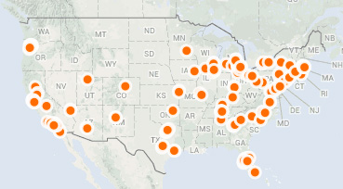
U.S. DOE Workplace Charging Challenge
Goal: Increase the number of employers offering charging by 10x by 2018
190 Partner employers committing to provide EVSE for employees
3,500+ EVSE installed or planned for installation
18 Ambassadors promoting and supporting workplace charging
Notes:
For those of you on the call who may not be familiar with the Workplace Charging Challenge, it was launched by the U.S. Department of Energy as part of the president’s EV Everywhere Grand Challenge which aims to make plug-in electric vehicles as affordable and convenient as gasoline powered vehicles by 2022.
The Workplace Charging Challenge works to raise the profile of workplace charging and increase the number of employers offering PEV charging to 500 by 2018. We are moving steadily toward our goal with 190 partners committing to provide charging station access to their employees.
These partners now represent over 350 worksites and they are providing over 3,500 workplace charging stations for nearly 1 million PEV driving employees across the country.
And some of the most exciting efforts to promote and support workplace charging are coming out of our 18 ambassador organizations and network of DOE Clean Cities coalitions.

Slide 3
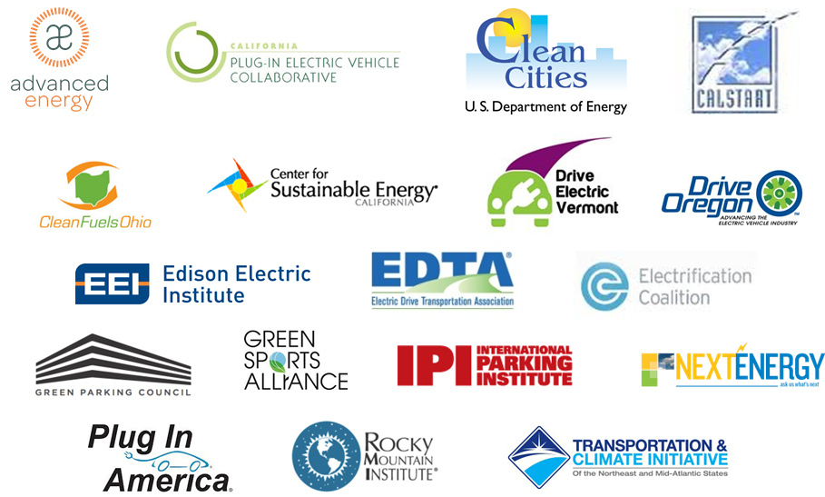
Ambassadors promote and support workplace charging
Notes:
Speaking of ambassadors, you can see that we have some really amazing organizations joining forces to help employers learn about the benefits of and overcome the challenges associated with workplace charging.

Slide 4
NEW REPORT: Overcoming Barriers to Deployment of PEVs
Finding: Charging at workplaces provides an important opportunity to encourage PEV adoption and increase the fraction of miles that are fueled by electricity.
Recommendation: Local governments should engage with and encourage workplaces to consider investments in charging infrastructure and provide information about best practices.
Notes:
Before we dive into our topic for today, we wanted to highlight a new report that just came out yesterday. At the request of Congress, DOE commissioned a study by the National Academies to address market barriers that are slowing the purchase of electric vehicles and hindering the deployment of supporting infrastructure. As a result of the request, the National Research Council (NRC)—a part of the National Academies—appointed the Committee on Overcoming Barriers to Electric-Vehicle Deployment.
The committee honed in on the importance of workplace charging and in 2013 two of our partners, Cisco and lynda.com, presented their experiences with workplace charging.
In yesterday’s final report, the committee underscored the importance of employee charging and recommended that local governments work with employers to promote the investment in workplace charging infrastructure.
The full report is now available on the academies’ website. Our thanks to Ali Ahmed at Cisco and Dana Jennings at lynda.com for providing leadership in workplace charging.

Slide 5
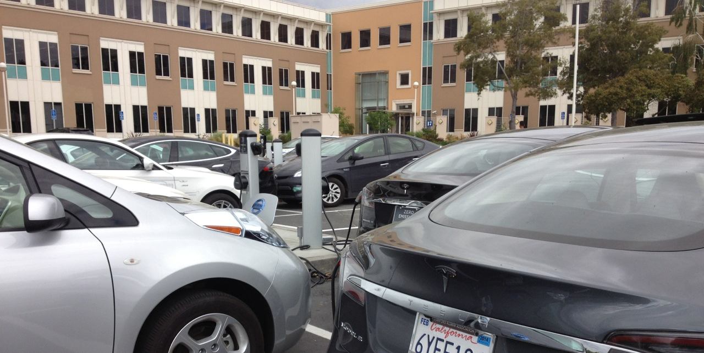
Workplace Charging Challenge Partner Plan
Program Background
Goals and Progress
Demand Assessment
Procurement & Installation
Management & Policy
PEVs/Charging Promotion
Notes:
As partners on the call know, one of the key things that we ask of our partners is that they complete and submit a partner plan. Whether or not you have already installed charging stations, Partner Plans are important in the establishment of a robust workplace charging strategy.
Utilizing best practices to develop the Partner Plan will help minimize barriers and smooth the way towards installing workplace charging at your organization and managing a workplace charging program. At DOE, we draw upon lessons learned from submitted plans and promote these best practices to other Partners.
One of the key parts of this plan is “Management and Policy” and focuses on establishing an internal company policy that will address all aspects of a well-managed workplace charging program.
For our partners on the call today, don’t forget that you can always talk to your account manager about your workplace charging plan.

Slide 6
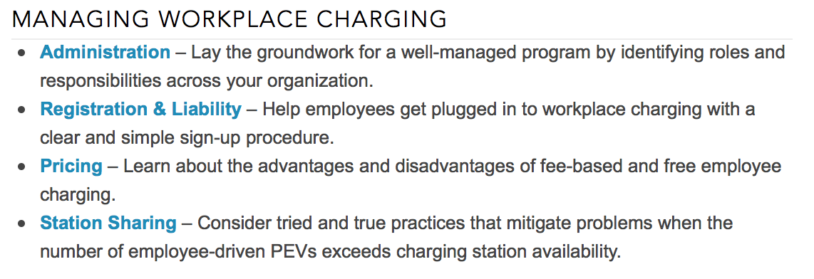
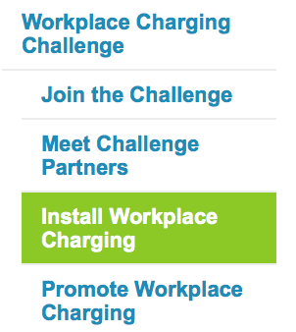
Workplace Charging Management & Policy Resources
Management & Policy
Resources available at : www.electricvehicles.energy.gov
Notes:
We encourage you to browse the new “Managing Workplace Charging” section of our website for useful templates and resources to assist you in your efforts.

Slide 7
Workplace Charging Management & Policy Resources
Management & Policy
Sample templates and ambassador resource highlights:
Sample charging agreement
Sample charging policy
Policy information guide
Workplace charging case studies
Charging pricing guide
Resources available at : www.electricvehicles.energy.gov
Notes:
In addition to DOE’s PEV Handbook for Workplace Charging Hosts, which serves as a good high-level overview of workplace charging, there are a lot of great resources that dig down into workplace charging management policy issues.
On our website you can find sample workplace charging policies and employee agreements and focused resources from some of our Workplace Charging Challenge ambassadors that deal with specific management issues. For example, Advanced Energy worked with employers in North Carolina to develop a workplace charging policy guide and the CA PEV Collaborative looked and management policy in 20 employer case studies. Lastly, Plug In America recently published a well-received pricing guide that reviews the pros and cons of providing free workplace charging.
We encourage you to check out these resources as you work to establish and evaluate the management of your workplace charging program.

Slide 8
Learn More: WorkplaceCharging@ee.doe.gov
www.electricvehicles.energy.gov
Notes:
If you are not already a Challenge partner and you want to learn more, please visit our website or email us to learn how you can join!
Thank you, again, for joining today, and now I’d like to introduce today’s featured speakers.

Slide 9
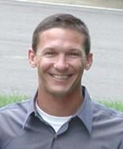
Workplace Charging Challenge Partner Speakers
Frank Marino, Raytheon
Zane Lichtneger,
SAS Institute
Rajit Gadh,
UCLA Smart Grid Energy Research Center
Notes:
We’re pleased to have three excellent partner representatives on the webinar with us today:
Frank Marino
Frank Marino is a Senior Corporate Environmental, Health, Safety and Sustainability Manager at Raytheon, where he is responsible for developing and implementing EHSS programs for the company. He has over 30 years of experience in industrial environmental, health, safety and sustainability management, including the manufacture of computers, appliances, military hardware and aircraft. Frank led the enterprise effort at Raytheon to install electric vehicle charging stations. Raytheon has been a partner since 2013 and Frank has been an invaluable resource to DOE as the Workplace Charging Challenge has evolved over the past couple of years.
Zane Lichtneger (Likt-nay-ger)
Zane Lichtneger is a Sustainability Analyst at SAS Institute where he has worked since 2011. In this role, he facilitates the collection and validation of greenhouse gas inventory, measurements and analysis related to Scope 1, 2 and 3 emissions among many other things. Zane received his Bachelor’s degree in Environmental Technology and Management from North Carolina State University.
Rajit Gadh (Raw-jeet Gawd)
Dr. Rajit Gadh is Professor of the Henry Samueli School of Engineering and Applied Science at UCLA, Founder and Director the Smart Grid Energy Research Center or SMERC. Dr. Gadh has a Doctorate degree from Carnegie Mellon University, a Masters from Cornell University and a Bachelor’s degree from IITKanpur, all in engineering. Dr. Gadh was responsible for establishing the workplace charging program at UCLA in 2011 and continues to support its expansion and management.

Slide 10
Today’s Discussion Format
Administration
Registration
Pricing
Sharing
Notes:
As you can see from our partner map, Raytheon, SAS and UCLA represent quite a bit of geographic diversity in addition to their sector diversity. We’re going to kick things off by giving Frank, Zane and Rajit a chance to give you some high-level background on their organization’s workplace charging program.
We’ll then divide the rest of their presentation time into four topic areas that delve down into the specifics of workplace charging management – Administration, Registration, Pricing and Sharing.
For each of these sections, Raytheon, SAS and UCLA will each present some highlights on how they have managed issues pertaining to each topic. Then, we’ll have some discussion to dig down into their organization’s decision making process. At the end we’ll have some time for Q&A from the audience so please think about questions that you may have along the way and feel free to submit them online via the webinar system or ask them by phone.
Alright, let’s get started – Frank, can you give us an introduction to Raytheon’s workplace charging program?

Slide 11
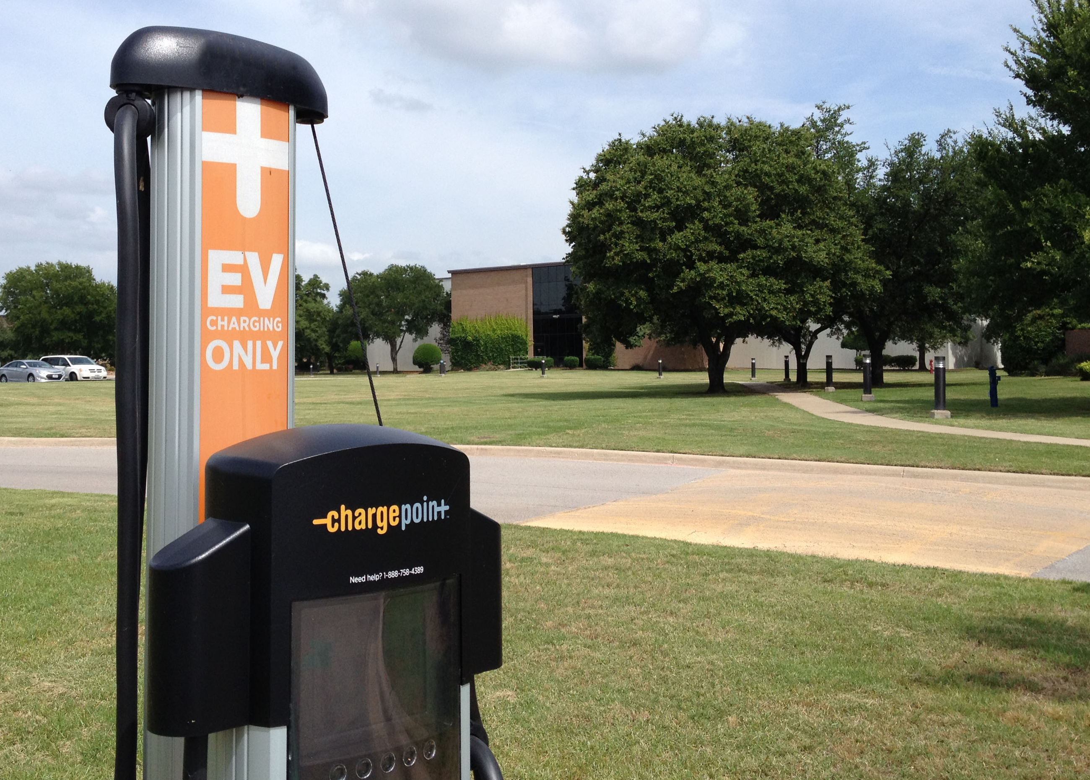
Headquarters
Waltham, MA
Locations with charging
6 – CA, CO, MA, TX, VA
Number of employees
60,000
Number of charging stations
15
Number of PEV driving employees
75
Biggest management challenge
Funding
Photo courtesy Raytheon Company
Notes:
We have installed fifteen dual 220-volt plug-in electric vehicle (PEV) charging stations spread across six operating locations in California, Colorado, Massachusetts, Texas and Virginia.
Workplace charging is one of many initiatives we have implemented as part of a formal sustainability program we established in 2008, aiming to achieve 15 long-term sustainability goals by 2015. These goals include reducing GHG emissions, energy usage, water usage, and waste, as well as the greening of Raytheon's supply chain operations and products.
We have had 11K charging sessions on our stations since 2012. We have avoided 41K kgs of GHGs, we delivered 100 MW of electricity, avoided the use of >12,000 gallons of gasoline, and collected $29K in fees. The ChargePoint networked stations makes these robust metrics readily available via the CP portal.
We have presented our lessons learned at numerous conferences and forums on the installation and use of EV charging stations.

Slide 12
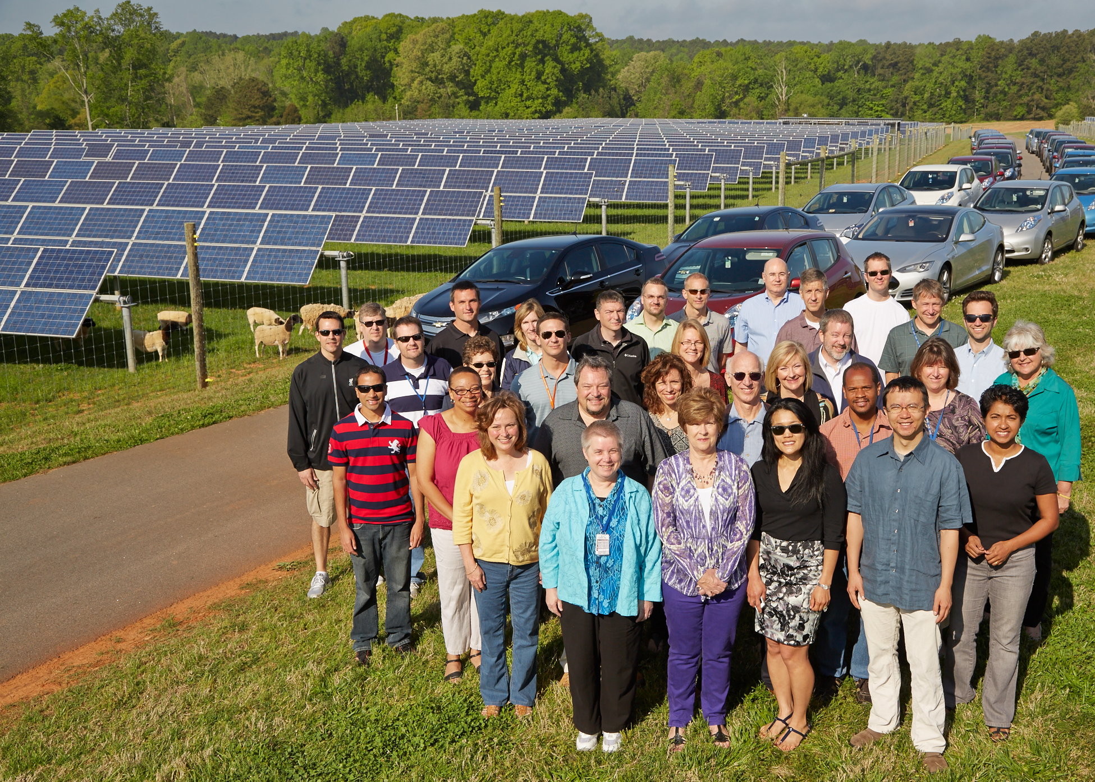
Headquarters
Cary, NC
Locations with charging
Cary, NC & Sweden
Number of employees
5,377 at Cary HQ
Number of charging stations
52 Global, 42 Cary, NC
Number of PEV driving employees
99
Biggest management challenge
COMMUNICATION
Photo courtesy SAS Institute
Notes:
1. Overview
SAS assigns top priority to minimizing energy consumption and related emissions from our operations.
Our Eco-Commuter Parking Program encourages employees to minimize the environmental impacts of their daily commute. SAS provides preferred parking spaces for plug-in electric vehicles, low-emission vehicles, and active carpool participants.
Eco-Commuter parking includes 90 designated PEV spaces with access to 52 charging stations- and SAS provides free charging for all registered employees and visitors.
At the beginning of 2014, SAS employees in Cary represented approximately 5% of PEVs in North Carolina.
We are also proud to be a Workplace Charging Challenge Partner.

Slide 13
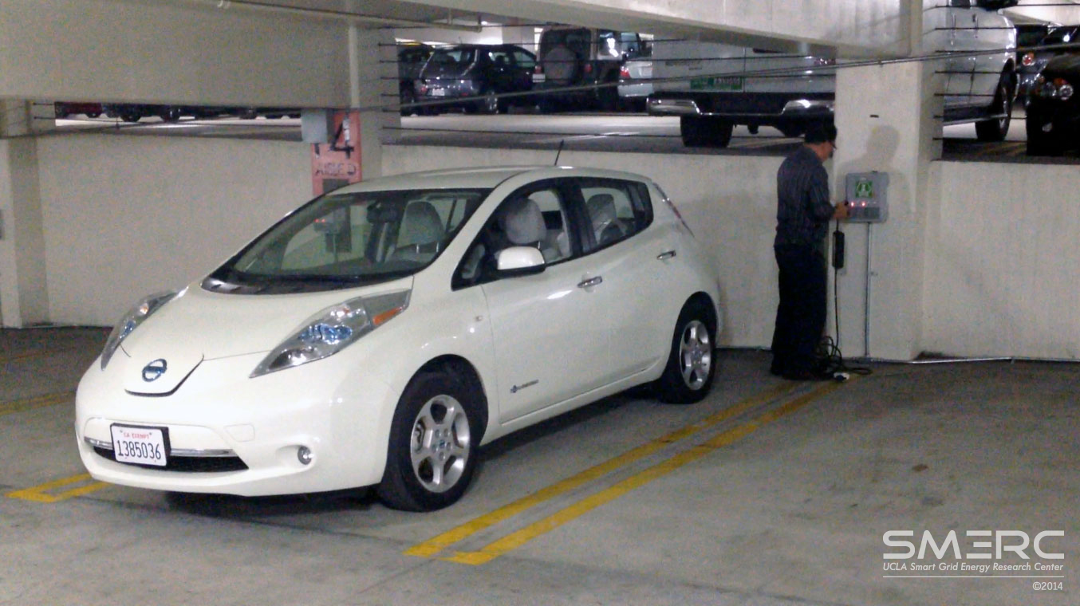
Headquarters
Los Angeles, CA
Locations with charging
1 – CA
Number of employees
31,000
Number of charging stations
137
Number of PEV driving employees
~250+
Biggest challenge
Infrastructure cost and cost recovery
Photo courtesy UCLA SMERC
Notes:
UCLA Smart Grid Energy Research Center (SMERC) provides thought leadership via partnerships between utilities, government, policy makers, technology providers, electric vehicle manufacturers, research labs and universities, to collectively work on envisioning, planning, and executing the smart grid of the future. SMERC currently provides charging for employees as part of its ongoing research on the topics of Electric Vehicle Integration Automated Demand Response Microgrids, and Distributed and Renewable Integration, and Energy Storage Integration. The current WINSmartEV infrastructure at UCLA consists of 137 electric vehicle supply equipment Smart Plugs in seven different locations for UCLA faculty and staff use.

Slide 14
What are partners saying about administration?
Key Players
Get leadership buy-in on early identification of who:
establishes and signs off on management policy
leads communication to employees & the public
manages ongoing operations & maintenance
funds procurement, installation & future expansion
Signage & Access
Use clear and consistent signage to:
draw attention to where charging stations are located
communicate designation for actively charging PEVs
advise on time or accessibility limitations
Policy Enforcement
Ensure that all employees understand:
who is responsible for enforcing charging policy
penalties for not adhering to policy
Notes:
Thank you for those overviews. The first topic of workplace charging management that we’re going to dive into is administration.
Our partners employers frequently underscore the importance of having all of the right players on board from the start – and getting senior leadership buy-in on the time of those players. These are the people within an organization who are responsible for establishing and approving the overall management policy that we’re discussing today. They’re also the folks who will lead both internal and external communication about the charging program and those who are responsible for the day-to-day operation of the program after the ribbon-cutting ceremony is complete. Having senior leadership buy-in where the funding of the program – both at the start and for future expansion – is essential.
Partners have learned that using clear and consistent signage from day one of their program is important for conveying the basics of their workplace charging policy.
Lastly, making sure that all employees – both PEV drivers and traditional internal combustion engine vehicle drivers – are aware of the policy, who enforces the policy and any penalties for not adhering to that policy are crucial elements for a well-functioning workplace charging program.

Slide 15
Workplace charging administration
Key Players
Signage/Access
Policy Enforcement
Installation &
Management Policy Establishment
EHSS and Facilities Partnership
Operations & Maintenance
Facilities
Funding
Facilities
Signage
No standard on signage
Hours of Use
First shift from
~7 AM to 7 PM
Access Employees Only
Responsible party Self-policing model
Repercussions
None
Security
None
Notes:
Our stations are installed by our facilities organization. EHSS partners with facilities on managing the stations once they are installed.
Where feasible, we install dual stations to allow access to 4 vehicles without having to move any vehicle. As station demand increases, this will minimize disruption to employees’ work schedules. Our stations are not currently available to those outside of Raytheon, as our sites have perimeter security due to our work with DoD.
Today we do not have common signage but we are working on developing Raytheon signage for the station bonnet and body.
Our stations are used predominantly on the first shift. We have discussed making the stations available during second and third shifts for on-site company electric vehicles.
Today our stations are available to Raytheon employees only. We may make them available to customers at selected locations where stations are located in close proximity to visitor parking.
We do not have any formal enforcement policy. Our EV drivers cooperate with each other on making use of our stations.

Slide 16
Workplace charging administration
Key Players
Signage/Access
Policy Enforcement
Installation &
Management Policy Establishment Corporate Services
Operations & Maintenance
Corporate Services
Funding
Corporate Services
Signage
Hours of Use
Open 24/7
Limit to 4hr/day
Access Registered Employees & Visitors
Responsible party Security & Employees
Repercussions
Yes- Contact Employee and Manager
Security
Yes –Routine
Patrol
Notes:
2. Administration
Key Players
Corporate Services Division manages the EVSE installation and management policy
The Corporate Services Division provides service & support for all of SAS- including construction, operation and maintenance, environmental sustainability, security and safety…
Policy management was a team effort involving EMP, Security, Facilities, and Legal
Facilities is responsible for ongoing operation and maintenance
Signage/Access
All EVSE parking spaces have pavement that is marked with an industry standard PEV charging logo
There are special EV charging signs on each charging station with an overview of the SAS policy and a link to the Use Policy and Guidelines
And for the most part the signage is effective. There is no way-finding signage to indicate charging station locations but there are maps are available on the internal website
All employees and guest who have registered their vehicles with security can use the charging stations and they are available 24/7 as long as the EV is registered and has permission to be on campus
Policy Enforcement
Employees
Security is responsible for enforcing workplace charging policies
There are repercussions for not adhering to these policies:
A parking advisory will be issued by a security officer
When an employee has been issued three parking advisories a Security Supervisor will email the employee, the employee's manager, and the Senior Security
If the employee continues to violate SAS' parking policy the Director of Security will be notified

Slide 17
Workplace charging administration
Key Players
Signage/Access
Policy Enforcement
Installation &
Management Policy Establishment
UCLA parking, facilities, and faculty
Operations & Maintenance
UCLA electrical, facilities, SMERC
Funding
R&D, Operations
Signage
Yes, for some
Hours of Use
Open 24/7
Access Employees/public
Responsible party UCLA parking personnel
Repercussions
Policies are in flux
Security
UCLA parking/ security
Notes:
Points to consider:
Administration
Who managed installation and established management policy?
Who were your internal partners through process of establishing program and communicating it to employees?
Who is responsible for ongoing operation and maintenance?
What department covers the costs associated with operation/maintenance?
Signage/Access
Does your organization have special PEV/workplace charging signage? If no, why?
What does the signage indicate/instruct?
Did you mark pavement in addition to signage? Why or why not?
How/from where did you acquire your signage?
Is your signage effective? If not, what would make it more effective?
Do you use any wayfinding signage to indicate charging station location?
Who has access to your charging stations?
What hours of the day/night are charging stations available for use?
Enforcement/Security
Who is responsible for enforcing workplace charging policies?
What are the repercussions for not adhering to these policies?
Did you consider cybersecurity of charging stations if they are “connected” units?
How ensure hardware security?

Slide 18
What are partners saying about registration?
Registration
An established registration process can provide:
certainty of charging demand (number & kind of PEV)
an opportunity for employee to agree to policy
Liability
Liability waivers can be used to:
stipulate who is responsible for risk associated with charging station usage
Evaluation
Periodic review of charging program can:
determine needs for infrastructure expansion
allow for management policy revision
Notes:
The second topic that want to cover is the registration process. How does a new PEV-driver start charging at her workplace?
Our partners have told us that having employees register for their workplace charging program is an essential way to get certainty about the population of their charging workforce. It allows them to have an official touch point where they can review the established policy for workplace charging as well.
In a recent assessment of employers, the California PEV Collaborative found that liability is one of the top concerns of employers offering workplace charging. The registration process can therefore also be a good place for organizations to identify who – the employer or the employee – is responsible for any risk associated with charging.
Lastly, the information gathered during the registration process can allow companies to evaluate the charging demand of their employee base.

Slide 19
Workplace charging registration
Liability
Liability waivers are required
Registration
Registration is required
Proof of registration : online record
Evaluation
Informal polling
Depends on capital money availability
New sites to have charging stations
Notes:
We require that a liability waiver be signed. We have a POC established at each location to serve as station administrator to approve drivers as they apply online in the ChargePoint system. ChargePoint now has the capability to incorporate the waiver into the online registration process and “auto approve” all drivers. We will be implementing this system at all our locations in the near future. We have found the time commitment for site administrators to be minimal, and with the new online waiver system, that commitment will be further reduced.
Today we do informal polls at our operating locations to assess station demand. Providing stations is contingent on having available capital money.
Leased facilities provide unique challenges, but in one instance we have succeeded in installing a station using funding from a landlord’s site improvement fund.
Any new facilities we construct will be outfitted with EV charging stations. We have a new facility under construction in Texas where we have 3 dual stations planned initially, with 2 additional single pole stations slated for installation, based on employee demand.

Slide 20
Workplace charging registration
Liability
Liability waivers are not required
Registration
Registration is required
Proof of registration: Eco-Commuter tag
Evaluation
Encouraging employee feedback
Notes:
3. Policy and Guidelines
Registration
By registering their vehicles employees are agree to follow the SAS EVSE Use Policy and Guidelines and display a SAS-issued car tag before they can use the charging stations
Electric vehicle charging stations are available for employees and visitors with PEVs only
Employees should be courteous while sharing available charging stations and limit times to 4 hours
Agree that their vehicle can be unplugged, by employees after charging is complete or by Security at any time
Do not park in charging station spaces if you do not need to charge
Liability
Users are not required to sign a liability waiver
Program Evaluation
We try to continually evaluate the program
SAS evaluates program performance by encouraging employee feedback. We have internal social media (The Hub) – with an EV dedicated group that is used for news, questions, and discussions
SAS created a report that summarizes registered plug-in EV owners by building. This report may be used by the SAS EV community for constructive collaboration about sharing campus stations. We also use the report to assess demand for additional EVSE.
It’s a perk not a guarantee- if you need to charge to complete your commute then reconsider your vehicle choice
The policy and guidelines document is dynamic and is adjusted when revisions are needed

Slide 21
Workplace charging registration
Liability
Liability waivers are required
Registration
Registration is required via WINSmartEV App
Proof of registration: access to app
Evaluation
Via cloud-based tracking software/app
Notes:
Points to consider:
Registration
Do you require users to register their vehicles prior to charging?
What is the value of requiring registration?
Do employees receive a permit (ie. window hang tag, sticker) to signal charging permission?
Do employees also need to register with charging station provider?
Liability
Do you require all users to sign a liability waiver?
If so, what topics are covered in the liability waiver?
Program Evaluation
Do you regularly assess demand to determine if your current infrastructure is meeting employee needs?
If so, how do you assess demand?
How do you evaluate whether or not the program is performing well and if policy revisions are needed?

Slide 22
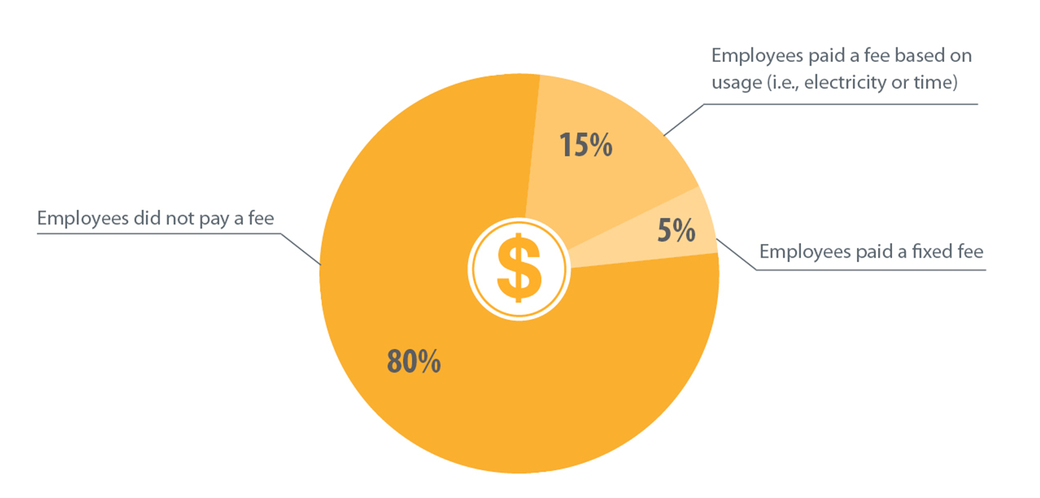
What are partners saying about pricing policy?
Employees paid a fee based on usage (i.e., electricity or time)
Employees did not pay a fee
Employees paid a fixed fee
Pricing
On deciding between fee or free charging:
free can be easier to administer and is an additional incentive for employee PEV purchase
fees can relieve charging station congestion
Notes:
Next up is pricing policy. Employers that provide workplace charging must decide if and how employees will pay for charging station use. Many existing workplace charging programs are free for employees.
In fact, 80% of employers who responded to DOE’s 2014 Workplace Charging Challenge Annual Survey provided free charging access. The remaining 20% required employees to pay a fee, which was either fixed or based on usage, such as electricity or time.
Partners have noted that free charging can be easier to administer, especially if Level 1 charging is deployed. In regions where PEVs have been slower to deploy, free charging at work can be another great way to incentivize employee PEV purchase. But many employers have found that as the number of PEV-driving employees expands, the policy of providing free charging may need to be revisited.

Slide 23
Workplace charging pricing
Fee-based charging
Fee varies by location
$1/hour
$1/hour and $0.40 each hour after
Fee-based due to government reimbursement as DoD contractor
$$$
Notes:
Pricing is determined by each operating location. We set this up to accommodate regional energy pricing. One location charges $1 per hour of charging, with the fee accumulating for the entire time the car is plugged into the station. Most other locations charge $1 for the first hour and $0.40 for each additional hour that the vehicle is plugged in. We charge by the hour to discourage employees from occupying a charging station parking spot once their EV is charged.
We found you must take into account the price employees are currently paying to charge their vehicles at home. We try to charge approximately the same price as they would pay at home. After all these are our own employees….
We are required to charge for station use because we are a government contractor. We recover the cost of the power we supply to our employees. This keeps us in good stead with our government customers and our ICE drivers too!
The next pricing model we are evaluating will be to charge by the kwh, where it is allowed by law, in the states that we have stations. This is a more equitable way to charge for station use, as the employee pays for exactly what they use in power. For example a Tesla driver and a Leaf driver draw much different kwh’s of power.

Slide 24
Workplace charging pricing
Free charging for 4 hours
Didn’t feel the added cost to charge for using the EVSE was worth the effort
Best fit for our workplace culture
$$$
Notes:
4. Pricing
SAS provides preferred parking and free charging for employees, their guests and campus visitors.
We choose this approach for several different reasons:
Didn’t feel the added costs to set-up and monitor a system to charge for using the EVSE was worth the effort- Never recoup the investment
Best fit for our workplace culture and SAS knows our commitment to our workplace culture is smart business
SAS' turnover rate remains below 5 percent versus an industry norm of more than 16 percent.
Up to 3 LEED points available
Good for the community reducing emissions leads to better air quality
Great PR- local media, global marketing
Employees may also take advantage of discounts through the Recreation and Fitness Center Discount page. They are eligible to receive a pre-negotiated Vehicle Purchase Program (VPP) price.

Slide 25
Workplace charging pricing
Some EVSE charging is free
Some EVSE charging is fee-based
$2/hour
Experimenting with different pricing models across campus
$$$
Notes:
Points to consider:
Pricing
Do you charge a fee for charging station use or provide free charging?
If free, why?
If fee, how much do you charge and how did you decide what amount to charge?
Do you offer any other financial incentives for PEV drivers?

Slide 26
What are partners saying about sharing policy?
More than 1 charging station for every PEV
Fixed number of charging stations regardless of the number of PEVs
1 charging station for every PEV
Less than 1 charging station for every PEV
Top ways to manage charging station sharing:
valet
station assignment
reservation system
time limit
employee self-management
Sharing
Notes:
Another question that we asked on our Partner survey was how employers plan to install their charging stations – in other words, what is their ideal ratio of PEVs to charging stations?
Just about half of respondents said that they were installing a fixed number of stations no matter how may employees are driving electric. These plus another 34% of partners expect their employees to share charging stations. This, coupled with the fact that 90% of our partners say that their existing charging stations are already full occupied at least 5 days a week, means that employers must come up with a solid policy to encourage charging station sharing among employees.
So our last topic that we’re going to have Frank, Zane and Rajit talk about is their workplace charging sharing policies.

Slide 27
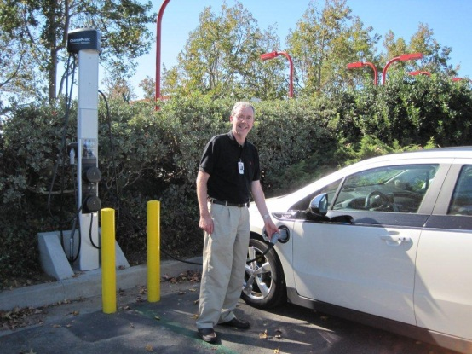
Workplace charging sharing
Employee demand is currently met
Sharing Method: employee self-managed
Communication Method: email, newsletters, plasma screens, EHSS Council Meetings
Photo courtesy of Raytheon
Notes:
Sharing
Today drivers police themselves to share the stations
ChargePoint is working on an electronic waiting line for employees so they can get in line electronically and be notified when the station is available. That will be available on the CP network soon.
We communicate through various channels with our employees including EHSS Council Meetings, plasma screens etc. We recently solicited comments from our EV drivers for our annual meeting with CP. We reviewed various driver testimonials.
What’s next?
Raytheon video on station screens – video only, no audio
Common signage for use in the CP stations (bonnet and body)

Slide 28
Workplace charging sharing
Employee demand is currently met
Sharing Method: employee self-managed, guided by use policy
Communication: Online -Green Initiative Site and The Hub (EV enthusiasts group page)
Electric Geese at SAS EVSE
Notes:
5. Sharing
Employees share the charging station infrastructure by following the Use Policy and Guidelines. Employees parking in these spaces must limit charging times to no more than 4 hours per day. They may also use these spaces for no more than 4 hours to wait for a charge. Combined waiting and charging times may exceed 4 hours.
Currently we have more PEVs than charging stations, thus requiring employees to share. It’s just about a 2:1 ration of EVs to charging stations so if everyone rotates after 4 hours all employees should be able to charge every day
It is a first come first serve basis. We want the sharing program to be self-managed. Owners consent for their vehicle to be unplugged when their vehicle is fully charged and this better enables sharing
SAS encourages EV owners who park in spaces adjacent to EVSE to open charge-port covers as a means to let other EV owners know it is ok to plug in your vehicle when they are done
When your charge is complete, move your vehicle so other employees can use EVSE
Charging cords and EVSE status indicators have matching identification numbers to better identify fully charged EVs and minimize confusion when moving charging cords
Additional helpful information about SAS EVSE infrastructure and plug-in electric vehicles can be found on our Green Initiative Site and on The Hub - Electric Vehicle Enthusiasts group page

Slide 29
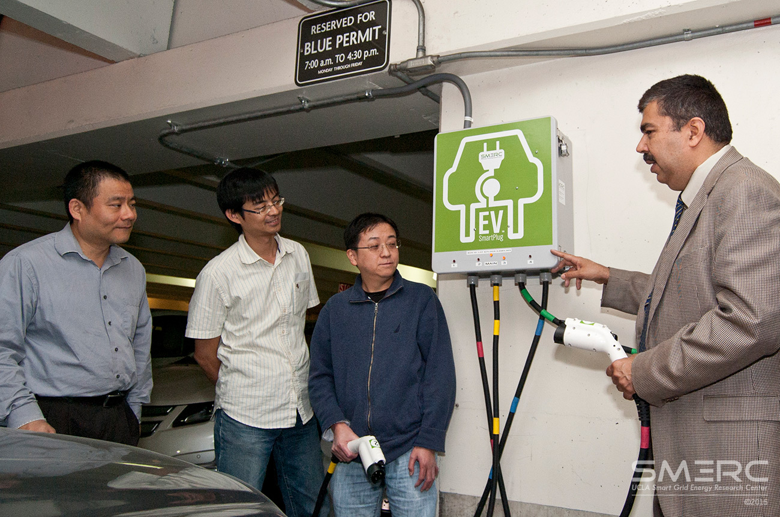
Workplace charging sharing
Employee demand is not currently met
Sharing Method: employee self- managed with help of multiplexing technology with WINSmartEV quad charger (photo on right)
Communication Method: Phone app, quarterly meetings
Photo courtesy of UCLA SMERC
Notes:
Points to consider:
Sharing
Do you currently have more PEVs than charging stations, thus requiring employees to share?
How are charging stations shared among employees? (ie. valet, assigned spaces, reservation system, time limit, or employee self-managed?)
What, if any, platform(s) do you use to facilitate communication among employees and with workplace charging program managers?

Slide 30
Workplace Charging Management Q&A
Frank Marino, Raytheon
Zane Lichtneger,
SAS Institute
Rajit Gadh,
UCLA Smart Grid Energy Research Center
Notes:
Thank you again to our speakers. With that, it looks like we have about (X MINUTES) left for questions from the audience. (Insert conference system host Q&A instruction) Our first question is for …

Slide 31
Learn More: WorkplaceCharging@ee.doe.gov
www.electricvehicles.energy.gov
Notes:
As we conclude this webinar, I’d like to thank our speakers for their valuable time and thank you to all who joined us for today’s webinar.
A recording of this webinar along with the presentation slides will be available on our website shortly following the presentation.
If you are not yet a partner and you would like to learn more, or if you are a partner and have questions about the information presented today, please reach out to us at WorkplaceCharging@ee.doe.gov or to your account manager.
Thank you very much and have a great day.

