Slide 1
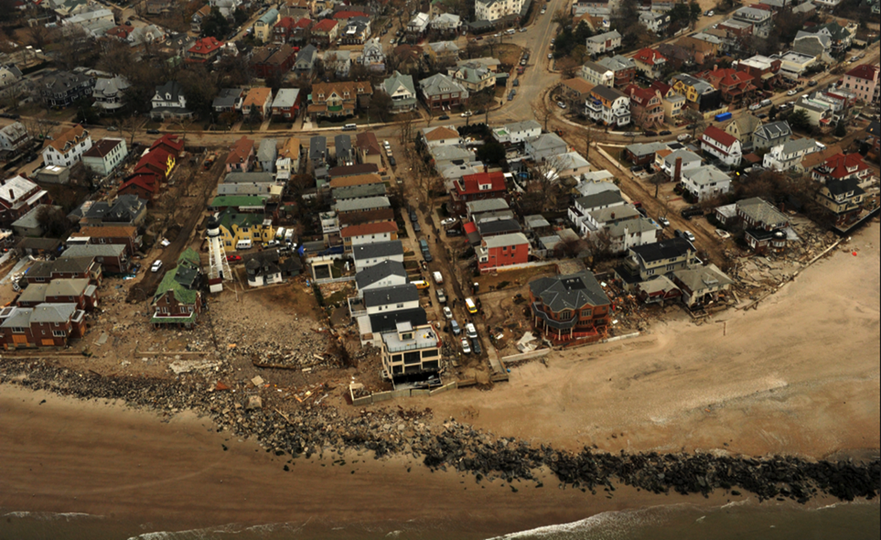
Slide 1
Unified Federal Review Process
Scenario Based Implementation
[Name]
[Title]
[Date]
Notes:
This presentation has been prepared and endorsed by the Unified Federal Review (UFR) Steering Group, which is responsible for oversight and implementation of the UFR Process. We thank you for your willingness to review and share these materials. We hope that this presentation will be beneficial and provide you with information that you can share with your peers during future recovery efforts.
Background photo: Nov. 2012. An aerial view of damage caused by the storm surge of Hurricane Sandy on the coastline of New York. Photo credit Jocelyn Augustino, FEMA.

Slide 2
Overview
Part 1: Introduction to the Unified Federal Review (UFR) Process
Part 2: UFR Process In Action
Disaster Scenario Timeline
Disaster Scenario 1: Annual Seasonal Flooding
Disaster Scenario 2: Major Hurricane
Additional Slides:
Abbreviations and Acronyms
Notes:
This presentation will include a brief introduction to the Unified Federal Review (UFR) Process and its background in Part I. In Part II, we will walk through a typical disaster timeline in relation to two different disaster scenarios and how the UFR Process, including specific UFR Tools and Mechanisms, can be applied to expedite and coordinate disaster recovery projects.

Slide 3
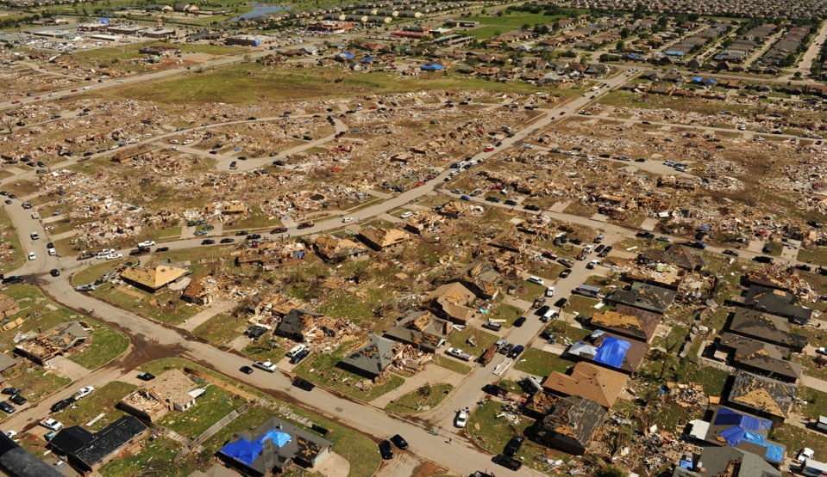
Part 1: Introduction to the UFR Process
Moore, Okla., May 22, 2013 --Aerial views of the damage caused by the tornado that touched down in the area on May 20, 2013. Jocelyn Augustino/FEMA
Part 1: Introduction to the UFR
3

Slide 4
Introduction to the UFR Process
New approach for disaster recovery projects, authorized by the Sandy Recovery Improvement Act of 2013, that provides enhanced coordination for environmental and historic preservation (EHP) reviews.
Federal agencies and staff increase consistency in EHP reviews by leveraging existing resources and creating process efficiencies.
Federal agency EHP Practitioners and stakeholders use the UFR Process, through Tools and Mechanisms, to improve the way EHP reviews are conducted for proposed disaster recovery projects.
The UFR Process does not change the EHP requirements under existing federal law.
It does accelerate processes and dispute resolution
Part 1: Introduction to the UFR
Notes:
(Please note, throughout this presentation, the term “EHP” will be used to refer to “environmental and historic preservation”)
How did the UFR Process begin?
In January 2013, the Sandy Recovery Improvement Act (SRIA) amended FEMA’s governing regulations, the Robert T. Stafford Disaster Relief and Recovery Act by adding Section 429, which called upon the President to “establish an expedited and unified interagency review process to ensure compliance with environmental and historic requirements under federal law relating to disaster recovery projects...”
In order to comply with the statute, the following agencies formed the UFR Steering Group to develop and implement the UFR Process:
Department of Homeland Security (including the Federal Emergency Management Agency)
Advisory Council on Historic Preservation
Council on Environmental Quality
To assist with the development of the UFR Process, the Steering Group formed a federal interagency UFR working group composed of headquarters and field staff.
In the development of the UFR, the UFR Steering Group wanted to develop a collaborative and unified approach to complying with EHP requirements that leverages each agency’s resources to achieve more consistent and expedited reviews for disaster recovery projects. The UFR Steering Group wanted to encourage agencies to share data and form interagency agreements in advance of disasters, as this pre-positioning leads to better federal decision making and expedited reviews by saving agencies time and resources that would otherwise be spent gathering new information and determining how to work together.

Slide 5
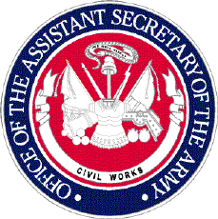
Memorandum of Understanding (MOU) Establishing the UFR Process, July 2014
Part 1: Introduction to the UFR
Notes:
In July 2014, the UFR Process was memorialized through the execution of an interagency Memorandum of Understanding, signed by 11 federal agencies, shown here. (In addition to the Steering Group agencies, these agencies include: Environmental Protection Agency, the Department of the Army (Civil Works), U.S. Department of Energy, U.S. Department of Agriculture, U.S. Department of Commerce, U.S. Department of Housing and Urban Development, U.S. Department of Interior, and U.S. Department of Transportation).
The Memorandum of Understanding (MOU) established the Unified Federal Review (UFR) Process for EHP reviews associated with Disaster Recovery Projects, committed the agencies to the following:
Providing and funding staff and resources to implement and continue the development of the UFR Process and resulting agreements.
To implement the Tools and Mechanisms of the UFR Process
To disseminate the UFR Guidance for EHP Practitioners to component offices
To provide training on the UFR Process to agency staff
Within 90 days of completion, to make the Unified Federal Environmental and Historic Preservation Review Guide for Federal Disaster Recovery Assistance Applicants (“Applicant Guide") available on federal agency websites that identify relevant federal funding opportunities
Provide the UFR Steering Group with lessons learned during implementation of the UFR Process
Develop Disaster-Specific Mechanisms when necessary, and
Align EHP reviews with those of other federal agencies jointly funding a disaster recovery project
Use of an issue elevation process to resolve disputes between agencies
A copy of the UFR MOU can be found at the UFR webpage located on FEMA.gov. A link to the UFR webpage can be found on the last slide of the presentation.

Slide 6
Tools and Mechanisms of the UFR Process
Tools and Mechanisms of the UFR Process
Data Sharing Agreement Content | Memorandum of Understanding Establishing the Unified Federal EHP Review Process
Data Standards List | Template Environmental Checklist for FEMA and HUD
Disaster-Specific Memorandum of Understanding Template | Training for Recovery Leadership and UFR Advisors
EHP Agency Point of Contact List | FEMA Prototype Programmatic Agreement (PPA) for Section 106 of the NHPA
EHP Guidance for Federal Disaster Recovery Assistance Applicants | Disaster-Specific Best Practice Documents
IT Resources List | UFR Webpage
Part 1: Introduction to the UFR
Notes:
The Tools and Mechanisms of the UFR Process were created during the development of the UFR Process with the assistance of the UFR Steering Group and interagency working group.
These Tools and Mechanisms help implement the UFR Process and support the unification of EHP reviews by providing EHP Practitioners, applicants and other stakeholders with valuable information and resources to enhance the efficiency and effectiveness of EHP reviews for disaster recovery projects.
For example, the EHP Guidance for Federal Disaster Recovery Assistance Applicants (Applicant Guide) navigates applicants through a typical EHP review by giving them insight into the EHP process and a list of the types of information they should be providing to the federal agency.

Slide 7
How Can the UFR Process Assist You?
UFR Process can assist you to:
Create opportunities for greater coordination across agencies to expedite EHP requirements.
Strive to reduce duplication of information provided by applicants working with multiple agencies.
Leverage existing and develop new interagency agreements, such as MOUs and programmatic agreements.
Align review processes and prepare joint reviews with other agencies to satisfy one or more EHP requirements.
UFR Process is not intended to:
Circumvent or supersede any existing federal, state, local or tribal EHP requirements.
Eliminate requirements for consultations between agencies and between agencies and applicants.
Change existing interagency agreements.
Establish a single review process for agencies funding a single project.
Part 1: Introduction to the UFR
Notes:
This slide provides additional information to clarify some of the finer points on the UFR Process, as well as explain what the UFR Process will not do. For example, agencies can use the UFR Process to collaborate and develop efficiencies for environmental and historic preservation reviews for disaster recovery projects. The UFR Process will not exempt agencies from the need to comply with any reviews, or create a “one size fits all” review under which all EHP requirements could be met by simply following the UFR Process. The UFR Process enhances, but does not replace, compliance with EHP requirements.
While some of the action necessary to successfully implement the UFR Process is occurring now, before a disaster hits, the majority of work for the UFR Process will occur following a disaster. This work will require the support of an informed and trained headquarters and field staff, such as yourselves, to successfully implement the UFR Process.
The UFR Process applies to all Presidentially declared disasters.
It is important to note that existing EHP requirements still apply, and are unaltered by, the UFR Process. The UFR Processes instead offers new Tools and Mechanisms and best practices that will enhance the ability of agencies, Tribes, applicants and other stakeholders to coordinate for EHP reviews.
For example, the UFR Process aims to improve the availability of data for reviews through use of the data sharing agreements which will be discussed later today. Through interagency coordination, the UFR Process promotes data sharing and therefore increases the organization and ease of access for data necessary in headquarters staff facilitation of EHP reviews.

Slide 8
Headquarters Roles that Support Implementation of the UFR Process
UFR Process for Disaster Recovery Projects
UFR Steering Group
UFR Working Group
National UFR Coordinator
Recovery Support Function Leadership Group
Part 1: Introduction to the UFR
Notes:
Who is responsible for implementing the UFR Process? At the headquarters level, you have the following support structures that you can reach out to for questions or guidance, appropriate to their respective roles in the UFR Process:
UFR Steering Group: Responsible for developing and implementing a process that enhances and improves efficiencies related to federal EHP reviews for disaster recovery projects. The UFR Steering Group also ensures resources are available to answer questions submitted to the UFR webpage, which is one avenue to solicit input when you are working in the field.
UFR Working Group: Will work to institutionalize and further develop the UFR Process during steady-state condition. During on-going recovery activities following a Presidential disaster declaration, the UFR Working Group will provide a forum for member agencies to coordinate and identify barriers to unification and expedited reviews. The Working Group will communicate at the headquarters level as well as with appropriate regional / field / state level staff. This is the primary headquarters level organization that will allow you to access your agencies’ headquarters resources, and those of other agencies, to identify paths forward and ways to use the UFR Process to enhance EHP reviews for disaster recovery.
National UFR Coordinator: The National UFR Coordinator is a position located at FEMA Headquarters within the Office of Environmental Planning and Historic Preservation that provides oversight for the implementation of the UFR Process. Primary responsibilities include identifying opportunities for interagency coordination and cooperation at the national and regional levels as well as tracking national EHP review efficiencies related to disaster recovery projects. The National UFR Coordinator will work with each of these other headquarter entities, as well as UFR Advisors that may be deployed to work with you, in order to address questions and concerns.
The UFR Advisor will be discussed in subsequent slides.
Recovery Support Function Leadership Group: is a national-level interagency body established to improve effectiveness and unity of effort of coordinated federal recovery support. The RSFLG provides a forum for information exchange, planning, and decision making among recovery interagency leadership. The RSFLG, through its membership and structure, is responsible for the coordination of federal interagency guidance and policy implementation, and the oversight of appropriate planning efforts.
* The reference to headquarters staff includes both national level and regional level staff depending on the organizational structure of individual agencies.*

Slide 9
Field Roles that Support Implementation of the UFR Process
UFR Process for Disaster Recovery Projects
UFR Advisor
EHP Practitioners
Applicants
Tribes*
Part 1: Introduction to the UFR
Notes:
In the field, such as at FEMA’s Joint Field Office or other deployment location, there are many people involved in the UFR Process. We will talk about each one of these roles and how they are involved in implementing the UFR Process in the next slides.
*NOTE: The term “Tribe” is used throughout the presentation. “Tribe” refers to any Tribe, band, nation or other organized group or community, including any Alaska Native village or organizations which is recognized as eligible for the special programs and services provided by the United States to Indians because of their status as Indians.

Slide 10
UFR Advisor
What is the UFR Advisor?
New position for FEMA’s Joint Field Office/Recovery Office.
Major Responsibilities:
Serve as the interagency coordinator for EHP compliance for disaster recovery projects.
Identify opportunities for environmental historic preservation efficiencies.
Work closely with the Recovery Support Functions, federal, state, local and regional agencies and National UFR Coordinator.
Part 1: Introduction to the UFR
Notes:
The UFR Advisor is the field-level position that is fully devoted to the UFR Process, when deployed. The UFR Advisor coordinates EHP compliance across federal agencies, provides expertise for the implementation of the UFR Process and recommends Tools and Mechanisms for the specific disaster event.
The UFR Advisor works closely with FEMA’s Environmental and Historic Preservation Advisor, who is leader for FEMA’s EHP compliance and reviews at the Joint Field Office (JFO) and/or recovery office, and also coordinates with other federal, state, tribal and local agencies’ regional and local representatives.
Note the UFR Advisor, when deployed, enhances the capabilities of the FEMA EHP Advisor. The EHP Advisor maintains all of his or her responsibilities.
Note the EHP Advisor serves as the leader for FEMA’s EHP reviews and compliance programs at the JFO and/or recovery office and supports disaster recovery leadership in carrying out EHP functions. The EHP Advisor is familiar with Tools and Mechanisms and prepared to implement them even absent a UFR Advisor.
The UFR Advisor position will usually be filled by a FEMA employee; however, if one is not available, FEMA will request support from the Natural and Cultural Resources Recovery Support Function, led by the Department of the Interior.
The UFR Advisor also will:
Work closely with the FEMA EHP Advisor
Coordinate with other federal, state, local and tribal agencies to expedite EHP reviews
Coordinate with Recovery Support Function (RSF) Field Coordinators

Slide 11
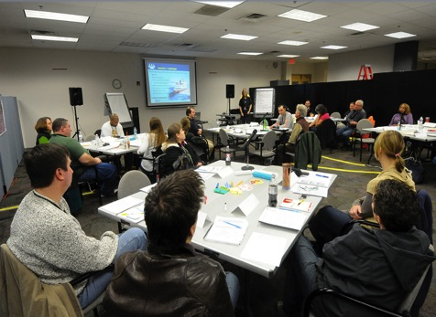
EHP Practitioners
Agency staff responsible for environmental and historic preservation reviews of proposed projects
Use Tools and Mechanisms to carry out the UFR Process
Work with EHP Practitioners from other agencies, including HUD Responsible Entities (REs), to coordinate reviews
Engage with stakeholders and the public
Leverage existing analyses, permits and agreements to expedite reviews
FEMA employees in a Environmental and Historic Preservation training class in Latham, N.Y., Dec. 2011 (photo credit Hans Pennink, FEMA).
Part 1: Introduction to the UFR
Notes:
EHP Practitioners are agency staff responsible for conducting or contributing to EHP reviews. When the responsibility for conducting the EHP review is delegated or assigned to someone other than the federal agency staff, such as contractors, these individuals also meet the definition of EHP Practitioner.
Before deciding to issue federal assistance, permits and other approvals to applicants, federal agencies must comply with EHP requirements. EHP Practitioners satisfy these requirements on behalf of agencies.
The UFR Process does not change existing responsibilities for agencies to perform EHP review for their actions; each agency will still need to comply with these requirements. However, the UFR Process assists EHP Practitioners with Tools and Mechanisms to help expedite the EHP reviews, as well as by gathering best practices inherent in existing requirements that can be used to expedite reviews.
For example, the UFR Practitioner Guidance discusses streamlining approaches for individual EHP requirements that are built into law and regulations.
In addition to the UFR Practitioner Guidance, the UFR Webpage also contains best practices in the UFR Library that EHP Practitioners can use to identify strategies to expedite reviews.
EHP Practitioners must leverage the resources they have, including existing information and reviews from other agencies, to implement the UFR Process.

Slide 12
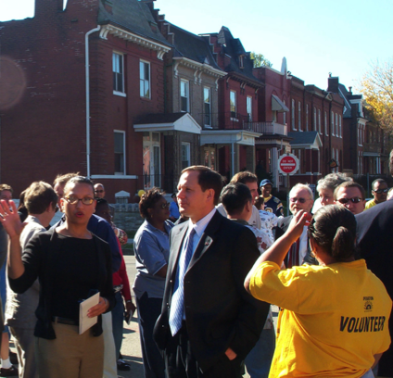
Applicants
An individual, organization or government who applies for direct federal funding or assistance
Provide project-related information
Obtain certifications and permits
Part 1: Introduction to the UFR
Notes:
An applicant is an individual, organization or government who applies for direct federal funding or assistance. This also includes sub-applicants.
The role of the applicant varies from agency to agency. When permitted by agency guidance or regulations, applicants may help prepare draft NEPA analyses, carry out mitigation measures and support public engagement. On the other end of the spectrum, the applicant’s role is solely to provide information about the environment in the project area and the potential for environmental and historic preservation impacts from and to the project. Regardless of the role that the applicant will play, EHP Practitioners and applicants need to collaborate in a unified process for environmental and historic preservation reviews that will effectively and efficiently support disaster recovery projects and achieve community resiliency.
The UFR Process supports a coordinated approach between federal agencies and their applicants. For example, the UFR Applicant Guidance encourages applicants to notify agencies if they are seeking funding from another agency. Once agencies are aware of multiple funding sources, they can begin coordinating roles and sharing information to expedite the environmental and historic preservation review. By empowering the applicant with knowledge about the needs and how they can support the environmental and historic preservation review, the UFR Process builds coordination and efficiencies to expedite the disaster recovery process.
See the Applicant Guidance and UFR Webpage for more information.
Applicants includes any of the following: state government agencies, individual home and business owners, local governments and special districts, private non-profit organizations, federally recognized Tribes, Alaskan Native Tribal Governments, or authorized Tribal organizations, and Alaskan Native Village Organizations.

Slide 13
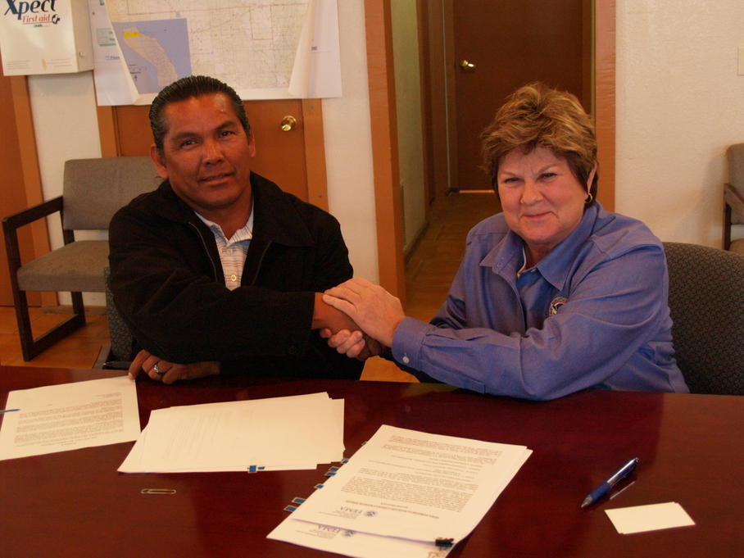
Tribes
Ability to request a Presidential disaster declaration on Tribal lands, independent of the state
Anza, CA, May 10, 2011 – (R) FEMA Federal Coordinating Officer Sandy Coachman facilitates the signing of the FEMA – Tribal Agreement with the (L) Cahuilla Band of Indians’ Tribal Chairman Luther Salgado, Sr.
Part 1: Introduction to the UFR
Notes:
“Tribe” refers to any Tribe, band, nation or other organized group or community, including any Alaska Native village or organizations which is recognized as eligible for the special programs and services provided by the United States to Indians because of their status as Indians.
Tribes should be engaged as early as possible during an EHP review to consider potential impacts, particularly for actions involving tribally managed lands or properties not owned/managed by the Tribe but are known to hold ancestral/historic significance. Tribes often possess special expertise and knowledge about the environment, tribal lands and properties of religious and cultural significance. Tribes can help assess potential impacts of activities to these resources.
In addition to supporting gathering and analyzing data for environmental and historic preservation reviews, federal agencies consult with Tribes, as sovereign entities, on a government-to-government basis if a proposed project may impact historic properties subject to treaties (regardless of location of the action). Native Hawaiian organizations and Native Alaskan villages/organizations have these same rights/roles. Tribes have expertise for identifying and assessing properties that may possess religious and cultural significance, and for assessing effects of these resources during environmental and historic preservation reviews.
Tribes are very important partners for the success of the UFR Process. Through the Sandy Recovery Improvement Act, Tribes have the option to request a Presidential emergency or major disaster declaration independently. This change reflects the role of tribal governments as sovereign entities and allows tribal governments to determine how they want to seek assistance. Tribal governments may still choose to seek assistance as applicants under a state declaration request.
The UFR Process recognizes the roles of Tribes, and tribal representatives, in the disaster recovery process. Tribal emergency managers play a key role in the UFR Process by often assessing damages to natural and cultural resources. Tribal Historic Preservation Officers may use the Tools and Mechanisms of the UFR Process to assist with disaster recovery reviews. For example, the Prototype Programmatic Agreement (PPA) for Section 106 of National Historic Preservation Act provides a framework to negotiate state-specific agreements that allows Tribes to either use the statewide programmatic agreement, or to develop separate agreements to outline tribal protocols.
See the UFR Process fact sheets, available on the UFR Webpage, for additional information.

Slide 14
Part 2: UFR Process in Action
Notes:
We have prepared two disaster scenarios to walk through with you for this part of the presentation. These NON-FACTUAL scenarios will demonstrate how to apply the UFR Process in different circumstances, using various Tools and Mechanisms as examples of ways to support EHP reviews. But first, let’s walk through the UFR’s integration into the disaster timeline.

Slide 15
Slide 15
Disaster Scenario Timeline
Pre-Disaster
Disaster Occurs
Emergency Response
Recovery Planning
Disaster Recovery
Restored and More Resilient Community
UFR MOU defines agency roles and responsibilities
Presidential disaster declaration
(EHP review requirements triggered)
Interagency forms and data collection simplify reviews (e.g., FEMA/HUD checklist)
RSF teams deploy to support the recovery mission
Formalizing the unification & standardization of EHP requirements
Proposed project or Grant application
Practitioner Guidance helps with efficient and informed impacts analysis and better decisions
Initial eligibility determination
Federal Disaster Recovery Leadership Training for appropriate staff
Impacts analysis
Disaster-specific MOUs adopted
Decision
Interagency agreements (e.g., PPA, Data sharing, etc.)
Permits
Applicant Guidance informs permit applications and compliance
Funds to grantee
UFR Advisor Training for appropriate staff
Notes:
This graphic depicts examples of where the UFR Tools and Mechanisms may apply during different phases of the disaster process. The dark blue boxes represent the phases of a disaster. The light gray boxes represent where the UFR Tools and Mechanisms can be used in the various phases of the disaster process. Depicted in light blue, are the other actions which might be occurring during the disaster process.
*Note: The UFR Applicant Guide is listed as a tool for Recovery Planning, but it can serve as a valuable resource throughout the entire disaster scenario timeline providing pre-disaster planning information, EHP contacts during the response phase, and a tool for providing guidance throughout recovery.
This timeline will be used to talk about each phase of disaster recovery.

Slide 16
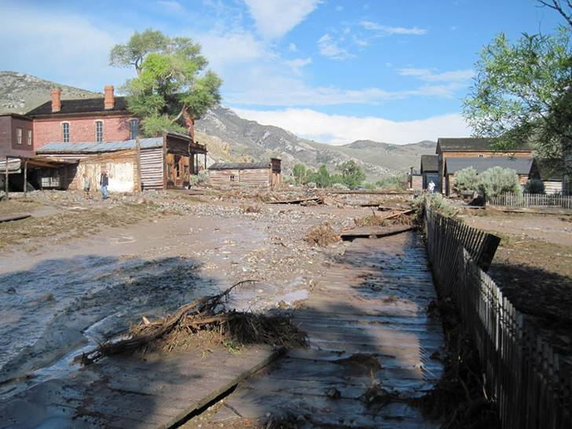
Disaster Scenario 1: Annual Seasonal Flooding
Aftermath of July 2013 in Bannack State Park, Montana. (photo credit Carl Davis/ U.S. Forest Service)
Notes:
The first NON-FACTUAL disaster scenario is based on an annual flooding event. Here we will look at a scenario in which a Federal Disaster Recovery Coordinator is not activated and deployed to manage interagency recovery operations.

Slide 17
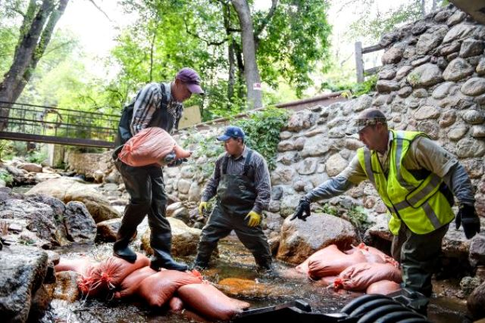
Annual Seasonal Flooding: Disaster Overview
The event:
Warm spring temperatures in Montana
Heavy rain and wind from spring thunderstorms
Small scale flooding
Exceeds capacity of state and local governments
Results in a Presidential disaster declaration
Agencies involved:
Multiple federal agencies
State agencies
Tribal agencies
Other factors:
UFR Advisor not deployed
Workers divert creek to begin repairs on bridge (photo credit HUD).
Notes:
Below are the details of the first disaster scenario:
Warm spring temperatures, as well as heavy rain and wind from spring thunderstorms causes annual flooding and power outages in Montana.
A Presidential disaster declaration is made, finding that the disaster is of such severity and magnitude that effective response is beyond the capabilities of the state and the affected local governments and that federal assistance is necessary.
Multiple federal agencies engage with the community to provide federal funding and technical assistance for disaster recovery operations.
Although Presidential disaster declarations are common for these flooding events, the flooding is generally considered small in scale relative to other events.
Impacts to the environment and community are usually consistent each year.
A FEMA Federal Disaster Recovery Coordinator (FDRC) is not appointed and none of the six Recovery Support Functions (RSFs) of the NDRF are activated in these annual flooding events because it is a single community with relatively minor impacts. In this case, given the relatively smaller scale of the disaster, number of projects and straightforward EHP compliance issues, a UFR Advisor is not deployed to the disaster. The agencies involved are clear about the needed coordination to complete EHP reviews.
Remember, even if the UFR Advisor is not deployed, the UFR Process still applies and Tools and Mechanisms can still be used. The EHP Advisor will implement the UFR Process when the UFR Advisor is not deployed.

Slide 18
Annual Seasonal Flooding: Pre-Disaster
Actions:
Interagency group formed by federal agency to:
Recognize UFR MOU commitments amongst federal agencies.
Share EHP compliance information among federal, state, local and tribal partners.
Share and understand other federal, state, local and tribal agencies funding and permitting programs, as well as, how they conduct environmental and historic preservation reviews.
Establish Data Sharing Agreements amongst agency participants.
Pre-Disaster
Disaster Occurs
Emergency Response
Recovery Planning
Disaster Recovery
Restored and More Resilient Community
Notes:
Since seasonal flooding is a common occurrence in Montana, federal agencies in Montana will convene an interagency group with federal and state funding and resource agencies to conduct the following activities:
The federal agencies participating in the recovery process have signed the UFR MOU, committing the agencies to:
Exercise flexibility in conducting EHP reviews to achieve a coordinated review process. This includes adopting reviews conducted by another agency, and aligning reviews with those of other agencies jointly funding a project.
Implement the Tools and Mechanisms of the UFR Process.
Participate in the development of disaster-specific mechanisms, in consultation with the federal, state or tribal officials, as appropriate, to expedite and unify reviews
Provide notification to the interagency group that an Applicant is seeking funding for one or more disaster recovery projects in a Presidentially declared disaster area
Data Sharing Agreements have been developed so that information can be exchanged and used consistently among all participants. The agencies participating in the interagency group in Montana each have their own data systems where they have been collecting environmental information that will be useful for disaster recovery projects. The agencies have collectively decided to share their data by agreement, and have developed a GIS platform to display environmental and cultural resource compliance information, as well a comprehensive representation of NEPA documents that have been completed in the geographic area where the flooding damages have occurred.
NOTE: These interagency groups are starting to be developed in some regions by FEMA Regional UFR Coordinators during steady state. Until these groups have been initiated however it will be the responsibility of the activated UFR Advisor to bring these groups together to promote and implement the UFR.

Slide 19
Annual Seasonal Flooding: Recovery Planning
Actions:
Interagency group will:
Share UFR Applicant Guide with applicants.
Begin to identify potential EHP issues with proposed projects.
State, Local and Tribal Agencies:
Begin to identify potential projects together and notify federal funding and permitting agencies.
Pre-Disaster
Disaster Occurs
Emergency Response
Recovery Planning
Disaster Recovery
Restored and More Resilient Community
Notes:
After the flooding begins and a Presidential declaration is made, emergency response is underway. Recovery planning may begin.
Potential projects for this disaster may include repairing power and telephone lines, road and bridge repairs, repair and replacement of damaged homes and future mitigation. It is important to know the potential projects in order to know the EHP review requirements that may apply.
All of the EHP Practitioners from the interagency group begin to report the types of projects that Applicants are proposing and work together to identify EHP compliance issues that may arise.
One of the objectives of the Recovery Planning stage should be to identify issues that will make it hard to coordinate EHP reviews. For example, one issue that often occurs during recovery planning is that it is difficult for agencies to track who the points of contact are within other agencies. For example, HUD often has difficulty knowing who within FEMA is the appropriate point of contact (POC) during recovery planning. These types of issues should be identified early and planned for, so that Tools and Mechanisms can be applied to avoid these impediments to the recovery process. (example: use of the Agency POC List). The National UFR Coordinator, REO or UFR Advisor in a given disaster may give notice of POC changes. Note as part of the UFR commitments, agencies are committed to responding to requests from FEMA asking to verify whether POC information is correct.

Slide 20
Annual Seasonal Flooding: Disaster Recovery
Actions:
Interagency Group will:
Develop Programmatic Environmental Assessments.
Adopt NEPA documents that tier from the Programmatic Environmental Assessments.
FEMA and HUD Responsible Entity identify projects which will utilize joint funding and use the Template Checklist for those projects.
Federal agencies with no Section 106 Programmatic Agreement in place decide to sign onto FEMA’s Prototype Programmatic Agreement using the addendum process.
Pre-Disaster
Disaster Occurs
Emergency Response
Recovery Planning
Disaster Recovery
Restored and More Resilient Community
Notes:
The interagency group will develop Programmatic Environmental Assessments to expedite NEPA reviews for multiple federal agencies funding similar projects. Programmatic environmental assessments (PEAs) enable agencies to evaluate typical recurring actions undertaken in response to a disaster, such as seasonal flooding events, in preparation for and in the wake of disasters. For example, the interagency group in Montana developed a PEA specific to debris removal activities, in which the impacts of these types of activities were studied for the general project area prior to applicants proposing projects for assistance. The PEA is now being used to simplify environmental reviews for debris removal activities, as EHP Practitioners can tier off of the existing PEA when additional review is needed, or categorically exclude those debris removal activities that the agencies know will not generate environmental impacts.
FEMA and HUD are jointly funding multiple similar projects through the FEMA Hazard Mitigation Grant Program and the HUD Community Development Block Grant (CDBG) Program.
FEMA and HUD use the Template Checklist for FEMA/HUD to allow for adoption of each other’s EHP reviews. This checklist provides a blueprint for the agencies to coordinate on a large number of EHP reviews. The graphic on this page illustrates how the Template Checklist walks EHP Practitioners through a review for Section 106 of the National Historic Preservation Act (NHPA).
FEMA and HUD also signed a programmatic agreement with the State Historic Preservation Officer (SHPO), negotiated using the Prototype Programmatic Agreement (PPA), to facilitate reviews for Section 106 of the NHPA. The Programmatic Agreement includes a list of activities that FEMA, HUD and the SHPO have determined will not have the potential to impact historic properties, including administrative actions, community disaster loans and assistance for training. The Programmatic Agreement also includes roles of FEMA and HUD, including an agreement for FEMA to conduct all Section 106 consultations with Tribes and for the SHPO to identify staff to assist FEMA with its Section 106 responsibilities. FEMA and HUD are encouraging other agencies to also sign the agreement to expedite Section 106 reviews so disaster relief funds can quickly be released to applicants.
Because the interagency group has developed Programmatic Environmental Assessments, NEPA analysis prepared for disaster recovery projects tiers from the PEA and can be done much more quickly and simply. For example, some projects analyzed in the PEA may be covered by that environmental review and the issuance of a Finding of No Significant Impact (FONSI) while other projects analyzed in the PEA may require further site-specific analysis before concluding whether a FONSI can be issued

Slide 21
EHP Review With and Without the UFR Process Section 106 Consultation
Without the UFR Process | With the UFR Process
Prior to SRIA, for each disaster recovery project, many federal agencies funding a disaster recovery project independently consider the effects of their undertakings on historic properties and allow the ACHP an opportunity to comment, as required by 36 CFR Part 800, the regulations implementing Section 106 of NHPA. | Federal agency, with FEMA and SHPO concurrence, signs onto FEMA Statewide Programmatic Agreement (PA) executed without ACHP participation, based on the 2013 FEMA Prototype PA, to satisfy their Section 106 consultation responsibilities for same type of activities as outlined in Appendix A of FEMA PA.
Other federal agency and SHPO staff time and resources are spent identifying and evaluating historic properties and assessing effects of projects that would have resulted in No Historic Properties Affected or No Adverse Effect to the historic properties. | Federal agency utilizes Appendix B of FEMA PA, Programmatic Allowances, to exempt from any review specific undertakings having no or minimal effect on historic properties. Professionally qualified staff required to apply some allowances.
Other federal agency resolves adverse effects on historic properties by negotiating an MOA in consultation with SHPO and other consulting parties, a process that requires extensive staff time | With agreement from other consulting parties, federal agency uses an abbreviated consultation process to resolve adverse effects through application of one or more treatment measures outlined in Appendix C of FEMA PA.
Session IV: UFR Process in Action
Notes:
To better appreciate the benefits of the UFR process, here is an example of how the compliance process established under Section 106 of the National Historic Preservation Act would have been addressed before the UFR process was implemented and how the UFR process improved the process and outcomes.
Prior to UFR process, FEMA often had benefit of executing State or Disaster Specific Programmatic Agreements (PAs) with State Historic Preservation Officers (SHPOs), State Emergency Management Agencies (SEMAs), and if participating, The Advisory Council on Historic Preservation (ACHP), and Federally recognized Tribal Nations to adequately satisfy its compliance responsibilities while minimizing delays to the delivery of FEMA assistance. Many other federal agencies providing funding for a disaster recovery project conducted independent review as outlined under 36 CFR Part 800, of the Section 106 implanting regulations. Under the UFR Process, a federal agency has the ability to sign onto an executed FEMA Statewide PA based on the 2013 FEMA Prototype PA, if FEMA and the SHPO agree in writing. No consultation with the ACHP is required since FEMA no longer invites them to participate in its Statewide PA’s based on the Prototype.
Before the UFR Process, federal agencies typically conducted independent Section 106 review which often resulted in federal agency and SHPO staff time resources being devoted to review of projects that ultimately determined would result in “No Historic Properties Affected“ or “No Adverse Effect.” However, if an agency has the benefit of using FEMA's Statewide PA, it has the significant advantage of using Appendix B of FEMA PA, Programmatic Allowances, which are scope of work having no or minimal effect on historic properties and thus exempted from any Section 106 review. Some of the allowances require the agency to use professionally qualified staff.
Before the UFR process, the resolution of adverse effects process that a federal agency in consultation with SHPO required additional consultation to negotiate a Memorandum of Agreement (MOA) to establish treatment measure(s) to avoid, minimize or mitigate for the adverse effect(s). This consultation process often takes several months of negotiation and may be extremely contentious and potentially unsuccessful. Under the UFR Process, a federal agency, with the concurrence of the SHPO and any other consulting parties*, has the ability to instead use Appendix C of the FEMA Statewide PA which outlines specific treatment measures such as photographic recordation, historic context statements, oral history documentation, and geo-referencing of historic maps that FEMA, SHPO, and SEMA agree can be selected to resolve the adverse effect(s) without having to go through the lengthy and unpredictable process of negotiating an MOA.
* Note that while the FEMA Prototype allows FEMA to execute a Statewide PA without the involvement of the ACHP, the abbreviated consultation process to resolve adverse effects still requires FEMA or another federal agency to notify the ACHP of the adverse effect and determine whether the ACHP will participate in the consultation.

Slide 22
How Agency Staff and Stakeholders used the UFR to enhance Disaster Recovery
Tools/Mechanisms used during disaster
Programmatic Environmental Assessment
Data Sharing Agreements
Practitioner Guidance
Prototype Programmatic Agreement (PPA)
Template Checklist for FEMA/HUD
Successful Implementation of the UFR Process
Expedited federal determinations for disaster recovery projects
Consistency and coordination among various agency EHP reviews
Leveraged and efficient use of agency staff and funds
Quick resolution of delays
More informed federal decision making
Notes:
Using the Tools and Mechanisms listed on this slide, the federal agencies and their partners (led by the interagency group) have implemented the UFR Process together with their stakeholders.
For example, here are a few ways the Tools and Mechanisms helped the agencies to achieve the benefits of the UFR Process:
The Programmatic Environmental Assessment (PEA) expedited decisions for debris removal projects subject to the PEA by allowing EHP Practitioners to issue FONSIs for debris removal activities and eliminate further NEPA review and thereby streamline the compliance activities.
The Data Sharing Agreements enabled agencies to leverage each other's information and inform decisions with better data, agreeing to data standards that they would use for shared data and committing to contribute to a shared platform as the preferred way to share GIS data. This data informed each agency’s EHP reviews, saving time that would otherwise be spent by each agency individually seeking the same information.
The Practitioner Guidance coordinated the way the parties conducted EHP reviews and made these reviews consistent across agencies as each funding agency followed a set process for review of disaster recovery projects, and resource/regulatory agencies coordinated with the funding agencies to expedite consultation timelines.
The PPA allows HUD REs the opportunity to adopt FEMA’s Section 106 project review process and use it as their own. It also helps SHPO with a more consistent way of approaching consultation and coordination with federal funding agencies conducting Section 106 Review with the SHPO who is tasked with providing technical expertise and guidance.
The Template Checklist also facilitated adoption by FEMA and HUD Responsible Entity (RE) of each other’s reviews because each agency’s requirements were covered in the PEA and tiered analyses, expediting its determinations for federal assistance applications.
Note: Some of these tools like the PPA or a PEA are most useful if executed before a disaster occurs. Consideration should be given during a disaster as to the benefits of developing tools such as a PPA or PEA, and work should continue during the recovery process and steady state to put these agreements in place so they can best assist recovery of future events.

Slide 23
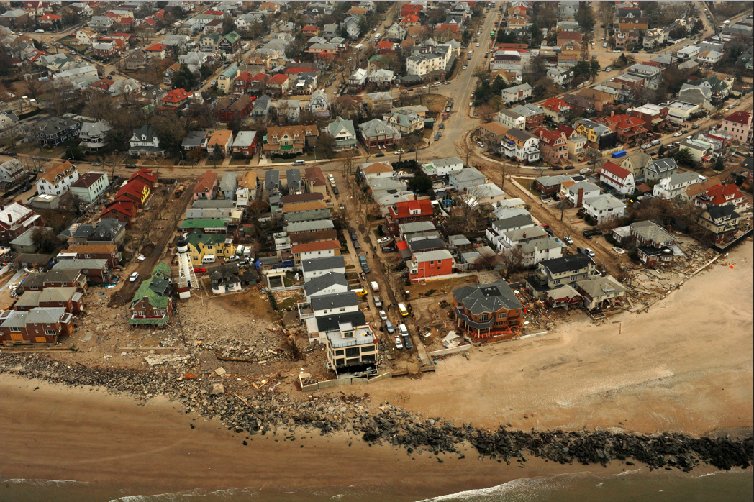
Disaster Scenario 2: Major Hurricane
Nov. 2012. An aerial view of damage caused by the storm surge of Hurricane Sandy on the coastline of New York. Photo credit Jocelyn Augustino, FEMA
Notes:
The second scenario is of a major hurricane event.

Slide 24
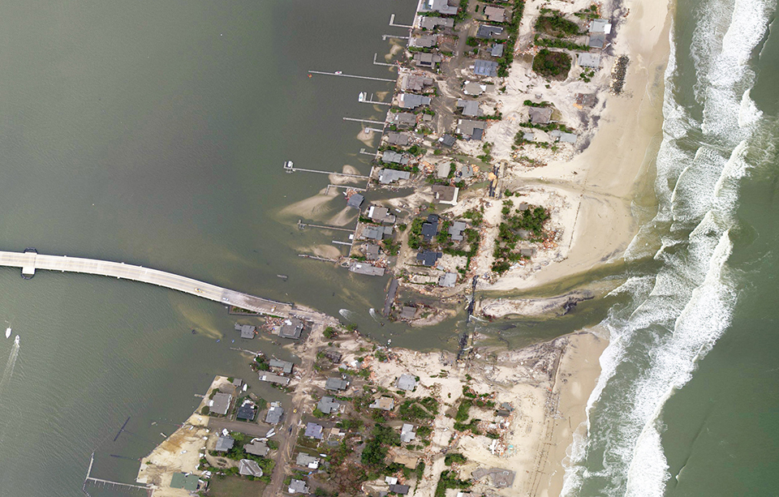
Major Hurricane: Disaster Overview
The event:
Mass evacuations and record floods in NY & NJ
Utility infrastructure is damaged
Debris amasses
Sensitive environmental areas impacted
Homes destroyed
Presidential disaster declaration
Agencies involved:
Multiple federal agencies
State agencies
Local governments
Tribal agencies
Other factors:
FDRC appointed and activated
RSFs are activated
UFR Advisor is deployed
Mantoloking, New Jersey after Hurricane Sandy storm surges and related fire ravaged the neighborhood, Oct. 2012 (photo credit FEMA)
Notes:
A category 5 hurricane forces mass evacuations and causes record floods in New York and New Jersey. Utility infrastructure is damaged and a large quantity of debris amasses in metropolitan areas. Sensitive environmental areas are impacted. Many homes are destroyed. A Presidential Disaster Declaration is made and DOT, FEMA, HUD, USACE, USCG, and state and local governments engage to provide federal assistance.
The FDRC is appointed and activated, and the RSFs are activated because of the catastrophic needs. The FDRC is a deputy to the FCO for matters concerning disaster recovery, activated under the NDRF when needed along with the RSFs. The FDRC is responsible for facilitating disaster recovery coordination and collaboration between federal agencies and their tribal, state and local partners.
There is a need for enhanced interagency coordination given the complexity of recovery amid multiple federal agencies, extensive damages and EHP impacts. A UFR Advisor is deployed to serve as the interagency coordinator for EHP reviews.

Slide 25
Major Hurricane: Pre-Disaster
UFR MOU commitments recognized.
Section 106 programmatic agreement executed based on the FEMA PPA.
ESA Matrix and how-to-guide developed. NOAA, HUD, USACE, USFWS and DOT have jointly developed.
Pre-Disaster
Disaster Occurs
Emergency Response
Recovery Planning
Disaster Recovery
Restored and More Resilient Community
Part 2: UFR Process in Action
Notes:
The federal agencies participating in the recovery process have signed the UFR MOU, committing the agencies to:
Exercise flexibility in conducting EHP reviews to achieve a coordinated review process. This includes adopting reviews conducted by another agency, and aligning reviews with those of other agencies jointly funding a project.
Implement the Tools and Mechanisms of the UFR Process.
Participate in the development of disaster-specific mechanisms which the disaster recovery leadership (FCO/FDRC), in consultation with the UFR Advisor, the EHP Advisor and the Parties’ Regional EHP Officers or other designated official, deem necessary to expedite and unify reviews.
Provide notification to disaster recovery leadership (FCO or FDRC) as soon as is practicable, that the Party is providing funding for one or more disaster recovery projects in a Presidentially declared disaster area for which that FCO/FDRC has responsibility.
FEMA and HUD have used the PPA, in coordination with state emergency management agencies and the state historic preservation offices in New York and New Jersey, to develop a programmatic agreement for Section 106 compliance with the NHPA in Region II.
*Note: HUD would likely not be negotiating the PPA under normal circumstance. HUD REs would be signing onto the PPA after FEMA has negotiated it using a negotiated addendum process where all parties would have to agree.
The programmatic agreement:
Lists routine actions that will have little to no impact on historic properties, and do not require review by the SHPO and consulting Tribe(s) or Native Hawaiian organizations;
Provides a process for expedited reviews when an undertaking may adversely affect a historic property; and
Provides a standardized project review process for undertakings that are not exempt from further Section 106 review.
FWS and FEMA in NJ also developed an ESA Matrix and how-to-guide. NOAA, HUD, USACE, USFWS and DOT have jointly developed the ESA Matrix.
The matrix identifies 137 potential post disaster activities and determines which, if any, of New Jersey’s endangered species could be affected.
The how-to-guide takes the agencies step-by-step to determine the appropriate level of review.
EHP Practitioners within the agencies can use these tools to assess potential impacts to endangered species and the reconstruction activity being reviewed, expediting the EHP review.

Slide 26
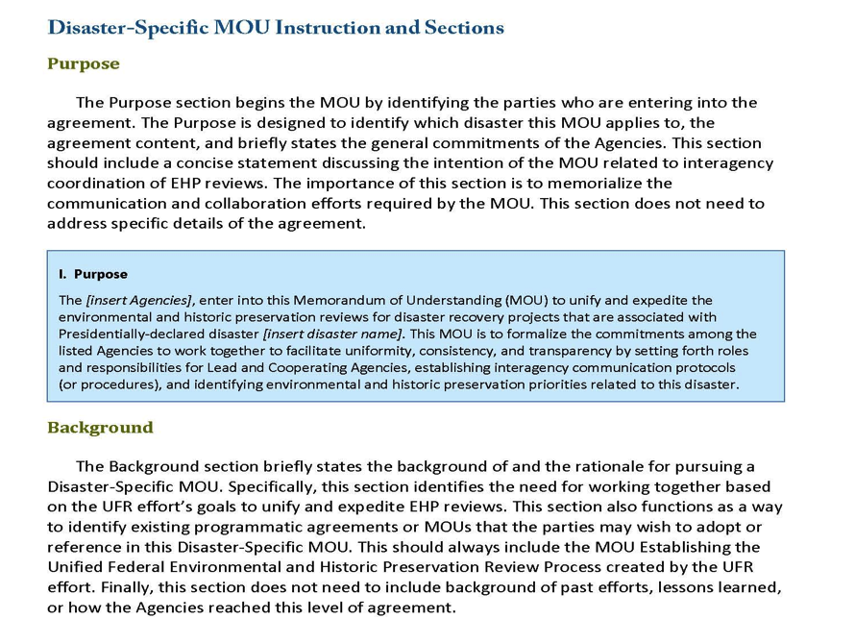
Major Hurricane: Recovery Planning
UFR Advisor assists parties to develop a Disaster-Specific MOU for:
Consultation timelines.
Agency roles and responsibilities.
Meeting coordination.
Agency points of contact.
Pre-Disaster
Disaster Occurs
Emergency Response
Recovery Planning
Disaster Recovery
Restored and More Resilient Community
Part 2: UFR Process in Action
Notes:
After a Presidential declaration is made, emergency response is underway and recovery planning may begin.
The UFR Advisor assists FEMA, FHWA, FWS, HUD REs, NOAA, USACE, SHPO, local governments and Tribes to develop a Disaster-Specific MOU for consultation timelines, agency roles and responsibilities and meeting coordination.
The Disaster-Specific MOU is an agreement to be used by federal, state, local and tribal agencies to assist and define the relationship between agencies during a specific disaster’s recovery efforts.. The MOU is used to increase communication, collaboration and transparency among

Slide 27
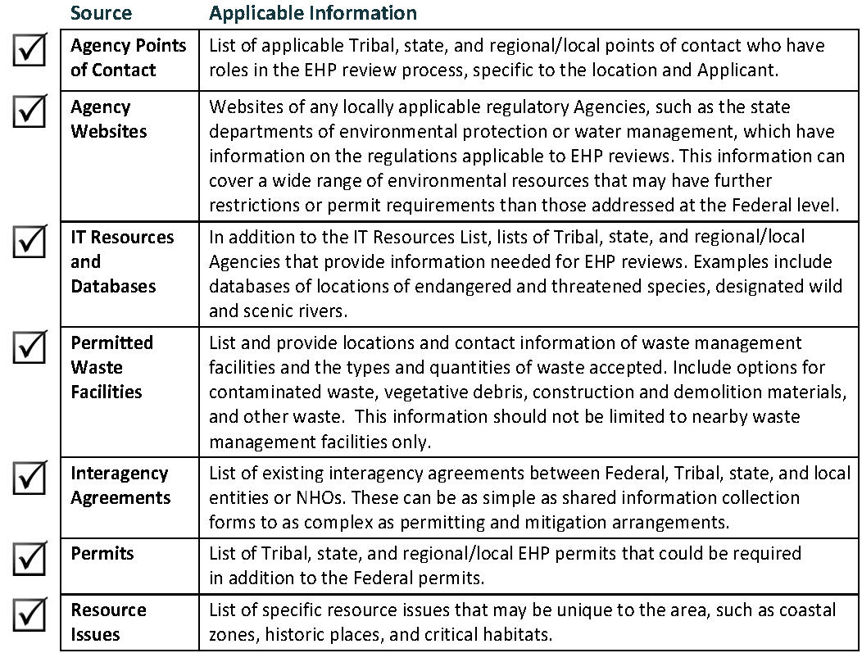
Major Hurricane: Disaster Recovery
Agencies share the Applicant Guide at applicant briefings.
EHP Practitioners inform applicants of agency specific requirements and coordinating joint funding timelines.
Applicants provide the necessary information for agencies to conduct the EHP reviews.
Applicants notify funding agencies of joint funding requests.
Pre-Disaster
Disaster Occurs
Emergency Response
Recovery Planning
Disaster Recovery
Restored and More Resilient Community
Part 2: UFR Process in Action
Notes:
Agencies share the Applicant Guide with Tribes, states and communities at applicant briefings. The guidance empowers applicants to provide the necessary information for agencies to conduct the EHP reviews, and for applicants to participate in the EHP review. The Applicant Guide also answers many of the most common questions and concerns encountered during an EHP review for proposed disaster recovery projects. Contents of the Applicant Guide include:
EHP requirements applicable to proposed disaster recovery projects,
Roles and responsibilities for agencies and applicants during EHP reviews,
Guidance for submitting information in the project application to support EHP review,
Clarification about the types of projects that usually require EHP review,
Information about funding sources, and
Summaries of federal EHP requirements.
The Applicant Guide also encourages applicant communication with all agencies and addresses the engagement of multiple federal agencies in one proposed project and the issue of applicants starting work prior to federal approval, both factors that can slow or prevent approval of proposed disaster recovery projects.

Slide 28
EHP Review With & Without the UFR Process Agency Coordination – Section 7 Consultation
Before the UFR Process | Under the UFR Process
Multiple agencies respond with assistance for disaster recovery efforts. | Multiple agencies respond with assistance for disaster recovery efforts.
Each agency (FEMA, HUD, DOT, etc.) independently completes EHP review (including consultation with NMFS/USFWS). | Agencies sign the Disaster-Specific MOU which identifies recovery project priorities, information sharing opportunities and roles and responsibilities of each agency.
Applicants/agencies collect data/information about the species that could be affected and the effect of their project on the species. | Using the Practitioner Guidance agencies share data / project information. The ESA Matrix is used to quickly assess species impacts.
NMFS/USFWS are overwhelmed with requests from multiple agencies concurrently. | Agencies coordinate on ESA consultations by submitting a joint consultation request to each consulting agency(NMFS and USFWS).
Federal agency effort may be duplicated. Staff resources may not be focused on the highest priority projects for recovery. | Reduced duplication of agency effort, allowing for determinations to be made quicker. Agencies share information/perspective on the projects improving the decision making. Highest priority projects are expedited.
28
Part 2: UFR Process in Action
Notes:
To understand how the UFR Process results in improvements in EHP review, here is an example of how the Section 7 of the Endangered Species Act consultation requirements would have been addressed before the UFR Process was implemented and how the UFR Process improved the process and the outcomes.
Before the UFR Process, there was a greater likelihood that federal agencies might address the EHP requirements for its projects independently. For example, each agency could collect information on endangered and threatened species and the potential effects of their project on the species, and they might not coordinate among themselves before seeking consultation with NMFS or USFWS per the requirements of Section 7 of the Endangered Species Act. NMFS/USFWS then has to determine the relationship between agency projects and interact separately with various agencies (e.g., USACE, DOT, HUD, FEMA). ... [U]sing the Practitioner Guidance as a basis for sharing project information, agencies can identify opportunities to coordinate Section 7 consultations, for example, by submitting a joint consultation request to NMFS or USFWS that addresses a group of related projects. NMFS and the USFWS can then work more efficiently to address multiple projects/multiple agencies.
Without prioritization or coordination, NMFS/USFWS consultation may result in delays for some projects, including high priority projects or projects that would have minimal effects. In the process, the federal agencies (funding agencies as well as NMFS/USFWS) may be duplicating efforts as well, collecting data and analyzing impacts from similar projects to the same species.
The UFR Process, through Disaster-Specific MOU, can coordinate and expedite the Section 7 consultation process for this disaster recovery. Agencies can collaborate on data collection (what species may be affected, what is the status of the species, what is the likely impact to the species using the ESA Matrix). Also using the Practitioner Guidance as a basis for sharing project information, agencies can identity opportunities to coordinate Section 7 consultations, for example, by submitting a joint consultation request that addresses a group of projects. NMFS/USFWS now has the opportunity to issue one determination for multiple projects/multiple agencies. Also the agencies can collectively communicate with NMFS/USFWS to ensure that the highest priority projects are addressed first.
The UFR Process reduced duplication of agency effort, expedites decision making and allows the highest priority disaster recovery projects to move ahead first.

Slide 29
Slide 29
EHP Review With & Without the UFR Process Agency Coordination – NEPA
Before the UFR Process | Under the UFR Process
Multiple agencies respond with assistance for disaster recovery efforts. | Multiple agencies respond with assistance for disaster recovery efforts.
Each agency independently completes EHP review for its own assistance programs and projects including compliance with NEPA. | Agencies sign the Disaster-Specific MOU which identifies information sharing opportunities and roles and responsibilities of each agency. Applicants notify agencies of joint funding efforts allowing them to better align NEPA timing and analyses.
Applicants/funding agencies collect data/information about the projects and analyze the effect of their project on the environment. | Agencies share data and project information and also coordinate analysis needs for related projects.
Agencies complete their own NEPA analyses on separate timelines and using different levels of NEPA analysis. | Coordination of analysis requirements for related projects allows one agency to adopt another agency’s NEPA analysis.
Federal agency effort may be duplicated. Applicants await the results of multiple overlapping NEPA analyses before proceeding with their project. | Reduced duplication of agency effort, allowing for determinations to be made quicker. Agencies share information/perspective on the projects improving the decision making.
Session IV: UFR Process in Action
Notes:
The UFR Process also expedited the National Environmental Policy Act (NEPA) compliance.
Before the UFR Process, each federal agency addressed the NEPA requirements for its projects independently. Since projects are likely to be related (for example located in the same area or be similar in nature) federal agencies may be duplicating efforts by each collecting data and analyzing impacts from similar projects.
The UFR Process, through Disaster-Specific MOU, can coordinate and expedite NEPA review for this disaster recovery. Agencies can collaborate on data collection, share project information and coordinate NEPA requirements. Coordination of analysis requirements for related projects allows one agency to adopt another agency’s NEPA analysis, as long as that analysis addresses the agency’s NEPA requirements, thereby eliminating the need to prepare separate analysis.
The UFR Process reduced duplication of agency effort and expedited decision making.

Slide 30
How Agency Staff and Stakeholders used the UFR Process to enhance Disaster Recovery
Tools/Mechanisms used during disaster
Prototype Programmatic Agreement (PPA)
ESA Matrix
Disaster-Specific MOU
Applicant Guidance
Successful Implementation of the UFR Process
Expedited federal determinations for disaster recovery projects
Consistency and coordination among various agency EHP reviews
Leveraged and efficient use of agency staff and funds
Quick resolution of delays
More informed federal decision making
Part 2: UFR Process in Action
Notes:
Using the Tools and Mechanisms listed on this slide, the federal agencies and their partners and stakeholders have successfully implemented the UFR Process.
For example, here are a few ways the Tools and Mechanisms helped the agencies to achieve the benefits of the UFR Process:
The Prototype Programmatic Agreement allowed FEMA and HUD to develop a consistent way of approaching reviews for jointly funded projects.
The ESA Matrix resolved potential delays by providing a readily available system for approaching consultations.
The Disaster-Specific MOU also supported faster consultation timelines and enhanced coordination through established meetings and roles and responsibilities for parties to the MOU.
The Applicant Guide supported applicants to notify federal agencies of all funding sought so the agencies could coordinate their reviews and properly allocate funding where it was needed.
Tools and mechanisms discussed are available on the UFR Webpage:
http://www.fema.gov/unified-federal-environmental-and-historic-preservation-review-Presidentially-declared-disasters
Or through e-mail request to the UFR Team.

Slide 31
Slide 31
How Can the UFR Process Assist You?
UFR Process can assist you to:
Create opportunities for greater coordination across agencies to expedite EHP requirements.
Strive to reduce duplication of information provided by applicants working with multiple agencies.
Leverage existing and develop new interagency agreements, such as MOUs and programmatic agreements.
Align review processes and prepare joint reviews with other agencies to satisfy one or more EHP requirements.
UFR Process is not intended to:
Circumvent or supersede any existing federal, state, local or local EHP requirements.
Eliminate requirements for consultations between agencies and between agencies and applicants.
Change existing interagency agreements.
Establish a single review process for agencies funding a single project.
Part 2: UFR Process in Action
Notes:
Now that we have had an opportunity to walk through a few disaster scenarios using the UFR Process, here is the table you’ve seen from this morning: did these example scenarios help explain how the UFR Process can assist you and clarify its application?

Slide 32
Session Summary
Agency staff and stakeholders use the UFR Process, through the Tools and Mechanisms, to:
Enhance interagency coordination for EHP reviews.
Expedite the EHP reviews.
The UFR Process has the following benefits:
Expedited federal determinations for disaster recovery projects.
Consistency and coordination among various agency EHP reviews.
Leveraged and efficient use of agency staff and funds.
Quick resolution of delays.
More informed federal decision making.
Closing Remarks
Notes:
We hope this presentation has been helpful to you in clarifying how the UFR Process applies in practice. Remember that it is through your efforts to implement the UFR Process that any benefits will be realized. You can help implement the UFR Process by using Tools and Mechanisms yourself or by promoting their use to your peer EHP Practitioners, applicants and other stakeholders.

Slide 33
Slide 33
Questions
Unified Federal Review Webpage:
https://www.fema.gov/unified-federal-environmental-and-historic-preservation-review-presidentially-declared-disasters
Unified Federal Review Library:
http://www.fema.gov/media-library/assets/documents/98911
UFR Team E-mail Address:
federal-unified-review@fema.dhs.gov
Closing Remarks

Slide 34
Slide 34
Abbreviations and Acronyms
ACHP – Advisory Council on Historic Preservation
CATEX – Categorical Exclusion
CEQ – Council on Environmental Quality
DOT – U.S. Department of Transportation
EA – Environmental Assessment
EHP – Environmental and Historic Preservation
EIS – Environmental Impact Statement
ESA – Endangered Species Act
FCO – Federal Coordinating Officer
FEMA – Federal Emergency Management Agency
FDRC – Federal Disaster Recovery Coordinator

Slide 35
Slide 35
Abbreviations and Acronyms (continued)
FHWA – Federal Highway Administration
FONSI – Finding of No Significant Impact
FWS – U.S. Fish and Wildlife Service
HUD – U.S. Department of Housing and Urban Development
MOA – Memorandum of Agreement
MOU – Memorandum of Understanding
NCR – Natural and Cultural Resources
NDRF – National Disaster Recovery Framework
NEPA – National Environmental Policy Act
NHPA – National Historic Preservation Act
NOAA – National Oceanic and Atmospheric Administration

Slide 36
Slide 36
Abbreviations and Acronyms (continued)
POC – Point of Contact
PPA – Prototype Programmatic Agreement
RE – Responsible Entity
RSF – Recovery Support Function
SHPO – State Historic Preservation Officer
SRIA – Sandy Recovery Improvement Act of 2013
THPO – Tribal Historic Preservation Officer
UFR – Unified Federal Environmental & Historic Preservation Review
USACE – U.S. Army Corps of Engineers
USDA – U.S. Department of Agriculture

