Slide 1
Briefing Guide: Senior Leadership Briefing

Slide 2
Objectives
Explain Legal Authorities
Provide an understanding of Continuity and Continuity of Operations
Emphasize the benefits of Continuity
Explain the importance of and need for securing support from senior leadership
Emphasize the need for Continuity planning considerations for agencies and organizations
Describe role of leadership
Summarize the Continuity Program
Notes:
At the end of this briefing, the presenter will be able to convey the following:
The legal authorities that established continuity.
Describe the importance of continuity to an organization.
Explain the roles senior leadership play in continuity.
Explain the benefits of developing a viable continuity program.
Identify the steps necessary to implement and manage a successful continuity program.

Slide 3
General Authorities
National Security Presidential Directive/NSPD-51 Homeland Security Presidential Directive/ HSPD-20, National Continuity Policy, May 2007
National Continuity Policy Implementation Plan (NCPIP), August 2007
National Response Framework, January 2008
DHS Management Directive 9300.1, Continuity of Operations and Continuity of Government Functions, July 2004
Notes:
Discuss briefly each of these legal authorities and share with the audience where these documents can be found.

Slide 4
National Continuity Policy
Continuity programs provide the foundation for
Enduring Constitutional Government
(NSPD-51/HSPD-20)
and the Nation’s First Essential Function,
“Ensure the continued functioning of our form of government under the Constitution, including the functioning of the three separate branches of government.”
(NCPIP)
Notes:
Point out to the audience that there are a total of (8) National Essential functions NEF’s that are the foundation for all continuity programs and capabilities at the federal level.
Visual aid: Have copies of the eight NEF’s to share with the audience.

Slide 5
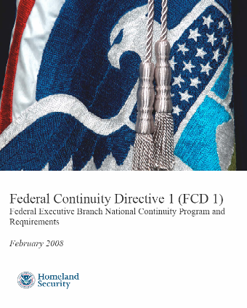
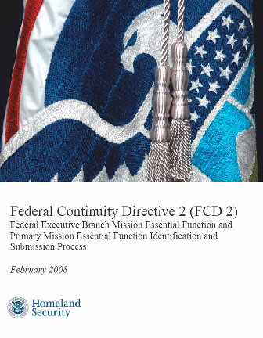
Federal Continuity Directives 1 & 2
Approved by the DHS Secretary on February 8, 2008
Provides direction for the development of Continuity plans and programs for the Federal Executive Branch
Provides guidance for Identifying Mission Essential Functions (MEFs) and Primary Mission Essential Functions (PMEFs)
Sets criteria for what a “Continuity facility” must provide
Establishes minimum Continuity communications requirements
Emphasizes the management of vital records as an essential element of Continuity planning
Notes:
Introduce this topic by explaining that, by Presidential Directive, FEMA is the lead agent for Continuity planning within the Executive Branch. FEMA issues guidance to promote and compliance with Federal mandates and requirements. Explain that each federal agency is responsible for developing their continuity plan and FEMA provides guidance and technical assistance.
Visual aid: Have copies of the FCD 1 & 2 to share with the audience.

Slide 6
Continuity Guidance Circular 1 & 2
CGC 1 approved by the FEMA Administrator on January 21, 2009
CGC 1 provides Continuity guidance on:
Continuity Program Management information for non-federal agencies
Elements and components of a viable continuity capability
Coordination of interdependencies
Continuity plan operational phases and implementation
CGC 2 approved by NCP Assistant Administrator on July 22, 2010
CGC 2 provides Continuity guidance on:
Identifying Mission Essential Functions
Conducting a Business Process Analysis and a Business Impact Analysis
Notes:
Convey to the audience that Continuity Guidance Circular (CGC) 1& 2 were created to provide critical guidance and direction to state, territorial, tribal, local and non-government entities on how to develop continuity plans. Explain the differences between to the documents…CGC 1- Provides guidance for developing continuity plans and programs for sustainment's of essential functions (EF’s) and services based on an all hazards emergency preparedness approach. CGC 2- Provides key guidance for identifying essential functions (EF’S) and conducting BPA’s and BIA’s to determine linkages, relationships, dependencies, and interdependencies for performing the EF’s.
Visual aid: have copies of CGC 1 and 2 documents to share with the audience.

Slide 7
National Response Framework
The National Response Framework (NRF) is a guide to how the Nation conducts all-hazards response
Continuity provides the foundation for the tiers to the NRF, operational governments at the local, state and federal levels capable of performing their essential functions under all conditions
Notes:
Indicate to the audience that regardless of the type of agency they represent , the National Response Framework (NRF) is a tool that can help them prepare an effective strategy for responding to emergency situation and continue their essential functions. The information in the document can be scaled up or down in terms of the size, type and responsible requirements of the agency.

Slide 8
Benefits of Continuity Programs
Supports good business practice
Enables agencies and organizations to continue their essential functions
Protects the fundamental mission of all agencies and organizations
Saves lives
Minimizes against property loss
Improves budget planning process
Identifies threats and mitigates risk
Notes:
Share with the audience that preparing for continuity of operations in the event of an emergency is a good business practice, because it enables agencies to continue to perform essential functions that are required. Explain that continuity planning should be a part of functional mission of their agency. Strongly emphasize that today’s national and international threat environment has increased the need for continuity plans at all levels of government and non-government sectors.
At this point give a relevant and timely example illustrating the benefits of continuity. Consider using examples from an international, national, regional, state or local event or emergency.
Convey to the audience that a good continuity plan is like having life, auto or health insurance.

Slide 9
Leadership Support for Continuity
Leaders should support Continuity because it:
Ensures the capability of continuing agency essential functions during a wide range of potential emergencies
Ensures critical planning gaps, budgetary, and management challenges are identified and addressed
Notes:
Stress to the audience that having a continuity plan is good business practice that will enable the agency to continue its core mission in the event of an emergency. Point out to the audience that having a robust and well designed continuity plan will provide for a safe and secure work environment for their employees. Let the audience know that you understand they are busy people and while continuity is not something that they need every day it does play a critical role in protecting their business….the continuity plan is like having life, home and auto insurance. Insurance is continuity approach against all-hazards.
You don’t need it (Continuity Plan) until something happens to you!

Slide 10
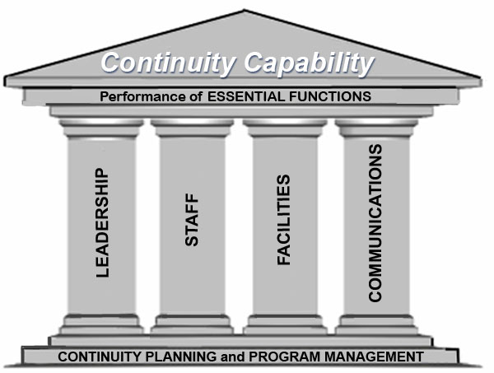
Importance of Continuity
Consider the impacts on your organization:
Leadership
Staff
Facilities
Communications
Notes:
Convey to the audience that the illustration represents the four (4) pillars of strategic continuity management planning. The resilience of an agency is directly related to the effectiveness of its continuity capability.
In addition, operations and security are also critical factors that an agency has to address as it relates to their ability to perform its essential functions continuously.

Slide 11
Role of Leadership
Appoint a Continuity Coordinator
Appoint a Continuity Program Manager
Integrate Continuity planning into daily operations
Identify and prioritize the Essential Functions
Approve the Continuity plan
Ensure budgetary support
Identify successor and delegation of authority
Approve the Multi-Year Strategy and Program Management Plan
Notes:
Share with the audience the definition of each roles and why it is importance to the overall success of continuity planning.
Example: Continuity Coordinator- appointed by senior leadership, signs off on continuity budgetary requests, continuity leadership team liaison, and provides guidance and direction to the Continuity Program Manager.
Continuity program Manager- serves as the continuity subject-matter-expert, develops the continuity plan, coordinates agency operations and emergency management to perform essential functions in any situation, and responsible for continuity updates, revisions and review process.
Integration- promote for the inclusion of continuity Test, Training and Exercise into the culture of the agency.
Essential Functions- the leaders must identify and prioritize the EF’s.
Budget Approval- the continuity budget should be a part of the annual agency budgetary process.
Multi-Year Strategy and Program management Plan (MYSPMP)- must be supported as one of the critical elements of the continuity program for the agency.

Slide 12
Summary of Continuity Program
Creating a proactive planning culture within the organization
Developing a multi-year strategy and program management plan
Defining planning priorities
Integrating Continuity into day to day operations
Incorporating critical information from internal and external stakeholders
Managing expectations
Managing facilities
Implementing a Test, Training and Exercise Program and Corrective Action Program
Notes:
Convey to the audience that a solid and well signed continuity plan will effectively address each of the areas list above. Remind the audience that the benefits of solid continuity planning create a proactive planning environment, enable the agency to continue essential functions in any situation, define important planning goals, address impute from stakeholders, addresses alternate site and devolution management planning.

Slide 13
Questions
Questions?

Slide 14
End of Presentation

