Slide 1
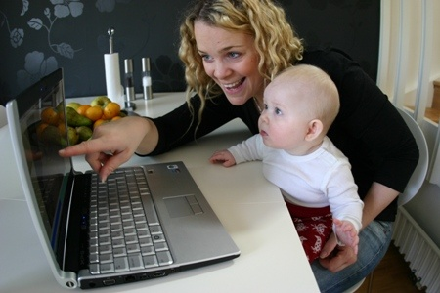
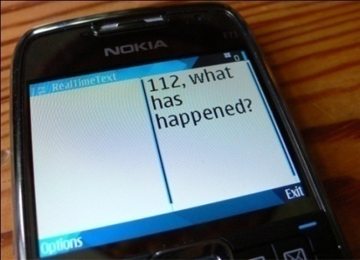
REACH112
European Project for conversational and emergency service access through Total Conversation and
Real-Time Text
Gunnar Hellström
Omnitor
EAAC 14 Jan 2007
Washington DC

Slide 2
Revised EU Universal Service Directive
Stronger requirements for equality:
A few excerpts from revised EU Universal Service Directive 2009:
Ensure that access to telephony services for disabled end-users
is equivalent to the level enjoyed by other end-users.
Ensure that access for disabled end-users to
emergency services is equivalent to that enjoyed by other end-users.
Publicly available telephone services also include means of
communication specifically intended for disabled end-users using text relay or total conversation services.
----------------------------

Slide 3
REACH112 – EU project
A practical response on the stronger directives
REACH112 is an EU Policy Support Project
It is a practical response to the stronger words for accessibility in the EU directives.
It shows how people who cannot use voice telephony can get equivalent services.
The solution is consistent application of the Total Conversation and Real-Time text concepts providing calls with real-time text, video and voice, and subsets thereof.
It is applied for person to person communication.
It is applied for emergency service access.

Slide 4
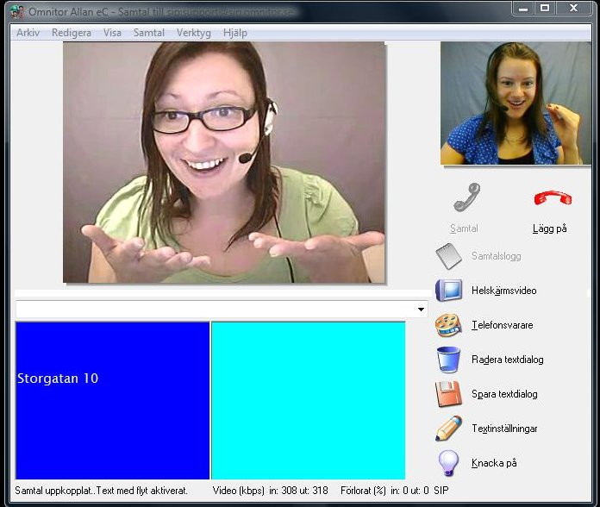
Total Conversation and
Real-Time text concepts
An open standardised concept, originally from ITU, now also in IETF, ETSI and 3GPP standards.
Enables consistent video, text and voice communication at the same time and in real time.
Media:
Video for sign language, lip reading, and general showing
Real-time text for good text contact for part or whole conversation
Audio for speech.
The base for conversational services for all. Combine media that support your capabilities.
Appreciated in implementations with thousands of users.
A small but important extension of the videophone concept by adding real-time text in a standardised way.
Real-time text: Text is sent with the same flow as it
is typed. Near character-by-character. Gives good
contact and efficient dialogue in intensive calls.
No waiting. Low transmission load.

Slide 5
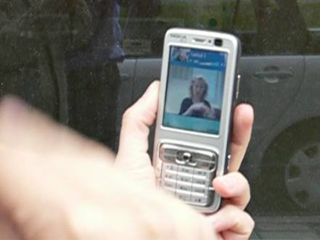
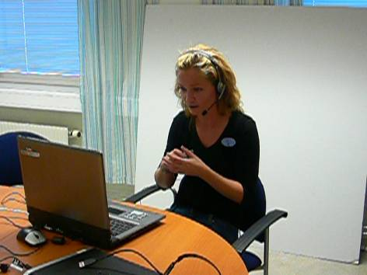
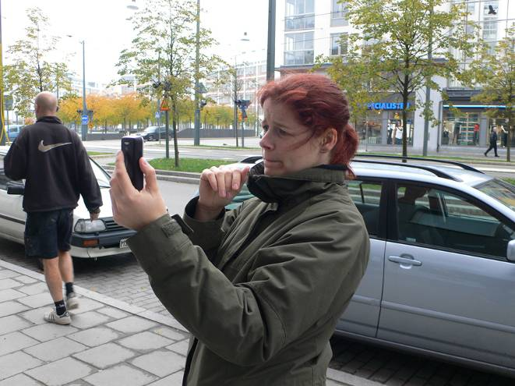
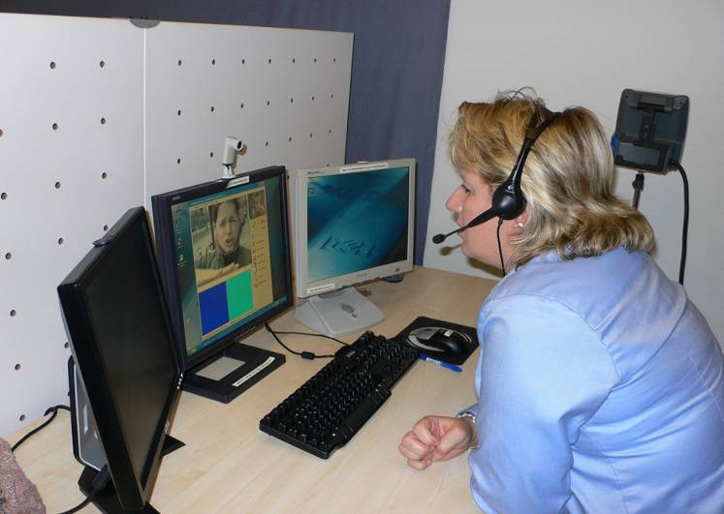
Relay service: important complement in everyday calls as well as in emergency
Some people need other modes than speech in emergency calls as well as everyday calls.
Example: Mobile video emergency call in sign language for deaf user.
Video relay service
translating
sign language<>voice
Signing user
PSAP

Slide 6
REACH112 brief facts
  3 year deployment project, 2009-2012, partly funded by
  EU CIP programme for wider deployment of emerging services of PAN-European interest.
  Task: validate sustainability of Total Conversation and
  Real-Time text for accessible calls and emergency calls.
  Partners: 4CT, AnnieS, AuPix, Avon Police, Avon firemen, Axega, Bristol University–CDS, EENA, France Telecom – Orange, Hospital of Grenoble, IES, Ivés, KLPD, Nokia, Omnitor, RNID, Sertel, SOS-Alarm, Siemens Spain, Websourd

Slide 7
REACH112 brief facts
  Main function: All users shall be able to call all and call emergency services. Requires interoperability standards.
  Pilot production from May 2011 in 5 pilot countries.
  Requested by European Commission, pointing at the standards reported by the TCAM working group for accessible communication.
  Various states at project beginning, Sweden had highest number of deployed Total Conversation users. Holland or UK most Real-Time text users.
  Goal, increased number of users, mixed RTT and Total Conversation, successful access to emergency services.

Slide 8
REACH112 Network of interoperable Total Conversation services

Slide 9


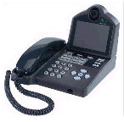
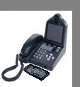
Total Conversation
Interoperability by standards
PSTN
Mobile phone
Other
Networks
( closed systems, other standards)
GATEWAY
PSTN Phones
Other
Protocols
Analog telephone network
PSTN
To IP
Gateway
GATEWAY
Traditional Textphones
Total Conversation
SIP
with RFC4103
for Real-time Text
video
and audio
Computer, PDA,
other Text device
with Textphone capability
(directly or indirectly)
Personal Computers
(text, voice and video)
IP text device
112
IP network
Text, video and Voice
VoIP Phone
VoIP Phones
(voice only)
VoIP Mobile phone with RTT

Slide 10
Making 112 calls more accessible
Include multimedia, include relay services, still dial 112.
Relay
User
PSAP
User
PSAP
Important principles
What you use for your everyday communication should also be what you
use in case of emergency.
We shall not expect the emergency services to implement all kinds of
proprietary communication methods. Just a few standardised.
Conclusion, service providers of proprietary communication need to convert to standardised protocols at least for emergency access.
Notes:
Relayed through a VRS or text relay service for text telephones.
Direct communication requires PSAP staff trained in sign language (France)

Slide 11

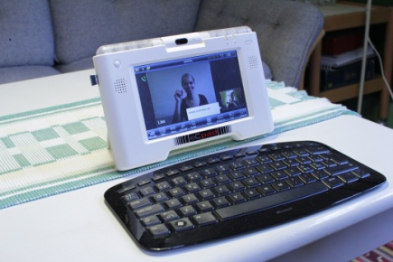

Varying implementations of
Total Conversation and Real-Time text
Eight technology providers in
REACH112. Provide different but
interoperable solutions.
Examples:
1. Windows based softphones
2. Hardware pad terminals
3. Mobile 3G phones with
text-only and Total Conversation
applications

Slide 12
Glimpses of REACH112 pre-history
  2001. Total Conversation and Real-Time Text is first standardised for IP networks in ITU, IETF and 3GPP standard bodies, supported by many telecom providers.
  2004. EU accessibility group INCOM reported general low functionality, severe fragmentation in everyday accessible communication and very little emergency service access for deaf, hard-of-hearing and Deafblind users. Recommended the Total Conversation and real-time text standards as a solution.
  2006-7. Effort to make a voluntary industry roadmap to amend the situation in subgroup of terminal regulatory group TCAM. Report describes the Total Conversation standards and steps forward. Progress was judged by the EC to be too weak and lacking committments.

Slide 13
Glimpses of REACH112 pre-history
  2007. DigitalEurope, European ICT Industry association publish a Vision Statement for deployment of Total Conversation. Use the Total Conversation standards for interoperability between operators, recommends use of same standards internally per operator, but accept other methods internally if strong reasons exist and the standard is used with others.
  2008 European Commission call for application of projects for deployment support to Total Conversation and Real Time text and emergency services, referring to the solution described by TCAM eWGD.
  July 2009, Project consortium REACH112 awarded the grant and project started.

Slide 14
REACH112 pre-history
  November 2009, revised Electronic communication directives were approved, containing enstrengthening of the rights to equivalent service level and access to emergency services and Total Conversation for people with disabilities.

Slide 15
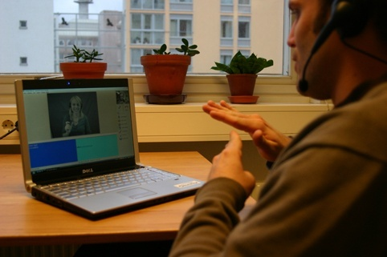
Conclusions
Relation to EAAC
REACH112 and its pre-history has a lot in common with the task and goals of EAAC.
Global interoperability is needed to fulfill requirements of functional equivalence with voice telephony for both REACH112 and EAAC.
EAAC and REACH112 are recommended to keep in touch for exchange of views, recommendations and experiences.

Slide 16
REACH112
www.reach112.eu
---
Gunnar Hellström, Omnitor
gunnar.hellstrom@omnitor.se
www.omnitor.se
Source of further info about real-time text:
www.realtimetext.org

