Slide 1
Freight Demand Modeling and Data Improvement Strategic Plan Photo: © iStockphoto.com/VallarieE (11989568)
SHRP 2 C20
Project Overview

Slide 2
Project Need
Goods movement is vital to prosperity.
Transportation improvements are capital-intensive, long-term commitments.
Transportation plans and programs must have a meaningful freight component to support sound decision making.
Passenger-oriented travel demand models and existing data are insufficient to reflect the complexity of freight.

Slide 3
Project Purpose
To foster fresh ideas and new approaches to freight demand modeling and data collection that ultimately enhance decision making.
Photos: © iStockphoto.com/ElFlacodelNorte (12748315); courtesy Gannett Fleming.

Slide 4
Strategic Objectives
Improve and expand the knowledge base for planners and decision makers.
Develop and refine forecasting and modeling practices that reflect the “real world” of supply-chain management.
Develop and refine forecasting and modeling practices based on sound economic and demographic principles.
Develop standard freight data to smaller geographic scales.
continued next slide

Slide 5
Strategic Objectives, cont’d.
Establish methods for maximizing the beneficial use of new freight analytical tools by state departments of transportation (DOTs) and metropolitan planning organizations (MPOs) in their planning and programming activities.
Improve the availability and visibility of data among agencies and between the public and private sectors.
Develop new and enhanced visualization tools and techniques for freight planning and forecasting.

Slide 6
Current State of the Practice

Slide 7
Current State of the Practice
Key factors: Globalization of trade, underlying economic forces, private sector inventory and logistics, and centralized warehousing
Freight planning, forecasting, and modeling response
Economic flow models
Land use and economic input-output models
Commodity-based models
Vehicle- and trip-based models
Estimation routines
Aggregate measures
Quick response procedures

Slide 8
Current Models Are Lacking in Terms of
Multimodal dimensions of freight transport
Key variables that “drive” freight demand
Transportation variation by commodity type
Obtaining proprietary data from private sources
Time sensitivity of mode choice
Local deliveries (i.e., “touring”) in metropolitan areas
Complex relationship of land use and freight generation

Slide 9
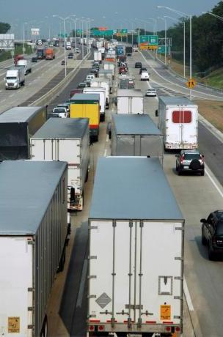
Current Data Shortcomings
Availability
Frequency of updates
Cost of collecting data to close gaps
Accuracy and suitability for planning and modeling at varied geographic levels
Potential errors aggregating or disaggregating data for geographic scaling
Relating freight data to transportation networks in models
Photo: © iStockphoto.com/LarryLawhead (3561709)

Slide 10
Decision-Making Needs

Slide 11
Decision-Making Needs
A recognized and valid inventory of standardized data sources with common definitions
A range of analytical tools and applications to address diverse decision-making needs
A process to routinely generate new data sources and problem-solving methods
Behavior-based facets of freight decision making that have been incorporated into modeling
continued next slide

Slide 12
Decision-Making Needs, cont’d.
Industry-level freight data at a local, subregional level and a better understanding of local deliveries in urban areas
Benefit-cost analysis tools that go beyond traditional financial measures by including direct and indirect benefits and costs (public and private)
Development of a statistical sampling of truck shipment data similar to the Carload Waybill Sample available for railroads
continued next slide

Slide 13
Decision-Making Needs, cont’d.
Intermodal transfer characteristics, volume, and trends
Leveraged freight data from GPS-based resources and ITS applications (e.g., CVO, Weigh-in-Motion, IntelliDrive)
Interplay of land-use policies and freight
Understanding of freight activity relative to fuel costs, currency valuation, and economic trends
continued next slide

Slide 14
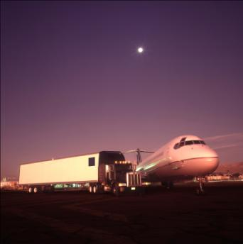
Decision-Making Needs, cont’d.
Freight forecasts applied to revenue projections
A multimodal, network-based freight demand model
for all modes of transport
with similar level of detail for varied geographic scales
Photo: © iStockphoto/ElFlacodelNorte (12748315)

Slide 15
Sample Research Initiatives

Slide 16
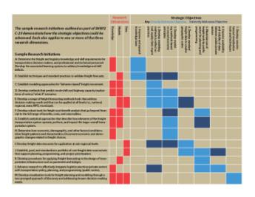
Sample Research Initiatives
The sample research initiatives demonstrate how the strategic objectives could be advanced.
Each also applies to one or more of the three research dimensions—knowledge, models, and data.
refer to handout

Slide 17
Sample Research Initiatives
Determine the freight and logistics knowledge and skill requirements for transportation decision makers and professional and technical personnel. Develop the associated learning systems to address knowledge and skill deficits.
Establish techniques and standard practices to validate freight forecasts.
Establish modeling approaches for “behavior-based” freight movement.
Develop methods that predict mode shift and highway capacity implications of various “what-if” scenarios.
continued next slide

Slide 18
Sample Research Initiatives, cont’d.
Develop a range of freight forecasting methods and tools that address decision-making needs and that can be applied at all levels.
Develop robust tools for freight cost-benefit analysis that go beyond the financial to the full range of benefits, costs, and externalities.
Establish analytical approaches that describe how elements of the freight transportation system operate, perform, and affect the larger overall transportation system.
continued next slide

Slide 19
Sample Research Initiatives, cont’d.
Determine how economic, demographic, and other factors and conditions drive freight patterns and characteristics. Document economic and demographic changes related to freight choices.
Develop freight data resources for application at subregional levels.
Establish, pool, and standardize a portfolio of core freight data sources and sets that support planning, programming, and project prioritization.
continued next slide

Slide 20
Sample Research Initiatives, cont’d.
Develop procedures for applying freight forecasting to the design of transportation infrastructure such as pavement and bridges.
Advance research to effectively integrate logistics practices (private sector) with transportation policy, planning, and programming (public sector).
Develop visualization tools for freight planning and modeling through a two-pronged approach of discovery and addressing known decision-making needs.

Slide 21
Strategic Road Map

Slide 22
Developing a Strategic Road Map
Fostering interest among the freight community based on extensive outreach and engagement of public and private freight stakeholders
Documenting freight decision-making needs—particularly those of state DOTs and MPOs
Piloting a successful international freight modeling and data-innovation symposium—to spur breakthrough thinking and innovative ideas (www.freightplanning.com)
Developing an initial set of sample research initiatives validated by freight stakeholders

Slide 23
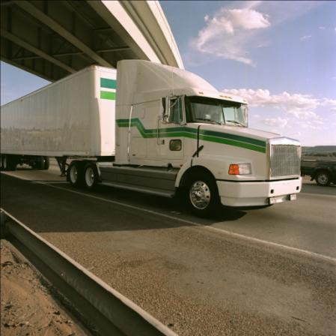
Road Map Elements – Organization
Global Freight Research Consortium (GFRC)
Road map that is an agile framework for achieving the strategic objectives
Elements include
GFRC,
freight modeling and data- innovation symposium, and
initiative advancement.
Photo: © iStockphoto.com/ElFlacodelNorte(12012568)

Slide 24
Road Map Elements – GFRC
Purpose: To promote a body of research through funding agencies and other stakeholders in improved freight performance and decision making.
Participation: Voluntary and including those with a stake in achieving road map strategic objectives—public domestic agencies, modal and other associations, universities, and the transportation research entities of other countries.
Responsibilities: Enable, fund, and promote research supported through public organizations (national and international) with assistance from private freight-oriented organizations.

Slide 25
Road Map Elements – Symposium
A good foundation is to build on the successful Freight Modeling and Data Innovation Symposium (Sept. 2010).
Small size to facilitate discussion: ≈50 in attendance and ≈15 presentations to address the challenge of developing the next generation of freight demand models and data.
Jury panel of freight experts to judge presentations.
A monetary award to competition winner.
An ongoing dialogue to incorporate innovations into modeling and data practices.

Slide 26
GFRC Role in Initiatives Advancement
Define issues ripe for research innovation.
Provide recognition and incentives to spur breakthroughs.
Conduct regular innovation forums.
Promote technology transfer from other disciplines.
Promote an international focus.
Recognize the application of completed research.

Slide 27
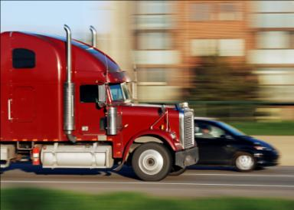
SHRP 2 C20 Research Results
Road map to move freight modeling and data innovation forward through
Implementing sample research initiatives that support seven key strategic objectives
Expanding the dialogue on freight analysis and data innovation through an ongoing international forum of key stakeholders
Photo: © iStockphoto.com/EasyBuy4u (6149923)

Slide 28
Longer-Term Vision
By the end of this decade, a vision for improved freight modeling and data will be characterized as follows:
Robust freight forecasting tools have been developed and are the standard for public sector freight transportation planning.
These tools and data are dynamic in terms of linking with other key variables such as development and land use, and are dynamic in terms of application to local scales, corridors, or regions.
The challenges associated with the data necessary to support new planning tools have been addressed through bringing together the varied resources of public and private sectors.
The knowledge and skills of DOT and MPO staff have been methodically enhanced to complement the development of better tools and data.
Decision makers recognize that transportation investments are being informed by an understanding of the implications, benefits, and trade-offs relative to freight.

Slide 29
C20 Technical Expert Task Group (TETG)
Susie Lahsene, Chair | Port of Portland
John Fuller | University of Iowa
Jim Gosnell | West Coast Corridor Coalition
Bob James | Port Authority of New York and New Jersey
Becky Knudson | Oregon DOT
Phillip Mescher | Iowa DOT
Randy Mullet | Con-way, Inc.
Rolf Schmitt | Federal Highway Administration
Spencer Stevens | Federal Highway Administration
SHRP 2 Staff
Ann M. Brach, Director, SHRP 2
David Plazak, Senior Program Officer, SHRP 2
Tom Palmerlee, Associate Division Director, Technical Activities, TRB

