Slide 1
RIA
Child, Youth and School Services
Town Hall Meeting
20 November 2015

Slide 2
AGENDA
Introduction of Panel Members
CYSS Facilities
Army Goal
Definitions
Challenges
CYSS Wait List Process
RIA Waiting List Priorities
Factors That Influence Placement
Army Fee Assistance Program
Way Ahead
Sources of Information
Q&A

Slide 3
Panel Members
Darrell Clay Director FMWR
David Vander Heyden CYSS Coordinator
Kelli Overturf CDC Director
Tim Hernandez SAC/YC Director
Nancy Lawson FCC Director
Tina Bevier Outreach Service Director
Sherry Morrison Outreach Admin Assistant

Slide 4
RIA
Child, Youth & School Services
Facilities
Child Development Center
Covenant Cottage
School Age Center/Youth Center
Homes Off Post

Slide 5
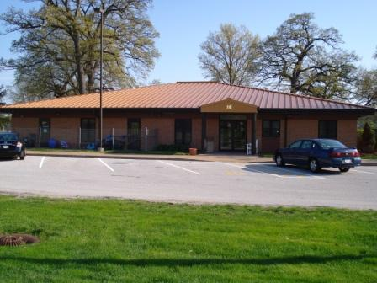
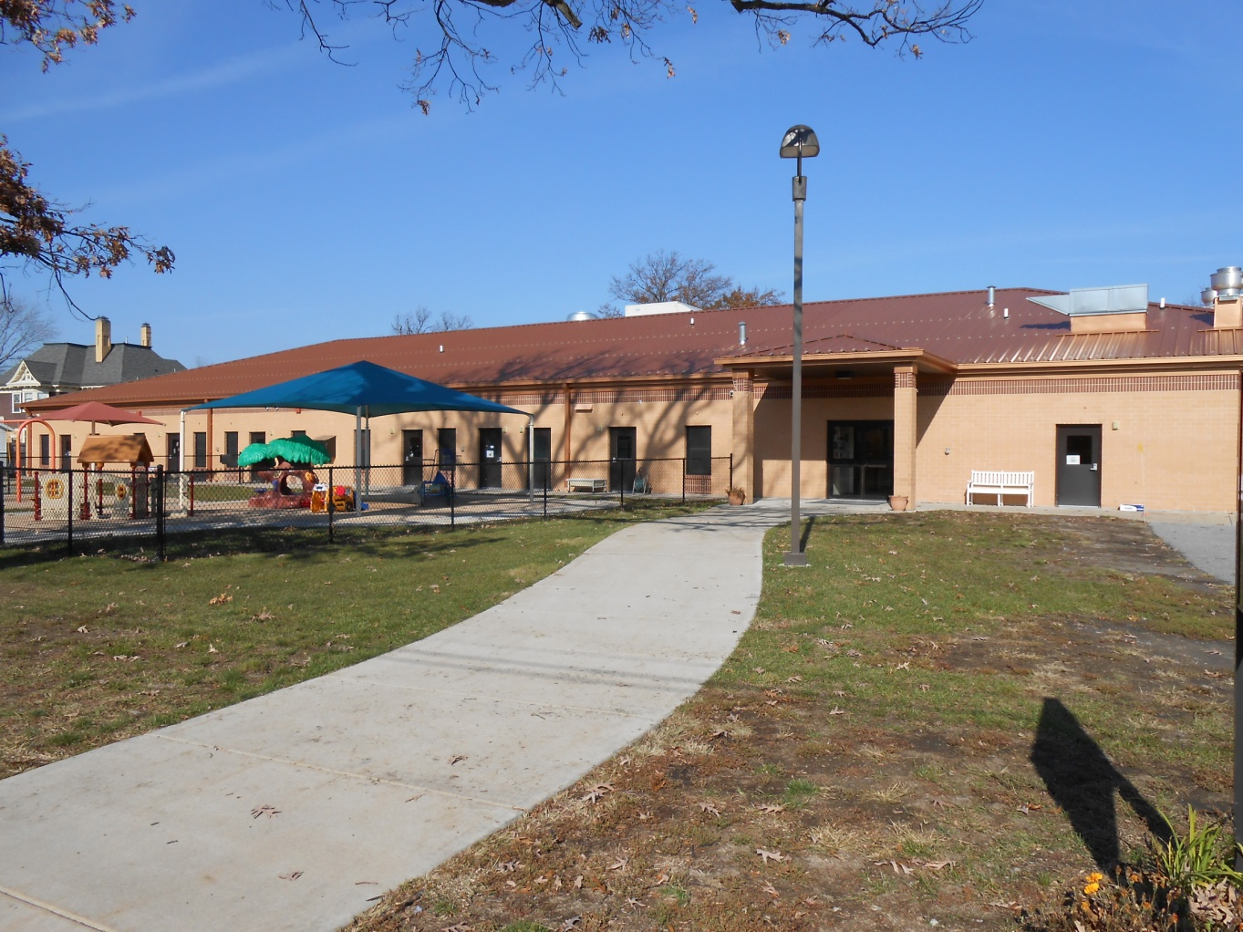

Child Development Center
Building 16
Building 15
Building 11

Slide 6
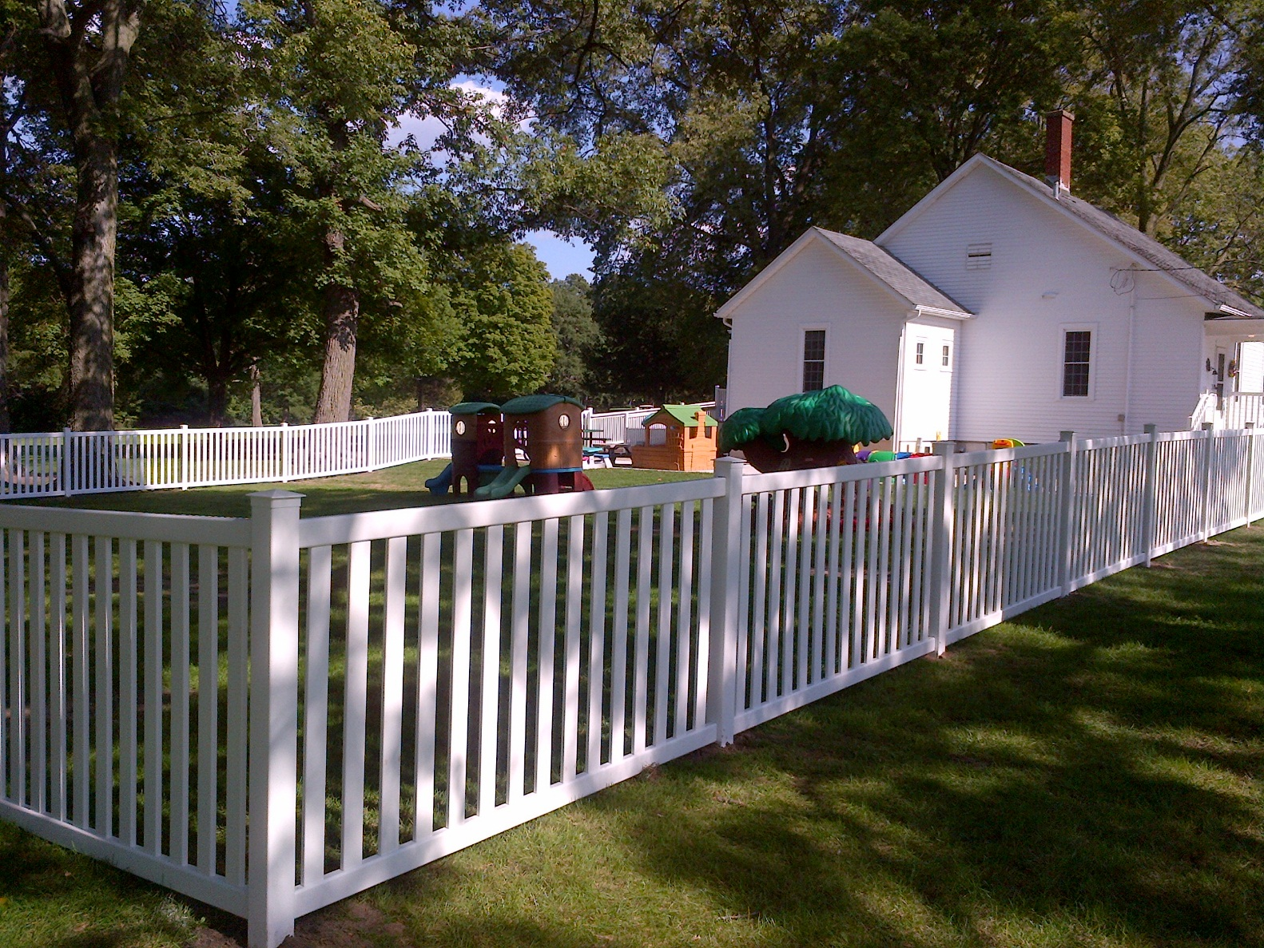
Covenant cottage
Building 85

Slide 7
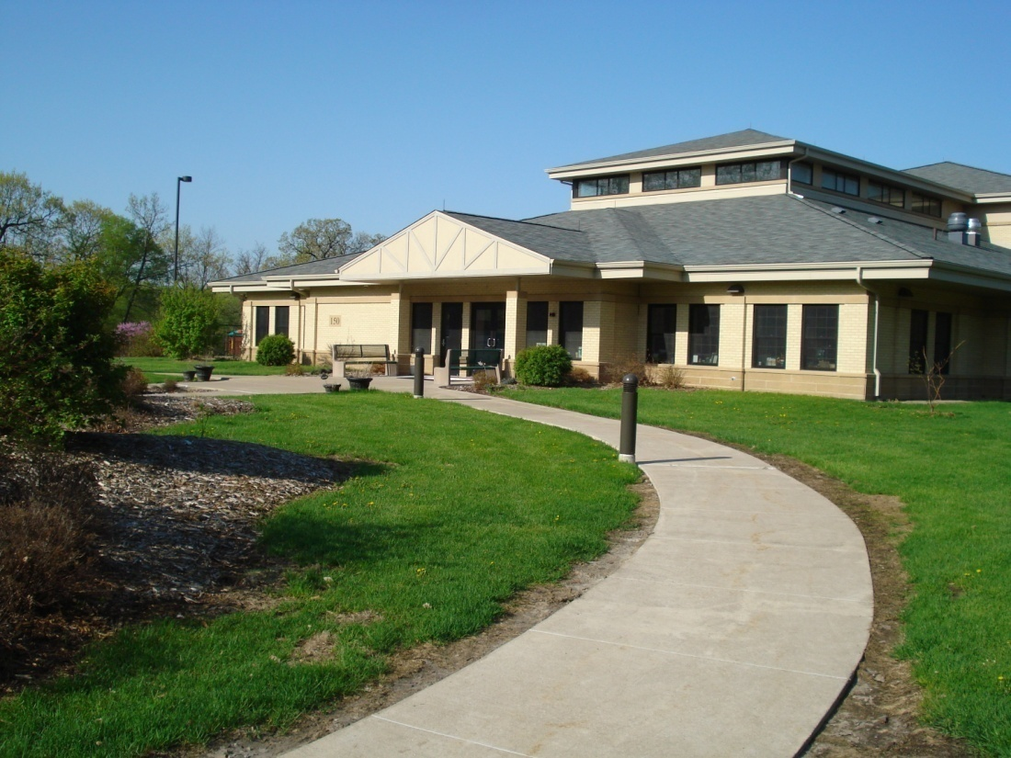
School Age center/youth center
Building 150

Slide 8
CYS Services Waiting List
Army Goal
Provide viable care options to patrons
Provide options within 30 days
Provide care options in
- Facility Base Programs (CDC & SAC/YC)
- Family Child Care (Covenant Cottage)
- Community Base Facilities (Homes Off Post)

Slide 9
Definitions
Excess Demand: The number of children whose parents (Military and civilian) request child care in any Army CYSS operated, or sponsored program for whom no viable care is available.
Preference for Care: The system (CDC, FCC/HOP, SAC) and type (full day, part day, special needs) of care in which parents want to enroll their children.
Projected Care: Includes unborn children and children transferring to the installation.
Viable Care: A child care option which meets the patron’s schedule, reflects the necessary program type and the appropriate age group for the child. Care may be on or off-post in any CYSS system, at any location convenient to either the home or work site. Viable off-post care options are those which are comparable in price and quality to CYSS sponsored child care options.

Slide 10
CYS Services Staffing
Lengthy fill time for hiring CYS Services staff has negatively impacted mission capability and places quality of care at risk
 | ARMY | RIA
Vacancies | 2,829 | 35
RPA | 1,870 | 12
LOSS | 1,072 | 8
Average Fill Time | 132.20 (Aug) | 112
Rooms Closed | 95 | 2

Slide 11
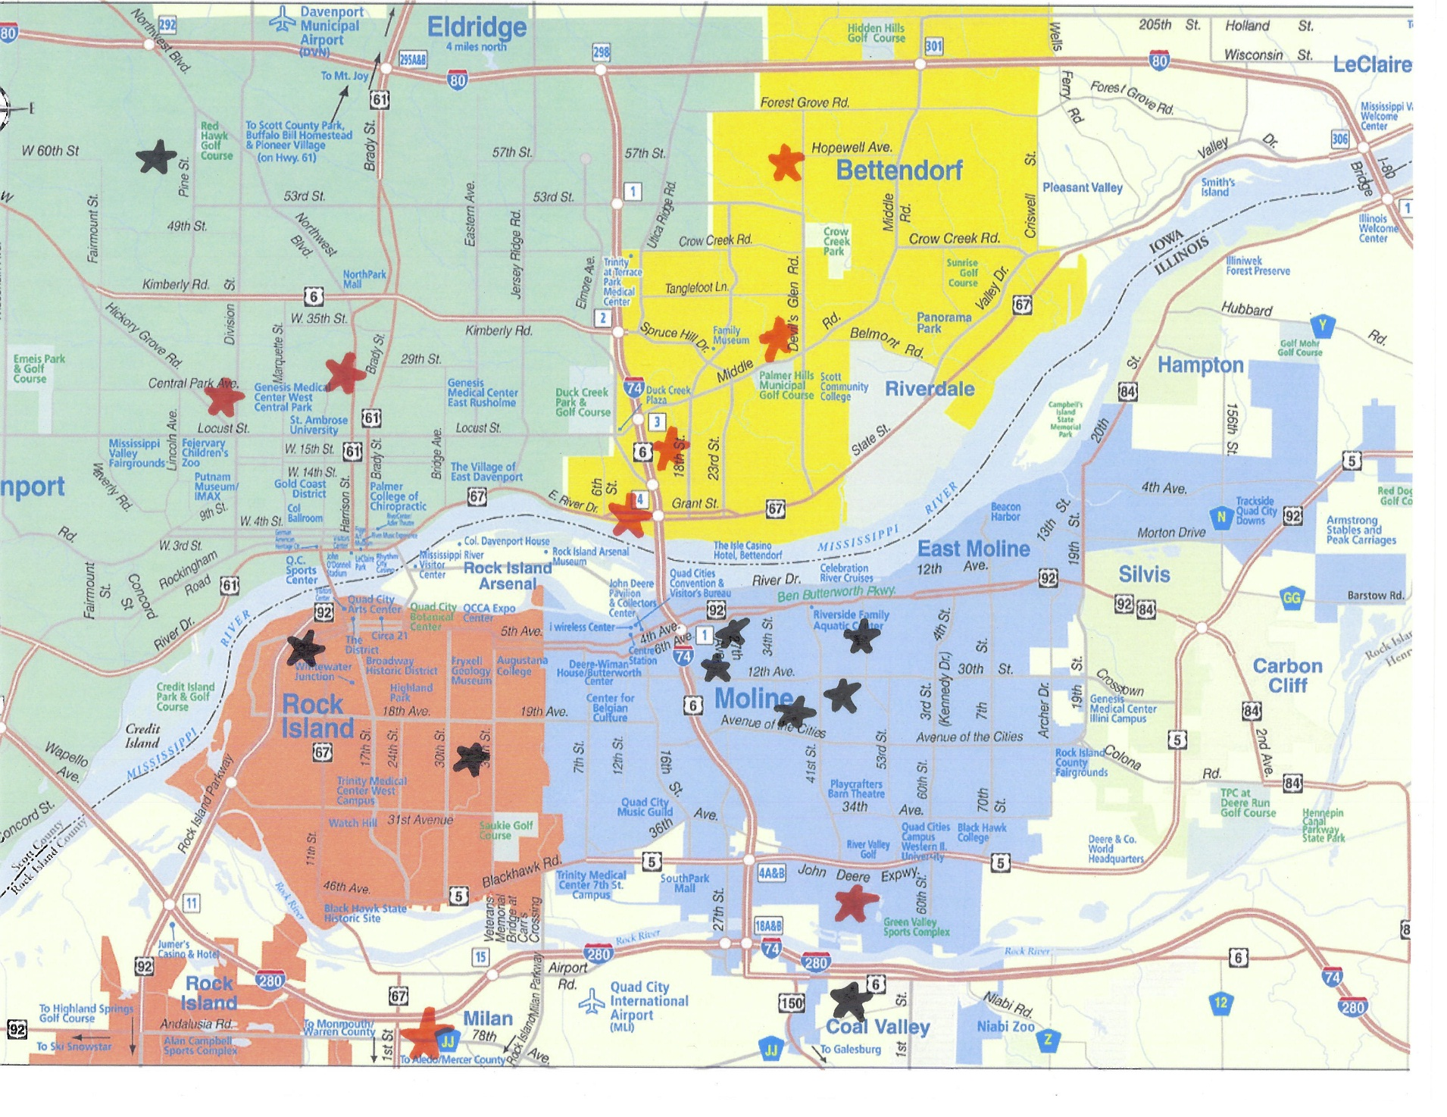
Homes off Post Locations

Slide 12
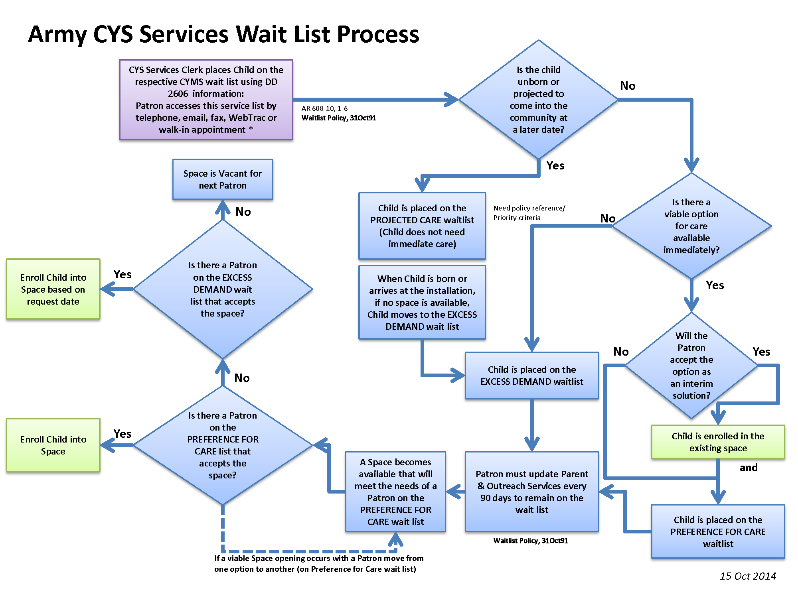
RIA
wait list form
RIA
Based on priority

Slide 13
RIA Excess Demand Waiting List Priorities
PRIORITY A: Military:
(1) Single Parent Active Duty Military
(2) Both Parents Active Duty Military
(3) Active Duty Military with full-time working/full-time student spouse
PRIORITY B: Civilian:
(1) Single parent DoD civilian.
(2) Both parents DoD civilian.
(3) DoD civilian with full-time working/full-time student spouse.
PRIORITY C: All other eligible Military & Civilian Patrons:
(1) Active duty Military with non working/non full-time student spouse.
(2) DoD civilian with non-working/non full-time student spouse.
(3) DoD contractors.

Slide 14
Factors that influence placement
Age Group
Date of Registration on Wait List
Priority (A, B or C)
Whether Parent Accepts 1st Viable Offer

Slide 15
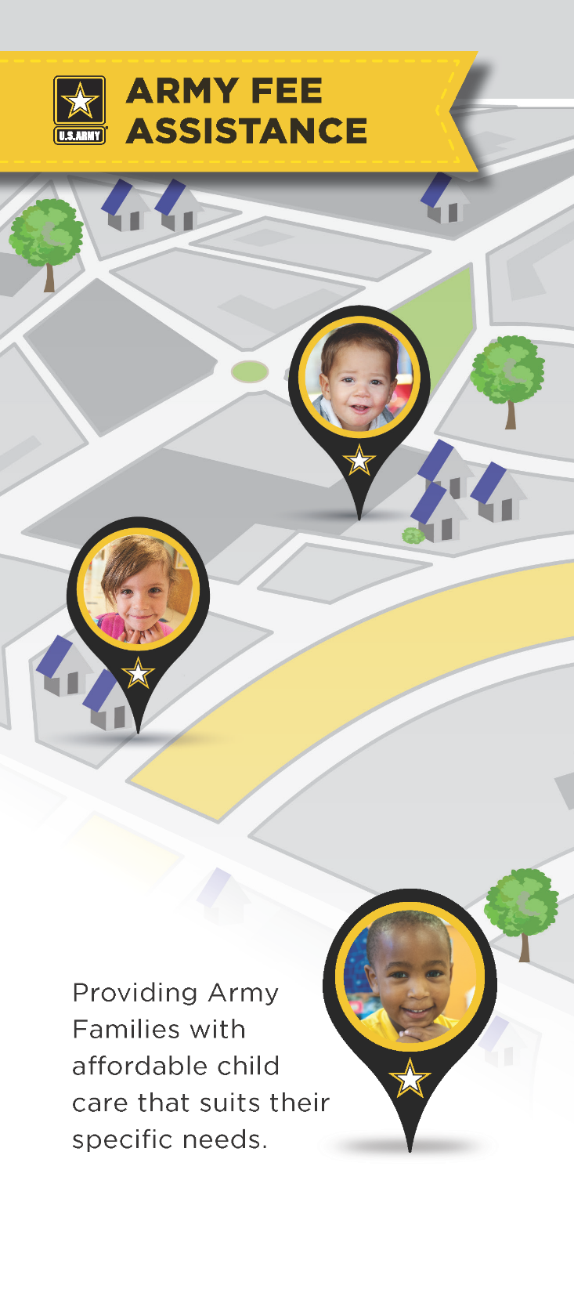
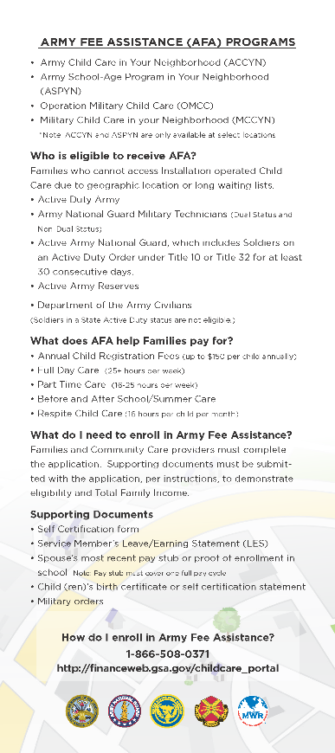

Slide 16
Way Ahead
Short term:
-Three Additional FCC /Homes Off Post
-Sponsors inform incoming families to register in advance
-Expecting mothers register unborn ASAP
Mid-term: New Part Day/Pre School Program
Long-term: CDC Extension

Slide 17
Sources of Information
CYSS home page
CYSS Facebook
CYMS notifications
Parent advisory board
Island Insight
Newsletters
Electronic marquees

Slide 18
Q & A

