Slide 1
Quarterly Southern Colorado working group
Prepared by Chris DeGaray, USAG Fort Carson Executive Officer
14 JAN 2015, 9:30 AM – 11:00 AM
Las Animas County Courthouse, Trinidad, Colorado

Slide 2
Agenda
Introduction New Working Group Members
Fort Carson
Community
Garrison Commander Opening Remarks
Purpose
Update Line of Effort Initiatives & Engagements
Training
Community
Stewardship
Due outs & next meeting schedule

Slide 3
Garrison commander opening remarks

Slide 4
Purpose
Ensure synchronization and coordination of on going military, civilian and local community efforts in the southern Colorado region
Establish initiatives and tasks to be accomplished in the southern Colorado region

Slide 5
Lines of Effort
Training
Community
Stewardship

Slide 6
Training Line of Effort Update (DPTMS)
Cultural Awareness DVD- Version 1 completed
- Commanding General talking points to be recorded following the
Change of Command in the spring. (Version 2)
- Intend to add SHPO talking points in the future.
- Trying to place it on the Public Website for awareness and viewing.
Cultural Resource site protection
- Purchased 300 boulders to enhance protection of eligible sites.
- Plan to re-use boulders from renovated erosion control dams.
- Requesting additional 200K for Site Protection resources
Repair of Maneuver Damage from 2/4HBCT exercise
- 2/4ABCT assembly area along MSR will managed as a limited
use area until re-analyzed this spring/summer.

Slide 7
Community LOE Way-ahead
30 JAN
Military Appreciation Day at the State Capitol (Commanding General or designated rep., and Support Staff)
(Denver)
16 MAY
Armed Forces Day Parade (Soldier & Equipment support) (Trinidad)
22 AUG
State Fair Parade (Soldier & Equipment support) (Pueblo)
14 JAN
Southern Colorado Engagement Working Group (Garrison Cdr & Support Staff) (Trinidad)
AUG 2015
JUL 2015
23 AUG
Colorado State Fair Military Appreciation Luncheon (Pueblo)
JUN 2015
MAY 2015
APR 2015
MAR 2015
FEB 2015
11 JUNE
Fort Carson Vietnam Vet Welcome Home Ceremony
JAN 2015
DEC 2014
4 MAR
2014 Fort Carson Good Neighbor Induction Ceremony & Luncheon (Fort Carson)
11 JUL
(T) Mt. Carmel Festival (Soldier & Equipment support) (Trinidad)
4 JUL
Pueblo West 4th of July Wet & Dry Parade (Soldier & Equipment support) (Pueblo West)
3 DEC
Mt. Carmel Holiday Open House (Soldier engagement w/local Veterans & residents)
(Trinidad)
Notes:
7

Slide 8
Stewardship Line of Effort Update
DEIS Status and Upcoming Actions
Purpose and need: Readiness training using emerging tactics and new equipment. Integration of ground and air resources
Mitigation actions may be required to avoid or reduce impacts to PCMS resources
Public comment period ended 15 Dec. Comments are being reviewed
Proposed edits to Final EIS and comment responses are being drafted (present)
Notice of Availability (NOA) for Final EIS (March)
30 day public waiting period after NOA is publish in Federal Register
Record of Decision (ROD) anytime after the public waiting period

Slide 9
Stewardship Line of Effort Update
Programmatic Agreements – Annual Reports
Fort Carson Built Environment
Proposed amendments forthcoming – include addition of select areas and off-post facilities
Fort Carson Military Training and Operational Support
Combine with Built Environment PA
Baseline monitoring complete in FY15
Mitigation projects initiated in FY15
PCMS Military Training and Operational Support
Update of Appendix 2 ongoing
Baseline monitoring – 150 sites in numbered TAs in FY15

Slide 10
Stewardship Line of Effort Update
Other Consultation Topics
Follow-up to 2/4 BCT training exercise and Hogback graffiti incident:
Seibert marking complete in primary maneuver area; remainder of numbered TAs first priority for additional marking
Added Seibert markers at 5 meter intervals to many of the entered sites
Resolved Tribal Site of Concern question with Jicarilla Apache Nation
Digital maps complete, maps have been distributed to BCTs
Met with 4 Tribes to discuss graffiti incident
AR15-6 Investigation
Improved restricted access with new gate and signage
Initiated development of individual Tribal agreements regarding site access and protection
Cultural Awareness Video

Slide 11
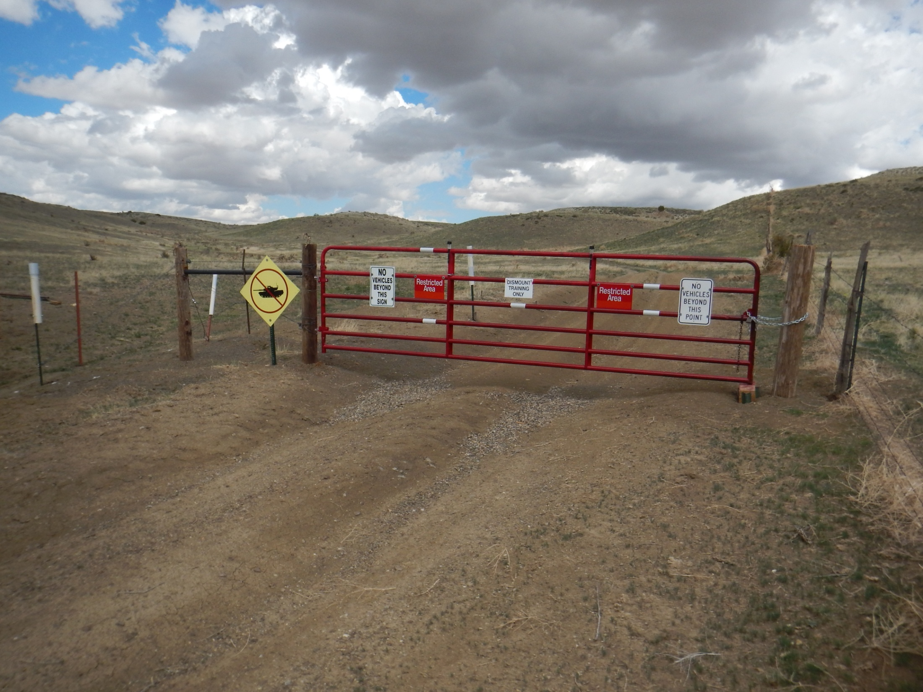
Stewardship Line of Effort Update
Cultural
HogBack Protection Gate & Fencing. Dismounted Training ONLY from this point

Slide 12
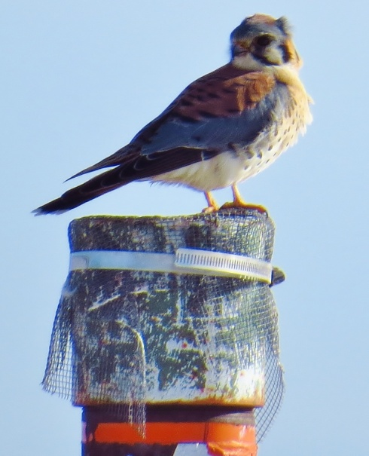
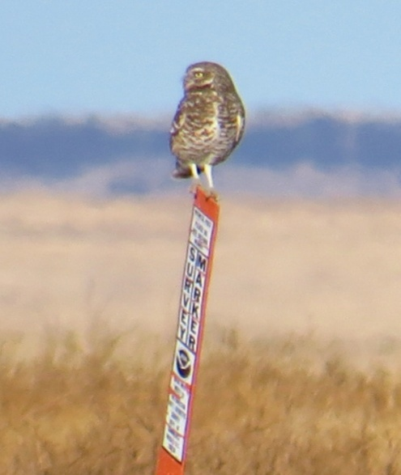
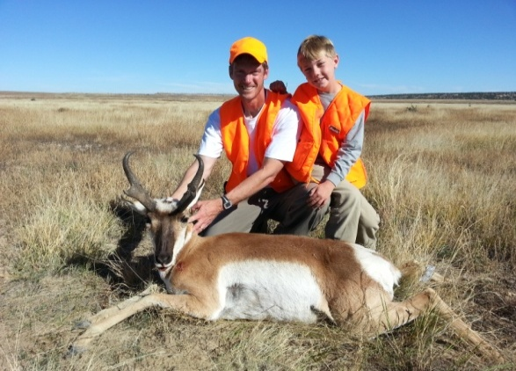
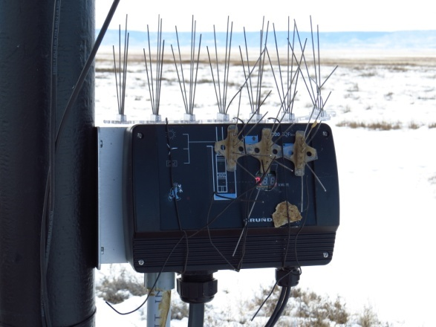
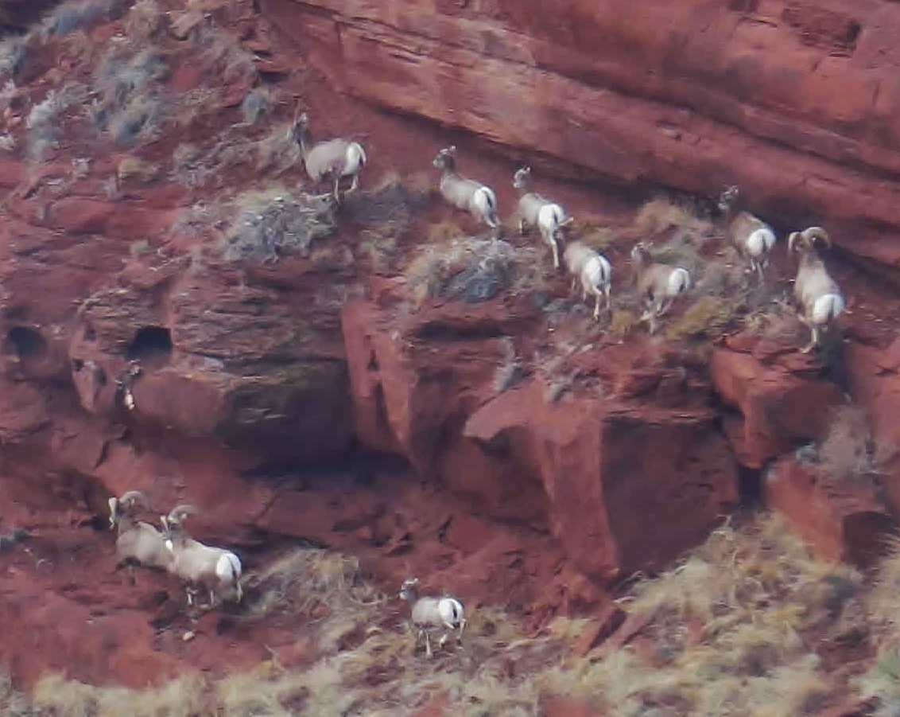
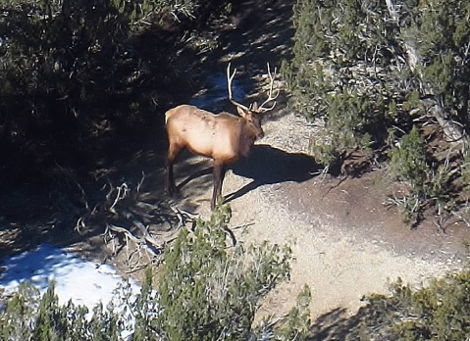
Wildlife Updates
American Kestrel
Burrowing Owl 12-16-14
Covering open pipes to prevent bird entrapment
Starting to survey for wintering burrowing owls
PCMS Hunting Program: Educating hunters, collecting B&C sheets, preparing for hunting management meeting (CP&W)
Note: The B&C (Boone & Crockett) score is the size of the antlers/horns. This data is important for management decisions.
Spikes
Installing bird deterrent spikes on wells’ automatic on/off switches to prevent further damage from ravens
Two day big game aerial survey completed

Slide 13
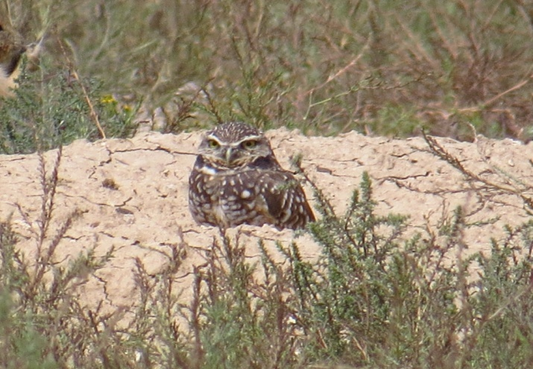
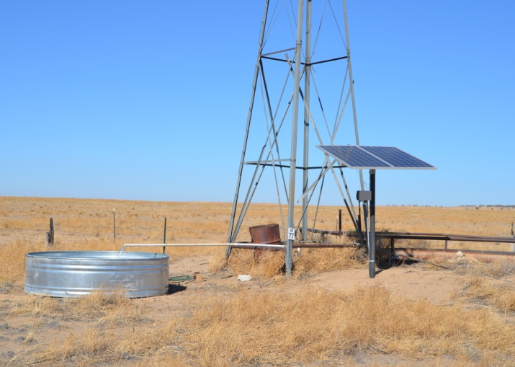
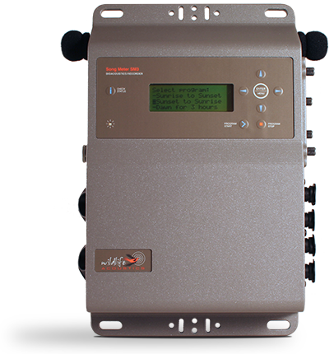
Wildlife Updates
Planning for this annual event is underway….
2015
2014 Burrowing Owl & Prairie Dog Survey has been completed.
Well contractor completed work on 7 new wells , including the placement of new tanks, solar pumps, on/off switches, pipes and escape ramps. Note: There are now 31 working wells, 3 stand alone tanks, 5 guzzlers and 10 pipeline tanks.
Acoustic Monitoring: Trial devices deployed. This summer they will be used for grassland bird and bat surveys.

Slide 14
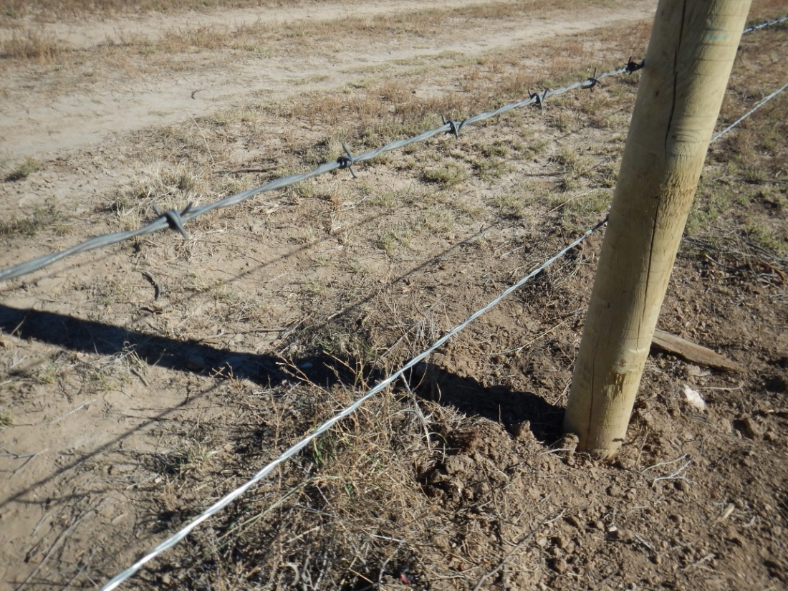
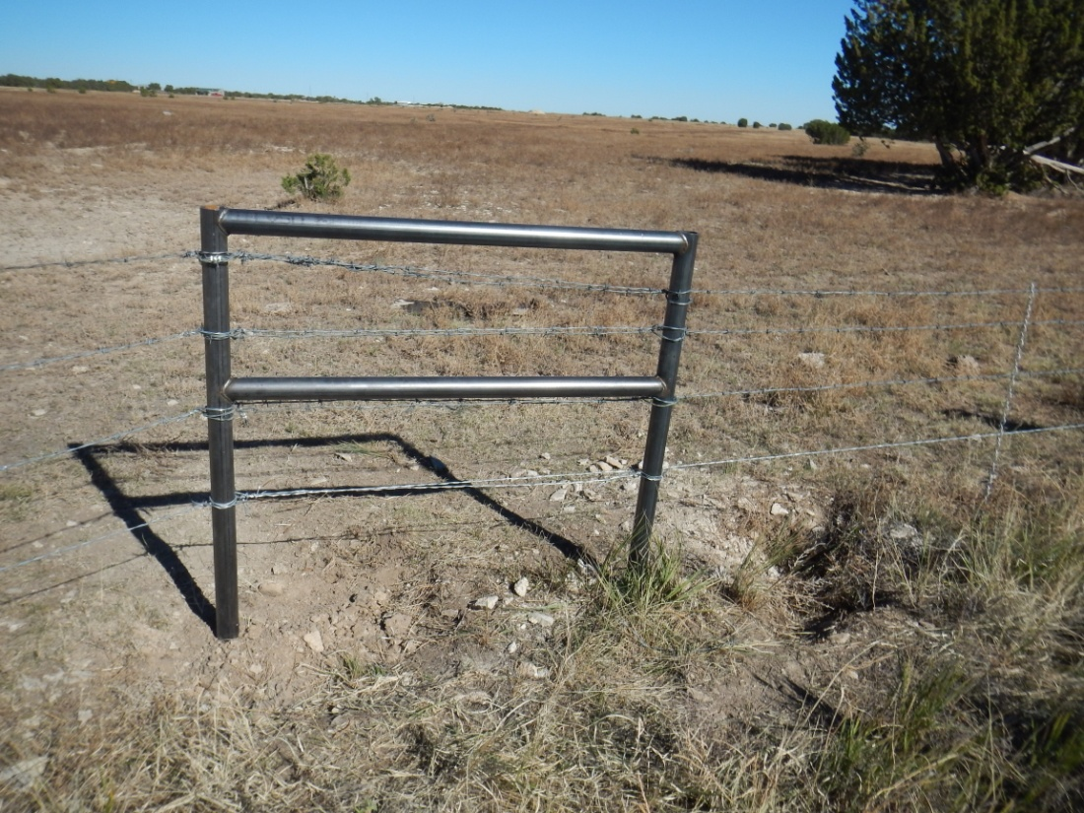
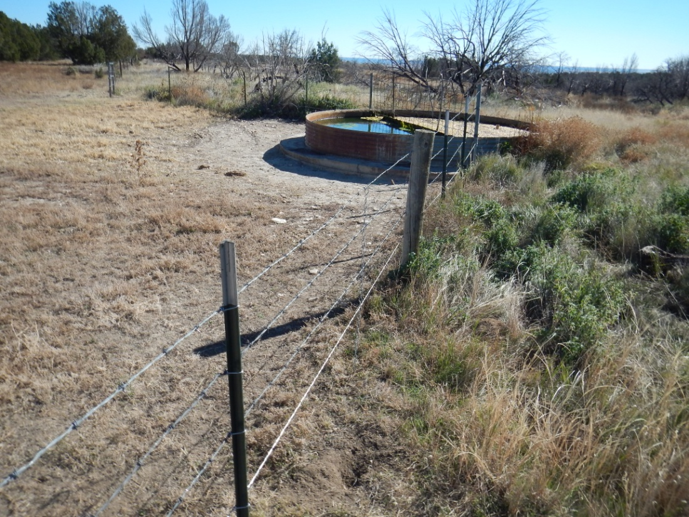
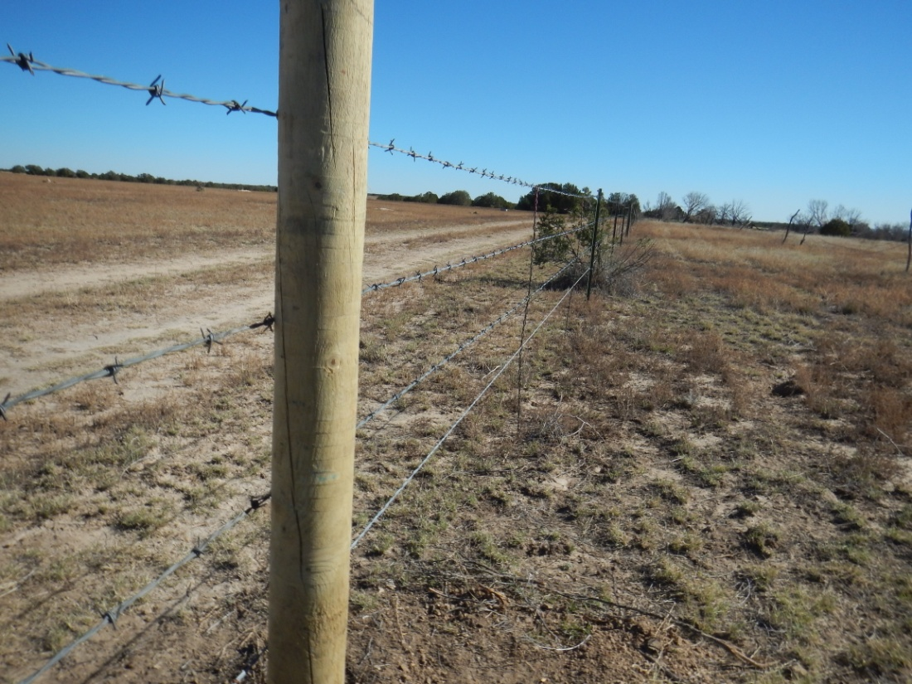
Stewardship Line of Effort Update
North perimeter fence line repaired. Note: bottom wire strand is smooth wire for wildlife
Steel “H” braces designed and installed to not burn during future wildfire events.
Shared water storage tank
Ranch Owner
Perimeter fence completed mid December 2014
PCMS

Slide 15
Review of Due Outs/Way-ahead
Commander’s Guidance
Review Due Outs
Date, time and location of next meeting of the working group:
Next meeting: MAY/JUNE 2015

