Slide 1
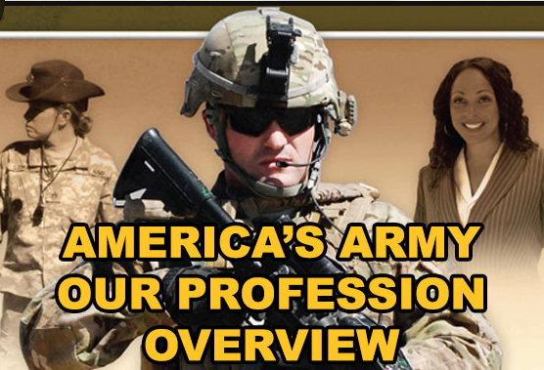

Slide 2
LEARNING OUTCOMES. Recognize and be able to discuss:
Army professionals:
Receive, discuss, and reflect on the concepts and terms contained within ADRP 1, focusing on the Five Essential Characteristics and the Three Criteria for Certification as an Army professional.
Promote the socialization of the Army Profession, infusing critical concepts from ADRP 1 into their organizational culture, developmental dialogues, and reflection.

Slide 3
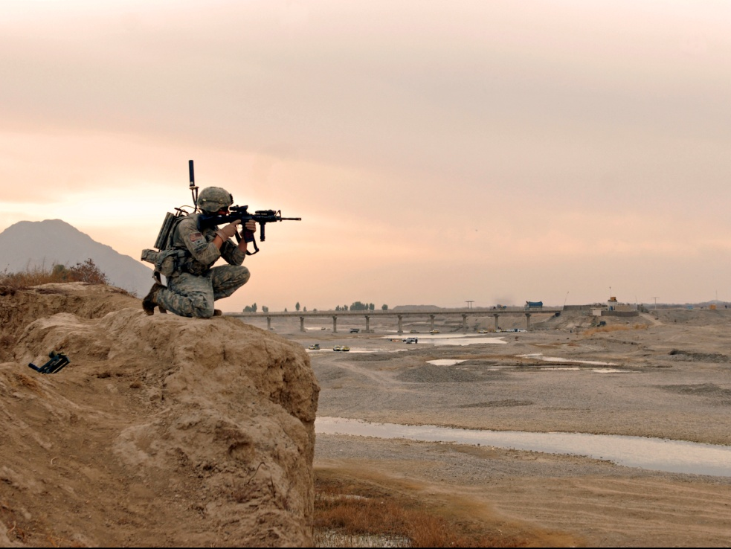
The Army Profession
A unique vocation of experts certified in the design, generation, support, and ethical application of landpower, serving under civilian authority, entrusted to defend the Constitution and the rights and interests of the American people.

Slide 4
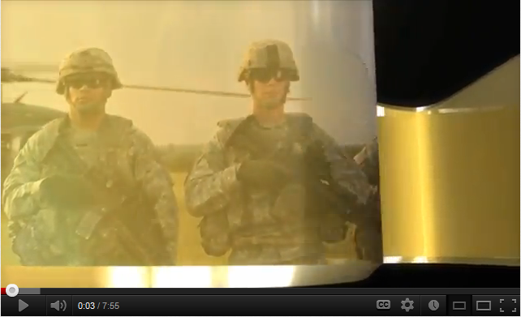
Army Profession Overview
http://www.youtube.com/watch?feature=player_embedded&v=1ggPg5fGids
Notes:
http://www.youtube.com/watch?feature=player_embedded&v=1ggPg5fGids

Slide 5
What does it mean for the Army to be a Profession?
The Army Profession works with expert knowledge to assure the nation’s security through land power; that expertise is the product of professionals’ long work and study.
Because our expert work is vital to society – providing to society unique and necessary expertise – there is a trust between the profession and society.
That trust is earned by effectively and ethically applying military expertise on the American society’s behalf, and by ensuring that members of the Army Profession continue to serve honorably.

Slide 7
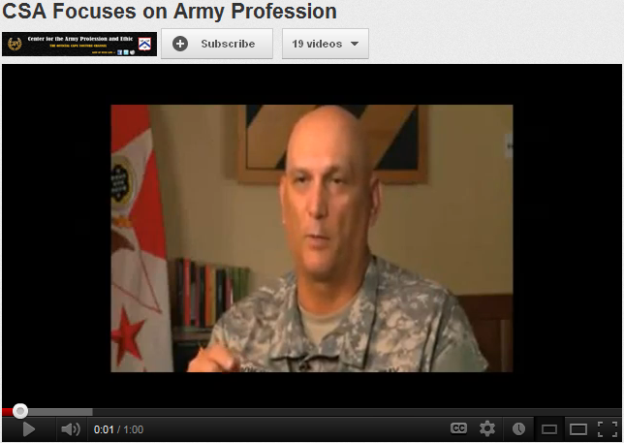
http://www.youtube.com/watch?v=kDzPEWdUzaM
Notes:
http://www.youtube.com/watch?feature=player_embedded&v=1ggPg5fGids

Slide 8
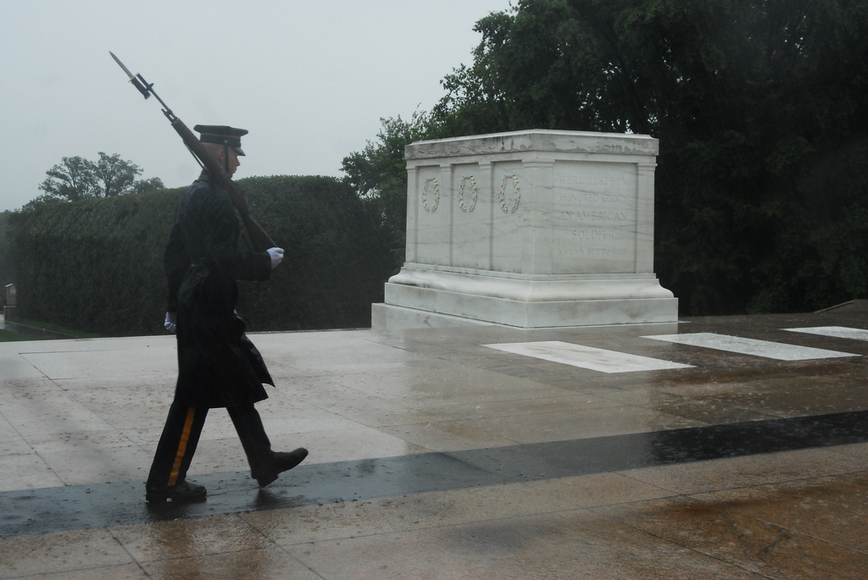
Trust

Slide 9
Trust – the bedrock of the relationship between the Army Profession and the American people – is vital to the profession. To succeed the profession sustains and develops trust:
- Between Army professionals (Soldiers and Army Civilians ) - Between Leaders, Soldiers and Civilians - Between Members, their Families and the Army
Between the Army and the American people

Slide 10
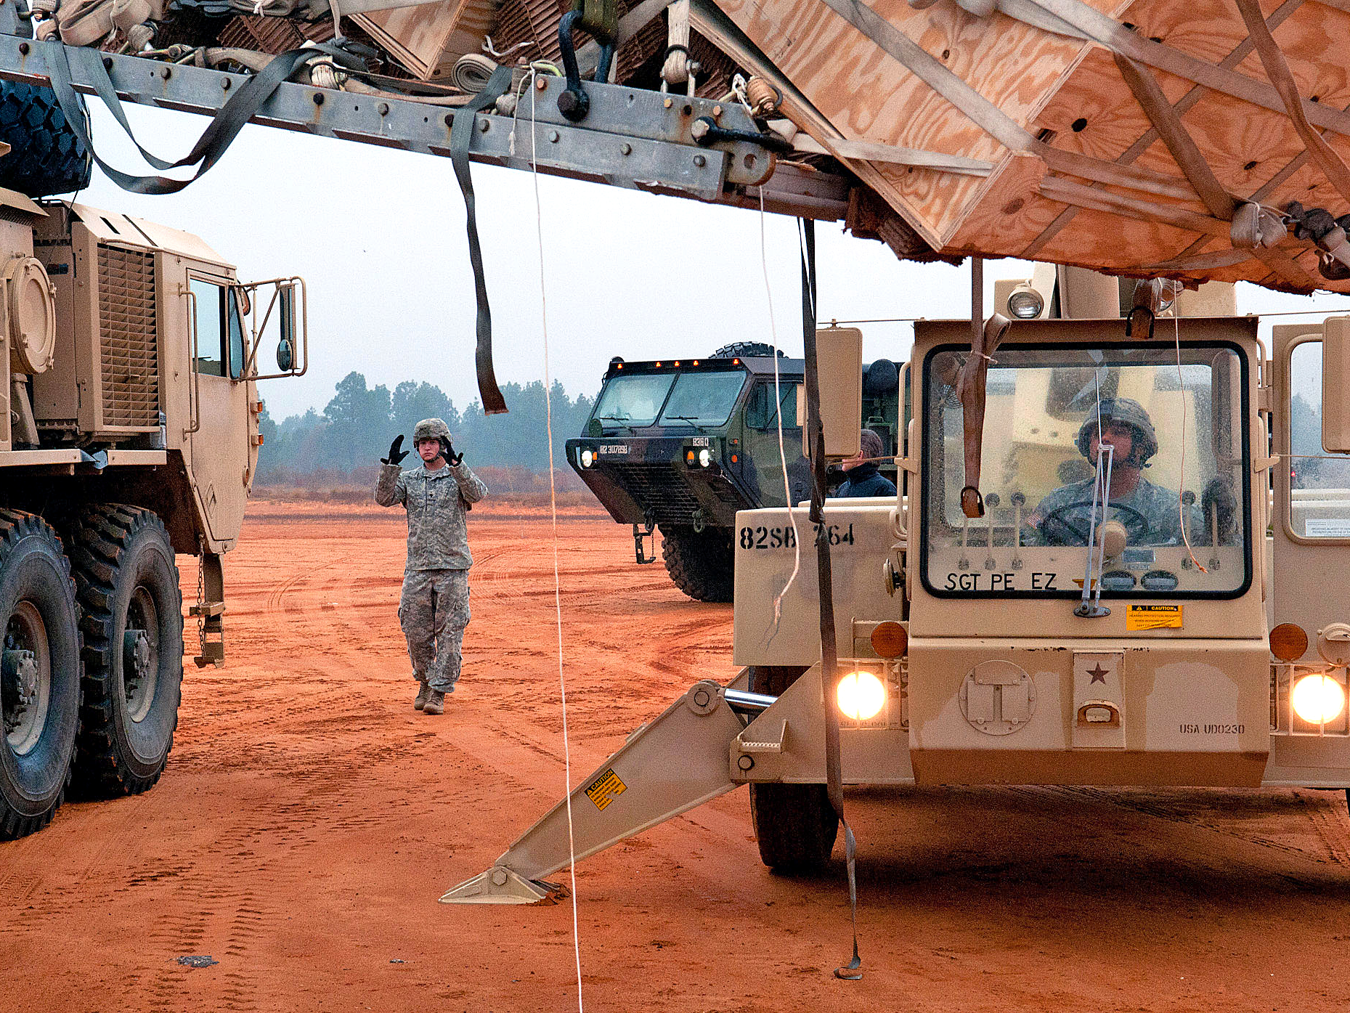
Military Expertise

Slide 11
Military Expertise comprises that expert knowledge society depends upon but cannot provide for itself. ADP 1, The Army, recognizes four categories of expert knowledge:
Military-Technical: how the Army applies landpower to accomplish the mission
Moral-Ethical: how the Army accomplishes the mission in the right way
Cultural-Political: how the Army understands and operates in a multi-cultural, complex world
Human Development: how the Army recruits, develops, and inspires Army professionals

Slide 12
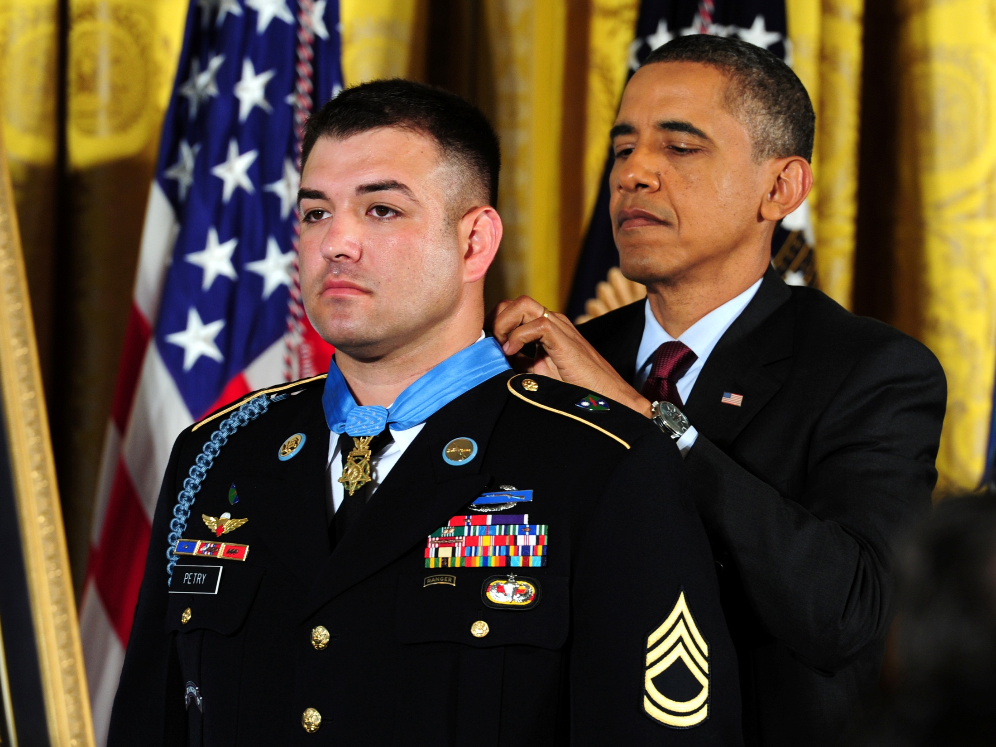
Honorable Service

Slide 13
Service to your Nation is an individual choice, to be part of something greater than yourself. Service to the Nation is not limited to a position you hold, an office you occupy, or an organization in which you are a member. Service to the Nation is a sense of belonging, an aspiration to help, a desire to make your community, town, state, or country better.
- General David M. Rodriguez

Slide 14
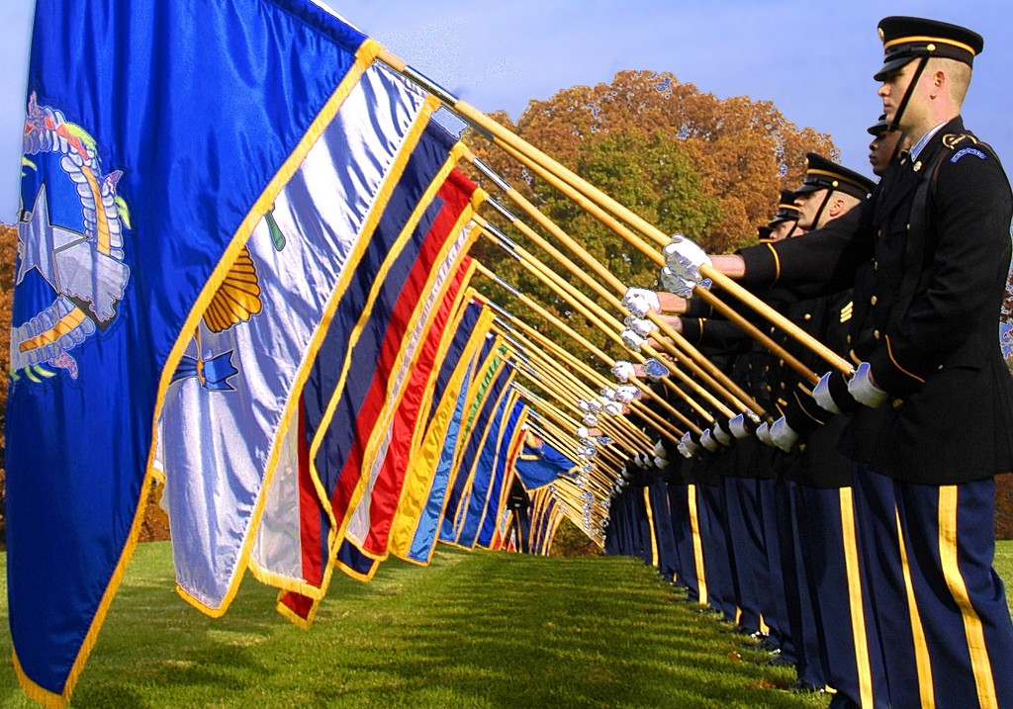
Esprit de Corps

Slide 15
The Soldier’s heart, the Soldier’s spirit, the Soldier’s soul are everything. Unless the Soldier’s soul sustains him, he cannot be relied on and will fail himself and his country in the end.
- General of the Army George C. Marshall

Slide 16
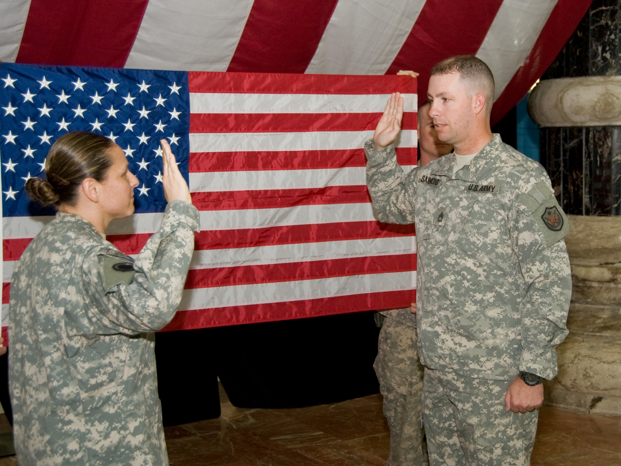
Stewardship

Slide 17
Stewardship of the Profession is the Army professional’s commitment to preserving the value of the Army by making these essential characteristics effective elements of every day through their actions and by their moral upholding of the Army’s earned trust.
Each professional Soldier “is a steward of the future of the Army Profession.”
- General Martin E. Dempsey

Slide 18
What does it mean to be an Army professional?
An Army professional, uniformed or civilian:
is an expert certified within the profession, consistently demonstrating competence, character, and commitment
is bonded with comrades in a shared identity and culture of sacrifice and service to the Nation
stewards the future of the Profession
adheres to the Army’s Ethic

Slide 19
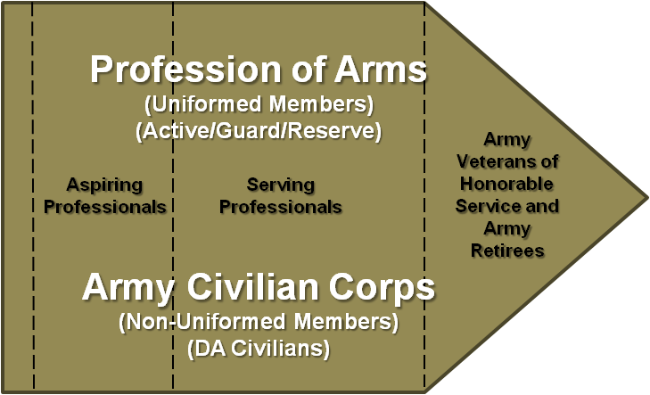
Membership in the Army Profession

Slide 20
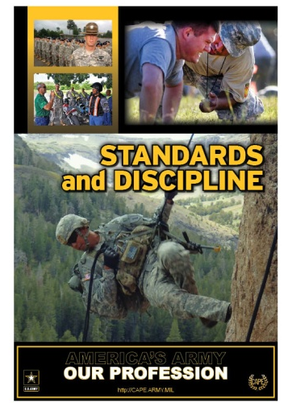
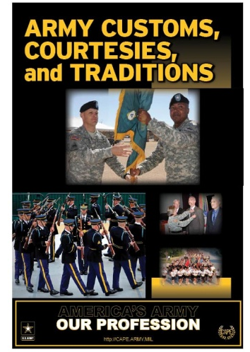
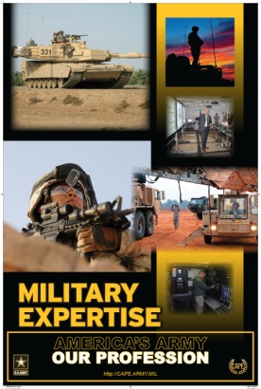
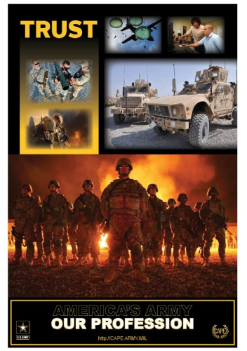
America’s Army – Our Profession
Education and Training Program (CY13)
Quarterly Themes
Standards and Discipline | Customs, Courtesies, Traditions | Military Expertise | Trust
Understand the Army Profession doctrine and concepts
Continue and promote the dialogue about the profession
Conduct ourselves in a manner worthy of our professional status

Slide 21
Visit us at http://cape.army.mil

