Slide 1
Navy Personnel Systems
How to Review Your OMPF and ESR
(step-by-step guide)
This brief is current as of 26 FEB 2016.
Notes:
POC: elizabeth.mcgrath@navy.mil

Slide 2
Before we get started…
Some of you already know how to use Navy personnel systems online. For you, this training will provide a review and update.
For those of you who are unfamiliar with online personnel systems, this training will introduce you to the steps required to view and verify your online personnel records.
For command leaders, this training will familiarize you with training materials that can be used in future command indoctrination and training events.

Slide 3
Introduction
Navy personnel records document your Navy career.
It is VERY IMPORTANT that you routinely and periodically verify that the information displayed in your personnel records is ACCURATE and COMPLETE.
Use information provided in the following slides to view and verify the personnel information displayed in your Official Military Personnel File (OMPF) and your Electronic Service Record (ESR).
_TIP_________
OMPF documents are used during Selection Board Review.
The ESR is NOT used by Selection Boards.

Slide 4
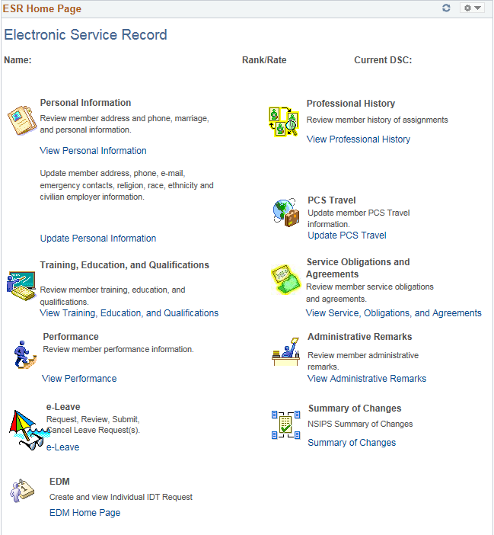
Two important personnel records
Today, your service record information is maintained in two primary systems:
Official Military Personnel File (OMPF)
Electronic Service Record (ESR)
Electronic Service Record
Official Military Personnel File
Notes:
Documents not represented by ESR data or OMPF files:
Performance Information Memorandum
Dependency Certification (NAVCOMPT 3072)
Dependency Status Action Letter
Questionnaire for Nation Security Positions (SF 86)
DON CAF Security Clearance Eligibility Certification
PCS orders with endorsements
Special Duty Screening (NAVPERS 1306/92)
Overseas Screening (NAVPERS 1300/16
State of Legal Residence (DD Form 2058)
Frocking Letter
Travel Claim (DD Form 1351-2)
Expeditionary Screening Checklist (NAVPERS 1300/22)
Also:
DON Family Care Certificate (NAVPERS 1740/6)
Family Care Plan Arrangements (NAVPERS 1740/7)
Alternate Final Multiple Score (AFMS) Worksheet (used by SPECWAR)

Slide 5
Official Military Personnel File (OMPF)
OMPF contains electronic images of documents generated throughout your career, from time of entry until final separation.
Every Navy officer and enlisted member has an OMPF, which is accessed via BUPERS Online (BOL).
BOL is located at https://www.bol.navy.mil.
OMPF documents your Navy career:
Performance
Professional History
Personal Information
Training, Education and Qualifications
Privileged and Adverse Information
Separation and Retirement
_TIP_________
OMPF documents are the primary images viewed by Selection Boards.

Slide 6
Frequency of Enlisted Record Update
Some OMPF documents are generated from data stored in your Electronic Service Record (ESR).
Personnel documents should be submitted to OMPF at the time they are generated.
EXCEPTION TO THE RULE: Awards, Training and Qualifications, and History of Assignments data is printed from your ESR and submitted to OMPF only when you reenlist or when you separate from service.
IMPORTANT: If you are going before a Selection Board and there are significant transactions in your ESR that are not in your OMPF, submit printed copies of ESR pages (NAVPERS forms) with your package to the Board.
_TIP_________
Routinely verify your OMPF is accurate and complete. See your Personnel Office, CPC or PSD when items are missing or incorrect.
ESR data printed and submitted to OMPF
Dependency Data (submitted to OMPF as form NAVPERS 1070/602)
Member Data Summary (submitted to OMPF as form NAVPERS 1070/886)
Training Summary (submitted to OMPF as form NAVPERS 1070/881)
Honors and Awards (submitted to OMPF as form NAVPERS 1070/880)

Slide 7
Selection Boards review OMPF documents
Enlisted
Administrative Remarks
Adverse Information
Assignment and Classification
Awards, Decorations, and Medals
Education and Training
Enlisted Performance Data
Enlistment / Reenlistment Data
Miscellaneous Professional Service History
Separation and Retirement
Officer
Awards, Decorations, and Medals
Educational Data / Transcripts
Fitness Reports
Letters of Appointments and Promotions
Miscellaneous Professional History
Photograph (most recent)
Privileged Information, Adverse Material, Family Advocacy Program, Medical Boards, Physical Evaluation Boards, etc.
Qualifications
Reserve Status
Service Determination, Separation, and Retirement
Types of Selection Boards
Retention, Advancement, Continuation (Officer and Enlisted), Special Programs, Special Promotions, Screening.

Slide 8
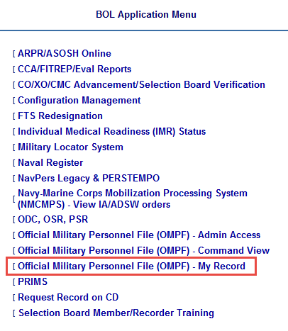
Action: Access your OMPF
You have automatic access to your OMPF.
Log in to BOL at https://www.bol.navy.mil
Select Official Military Personnel File (OMPF) – My Record.

Slide 9
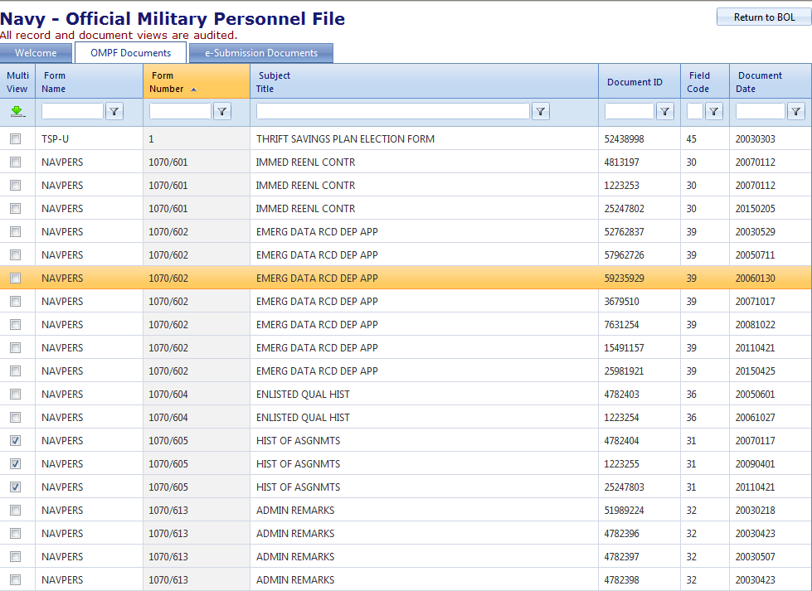
Action: Navigate and View OMPF Documents
1
Click headings to sort by Form Number, Document Date, etc.
2
Click on a highlighted row to download individual documents.
Click several boxes and select the green arrow to view multiple documents.
3

Slide 10
Action: Sort by OMPF “Field Code”
OMPF documents are assigned a “Field Code” based on the type of information in the document.
Documents in Field Codes 30 through 38 are provided to enlisted Selection Boards for review.
See BUPERSINST 1430.14F, BUPERSINST 1070.27B, and MILPERSMAN 1070-080
To verify ALL OMPF documents are available to the Selection Board, sort by Field Code desired.
If documents are duplicated, illegible or missing, or if you discover another person’s document misfiled in your OMPF, take immediate action.
Field Codes provided for Enlisted Selection Board Review
30 Procurement, Enlistment/Reenlistment
31 Classification and Assignment
Administrative Remarks
Separation and Retirement
Professional Service History
35 Enlisted Performance Data
36 Training and Education
37 Decorations, Medals and Awards
38 Adverse Information
For more information, go to the NPC website at http://www.public.navy.mil/bupers-npc/Pages/default.aspx.
Hover over Career Info. Click Records Management > Military Personnel Records > Document Correction

Slide 11
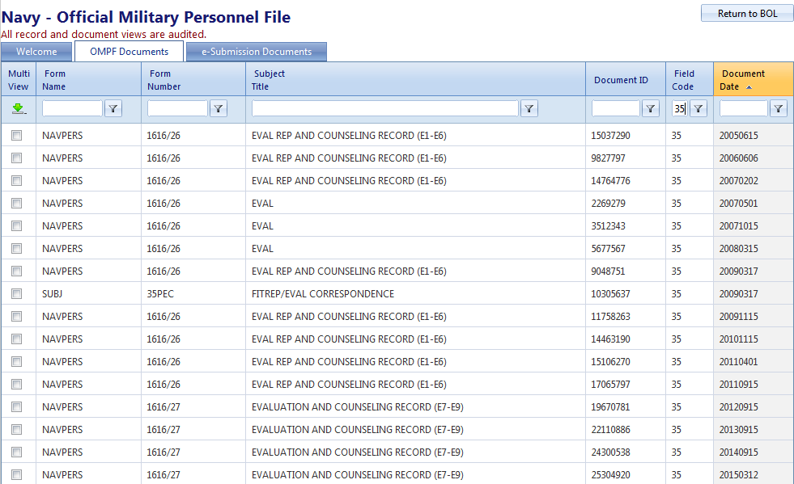
Action: Verify Performance Records
Field Code 35
1
To view Performance Records, enter “35” in the “Field Code” box and filter ( ) with the word “Contains”.
2
Sort by “Document Date” to ensure no evaluations are missing.
_TIP_________
Ensure the evaluations and fitness reports documented in OMPF maintain “continuity” and none are missing (see next page).

Slide 12
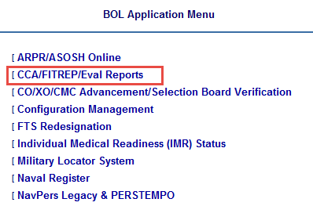
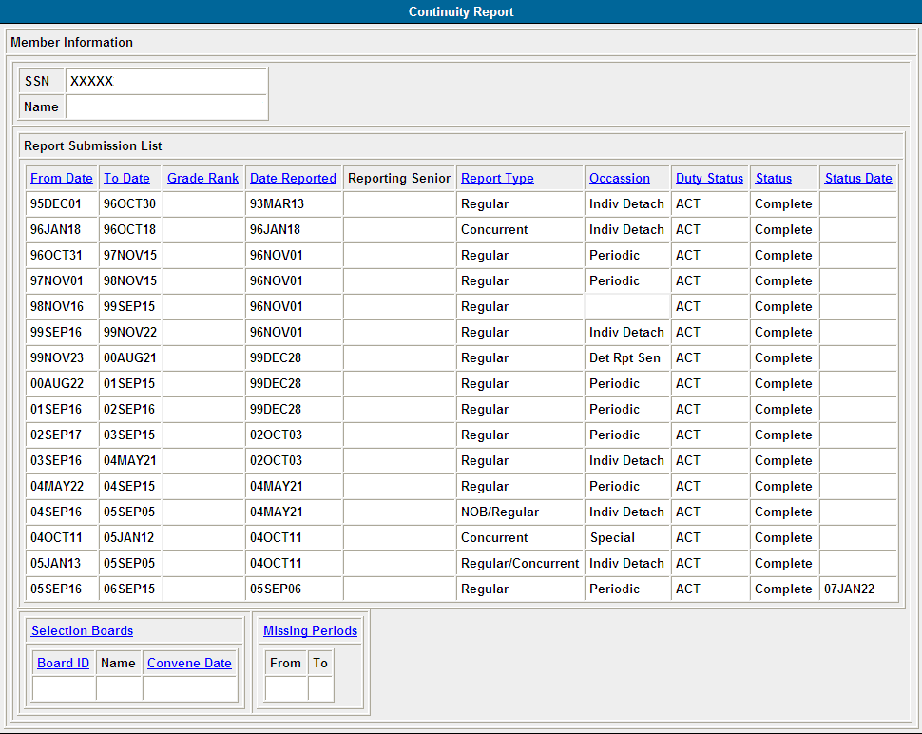
Action: Verify Evaluation Continuity
1
Click CCA/FITREP/Eval Reports on BOL Application Menu.
2
Click Performance Evaluation Continuity.
Verify no “Missing Periods” and no gaps.
3
Verify Board eligibility.
4
IMPORTANT: Board ID field is normally populated 30 days prior to enlisted Selection Board and 60 days prior to officer Selection Board convening dates. If blank within this time period, you are not being considered. Follow procedures in the cycle NAVADMIN to ensure your eligibility is validated prior to Board convening date.

Slide 13
Action: Verify Training, Education, Quals
Field Code 36
1
Review Qualification History.
2
Download individual documents to verify all training/quals are documented in OMPF.
IMPORTANT: Warfare Qualifications awarded since 2006 are entered into your ESR and listed on the ESR Member Data Summary page. When printed, the Member Data Summary page becomes NAVPERS 1070/886. You may need to print and submit a copy of your Member Data Summary (NAVPERS 1070/886) with your letter to the Selection Board.

Slide 14
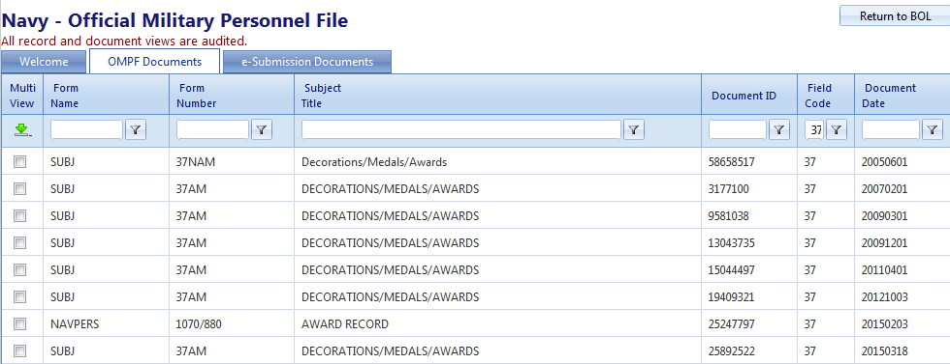
Action: Verify Personal Awards
Field Code 37
1
Verify all Personal Awards are listed.
_TIP_________
Ensure personal awards documented in OMPF match those reflected on the U.S. Navy Awards website (see next page).
Periodically, your ESR Honors and Awards page is printed as form NAVPERS 1070/880 (which, along with NAVPERS 1070/881, replaces the old Page 4) and submitted to your OMPF.

Slide 15
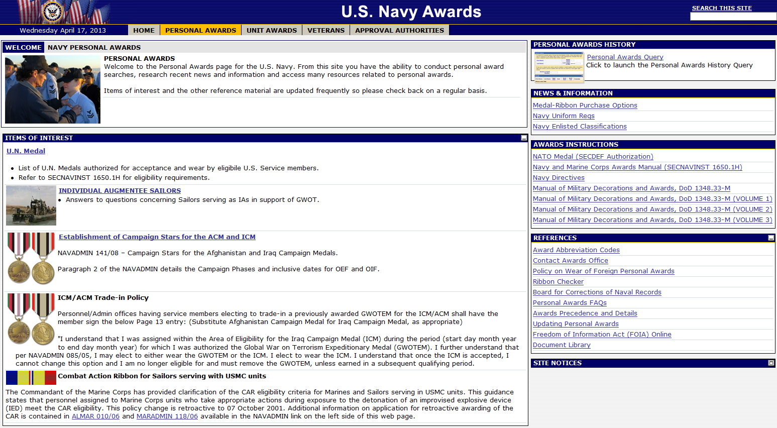
U.S. Navy Awards
1
Click PERSONAL AWARDS.
2
Run Personal Awards Query to view and verify Awards.
View Personal Awards FAQs and Updating Personal Awards.
3
U.S. Navy Awards is located on the Internet at https://awards.navy.mil.
Use information provided in the REFERENCES box to submit updates and corrections (see #3 above).

Slide 16
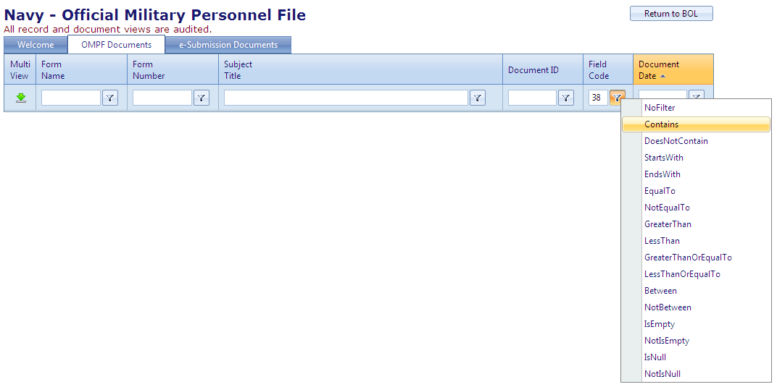
Action: Verify Field Code 38 (Adverse Info)
Field Code 38
1
Enter “38” in the Field Code box and filter with the word “Contains”.
2
If you have zero results, that’s a good thing!
Other Useful Field Codes
39 Emergency Data (NAVPERS 1070/602)
41 Security Clearances and Investigations
See MILPERSMAN 1070-080 for more information
NOTE: Sometimes an adverse Page 13 will be filed in Field Code 32. Check there, too.
IMPORTANT: Take immediate action to remove Adverse Information filed in your record by mistake!

Slide 17
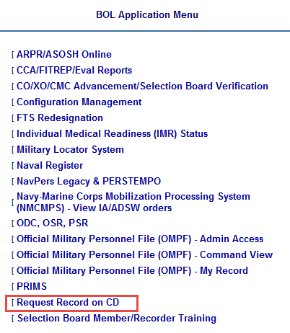
Action: Review OMPF Routinely
Periodically, verify your official record is accurate and complete:
Verify 6 months prior to Selection Board review.
Every year, order a CD copy of your OMPF and place it in a safe and secure place (order through BUPERS Online).
Work with your Personnel Office, CPC or servicing PSD to update your record, as necessary.

Slide 18
Action: Update or correct your OMPF
Your OMPF reflects documents that have been received, reviewed, and accepted as an official document.
If you discover a duplicate document or a document that belongs to someone else, you may contact NPC directly to have the error corrected.
For information helping you correct your OMPF, go to the NPC website and follow this path:
Hover over Career Info. Click Records Management > Military Personnel Records > Document Correction.
Hover over Career Info. Click Records Management > Military Personnel Records > Document Submission.
IMPORTANT
Actions taken to update OMPF will not automatically update other personnel systems, such as Navy Awards or ESR.
You may be required to update each personnel system individually.

Slide 19
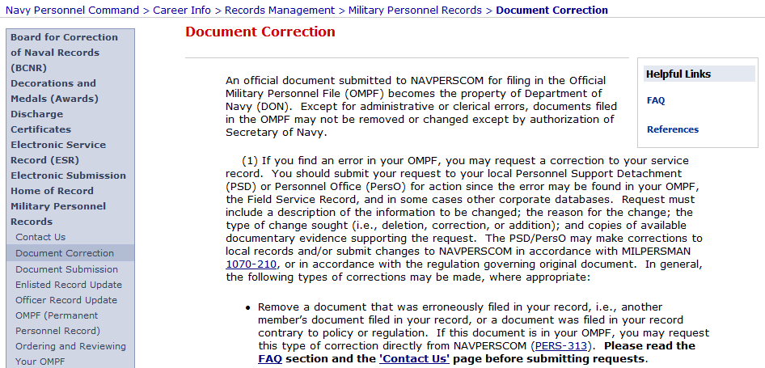
NPC website provides supporting resources
Go to http://www.public.navy.mil/bupers-npc/Pages/default.aspx to find resources helping you view and manage the career information displayed in your Navy Personnel Records.
1

Slide 20
Electronic Service Record (ESR)
ESR contains electronic data representing some, but not all, of the information previously held in the paper Field Service Record.
ESR allows you to view information contained within the Navy Standard Integrated Personnel System (NSIPS).
NSIPS contains pay and personnel information entered by your command and/or servicing PSD.
Periodically, usually at specific career milestones such as reenlistment, separation or retirement, ESR information is printed, signed and electronically submitted to your OMPF.

Slide 21
Action: Establish your ESR account
All Sailors – Officer and Enlisted – must establish a "Self-Service" ESR account.
Ashore versus Afloat
All Sailors establish their ESR account ashore: https://nsipsprod.nmci.navy.mil/nsipsclo/jsp/index.jsp
Afloat Sailors should establish a second ESR Afloat account for use underway.
If you need assistance, contact the NSIPS Help Desk.
(877) 589-5991
NSIPSHelpdesk.fcm@navy.mil
IMPORTANT
When communicating with support personnel (including CPC, PSD or Help) take special care to safeguard sensitive personal information by ENCRYPTING your email!
_TIP_________
Find QuickStarts and other user aids on the NPC website. From the homepage, click Career Toolbox (on left-hand side of page).

Slide 22
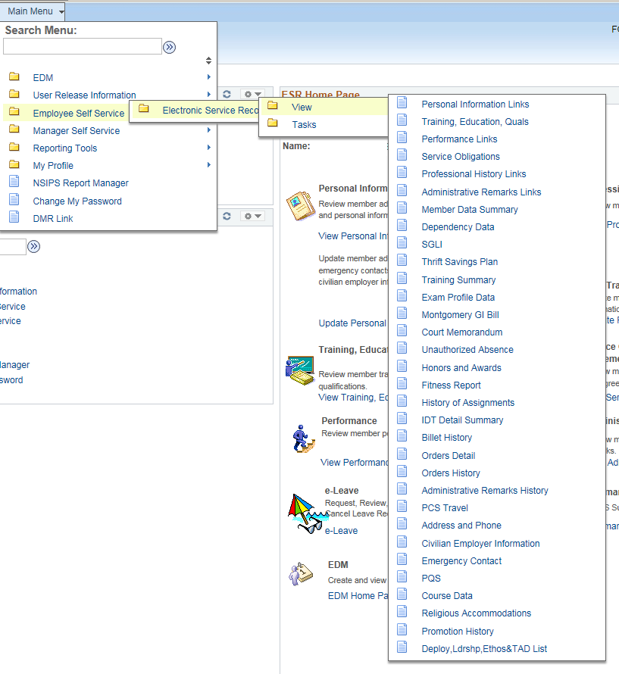
View ESR data, beginning on the Home Page
Navigate the ESR Home Page using links provided in the top navigation bar.
ESR Home Page Main Menu

Slide 23
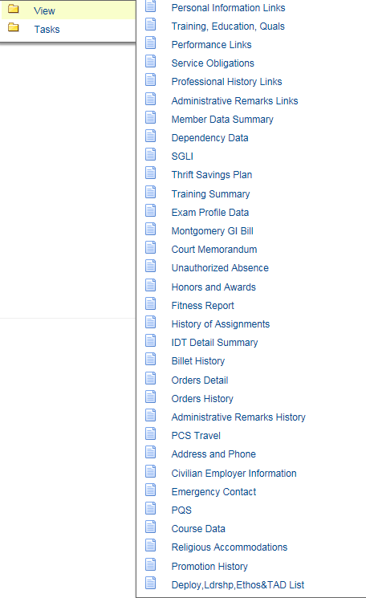
Action: View ESR data
Links provided under View are read-only, which means that you cannot enter or change information displayed.
View functionality allows you to verify information submitted to the Navy Standard Integrated Personnel System (NSIPS).
If you discover errors, contact your Personnel Office, CPC or servicing PSD.

Slide 24
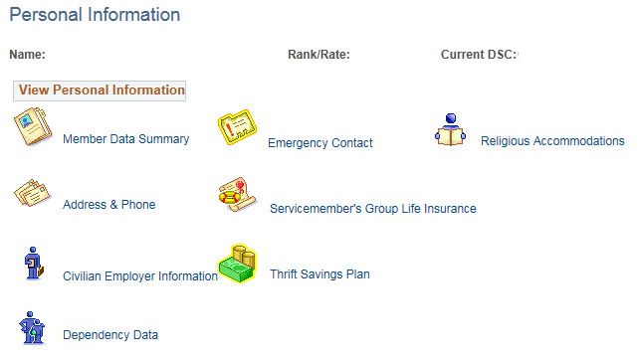
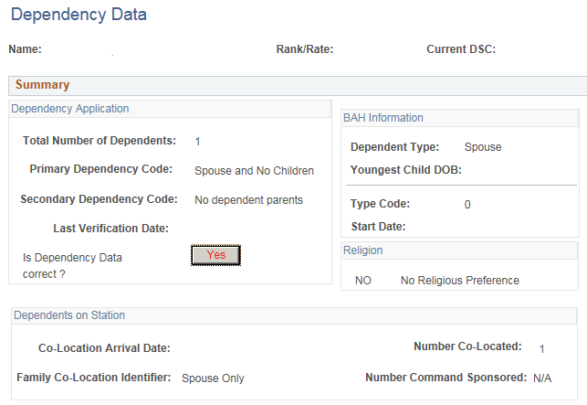
Action: Verify “Dependency Data”
Dependency Data Includes dependency data for spouse, children and parents, Emergency Contact, and Beneficiaries for unpaid pay and allowances, death gratuity, etc.
When updated, your Dependency Data is printed as form NAVPERS 1070/602 (Dependency Application/Record of Emergency Data, or “Page 2”) and submitted to OMPF. (Print your own copy, using button at bottom of page.)

Slide 25
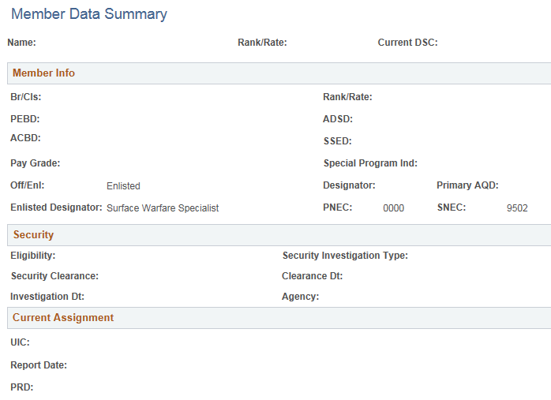
Action: Verify “Member Data Summary”
Member Data Summary includes Security eligibility and status, Current Assignment, Dependents Information, Education (AFQT scores), NEC History, Warfare Qualification History, Promotion History, etc.
Periodically, your Member Data Summary is printed as form NAVPERS 1070/886 and submitted to OMPF. (Print your own copy, using “Print Form” button at bottom of page.)

Slide 26
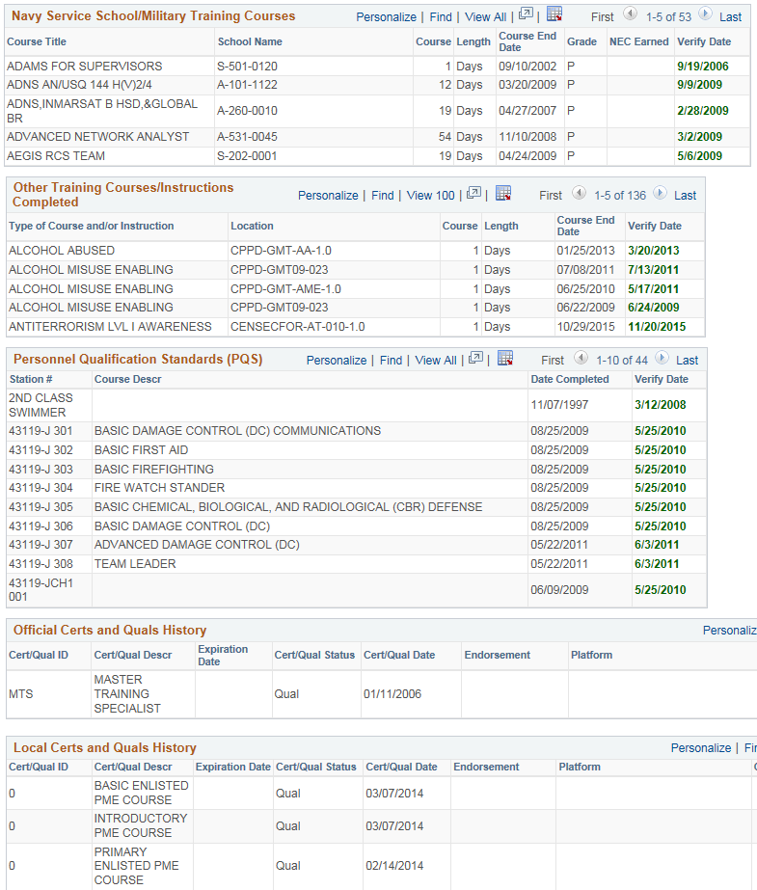
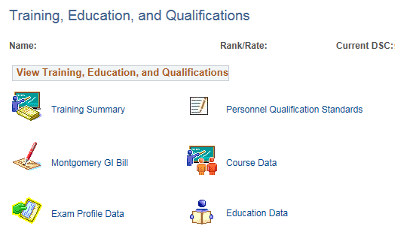
Action: Verify "Training Summary"
Training Summary includes Civilian education, Navy training, Navy eLearning courses, Certifications, PQS, etc.
NOTE: for Warfare Quals, review your “Member Data Summary” page.
Periodically (Reenlistments, Retirements, Separations, etc.), your Training Summary is printed as form NAVPERS 1070/881 (which, along with NAVPERS 1070/880, replaces the old Page 4) and submitted to OMPF. (Print your own copy, using the “Qualification History” button at bottom of page.)

Slide 27
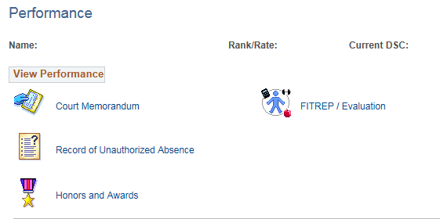
Action: Verify "Honors and Awards"
IMPORTANT
If data entries are “Not Verified”, request your Personnel Office, CPC or PSD to investigate. (You may be required to provide documentation to support Verification approval.)
Information “Not Verified” will NOT print on NAVPERS forms.
Periodically, your Honors and Awards are printed as form NAVPERS 1070/880 (which, along with NAVPERS 1070/881, replaces the old Page 4) and submitted to OMPF. (Print your own copy, using button at bottom of page.)

Slide 28
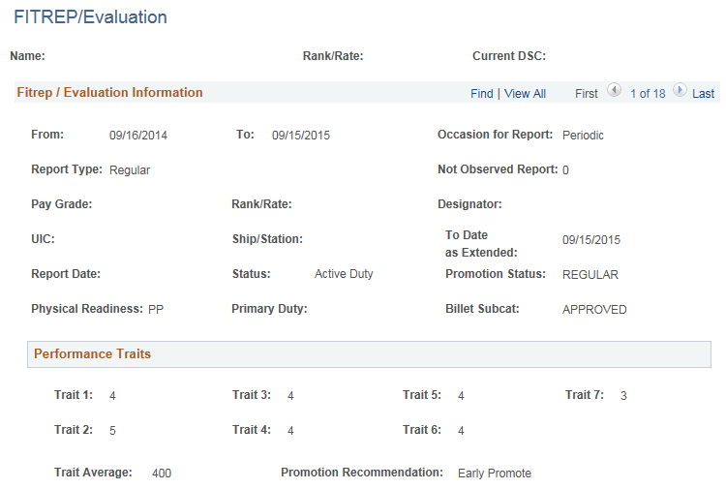
Action: Verify Performance data
Performance FITREP/Eval performance marks, recommendations, etc.
Your signed FITREP/Eval is mailed to NPC by your command. Once verified, it is submitted to OMPF. Additionally, information is extracted and sent to your ESR.
Click View All to review past reports.
NOTE: Narrative comments are not entered into ESR and can be viewed only in your OMPF.

Slide 29
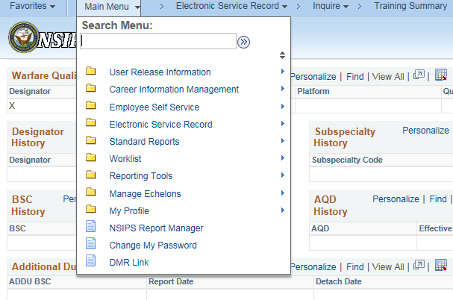
How to print documents from ESR
1
At the bottom of ESR pages, look for and click on buttons provided.
When pop-up message opens, click “OK”.
Go to “NSIPS Report Manager” using Main Menu dropdown.
Click “Refresh” several times, then click “View” when the button appears.
Locate the PDF file and click to view and print your document.
2
3
4
5

Slide 30
Action: Review ESR routinely
Every six months review your ESR and verify that it contains accurate and current information.
If you discover errors or missing information, contact your command Personnel Office, CPC or servicing PSD.
IMPORTANT
Actions taken to update your ESR will not automatically update other personnel systems, such as Navy Awards or your OMPF.
You may be required to update each personnel system individually.

Slide 31
Caution and a Warning: You must Safeguard Personal and Private Information
Your records contain Personally Identifiable Information (PII).
PII is any information that can be used to distinguish or trace your identity.
Examples of PII include, but are not limited to:
Name
Social Security Number (SSN)
NOTE: Full and partial SSNs associated with a name are especially sensitive and commonly found on many of your service record documents.
Date of birth, home address, home phone number, personal email address
Family data
Religion, Race, National Origin
Fingerprints, Photographs
Performance Rating
Security Clearance
Leave balances, types of leave used
Financial and Medical Information
IMPORTANT
Take special care to safeguard sensitive personal elements and all medical and financial information from persons without a need to know.

Slide 32
Action: Protect your PII
Protect PII using the following best practices:
Share PII only with those who have a need to know.
Store PII in a locked container, in a locked space, or on an encrypted hard drive.
When sending an email containing PII or attachments with PII, you must Encrypt and digitally Sign the email.
Destroy any document or electronic file containing PII if you don’t need it. Keep only what is absolutely required.
IMPORTANT
Personnel documents contain personal and private information that can be misused for a variety of purposes, including identity theft.
You must retain service record documents in a safe, secure place!

Slide 33
Summary
Your Navy service record is maintained in two systems:
OMPF contains official documents
ESR contains personnel data
You should review OMPF and ESR routinely and take necessary action to update missing or inaccurate information.
Actions taken to update OMPF and ESR will not automatically update other personnel systems. Each system must be updated individually.
Sources of support are your Personnel Office, CPC or servicing PSD.
The Navy Personnel Command (NPC) website provides helpful information (http://www.public.navy.mil/bupers-npc/Pages/default.aspx).
You must protect your personnel documents by storing in a safe, secure space.
This is a product of the OPNAV N1 Fleet Introduction Team with support from BUPERS-803 and PERS-313.
Please address comments and feedback to elizabeth.mcgrath@navy.mil.

