Slide 1
North Atlantic Coast Comprehensive Study Application of Vulnerability Analyses
U.S. Army Corps of Engineers
Coastal Storm Risk Management
Planning Center of Expertise
25 September 2013

Slide 2
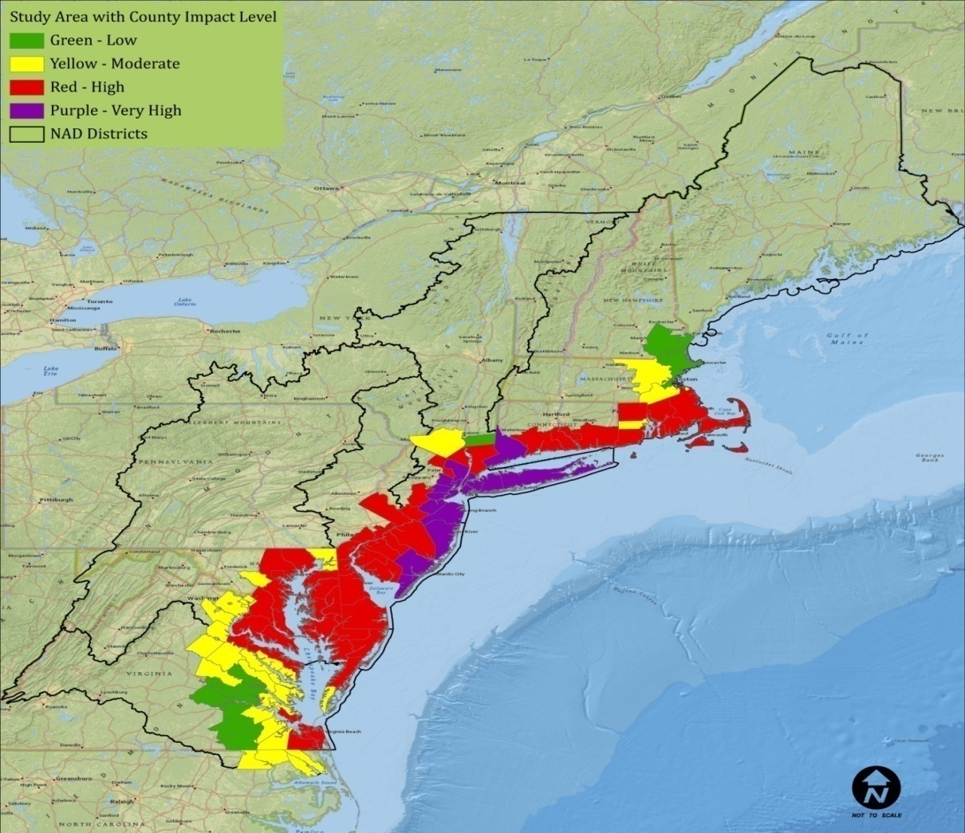
Context
Coastal Framework
Regional scale
Opportunities by reach/state
Identify range of potential solutions/measures by reach/state
State Narrative Appendices
Plan Formulation

Slide 3
Plan Formulation
Existing/future conditions and projects
Sea level rise and inundation mapping
Planning reaches
Existing and ongoing plans by others
Risk exposure assessment/mapping
Identify areas of high exposure
Strategies/opportunities to manage risk
Range of appropriate risk reduction measures

Slide 4
Study Area - Reaches
38 Reaches defined by:
Physiographic/geographic characteristics (shoreline type)
USACE and other shore protection projects
Land use
Jurisdictions

Slide 5
USACE Project Map
Existing USACE projects
Considered in the Without Project Condition
From PL 113-2 Interim 1 and 2 Reports and The Coastal Systems Portfolio Initiative (CSPI) report

Slide 6
NJ State Project Map
Existing State projects
Considered in the Without Project Condition
Integrate other agency strategies/regional plans
PlaNYC report
Joint Field Offices State Recovery Support Strategies
Hurricane Sandy Rebuilding Task Force

Slide 7
Exposure Assessment
*Composite Exposure Index
*Infrastructure + Population
*Social
-2010 Census (tract level)
-% Population 65 and over
-% Population under 5
-% Population w/income below poverty
-% Population non-proficient English speakers
-Index of income inequality
*Environmental and Cultural
*USGS Coastal Vulnerability Index

Slide 8
Composite Exposure Index for Study Area

Slide 9
Composite Exposure Index : State of New Jersey

Slide 10
Infrastructure + Population Exposure Index

Slide 11
Infrastructure and Population Exposure Index : State of New Jersey

Slide 12
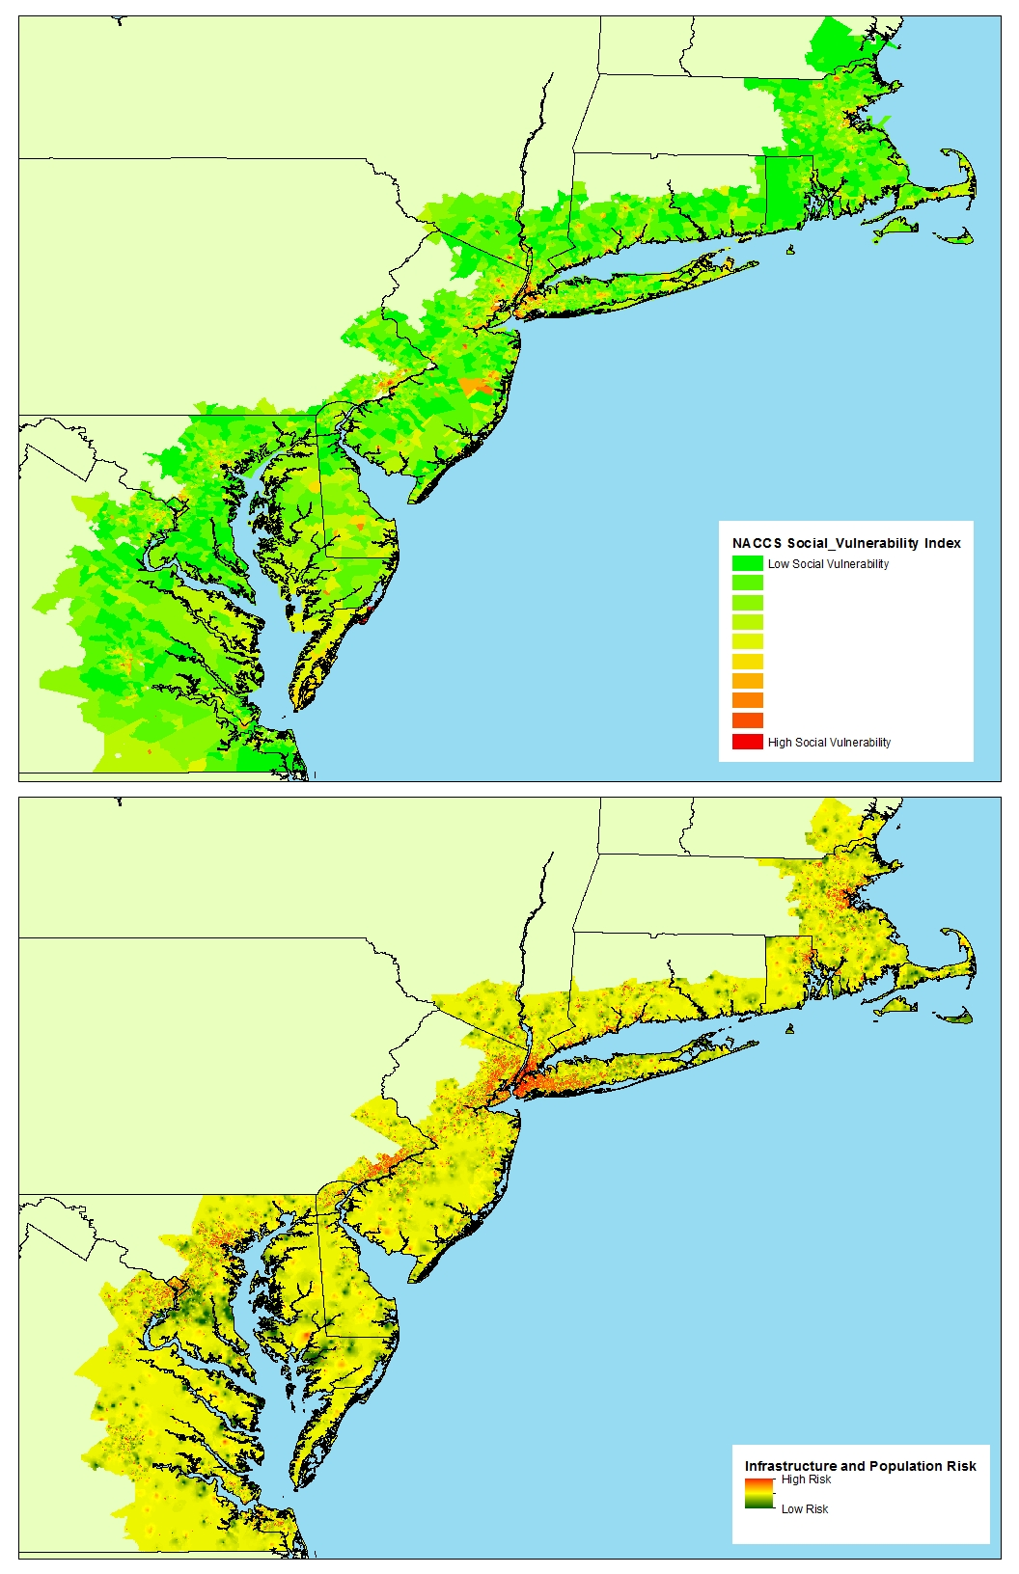
Social Vulnerability Index
Notes:
The NACCS Social Vulnerability Index was computed by adding the following US 2010 Census variables at the Census Tract level:
% Population 65 and over
% Population under 5
% Population w/ Income below poverty
% Population Non-proficient English speakers
Gini index of income inequality

Slide 13
USGS Coastal Vulnerability Index

Slide 14
Problem Area Identification: State of New Jersey
Notes:
The identification of problem areas will help us to identify opportunities to manage risk manage risk, address SLR/climate change, and improve resiliency including the consideration of appropriate strategies, such as: hold the line, phased retreat, retreat and restoration of natural systems.

Slide 15
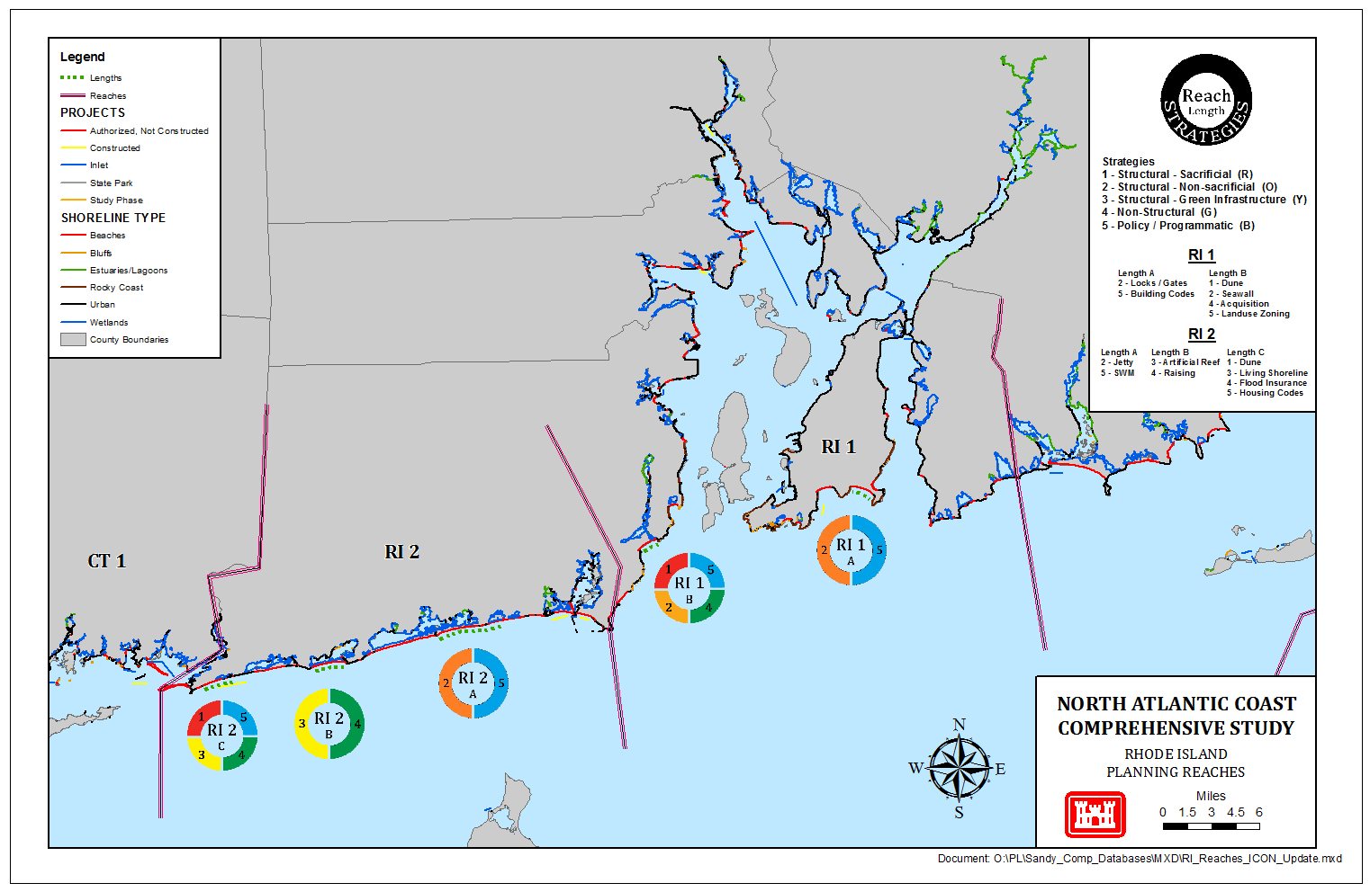
Risk Reduction Framework Example Map

Slide 16
Questions/Discussion

