Slide 1

Vulnerability Metrics
Ty Wamsley, PhD
Chief, Flood and Storm Protection Division
Coastal and Hydraulics Laboratory
25 September 2013
Team: Kate Brodie, CHL
Zach Collier, EL
Lauren Dunkin, CHL
Patrick O’Brien, EL
David Raff, IWR
Julie Rosati, CHL
Edmond Russo, EL
See instructions for customizing these images on slide 3.

Slide 2
Scope of Task
Define vulnerability concepts and assessment
Develop metrics relevant to evaluating vulnerability of Nature-Based Infrastructure (NBI) systems.
Describe how NBI contributes to reducing vulnerability.

Slide 3
Approach
Vulnerability metrics are a function of:
  Policy and decision making objectives of vulnerability assessment
  Spatial scale
  Data availability
  Range of hazards to be considered
  Range of systems to assess
  Specific characteristics of the systems to be assessed.

Slide 4
Approach
Therefore, no “one size fits all” set of metrics can reasonably be developed outside the actual vulnerability assessment activity.
Focus is therefore on:
  Clearly defining vulnerability
  A conceptual approach for developing metrics.

Slide 5
Vulnerability
Situation
Dimensions of vulnerability factors:
  Internal – properties of the vulnerable system or community itself
  External – factors outside the vulnerable system
  Socioeconomic – relate to economic resources, distribution of power, social institutions, cultural practices, etc.
  Biophysical – properties investigated by the physical sciences
Time Period
System
Exposure
Sensitivity
Adaptive
Capacity
Potential for
Metrics must consider EXPOSURE, SENSITIVITY, and ADAPTIVE CAPACITY of a system.
Impact
Vulnerability
Managed
Adaptation

Slide 6
Process
Identify purpose and policy/decision making objectives for assessing vulnerability.
Create a matrix of internal and external socioeconomic and biophysical factors to describe the vulnerability profile of a given situation.
Define system components and valued functions.
Link the vulnerability factors and their characteristics to valued functions of the system, explicitly considering the exposure, sensitivity, and adaptive capacity of the system to the hazard.
Establish metrics that can be used to measure the identified suite of vulnerability factors.
  As few as possible.
  As simple as possible.
  Appropriate for the temporal and spatial scale of the assessment.
  Subject to data availability.
  Must consider the schedule and budget for conducting the assessment.

Slide 7
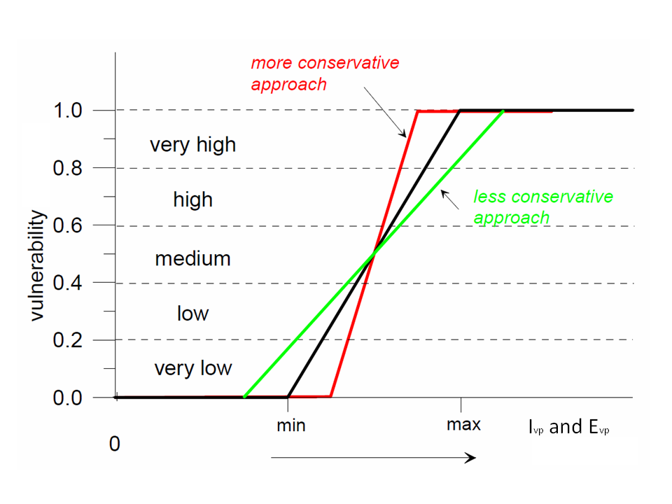
Vulnerability Assessment
METRIC
Vulnerability = f(factor measure x value assignment)

Slide 8
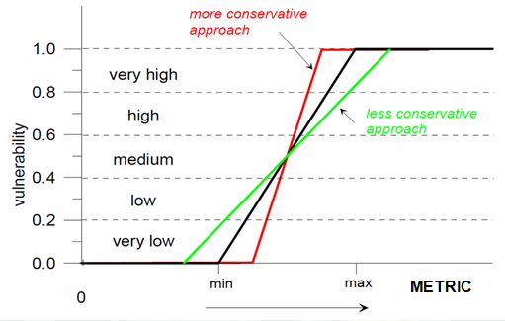
Vulnerability Assessment
X Weighting factor
X Weighting factor
+
+
X Weighting factor

Slide 9
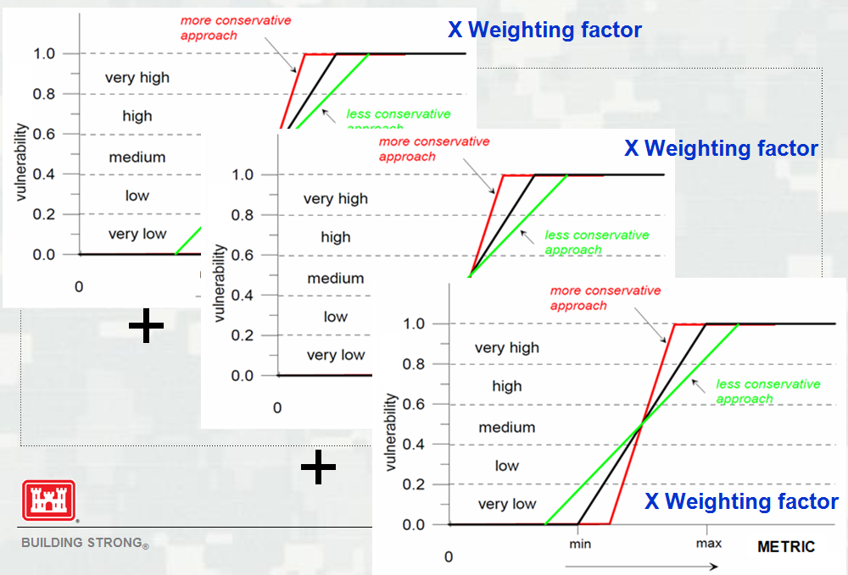
Vulnerability Assessment
“Valuing” and weighting metrics is a subjective process and therefore should be:
  Based on a structured decision making process
  Transparent
  Well documented

Slide 10
Summary
Vulnerability is a function of the hazard to which a system is exposed, the sensitivity of the system to the hazard, and the system’s adaptive capacity. Vulnerability assessment must consider all three.
Biophysical as well as socioeconomic factors must be considered.
Vulnerability assessment metrics, values, and weights will vary depending on purpose, scale, data availability, schedule and budget.
Valuing and weighting metrics must be transparent and well documented.

