Slide 1
The importance of branding
Rob Holder
Account Executive/DoJ
HP Enterprise Services

Slide 2

The Importance of Branding

Slide 3

It Starts With An Identity

Slide 4

What Will Your Company Be Known For

Slide 5
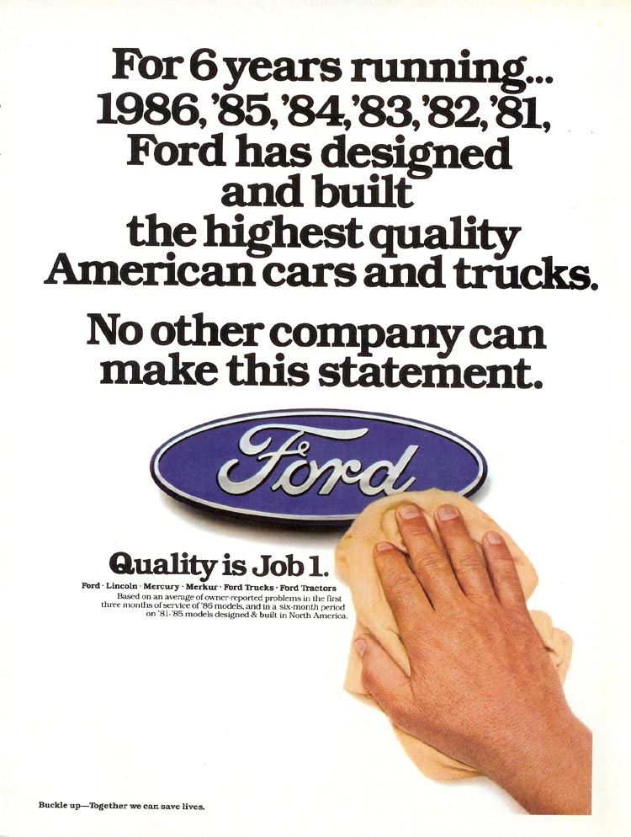
What Is Your Strength

Slide 6

How Do You Expand On Your Strength

Slide 7

How Is Your company recognized In the Market space in which you compete

Slide 8


What Is Your Value Differential And Is It Contained In Your Brand

Slide 9

Why is this Important

Slide 10
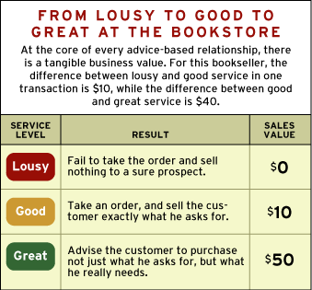
Just being Good Is Not Good enough

Slide 11
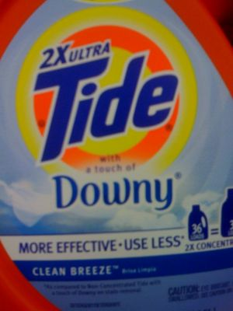
The Devil is not in the Details Greatness is

Slide 12
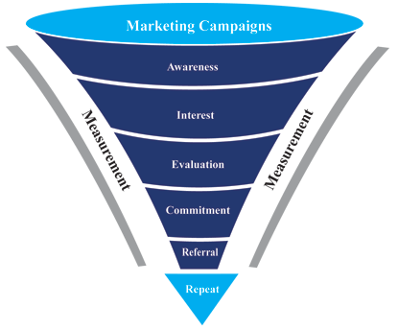
Understand the market place and Adapt

Slide 13

Lead the change that others will follow

Slide 14

Let your Brand Be your Flag

Slide 15

Its more than just a slogan, it becomes the soul of your company

Slide 16
Questions

