Slide 1
Explainable Artificial Intelligence (XAI)
David Gunning
DARPA/I2O
Proposers Day
11 AUG 2016
Notes:
Welcome

Slide 2
XAI BAA Outline
A. Introduction
B. Program Scope
  1. Explainable Models
  2. Explanation Interface
  3. Psychology of Explanation
  4. Emphasis and Scope of XAI Research
C. Challenge Problems and Evaluation
  1. Overview
  2. Data Analysis
  3. Autonomy
  4. Evaluation
D. Technical Areas
  1. Explainable Learners
  2. Psychological Model of Explanation
E. Schedule and Milestones
F. Deliverables
Notes:
The briefing will follow the outline of the BAA

Slide 3
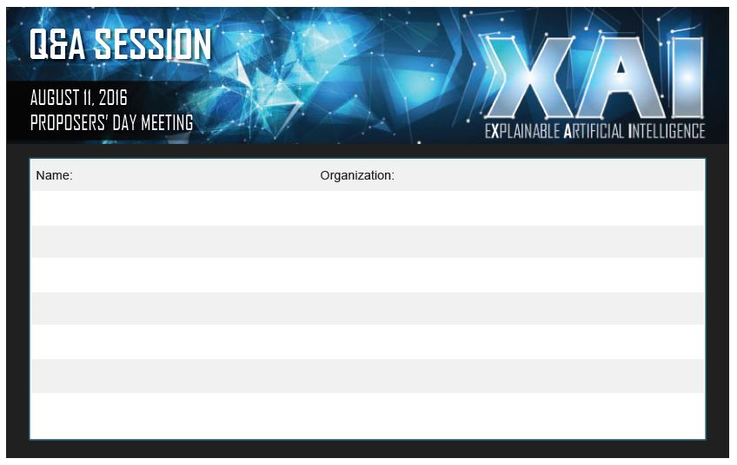
Questions
Fill out a question card
Send an email to: XAI@darpa.mil

Slide 4
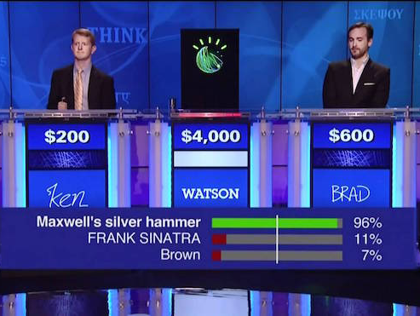


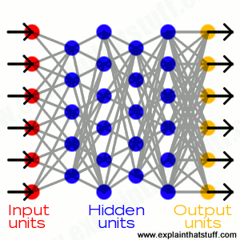


A. Introduction - The Need for Explainable AI
AI
System
Watson
User
AlphaGo
We are entering a new age of AI applications
Machine learning is the core technology
Machine learning models are opaque, non-intuitive, and difficult for people to understand
©IBM
©Marcin Bajer/Flickr
Why did you do that?
Why not something else?
When do you succeed?
When do you fail?
When can I trust you?
How do I correct an error?
Sensemaking
Operations
©NASA.gov
©Eric Keenan, U.S. Marine Corps
The current generation of AI systems offer tremendous benefits, but their effectiveness will be limited by the machine’s inability to explain its decisions and actions to users.
Explainable AI will be essential if users are to understand, appropriately trust, and effectively manage this incoming generation of artificially intelligent partners.
Notes:
Dramatic success in machine learning has led to an explosion of new AI capabilities.
These systems offer tremendous benefits, but their effectiveness will be limited by the machine’s inability to explain its decisions and actions to human users.
This is especially important for the Department of Defense (DoD), who is facing challenges that demand the development of more intelligent, autonomous, and symbiotic systems.
Explainable AI will be essential if users are to understand, appropriately trust, and effectively manage this incoming generation of artificially intelligent partners.
By creating new machine learning methods to produce more explainable models and combining them with explanation techniques, XAI aims to help users understand, appropriately trust, and effectively manage the emerging generation of AI systems

Slide 5

B. Program Scope – XAI Concept
Today
Task
Why did you do that?
Why not something else?
When do you succeed?
When do you fail?
When can I trust you?
How do I correct an error?
Training Data
Machine Learning
Process
Learned
Function
Decision or
Recommendation
User
XAI
Task
Training Data
New Machine Learning
Process
Explainable Model
Explanation Interface
I understand why
I understand why not
I know when you succeed
I know when you fail
I know when to trust you
I know why you erred
User

Slide 6
B. Program Scope – XAI Concept
XAI
Task
Training Data
New Machine Learning
Process
Explainable Model
Explanation Interface
I understand why
I understand why not
I know when you succeed
I know when you fail
I know when to trust you
I know why you erred
User
The target of XAI is an end user who:
  depends on decisions, recommendations, or actions of the system
  needs to understand the rationale for the system’s decisions to understand, appropriately trust, and effectively manage the system
The XAI concept is to:
  provide an explanation of individual decisions
  enable understanding of overall strengths & weaknesses
  convey an understanding of how the system will behave in the future
  convey how to correct the system’s mistakes (perhaps)

Slide 7
B. Program Scope – XAI Development Challenges
XAI
Task
Training Data
New Machine Learning
Process
Explainable Model
Explanation Interface
I understand why
I understand why not
I know when you succeed
I know when you fail
I know when to trust you
I know why you erred
User
Explainable
Models
Explanation
Interface
Psychology of
Explanation
develop a range of new or modified machine learning techniques to produce more explainable models
integrate state-of-the-art HCI with new principles, strategies, and techniques to generate effective explanations
summarize, extend, and apply current psychological theories of explanation to develop a computational theory

Slide 8
B. Program Scope – XAI Development Challenges
XAI
Task
Training Data
New Machine Learning
Process
Explainable Model
Explanation Interface
I understand why
I understand why not
I know when you succeed
I know when you fail
I know when to trust you
I know why you erred
User
Explainable
Models
Explanation
Interface
Psychology of
Explanation
develop a range of new or modified machine learning techniques to produce more explainable models
integrate state-of-the-art HCI with new principles, strategies, and techniques to generate effective explanations
summarize, extend, and apply current psychological theories of explanation to develop a computational theory
TA 1: Explainable Learners
TA 2: Psychological Models

Slide 9
B.1 Explainable Models
New
Approach
Learning Techniques (today)
Explainability
(notional)
Neural Nets
Create a suite of machine learning techniques that
produce more explainable models, while maintaining a high level of learning performance
Graphical
Models
Deep
Learning
Ensemble
Methods
Bayesian
Belief Nets
Prediction Accuracy
SRL
Random
Forests
AOGs
CRFs
HBNs
Statistical
Models
MLNs
Decision
Trees
Markov Models
SVMs
Explainability

Slide 10
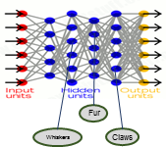
B.1 Explainable Models
New
Approach
Learning Techniques (today)
Explainability
(notional)
Neural Nets
Create a suite of machine learning techniques that
produce more explainable models, while maintaining a high level of learning performance
Graphical
Models
Deep
Learning
Ensemble
Methods
Bayesian
Belief Nets
Prediction Accuracy
SRL
Random
Forests
AOGs
CRFs
HBNs
Statistical
Models
MLNs
Decision
Trees
Markov Models
SVMs
Explainability
Deep Explanation
Modified deep learning techniques to learn explainable features

Slide 11
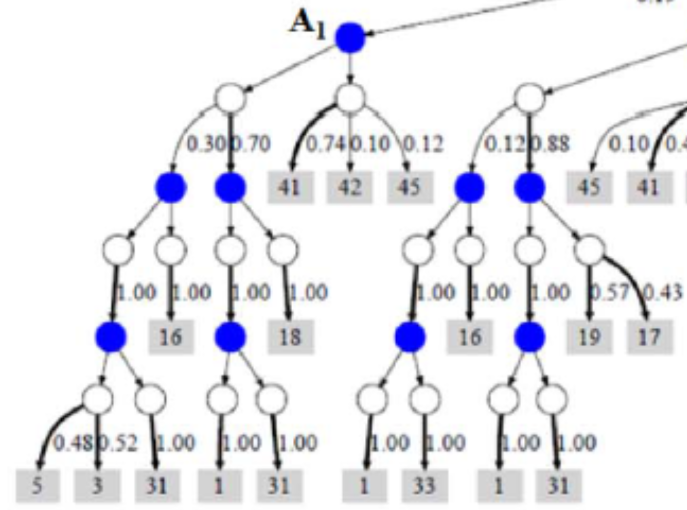
B.1 Explainable Models
New
Approach
Learning Techniques (today)
Explainability
(notional)
Neural Nets
Create a suite of machine learning techniques that
produce more explainable models, while maintaining a high level of learning performance
Graphical
Models
Deep
Learning
Ensemble
Methods
Bayesian
Belief Nets
Prediction Accuracy
SRL
Random
Forests
AOGs
CRFs
HBNs
Statistical
Models
MLNs
Decision
Trees
Markov Models
SVMs
Explainability
Deep Explanation
Modified deep learning techniques to learn explainable features
Interpretable Models
Techniques to learn more structured, interpretable, causal models

Slide 12
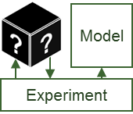
B.1 Explainable Models
New
Approach
Learning Techniques (today)
Explainability
(notional)
Neural Nets
Create a suite of machine learning techniques that
produce more explainable models, while maintaining a high level of learning performance
Graphical
Models
Deep
Learning
Ensemble
Methods
Bayesian
Belief Nets
Prediction Accuracy
SRL
Random
Forests
AOGs
CRFs
HBNs
Statistical
Models
MLNs
Decision
Trees
Markov Models
SVMs
Explainability
Deep Explanation
Modified deep learning techniques to learn explainable features
Interpretable Models
Techniques to learn more structured, interpretable, causal models
Model Induction
Techniques to infer an explainable model from any model as a black box

Slide 13
B.2 Explanation Interface
State of the Art Human Computer Interaction (HCI)
  UX design
  Visualization
  Language understanding & generation
New Principles and Strategies
  Explanation principles
  Explanation strategies
  Explanation dialogs
HCI in the Broadest Sense
  Cognitive science
  Mental models
Joint Development as an Integrated System
  In conjunction with the Explainable Models
Existing Machine Learning Techniques
  Also consider explaining existing ML techniques

Slide 14
B.3 Psychology of Explanation
Psychology Theories of Explanation
  Structure and function of explanation
  Role of explanation in reasoning and learning
  Explanation quality and utility
Theory Summarization
  Summarize existing theories of explanation
  Organize and consolidate theories most useful for XAI
  Provide advice and consultation to XAI developers and evaluator
Computational Model
  Develop computational model of theory
  Generate predictions of explanation quality and effectiveness
Model Testing and Validation
  Test model against Phase 2 evaluation results

Slide 15
B.4 Emphasis and Scope of XAI Research
End User
Explanation
Visual
Analytics
Question
Answering
Dialogs
XAI
Emphasis
Human
Computer
Interaction
Machine
Learning
Interactive
ML

Slide 16
DoD Funding Categories
Category | Definition
Basic Research (6.1) | Systematic study directed toward greater knowledge or understanding of the fundamental aspects of phenomena and/or observable facts without specific applications in mind.
Applied Research (6.2) | Systematic study to gain knowledge or understanding necessary to determine the means by which a recognized and specific need may be met.
Technology Development (6.3) | Includes all efforts that have moved into the development and integration of hardware (and software) for field experiments and tests.
XAI

Slide 17
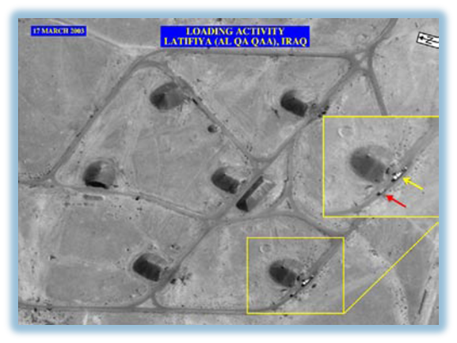

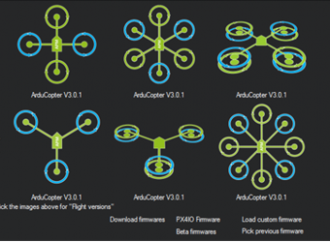

Explainable AI – Challenge Problem Areas
Learn a model to perform the task
Explain decisions,
actions to the user
Use the explanation to perform a task
Data Analytics
Classification Learning Task
Two trucks performing a loading activity
  An analyst is looking for items of interest in massive multimedia data sets
Explainable Model
Explainable
Model
Explanation Interface
Recommend
Explanation
©Air Force Research Lab
©Getty Images
Multimedia Data
  Classifies items of interest in large data set
  Explains why/why not for recommended items
  Analyst decides which items to report, pursue
Autonomy
Reinforcement Learning Task
Explainable Model
Explanation Interface
  An operator is directing autonomous systems to accomplish a series of missions
Actions
Explanation
©ArduPikot.org
©US Army
ArduPilot & SITL Simulation
  Learns decision policies for simulated missions
  Explains behavior in an after-action review
Operator decides which future tasks to delegate
Notes:
Research Focus
How will we focus the research?
This chart illustrates two general challenge problem areas we will ask researchers to address:
One, a classification problem to classify events of interest in multimedia data
the second, a reinforcement learning problem to train an autonomous UAV to perform a variety of missions
The basic framework for either problem is the following:
The performers are asked to train their system, thru machine learning, to solve problems in that domain
The system produced would contain an explainable model and an explanation interface
The trained system will then be tested by surrogate users who will use the system—and its explanations—to perform a related task
In the data analytics task, users would need to decide which recommendations to pursue and which recommendations were false alarms
In the autonomy task, users would need to decide how and when to use the autonomous system on future missions
We will then evaluate both the learning performance and the explanation performance the system
In the BAA I will ask each bidder to propose their own test problem in one or both of these areas
During the first year of the program, I will asks the evaluator to design a set of common test problems and metrics in each area

Slide 18
C. Challenge Problems and Evaluation
Developers propose their own Phase 1 problems
  Within one or both of the two general categories (Data Analytics and Autonomy)
During Phase 1, the XAI evaluator will work with developers
  Define a set of common test problems in each category
  Define a set of metrics and evaluation methods
During Phase 2, the XAI developers will demonstrate their XAI systems against the common test problems defined by the XAI evaluator
Proposers should suggest creative and compelling test problems
  Productive drivers of XAI research and development
  Sufficiently general and compelling to be useful for multiple XAI approaches
  Avoid unique, tailored problems for each research project
  Consider problems that might be extended to become an open, international competition

Slide 19
C.1 Data Analysis
Machine learning to classify items, events, or patterns of interest
  In heterogeneous, multimedia data
  Include structured/semi-structured data in addition to images and video
  Require meaningful explanations that are not obvious in video alone
Proposers should describe:
  Data sets and training data (including background knowledge sources)
  Classification function to be learned
  Types of explanations to be provided
  User decisions to be supported
Challenge problem progression
  Describe an appropriate progression of test problems to support your development strategy

Slide 20
C.2 Autonomy
Reinforcement learning to learn sequential decision policies
  For a simulated autonomous agent (e.g., UAV)
  Explanations may cover other needed planning, decision, or control modules, as well as decision policies learned through reinforcement learning
  Explain high level decisions that would be meaningful to the end user (i.e., not low level motor control)
Proposers should describe:
  Simulation environment
  Types of missions to be covered
  Decision policies and mission tasks to be learned
  Types of explanations to be provided
  User decisions to be supported
Challenge problem progression
  Describe an appropriate progression of test problems to support your development strategy

Slide 21
C.3 Evaluation – Evaluation Sequence
XAI developers are presented with a problem domain
Apply machine learning techniques to learn an explainable model
Combine with the explanation interface to construct an explainable system
The explainable system delivers and explains decisions or actions to a user who is performing domain tasks
The system’s decisions and explanations contribute (positively or negatively) to the user’s performance of the domain tasks
The evaluator measures the learning performance and explanation effectiveness
The evaluator also conducts evaluations of existing machine learning techniques to establish baseline measures for learning performance and explanation effectiveness

Slide 22
C.3 Evaluation – Evaluation Framework
Measure of Explanation Effectiveness
User Satisfaction
Clarity of the explanation (user rating) Utility of the explanation (user rating)
Mental Model
Understanding individual decisions Understanding the overall model Strength/weakness assessment ‘What will it do’ prediction ‘How do I intervene’ prediction
Task Performance
Does the explanation improve the user’s decision, task performance? Artificial decision tasks introduced to diagnose the user’s understanding
Trust Assessment
Appropriate future use and trust
Correctablity (Extra Credit)
Identifying errors Correcting errors, Continuous training
Explanation Framework
Task
Recommendation,
Decision or
Action
Explainable Model
Explanation Interface
Decision
The user makes a decision based on the explanation
XAI System
Explanation
The system takes input from the current task and makes a recommendation, decision, or action
The system provides an explanation to the user that justifies its recommendation, decision, or action

Slide 23
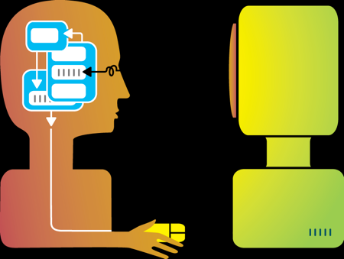


D. Technical Areas
Challenge Problem
Areas
TA 1:
Explainable
Learners
TA 2: Psychological Model of Explanation
Evaluation Framework
Deep
Learning
Teams
Teams that provide prototype systems with both components:
Explainable Model
Explanation Interface
Interpretable
Model
Teams
Learning Performance
Data Analytics
Multimedia Data
Psych. Theory of Explanation
Computational Model
Consulting
Explanation Effectiveness
Model
Induction
Teams
Explanation Measures
  User Satisfaction
  Mental Model
  Task Performance
  Trust Assessment
  Correctability
Evaluator
Autonomy
ArduPilot &
SITL Simulation
TA1: Explainable Learners
  Multiple TA1 teams will develop prototype explainable learning systems that include both an explainable model and an explanation interface
TA2: Psychological Model of Explanation
  At least one TA2 team will summarize current psychological theories of explanation and develop a computational model of explanation from those theories

Slide 24
Expected Team Characteristics
TA1: Explainable Learners
  Each team consists of a machine learning and a HCI PI/group
  Teams may represent one institution or a partnership
  Teams may represent any combination of university and industry researchers
  Multiple teams (approximately 8-12 teams) expected
  Team size ~ $800K-$2M per year
TA2: Psychological Model of Explanation
  This work is primarily theoretical (including the development of a computational model of the theory)
  Primarily university teams are expected (but not mandated)
  One team expected

Slide 25
D.1 Technical Area 1 – Explainable Learners
Challenge Problem Area
  Select one or both of the challenge problems areas: data analytics or autonomy
  Describe the proposed test problem(s) you will work on in Phase 1
Explainable Model
  Describe the proposed machine learning approach(s) for learning explainable models
Explanation Interface
  Describe your approach for designing and developing the explanation interface
Development Progression
  Describe the development sequence you intend to follow
Test and Evaluation Plan
  Describe how you will evaluate your work in the first phase of the program
  Describe how you will measure learning performance and explanation effectiveness

Slide 26
D.2 Technical Area 2 – Psychological Model
Theories of Explanation
  Describe how you will summarize the current psychological theories of explanation
  Describe how this work will inform the development of the TA1 XAI systems
  Describe how this work will inform the definition of the evaluation framework for measuring explanation effectiveness by the XAI evaluator
Computational Model
  Describe how you will develop and implement a computational model of explanation
  Identify predictions that might be tested with the computational model
  Explain how you will test and refine the model
Model Validation
  Describe how you will validate the computational model against the TA1 evaluation results in Phase 2 of the XAI program
  The government evaluator will not conduct evaluation of TA2 models

Slide 27
E. Schedule and Milestones
Technical Area 1 Milestones:
  Demonstrate the explainable learners against problems proposed by the developers (Phase 1)
  Demonstrate the explainable learners against common problems (Phase 2)
  Deliver software libraries and toolkits (at the end of Phase 2)
Technical Area 2 Milestones:
  Deliver an interim report on psychological theories (after 6 months during Phase 1)
  Deliver a final report on psychological theories (after 12 months, during Phase 1)
  Deliver a computational model of explanation (after 24 months, during Phase 2)
  Deliver the computational model software (at the end of Phase 2)

Slide 28
E. Schedule and Milestones – Phase 1

Slide 29
E. Schedule and Milestones – Phase 2

Slide 30
F. Deliverables
Slide Presentations
XAI Project Webpage
Monthly Coordination Reports
Monthly expenditure reports in TFIMS
Software
Software Documentation
Final Technical Report

Slide 31
Summary
Goal: to create a suite of new or modified machine learning techniques
    to produce explainable models that
    when combined with effective explanation techniques
    enable end users to understand, appropriately trust, and effectively manage the emerging generation of AI systems
XAI is seeking the most interesting and compelling ideas to accomplish this goal

