Slide 2
SAAM Situation
Sexual Assault Awareness Month is a nationally recognized month which occurs in April and commits to raising awareness and promoting prevention of sexual violence through use of special events and public education.

Slide 3
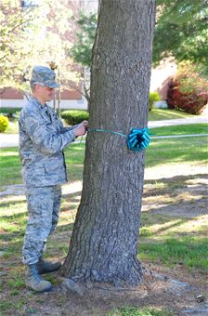
SAAM Mission
Team APG prepares for and executes Sexual Assault Awareness Month activities through the month of April in order to raise awareness and promote prevention of sexual harassment and violence, as well as increase the installation’s SHARP program visibility.

Slide 4
Execution: Concept of the Operation
2 April: 2013 SAAM Day of Action
5K Run/Walk – Meet at 0630 in Fanshaw Field
“Pledge to Intervene Act Motivate” – Leadership signs board
APG Team “Human Ribbon” Picture
SAAM Kick off Ceremony – 1000 at the Post Theater
3 April: It’s time… to talk about it! (Forum/Discussion Day) 0800
Breakfast at the Chapel with Panel of Experts– Statistics tell us that we either have been or know somebody who has been a victim of assault. The Chaplain ,along with a panel of counselors and psychologists, hosts a breakfast and leads a open forum/discussion on coping mechanisms if you or someone you know has been a victim, how you can help a friend in need, speaking and listening techniques, tips on talking to our children about sex, age appropriate behaviors., etc. In conjunction with Substance Abuse Awareness Month, the ASAP team will also be present to discuss the facts and myths about using alcohol or other drugs and their links to sexual assault, as well as prevention techniques and taking care of our peers
4 April: Screening of “The Invisible War” – 0900, Edgewood REC Center and1300, APG Post Theater. The screening at the Post Theater will include a panel of experts for discussion of movie and to answer questions.
10 April: Installation SHARP Training, Post Theater ,0900 and 1300.
16 April: Self Defense class, 1130, location TBD.
18 April: The Sex Signals, (three shows, sponsored by ACS) 0900, 1300 and 1500, Post Theater
24 April: Honor Demin Day

Slide 5
Day of Action Timeline
Sexual Assault Awareness 5K Run/Walk:
0600, personnel begin arriving, conduct warm ups, pick up t-shirts (if available)
0630, Welcome and opening remarks
0640, Introduction of Pledge Board and signing of it by Installation Leaders and Guest Participants.
0650 - 0655, move to the run start line! Run starts!
0745, All runners and walkers return to Fanshaw Field. As people arrive they get water and fruit (if available) and SHARP staff will position them for the Human Ribbon picture.
0800, Picture is taken!
0815 to 0830, everybody is released for personal hygiene

Slide 6
Timeline (cont)
SAAM Kick off ceremony
1000, Ceremony Starts
1005, National Anthem
1010, Invocation
1015, Remarks: history of SAAM
1025, Band of Brothers and Sisters video
1035, introduction to guest speaker
1040, Guest Speaker
1050, SAAM Proclamation
1100, Guest Speaker gift presentation
1105, Closing Remarks
1110, Conclusion of Ceremony

Slide 7
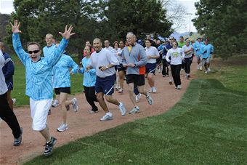
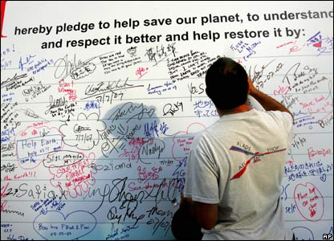
Day of Action: Fanshaw Field

