Slide 1
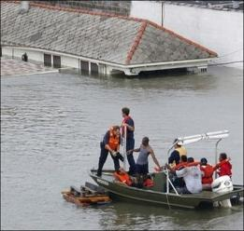
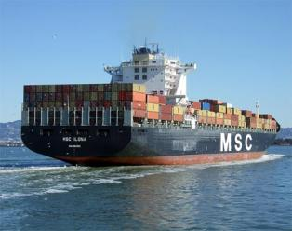
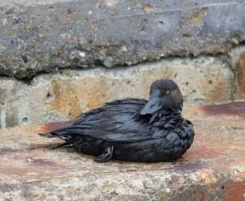
U.S. Integrated Ocean Observing System (IOOS®)
A tool that enables the Nation to track, predict, manage and adapt to changes in our marine environment and delivers critical information to decision makers to…
Improve safety
Enhance our economy
Protect our environment
ICOOS Act Annual Report to the IOOC
Zdenka Willis, Director, U.S. IOOS Program
December 15, 2011
Notes:
This briefing is the annual US IOOS report to the IOOC. This task is assigned to the Lead Federal Agency
ACTIVITY: “report annually to the Interagency Ocean Observing Committee on the accomplishments, operational needs, and performance of the System to contribute to the annual and long-term plans developed pursuant to subsection (c)(2)(A)(i).”

Slide 2
FY2011 Annual Report Scope
ICOOS Act Requires Lead Federal Agency provides an FY2011 System report on accomplishments, operational needs, and performance
Report also covers relevant U.S. IOOS Program Office and IOOC FY2012 Priorities and Challenges
Notes:
This is the annual Lead Federal Agency Report as required by the Act and is intended to cover all of the US IOOS activity but if you have read to the end of my presentation you will see I list that as a challenge.
It reflects the US IOOS Program Office and RCOOS activities. Conveys NOAA activities. We still need to convey the remainder of the national activities in a more meaningful way.

Slide 3
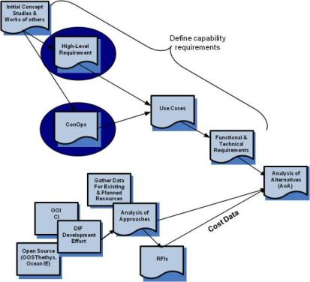
Pathway to a National DMAC
Acquisition Track (Traditional)
Building DMAC with Partners
FY
08
FY 09
FY 10
FY 11
FY 12-14
Water quality Variables Added
Biological Variables Added
DIF
Development
Completed
DIF
Development
Completed
DIF
Development
Completed
DMAC 1.0
Use Cases
Use Cases
DMAC N.0
And
OOI CI
Use Cases
Use Cases
Use Cases
Use Cases
OOI
CI
OOI
CI
OOI
CI
OOI
CI
OOI
CI
Notes:
Talking Points:
The #1 request we hear is, “I need to get to my data easily and in the same format.”
Data Integration has been a prime focus of the IOOS program office.
We are now providing real-time data available in a consistent format, within major NOAA centers of data and also across the IOOS regions.
In 2007 we had a two pronged effort
Data Integration Framework (DIF) a pilot to integrate 7 variables across NOAA Centers of Data
Traditional Acquisition path similar to the Department of Defense and NASA
In 2009 we determined we were not going to receive funding for a DMAC Acquisition so we put that effort on hold after completing the Analysis of Alternatives
The successful Data Integration Framework (DIF) project was a limited-scope, 3-year pilot project to provide an initial nationwide U.S. IOOS DMAC operating capability, to evaluate interoperability specifications, and to demonstrate the feasibility and value of providing integrated ocean observations. It concluded in 2010 with recommendations for standardized coding conventions for a small set of data and provides a baseline for initial U.S. IOOS DMAC capabilities.
In 2011 we have laid out and vetted a DMAC implementation plan based on collaborative build out with the IOOS Federal and regions within current funding levels – Working to support a co-development of data management structures in with OOI.

Slide 4
DMAC Developments Nationally
Data Management Plan drafted, reviewed by DMAC ST
US Navy (METCON – NMDSF)
  Project compared and contrasted the technical architectures underlying the Navy METOC Data Services Framework and IOOS DMAC subsystem.
  Final report to be delivered in Dec 2011.
NSF OOI (covered later in presentation)
USACE
  Completed Phase 1 project with Mobile (AL) District to expose USACE water level data via US IOOS web services
  Successful first steps provide opportunity for expansion at Mobile and other districts
NOAA (NWS/NDBC, NOS/CO-OPS)
  Continue to develop web based data access services
  Expand the number of data sets delivered by these services.
  CO-OPS “collections” service – retrieve data 2X as fast and process 70% faster
DMAC ST (NSF, USACE, US EPA, USGS, USCG, NPS, MMC, BOEMRE, NASA, NOAA)
Notes:
Talking Points:
Data Management Plan V1 is on the IOOS website
We have a small project with CNMOC and NAVO to evaluate their technical architectures
USACE and IOOS agreed to collaborate on a demonstration project at the USACE's Mobile district for exposing USACE water level data via US IOOS protocols and web services
Initial testing using OGC's tools of the prototype SOS services for a few water level stations have been successful
Discussions are now in motion to potentially expand these services to all Mobile water level stations via their local developmental server and then bring these services on-line and potentially expand to other USACE districts
Further collaboration with NOAA CO-OPS and USGS for a more rigorous set of capabilities is also proposed
NOAA (NWS/NDBC, NOS/CO-OPS): Additional talking points
“Continues to develop the functionality of web based data access services as well as expand the number of data sets delivered by these services. Services are evolving into a mission critical data dissemination mechanism for each organization. For example, in FY2011 50% of the nearly 30 terabytes (Tb) of data served by CO-OPS was delivered by one of the web services developed as part of the IOOS CO-OPS collaboration.”
CO-OPS now offers retrieval of its latest observations and time series data as a Collection from multiple stations versus a single station as a new tool in the IOOS Data Management and Communications (DMAC) toolbox. Users can now request data from multiple stations using a bounding box defined by latitude and longitude with the bounding box covering the entire network of stations or a subset of them i.e. East Coast stations only.
This new data service can retrieve data twice as fast and process that data 70% faster than processing one data-file per station at a time. The following data measurements are available as a Collection of stations:
Currents Data
Water Level Data
Water Level Predictions Data
Meteorological & Ancillary Data (Air Temperature, Barometric Pressure, Conductivity, Salinity, Water Temperature and Wind)

Slide 5
DMAC Developments in the Regions
NANOOS upgraded NVS, adds 2nd Sensor Observation Service
CeNCOOS improved CDP, releases New CDIP wave model viewer
PacIOOS released new Near Shore Water Conditions map for Hawaii.
AOOS released its new Transition Data Portal
GLOS released the Great Lakes Model Inventory
GCOOS began pilot project to bring SW Florida water quality from multiple sources into the US IOOS data management subsystem
SECOORA began serving on the newly developed Southeast Atlantic Marine Debris Initiative (SEA-MDI)
SCCOOS released new product, Optimally Interpolated Surface Currents
NERACOOS adds new Right Whale detection information to their website.
Notes:
The Regions are all working to improve their data access and distribution.

Slide 6
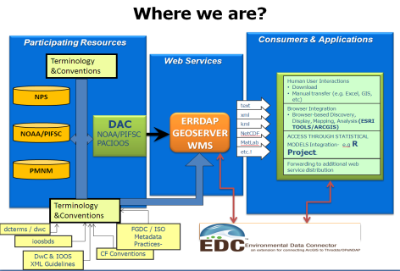
IOOS Biological Data Project (BDP)
Implemented IOOS BDP in PacIOOS Region
Completed data integration from NOAA Fisheries, NOS and NPS
Tested/evaluated system by the end users customers
Received feedback from data providers/data users
Next Steps:
Focus on refining the data services implemented in PacIOOS
Develop plan for national implementation through IOOS RAs
Partnership with:
US Geological Survey/OBIS USA
US National Park Service
NOAA Fisheries
NOAA Sanctuaries
Notes:
Talking Points:
We have started to work with biological data. This is effort is about species and abundance of reef fish.
The goal was to increase the amount of data and ease of use of the data by NOAA for fish stock assessments.
We did that by putting National Park Service and 2 NOAA data centers data in the same format. Before we got to standardizing how we report fish size and mass we had to invoke the IOOS standards to have the lat/long and time information being reported in the same way.
Feedback has been positive.
Next steps – take this nationally and work with the international standards bodies to include this work.

Slide 7
Marine Animal Telemetry Network (ATN)
ATN workshop held to:
Establish a sustainable U.S. Animal Telemetry Observing Network
Linking observations from this network to the National Ocean Observing System
Recommendations include:
Make animal telemetry data and products available to advance National Ocean Policy Priority Objectives.
Improve data standards, management, and sharing capability.
Collaborate more closely with industry on tag identification coding management, and manufacturing standards.
Promote development of new animal telemetry technology.
www.ioos.gov/observing/animal_telemetry/workshop/mar2011/atn_synth_wrkshp_rprt_jul2011.pdf
USGS
US Navy (ONR, NAVO)
US Navy/ONR
NOAA Fisheries
NOAA NWS/NCEP
Partnership with:
Notes:
We announced this partnership last year and this is another community that is looking to have their data exposed and used.
In support of this effort the US IOOS program and Office of Naval Research to expose TOPPS data into Navy and NOAA models.

Slide 8
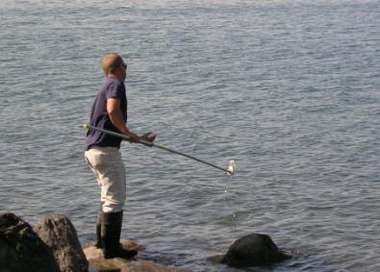
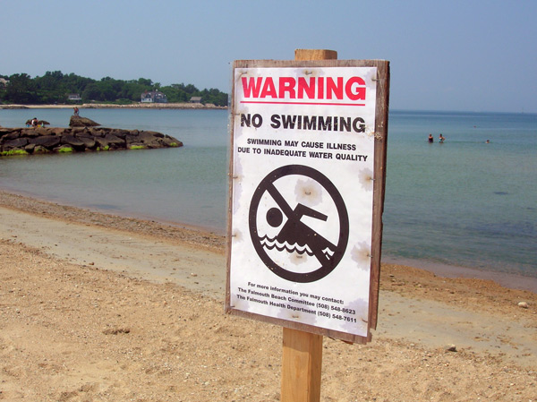


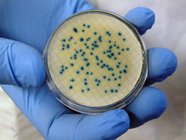



Beach Water Quality Predictive Modeling
Beach Water Quality Predictive Modeling
Notes:
Talking Points:
Issue:
State, public health agencies, and local governments routinely monitor and test U.S. waters for bacterial indicators Enterococcus or E. coli (freshwater)
to determine if waters are safe for swimming.
Methods used to determine indicator bacteria concentrations can require a 24-hour incubation period before results are known.
Beach and public health officials are making decisions to post or lift advisories based on a previous day’s sample.
Objective:
To improve advisory decision making, by improving decision support tools and forecast modeling techniques that can provide more timely indication of
whether an advisory should be issued for a beach area.

Slide 9
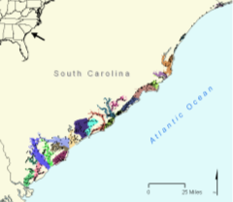
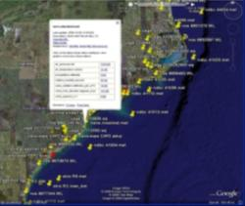
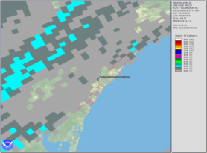



Data Assimilation
Beach Water Quality Predictive Modeling
Integration of Data from multiple sources
Field programs
Observing systems
Remote sensing / Models
Bacteria density
Salinity
Air/water temperature
Tide
Weather
Rainfall
Currents
Salinity
Wind
Salinity
Air/water temperature
Rainfall
Currents
Wave activity
Notes:
Effective use of monitoring data from an array of available water quality, meteorological, ocean observing platforms, and remotely-sensed products will be made.
The data from these observing platforms will be ingested into models to provide outputs that can be used by public health officials.
The ensemble modeling approaches utilized in this project are designed to be transferrable to other swimming beach areas in the United States. By comparing model outputs to existing models, and by implementing the model development tools in new areas, the project will evaluate the utility and transferability of these approaches.

Slide 10

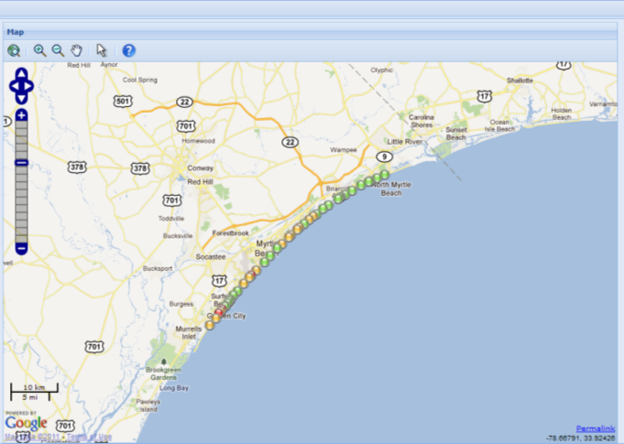
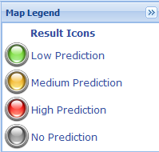
Results
  "This model has reduced the sampling burden for our Regional staff; but the major benefit has been the Department's quicker response time for posting beach advisories and subsequent enhancement of our agency's primary mission of protecting the public health.“
David E. Tilson, PE, Chief, Bureau of Water, South Carolina Department of Health and Environmental Control (SCDHEC)
Notes:
This graphic represents a Web-based view of the predictions for the water quality conditions at beaches on the South Carolina coast.
The high, medium, low or no prediction scale represented by color-coded icons identify the bacterial water quality conditions based on the SC predictive model used per EPA criteria for safe swimming conditions.
The model outputs will benefit the public by providing more timely delivery of swimming advisories or other relevant beach water quality information to decision makers (i.e. public health officials) to disseminate advisories or through real-time notification systems.
As part of this project, an automated web based decision support tool will be implemented to support local decision making.

Slide 11
U.S. IOOS: Modeling Testbed
US IOOS Costal Ocean Ecosystem Modeling Testbed
5 teams, 64 scientists/analysts
SURA is overall lead for execution
Began in June 2010; now in the second year
Multi-sector engagement (federal agency, academia, industry)
Goals:
  Less about model than process
  Focus is on stable infrastructure (testing environment, tools, standard obs) and transition to operations
  Enable Modeling and Analysis subsystem
Coastal Inundation
Gulf & Atlantic Coast
Rick Leuttich, UNC-CH
Shelf Hypoxia
Gulf of Mexico
John Harding, USM
Estuarine Hypoxia
Chesapeake Bay
Carl Friedrichs, VIMS
Cyber Infrastructure
Eoin Howlett, ASA
Testbed Advisory
Evaluation Group
Rich Signell, USGS
US Geological Survey
US Navy/NAVO
USACOE
NOAA (NOS/CSDL, NWS/NCEP)
USCG
NASA/JPL
Partnership with:
Notes:
Talking Points:
In 2010, with funding included in the FY2010 appropriations, U.S. IOOS initiated a project under the Southeastern Universities Research Association (SURA) to evaluate the readiness of marine forecasts along the Atlantic and Gulf of Mexico coasts and improve them for operational use. This project creates an objective environment to compare the latest models for improved forecasting of chronic issues of high relevance in the Atlantic and Gulf regions such as flooding from storm surge and seasonal depletion of oxygen in shallow waters. Through this project, methods will also be explored for effectively delivering model results to regional centers, scientists, and managers relying on U.S. IOOS.
This has been a very successful effort which has gained support from NOAA, Navy, BOEM, USGS, USACE, NASA and USCG.

Slide 12
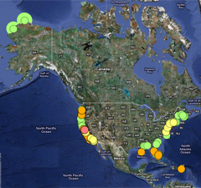
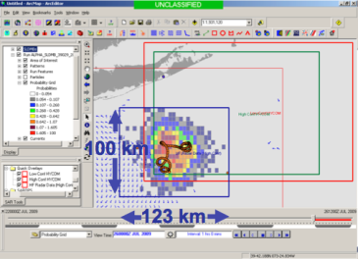
Examples of National Observing Networks
Stakeholders
> 30 institutions operate HF Radars; represents a Federal/State investment of $55M in last 15 years
Used by >40 government/private entities
Partnership with Industry: US-based CODAR Ocean Sensor
Who Depends on it
USCG Search and Rescue: Oil spill response
Water quality; Criminal forensics
Commercial marine navigation
Offshore energy; Harmful algal blooms
Marine fisheries
Emerging - Maritime Domain Awareness
Emerging – Tsunami
Decreases search area by 66% in 96 hours
Notes:
Talking Points:
HF Radar remains one observing system where >98% is provided by the non-Federal part of US IOOS
Great partnership with Industry – US company CODAR provides 80% of the HF Radars world wide
Uses are growing – this year has seen a growing interest by the Maritime Domain Awareness community – through DHS’s funded Centers of Excellence
Tsunami – detection – 10 -43 mins ahead of tide gauges.
More info see Emerging uses include ecosystem based studies, vessel tracking and most recently HF Radar did pick up the signal from the March 2011 Pacific Tsunami – see Journal of Remote Sensing - http://www.mdpi.com/2072-4292/3/8/1663/pdf
ISSUE remains working with DOD on primary frequency allocations within the United States

Slide 13
Examples of National Observing Networks
FY2011 Increases in Operational Capacity:
CariCOOS and AOOS deployed new CDIP (Datawell)
PacIOOS/AOML deployed new ICON station in American Samoa
CO-OPS – New PORTS® station in Mobile, AL
NDBC began testing of Wave Glider – coastal buoy replacement/surface expression of DART buoy
CariCOOS commissioned 2 buoys, launched CariCOOS Buoy C
MARACOOS with Rutgers, Challenger Mission - Phase One underway
FY2011 saw more assets in the water
Notes:
In situ – Coastal observing increases that we are aware of

Slide 14

NSF/OOI cyberinfrastructure collaboration
Release 1 contributions:
OOI-CI/IOOC DMAC use case for coastal modelers as "early adopters“
Tool to simplify/improve modeler access to over 50 sources of data
Release 2 planning:
Gliders, high frequency radar and coastal modeling are focus areas for OOI-CI's R1
Currently defining priorities/developing use cases and requirements
Notes:
Talking Points
US IOOS/NSF-OOI cyberinfrastructure collaborations are in their third year
US IOOS DMAC is a development partner with the OOI-CI team per demonstrating value of the CI for access/distribution of operational ocean observing data
OOI-CI's program is being executed through a series of four software releases (R1-4)
During R1 OOI-CI and IOOS-DMAC teams developed a detailed collaboration plan to focus on the data access requirements of coastal modelers as a way to reveal challenges per data formats, access tools, and integration/assimilation requirements
Modelers from MARACOOS/Rutgers and PacIOOS/UH participated in the development of detailed requirements that resulted in an OOI-CI tool for improved access (inc. subscriptions) to dozens of operational observing data sources
US IOOS will continue to be a developmental partner on all four phases of the OOI-CI program

Slide 15
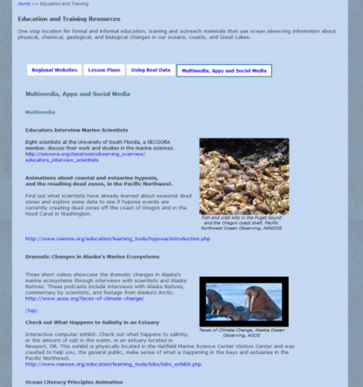
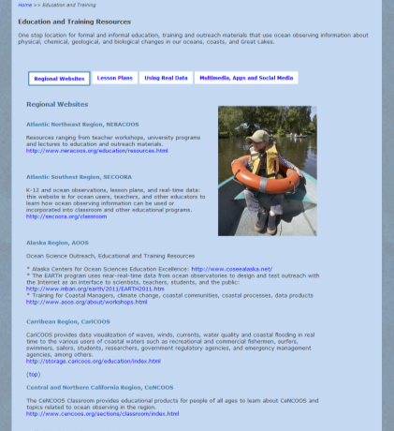
U.S. IOOS: Education
Promote Regional Activity
Notes:
Talking Points:
From the US IOOS Program office we do not have our own educational projects but in this case coordinate access to what the regions are doing.
My favorite tab here is “Using Real Data” which focuses on using data in the classrooms

Slide 16
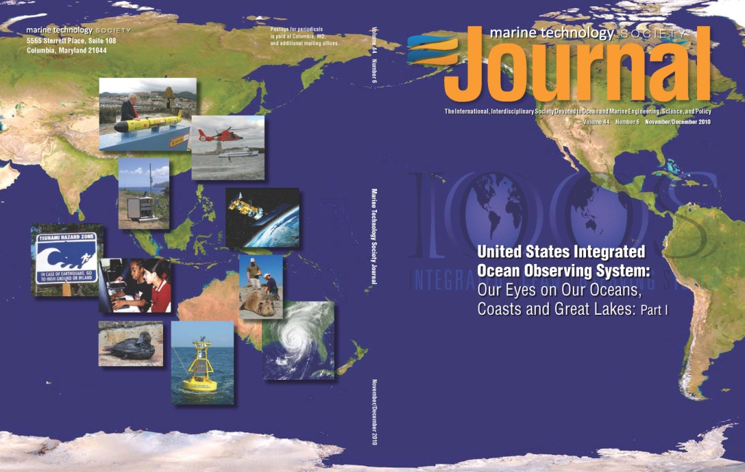
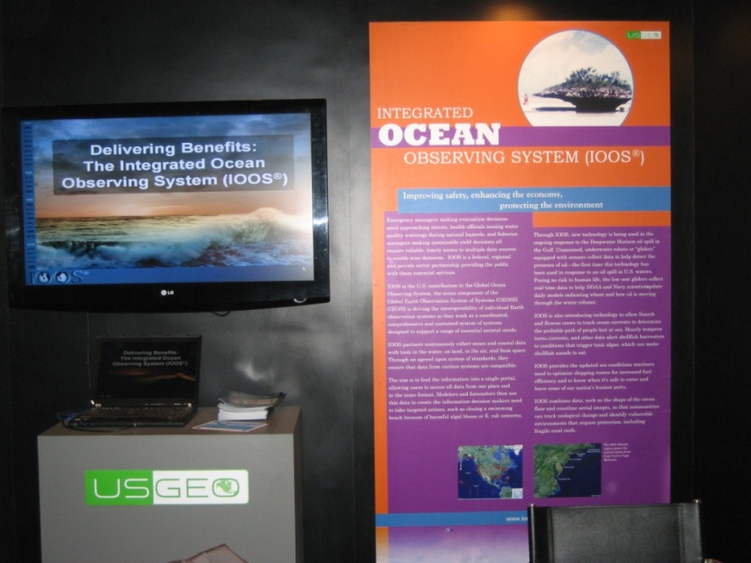
U.S. IOOS Outreach
MTS 2010 IOOS Journals Vols 1 & 2 published
ASLO – CMSP IOOS session
CZ IOOS booth, sessions & café talk
U.S. GEO Ministerial, Beijing, IOOS display
MTS 2011 IOOS booth, papers and 2 Town Halls
Quarterly visits to the Hill
US GEO Booth Display
MTS IOOS Journal
Notes:
Talking Points:
Statistics are for the digital platform, which is used primarily by libraries.
It’s not a full indicator of any paper version usage or folks who may look at the PDF that’s available to members.
That said, clearly this is a very successful double issue with a large number of full text downloads viewed by researchers using library resources.
The first issue with 168 downloads was not only the most used of the volume year, but that’s also the most of any issue in our online archive (Vol 43 No 5, 50th Anniversary of Trieste dive, had 166 full text downloads).
General Stats:
Vol 44 No 6: 415 TOC views, 1,195 abstract views, 168 full text downloads (#1 for volume year)
Vol 45 No 1: 313 TOC views, 709 abstract views, 64 full text downloads (#2 for volume year)

Slide 17
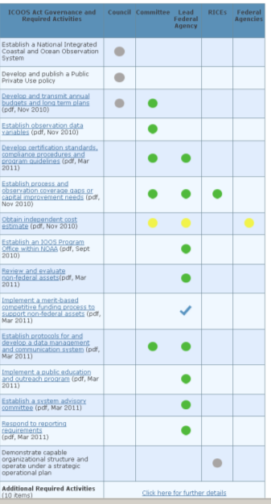
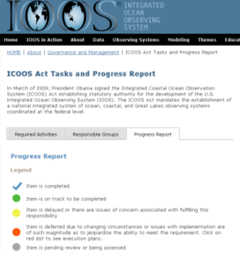
ICOOS Act Accomplishments
Certification
ICE
Biennial Report to Congress
IOOS Advisory Committee
www.ioos.govabout/governance/icoosact_progress.html
Notes:
We continue to make strides on the 35 SHALLS in the Act.
Suzanne has kept you up on the ICE, Josh and April on the certification efforts
Congressional report sent to the Hill on 10 November
We brief Dr. Lubchenco on the FACA recommendations (provided through the IOOC working group in July) on 20 Dec

Slide 18
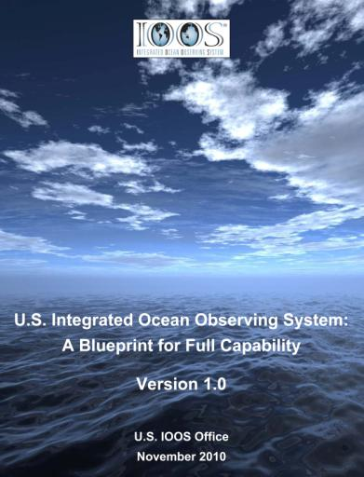
U.S. IOOS: A Maturing National Program
US IOOS Blueprint for Full Capability adopted by Interagency Ocean Observation Committee (IOOC) – Partner Assessments ongoing as part of NOP Strategic Action Plan #9.
Independent Cost Estimate is beginning
Moved from legacy system of earmarks and independent PI’s to a national network of integrated observations that is delivering:
  New observational capability
  Systematic data integration
  Benefits across many sectors
Notes:
Talking Points:
Interagency Ocean Observation Committee (IOOC) has two projects underway which will yield detailed level of information long desired but elusive for US IOOS:
Blueprint Assessments
Assessments of each federal and non-federal entity’s contributions to US IOOS against the framework detailed in U.S. IOOS: A Blueprint to Full Capability aka the Blueprint.
Blueprint defines US IOOS from a systems engineering perspective, without regard to which entity delivers the capability needed for the national system
Six subsystems comprise US IOOS: observing; data management & communication; modeling & analysis; R&D; training & education; governance & management
2) Independent Cost Estimate – required by ICOOS Act
IOOC is conducting an independent cost estimate
US IOOS Program Office (NOAA) is substantially leading this effort
Since passage of ICOOS Act, there has been improvement in cohesion among Federal agencies.
Next big step is to build on this cohesion and foster enhanced collaboration among Federal agencies and IOOS Regions.

Slide 19
U.S. IOOS Assessment: Update
U.S. IOOS Assessment Background
U.S. IOOS Assets
U.S. IOOS Core Functional Activities
Next Steps
U.S. IOOS Assessment

Slide 20
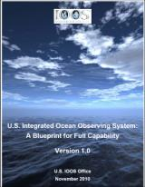
U.S. IOOS Implementation
Identify Federal and non-Federal contributions to U.S. IOOS to meet customer needs
Document contributions in the context of the U.S. IOOS Blueprint
Address partner collaboration opportunities to fill selected gaps identified in the Assessment
Use resulting capabilities and gaps to inform U.S. IOOS implementation planning
U.S. IOOS Assessment Complete
Assess Current Capabilities
of U.S. IOOS Partners
Identify Capability Gaps Required for U.S. IOOS
Assess Gap-Filling Feasibility for U.S. IOOS Summit
U.S. IOOS Blueprint Approval
We Are Here
Nov 2010 - - - - - - - - - - - - - - - - - Dec 2011 - - - - - - - - - - - - - - - - - - - - - - 2012 →
U.S. IOOS Assessment
Notes:
The U.S. IOOS Assessment is another step on the road we undertook starting in November 2010 with the approval of the U.S. IOOS Blueprint.
The goal is to identify and fill gaps and to fulfill the mandate of the ICOOS Act of 2009, the requirements of the IOOS Development Plan, and the direction of the IWGOO Strategic Plan.

Slide 21
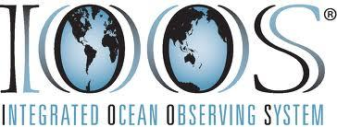
U.S. IOOS Assessment Background
The U.S. IOOS Assessment surveyed two types of information:
  3 categories of U.S. IOOS assets
  37 U.S. IOOS core functional activities (CFAs)
U.S. IOOS asset categories:
  Observing assets
  R&D assets
  Training & Education assets
CFAs describe U.S. IOOS Program management products and services
CFAs are derived from stated or implied requirements in:
  ICOOS Act of 2009
  IOOS Development Plan
  IWGOO Strategic Plan
U.S. IOOS Assessment
Notes:
The U.S. IOOS Assessment is an effort to collect two types of IOOS related information as outlined on this slide
Results of the Assessment help illustrate what remains to be accomplished to achieve full U.S. IOOS capability and will serve as a foundation for implementation planning for the development of a fully functioning U.S. IOOS.

Slide 22
U.S. IOOS Partner Roles
U.S. IOOS Assessment
Notes:
This slide is animated with two different views.
This is a high-level depiction of U.S. IOOS Partner roles.
The U.S. IOOS Assessment collected data in the blue and green areas from Federal and Non-Federal IOOS partners.
This briefing will provide an overview of what we were told.

Slide 23

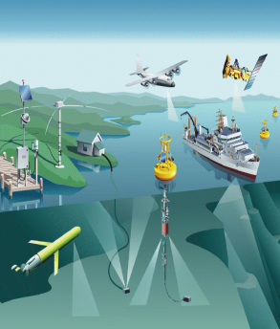









U.S. IOOS Partner Reported Observing System Assets
Observing Assets Measuring U.S. IOOS Core Variables
45 obs systems & obs asset database (NOSA)
2 satellite obs systems
4 obs systems
1,500 obs platforms
Regional
IOOS
4 obs programs
21 obs systems
8 water resource programs & 1 satellite obs system
4 obs systems
Animal-borne sensors
Defense-related obs systems
U.S. IOOS Assessment
Notes:
Non-NOAA Federal obs systems:
USACE Coastal Data Information Program (CDIP)
USACE National Coastal Mapping Program
USACE Navigation and Coastal Databank
USACE Mobile District Water Level Gages
USCG Self-Locating Datum Marker Buoy (SLDMB)
USCG Iceberg Analysis & Prediction System (BAPS)
USCG Ships & aircraft supporting NDBC and other obs asset installations and maintenance
USCG USCG Polar Ice Breakers
NPS Alaska Weather Station
NPS Alaska Intertidal temperature loggers
NPS Alaska Intertidal salinity loggers
NPS Arctic Network long-term ecological monitoring program
NPS Arctic Climate Monitoring Network
NPS Gulf Coast Vital Signs Network (GULN)
NPS Rocky Intertidal Monitoring
NPS Northeast Estuarine Nutrient Enrichment Monitoring
NPS Northeast Salt Marsh Monitoring
NPS Northwest Marine Fish Monitoring
NPS Northwest Benthic Marine Communities Monitoring
NPS Northwest Water Quality Monitoring
NPS Pacific Intertidal Water Temperature
NPS SE Alaska Network - Oceanography Vital Sign Program
NPS SE Alaska Network - Marine Contaminants Vital Sign Program
NPS SE Alaska Network - Ocean Acidification assessment project
NPS South Florida Marine Fish Community Monitoring
NPS South Florida Marine Benthic Community Monitoring
NPS SEAN Glacier Bay monitoring
EPA National Estuary Program (NEP)
EPA Beaches Environmental Assessment and Coastal Health (BEACH) Monitoring Program
EPA National Pollutant Discharge Elimination System (NPDES) - Cost of the monitoring is borne by the permittee
EPA National Aquatic Resource Surveys (replaces former program National Coastal Assessment) – data collected by Bold and Lake Guardian (Great Lakes) ships
USGS Cooperative Water Program
USGS National Streamflow Information Program (NSIP)
USGS National Water-Quality Assessment Program (NAWQA)
USGS Toxic Substances Hydrology (Toxics) Program
USGS Groundwater Resources Program
USGS Hydrologic Research and Development
USGS State Water Resources Research Institute Program
USGS Hydrologic Networks and Analysis (HNA)
USGS LandSAT satellite
(USGS Oceanographic buoys)
(USGS Great Lakes vessels)
(USGS survey aircraft)
NASA Terra (ocean color)
NASA Aqua (sea ice/sea surface temperature)
MMC MMC animal-borne sensors
Navy/ONR Defense-related obs systems

Slide 24






U.S. IOOS Partner Reported Observing R&D Assets
40 Federal partner R&D ocean observing facilities/programs, plus a network of
23 Regional partner R&D programs
(schools, curricula, science centers, aquaria, institutes, workshops, reserves, sanctuaries)
U.S. Army Engineer Research and Development Center (ERDC) Coastal and Hydraulics Laboratory (CHL)
Joint Airborne Lidar Bathymetry Technical Center of Expertise
23 Regional IOOS research programs
Pacific Marine Environmental Laboratory
Earth System Research Laboratory National Severe Storms Laboratory
Air Resources Laboratory
Great Lakes Environmental Research Lab
Atlantic Oceanographic & Meteorological Lab
Geophysical Fluid Dynamics Laboratory
Ocean Exploration and Research
Climate Program Office
National Sea Grant College Program
Office of Weather and Air Quality
Center for Coastal Fisheries & Habitat Research
Center for Coastal Monitoring & Assessment
Center for Environmental Health & Biomolecular Research
Ocean Systems Test and Evaluation Program
Center for Sponsored Coastal Ocean Research
Coast Survey Development Laboratory
National Geodetic Survey Geosciences Research Division
Hollings Marine Laboratory
National Geodetic Survey Remote Sensing Research Group
Center for Human Health Risk at the Hollings Marine Laboratory
Cooperative Oxford Lab
Center for Satellite Applications & Research
National Climatic Data Center
Alaska Fisheries Science Center
Northeast Fisheries Science Center
Northwest Fisheries Science Center
Pacific Islands Fisheries Science Center
Southeast Fisheries Science Center
Southwest Fisheries Science Center
National Systematics Laboratory
National Seafood Inspection Laboratory
Environmental Modeling Center
Meteorological Development Laboratory
Office of Hydrological Development’s Hydrology Laboratory
Space Weather Prediction Center
National Centers for Environmental Prediction
Ocean Observatories Initiative (OOI), the R&D contribution to U.S. IOOS
Marine monitoring programs
Independent verification & validation
U.S. IOOS Assessment
Notes:
These are the IOOS partner R&D labs and capabilities related to Ocean Observing. Collectively, we as an IOOS community have significant R&D leveraging opportunities.
As we progress in determining feasibility for filling IOOS gaps, these R&D capabilities represent potential partners with which to work.
NOAA R&D assets:
Pacific Marine Environmental Laboratory
Earth System Research Laboratory National Severe Storms Laboratory
Air Resources Laboratory
Great Lakes Environmental Research Lab
Atlantic Oceanographic & Meteorological Lab
Geophysical Fluid Dynamics Laboratory
Ocean Exploration and Research
Climate Program Office
National Sea Grant College Program
Office of Weather and Air Quality
Center for Coastal Fisheries & Habitat Res
Center for Coastal Monitoring & Assessment
Center for Environmental Health & Biomolecular Research
Ocean Systems Test and Evaluation Program
Center for Sponsored Coastal Ocean Research
Coast Survey Development Laboratory
National Geodetic Survey Geosciences Research Division
National Geodetic Survey Remote Sensing Research Group
Hollings Marine Laboratory
Center for Human Health Risk at the Hollings Marine Laboratory
Cooperative Oxford Lab
Center for Satellite Applications & Research
National Climatic Data Center
Alaska Fisheries Science Center
Northeast Fisheries Science Center
Northwest Fisheries Science Center
Pacific Islands Fisheries Science Center
Southeast Fisheries Science Center
Southwest Fisheries Science Center
National Systematics Laboratory
National Seafood Inspection Laboratory
Environmental Modeling Center
Meteorological Development Laboratory
Office of Hydrological Development’s Hydrology Laboratory
Space Weather Prediction Center
National Centers for Environmental Prediction

Slide 25
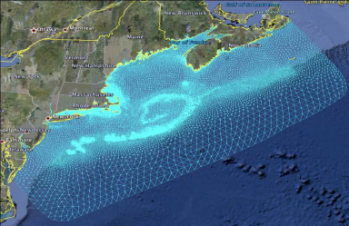
U.S. IOOS Modeling Subsystem Assets
Models are in use by most Federal and non-Federal partners
Models are designed to meet the specific needs of partners and/or their customers
Gulf of Maine / Scituate Harbor - Extratropical Domain
The U.S. IOOS Program’s role is to:
  Simplify access to data to support models
  Simplify access to data outputs for customers
  Help match customer needs to existing models
Cataloging all models employing U.S. IOOS core variables and maintaining an accurate database is a major effort not undertaken as part of this assessment
U.S. IOOS Assessment

Slide 26


U.S. IOOS DMAC Subsystem Capabilities
Data Assembly Centers (20)
NDBC (IOOS RAs (GTS), OceanSITES, TAO)
CO-OPS
CoastWatch
Regional DACs (11)
Univ. of Hawaii Sea Level Center (Global Tide Gauge Network)
PMEL (Global Tropical Moored Buoy Array)
NRL / USGODAE (ARGO)
NPS federal data center at the South Florida Natural Resources Center
EPA – STORET/Water Quality Exchange Data Warehouse
DOE Carbon Dioxide Information Analysis Center (CDIAC)
Data Archive Centers (6)
NODC
NCDC
NGDC
NASA Distributed Active Archive Centers (DAACs) – Goddard DAAC and Physical Oceanography DAAC at JPL
DOE Carbon Dioxide Information Analysis Center (CDIAC)
33 U.S. IOOS DMAC subsystem capabilities
DRAFT
DMAC Data Access Services (5)
DMAC Utility Services (2)
(Federal and non-Federal)
RCV (registry, catalog, viewer) – V1 produced; V2 under development
  Service registry
  Data catalog service
Data Access Service | Accomplished | Ongoing Work
SOS | Prototype Solution in use NDBC, COOPS, some RAs; USACE water-level project | Expanded development
CF-NetCDF - OPENDAP | RA model outputs (structured grids) available | Expand to unstructured grids and in situ
KML (through SOS) | Available NDBC, CO-OPS | Expand to RAs
CSV (through SOS) | Available NDBC, CO-OPS, some RAs | Expand to remaining RAs
Biological Variables | Developed an information framework to integrate U.S. IOOS core biological observations (fish species, and fish abundance).; now implemented at PacIOOS | Expand to remaining RAs
U.S. IOOS Assessment
Notes:
Central to the success of U.S. IOOS is the presence of a Data Management and Communication (DMAC) system capable of delivering real-time, delayed-mode, and historical data for in-situ and remotely sensed physical, chemical, and biological observations.

Slide 27
Core Functional Activities
Core functional activities (CFAs) describe U.S. IOOS Program management products and services
CFAs are derived from requirements in:
    ICOOS Act of 2009
    IOOS Development Plan
    IWGOO Strategic Plan
CFAs are described in
the U.S. IOOS Blueprint
U.S. IOOS Assessment
Notes:
List of U.S. IOOS Subsystems and Core Functional Activities (CFAs):
A.1 - Governance & Management Subsystem
A.1.1 - User Councils
A.1.2 - Financial Management
A.1.3 - Policy
A.1.4 - Plans and Ops
A.1.5 - Human Resources
A.1.6 - Acquisition and Grants
A.1.7 - Marketing, Outreach and Engagement
A.1.8 - IT Support
B.1 - Observing Systems Subsystem
B.1.1 - Observing Subsystem Management
B.1.2 - Surveys
B.1.3 - Optimization Studies
B.1.4 - Asset Management
B.2 - DMAC Subsystems
B.2.1 - Register Data Providers
B.2.2 - Manage Data Providers
B.2.3 - Deregister Data Providers
B.2.4 - Standards Management
B.2.5 - Utility Services Management
B.2.6 - Utility Services Development
B.2.7 - Data Services and Component Development
B.2.8 - Data Services and Component Management
B.2.9 - Configuration Control
B.3 - Modeling & Analysis Subsystem
B.3.1 - Customer Needs
B.3.2 - Sponsored Models
B.3.3 - MOU Management
B.3.4 - Publish Standards
C.1 - Research & Development Subsystem
C.1.1 - Requirements Determination
C.1.2 - Coordinate R&D Programs
C.1.3 - R&D Pilot Projects
C.1.4 - Technical Assessments
C.1.5 - Technology Enhancements
C.1.6 - Technology Transition
D.1 - Training & Education Subsystem
D.1.1 - Train and Education Strategy and Plans Development
D.1.2 - Training and Curriculum Development
D.1.3 - Training and Education Pilot Projects
D.1.4 - Assessments
D.1.5 - Collaboration with Education Delivery Managers
D.1.6 - Professional Certifications

Slide 28
Core Functional Activity Findings: Federal Partners
U.S. IOOS capability can be improved with Federal partner cooperation
 | U.S. IOOS Program Office Functional Capabilities (Current) | Federal Partners with Gap-Filling Capabilities in These Core Functions | Composite Across All Federal Partners (Possible)
A.1 Governance and Management (8 core functions)
B.1 Observing Systems Subsystem (4 core functions) |  | USACE, Navy/ONR
B.2 DMAC Subsystem (9 core functions) |  | USACE, USGS, NOAA
B.3 Modeling & Analysis Subsystem (4 core functions) |  | USACE, USGS
C.1 Research & Development (6 core functions) |  | USACE, USGS, NOAA, Navy/ONR, BOEM
D.1 Training and Education (6 core functions)
Internal U.S. IOOS use only
No capability Some capability/less than half Some capability/ more than half Some capability in all Full capability in all
U.S. IOOS Assessment
Notes:
As mentioned previously, the U.S. IOOS Office Assessment formed the basis for Federal partner gap-filling opportunities.
Bottom Line: Possible opportunities to pursue growth in U.S. IOOS capability through partner contributions in Observing (B.1), DMAC (B.2), Modeling & Analysis (B.3), and R&D (C.1) subsystems.
Specific recommendations for Federal partners:
Plan for preliminary discussions with identified subset of U.S. IOOS Federal partners:
Observing Subsystem: Pursue partnership agreement opportunities with USACE and Navy/ONR in core functions within the Observing Systems subsystem (B.1): optimization studies (B.1.3) and asset management (B.1.4).
DMAC Subsystem: Pursue partnership agreement opportunities with USACE, USGS, and NOAA in core functions within the DMAC subsystem (B.2): deregister data providers (B.2.3), utility services development (B.2.6), and configuration control (B.2.9).
Modeling & Analysis Subsystem: Pursue partnership agreement opportunities with USACE and USGS in assessment and management of sponsored models (B.3.2). [“Sponsored Model” is defined as - a model or other analytical tool that takes raw or refined ocean observation data and provides value-added output that is of such significance to the U.S. IOOS community that the output is certified by and served through U.S. IOOS]
R&D Subsystem: Pursue partnership agreement opportunities with USACE, USGS, NOAA, Navy/ONR, and BOEM in core functions within the R&D subsystem (C.1): requirements determination (C.1.1), coordinate R&D programs (C.1.2), R&D pilot projects (C.1.3), technical assessments (C.1.4), technology enhancements (C.1.5), technology transition (C.1.6).
Also, during the course of the assessment, the National Park Service expressed a strong interest in U.S. IOOS and asked to participate in the Assessment. Based on NPS’s potential contributions to U.S. IOOS, consider adding NPS as a formal member organization of the IOOC.

Slide 29
Potential Gap-Filling Opportunities of Federal Partners
Green shading indicates routine capability in this CFA by the Federal partner.
Bright yellow shading (CFA D.1.4 – Training and Education Assessments) highlights a gap for which no capability to fill currently exists within the Federal partner community. (* Two non-Federal partners routinely perform this CFA.)
U.S. IOOS Assessment
Notes:
This table depicts the specific core functional activity gaps in the U.S. IOOS Program Office and possible Federal partner contribution opportunities based on Assessment responses received.
[Note: Training and Education Assessments refers to assessing the results of U.S. IOOS training and education programs.]

Slide 30
Core Functional Activity Findings: Non-Federal Partners
Non-Federal partners were evaluated for U.S. IOOS capability on a Regional scale
Non-Federal partners are active in all 6 U.S. IOOS subsystems
U.S. IOOS Assessment
Notes:
Because our Regional partners execute core functional activities on a regional scale, the U.S. IOOS Assessment evaluated their abilities in this area (highlighted blue area on the chart).

Slide 31
Core Functional Activity Findings: Non-Federal Partners
U.S. IOOS Subsystem | Minimum Regional Capability | Maximum Regional Capability
A.1 Governance and Management
B.1 Observing Systems Subsystem
B.2 DMAC Subsystem
B.3 Modeling and Analysis Subsystem
C.1 Research and Development
D.1 Training and Education
No Region has full capability in each subsystem
There is variation in the level of capability among the Regions
Regions collectively display solid foundation of U.S. IOOS capability
ACT displays capability in 4 R&D CFAs
Internal U.S. IOOS use only
No capability Some capability/less than half Some capability/ more than half Some capability in all Full capability in all
U.S. IOOS Assessment
Notes:
Findings:
Regions are generally active in all subsystems
Overall trend: Regions have capability in some of the sub-activities in each subsystem
Improvements in selected national IOOS capabilities will likely improve regional capabilities and vice versa (e.g., DMAC)
No Region has “full capability” in any subsystem
Regional Build-out Plans will help address gaps.
ACT responses indicate R&D strengths in U.S. IOOS required core functions:
Requirements Determination (C.1.1)
R&D Pilot Projects (C.1.3)
Technical Assessments (C.1.4)
Technology Transition (C.1.6)
Conclusions:
Non-Federal partners are active in all U.S. IOOS CFAs except for Professional Certifications (D.1.6).
Non-Federal partners are strongest in the Governance & Management subsystem (A.1).
Non-Federal partners, except for ACT, are weakest in the R&D subsystem (C.1).
Some non-Federal partners are significantly more capable in terms of U.S. IOOS functions than are others.
ACT has R&D capabilities that match gaps in U.S. IOOS Program Office capabilities.
Non-Federal partners have significant capability in terms of Marketing, Outreach, and Engagement (A.1.7); Plans and Ops (A.1.4); and Customer Needs (B.3.1).
Recommendations:
Pursue leveraging non-Federal partner Marketing, Outreach, and Engagement core functional activity (A.1.7) as a delivery mechanism to U.S. IOOS customers.
Pursue leveraging non-Federal partner Customer Needs (B.3.1) core functional activity to gather and maintain U.S. IOOS system requirements.
Consider integrating Customer Needs activities/results into Non-Federal partner planning activities (Plans and Ops A.1.4).

Slide 32
Next Steps: Implementation Planning Implications
Coordinate partner agreements and feasibility of gap filling
Support Summit planning, incorporating latest U.S. IOOS information
  Use results of U.S. IOOS Assessment
  Regional Build-out Plans
  DMAC Plan (5-year plan for coordinated execution)
  Independent Cost Estimate
2012 IOOS Summit
Summit results and agreements inform U.S. IOOS implementation planning
U.S. IOOS Assessment

Slide 33
FY2011 Regional Milestones
IOOS Program Office worked with Regions to develop quarterly milestones.
These milestones were used to demonstrate performance and accomplishments of Regional IOOS to NOAA leadership.
Several milestone examples are:
  Launch first Coastal Data Information Program (CDIP) wave buoy in Cook Inlet in cooperation with the U.S. Army Corps of Engineers & National Weather Service to provide real-time data into Cook Inlet wave and ocean circulation models and forecasts.
  Deliver operational real-time wind, wave and current observations in US Virgin Islands waters in support of inter-island ferry and cruise ship operations
FY2012 milestones are being developed.
Notes:
Talking Points:
FY2011 was the first year we worked with the Regions to develop milestones which then synched to NOAA’s reporting schedule.
In FY2011, Regions met 66% (37 of 56) of their milestones.
Many “unmet” milestones were delayed due to a number of different factors, and Regions continue to work to meet them in FY2012
NOTE: Regions largely reported milestones by quarter they expected work to be done, without adding any buffer to account for unforeseen or uncontrollable events. We are working with the Regions to include this buffer in FY2012.
We are working with them to build better and more compelling milestones for FY2012.

Slide 34
Non-Federal Asset Inventory
A collated list of the observing assets that operate in the IOOS Regional Associations and by the Alliance for Coastal Technologies.
Supports Requirements in the ICOOS Legislation:
  Independent Cost Estimate
  Biannual Report to Congress
  Process to id gaps in observation coverage
Supports IOOS Operations:
  Through use in identifying gaps in observation coverage needs for capital improvements of federal assets and non-federal assets of the system.
Notes:
Talking Points:
We completed this in FY2011.
As Carl told you, we have 1500 platforms.
I’ll show you more on this later.

Slide 35
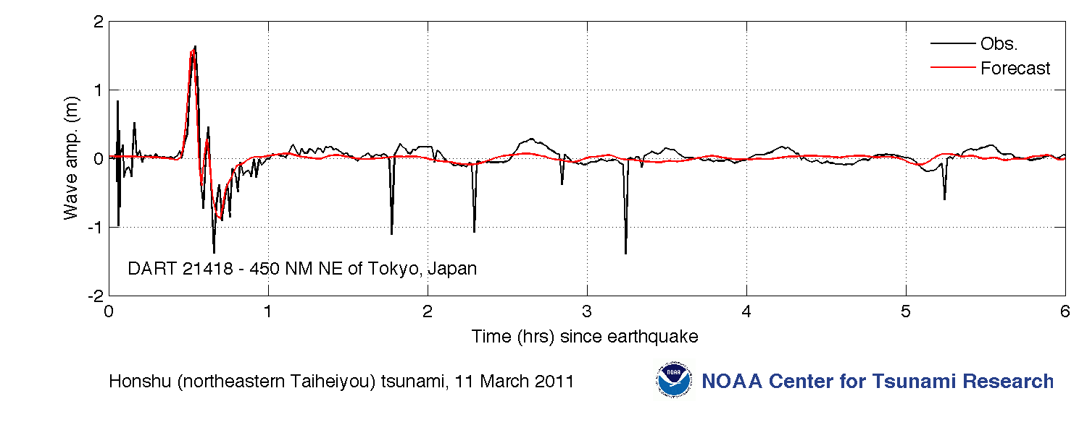
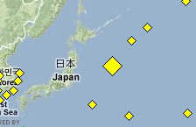
Responding to Crisis: Japan Tsunami Warning
Graphic courtesy NOAA / PMEL / Center for Tsunami Research
International buoy program
Tsunami wave at DART Station 21418 located 470n mi northeast of Tokyo.
Largest peak 1.8M
Notes:
Talking Points:
An example of how the US IOOS system works both globally and regionally. The DART program, in NOAA that supports the global Tsunami warning system, detected and provided the official warnings on the Tsunami

Slide 36
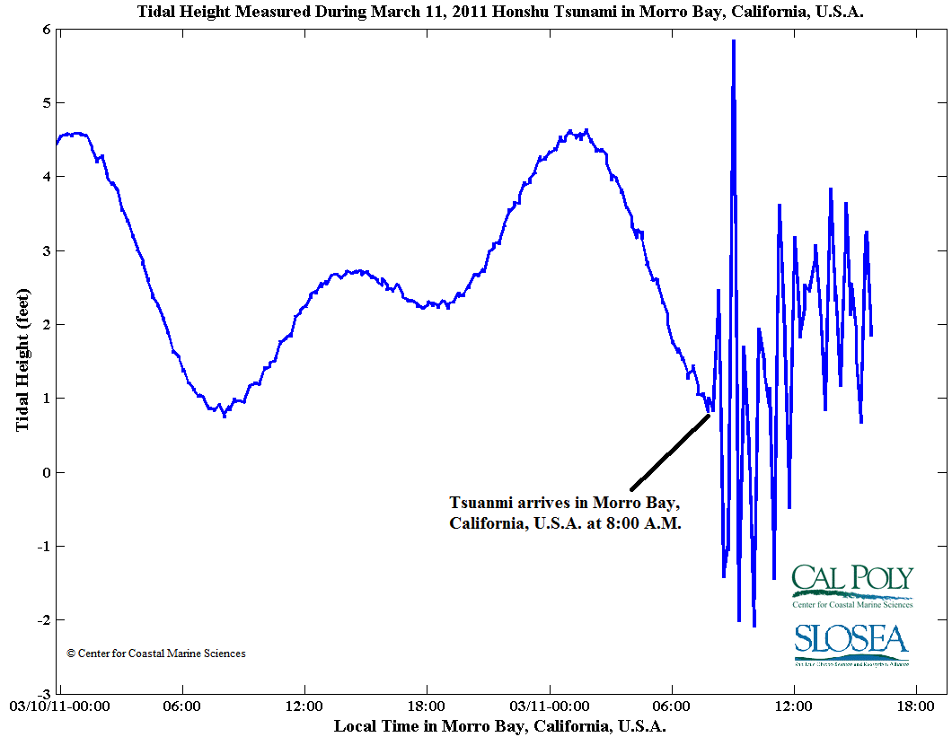
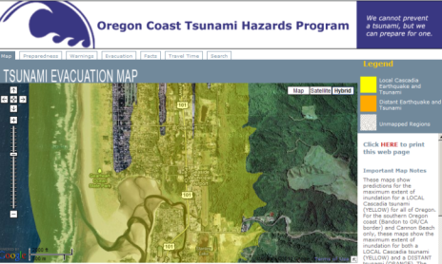
Responding to Crisis: Japan Tsunami Response
CeNCOOS:
  Recorded the tsunami passage with U.S. IOOS sensors
  Five-fold increase in web traffic
NANOOS:
  Featured “Tsunami Evacuation Zones for the Oregon Coast” application
  NANOOS Visualization System provided easy access to current and water height data
  Four-fold increase in web traffic
  PacIOOS:
  Provided the only real-time water level and turbidity measurements for Waikiki
  Ten-fold increase in web traffic
Notes:
Talking Points:
The West Coast Regions of US IOOS were ready to provide support to their constituents that they have been working with over the past 10 years.
A number of sensors now exist that are resourced through US IOOS. These were able to record the tsunami passing and each of the websites saw increases in their web hits as local folks sought information.

Slide 37
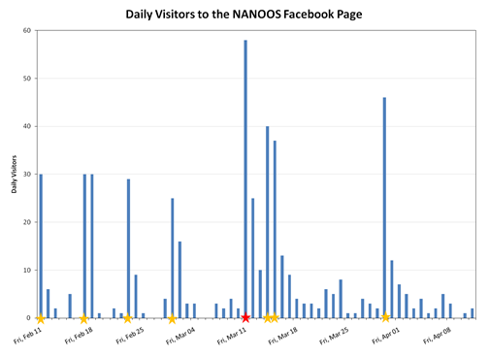
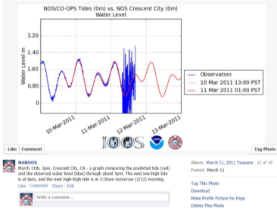

Using Social Media to reach out in new ways
Types of Information:
Initial info including link to tsunami portal;
graphs of water level for various locations;
synthesis information
Facebook:
= Posts
= Tsunami event
www.facebook.com/NANOOS.PNW
Notes:
Talking Points:
I also found it interesting that we must be thinking about new ways to reach our audiences.
The Pew Research Center indicates that 52% of folks are on Facebook and so we see that NANOOS and many of the other regions are using this medium to augment their traditional methods.

Slide 38
IOOS Industry Participation
MTS/IEEE 2011 Town Halls
  Emerging Ocean Observing Technology Forum
  Partnerships to Integrate Ocean Observing to Address Customer Needs
IOOC Great Lakes Workshop, June 2011
NOAA/AOOS Arctic MOU Annex
Notes:
38

Slide 39
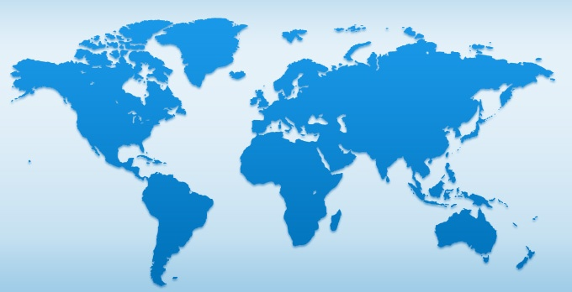
Advancement with the Global Obs Community
Ocean Obs 2009, “Framework for Ocean Observing” near final
PICO Implementation led by Paul DiGiacomo
GOOS Regional Alliance: U.S. turn to Chair
  Paul DiGiacomo providing support
Global Open Ocean continued support for JCOMM, Carbon Program

Slide 40
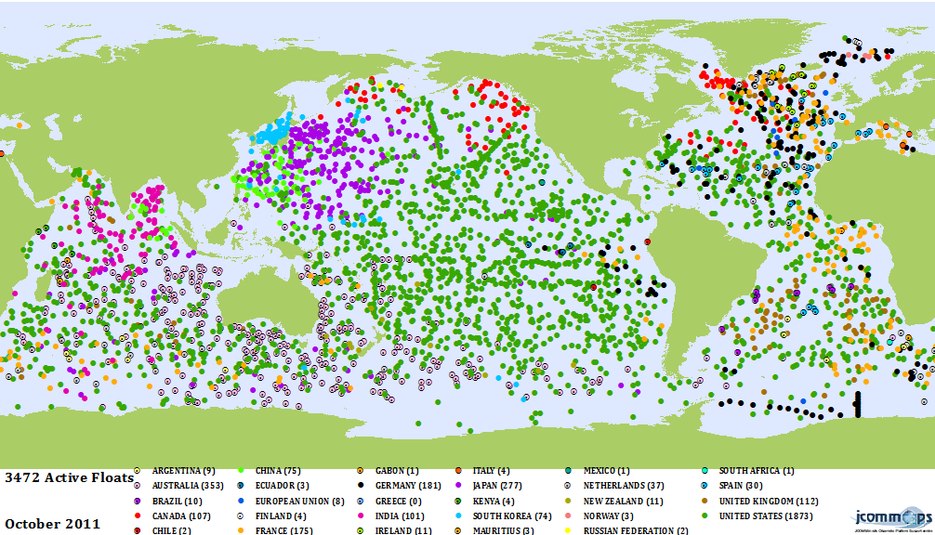
Argo
Active
U.S. Argo Floats
(As of 10/11)
“Today Argo provides over 110,000 high quality profiles of temperature and salinity annually, most to 2,000 meters, homogeneously distributed over the global ocean, without seasonal bias¹.”
¹The Argo Project: Global Observations for Understanding and Prediction of Climate Variability. Report on Progress in FY11, October 1, 2010 – September 30, 2011 (draft)
Notes:
Talking Points (from S. Piotrowicz):
The goal of 1500 active US Argo floats has been achieved. As of October 2011 there are 1789 active US Argo Program floats, plus 84 US Argo-equivalent instruments that also feed data to the US Argo DAC. Floats are presently being deployed at a rate of ~370 per year.
FY11 also showed an increase in U.S. Argo Program profiles available at the Global Data Assembly Centers (increases occurred each year since 2007).

Slide 41
Global Open Ocean Advancements
Increased investment to develop deep flow technology
  Floats will go 6,000M, enabling full depth profiling
Increased incremental support for tide gauge network
  Added GPS to better determine land position relative to sea level changes

Slide 42
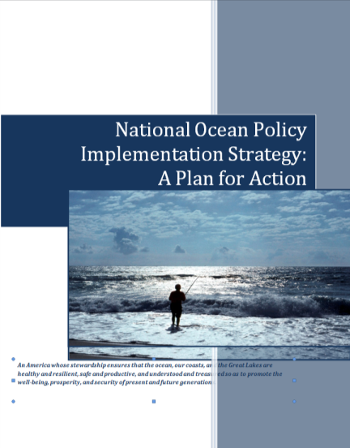
U.S. IOOS and the National Ocean Policy
U.S. IOOS worked with the interagency team to draft, vet and revise strategic actions for the national plan.
Notes:
Talking Points:
Members of the IOOC, including Bob Houtman, Eric Lindstrom, Bob Winoker, and Jessica Snowden (on behalf of the IOOS office) worked as part of the interagency writing team for the Priority Objective on Observations, Mapping, and Infrastructure.
This objective focuses on activities planned within current funding levels.
The complete National Ocean Policy is in review final stages of NOC-Deputy review, and will go out for a 45-day public comment period in early January 2012 before it is finalized.

Slide 43
Forward Look at FY2012
IOOS Program Office Over-Arching Priorities
  ICE Completion
  Regional Build Out Plans, Synthesis Document
  DMAC and Modeling Progress
IOOS and IOOC Opportunities and Challenges
  2012 Summit
  Increasing Federal-Regional partnering
Notes:
ICE Suzanne talks weekly with JPL
Regional Build Out
Program office participated in Regional Working Group that coordinated development of regional build out plans. Important to note that there was extensive involvement by regional representatives throughout the development of templates & framing of the ‘ask’ of the regions.
Jan 2011 – initiated discussion with NFRA re: regional IOOS in independent cost estimate
Feb 2011 – program office (Suzanne) briefed the NFRA Board on ICE & need for more refined description of regional build out over next 10 years
Mar – Jun – Regional WG formed & met to create a template for Regions to use to describe resources/assets needed over next 10 years
Oct 14 – Regions completed templates. Delivered to independent cost estimators
Oct 15- Nov 14 – Consultants summarized results
Nov 16-17 – summarized template submissions reviewed, compared at annual Regional meeting
Dec 2 – summary results revised by regions after having learned & shared approaches at regional meeting. Revisions delivered to ICE on 12/9.
Mid Dec – Regional WG reviews outline of national synthesis
End Feb – Regions review draft national synthesis
Mid Mar – Publish national synthesis document
End April – independent cost estimate completed

Slide 44
DMAC & Modeling in FY12
DMAC Focus
  Moving from DIF pilot project to wide-spread adoption across Regions
  Reference implementation team with Federal and Regional representation
  Continue to increase access to biological and ecological system data by expanding current project to more Regions
  Provide animal telemetry data for use in Navy and NOAA models
  Take ownership of QARTOD QA/QC process
Model Test Bed
  Solidify interagency support for test bed
  Produce test bed concept paper outlining needs for an operational test bed
Notes:
Talking Points (for DMAC only):
The DIF pilot project led to, among other things, software implementations of the OGC Sensor Observation Service at CO-OPS and NDBC which serves met/physical ocean data using an IOOS specific data model and format. The DIF concluded with a thorough and somewhat critical analysis of the strengths and weaknesses of these software implementations. In the near future we will improve these services by building on the strengths, and re-engineering the weaknesses. The reference implementation team's work will provide for:
new data models that are immediately available to a larger suite of clients than the DIF solutions
a software implementation that builds off of a common code base rather than distinct implementations at every institution, which immediately improves the configuration management of the entire system
a commitment by the members of the team to institute these changes at many of the IOOS Regional Associations which will double the number of services available to the ocean observations community
open the door to extending the data model to new and different data types not previously considered including, water quality monitoring by laboratory analyses, glider trajectory data, select biological data streams.

Slide 45
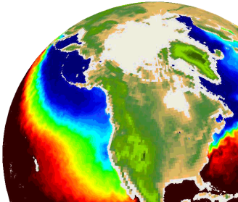

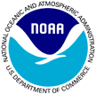
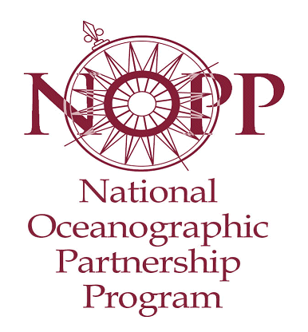
Multi-sensor Improved SST (MISST) for IOOS
www.misst.org
Sea Surface Temperature (SST) is vital to coastal and marine spatial planning, global weather prediction, climate change studies, search and rescue, and ecosystem based management.
Partnership consists of 28 scientists from industry, academia, and government
Project objectives (2012-2017)
(1) improve and continue generation of satellite SST data and SST analyses in GHRSST Data Specification GDS format
(2) distribute and archive these data
(3) use this improved SST data in applications,
many specifically targeted for IOOS

Slide 46
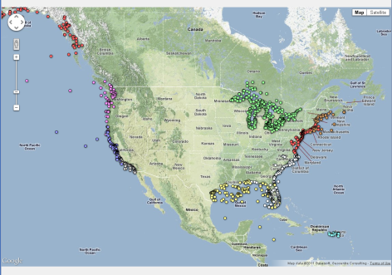
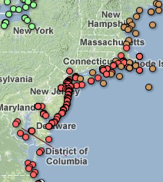
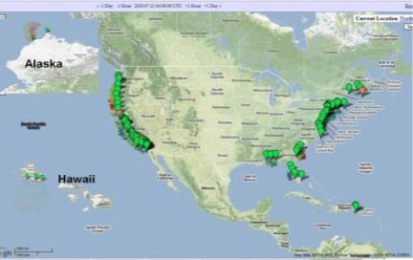
FY12 Asset Inventory Maps
Regional Assets
Expand to Global HFR
(part of FY12-15 GEO Work Plan)
128 U.S. sites

Slide 47
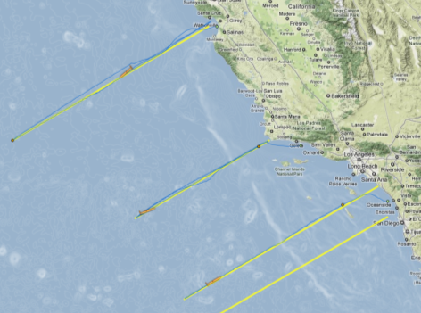
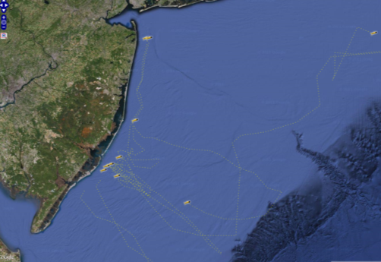
Glider Asset Mapping in FY12
MARACOOS
SCCOOS

Slide 48
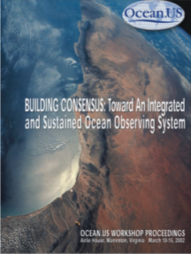
IOOS Summit Planning
The exercise in planning for this Summit crosses IOOC agencies as well as IOOS Regions
Through thoughtful planning and design of the Summit, the IOOS community will come together to identify current and jointly plan future performance of the System
IOOS
2012
Summit
10 Years
of IOOS
The Next 10 Years of IOOS
Notes:
Talking Points:
The IOOC will be hearing a full update on the planning process and goals during the IOOC meeting when you present this report.

Slide 49
IOOS and the IOOC: Growing Connections
The Gulf of Mexico Region BOEM Studies Chief recently sent a letter to the Chairman of the GCOOS Board of Directors, describing several activities that are in both GCOOS and BOEM interest.
Activities include:
  Development of improved systems for optimizing observations and deployment of acoustic telemetry of moored data to the surface.
  Cooperative support of biophysical ecosystem modeling and studies of socio-economic processes in the Gulf states.
49
Notes:
Talking Points

Slide 50
Challenge
Portraying the full US IOOS Spectrum
Still not capturing the other Federal Agency contributions
USACE briefing will layout this challenge and set up the discussion

Slide 51
Back Up

Slide 52

Modeling Testbed: Surge, Waves and Inundation Results
Development of common Testbed infrastructure
Data Archiving
Model development/ Enhancement
Additional Computer Run time
Skill Analysis
Gulf of Maine / Scituate Harbor - Extratropical Domain
Notes:
Talking points:
Overall:
We’re wrapping up the Phase 1 No Cost Extension. Expect all milestones to be met. Demonstration successful and in progress of developing sustainable operational Ocean Modeling Testbed by completion of Phase 2 Aug 31, 2012
Testbed has enabled significant community building (Modeling Community) which has improved model development and enhancement.
Able to disseminate results at multiple conferences with so many scientists/institutions involved
Inundation:
Development of common Testbed infrastructure: 2 hurricanes in Gulf of Mexico and 2 extratropical storms in the Gulf of Maine
Data Archiving: Populating SURA Testbed server as key repository for data archiving and exchange
HPC Time: Acquisition of HPC time on LONI(LSU) and Teragrid (UT) by SURA IT staff critical for project success
Model development/Enhancement
Skill Analysis: Customization of the USACE Interactive Model Evaluation and Diagnostics System (IMEDS) for systematic and consistent skill assessment use by the team
Background/More info:
Gulf of Maine results:
Completed comparison between ADCIRC, SELFE, FVCOM for tides in Scituate for 3 time periods – minimal differences
Demonstration of significance of wave current interaction in surge development in Scituate
Harbor using FVCOM + SWAVE
Demonstration of sensitivity of wave model output to model discretization parameters
(# frequencies, # directions, etc).
Gulf of Mexico results:
Completed comparison between ADCIRC, SELFE, FVCOM for tides in Gulf of Mexico. Similar skill scores vs observations at 59 NOAA gauges
Completed comparison between ADCIRC, SELFE, FVCOM, SLOSH for hurricane Ike.
Hydrographs computed at 700+ gauge locations in LA & TX. ADCIRC & SELFE similar results, compare well with data, FVCOM lower, SLOSH ~25% below ADCIRC, doesn’t capture geostrophic Setup.
Comparison between ADCIRC on Testbed grid and 20x grid indicate difference primarily in over land or upper estuary areas

Slide 53
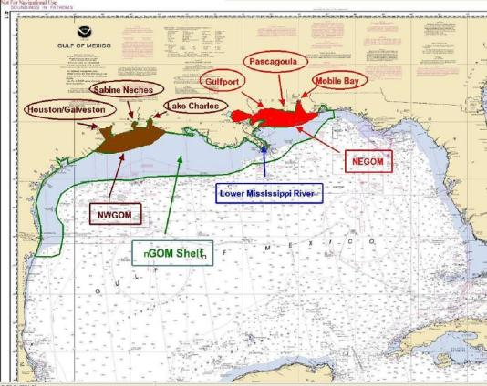
Modeling Testbed: Shelf Hypoxia Results
Improving Collaboration
Improving Data
Model Development
Supporting Operations
NOAA CSDL planned coastal physical model implementations (nGOM shelf domain above currently planned for 2nd Qtr FY 12 initial NGOFS coastal ocean forecast operational capability)
Notes:
Talking points:
Improving Collaboration: Academic hypoxia researchers and NOAA CSDL operational Gulf of Mexico hypoxia model developers working together
Improving Data: Multi-year hypoxia data set available to SURA CI team and to NODC for future availability via NOAA Hypoxia Watch Data Portal.
Model Development: Linking Sediment Transport and Biogeochemical Models within ROMS.
Supporting Operations:
Transition of U.S. Navy operational Gulf of Mexico regional ocean nowcast/forecast capability.
Provided insight relevant to NOAA CSDL operational Gulf of Mexico coastal nowcast/forecast system developers.

Slide 54
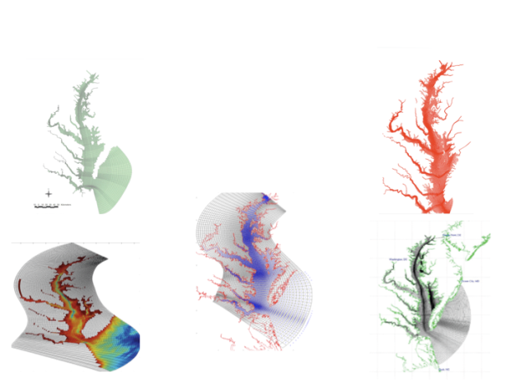
Modeling Testbed: Estuarine Hypoxia Results
Transitioning information to federal agencies
Model Comparison
Conducting sensitivity experiments
New, single term hypoxia model
Five Hydrodynamic Models Configured for the Chesapeake Bay
CH3D
Cerco & Wang
USACE
EFDC
Shen
VIMS
UMCES-ROMS
Li & Li
UMCES
ChesROMS
Long & Hood
UMCES
CBOFS (ROMS)
Lanerolle & Xu
NOAA
Notes:
Talking points:
Transitioning information to federal agencies: NOAA-CSDL has already incorporated Testbed model in the research version Chesapeake Bay Operational Forecast System
Model Comparison: 5 different hydrodynamic models with 5 different dissolved oxygen models (examined 12 different combinations of hydrodynamics+DO for 2004, subset of these for 2005)
Conducting sensitivity experiments
New, single term hypoxia model shows significant improvement in predicting dissolved oxygen

Slide 55
Modeling Testbed: Cyber Infrastructure Team
Interactive Web Site: browse model results, view model grid data, side by side comparisons, and MUCH MORE
Unstructured Grid Support: Time series extraction completed for FVCOM, SELFE, ELCIRC, ADCIRC.
Matlab Toolbox: standardized data transformations, new methods for comparing data (including unit conversion). Coordination with OOI-CI
Matlab as a Web Service: Matlab processes - no desktop license required.
Skill Assessment Tools: Measure the degree of correlation between model prediction and observations
Collaborative Web Site: public/private access to portal, content organization with internal/external tools.
Notes:
Talking points:
Unstructured Grid Support and assessment tools are major victories
Websites being combined for better one stop shopping

Slide 56
List of Assessment Acronyms
ACT – Alliance for Coastal Technologies
AOOS – Alaska Ocean Observing System
BOEM – Bureau of Ocean Energy Management
CaRA – Caribbean Regional Association for Coastal Ocean Observing
CDIAC – Carbon Dioxide Information Analysis Center
CeNCOOS – Central and Northern California Ocean Observing System
CFA – core functional activity
CHL – Coastal and Hydraulics Laboratory
CO-OPS – Center for Operational Oceanographic Products and Services
DAAC – distributed active archive center
DAC – data assembly center
DMAC – Data Management and Communication
DOE – United States Department of Energy
DOS – United States Department of State
DOT – United States Department of Transportation
EPA – Environmental Protection Agency
ERDC – Engineer Research and Development Center
FDA – Food and Drug Administration
GCOOS – Gulf of Mexico Coastal Ocean Observing System
GLOS – Great Lakes Observing System
GODAE – Global Ocean Data Assimilation Experiment
ICOOS Act – Integrated Coastal Ocean Observation System Act
IOOC – Interagency Ocean Observation Committee
IOOS® – Integrated Ocean Observing System
IWGOO – Interagency Working Group on Ocean Observations
JCS – Joint Chiefs of Staff
JPL – Jet Propulsion Laboratory
MARACOOS – Mid-Atlantic Regional Association Coastal Ocean Observing System
MMC – Marine Mammal Commission
NANOOS – Northwest Association of Networked Ocean Observing Systems
NASA – National Aeronautics and Space Administration
NCDC – National Climatic Data Center
NDBC – National Data Buoy Center
NERACOOS – Northeastern Regional Association of Coastal Ocean Observing Systems
NGDC – National Geophysical Data Center
NIFA – National Institute of Food and Agriculture
NOAA – National Oceanic & Atmospheric Administration
NODC – National Oceanographic Data Center
NOSA – NOAA Observing Systems Architecture
NPS – National Park Service
NRL – Naval Research Laboratory
NSF – National Science Foundation
ONR – Office of Naval Research
OOI – Ocean Observatories Initiative
PacIOOS – Pacific Islands Ocean Observing System
PMEL – Pacific Marine Environmental Laboratory
SCCOOS – Southern California Coastal Ocean Observing System
SECOORA – Southeast Coastal Ocean Observing Regional Association
STORET – STOrage and RETrieval
TAO – Tropical Atmosphere Ocean
USACE – United States Army Corps of Engineers
USARC – United States Arctic Research Commission
USCG – United States Coast Guard
USDA – United States Department of Agriculture
USGS – United States Geological Survey
U.S. IOOS Assessment

Slide 57
Final Status of Assessment Responses
Blue Indicates Completed
Gray Indicates Canceled
A blue block indicates feedback provided on all CFAs and all applicable asset categories
Approximately half the respondents provided additional detail down to the subactivity level
U.S. IOOS Assessment
Notes:
This graphic depicts responses from assessment participants.

Slide 58














U.S. IOOS Partner Training & Education Assets
21 reported partner ocean observing Training & Education facilities & programs
Grade School (K-12)
College / University
Federal
Non-Federal
U.S. IOOS Assessment
Notes:
Selected Federal and non-Federal Partner Training & Education Assets:
NOAA National Estuarine Research Reserves
NOAA National Estuarine Research Reserves, Office of National Marine Sanctuaries, National Oceanographic Data Center, Corals, Office of Education
NOAA Office of National Marine Sanctuaries
NOAA Sea Grant
NOAA National Ocean Service Education and Communications
AOOS Univ of AK School of Fisheries & Ocean Sciences COSEE Alaska
AOOS UA Anchorage - engineering AOOS UA Southeast AOOS Sitka Sound Science Center
AOOS Kachemak Bay Research Reserve
AOOS Barrow Arctic Science Consortium
AOOS Prince William Sound Science Center
GCOOS GCOOS interactive kiosk
GCOOS Recreational Boaters and Fishermen in the GCOOS Footprint
GCOOS GCOOS-RA Global Positioning System Workshops for Educators
GCOOS Gulf Coast Informal Science Educators Collaborative Workshop
SCCOOS Ocean Institute
SCCOOS Birch Aquarium
SCCOOS COSEE West/USC Sea Grant
SECOORA Waccamaw Watershed Academy
SECOORA Florida International University School of Environment, Arts and Society

Slide 59
U.S. IOOS Next Steps: Implementation Planning Implications
U.S. IOOS Subsystem | Initial Capability | Full Capability
A.1 Governance and Management | As defined in the U.S. IOOS Blueprint | As defined in the U.S. IOOS Blueprint
B.1 Observing Systems Subsystem | Status quo as of the IOOS Assessment | Defined by Federal Plans and Regional Build-out Plans
B.2 DMAC Subsystem | As defined in the U.S. IOOS Blueprint | As defined in the U.S. IOOS Blueprint
B.3 Modeling & Analysis Subsystem | Status quo as of the U.S. IOOS Assessment | Status quo as of the U.S. IOOS Assessment
C.1 Research & Development | Status quo as of the IOOS Assessment | Defined by Federal Plans and Regional Build-out Plans
D.1 Training and Education | Status quo as of the IOOS Assessment | Defined by Federal Plans and Regional Build-out Plans
U.S. IOOS Assessment

