Slide 1
BUREAU OF TRANSPORTATION STATISTICS
Advisory Council on Transportation Statistics
BTS Program Resources
June 4, 2010

Slide 2
Bureau of Transportation Statistics Budget
Budget Enacted, by fiscal year
  2008 – $27M
  2009 – $27M
  2010 – $28M ($27M available under contract authority)
  2011 – $30M (President’s request, $27M under contract authority)
- The FY 2011 increase request reflects $2M for Commodity Flow Survey and $1M for general BTS programs
- Although the requested obligation limitation increase is $2 million, there is insufficient contract authority to provide for this enhancement. The BTS account is limited to the $27 million SAFETEA-LU Extension Act.

Slide 3
Highway Trust Fund Allocation
Bureau of Transportation Statistics
Appropriations Summary by Program Activity
Appropriations, Obligation Limitations, and Exempt Obligations ($000)
 | FY2009 Actual | FY2010 Enacted | FY2011 Request | FY10-11 Change
Travel Statistics | 2,947 | 3,056 | 3,056 | 0
Freight Statistics | 10,723 | 11,120 | 13,120 | 2,000
Transportation Economics | 1,811 | 1,878 | 1,878 | 0
Geospatial Information | 1,758 | 1,823 | 1,823 | 0
Compilations, Methods, and Standards | 7,416 | 7,691 | 7,691 | 0
National Transportation Library | 2,345 | 2,432 | 2,432 | 0
TOTAL: [Discretionary] | [27,000] | [28,000] | [30,000] | [2,000]
Direct Funded | 68 | 70 | 70 | 0
Reimbursable FTE | 16 | 19 | 19 | 0

Slide 4
Airline Statistics
Actual and Requested Program Budget ($000)
FY2010 Actual – 4,000
FY2011 Requested – 4,000
FY10-FY11 Change – 0
Airline Statistics is a BTS Reimbursable Program

Slide 5
Travel Statistics
Program Budget ($000)
FY2009 Actual – 2,947
FY2010 Enacted – 3,056
FY2011 Requested – 3,056
FY10-FY11 Change – 0
The Travel Statistics Program provides information regarding business and personal travel as well as passenger travel facilities. Travel data is prepared and disseminated for Federal, State, and local governments to effectively establish transportation policy, planning, and program management.

Slide 6
Freight Statistics
Program Budget ($000)
FY2009 Actual – 10,723
FY2010 Enacted – 11,120
FY2011 Requested – 13,120
FY10-FY11 Change – 2,000
The Freight Data Program develops and compiles data and information on the movement of freight within, through, into, and from United States by all modes of transportation. It is a critical program that focuses on collecting, compiling, analyzing, and publishing a comprehensive set of transportation statistics on the performance and impacts of national and international freight flows on the Nation’s transportation system.

Slide 7
Transportation Economics
Program Budget ($000)
FY2009 Actual – 1,811
FY2010 Enacted – 1,878
FY2011 Requested – 1,878
FY10-FY11 Change – 0
The Transportation Economics Program develops basic economic and financial data to support transportation decision making, including the development of economic indicators that explain the relationship between transportation and the economy. Program products provide transportation policy officials with information and data on how decisions influence the larger economy to optimize transportation investments, improve transportation system productivity, and increase the value of transportation to users.

Slide 8
Geospatial Information
Program Budget ($000)
FY2009 Actual – 1,758
FY2010 Enacted – 1,823
FY2011 Requested – 1,823
FY10-FY11 Change – 0
The Geospatial Information Program provides a comprehensive set of geospatial information as the basis for planning, policy, investment, asset management, and improved transportation decision making. Transportation planners and others can use geospatial information to prioritize highway maintenance projects, study noise footprints around airports, and plan for system disruptions due to natural disasters or national security threats.

Slide 9
Compilations, Methods, and Standards
Program Budget ($000)
FY2009 Actual –7,416
FY2010 Enacted – 7,691
FY2011 Requested – 7,691
FY10-FY11 Change – 0
The Compilations, Methods, and Standards Program compiles and publishes multi-modal and intermodal transportation data and analysis covering critical and timely transportation topics with the ultimate goal of providing quality data and information for all modes of transportation for decision making. The program assembles data and provides technical support regarding performance measure scope, sources, statistical issues, completeness, and reliability for the DOT operating administrations.

Slide 10
National Transportation Library
Program Budget ($000)
FY2009 Actual – 2,345
FY2010 Enacted – 2,432
FY2011 Requested – 2,432
FY10-FY11 Change – 0
The National Transportation Library maintains and facilitates access to statistical and other information needed for transportation decision making at the Federal, State, and local levels. These goals are achieved through coordination with public and private transportation libraries and information providers to improve information sharing among the transportation community.

Slide 11
BUREAU OF TRANSPORTATION STATISTICS
Advisory Council on Transportation Statistics
BTS Stakeholder Key Ideas Regarding Data to Enhance Decision Making
June 4, 2010

Slide 12
Stakeholder Ideas for Enhanced Decision Making
Continued…
Ten Priority Data Ideas
Enhanced Airline Statistics and Analysis
Vehicle Inventory and Use Survey (VIUS)
Commodity Flow Survey (CFS) Enhancements
International Freight Data System (IFDS)
Expanded Safety Data

Slide 13
Stakeholder Ideas for Enhanced Decision Making
Ten Priority Data Ideas (continued)
Local Freight Data (e.g., metro truck movement)
Improved Data Quality and Performance Measures
Economic Competitiveness and Livability
Transit Data
Intelligent Transportation Systems Data Analysis

Slide 14
Stakeholder Outreach, Customer Feedback, and Knowledge Sharing
Thomas Bolle & Amanda J. Wilson
Advisory Council on Transportation Statistics
4 June 2010

Slide 15
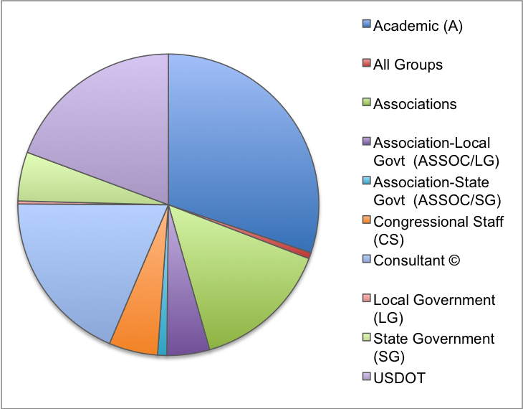
BTS Listening Sessions Stakeholders
Group | Number of Groups | Percentage of Total User Groups
Academic | 92 | 30%
All Groups | 2 | 1%
Associations | 45 | 15%
Association-Local Government | 14 | 5%
Association-State Government | 3 | 1%
Congressional Staff | 16 | 5%
Consultant | 57 | 19%
Local Government | 1 | 0%
State Government | 16 | 5%
USDOT | 59 | 19%
Total | 305 | 100%

Slide 16
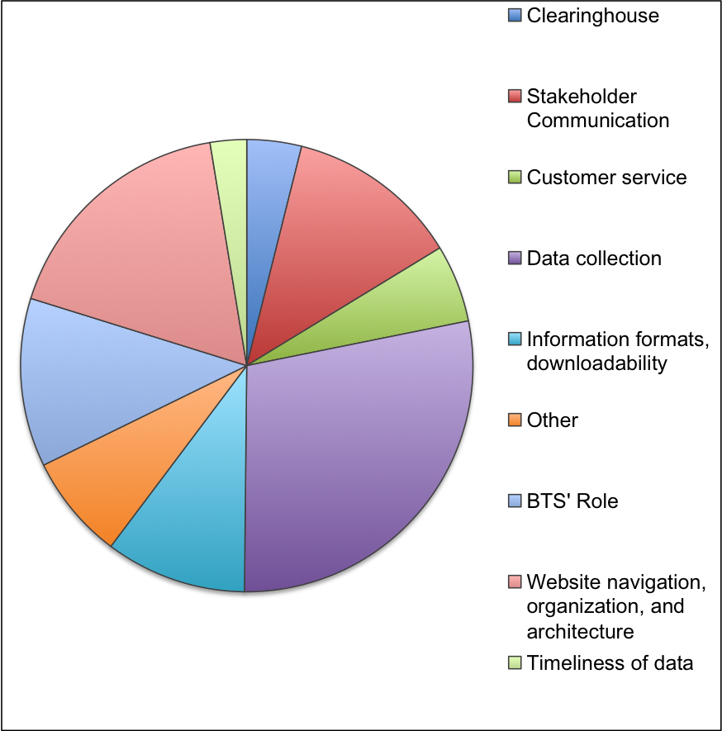
Themes from BTS Listening Sessions
Category | Number of Comments | Percentage of Total Comments
Clearinghouse | 12 | 4%
Stakeholder Communication | 38 | 12%
Customer service | 17 | 6%
Data collection | 87 | 28%
Information formats, downloadability | 31 | 10%
Other | 23 | 7%
BTS’ Role | 37 | 12%
Website navigation, organization, and architecture | 54 | 18%
Timeliness of data | 8 | 3%
Total Comments | 307 | 100%

Slide 17
ACSI Web Survey Results – Reason For Using BTS Website
 | 1 | 2 | 3 | 4 | 5 | 6
 | Data and statistics | Publications and reports | News and updates | General information about RITA / BTS | Links to other websites | Other primary reasons (please specify) | Overall
Responses: | 341 | 101 | 37 | 30 | 17 | 7 | 533
 | 91% | 27% | 10% | 8% | 5% | 2%
Content | 77 | 77 | 79 | 80 | 81 | 82 | 77
Functionality | 74 | 75 | 76 | 75 | 77 | 64 | 73
Look and Feel | 67 | 69 | 71 | 71 | 71 | 58 | 67
Navigation | 62 | 64 | 68 | 72 | 66 | 47 | 62
Online Transparency | 72 | 74 | 77 | 77 | 69 | 73 | 72
Search | 64 | 67 | 75 | 78 | 73 | 54 | 65
Site Performance | 82 | 82 | 81 | 83 | 84 | 81 | 82
Satisfaction | 67 | 72 | 78 | 75 | 76 | 54 | 67
Likelihood to Return | 82 | 84 | 86 | 86 | 90 | 59 | 81
Primary Resource | 79 | 79 | 83 | 84 | 85 | 62 | 78
Recommend | 76 | 81 | 86 | 86 | 89 | 54 | 76

Slide 18
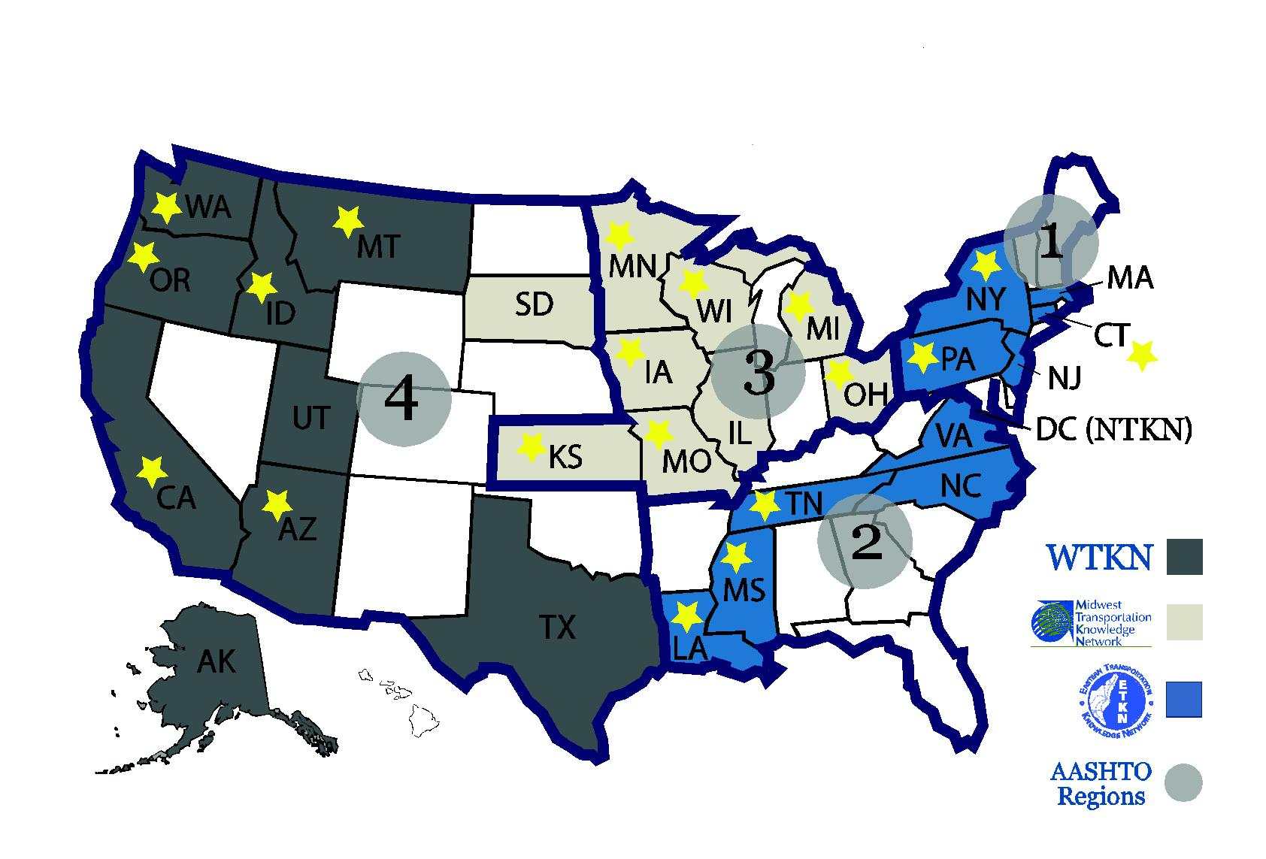
Transportation Knowledge Networks

Slide 19
Future Vision: Information Sharing Infrastructure
Central Portal
Broad Participation
Diverse Resources
Common Standards
Notes:
Example: Agency X is a member of one of the regional TKNs. Their agency provides a link to the national portal on the intranet site. A policy office employee goes to “transportation topics” to find information about the new stimulus package. They find links to FHWA and FTA web pages with official information, as well as several powerpoints and fact sheets prepared by peer agencies – also TKN members. In 5 minutes, they have the information they need.

Slide 20
Contact Information
Thomas Bolle
thomas.bolle@dot.gov
(202) 366-0665
Amanda J. Wilson
amanda.wilson@dot.gov
(202) 366-2480

Slide 21
Bureau of Transportation Statistics
2007 Commodity Flow Survey
Ron Duych
June 4, 2010
Advisory Council on Transportation Statistics

Slide 22
CFS Objective and Background
Section 111 of ISTEA, requires BTS to collect statistics on goods movement
The Commodity Flow Survey is the only comprehensive source of information on National Freight Flow. Provides information on commodities shipped, value, weight, ton-miles, origin/destinations by all modes of transportation, either single mode or multi-mode.
National source of data for the highway mode that carries about 75 percent of the value and 70 percent of the tonnage of freight transported.
Fourth in series - previously conducted in 1993, 1997 & 2002
Conducted through a major partnership between:
    Bureau of Transportation Statistics (BTS),
    Research and Innovative Technology Administration, U.S. Department of Transportation
    U.S. Census Bureau,
    U.S. Department of Commerce

Slide 23
Major Uses and Key Applications of the CFS
Foundation of Federal Highway Administration’s Freight Analysis Framework.
Fundamental input for freight flow datasets developed and marketed by private vendors.
Provides input and calibration for freight flow models.
Used by federal, state and local/regional analysts for policy, management and investment decisions.
Analyze and map spatial patterns of commodity and vehicle flows.
Provides denominator data for conducting safety risk analyses and security assessments of hazardous material flows.

Slide 24
Key Highlights of 2007 CFS Results
American businesses shipped 12.5 billion tons of goods in 2007, valued at $11.7 trillion, totaling 3.3 trillion ton-miles.
Trucking continues to dominate the movement of freight, accounting for 71% of the value ($8.3 trillion), 70% of weight (8.8 billion tons), and 39% of the ton-miles (1.3 trillion ton-miles) of the nation’s total freight shipment.
Industries in the manufacturing sector contributed 45% of the value ($5.2 trillion) and 38% of the weight (4.8 billion tons) of all transported goods.
The top commodities by total value were electronic and office equipment ($1 trillion). By weight, gravel and crushed stone represented the largest tonnage (2 billion tons). Coal was the top commodity by ton-miles in 2007 with 836 billion ton miles.
Since 2002, the value of shipments increased 39%, tonnage increased 8%, and ton-miles increased 7%.

Slide 25
2007 CFS: Ton-miles by Total Modal Activity

Slide 26
2007 CFS: Tons by Mode of Transportation for the U.S.

Slide 27
2007 CFS: Value by Mode of Transportation for the U.S.

Slide 28
Results: Ton-miles of Hazardous Material by Mode
Note: Data suppressed for Pipeline and Air

Slide 29
2007 CFS Key Enhancements and Improvements
Apparent Improvements for 2007 CFS
Non Apparent Improvements for 2007 CFS
Clusters
Data Dissemination: American Fact Finder (AFF) and Data by type of Industry (NAICS)
Expanded coverage of Freight gateways – growing ports and border crossing
Expanded coverage for hazardous materials
Third Party Logistics questions on the fourth quarter questionnaire
Pre-canvass for improving CFS frame
Increased sample size and improved sample design
Noise added in an effort to publish a greater number of data cells
Dedicated BTS staff in involvement in planning and operations of 2007 CFS
Developed GeoMiler, a GIS software routing tool
Improved data quality by correcting problematic shipments more consistently and systematically
Expanded editing process
Joint Investigative Teams (BTS-Census)
Lessons learned documented from 2002 CFS, used in planning for the 2007 CFS

Slide 30
CFS Improvements from 2002 CFS
Scope and Coverage:
  Returned shipping establishments ‘lost’ due to the SIC to NAICS conversion
  Improved efficiency of coverage of auxiliaries
  Expanded coverage and over sampling of hazardous materials – fuel oil dealers, hydrogen – HM certainties
  Expanded geographic coverage to include 9 new major freight gateways (Ports and Border Crossing)
  Gained more knowledge regarding Third Party Logistic providers (3PL)
Questionnaire Design:
  Conducted 3-stages of cognitive interviewing efforts
    Approximately 70 company interviews
  Conducted November 2005 – August 2006
  Improved questionnaire, instruction guide, form layout and commodity coding manual
  Tested and added new survey content (intermodal shipment, and Third Party Logistics usage on fourth quarter questionnaire)
  Developed electronic reporting option

Slide 31
CFS Improvements from 2002 CFS (cont.)
Sample Size and Design:
  Increased sample size
    2002 CFS: 50,000
    2007 CFS: 100,000
  Established national parameters
  Conducted pre-canvass operation to improve sample efficiency of 85,000 establishments including targeted auxiliaries and ‘likely’ certainties
Data Dissemination:
  American Fact Finder (AFF)
  2007 CFS will use AFF for the first time – greater flexibility with the CFS data and more control by the data user. Combining related tables into a single dataset, sorting rows, creating custom columns, downloading customized datasets, etc.
  Summary Statistics
    Data table by type of industry, North American Industry Classification System (NAICS)
    Third Party Logistic providers (3PL) Results

Slide 32
CFS Improvements from 2002 CFS (cont.)
Data Processing:
  Improved Mileage Calculation of Shipment Distance
    Developed GeoMiler to fully utilize Geographic Information System (GIS) capability
    Provided map-visualization features and streamlined the processing flow
    Highway Routing: Selected Interstate/U.S. roadways first before state/county/local
    Railway Routing: Calibrated route densities from a sample of 2005 rail waybills
    Airway Routing: Calibrated 2005 air route information from RITA/BTS/Office of Airline Information
    Routing of Export Shipments: Counted domestic mileage to the U.S. border for ALL modes of transportation
    Multiple-Mode Routing: Added railway/highway drayage to/from waterside dock
    Routing in Alaska: Expanded the network of mini-airports to accommodate short-hop flights by "bush" airplanes
    Consistent and systematic approach in correcting problematic shipments
  Expanded Editing
  Improved Variance Estimation Methodology

Slide 33
Future Efforts
Improve all aspects of survey to better adapt the changing nature of transportation – the growing role of third party logistic providers (3PL, contracting out and consolidation of and establishment’s transportation needs)
Provide for alternative reporting of shipment data via electronic means
Reduce the cost of conducting CFS
Improve all aspects of survey for better data reliability and accuracy through independent research efforts undertaken
  Mileage calculation data processing detailed questionnaire research – non response study
  SCTG two digits research – 41 commodity codes
Update and improve commodity coding manual – SCTG to include emerging commodities such as bio fuels
Update and improve GeoMiler software for mileage calculation data processing

Slide 34
Contact Information
Ron Duych
Ronald.Duych@dot.gov
(202) 366-8908
Joy Sharp
Joy.sharp@dot.gov
(202) 366-0881
Commodity Flow Survey Data User’s Workshop
Transportation Research Board – Keck Center
Washington, DC
November 16, 2010

Slide 35
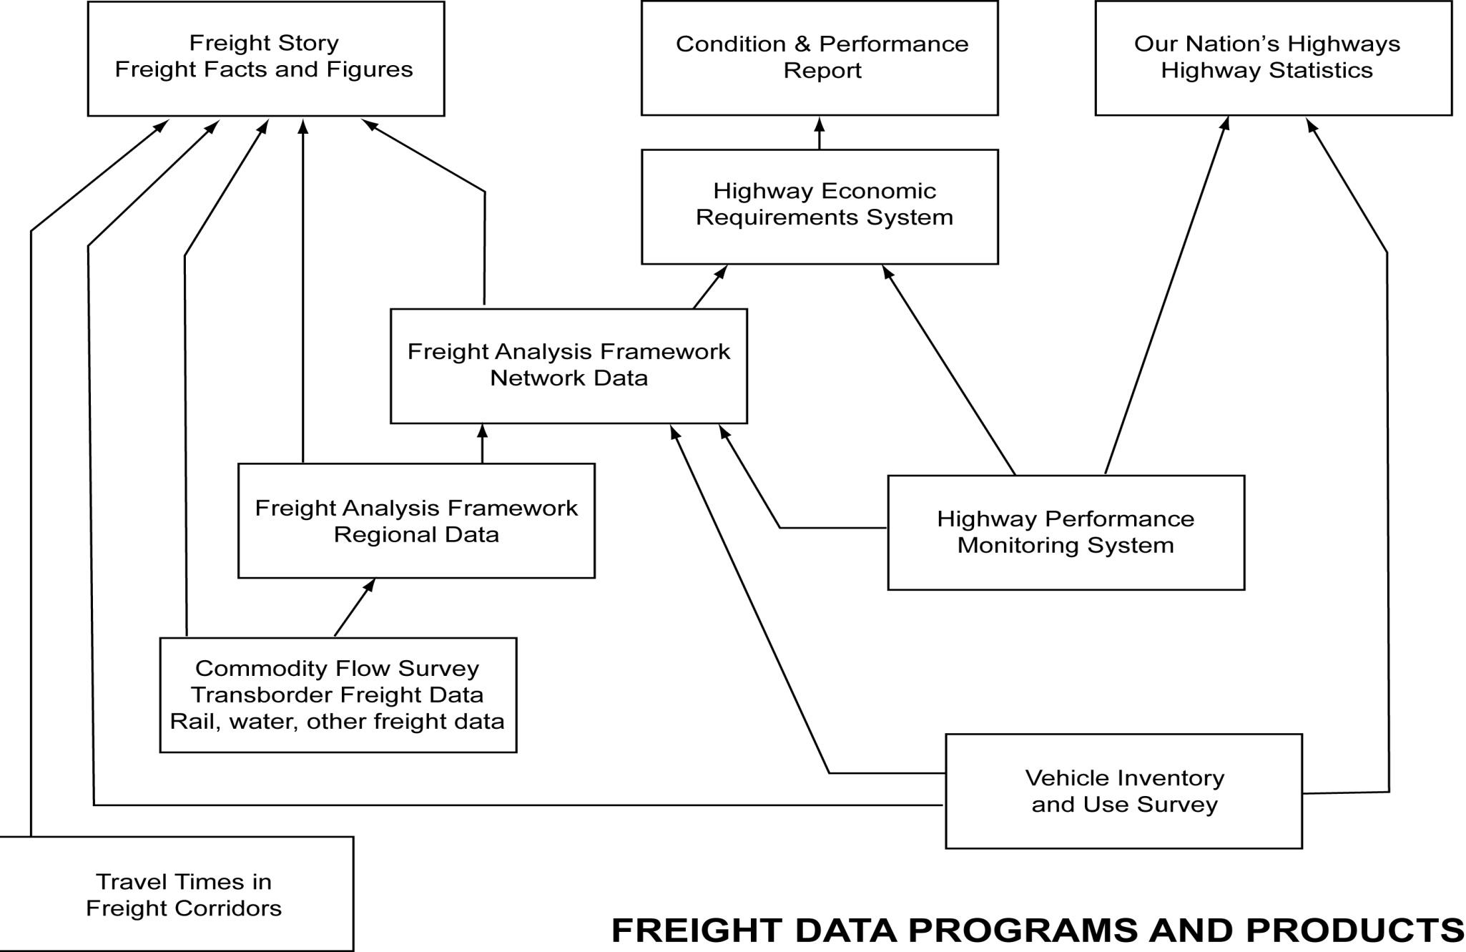

Slide 36

Bureau of Transportation Statistics
Office of Airline Information
Aviation Data Program Overview
Director, Anne Suissa
202-366-4373
Friday June 4, 2010

Slide 37
Mission
OAI’s Mission is governed by
  Public Law,
    49 USC (United States Code) 329(b)
    SAFETEA-LU
    AIR-21
    39 U.S.C. 5402(k)
    Rural Service Improvement Act of 2002 (has to do with allocating mail tender and setting rates in AK)
  Treaty, Convention on International Civil Aviation, 1947 (ICAO)
  Regulations, 14 CFR (Code of Federal Regulations)
Aviation data collections began in the 1930’s by the Civil Aviation Authority (CAA) at the direction of President Roosevelt and Congress.
Notes:
The Secretary of Transportation must collect and disseminate data on the origin and destination of passengers and on the number of passenger traveling between pairs of points (49 U.S.C. 329(b)(1))
SAFETEA-LU requires DOT to collect transportation information related to global competitiveness.
AIR-21 requires the Secretary to disclose more fully to the public the nature and source of delays and cancellations experienced by air travelers
39 U.S.C. 5402(k) requires the Secretary to collect suitable data to be provided to the U.S. Postal Service for mail tender purposes
Rural Service Improvement Act of 2002
Requires The Secretary to collect T-100 market and segment data from Alaskan Bush Air Carriers to be used by the United States Postal Service for mail tender.
Records, that pertain to Bush Mail Tender or Bush Mail ratemaking, must be retained for 7 years.

Slide 38
OAI Services-Mandate
Collect, Validate, Compile & Disseminate
Traffic
  Passengers
  Freight/Mail
  Capacity
  Operational Statistics
    Departures
    Aircraft hours
Financial
  Balance Sheet
  Income Statement
  Operating Expenses
    Employment
    Fuel Cost and Consumption
Ticket Information
Passenger Itinerary & Cost (O&D)
  Average Fare
  Market
Performance
  On-time arrivals
  Causes of Delay
Each quarter, BTS’ Office of Airline Information processes, 380+ reporting air carriers, 1.3 GB+ of data, 3800+ filings/carrier submissions
Notes:
Traffic – (T-100 and T100f)
Monthly reports (transported and enplaned)
Financials – (Form 41 and 298c)
Monthly, Quarterly, Semi-Annual, Annual reports
Performance – (On-Time/234)
Monthly (performance with published schedules, causes of delay, tarmac times)
Ticket Information – (Origin & Destination – O&D)
Quarterly (ticket itinerary and fare details)
See Handout for details on
Airline Data Reporting by Group

Slide 39
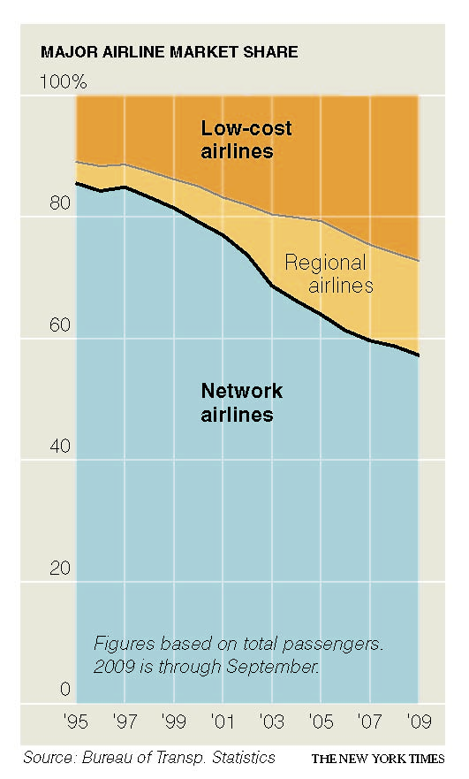
BTS maintains extensive data on the airline industry
BTS regularly collects a wide range of airline-related data used by USDOT, including the Office of Aviation Analysis, the Federal Aviation Administration (FAA), and the Office of the General Counsel. Stakeholders outside of the USDOT, such as Congress, the Department of Homeland Security, state and local governments, the air transportation industry, researchers, academia, and the public, also rely on BTS airline data products and reports.

Slide 40
Monthly Air Carrier Submittals
Monthly Financial Reports Reporting Period
P-1 a Interim Operations Report due 30 days after
P-12A Fuel Costs and Consumption due 20 days after
F-183 Extension of Credit to Political Candidates
Monthly Traffic Reports
T100 Traffic & Capacity by Nonstop
Segment and On flight Market due 30 days after
T100F - Traffic & Capacity by Nonstop
Segment and On flight Market due 30 days after
Monthly OnTime Reports
234 OnTime performance due 15 days after
234-6 Mishandled Baggage Report due 15 days after
Monthly Schedule for Press Releases
Monthly Airline Traffic Data
Monthly Passenger Airline Employment
Monthly Air Travel Consumer Report, Input On Time data
-
-

Slide 41
Quarterly Air Carrier Submittals
Quarterly Financial Reports Reporting Period
A Certification due 40 days after
B-1 Balance Sheet due 40 days after
B-7 Airframe/Engine
Acquisition/Retirement due 40 days after
B-12 Cash Flow due 40 days after
P-1.2 Income Statement due 40 days after
P-2 Notes due 40 days after
P-5.2 Aircraft Operating Expense due 40 days after
P-6 Expenses by Objective Grouping due 40 days after
P-7 Expenses by Functional Grouping due 40 days after
Quarterly Traffic Reports
251D Passengers Denied Boarding due 30 days after
O&D Origin & Destination Survey due 45 days after
Quarterly Press Releases
  Quarterly Airline Financial Data
  Quarterly Air Fares (ATPI)

Slide 42
Semi-Annual and Annual Air Carrier Submittals
Semi-annual Financial Reports Reporting Period
B-1.1 Balance Sheet due 40 days after
P-1.1 Income Sheet due 40 days after
P-5.1 Aircraft Operating Expense due 40 days after
Annual Financial Reports
B-43 Airframe/Engine Inventory due March 30
P-10 Employee Statistics due 40 days after
AR-248 Annual Audit Report due when completed
T-8 Report of All Cargo Operations due March 30
291A Domestic All Cargo Operations due March 30
ICAO EF Group III & II selected financials due March 30
Annual Press Releases
  Annual Employment by Category

Slide 43
Stakeholders
DOT Aviation and International
Affairs
Justice Department Anti-trust
Division
DOT IG
DOT Counsel
Federal Aviation Administration
Congress
General Accountability Office
Council of Economic Advisors
(EOP-CEA)
Transportation Security
Administration
International Civil Aviation
Organization (ICAO)
Airlines
Air Transport Association
Aviation Consultants
State and Local
Governments
Airport Authorities
Academia
Members of the general
public
Notes:
DOT Aviation and International Affairs
analyzes airline competition, negotiates international air service agreements, sets international & Alaskan mail rates, determines community eligibility for Essential Air Service subsidies, evaluates air carrier fitness & air carrier merger requests, conducts policy analyses, and advises the Secretary on major air transport industry issues
Justice Department Anti-trust Division
analyzes airline competition as it relates to mergers, acquisitions and alliances.
DOT IG
investigates airline industry issues & the DOT aviation programs
DOT Counsel
Issues Monthly Air Travel Consumer Report. Provide enforcement assistance with carriers that do not meet reporting obligations. Monitors the impact of airline policies on the traveling public (flight delays, cancellations, mishandled baggage, & denied boarding on oversold flights).
Federal Aviation Administration
develops the annual Aviation Forecast, allocates airline safety inspection resources, determines control tower staffing, allocates Airport Improvement Program grant funds, and monitors flight delays to measure National Airspace System (NAS) performance
Congress
data provides policymakers with national, regional and local airport, airline and passenger statistics to inform decision-making and serve constituent needs
General Accountability Office
performs studies in response to Congressional requests.
Council of Economic Advisors (EOP-CEA)
monitors status of air transportation system and advises the President on major economic policy issues
International Civil Aviation Organization (ICAO)
collects and disseminates global air transportation data and works to harmonize data.
TSA assignment of resources and collection of security fees

Slide 44
DOT Uses of the Airline Data
Air Carrier “Fitness” Appraisals and Operating Authority Awards
Mail ratemaking and mail tender allocations
International negotiations of routes and services
The Standard Industry Fare Level (SIFL)
The Standard Foreign Fare and Rate Levels (SFFL)
Consumer protection and information (Air Travel Consumer Report)
Small community air service needs (Essential Air Service determinations for eligibility and subsidy)
Air carrier and charter operator compliance with statutory regulations
Allocation of airport improvement funds
Forecasting of air traffic demand

Slide 45
Part 234 Airline Service Quality Performance
Required for airlines with1 percent or more of scheduled domestic passenger revenues, see 14 CFR . Others may voluntarily report
  Collections began in 1987
  Additional elements added in – 2003, 2008, 2010
APRIL 2010 CONSUMER RULE
  Fines can be levied for tarmac time of 3 hours or more
  Fines can be levied when flight is chronically late for 4 consecutive months
  Chronically late flights are defined as late or cancelled more than 50 percent of time.
  Flights must be scheduled at least 10 times in the month
  Flights operated within 30 minutes of each other in the same city pair can be combined in determining chronically late flights
  Carrier must publish on-time data on their websites
Notes:
In 2008, 88 percent of all domestic passengers were covered by ASQP
77 percent of all scheduled domestic flights reported in ASQP
Since September 1987 for Data Elements A. through S.
January 1995 added Data Elements T. through V
– added wheels on time, wheels off time, and tail number
June 2003 added Data Elements W. through AB.
W. Cancellation Code
X. Minutes late for delay code E – Carrier Caused
Y. Minutes late for delay code F - Weather
Z. Minutes late for delay code G – National Aviation System
AA Minutes late for delay code H - Security
AB Minutes late for delay code I – Late Arriving Aircraft
Data collected since October 2008 for Data Elements AC. through BJ, includes:
Time on tarmac before gate return
Wheels-on time at diverted airport
Longest single tarmac time at diverted airport
Total tarmac time at diverted airport
Wheels-off time at diverted airport
April 2010 New additional reporting requirements –

Slide 46
Questions
Contact us at
  Airlinedata@dot.gov
  Director, Anne Suissa
  202-366-4373
  Customer Service Representative, Steve Anderson
  202-366-2876

Slide 47
Bureau of Transportation Statistics
TRANSPORTATION SERVICES INDEX (TSI)
Peg Young, Ph.D.
June 4, 2010

Slide 48
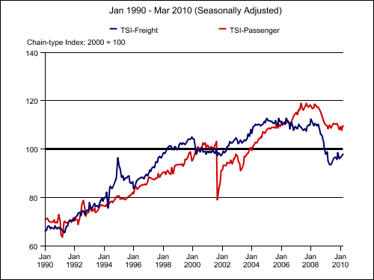
What is the Transportation Services Index (TSI)?
The TSI is the broadest monthly measure of U.S. domestic transportation services.
The TSI is a measure of the volume of services performed by the for-hire freight carriers and for-hire passenger carriers.
The TSI reflects real monthly changes in freight and passenger transportation services.
  Taken from www.bts.gov

Slide 49
Origin of TSI
BTS Research Grant (FY 2002)
  “The Theoretical Development, Selection, and Testing of Economic Indicators for the Transportation Industry”
Grant recipients: Economic researchers:
  The State University of New York at Albany (Lahiri and Yao)
  George Washington University (Stekler)
BTS brought the research in-house, where its name was changed from the Transportation Services Output Index (TSOI) to the Transportation Services Index (TSI)

Slide 50
TSI Components for Passenger
Air Revenue Passenger Miles
    Data from BTS / Office of Airline Information
National Transit Ridership
    Data from American Public Transportation Association
Rail Revenue Passenger Miles
    Data from Federal Rail Administration
    Primarily AMTRAK and Alaska Railroad

Slide 51
TSI Components for Freight
Truck Tonnage
    Data from American Trucking Associations
Rail Carloads and Intermodals
    Data from Association of American Railroads
      Weekly Railroad Traffic
Waterborne Commerce
    Data from Army Corps Of Engineers
      Inland Waterways Monthly Indicator
Air Ton-Miles
    Data from BTS / Office of Airline Information
Gas and Petroleum Movement
    Data from Energy Information Administration

Slide 52
Calculation of TSI
Seasonal Adjustment:
  X12 method (Census procedure)
Indexing
  Base = 2000
Weighting
  Value-added GDP weights derived from BEA’s Survey of Current Business
Chaining

Slide 53
Transportation Services Index,
January 1990 – March 2010

Slide 54
Does TSI Lead the Economy?
Research on the history of the TSI (from 1979 to the present) shows that the freight component of the TSI demonstrates a strong leading relationship to the economy.
When the accelerations and decelerations of the freight TSI are compared to the growth cycles of the economy, declines in the freight TSI lead decelerations in the growth cycle.
Published results in:
  Technical Report #2:
    Transportation Services Index and the Economy, December 2007
  Transportation Trends in Focus #2:
    The Freight Transportation Services Index as a Leading Economic Indicator, September 2009

Slide 55
Recent Turning Point in Freight TSI

Slide 56
Current research
Updating turning points in Freight TSI
Creating a Passenger TSI with highway VMT
Comparing TSI to other measures
  Transportation equipment index (data from Federal Reserve Board)
  Transportation employment
Updating Passenger TSI with Federal Transit Administration data

Slide 57
BUREAU OF TRANSPORTATION STATISTICS
Advisory Council on Transportation Statistics
BTS Program Resources
June 4, 2010

