Slide 1
NEW MOTOR VEHICLE REPORTING SYSTEM (MVRS) TRAINING PRESENTATION

Slide 2
MVRS Highlights
Improved screen flow
Enhanced Causal factors. Incorporates Human Factors Analysis and Classification System (HFACS)
New module not used for entering:
Off-Road Vehicle mishaps (ATV, Dirt Bikes, etc)
Tactical Vehicle Mishaps
Use previous WESS version for off-road and tactical vehicles

Slide 3
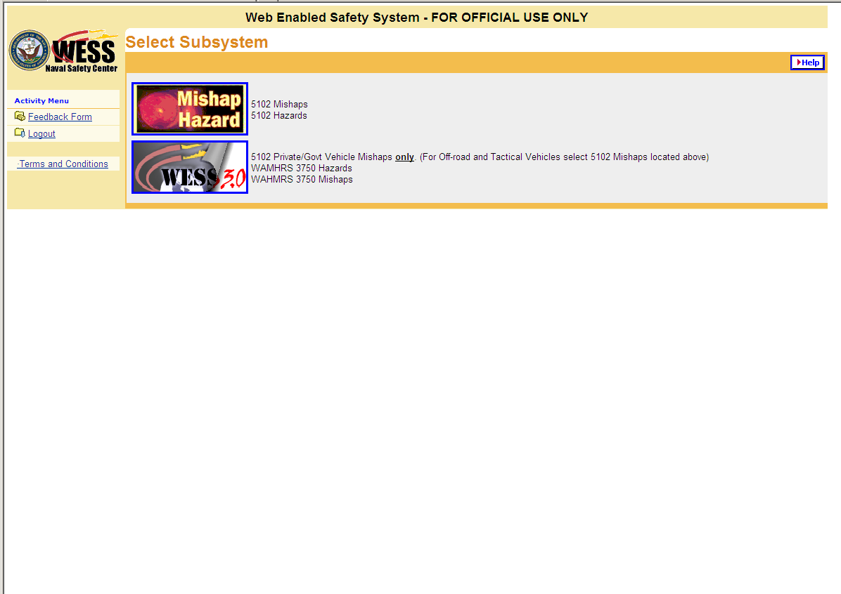
After WESS log-in, select this box to be redirected to the Motor Vehicle Reporting System.

Slide 4
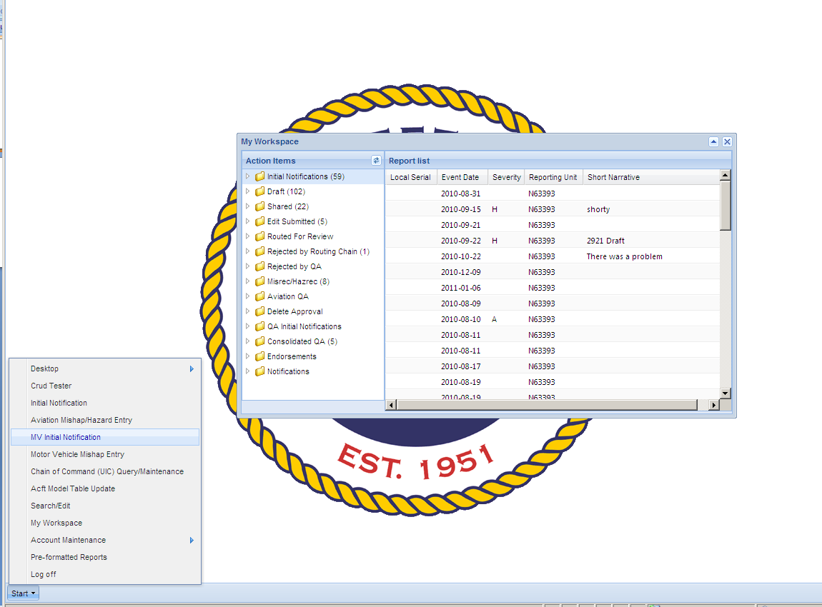
For a class A or B MV Initial Notification, click “Start” button and select “MV Initial Notification”.
Initial Notification required only for a class A or B mishap. For events less severe than class B select Motor Vehicle Mishap Entry on the “start” menu.

Slide 5
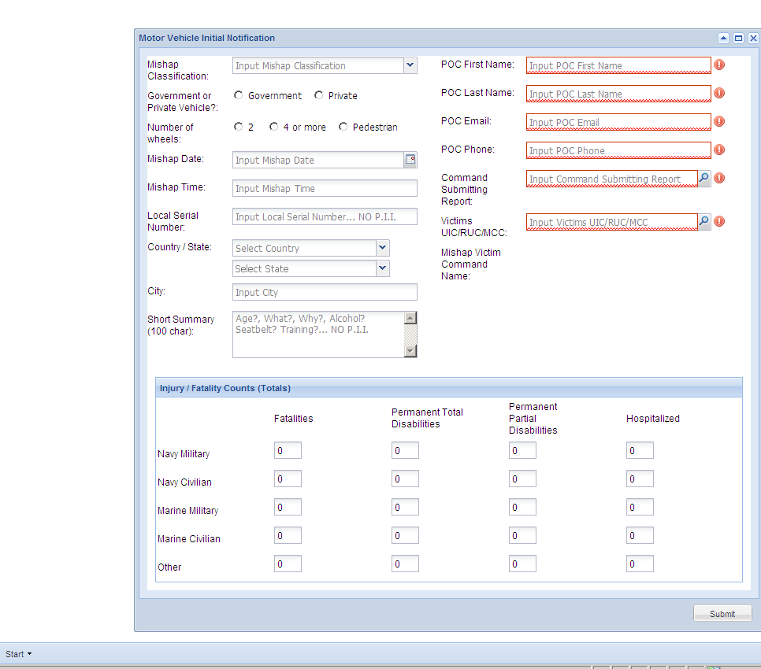
Class A/B Initial Notification
All boxes are required to have an entry
Auto populated from log-in information. User may edit if required
Choose 1:
Fatality
Perm Total Disability
Perm Partial Disability
3 or more hospitalizations
>200,000 govt prop damage
Enter victims UIC
Auto populated from victims UIC
Fatality/Injury Counts – Type in appropriate numbers
Hit submit after all data is entered

Slide 6
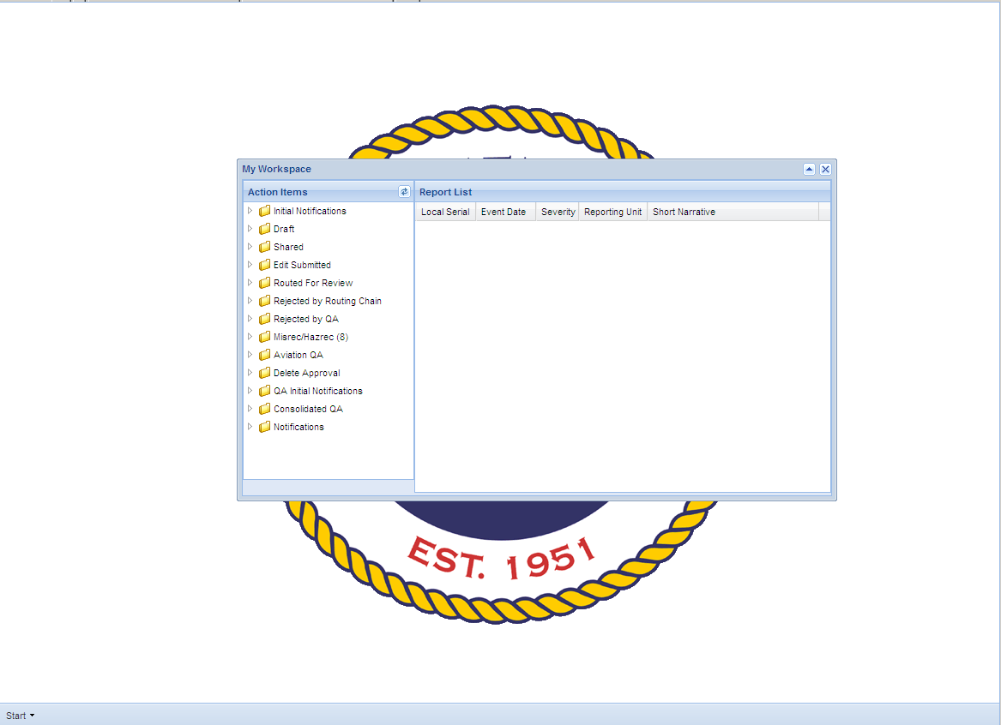
To update your class A/B initial notification and submit a final report or to modify reports that have not yet been submitted to NSC open draft folder.

Slide 7
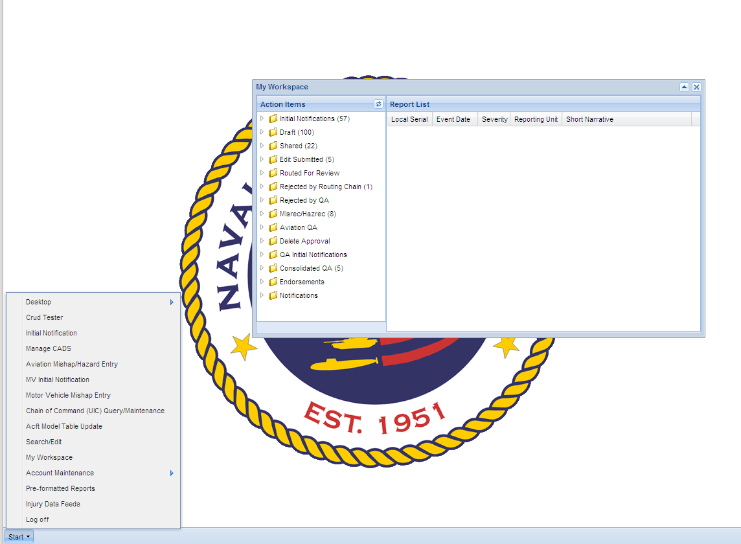
To enter a new class C or D motor vehicle report click the start button then select Motor Vehicle Mishap Entry.

Slide 8
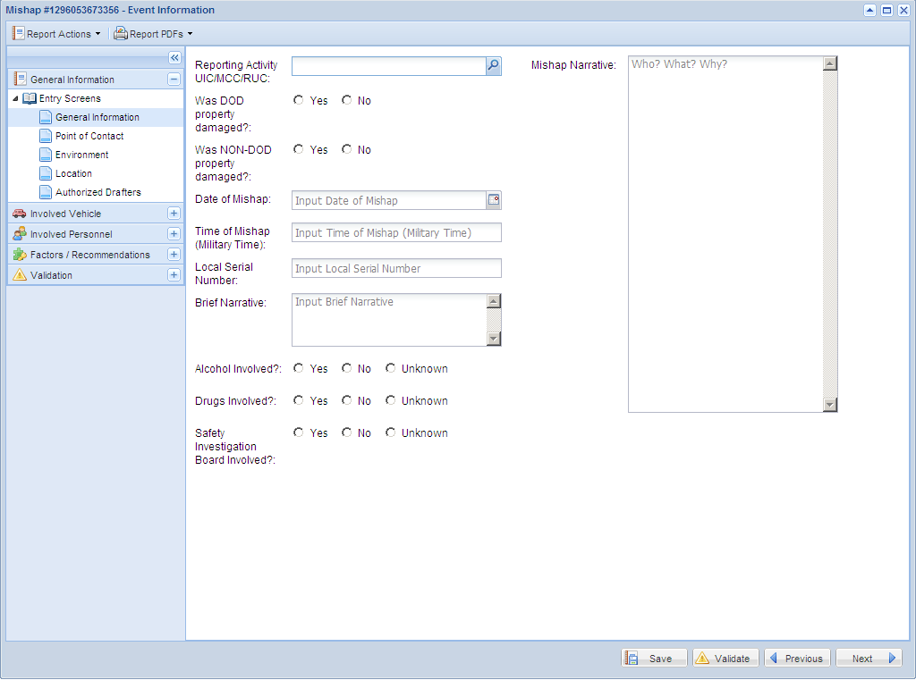
Type a very detailed narrative here.
If yes you will need the damage cost.
Short narrative here. 100 character limit.

Slide 9
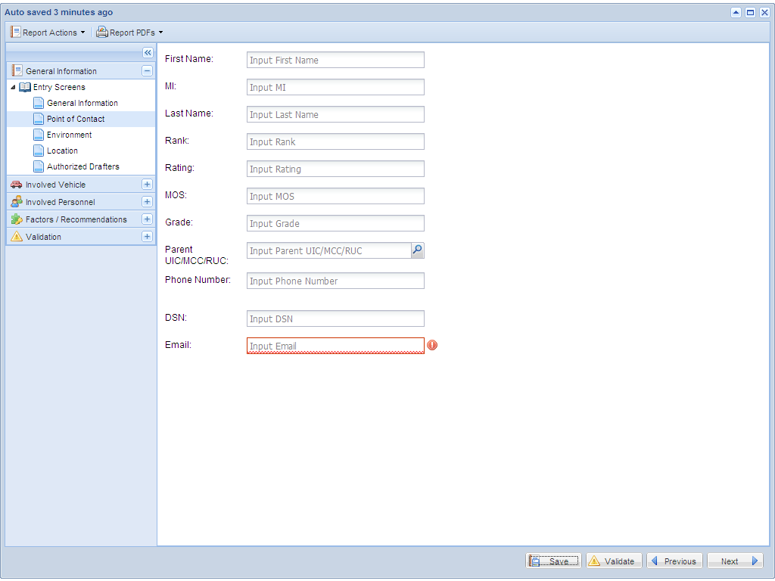
WESS will auto-populate most of this from your log-in information. You can manually change if required.

Slide 10
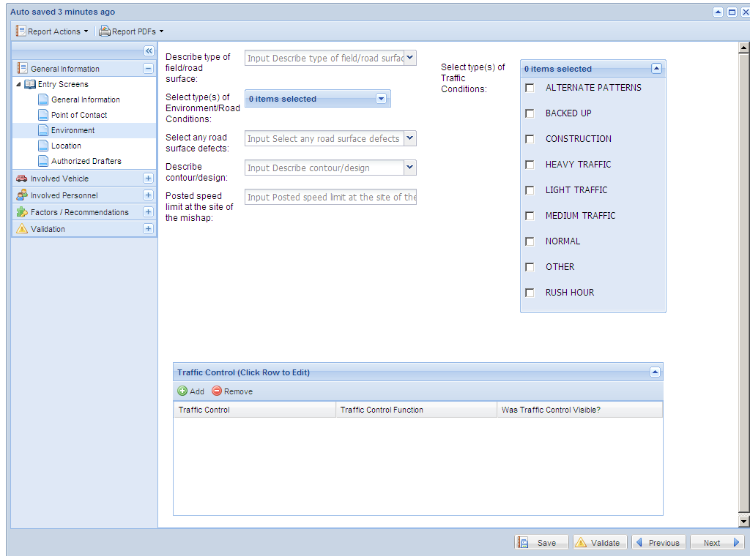
Text entry
Blue colored box allows multiple items for selection
Clear boxes allow only 1 item for selection
If traffic controls (e.g. stop sign) were involved, you may add them by clicking here. If none were involved in the mishap, you may skip this section.

Slide 11
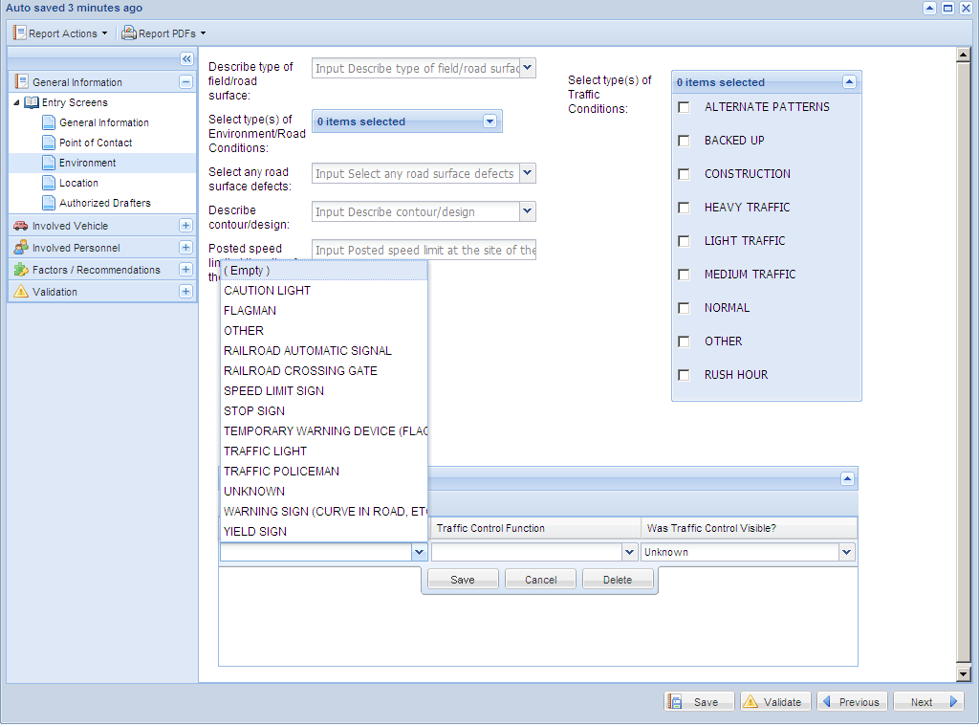
After selection of stop sign, answer traffic control function and whether the stop sign was visible. Then hit save.

Slide 12
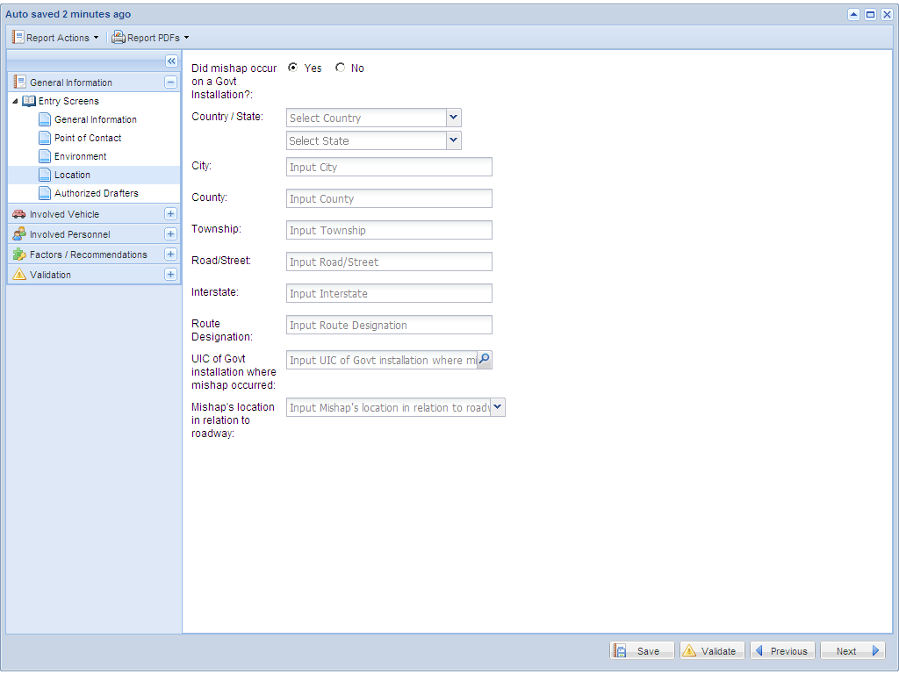
Only appears if mishap occurred on govt installation.

Slide 13
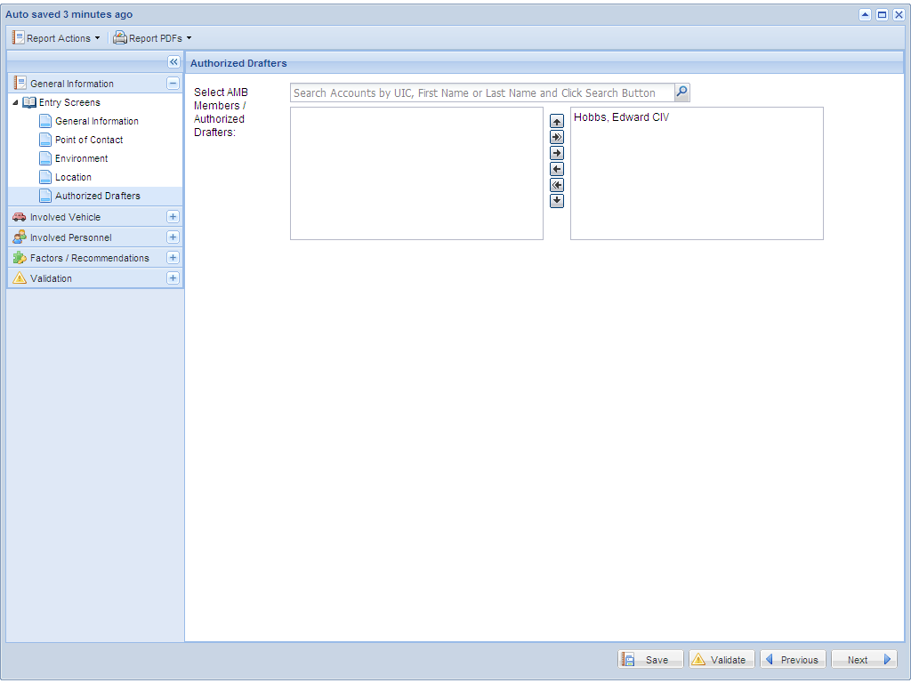
This screen allows the user to designate other individuals who may access and update this report.

Slide 14
To input information concerning involved vehicles, select the “add” button. Each mishap must have at least 1 involved vehicle.

Slide 15
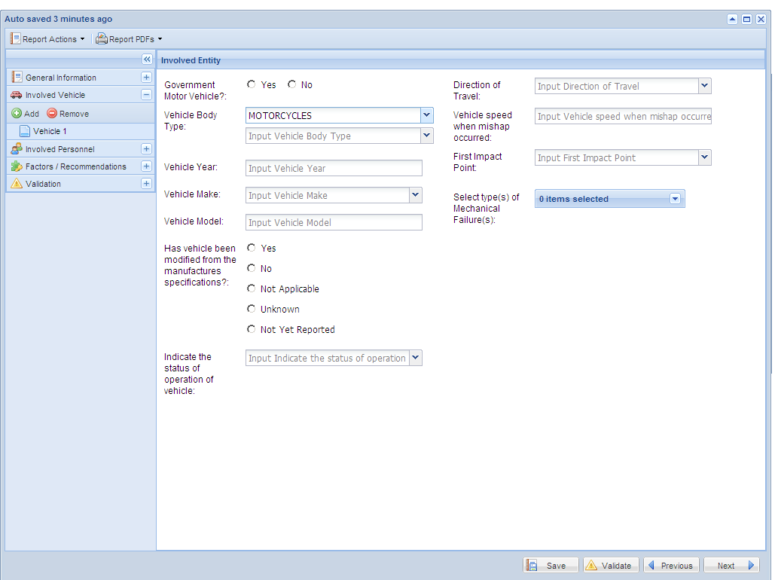
Re-select the “add” button to enter an additional vehicle.
Selection of vehicle body type will determine whether you will see automobile specific or motorcycle specific questions for the remainder of the application.

Slide 16
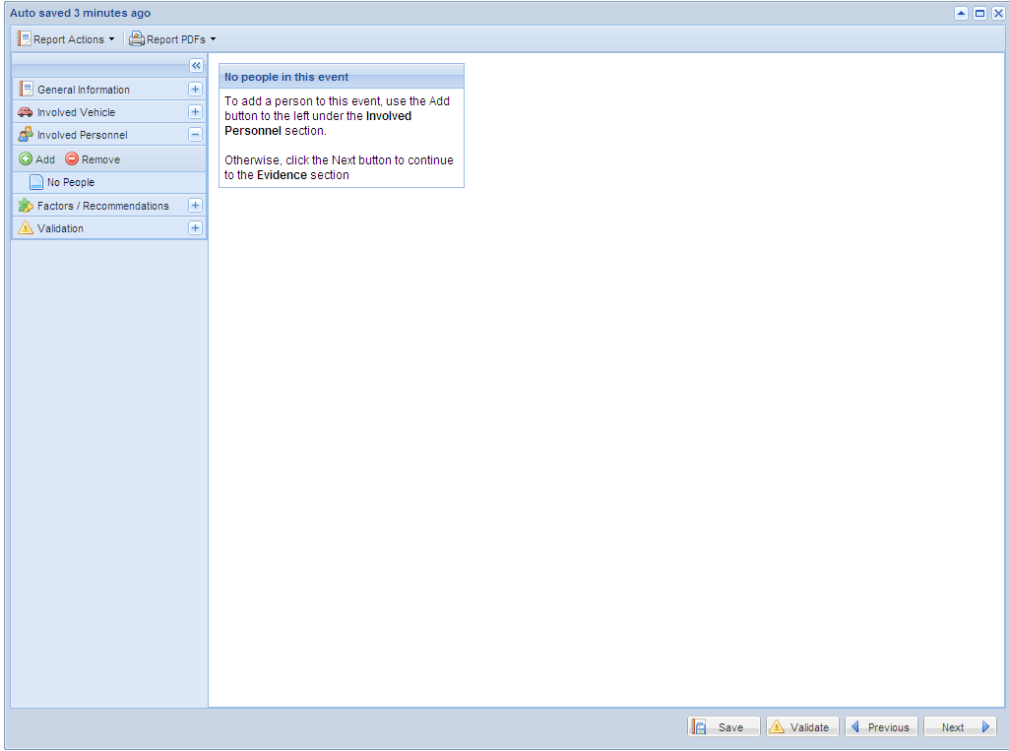
To input information concerning people, select the “add” button.

Slide 17
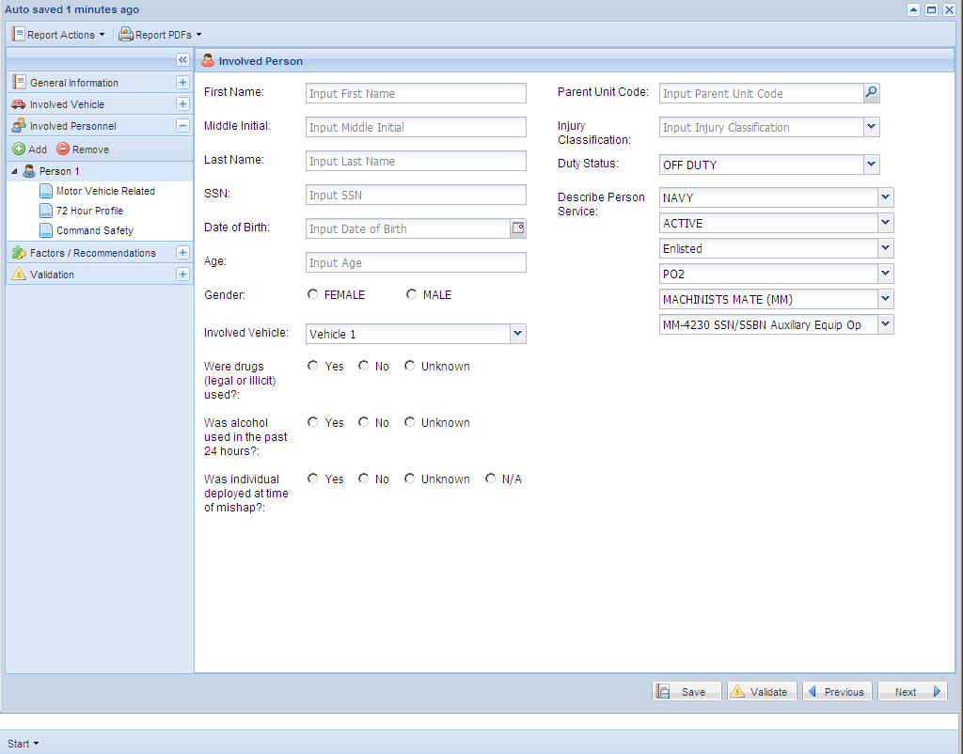
Match person with vehicle
Rate, Pay Grade, NEC, Designator section
If yes, you will need to provide the type of drug

Slide 18
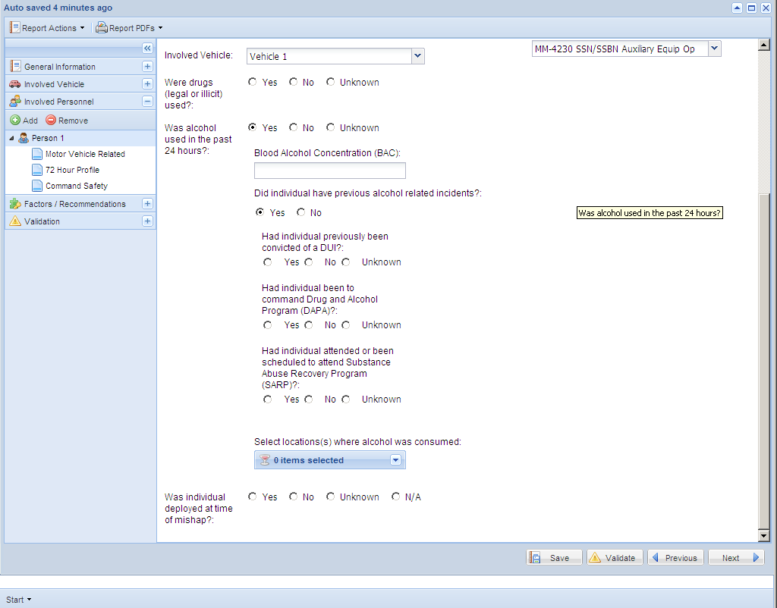
If no to alcohol in past 24 hrs, this will not appear.
If you selected “alcohol involved” in the general information screen (first screen), then at least one person in the event had to have used alcohol in the past 24 hours.
If no to previous alcohol incidents, these questions will not appear.

Slide 19
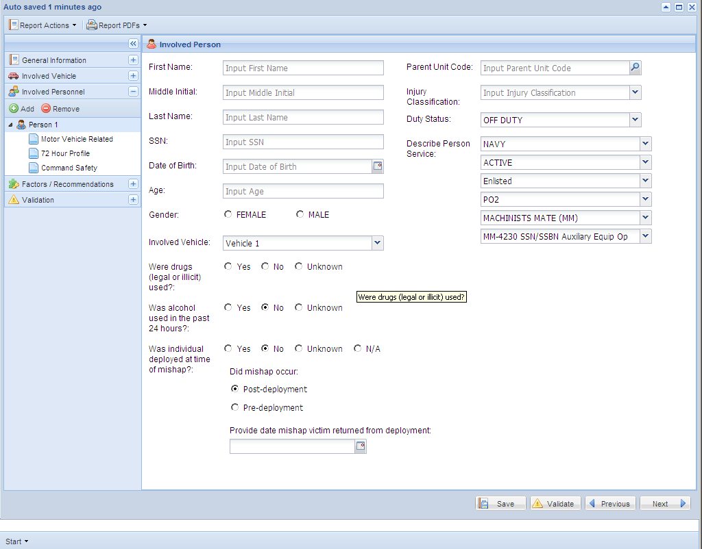
If yes, unknown or N/A to deployed then follow-on questions will not appear.
For post-deployment mishaps, provide the date returned

Slide 20
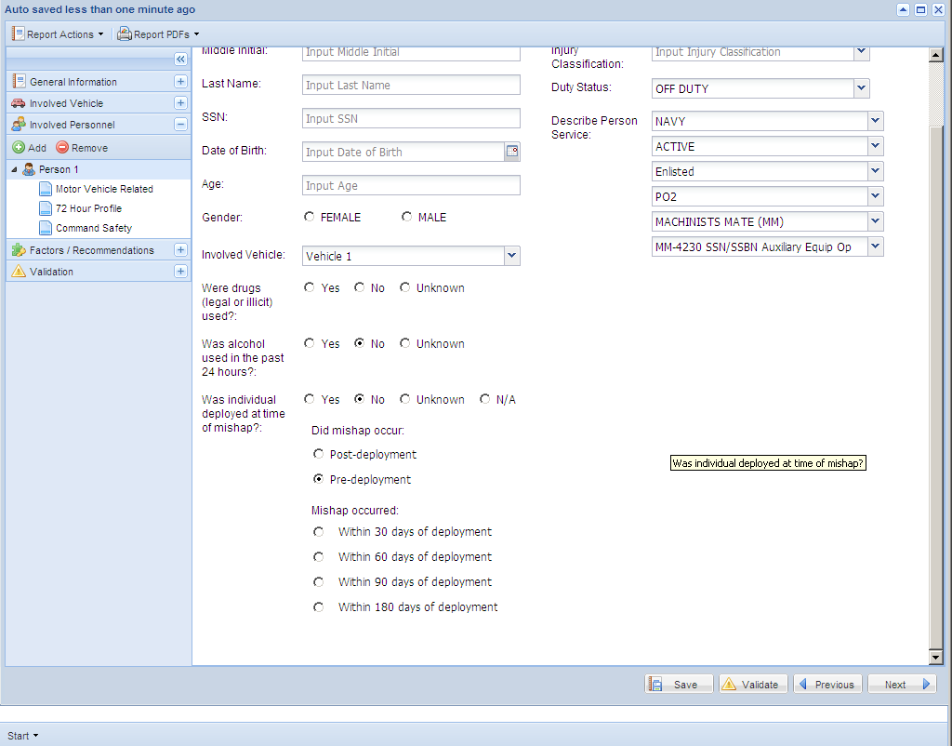
For pre-deployment mishaps, provide the appropriate value

Slide 21
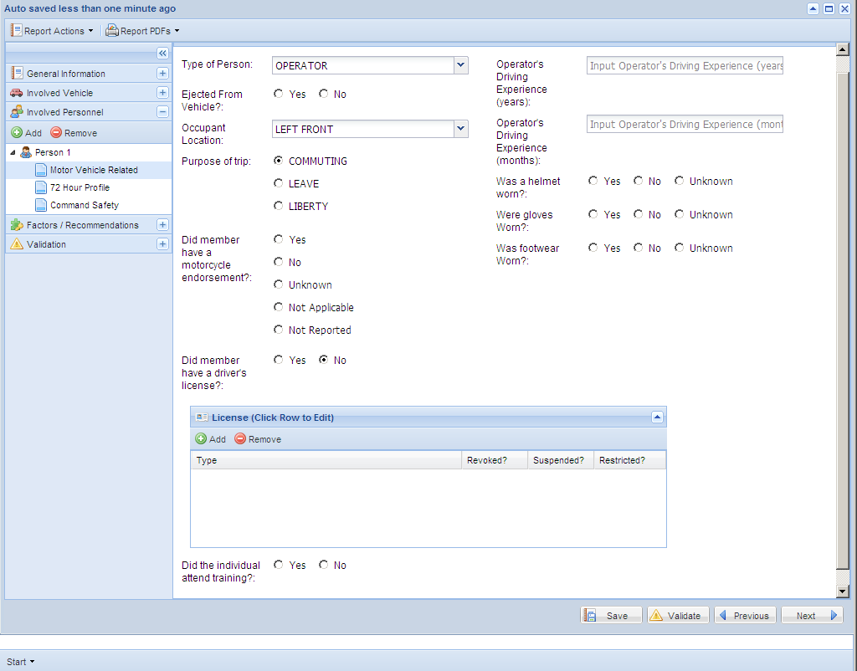
IF LEAVE/LIBERTY SELECTED, YOU WILL NEED THE DATES
If an automobile was selected for vehicle body type, seat belt PPE questions will appear instead.
THESE QUESTIONS WILL NOT APPEAR FOR PASSENGERS
If yes was selected then provide type of license.

Slide 22
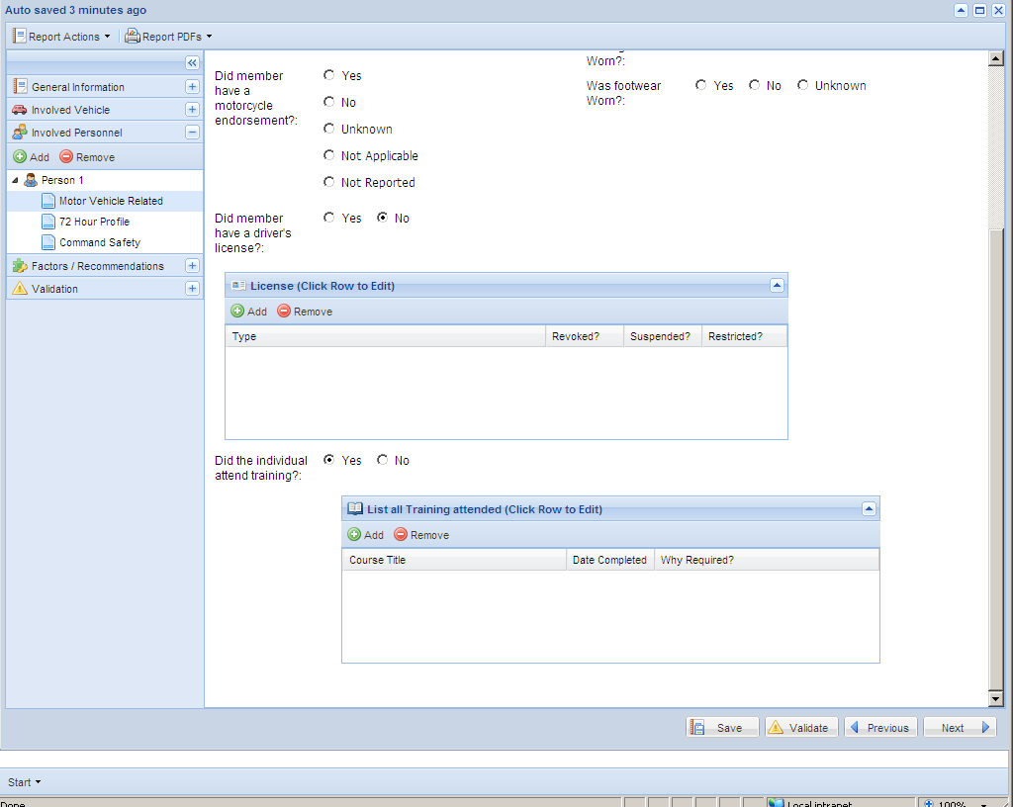
If yes was selected then provide type of training.

Slide 23
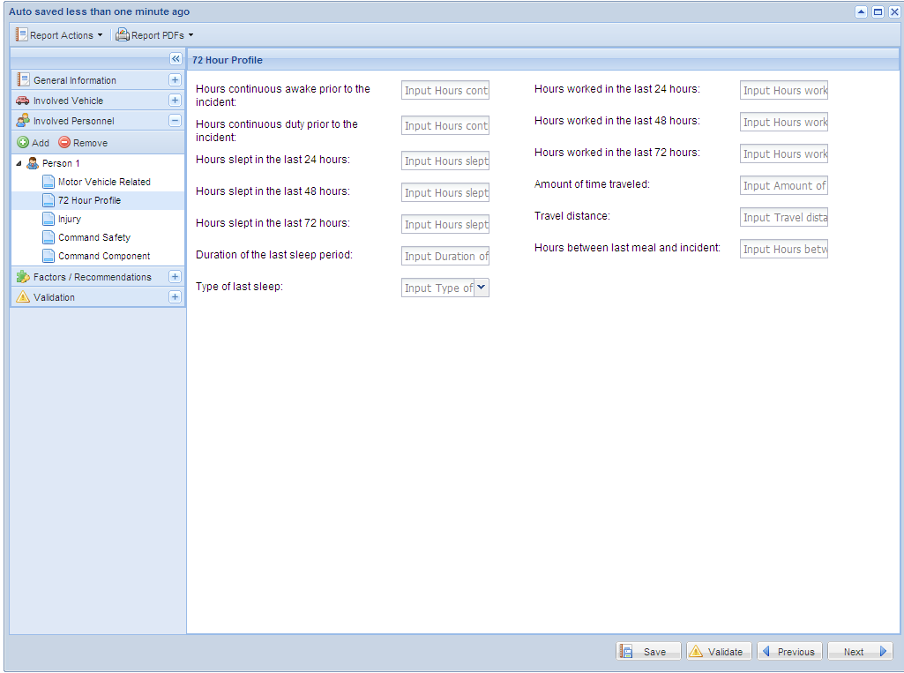
Screen appears only for individuals affiliated with the government. Input as many of the data fields as possible. None are required in order to submit the report.

Slide 24
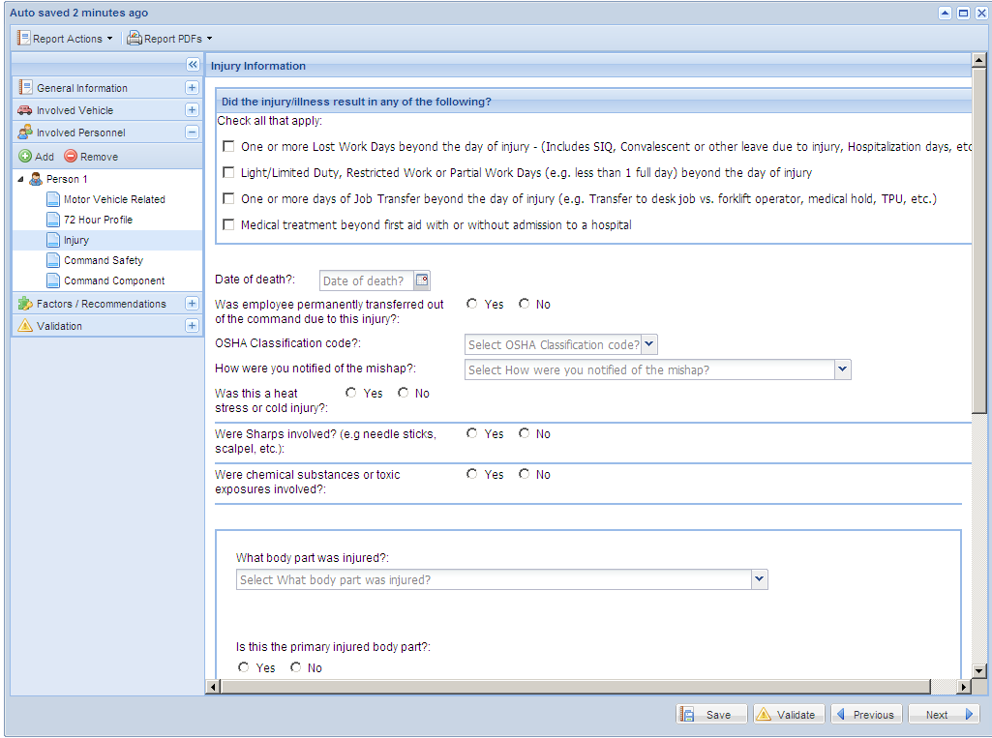
If checked you will be asked to enter the lost work, light/limited, or job transfer start/stop days. The three different types of lost time can not overlap.
If checked you will be asked a few additional questions about the medical treatment.
If yes to heat/cold, sharps or chemical injury you will be asked a few additional questions.
If yes you will be asked the transferring command UIC.
Scroll down for more injury questions.

Slide 25
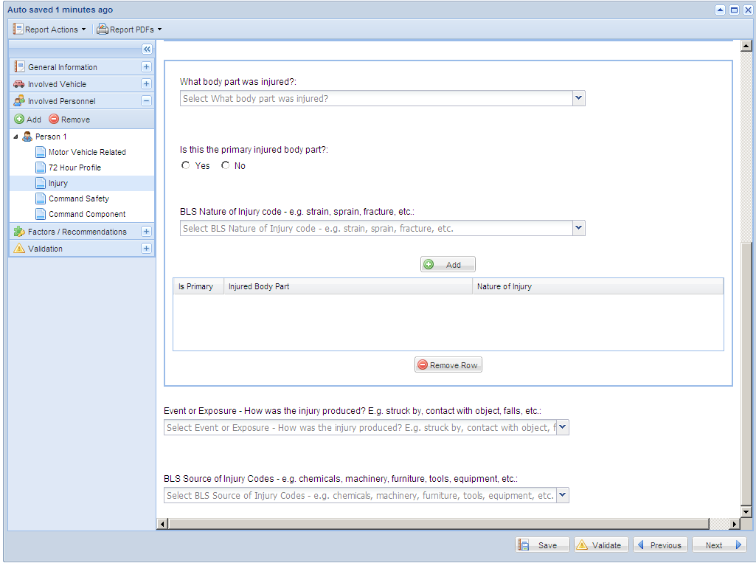
Select add for each injured body part and BLS injury code.

Slide 26
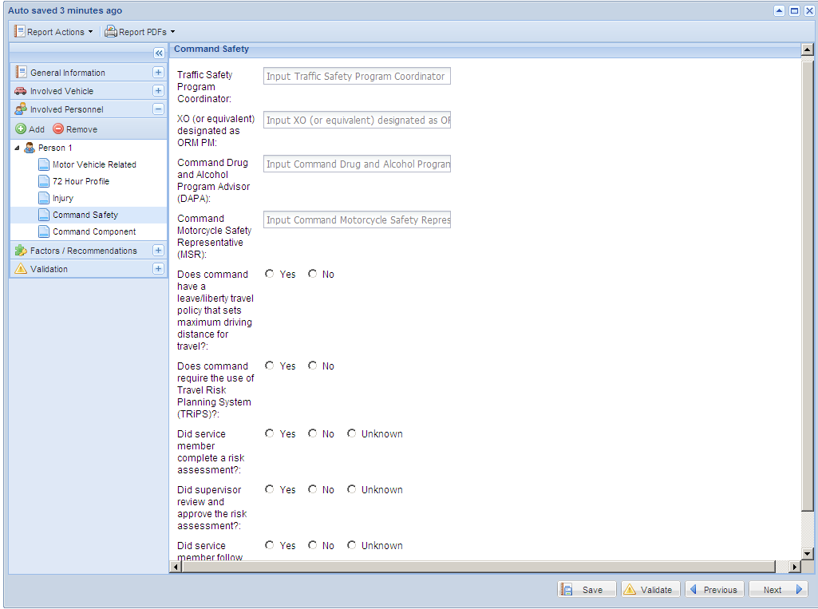
This screen is not required for non-governmental individuals

Slide 27
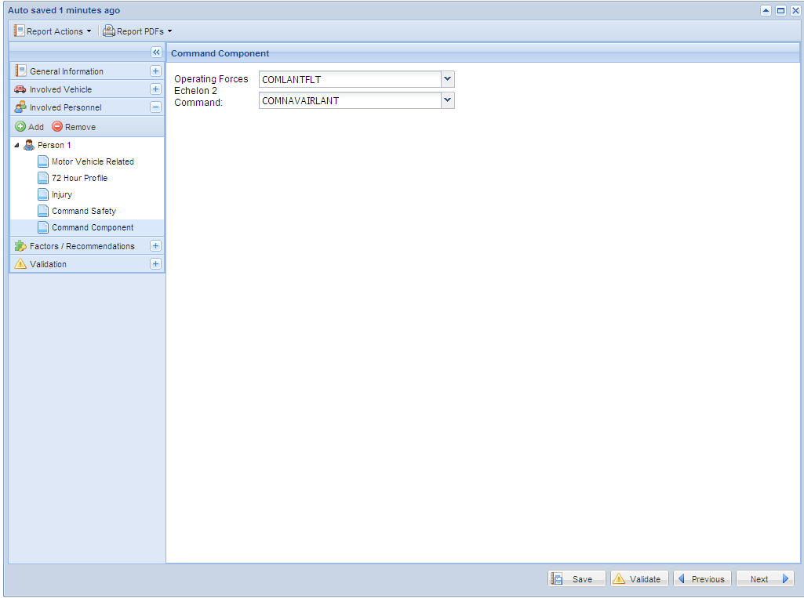
This screen is not required for non-governmental individuals

Slide 28
Human Factors Analysis And Classification System (HFACS)
HFACS replace previous causal factors
HFACS involve an unsafe act with preconditions for that unsafe act
Unsafe act = “what happened”. Example – failed to yield right of way
Precondition = “Why did unsafe act happen”. Example – fatigue and slippery road surface
For the Motor Vehicle Reporting System, each factor will have one unsafe act. For the selected unsafe act, the user will then add all applicable preconditions
If the event involved more than one factor, additional unsafe acts may be added with the appropriate preconditions

Slide 29
Human Factors Analysis And Classification System (HFACS) Example
Single car mishap. The driver was drunk and speeding.
Factor 1:
Unsafe Act = Drunk-driving (BAC≥ .08%)
Preconditions for unsafe act
Stress
Lack of sleep
Inappropriate peer pressure
Factor 2:
Unsafe Act = Speeding 20-29 MPH over speed limit
Preconditions for unsafe act
Complacency
Overconfidence
Misunderstood instructions
Note: Each factor has ONE unsafe act with multiple preconditions

Slide 30
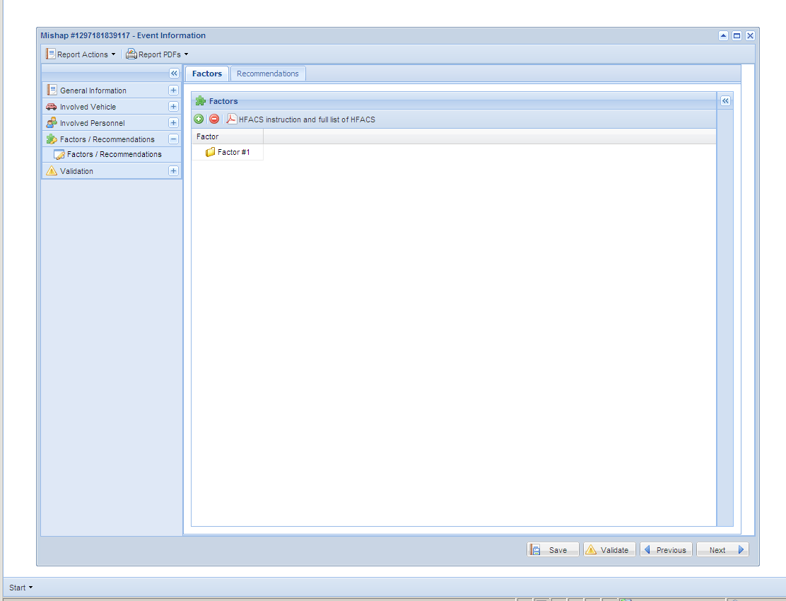
This page is used to enter HFACS (Human Factors Analysis Classification System). The list of HFACS is extensive. It is important to examine the entire list of HFACS before proceeding. Click the PDF to bring up a document that contains all HFACS and a brief explanation. Once you have an idea of the unsafe acts and preconditions you desire to use, click the green button to begin.

Slide 31
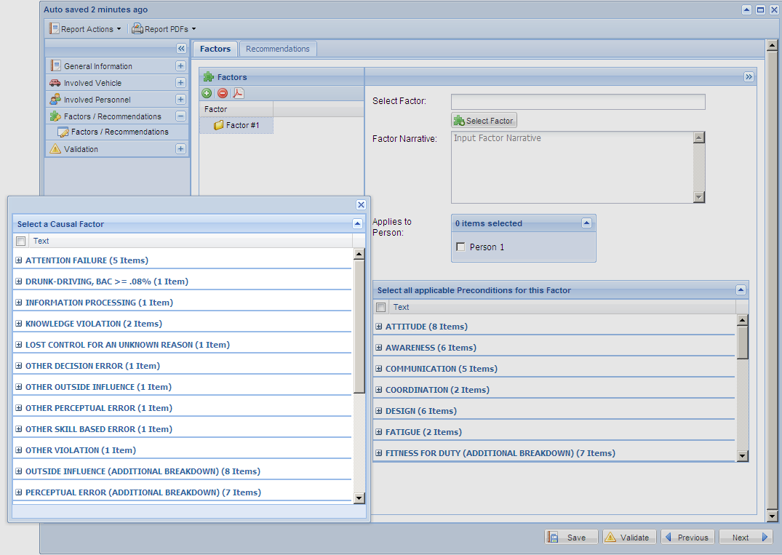
1: Click “Select Factor”.
2: Select ONE unsafe act. Click “+” to expand list.
3: Type narrative.
4: Select the person to whom this unsafe act applies.

Slide 32
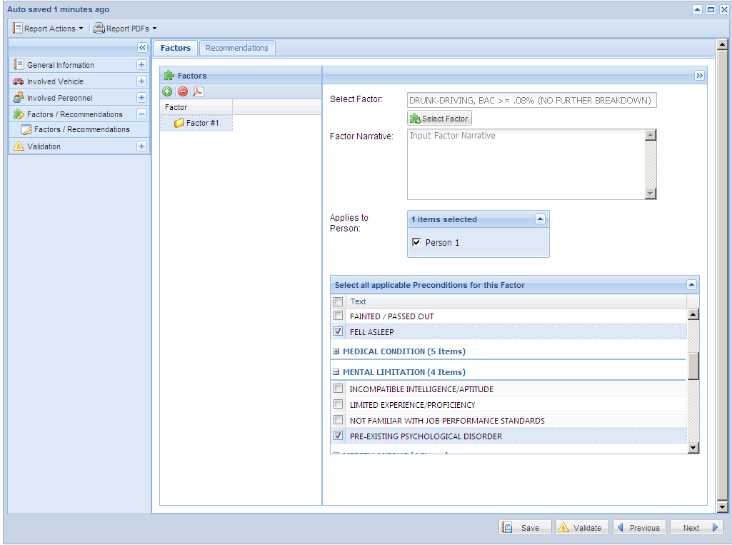
Select all applicable preconditions that apply to the unsafe act. Remember, you may choose more than one precondition.

Slide 33
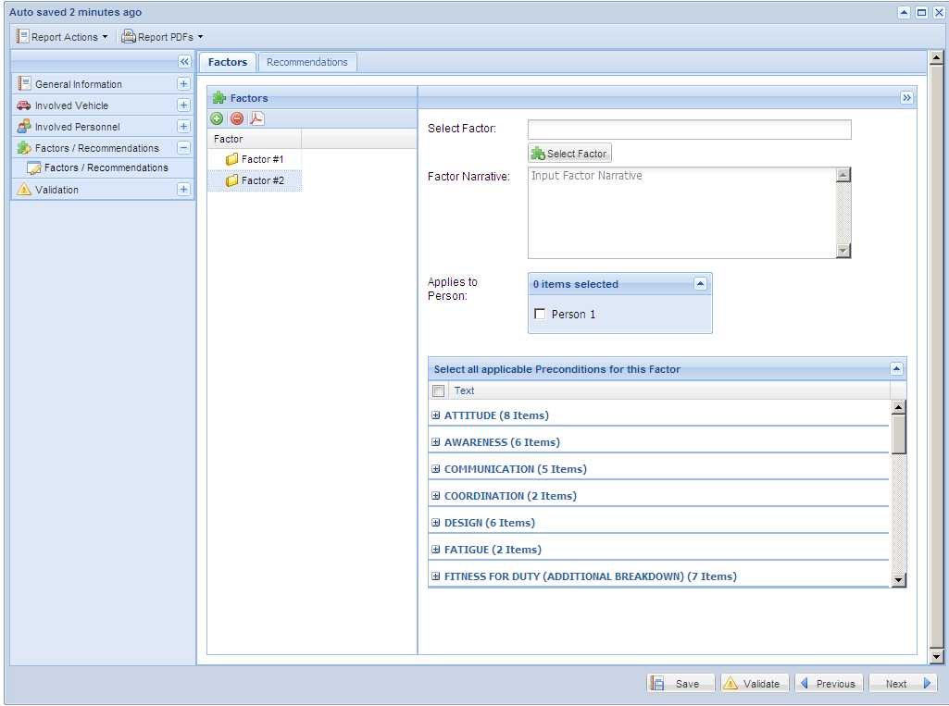
Repeat the same process if there additional factors to be entered. Select the appropriate factor, apply it to the appropriate person(s), then select all applicable preconditions.
After all factors have been entered, select the recommendations tab only if you have recommendations to enter. If none, you may proceed to the next page.

Slide 34
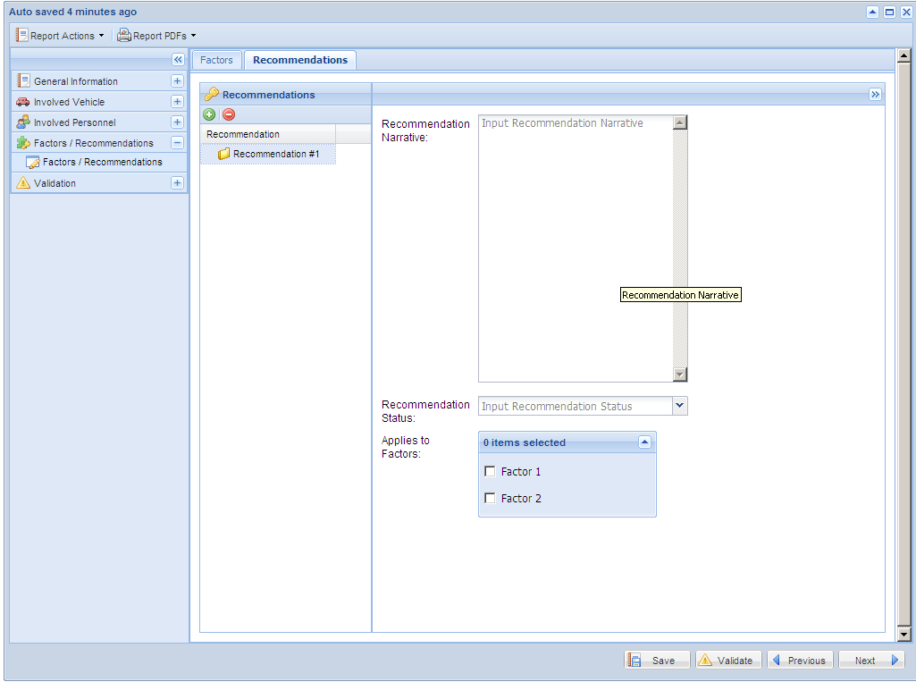
Each factor has to have at least one recommendation. Click the green button to begin. The recommendation is entered as text in the space provided.
You may apply the recommendation to more than 1 factor if required.

Slide 35
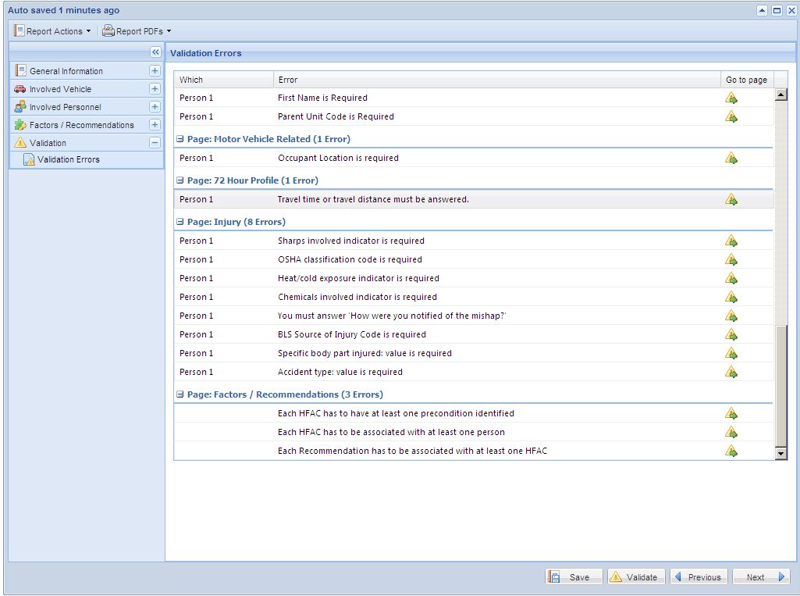
This page shows a list of required fields that must be entered prior to submission. Click on green arrow to navigate to appropriate page to fix error.
Click “validate” on bottom of page to begin validation.

Slide 36
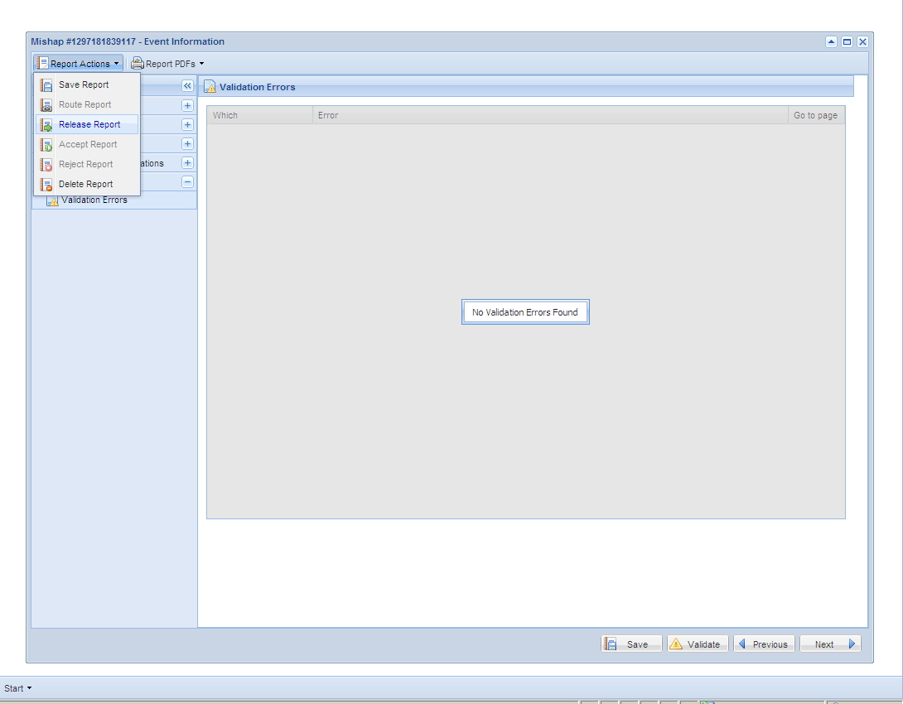
If there are no validation errors, the report may be released to the Safety Center.

Slide 37
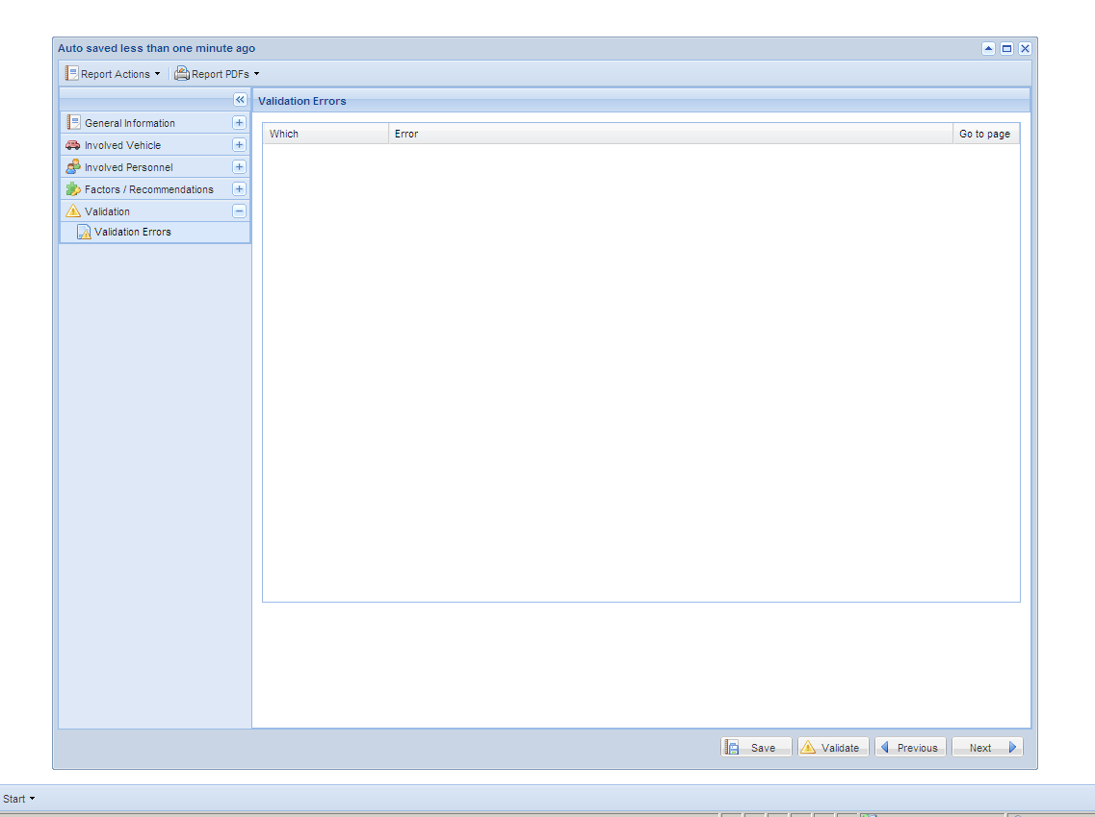
To extract a PDF copy of your report, you may click here at any time during mishap entry.

Slide 38
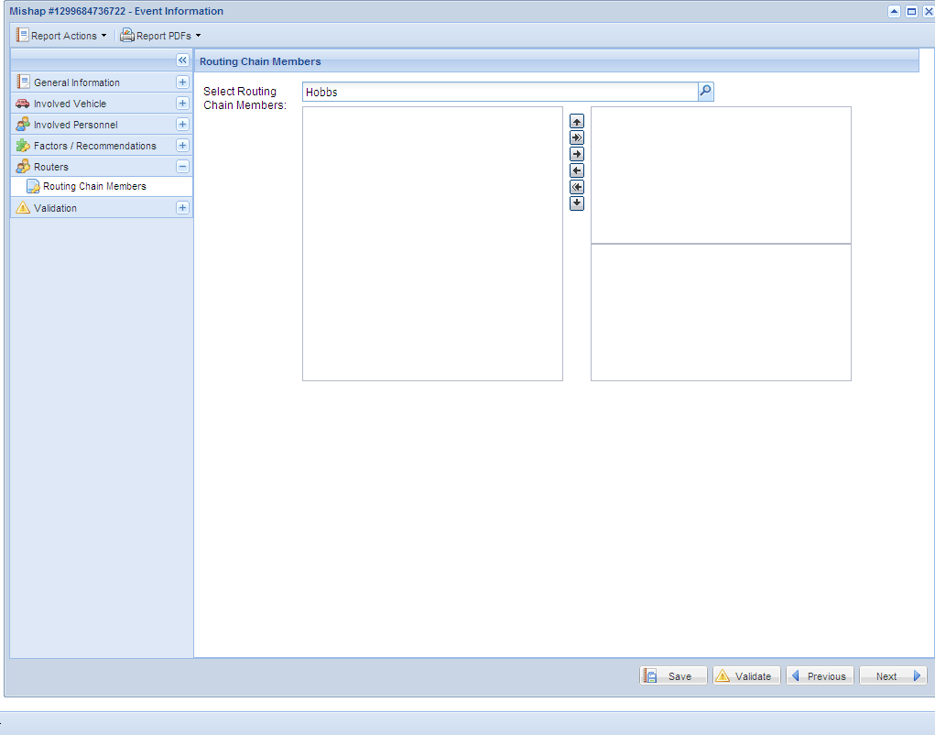
Type the name of the WESS account holder who will review your report in the search area.
The routing function will allow you to send your report to another person or persons for review prior to release.

Slide 39
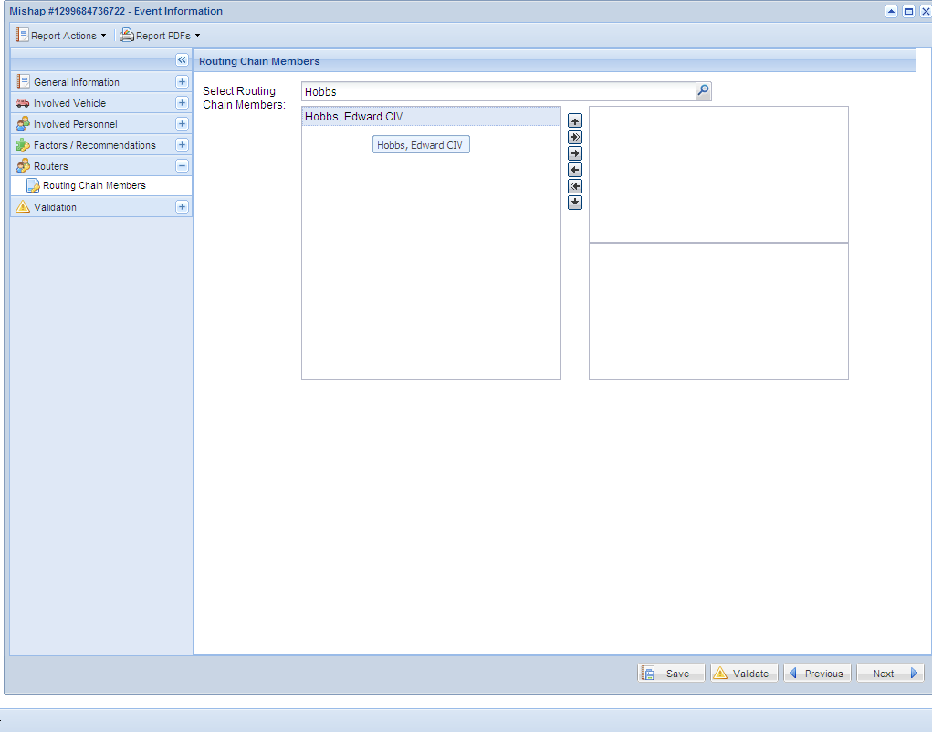
Select the name, then use the arrow key to add him/her to the routing chain.

Slide 40
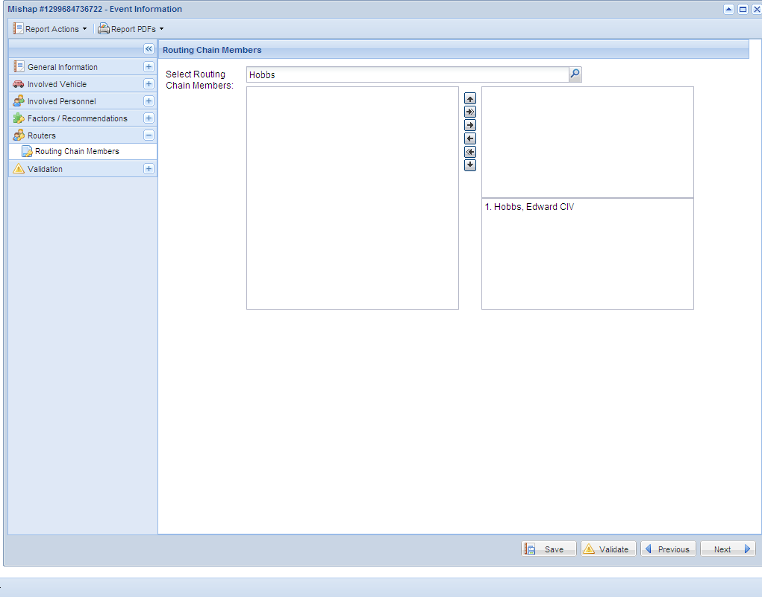
The person selected is now the first in the routing chain.

Slide 41
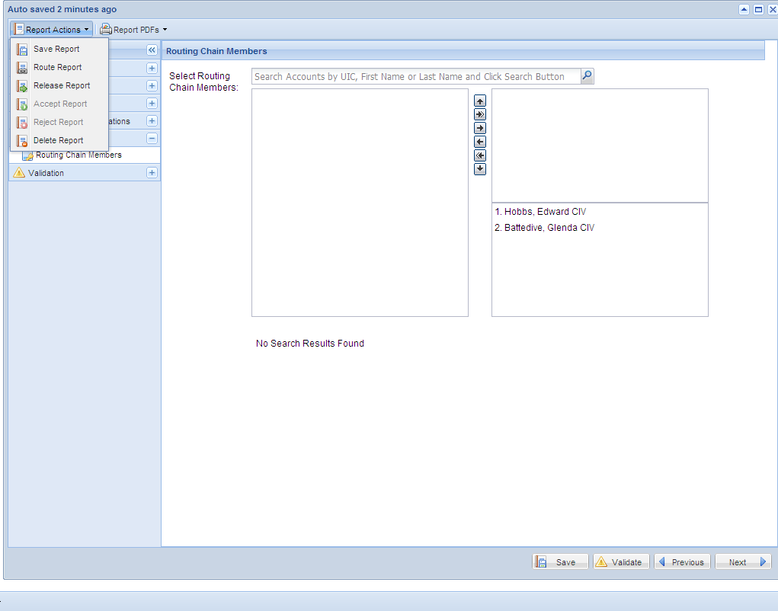
Multiple people may be added to the routing chain if desired. When ready to route the report, select “Route Report”.

Slide 42
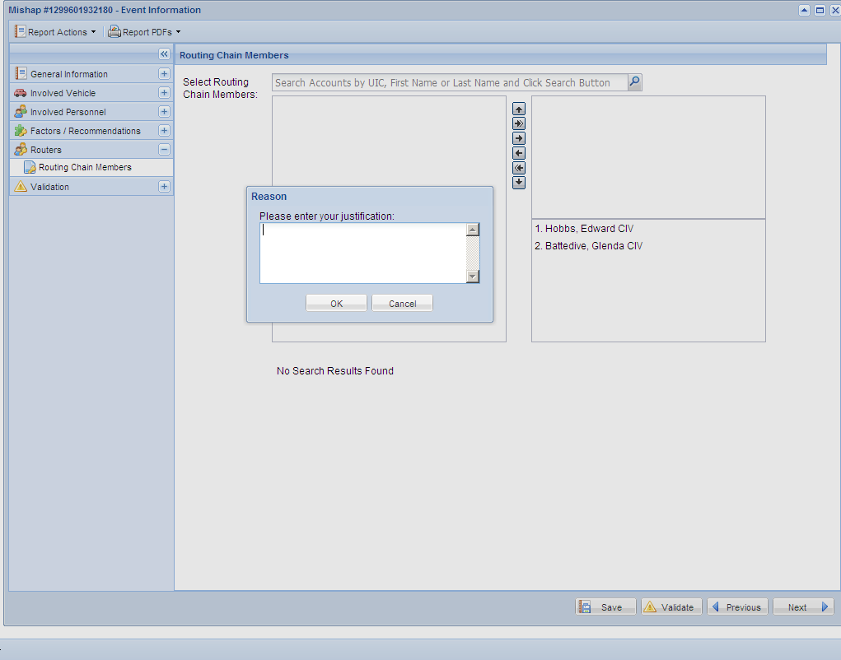
Enter a brief note for the person in the routing chain then select “OK”.

Slide 43
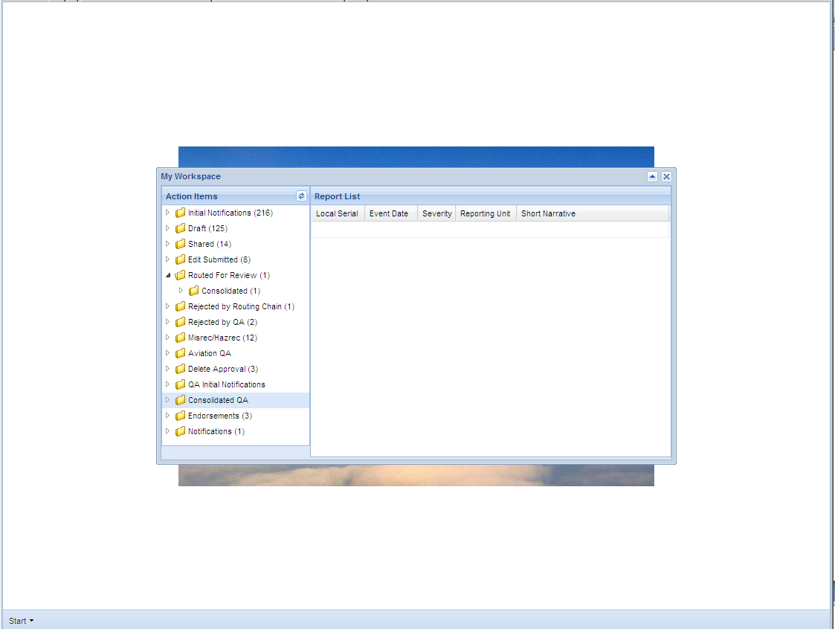
The report will appear in this folder for the first person in the routing chain.

Slide 44
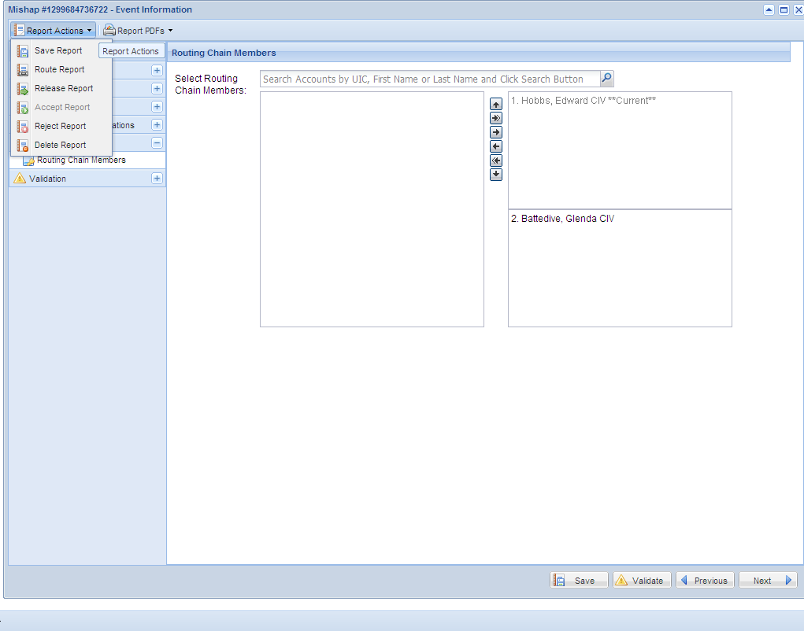
After reviewing the report, the individual may route it to the next person in the chain, or release it to the Safety Center. He may also reject the report back to the original drafter with desired changes.

Slide 45
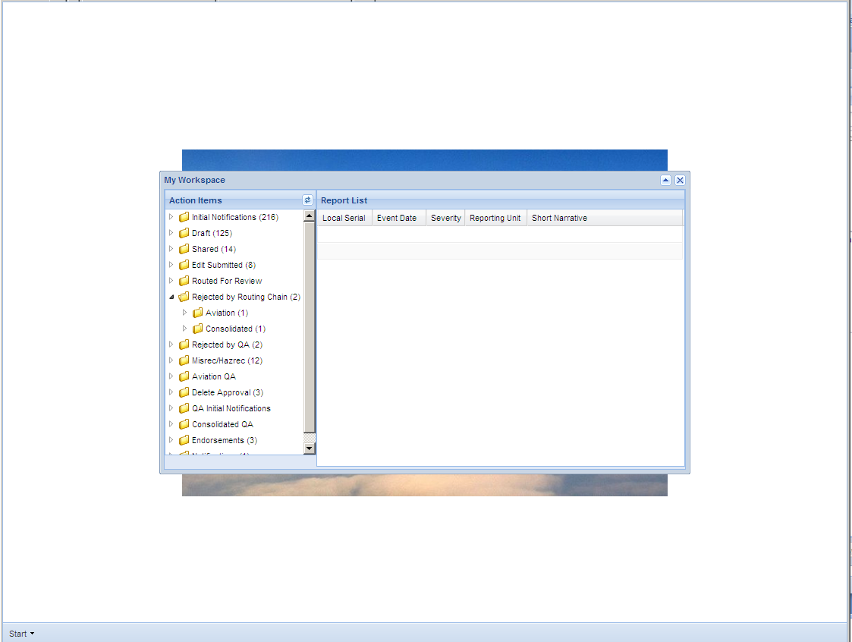
If the report is rejected back to the original drafter, it will appear here.

