Slide 1
Rural Development
ARRA Recipient Reporting
Job Calculation Tool and Narrative Description
Webinar
February 2, 2011

Slide 2
Introduction
Speakers
  Will Davis, Recipient Reporting, Rural Development, USDA
Format for Webinar
  30 minutes of presentation
  Remaining 30 minutes for questions

Slide 3
Agenda
Review and Practice Job Calculation Tool
Review Narrative Descriptions – What is OMB looking for?
Questions & Answers

Slide 4
OMB’s Guiding Hand
OMB M-10-08 is the requisite guidance for Jobs Reporting
  “Recipients will no longer be required to make a subjective judgment on whether jobs were created or retained as a result of the Recovery Act. Instead, recipients will more easily and objectively report on jobs funded with Recovery Act dollars “
  GAO’s recommendation to “[make] more explicit that ‘jobs created or retained’ are to be reported as hours worked and paid for with Recovery Act funds.”
Highlights of memo:
  Recipients will now report job estimates on a quarterly, rather than cumulative, basis.
  Recipients will no longer be required to sum various data on hours worked across multiple quarters of data when calculating job estimates. This update aligns with GAO’s recommendation to “standardize the period of measurement for [Full Time Equivalents].”
Reporting for Jobs is only for the Quarter and related to RD ARRA Funding in that quarter!

Slide 5
OMB’s Guiding Hand - continued
  Some Definitions
  Job Created
    A job created is a new position created and filled, or an existing unfilled position that is filled, that is funded by the Recovery Act;
  Job Retained
    A job retained is an existing position that is now funded by the Recovery Act.
  Using the definitions above, recipients must estimate the total number of jobs that were funded in the quarter by the Recovery Act. A funded job is defined as one in which the wages or salaries are either paid for or will be reimbursed with Recovery Act funding.

Slide 6
Job Calculation Math
Number of Hours in a Full Time Schedule (For Reporting Quarter) - A calculated field based on the Total Hours in a Work Week x 13 (# of weeks in a quarter).
Number of FTE's - Total Hours Worked and Funded by Recovery Act For Reporting Quarter / Total Number of Hours in a Full Time Schedule For Reporting Quarter.
Notes:
From Page 12 of USDA Recipient Reporting Guidelines:
- If a recipient is non-compliant for two or more consecutive reporting quarters, the following actions should be taken within 20 business days.
Require frequent progress reports;
- - Make note of non-compliance in recipient’s performance record;
- - Formally elevate the failure to perform within the recipient’s organization or company;
- - Withhold payments until the recipient becomes fully compliant; and
- - Take other appropriate enforcement actions as deemed pertinent to the circumstances

Slide 7
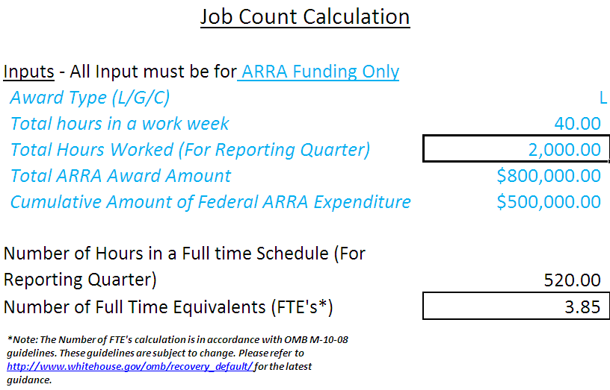
Job Calculation Data Elements
Award Type - Enter either "L"(Loan), "G"(Grant), or "C"(Contract).
Total Hours in a Work Week - Enter the number of weekly hours expected to be worked during the reporting quarter. This input is limited to 100 hours as a data validation tool based on a typical work week of 40 hours.
Total Hours Worked (For Reporting Quarter) - Enter the total number of hours actually worked during the entire reporting quarter.
Total Award Amount - Enter the total (L)oan, (G)rant, or (C)ontract Amount.
Cumulative Amount of Federal ARRA Expenditure - Enter the total cumulative Amount of Federal ARRA Expenditures. Keep in mind this is only for (L)oans and (G)rants.
Notes:
From Page 12 of USDA Recipient Reporting Guidelines:
- If a recipient is non-compliant for two or more consecutive reporting quarters, the following actions should be taken within 20 business days.
Require frequent progress reports;
- - Make note of non-compliance in recipient’s performance record;
- - Formally elevate the failure to perform within the recipient’s organization or company;
- - Withhold payments until the recipient becomes fully compliant; and
- - Take other appropriate enforcement actions as deemed pertinent to the circumstances

Slide 8
Data Checks – What do they mean?
Data Check: - These fields are formulas that are protected and require no user input. They are intended to alert the enduser of possible data input errors based on the criteria set forth below:
Jobs Over Reported - Purpose: To verify that each job reported per quarter would be paid at minimum wage or above based on the Award Amount (adjusted to a quarterly amount). Flagged reports indicate job numbers that would result in less than minimum wage per job.
Report flagged if Job Count multiplied by $3770 < Award Amount divided by 4. The $3770 = ($7.25 minimum wage rate) x (40 hours per week) x (13 weeks). The Award Amount is divided by 4 for the 4 quarters in the year.
Suggested Action: Too many jobs reported using minimum wage as lowest amount of money a job can be paid. Job count should be discussed with recipient.
Jobs Under Reported - Purpose: To identify records which report a zero job number and report Receipts (contracts) or Expenditures (grants) that exceed $500,000
Report flagged if Job count = 0 and receipt/expenditure > 500,000
Suggested Action: Receipt/Expenditure in the report is over $500K but reporting a zero job number. Agency may consider contacting recipient.

Slide 9
The Input Sheet and Examples (for fun!)

Slide 10
Examples used

Slide 11
Examples used – Job Over Reported

Slide 12
Examples used – Job Under Reported

Slide 13
Narrative Descriptions
OMB has become focused on the quality of the Narrative Descriptions for the following fields in the Daily Extract (FR.gov):
  Award Description
  Project Description
  Description of Job Created (If Jobs Created > 0 )
  Infrastructure Purpose and Rationale
These fields must include narratives containing the following attributes:
  Explanation of all abbreviations or acronyms that may be unfamiliar to the general public
  Use of complete sentences
  Adherence to instructions and examples for narrative fields in OMB and agency-specific guidance
  Taken in conjunction, entries in the “Award Description” and “Quarterly Activities/Project Description for Prime and Sub-recipients” fields must provide, at a minimum, clear and complete information on the award’s purpose, scope and nature of activities, outcomes, and status of activities
  OMB Guidance is available here: http://www.whitehouse.gov/sites/default/files/omb/memoranda/2010/m10-34.pdf

Slide 14
Narrative Descriptions - Continued
Examples of clear narrative descriptions:
  Rural Development grant funds will be used to purchase furnishings and equipment for the Parke County EMS facility when renovations are completed
  Purchase of a new fire truck for the county
    Long descriptions are not necessarily better. Key is to keep it simple and clear and ensure that it is inclusive of sub-recipient and vendor activities
Examples of descriptions requiring clarification:
  538 - (Loan Only) Water Only - 09/10 Stimulus
    Does not meet the requirement of being clear and spelling out acronyms unfamiliar to the general public
Ask yourself: “Would a laymen understand what the funds are being used for?”
All narrative description and award data reported in FR.gov is sent to Recovery.gov for review by the general public

Slide 15
Resources
Job Calculation Tool - https://rd.sc.egov.usda.gov/teamrd/recipientreporting/Shared%20Documents/Q4%20January%202010%20Reporting%20Cycle/Reporting%20Tools/Job%20Estimation%20Tool.xlsx
OMB Guidance on Jobs Reporting - http://www.whitehouse.gov/sites/default/files/omb/assets/memoranda_2010/m10-08.pdf
OMB Guidance on Narrative Descriptions - http://www.whitehouse.gov/sites/default/files/omb/memoranda/2010/m10-34.pdf

Slide 16
Questions and Answers

