Slide 1
Rural Development ARRA Recipient Reporting:
States and Circuit Riders/Technical Assistance Providers Only
Webinar
March 2012

Slide 2
Introduction
Speaker
Francis Hayes, Recipient Reporting, Rural Development, USDA
Panelists
Cali Chen, Recipient Reporting, Rural Development, USDA
Tyson Whitney and Fransi Dunagan, Transparency and Accountability Reporting Division, Office of the Chief Financial Officer, USDA
Format for Webinar
30-45 minutes of presentation
Remaining 45 minutes for questions
Listen only and ask questions via “type in” feature

Slide 3
Agenda
Discuss objectives & requirements
Review tentative April reporting cycle schedule
Examine available resources and personnel for reporting
Discuss best practices
Revisit key elements for reporting - - DUNS, CCR, and FRPIN
Discuss lessons learned and common mistakes from past reporting quarters
Summary
Questions & Answers

Slide 4
Webinar objectives: Why are we doing this?
Serves as a refresher for ARRA Recipient Reporting requirements
Reporting occurs on a quarterly basis
ARRA reporting is typically one of many responsibilities for the recipient
New reporting staff (both RD staff and recipients) need to understand ARRA Recipient Reporting requirements
Reporting staff changes may have occurred because of new responsibilities, elections, turnover, etc.
Recipients need to determine if they have everything (DUNS, CCR, and FRPIN) in place and renewed in time for the upcoming reporting cycle
There may be new guidance to disseminate from OMB regarding this upcoming reporting cycle
The Office of Management and Budget (OMB) may change the timeframes for reporting
OMB may also send out revised guidance or clarifications related to ARRA reporting requirements

Slide 5
Requirements for Recipient Reporting
American Recovery and Reinvestment Act of 2009 (ARRA)
Section 1512 covers Recipient Reporting: “(c) RECIPIENT REPORTS— Not later than 10 days after the end of each calendar quarter, each recipient that received recovery funds from a Federal agency shall submit a report to that agency that contains—…”
Who is required to report under the Recovery Act?
Prime Recipients: Non-Federal entities that receive greater than $25,000 in Recovery Act funding as Federal awards in the form of grants or loans
Sub Recipients (not applicable to Broadband Initiative Program recipients): Non-Federal entities awarded Recovery funding through a legal instrument from the Prime Recipient
What happens to the submitted data?
The submitted data is published to Recovery.gov for public review on the 30th of the month of the Reporting Cycle
The remaining 60 days of the Reporting Cycle are dedicated to data quality improvement
Is it a big deal if you do not report?
Yes, it is a big deal!

Slide 6
Consequences for non-compliant recipients
Why do recipients need to report?
Ensure that the American public has a clear understanding of the use of Recovery Act funds
Not reporting could put your award and future federal funding at risk
What is the definition of non-compliant recipient?
Those who are negligent in their reporting obligations for the reporting quarter
Further action is taken if a recipient is non-compliant for a reporting quarter
What happens when you are non-compliant?
Recipients who have failed to submit a Section 1512 report as required by the terms of their award are considered to be non-compliant
Recipients receive a letter from USDA recognizing non-compliance
Listed as non-compliant on the public-facing Recovery.gov website
May be subject to Federal action, up to and including the termination of Federal funding or the ability to receive Federal funds in the future
Per Office of Management and Budget’s (OMB) Memorandum 10-17, sanctions or remedies for repeated non-compliance may include: termination of federal funding, suspension and debarment, or other enforcement action as the Agency determines appropriate

Slide 7
Recipient Reporting Schedule and significant milestones
April 1-10*: Initial Submission Period. Recipients need to submit reports via FederalReporting.gov
Please file as early as possible to allow for technical issues or concerns
Agencies will have “View only” access of reports and review Daily Extracts from FederalReporting.gov
Agencies will work with recipients, on a rolling basis, to make any corrections to recipient reports
April 11-14: Extended Submission Period
April 15-17: Prime Recipient review and correction period. (Prime Recipients Review Data Submitted by Sub(s) / Prime Recipients & Subs Make Corrections)
No new reports, just corrections to existing records filed
April 18-29: Agency Review and Comment Period (Agency Review or Data Submitted / Prime Recipients & Subs Make Corrections)
April 30: Data is published on Recovery.gov
May 1- mid June 2012: Continuous Quality Assurance (QA) Period
End of June 2012: Final Continuous QA data published on Recovery.gov
It is important to note that for Submission, there is a compressed schedule of only 10 working days for submission (April 1-14)
*Note: Dates highlighted in Blue underline indicate major milestones for Recipients. Also, all time frames are based off of OMB Guidance and may change as we get closer to the reporting period
Notes:
Dates highlighted in Blue underline indicate major milestones for Recipients

Slide 8
Available resources for recipients
There are several resources available for recipients
ARRA Recipients
FederalReporting.gov Helpdesk
USDA Rural Development (RD) Offices
Training materials
USDA RD Computer
Locations
USDA Technical Assistance Providers (RCAP and NRWA)
USDA Rural Development
Recipient Reporting
USDA Office of the Chief Financial Officer
* Listing of USDA RD computer locations are posted on www.rurdev.usda.gov/recovery.html
Notes:
RD has Circuit Riders and Technical Assistance Providers throughout the country: Your RD State office contact will have a list of these resources. Please contact them and they will put you in touch with someone who can provide you assistance.
USDA RD Computer locations: A consolidated list with a map and addresses for each computer location may be found on the ARRA Recipient Reporting web site: http://www.rurdev.usda.gov/arra/reporting.html
In addition to the State Office POC, some states have designated Area Office (Field Office) points of contact which work directly with the recipients.
In these cases, the State POC coordinates all the reporting activities in the State and works directly with the Area Office POC’s and recipients. This will vary state-to-state.

Slide 9
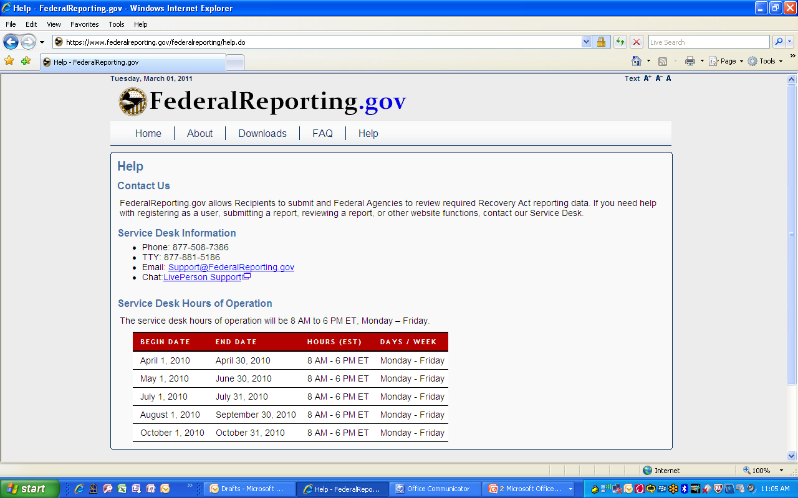
Available resources for recipients (con’t)
There is a wealth of training materials and resources, such as presentations and webinars, available for recipients
https://www.federalreporting.gov
Live Chat function is helpful to get real-time documented help from customer service representatives
Click on the link from the “Help” tab on FederalReporting.gov.
The response is almost immediate
“Operators” have the ability to solve problems in minutes, rather than waiting several hours or days for something to go through the normal process
For example, one recipient had not obtained their FRPIN despite several emails advising them to do so. When it got down to “crunch time”, we advised the recipient to use the “Live Chat”, and they had the FRPIN emailed to them almost immediately and they were able to report successfully and on time
Function is much more useful than having the recipients “wading through the websites, help screens, etc.”
The post-chat email that is sent to the recipient documents the entire conversation, and is important to support their efforts to report.
Additionally, “Downloads” section has templates, Recipient Reporting Data Dictionary, Webinars, User Guide, Quick Reference Guide, and Reference Data and additional links

Slide 10
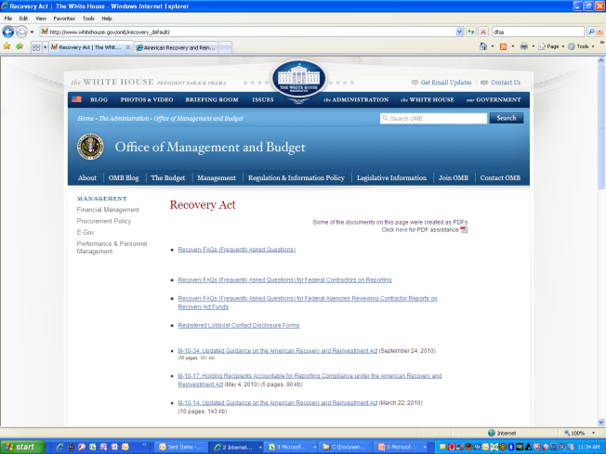
Available resources for recipients (con’t)
There is a wealth of training materials and resources, such as presentations and webinars, available for recipients
http://www.rurdev.usda.gov/recovery.html
USDA Rural Development Recovery Web site with useful links at the bottom under “Recipient Reporting” section
Includes links to FR.gov, Dun & Bradstreet, CCR, Recovery.gov, RD Computer locations, USDA Recipient Reporting guidelines, 1511 Certifications
http://www.whitehouse.gov/omb/recovery_default/
Contains Recovery Frequently Asked Questions and links to OMB Memorandums
Including links to the most recent OMB Guidance
Memorandum 10-34 (September 24, 2010)
Memorandum 11-34 (September 15, 2011)

Slide 11
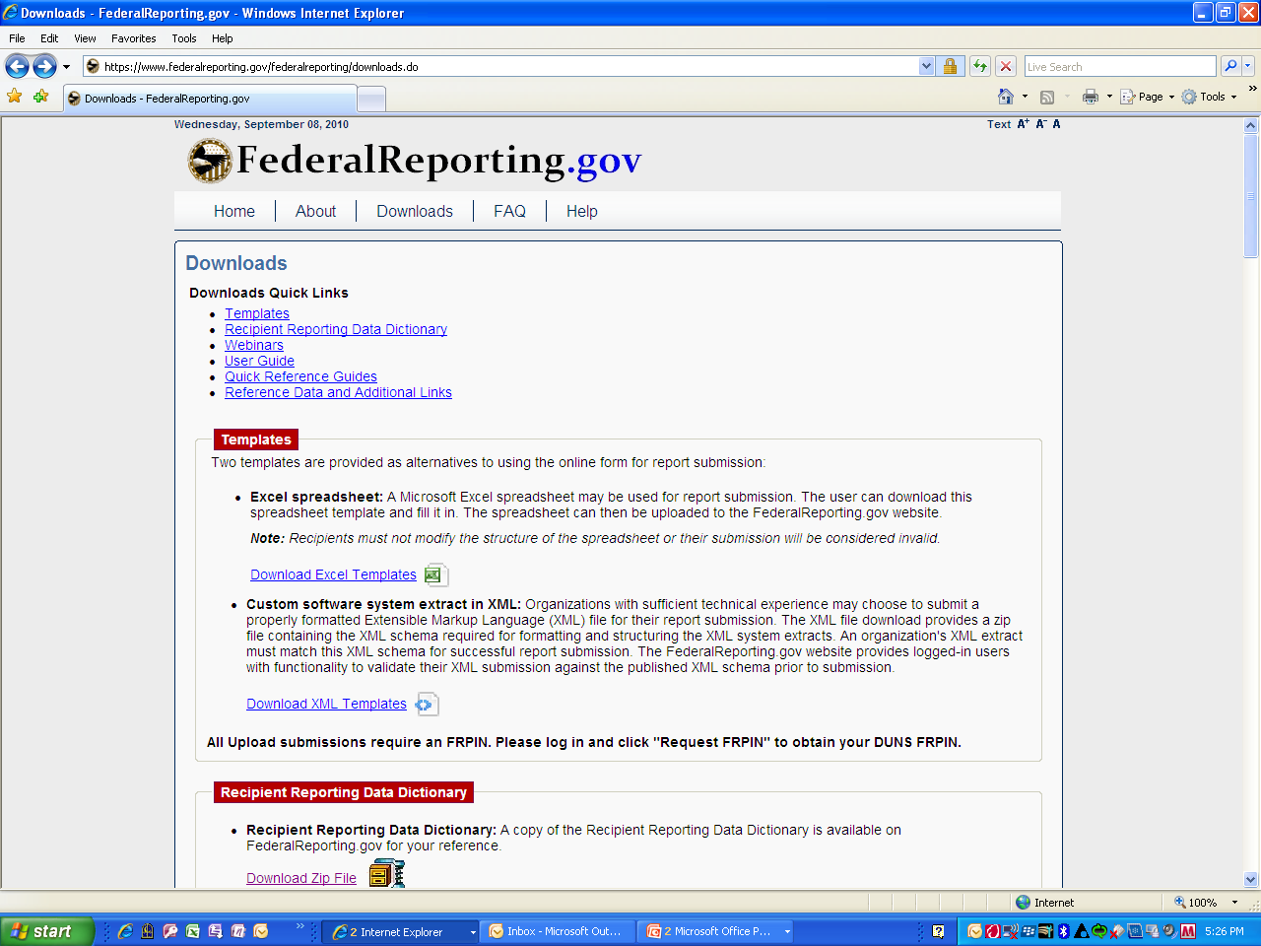
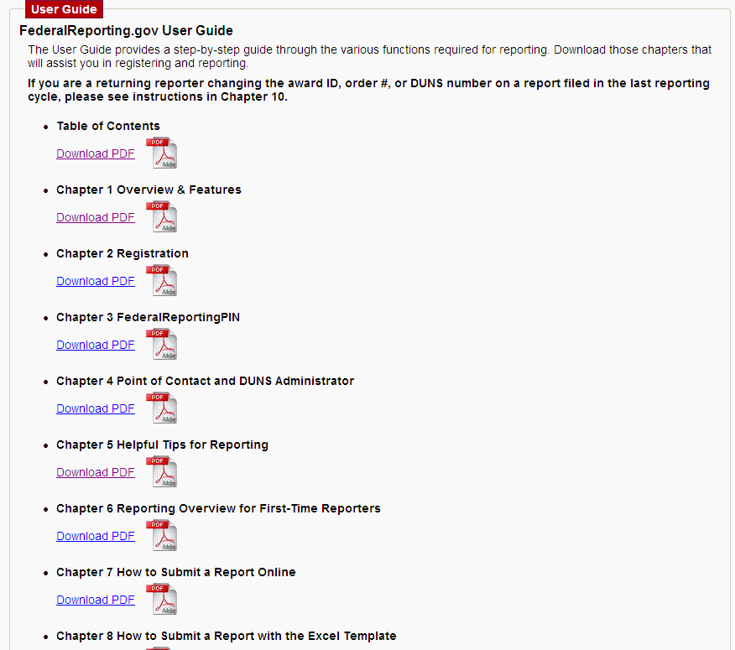
Available resources for recipients (con’t)
Use available guides and quick reference cards to get you started (from https://www.federalreporting.gov/federalreporting/downloads.do)

Slide 12
Available resources for recipients (con’t)
Use available guides and quick reference cards to get you started (from https://www.federalreporting.gov/federalreporting/downloads.do)

Slide 13
Best practices: Reporting
There are several critical elements which are used by Rural Development and by OMB M10-08 in their review of Recipient Reporting
The Major Comparison Points include:
Award ID
Award Type
Award Amount $
Award Date (date of obligation per RD)
Awarding/Funding Agency code
DUNS number
Catalogue of Federal Domestic Assistance (CFDA) Number
Program Treasury Accounting Symbol (TAS) Code
Order Number (Contracts only)
The descriptive narrative fields should also become a focus for recipients
OMB Memorandum 10-34 emphasizes that recipients should ensure that narrative field descriptions are clear

Slide 14
Best practices: Narrative descriptions
The Narrative Description fields in FR.gov should provide sufficient clarity and detail to facilitate understanding by the general public. These narrative fields include:
Award Description
Quarterly Activities/Project Description for Prime and Sub-Recipients
Description of Job Created (If Jobs Created > 0 )
Infrastructure Purpose and Rationale (if applicable)
OMB Guidance is available here: http://www.whitehouse.gov/sites/default/files/omb/memoranda/2010/m10-34.pdf

Slide 15
Best practices: Narrative descriptions (con’t)
Use clear and concise narrative descriptions, explaining all abbreviations/acronyms which may be unfamiliar to the general public; and, use of complete sentences:
Example: Rural Development grant funds will be used to purchase furnishings and equipment for the XXX County Emergency Medical Services (EMS) facility when renovations are completed.
Example: XXX Water Project. This is construction of a new municipal water well, approximately 400 feet deep with a 14" casing. It includes installation of a pump, controls, emergency generator, well house building and approximately 1,400 feet of pipeline for connection to existing City water lines. Project is over 50% complete and is also funded with other funding, as well as our ARRA grant award ID XX-XX.
Entries in the “Award Description” and “Quarterly Activities/Project Description for Prime and Sub-recipients” fields must provide, at a minimum, clear and complete information on the award’s purpose, scope and nature of activities, outcomes, and status of activities
Ensure narratives are clear enough for the layman/general public to understand how funds are being used
All narrative description and award data reported in FR.gov is sent to Recovery.gov for review by the general public
Need to demonstrate that we are being good stewards of taxpayer monies by being transparent about how the monies are being used in our communities

Slide 16
Best practices: Jobs calculation
Report the total number of Jobs created/retained using ARRA funds only
The jobs number in the ARRA report is a snapshot of those jobs created/retained for the reporting quarter only (January 1 – March 31, 2012) and should reflect jobs created/retained as result of that specific ARRA award
Even if prior reported job numbers may have been incorrectly reported, only report those jobs created/retained for the reporting period only
Per OMB M-10-34, there is not a requirement to correct job numbers in prior reporting periods
Therefore, it is important that the job count is accurate for the reporting quarter
Report Jobs created/retained for the reporting quarter even if there have not been any ARRA disbursements
Note an explanation in the Project Description to indicate that the work is going forward and funds to be disbursed at end of the project (if applicable)
This would explain to the public the reason that they had jobs created even though no funds were invoiced or disbursed/expended
If needed, create further explanation about the job activities in the accompanying narrative field
Do not duplicate job numbers for loan & grant combination awards
Ensure the jobs number is reflective of sub-recipient and vendors, if applicable
Include hours worked by sub-recipients and vendors, if applicable, if the hours were funded by the specific ARRA award
If needed, create further explanation about the job activities in the accompanying narrative field
Utilize available resources to create accurate job estimates
Reference OMB-10-08 “Updated Guidance on the American Recovery and Reinvestment Act – Data Quality, Non-Reporting Recipients, and Reporting of Job Estimates” (December 18, 2009) (24 pages, 188 kb)
Utilize the Rural Development-created Job Calculations tool (http://www.rurdev.usda.gov/arra/reporting.html)

Slide 17
Best practices: Loan/Grant Combinations
Concern: Loan award portion of project award has been fully expended, but Grant award portion is still active and may have no funds invoiced or expended
Recipient is unsure how to report project status for both awards and does not want the continued burden to report on the loan award
Best practice: Report Loan award portion as final report and Grant award portion according to overall project status
Loan award portion should be reported as final report, with reference in the narrative of the associated Grant award ID for the project
Grant award portion should indicate the full project status, regardless of ARRA funds expensed, etc.
Indicate in the remaining Grant award narrative description (quarterly activities narrative) the activities performed in the quarter by the prime and sub recipients, referencing other ARRA award IDs which are part of the particular project. If applicable, mention other funding
Ensure report reflects project status on award for entire project, regardless of ARRA funds expended on award
The Office of the Chief Financial Officer for USDA (OCFO) has told us that recipients should use the narrative spaces to explain any reporting that may show a flag to OMB, but which can be fully explained.
Prose tool may continue to show a “flag” in the Status column, which the State can ignore after performing the due diligence review
The key is to maintain transparency on the entire project, referring to the award as a part of the overall project
The recipient should feel free to rely on the narrative areas (when there are status flags, use the quarterly description of activities area) to explain any potential areas where OMB or the public may cause question.
Notes:
CF/WEP: Loan funds completely disbursed followed by grant funds
Broadband: Loan and grant funds are disbursed in proportion to the ratio of the grant-to-loan of the total Award. If the grant and loan are the same amount, the disbursements will be the same.
Ex: $4,627,306 (Total Award Amount) = $2,267,380 grant (49%) + $2,359,926 (51%)
Disbursement: $103,107.00 = $50,522.00 (grant funds) + $52,585.00 (loan funds)

Slide 18
Best practices: Loan/Grant Combos (Cont’d)
Concern: Prose tool flags award for “Status” and Agency user has verified that report is correct
Status flags are based on a formula looking at award value, funds expended, and project status reported; flags when something falls out of the suggested OMB guideline
Best practice: Ensure report reflects project status on award for entire project, regardless of ARRA funds expended on award
If Loan award portion is final report, project status should be “Fully complete” with reference in the narrative of the associated Grant award ID for the project
Grant award portion should indicate the full project status, regardless of ARRA funds expensed, etc.
Indicate in the remaining Grant award narrative description (quarterly activities narrative) the activities performed in the quarter by the prime and sub recipients, referencing other ARRA award IDs which are part of the particular project. If applicable, mention other funding
The Office of the Chief Financial Officer for USDA (OCFO) has told us that recipients should use the narrative spaces to explain any reporting that may show a flag to OMB, but which can be fully explained
Prose tool may continue to show a “flag” in the Status column, which the State may ignore after performing the due diligence review of the report
The key is to maintain transparency on the entire project, referring to the award as a part of the overall project
The recipient should feel free to rely on the narrative areas (when there are status flags, use the quarterly description of activities area) to explain any potential areas where OMB or the public may cause question.

Slide 19
Getting started: Recipients
A little bit of planning goes a long way with Recipient reporting requirements
Verifying and validating DUNS number on record associated with award
Reviewing and validating Central Contractor Registry (CCR) registration
Obtaining FRPIN (from FederalReporting.gov)
Understanding functions of FederalReporting.gov functions which may make reporting easier
“Copy forward” function
1
2
3
4

Slide 20
Getting started: Recipients (con’t)
1
Verifying and validating Dun & Bradstreet Numbering System (DUNS) number on record associated with award
It is the recipient’s responsibility to ensure that that their DUNS number and entity record is accurate and active with Dun and Bradstreet (D&B).
While DUNS numbers don’t expire, D&B does conduct routine and continuous data maintenance and outreach to verify operations at a location. When operations cannot be verified for a particular DUNS number, D&B may flag the number “inactive,” which could interfere with successful reporting. It is also important that the entity information is accurate when reporting on government websites.
The DUNS record the recipient plans on reporting in FederalReporting.gov should be compared against that on record with the Rural Development point of contact
In order to request a DUNS number or to lookup, review, or modify a record at D&B, recipients may use the following two free resources:
The self-service web form at http://fedgov.dnb.com/webform allows a recipient to lookup their DUNS number, review the data on file, request changes if necessary, or request a new DUNS number, if needed.
Recipients may call (866) 705-5711 to verify that a DUNS number is active and confirm other details about their entity

Slide 21
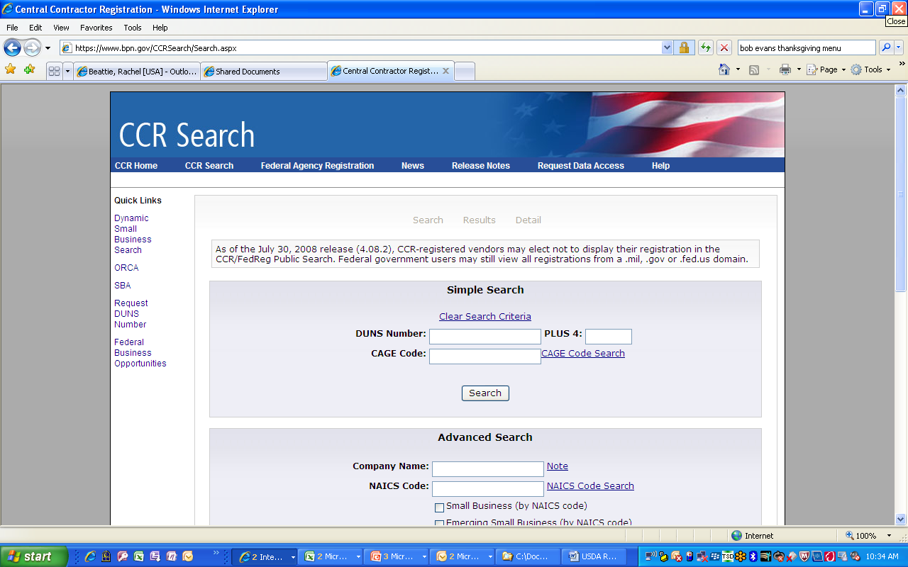
Getting started: Recipients (con’t)
2
Reviewing and validating Central Contractor Registry (CCR) registration (https://www.bpn.gov/ccr/default.aspx)
For recipients with existing CCR registrations, ensure your CCR information is up-to-date and will be active throughout the reporting cycle
Recipients may use the Search function on the CCR website: https://www.bpn.gov/CCRSearch/Search.aspx to verify status
CCR registration must be renewed at least every 12 months and an expired registration will prevent report submission &/or modification by the recipient
Maintaining current Points of Contact in the CCR record will assure recipients that renewal reminders are received and that FRPINs are approved in FR.gov
For recipients requiring CCR registration, register with CCR and obtain a DUNS number in order to register
Re-instating an expired registration requires specific recipient actions to protect the security of the record, processing time, and additional time to update FederalReporting.gov
Recipient instructions may be found at Chapter 2 of the User Guide at the downloads page of FederalReporting.gov
Notes:
From Pages 4-5 of USDA Recipient Reporting Guidelines:
For recipients with existing CCR registrations, ensure your CCR information is up-to-date and will be active throughout the reporting cycle
Go to CCR's home page (http://www.ccr.gov), and log in with your user ID and password. You will be directed to your “Manage Registrations” page.
Under the “CCR Registrations Linked to Your Account” section, select “Update/Renew” for the DUNS number of the record you wish to change.
Make the necessary changes. Then click the “Validate/Save Data” button to register an update in the system. When you receive the “Registration Complete” screen your registration will process the update.
To submit a renewal with no changes, follow the same steps listed above with the exception of making changes to your information. Reminder: you must click “Validate/Save Data” to activate the renewal even if none of your information has changed. Please be aware that requirements may have been implemented since your last visit. You may receive an error on your renewal if a new requirement is not fulfilled.
If recipients have questions, they should refer to the CCR help page at: http://www.bpn.gov/ccr/Help.aspx. It contains further directions and a helpdesk line.
For recipients requiring CCR registration, register with CCR and obtain a DUNS number in order to register
New reporters are encouraged to register early to ensure time for Dun and Bradstreet Universal Numbering system (DUNS) number and Central Contractor Registry (CCR) registration. For instructions, please read Chapter 2 of the User Guide at the downloads page of FederalReporting.gov. Additionally, all recipients carry the responsibility to ensure that their CCR information is up-to-date and will be active throughout the reporting cycle. CCR registration must be renewed at least every 12 months and an expired registration will prevent report submission &/or modification by the recipient.
Maintaining current Points of Contact in the CCR record will assure recipients that renewal reminders are received. It is the recipient’s responsibility to ensure that that their DUNS number and entity record is accurate and active with Dun and Bradstreet (D&B). While DUNS numbers don’t expire, Dun and Bradstreet (D&B) does conduct routine and continuous data maintenance and outreach to verify operations at a location. When operations cannot be verified for a particular DUNS number, D&B may flag the number “inactive,” which could interfere with successful reporting. It is also important that the entity information is accurate when reporting on government websites. In order to request a DUNS number or to lookup, review, or modify a record at D&B, recipients may use the following two free resources:
The self-service web form at http://fedgov.dnb.com/webform allows a recipient to lookup their DUNS number, review the data on file, request changes if necessary, or request a new DUNS number, if needed.
Recipients may call (866) 705-5711 to verify that a DUNS number is active and confirm other details about their entity

Slide 22
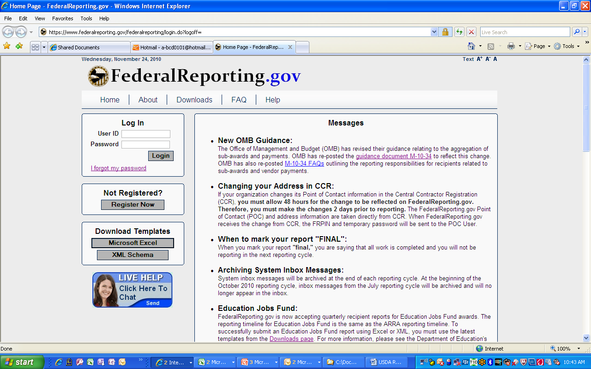
Getting started: Recipients (con’t)
3
Obtaining Federal Reporting.gov PIN (FRPIN) from FederalReporting.gov
A FRPIN is required for successful FR.gov submission
FRPINs are unique to the users’ DUNS and CCR combinations
There may be multiple FRPINs assigned to a single CCR/DUNS combination
Typically, the CCR point of contact is automatically assigned an FRPIN and also serves as the organization’s DUNS administrator, unless the administrator delegates it to someone else
FRPIN issuance can occur at any time, however, the FR.gov organization POC must approve issuance of FRPINs
Once approval occurs by your organization’s POC, FR.gov issues the FRPIN automatically
If you have not received approval within 24 hours by FR.gov, contact your organization’s POC to ensure they have approved your request
From FederalReporting.gov User Guide: Chapter 3 – FederalReportingPIN - FRPIN
Notes:
From Pages 4-5 of USDA Recipient Reporting Guidelines:
For recipients with existing CCR registrations, ensure your CCR information is up-to-date and will be active throughout the reporting cycle
Go to CCR's home page (http://www.ccr.gov), and log in with your user ID and password. You will be directed to your “Manage Registrations” page.
Under the “CCR Registrations Linked to Your Account” section, select “Update/Renew” for the DUNS number of the record you wish to change.
Make the necessary changes. Then click the “Validate/Save Data” button to register an update in the system. When you receive the “Registration Complete” screen your registration will process the update.
To submit a renewal with no changes, follow the same steps listed above with the exception of making changes to your information. Reminder: you must click “Validate/Save Data” to activate the renewal even if none of your information has changed. Please be aware that requirements may have been implemented since your last visit. You may receive an error on your renewal if a new requirement is not fulfilled.
If recipients have questions, they should refer to the CCR help page at: http://www.bpn.gov/ccr/Help.aspx. It contains further directions and a helpdesk line.
For recipients requiring CCR registration, register with CCR and obtain a DUNS number in order to register
New reporters are encouraged to register early to ensure time for Dun and Bradstreet Universal Numbering system (DUNS) number and Central Contractor Registry (CCR) registration. For instructions, please read Chapter 2 of the User Guide at the downloads page of FederalReporting.gov. Additionally, all recipients carry the responsibility to ensure that their CCR information is up-to-date and will be active throughout the reporting cycle. CCR registration must be renewed at least every 12 months and an expired registration will prevent report submission &/or modification by the recipient.
Maintaining current Points of Contact in the CCR record will assure recipients that renewal reminders are received. It is the recipient’s responsibility to ensure that that their DUNS number and entity record is accurate and active with Dun and Bradstreet (D&B). While DUNS numbers don’t expire, Dun and Bradstreet (D&B) does conduct routine and continuous data maintenance and outreach to verify operations at a location. When operations cannot be verified for a particular DUNS number, D&B may flag the number “inactive,” which could interfere with successful reporting. It is also important that the entity information is accurate when reporting on government websites. In order to request a DUNS number or to lookup, review, or modify a record at D&B, recipients may use the following two free resources:
The self-service web form at http://fedgov.dnb.com/webform allows a recipient to lookup their DUNS number, review the data on file, request changes if necessary, or request a new DUNS number, if needed.
Recipients may call (866) 705-5711 to verify that a DUNS number is active and confirm other details about their entity

Slide 23
Getting started: Recipients (con’t)
4
Understanding functions of FederalReporting.gov functions which may make reporting easier
“Copy forward” function
Returning Recipient reporters should utilize this function within FederalReporting.gov report submission process
“Links” current and previous quarter’s reports (Q3 2011) and allows the public to follow the progress of projects over time (via data sent from FR.gov to Recovery.gov)
When using this function, the responsibility resides with the recipient to make updates to the draft report created for the current reporting cycle
The recipient must review all data fields to ensure all data is complete and correct (all financial fields are cumulative to date; number of jobs created/retained is a quarterly snapshot, narratives may need to be updated)
A full discussion of this process is available in Chapter 10 of the User Guide at FederalReporting.gov

Slide 24
Lessons Learned from 4th Quarter 2011
Rural Development had a very successful reporting quarter in Q4 2011 (99% compliance)
Out of a total of 2293 awards, there were just 23 awards considered non-compliant
1
Validate DUNS, CCR registration, and FRPIN early, well before April reporting cycle
Verify DUNS is active
Validate CCR information is up-to-date (POC info) and registration is active (not expired or pending expiration during reporting period) and linked to DUNS
Ensure that the recipient POC performing the reporting has a FRPIN, which has been issued by FederalReporting.gov
Start the process early to avoid potential technical glitches or errors in reports
It may take between 48-72 hours within each system (DUNS, CCR or FederalReporting.gov) to update records
This takes away valuable reporting time during the Initial Submission Period (typically only 10 calendar days!)
Preparation and communication are key to successful reporting
Understand whether or not recipients are running into any obstacles related to reporting
Understand additional staff which recipients may have available to help them (for WEP: RCAP and NRWA are available)
2
3
Notes:
From USDA Recipient Reporting Guidelines:
Recipients register at the FederalReporting.gov Web portal (federalreporting.gov). All recipients, including grantees) must register with Central Contractor Registry (CCR) and obtain a DUNS number in order to register. CCR registrations must be fully up-to-date and remain active throughout the reporting cycle. Because re-instating an expired registration requires specific recipient actions to protect the security of the record, processing time, and additional time to update FederalReporting.gov, agencies must advise recipients to check their CCR registration prior to the beginning of each reporting cycle.
New reporters are encouraged to register early to ensure time for Dun and Bradstreet Universal Numbering system (DUNS) number and Central Contractor Registry (CCR) registration. For instructions, please read Chapter 2 of the User Guide at the downloads page of FederalReporting.gov. Additionally, all recipients carry the responsibility to ensure that their CCR information is up-to-date and will be active throughout the reporting cycle. CCR registration must be renewed at least every 12 months and an expired registration will prevent report submission &/or modification by the recipient. Maintaining current Points of Contact in the CCR record will assure recipients that renewal reminders are received. It is the recipient’s responsibility to ensure that that their DUNS number and entity record is accurate and active with Dun and Bradstreet (D&B). While DUNS numbers don’t expire, Dun and Bradstreet (D&B) does conduct routine and continuous data maintenance and outreach to verify operations at a location. When operations cannot be verified for a particular DUNS number, D&B may flag the number “inactive,” which could interfere with successful reporting. It is also important that the entity information is accurate when reporting on government websites. In order to request a DUNS number or to lookup, review, or modify a record at D&B, recipients may use the following two free resources:
The self-service web form at http://fedgov.dnb.com/webform allows a recipient to lookup their DUNS number, review the data on file, request changes if necessary, or request a new DUNS number, if needed.
Recipients may call (866) 705-5711 to verify that a DUNS number is active and confirm other details about their entity.

Slide 25
Common mistakes in reporting
New reports for the reporting quarter can only be submitted during the Submission period (April 1-14)
Recipients will not be able to submit new reports after the Submission period passes and they will be considered non-compliant reporters
Only edits and revisions to existing reports will be allowed after Submission period
Report Grants and Loans separately within FederalReporting.gov
Combination Loan and Grant projects must report for the Grant and for the Loan separately (i.e., 2 reports)
Do not report duplicate job numbers for a loan and grant combo
Obtain correct award ID information for your award(s)
Pay attention to the reported Award ID, especially dashes, spaces, numbers, etc.
Recipients should refer to their USDA Rural Development staff point of contact for the correct information for your award(s)

Slide 26
Common mistakes in reporting (con’t)
Ensure recipients receive a confirmation for each reported award from FR.gov
Draft reports do not count towards submission; ensure report is “Submitted”
FederalReporting.gov will generate an email to the recipient indicating any errors to the report and will indicate that these errors need to be corrected before the report is considered “Submitted”
For example, if the recipient is submitting 3 reports, they should have 3 submission confirmations from FR.gov
Save and print out ARRA report submission confirmation from FR.gov for each award(s) and send it to your Rural Development POC for their records
Work with RD staff to obtain the Date of Award and TAS Code for your USDA Rural Development award
Recipients should refer to their USDA Rural Development staff point of contact for the correct information for their award(s)
Ensure recipients make themselves available during the reporting period
Recipients may need to turn around changes to their report or clear up errors on reports during Initial Submission before the reports are considered submitted
Provide valid contact numbers and email addresses to Rural Development POCs

Slide 27
Summary
Submission begins on April 1st and goes through April 14th
New reports will be accepted by FederalReporting.gov until 11:59 PM EST on April 14th
Begin the processes now to validate, verify, and register (if necessary) each of the following:
DUNS, CCR Registration, FRPIN (from FederalReporting.gov)
All these data elements (DUNS, CCR, and FRPIN) are linked to each other and errors in one system will cause errors or non-submission in the other systems
Pre-fill out reporting templates with award ID and other relevant Recipient Reporting award data for submission on April 1st or early in the Initial Submission to ease the submission process and account for any technical glitches
Reach out to your Rural Development points of contact as soon as they encounter any obstacles
For Water and Environmental Programs recipients, also utilize the ARRA Technical Assistance Providers and Circuit Riders and to help with reporting

Slide 28
Rural Development points of contact for ARRA Recipients
1st level:
Rural Development point of contact in your local RD office
For Broadband recipients, utilize your assigned Rural Development General Field Representatives (GFRs) in the RD office
2nd level:
Recipient Reporting Team, USDA Rural Development
Broadband Initiatives Program (BIP) POC: Joseph Sorresso, Broadband Industry Economist, Rural Development, Joseph.Sorresso@wdc.usda.gov

Slide 29
Questions and Answers

