Slide 1
GOES-R Ground System and Algorithm Implementation Design
Alex Werbos
Lizzie Lundgren
Scott Zaccheo
Cristina Bories
Rob Kaiser

Slide 2
Outline
Product Generation Overview
Algorithm Execution Model
Algorithm Design
Algorithm Pre-invocation
Defines algorithm contexts
Gathers inputs
Algorithm Execution
Reads input
Processes data
Write output to persistence layer
End-Product Generation
System collects algorithm outputs into products
Algorithm Software Structure

Slide 3
Product Generation Overview
Product Generation Overview
Algorithm Execution Model
Algorithm Design
Algorithm Pre-invocation
Defines algorithm contexts
Gathers inputs
Algorithm Execution
Reads input
Processes data
Write output to persistence layer
End-Product Generation
System collects algorithm outputs into products
Algorithm Software Structure

Slide 4
Product Generation Responsibilities
Algorithms generate product data, not products
Not concerned with end-product formats, encoding
Only dynamic scientific data needed for end-products
Generate summary statistics on a per-block basis
Products are assembled by other entities
The Data Fabric, the underlying data infrastructure layer, automatically assembles image pieces as they arrive
Operational Metadata Assembly Service (OMAS) builds block-level metadata into scene metadata
Product Distribution assembles raw image data, scene metadata, and supporting semi-static data into final product files

Slide 5
Product Generation Responsibilities

Slide 6
Algorithm Execution Model
Product Generation Overview
Algorithm Execution Model
Algorithm Design
Algorithm Pre-invocation
Defines algorithm contexts
Gathers inputs
Algorithm Execution
Reads input
Processes data
Write output to persistence layer
End-Product Generation
System collects algorithm outputs into products
Algorithm Software Structure

Slide 7
Algorithm Execution Model
Passive Software Component
Algorithms are effectively subroutines run on a particular “area”
A piece of software called the Algorithm Executor is responsible for scheduling and running algorithms
Operate on Output Contexts
Since “areas” may be spatial and/or temporal, we use generalized notion of a Context, which encapsulates an algorithm’s output region
Execution Paradigm
Invoked for a particular Context
Get input necessary to produce output for Context
Generate outputs for Context
Terminated

Slide 8
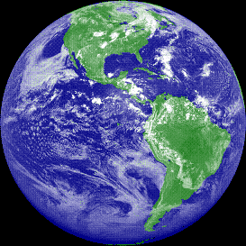
Contexts Overview
Example Context
Absolute location
Spatial extent
Absolute Time
Definition
Structure defining spatial and/or temporal extent of a processing region
Application
Input : Defines extent of dynamic and static inputs
Output : Defines output block size

Slide 9
Getting from New Data to End-Products
There are several steps in the algorithm execution environment to move from new data to end-product
Pre-Invocation (Algorithm Executor)
Defines algorithm Contexts
Gathers input
Algorithm Execution (Algorithm)
Reads input
Processes data
Writes output to Data Fabric
End-Product Generation (Multiple GS actors)
Collects algorithm outputs into scene data
Formats scene data into product files

Slide 10
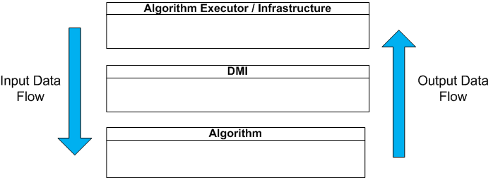
Basic Software Building Blocks
Algorithm Executor
Schedules and executes algorithms on a Context by Context basis
Data Model Interface (DMI)
Abstract interface between interworking of infrastructure and algorithms
Sub-interfaces exist for reading and writing different types of data (ABI data, Ancillary data, predecessor product data, etc.)
Algorithm
Autonomous and stateless compute engine

Slide 11
Algorithm Pre-invocation
Product Generation Overview
Algorithm Execution Model
Algorithm Design
Algorithm Pre-invocation
Defines algorithm contexts
Gathers inputs
Algorithm Execution
Reads input
Processes data
Write output to persistence layer
End-Product Generation
System collects algorithm outputs into products
Algorithm Software Structure

Slide 12
Creating Algorithm Contexts
Contexts are built to cover entire images
Instantiated by Algorithm Executor as new images arrive
Contexts may vary between algorithms
High computational needs may require smaller, more numerous blocks

Slide 13
Algorithm Strategies
Algorithm Strategies Define Context Requirements
Processing Requirements
Processing block size restrictions (minimum, integer multiple)
Input padding requirements
Temporal requirements
Required and Optional Data
L1b products
Predecessor L2+ products
Ancillary data
Auxiliary data
Predecessor intermediate data
Required algorithm specific scratch/persist data
Algorithm processing parameters

Slide 14
Combining Context and Algorithm Strategies
The Algorithm Executor combines Contexts with Algorithm Strategies to determine the data necessary to run a particular algorithm on a particular Context.
Algorithm Strategy provides
Desired Product name(s)
Spatial padding
Temporal offset
Context provides
Absolute location and time information

Slide 15
Gathering Inputs
Inputs are defined by the Algorithm Strategy and the Current Context
Algorithms are only invoked once all inputs for the context are available
Wait for the input data specified in the algorithm strategy
If some data are unavailable, wait for a timeout, then run algorithm anyway
Some contexts will start before others
Processing is spread across entire image arrival timeline

Slide 16
Algorithm Execution
Product Generation Overview
Algorithm Execution Model
Algorithm Design
Algorithm Pre-invocation
Defines algorithm contexts
Gathers inputs
Algorithm Execution
Reads input
Processes data
Write output to persistence layer
End-Product Generation
System collects algorithm outputs into products
Algorithm Software Structure
Notes:
LL:
-change Write to Writes. Global for all instances of this slide.

Slide 17
Algorithm Execution Lifecycle
Four Stages
Algorithm Initialization
Compute
Output
Termination

Slide 18
Algorithm Process Flow: Initialization
Initialization Process
Creates DMI instance
Interface to Pre-fetched infrastructure data
I/O interfaces for algorithm
Creates Algorithm instance
Context information
Interface to DMI
Algorithms read data in an on-demand fashion from DMI based on the provided context
Notes:
LL:
-I would add “Once initialized, ” to beginning of second bullet
-Why is the algorithm object yellow?

Slide 19
Algorithm Process Flow: Compute
Algorithm gets data from DMI in immediately-usable formats (e.g. floating point, integer, enumeration)
Algorithm places results in DMI-provided structures
Matrices of numbers
Custom structs/classes to hold packed data (e.g. radiance + quality flag)

Slide 20
Algorithm Process Flow: Output
All persistent data must pass through DMI
Output data, context-level summary statistics and algorithm persistent/scratch data
Output generated for entire Context

Slide 21
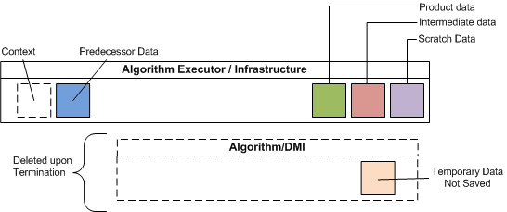
Algorithm Process Flow: Termination
Algorithm terminates after writing context output
Algorithm and DMI instances can be destroyed
All data not saved in infrastructure is lost

Slide 22
End-Product Generation
Product Generation Overview
Algorithm Execution Model
Algorithm Design
Algorithm Pre-invocation
Defines algorithm contexts
Gathers inputs
Algorithm Execution
Reads input
Processes data
Write output to persistence layer
End-Product Generation
System collects algorithm outputs into products
Algorithm Software Structure

Slide 23
Complete Product Creation Process

Slide 24
Algorithm Software Structure
Product Generation Overview
Algorithm Execution Model
Algorithm Design
Algorithm Pre-invocation
Defines algorithm contexts
Gathers inputs
Algorithm Execution
Reads input
Processes data
Write output to persistence layer
End-Product Generation
System collects algorithm outputs into products
Algorithm Software Structure

Slide 25
Algorithm Software
Algorithms are all derived from a common base class
Defines run(…) method which takes a Context as a parameter
Algorithm logic is contained within algorithm-specific implementation of run interface
Algorithms use shared library calls to read data and perform common functions
Algorithm queries DMI objects to get inputs needed to generate output for context
DMI_ABI.readRadiances(Context.time, Context.pixelRegion, ABI_BAND_5)
Common utilities such as Local Radiative Center are defined in common library and can be invoked by all algorithms
Notes:
Mention specific C++ details of how these things work
LL:
This slide kind of hangs out all by itself at the end. You’ll have to make the function of it clear when you talk…like this is a very short and simple overview of the software because the details are beyond the scope of the talk. And welcome people who have more specific questions regarding the details of the software implementation design to seek us out later or ask during the Q&A. Speaking of which, there should be an end slide asking for questions.

Slide 26
Algorithm Implementation Summary
Algorithms are subroutines parameterized by Contexts, which determine the input and output regions of one execution
Algorithms use DMIs to read their necessary inputs without having to know how those data are stored
Software called the Algorithm Executor builds Contexts to cover all the input data, and run the algorithm software on those contexts
Algorithms produce block level outputs that are stitched together by the Data Fabric and OMAS

