Slide 1
National Broadband Map
API Case Study

Slide 2
National Broadband Map
The National Broadband Map is the statutory responsibility of the
  National Telecommunications Information Administration (NTIA)
  Under the Broadband Data Improvement Act, congress directed NTIA to build and maintain a database of broadband availability that is ‘searchable and interactive’
  NBM was funded under ARRA

Slide 3
National Broadband Map
NTIA awarded grants to each state and territory to collect broadband data
The broadband data is about;
  Which company provides service
  Where do they provide that service
  What kind of service do they provide
  How fast do they advertise that service
  For all providers
Data is collected at the US Census Block Level

Slide 4
Project Focus – Collaboration
Federal to Federal; Federal to State; State to private sector; Private sector to Federal
See http://www.fgdc.gov/library/whitepapers-reports/annual%20reports/2011
NTIA – FCC
  NTIA distributing ARRA funds for broadband infrastructure investment
  FCC making regulatory decisions on the distribution of Universal Service money

Slide 5
Size and Scope of Data
US Census Block level (10.5 million)
Addresses (~130 million of these)
Street Segments (~40 million)
Data collection twice a year, each collection has about 25 million records (predominantly block based)

Slide 6
Thinking about data architecture first
Embody the spirit of the internet
‘Searchable and Interactive’
Search meant, search at a place; an address
  1325 J St, Sacramento CA
  Our challenge is to deliver 25 million rows in less than 1 second AND make something functional

Slide 7
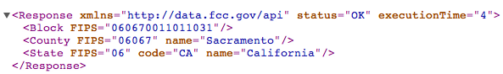
Agile – start small, success, repeat
  1325 J St, Sacramento CA
  38.579, -121.488
  http://data.fcc.gov/api/block/2010/find?latitude=38.579&longitude=-121.488
  Add Providers …

Slide 8
Agile – start small, success, repeat
  http://data.fcc.gov/api/block/2010/find?latitude=38.579&longitude=-121.488
  Add Providers …
  http://www.broadbandmap.gov/broadbandmap/broadband/jun2011/wireline?latitude=38.579&longitude=-121.488&format=xml

Slide 9
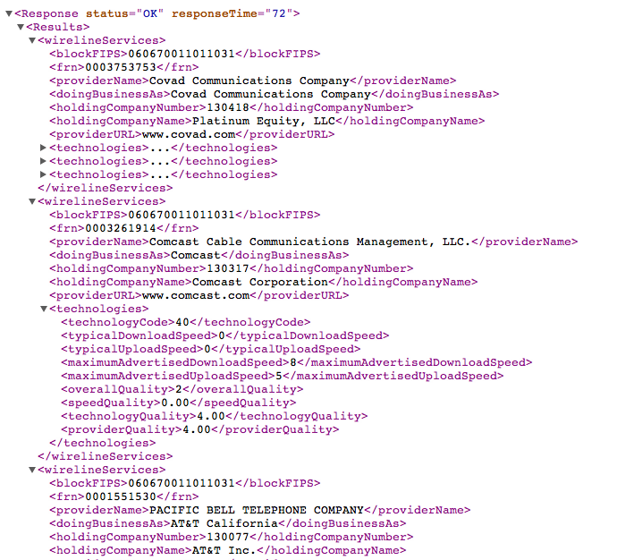

Slide 10
Agile – start small, success, repeat
The site www.broadbandmap.gov consumes 100% of our data via APIs we also publish for public availability (dogfooding)
Value
  We demonstrate how sure we are in our process for developers
  It’s the definition of transparency
  Small digestible bites are more robust
  Get more people to our data

Slide 11
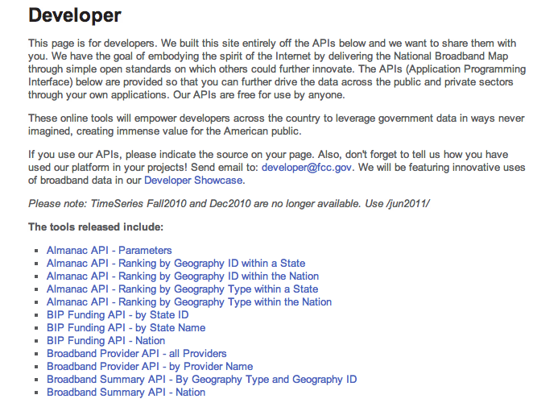
All NBM APIs - http://broadbandmap.gov/developer

Slide 12
More people to our data
We track our API usage
  Our APIs have been used in a ratio of about 4:1 vs. normal web traffic.
  We know of 4 – 6 applications built using our APIs

Slide 13
Parallel Paths
We offer
  APIs
  Data Downloads
  Map services

Slide 14
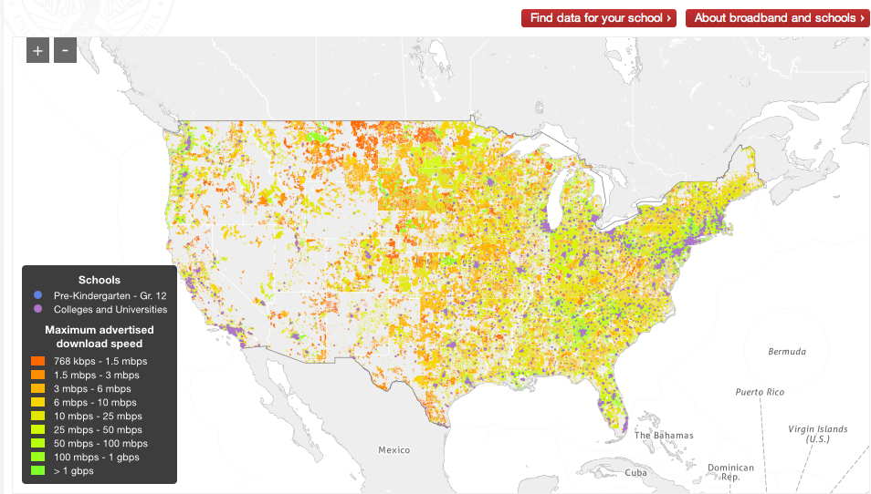
Low barrier to consume
API and Map services present a low barrier for others to consume
Department of Education Example

Slide 15
Thanks

