Slide 1
Social Security
www.socialsecurity.gov

Slide 2
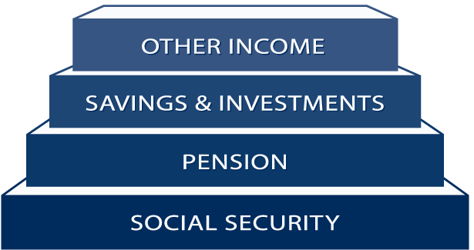
A Foundation for Planning Your Future
Notes:
Social Security provides a foundation on which to build
retirement security.

Slide 3

In 2016, Social Security Will Begin Paying
More in Benefits than is Collected in Taxes
Notes:
Social Security's annual surplus of tax income over expenditures fell sharply in 2009 and will stay about constant in 2010 because of the economic recession, and rise only briefly before declining and turning to cash flow deficits beginning in 2016 that grow as the baby boom generation retires. The deficits will be made up by redeeming trust fund assets until reserves are exhausted in 2037.

Slide 4
Social Security Trust Funds will
be Exhausted in 2037
At exhaustion in 2037,
only about 76% of
benefits could be paid.
Calendar Year
Notes:
After 2037, only about 76% of benefits could be paid if no changes are made.

Slide 5

How Do You Qualify for
Retirement Benefits?
You need to work to earn
Social Security “credits”
Each $1,120 in earnings
gives you one credit
You can earn a maximum
of 4 credits per year
Example: To earn 4 credits in 2011, you must earn
at least $4,480. Earning 40 credits (10 years of work) throughout your working life will qualify you for a retirement benefit.
Notes:
Wages are reported to Social Security on an annual basis via the W-2 form. It doesn’t matter when in the year the wages were earned.
In 2010, when a worker earns $4,480 or more, he or she has earned their 4 credits for the year ($1,120/credit).
Since a worker only needs 40 credits throughout his or her working career, it is relatively easy to become insured (vested) for a Social Security Retirement Benefit.
In the year 2010, the Maximum Earnings Taxable is $106,800.

Slide 6

Your Age At The Time You Elect
Retirement Benefits Affects the Amount
For example, if you were born from 1943 through 1954:
Age 62 75% of benefit
Age 66 100% of benefit
Age 70 132% of benefit
Notes:
The reduction for early retirement is:
20% if you were born before 1938
25% if you were born between 1943 and 1954
30% if you were born 1960 or later

Slide 7
Full Retirement Age
Year of Birth Full Retirement Age
1937 or earlier 65
1938 65 & 2 months
1939 65 & 4 months
1940 65 & 6 months
1941 65 & 8 months
1942 65 & 10 months
1943 – 1954 66
1955 66 & 2 months
1956 66 & 4 months
1957 66 & 6 months
1958 66 & 8 months
1959 66 & 10 months
1960 or later 67
Notes:
The increase in full retirement age was the result of the 1983 Amendments. Full retirement age increases apply to all Retirement Benefits and to Survivors Benefits. Although, we at Social Security have always used the term “full” retirement age, you may find that some people now refer to “full retirement age” as “Normal Retirement Age”.
Regardless of your full retirement age, reduced benefits can still be paid as early as age 62.
In addition, the Medicare eligibility age of 65 has not changed. You should apply for Medicare 3 months before your 65th birthday, even when you plan to apply for your retirement or spouse’s benefits later.

Slide 8

In Addition to the Retiree,
Who Else Can Get Benefits?
Your Child
Not married under 18
(under 19 if still in high school)
Not married and disabled before age 22
Your Spouse
Age 62 or older
At any age, if caring for a child under age 16 or disabled
Notes:
The worker and his or her spouse must be married for one year (continuously) immediately before the day on which the application is filed.
(Note: The one-year requirement can be waived if the spouse is the natural mother or father of the worker’s biological child or if the spouse was entitled or potentially entitled to certain auxiliary or survivor’s benefits in the month before the month of marriage to the worker.)
If a spouse is caring for a child under age 16 of the worker, the spouse could qualify regardless of age. When the youngest child turns 16, the spouse’s benefit will stop, even though the child’s benefit will continue. However, if the child is disabled, the spouse’s benefits will continue as long as the child is under his or her care.

Slide 9
Spouse’s Benefit Computation
Benefit is 50% of worker’s
unreduced benefit
Reduction for early retirement
If spouse’s own benefit is less than
50% of the worker’s, the benefits
are combined
Does not reduce payment to worker
Notes:
A spouse who has not worked or who has low earnings can be entitled to as much as one-half of the retired worker’s full benefit. If you are eligible for both your own retirement benefits and for benefits as a spouse, we always pay your own benefits first. If your benefits as a spouse are higher than your retirement benefits, you will get a combination of benefits equaling the higher spouse benefit. If spouses want to get Social Security retirement benefits before they reach full retirement age, the amount of the benefit is reduced. The amount of reduction depends on when the person reaches full retirement age.
For example:
If full retirement age is 65, a spouse can get 37.5 percent of the worker’s unreduced
benefit at age 62;
If full retirement age is 66, a spouse can get 35 percent of the worker’s unreduced
benefit at age 62;
If full retirement age is 67, a spouse can get 32.5 percent of the worker’s unreduced
benefit at age 62.
The amount of the benefit increases at later ages up to the maximum of 50 percent at full retirement age. If full retirement age is other than those shown in our example, the amount of the benefit will fall between 32.5 percent and 37.5 percent at age 62.
However, if a spouse is caring for a child under age 16 or disabled, who gets Social Security benefits on the worker’s record, the spouse gets full benefits, regardless
of age.

Slide 10
In Addition to the Retiree,
Who Else Can Get Benefits?
Note: If own benefit amount is more than half of spouse’s, cannot file for spouse’s benefits.
Example: John Doe receives $1200 a mo. Sally Joe files for benefits, she is entitled to $1000 a mo. Sally cannot file for benefits on Joe’s record. Her benefit amount is more than half of John’s
Example: Mary Joe receives $1800 a mo. Her husband, Ricky Bobby files for benefits, he is entitled to $600.00 a mo. Ricky will receive $600.00 from his record and an additional $300.00 from Mary Joe’s record.

Slide 11
In Addition to the Retiree,
Who Else Can Get Benefits?
Divorced Spouse
Marriage lasted at least 10 years
Age 62 or older and unmarried
Divorced at least two years and you and your
ex-spouse are at least 62, he or she can get benefits
even if you are not retired
Ex-spouse’s benefit amount has no effect on the
amount you or your current spouse can get
Notes:
Your divorced spouse can get benefits on your Social Security record if the marriage lasted at least 10 years. Your divorced spouse must be 62 or older and unmarried.
Also, if you and your ex-spouse have been divorced for at least two years and you and your ex-spouse are at least 62, he or she can get benefits even if you are not retired. Your current spouse cannot receive spouse’s benefits until you file for retirement benefits.
The amount of benefits your divorced spouse gets has no effect on the amount of benefits you or your current spouse can get.

Slide 12
Who Can Get Survivors Benefits?
Your Child if:
Not married under age 18 (under 19 if still in high school)
Not married and disabled before age 22
Widow or Widower:
Reduced benefits at age 60
Full benefits at full retirement age
If disabled as early as age 50
At any age if caring for child under 16 or disabled
Divorced widows/widowers may qualify
Notes:
The length of marriage requirement for a widow or widower is 9 months, and for a surviving divorced wife it is 10 years immediately before the date of divorce. Please note, there are exceptions to the duration of marriage requirements.
Generally, you cannot get widow’s or widower’s benefits if you remarry before age 60. But remarriage after age 60 (or age 50 if you are disabled) will not prevent you from getting benefit payments based on your former spouse’s work. And at age 62 or older, you may get benefits based on your new spouse’s work, if those benefits would be higher.

Slide 13
Widow or Widower Benefit Computation
At age 60, 71.5% of deceased worker’s
unreduced benefit
At full retirement age, 100% of
deceased worker’s unreduced benefit
Reduced benefits on one record at age
60, reduced or unreduced benefit
on other record at age 62 or older
Full benefits to both widow or widower
and divorced widow or widower
Notes:
Regardless of the change in full retirement age, a widow or widower can still receive 71-1/2% of the worker’s benefit at age 60.
A widow or widower can receive a survivors benefit at age 60 and then switch to a benefit on his or her own work record at age 62. Or, a widow or widower could receive a reduced survivors benefit at age 60 and then file for an unreduced benefit on his or her own work record at full retirement age.
Benefits paid to a surviving divorced spouse who is 60 or older (age 50 if disabled) will not affect the benefit rates for other survivors receiving benefits.

Slide 14

Other Survivors Benefits
Lump Sum Death Payment ($255)
Most spouses
Some children (Under 18)
Notes:
Although parents’ benefits are included, the number of parent beneficiaries is negligible.
Misleading advertising is sometimes used by some insurance companies that imply that the only benefit payable is the LSDP, without regard to the monthly widow or widower’s benefits.

Slide 15

How Social Security
Determines Your Benefit
Social Security benefits are based on earnings
Step 1 -Your wages are adjusted for changes in wage levels over time
Step 2 -Find the monthly average of your 35 highest earnings years
Step 3 -Result is “average indexed monthly earnings”
Notes:
This slide provides an overview of the first step that we use in computing a benefit. We are looking for the highest 35 years during a worker's lifetime of earnings, regardless of when earned.
This formula also makes clear how a worker who qualifies for a retirement benefit with just 10 years of work would have a low benefit payment. Since we are looking for his or her highest 35 years, in this example, we would be adding in 25 zero years. Needless to say, this worker would be receiving a lower benefit. There is, however, no such thing as a minimum benefit.

Slide 16
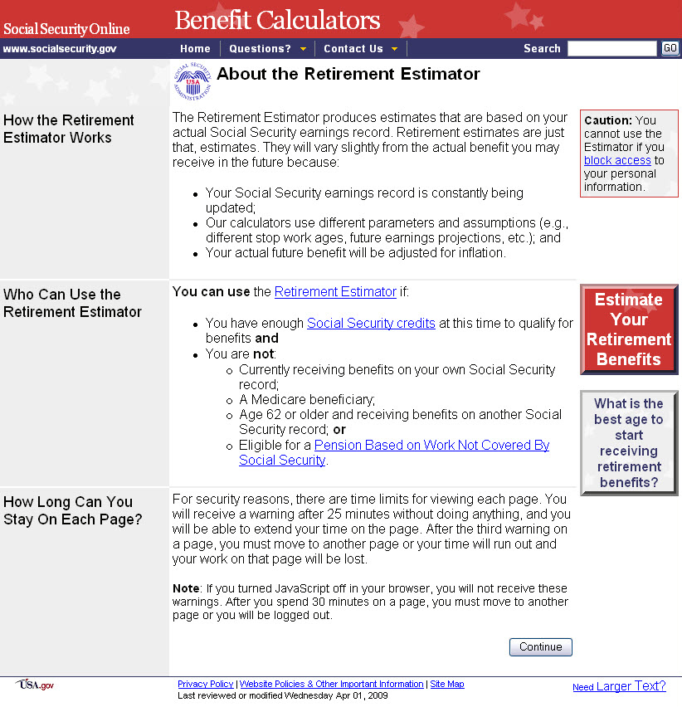
Use the Retirement Estimator
Convenient, secure, and
quick financial planning
tool
Immediate and accurate
benefit estimates
Lets you create “What if”
scenarios based on
different ages and earnings
www.socialsecurity.gov/estimator
Notes:
You can get estimates of your future Social Security
retirement benefits using our online Retirement Estimator.
You must enter certain ID information about yourself to use, such as your name, date of birth, Social Security number, place of birth and mother’s maiden name. This service is drawing high favorability ratings from users.

Slide 17
What You Can Expect
at Full Retirement Age
56%
41%
34%
Notes:
An underlying principle is that Social Security provides a weighted benefit formula that is consistent with the basic tenet of social adequacy.
You can find more information on earnings replacement from the 2009 Trustees Report.

Slide 18

You Can Work & Still Receive Benefits
You Can If You Make More,
If You Are Make Up To Some Benefits Will
Be Withheld
Under Full
Retirement Age $14,160/yr. ($1,180/mo.) $1 for every $2
The Year Full Retirement
Age is Reached $37,680/yr. ($3,140/mo.) $1 for every $3
Month of Full Retirement
Age and Above No Limit No Limit
Note: If some of your retirement benefits are withheld because of your earnings, your benefits will be increased starting at your full retirement age to take into account those months in which benefits were withheld.
Notes:
In the year you reach full retirement age, you are subject to a different annual earnings test. In that year, for the months prior to attaining full retirement age, you can earn up to $37,680/year ($3,140/mo.) without affecting your benefits. For every $3 in earnings above the limit, one dollar in benefits will be withheld. At full retirement age, there is no limit on the amount you can earn without affecting your benefit payments.
The annual retirement earnings test exempt amounts are increased annually by the average increase in wages in the U.S.

Slide 19
How Do I Apply for Retirement Benefits?
Apply online at www.socialsecurity.gov
It is the most convenient way to apply;
Call Social Security to schedule an appointment 1-800-772-1213 (TTY 1-800-325-0778); or
Apply at your local Social Security office.

Slide 20

Applying for Retirement Benefits
You can apply online for Retirement Benefits by visiting www.socialsecurity.gov and then clicking on
“Retirement/Medicare”

Slide 21
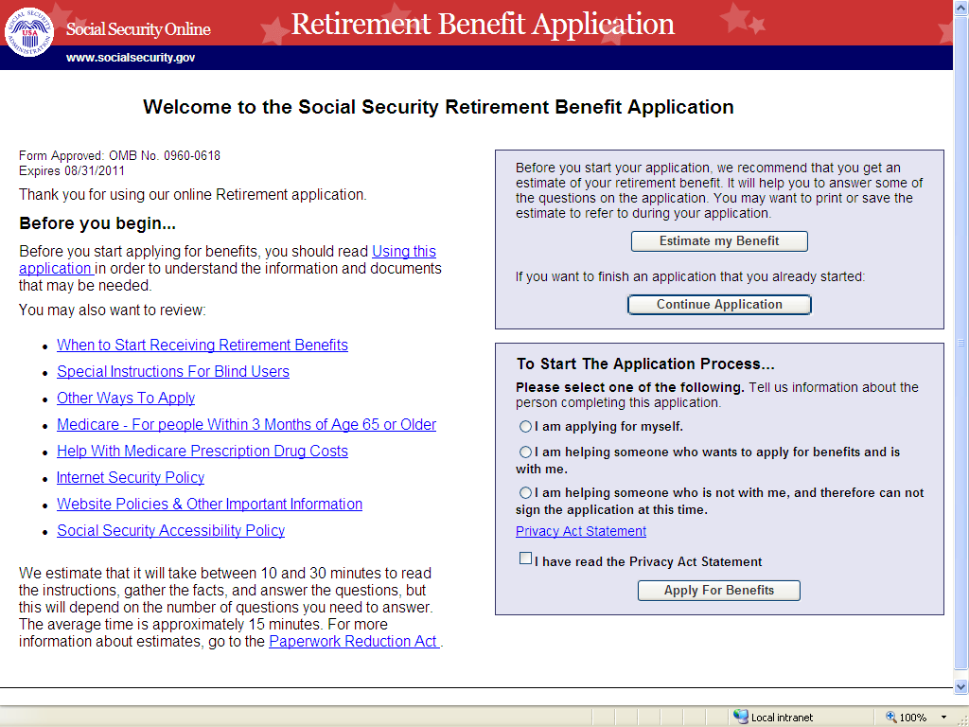
Applying for Retirement Benefits
1.
2.
3.

Slide 22
What Will You Need When Applying
for Your Social Security Benefits?
Social Security number for each applicant
Proof of age (only if date of birth allegation doesn't match Social Security records)
Latest W-2 or self-employment tax return
Earnings estimate
Bank information for direct deposit
Information about marriages/divorces
Information about military or railroad service
Notes:
We need to see the appropriate proofs when you file
your claim.

Slide 23
Who Can I Get Medicare ?
65 & older
-or-
24 months after entitlement to Social Security disability benefits
-or-
Amyotrophic Lateral Sclerosis
-or-
Permanent kidney failure and receive maintenance dialysis or a kidney transplant
-or-
Exposure to Environmental Health Hazards
(New Legislation)
Notes:
Remember that although the full retirement age has increased above age 65, Medicare eligibility is still age 65. You should apply for Medicare 3 months before your 65th birthday, even when you plan to apply for your retirement or spouse’s benefits later.
You also are eligible for Medicare benefits, 24 months from the month you were entitled to receive Social Security disability benefits, not from the first month you receive a payment. If you have Amyotrophic Lateral Sclerosis (Lou Gehrig’s disease), or permanent kidney failure and you receive maintenance dialysis or a kidney transplant, you become entitled for Medicare beginning with the month you first become entitled to disability benefits.

Slide 24

When Can I Sign Up for Medicare Part B?
Medicare Enrollment Periods:
Initial – Age 65
Special – if still working
General – January-March
Notes:
The Initial Enrollment Period starts 3 months before the month you turn age 65 and extends 3 months past the month you turn 65. If you are not receiving benefits, you should inquire about filing for Medicare 3 months prior to turning age 65 so that your coverage can start the month you turn 65. If you already are receiving Social Security benefits, you'll automatically be enrolled in Medicare Part A (hospital insurance) and B (medical insurance). (Note: Residents of Puerto Rico or foreign countries will not receive Part B automatically. They must elect this benefit.) However, because you must pay a premium for Part B coverage, you have the option of turning it down. Most people choose Part B even though it’s optional. You will be contacted by mail a few months before you become eligible and given all the information you need.
The Special Enrollment Period is for people (and their spouses) who continue to work past age 65. Since Medicare pays second after their employer group health plan pays first, they are not required to file for Part B. Since Medicare pays second there may be no need for Part B coverage. It is extremely important for workers to check with their employer group health plan for specific guidance. For this reason, they are offered a special period in which to file for Medicare. As a general rule, we recommend that people file for Part A 3 months prior to turning age 65, and then on the day they stop working call Social Security to file for Part B.
The General Enrollment Period is for those people who missed their Initial or Special Enrollment Periods. The window to file is January to March with coverage beginning in July. Anyone filing in the General Enrollment Period will be assessed a 10% penalty for each year after the Initial or Special Enrollment Period.

Slide 25
Medicare Coverage
Part A - Hospital Insurance
    Covers most inpatient hospital expenses
    2010 Deductible $1,132
Part B - Medical Insurance
    Covers 80% doctor bills & other
    outpatient medical expenses after 1st
    $162 in approved charges
    2010 Standard Monthly Premium $115.40
Part D - Medicare Prescription Drug Plan
    Covers a major portion of prescription drug costs for Medicare beneficiaries
    Enroll With Medicare prescription drug provider not SSA
    Annual enrollment period expanded beginning 2011 to October 15 through December 7
Notes:
There is no monthly premium for Part A if you are insured for
retirement benefits.
After you retire, your health insurance may only pay after Medicare pays. Many supplemental plans require you to file for Medicare Part B. The Medicare premium beneficiaries pay represents 1/4 of the actual cost; the federal government covers the balance of the cost.
Medicare Part D Prescription Drug Plan covers a major portion of prescription drug costs for Medicare beneficiaries.

Slide 26
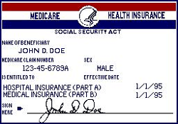
Example of a Medicare Card

Slide 27
For More Medicare Information
1-800-MEDICARE
(1-800-633-4227)
TTY 1-877-486-2048
www.medicare.gov

Slide 28
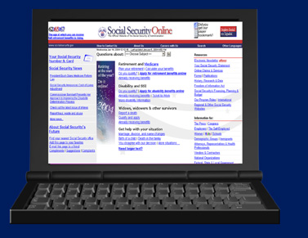
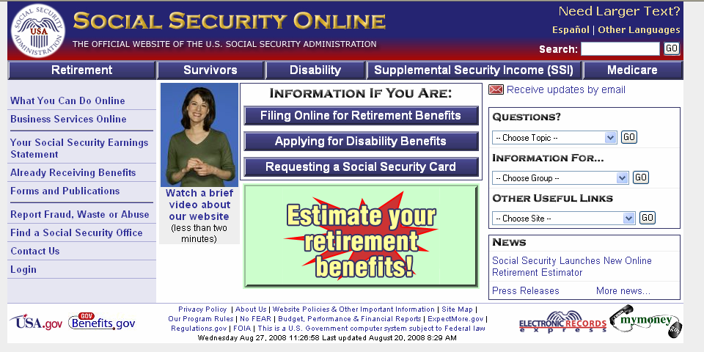
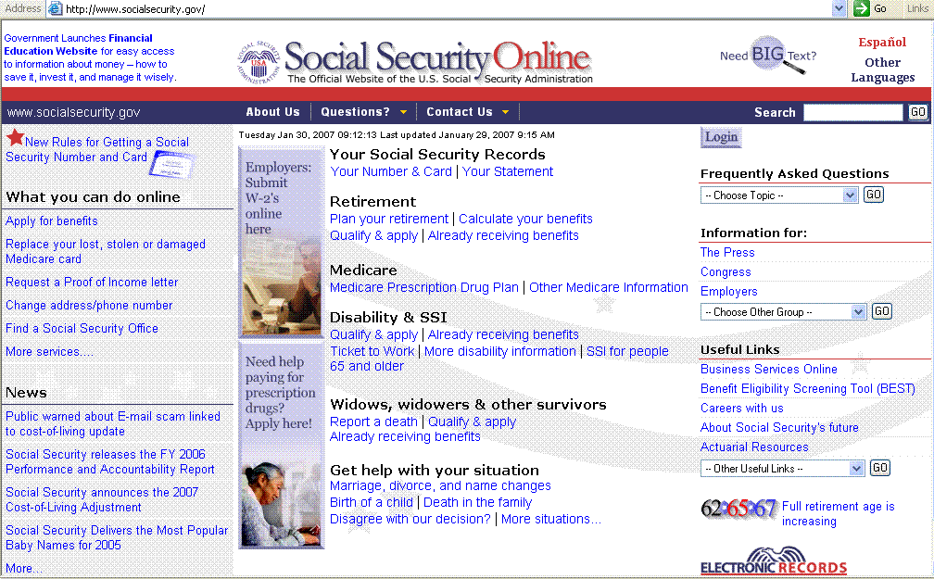
Visit Our Website or Call!
www.socialsecurity.gov
-or-
1-800-772-1213
TTY 1-800-325-0778

Slide 29

Notes:
2010 Social Security Administration Presentation
for National Rural Electric Cooperative Association
Produced by
Social Security Administration
Office of Communications/
Office of External Affairs
29

