Slide 1
Discussion of Fixler and Johnson
Robert J. Gordon,
Northwestern University, NBER, CEPR, and OFCE
BEA Advisory Panel, November 16, 2012

Slide 2
This is a Terrific Paper
It is a professional guide for amateurs on the strengths and weaknesses of a variety of data sources
It will instantly become the bible for anyone attempting to reconcile growth rates of Census income vs. BEA income and productivity
The reference list is a gold mine of sources for people doing research in many areas.
Authors should be proud. Their Table 1 of differences between alternative income concepts should be the title page of the new bible.

Slide 3
Now Let’s Broaden the Horizon
I have two complaints about this paper which are easily fixed
The first is that the relationships quantified in the tables for 1999-2009 are RADICALLY different before 1999 or 1995. Why limit the scope to such a short period?
The second is that the paper has a diffused focus on numerous data issues and loses the chance to focus on the fundamental question:
WHERE DID THE PRODUCTIVITY GROWTH GO?

Slide 4
How This Subject Evolved
During 1948-72 nobody asked about the discrepancy between real wage growth and productivity growth, because there was none.
Inequality measures started growing after 1977 and people gradually noticed.
Paul Krugman’s breakthrough in the 1992 election campaign
The topic temporarily died during the halcyon Clinton years 1995-2000 when everyone did well.
Then it revived during 2000-07 when median incomes again fell behind productivity growth

Slide 5
How Much to Explain? The Dynamics of US Productivity Growth
My interpretation of fast-slow-fast-slow
1891-1972. The supreme 2nd Industrial Revolution took almost a century to deliver its benefits (last stage 1950-70: interstate highways, jet planes, air conditioning)
1972-1996. The dismal slowdown
1996-2004. The revival doesn’t last long
2004-2012. Back to the slowdown
P.S. This is “Total Economy” Productivity not NFPB Productivity

Slide 6
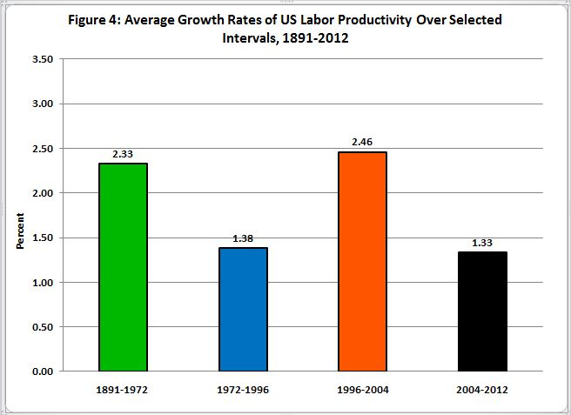

Slide 7
The Discrepancy Between Wage and Productivity Growth Grew Sharper
2000-04 productivity growth was as fast as 1996-2000 despite collapse in IT investment
Alarm bells sounded
“Where Did the Productivity Growth Go?” was a BPEA paper in 2005 with Ian Dew-Becker
Four sources of discrepancy
Wages vs. earnings
Deflators
Total economy vs. NFPB sector
Median vs. mean from IRS micro stats.

Slide 8
Some of our IRS Statistics for 1966-2001
Skewed real income growth by percentile
Median 0.30%
80th percentile 0.94%
90th percentile 1.30%
99th percentile 2.26%
99.9th percentile 3.44%

Slide 9
What We Learned and Didn’t Learn in 2005
Much of the discrepancy before 1995 is explained by
Wages vs. compensation (incl. fringe benefits)
Price deflators
Total economy vs. NFPB productivity
We didn’t take account of shrinking household size
Updated contribution of inequality from Saez web site
1993 to 2008. Average real income growth = 1.30
For bottom 99% average = 0.75
This gigantic gap of 0.55 is percent per year

Slide 10
But the Role of these four factors differ over time
Big conclusions of the handout
#1 For 1979-95 ALL of the growth discrepancy between median income and NFPB productivity growth can be explained by traditional answers
But very little after 1995 can be explained by these traditional factors. Why?
This paper provides only a few hints and the authors do not address the wage/productivity gap framework that would help clarify their findings

Slide 11
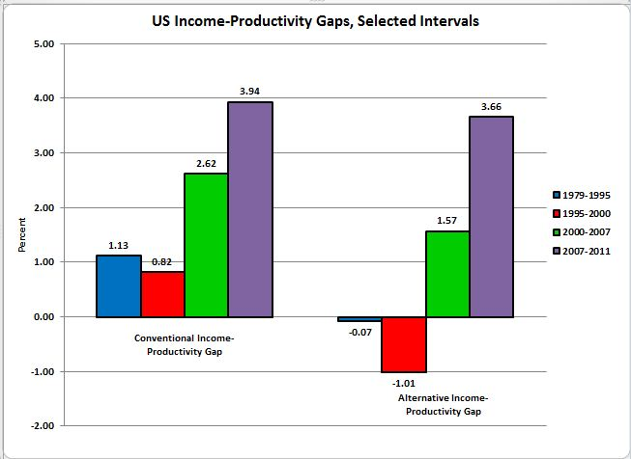

Slide 12
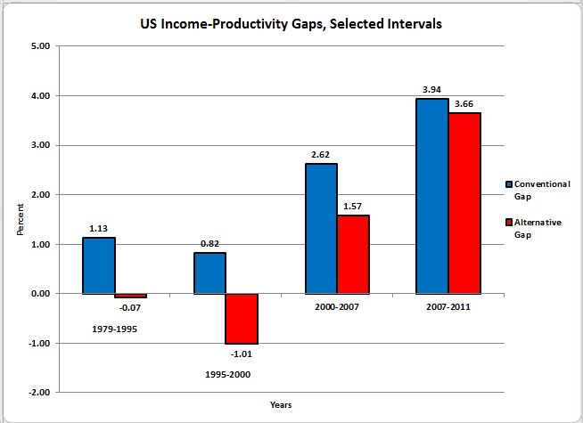

Slide 13
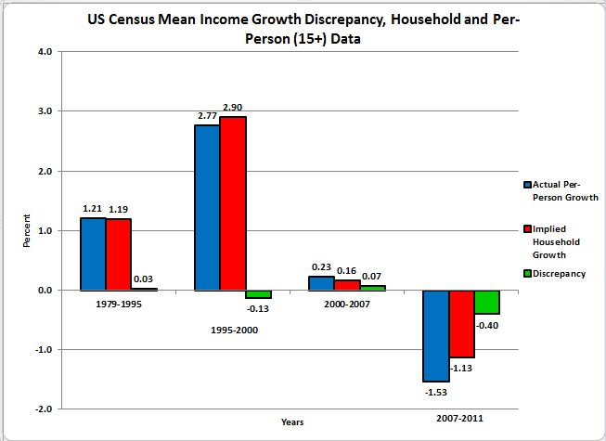

Slide 14
Assessment of the Paper
The time period should have gone back to 1979 because none of these relationships in 1999-2009 was similar to 1979-99.
The focus should have been on “why not?”
Almost all the data examined by the authors is available back to 1979
The primary conclusions of the paper:
Underreporting at the top understates rise of inequality. Question: underreporting vs. top-coding?
Omission of Medical care-in-kind overstates “ “ “

Slide 15
Decadal Growth vs. AAGR
My starting point of a conventional income-productivity gap for 1979-2011 of 1.76 is reduced to 0.46 by alternative data
Use the EXP function, this is restated for the 32 years:
Conventional gap (line 13 of handout) grows by 75.6 percent 1979-2011
Revised gap (line 14) grows by 15.8 percent
These are big differences

Slide 16
Compare These to the Paper’s Small Numbers
These are an indirect consequence of the limited time period
P. 25 of paper, the choice is between cumulative changes of 3.1 and 7.4 and 5.9.
These are small numbers in the context of the overall subject

Slide 17
Fiscal Multipliers
They provide a valuable service by quantifying multipliers by which slice of the income distribution receives the government benefits or spending or tax cuts
They should cite the summer 2010 paper by Blinder and Zandi
Multipliers: 1.8 for food stamps and U comp
But only 0.4 for corporate taxes and tax cuts for the rich
Solution to our current fiscal cliff problem lies in Chapter 12 of my econ principles text: the balanced budget multiplier

