Slide 1
FY2012-13 Budget School:
Forecasting the Fiscal Cliff
Congressman Marsha Blackburn

Slide 2
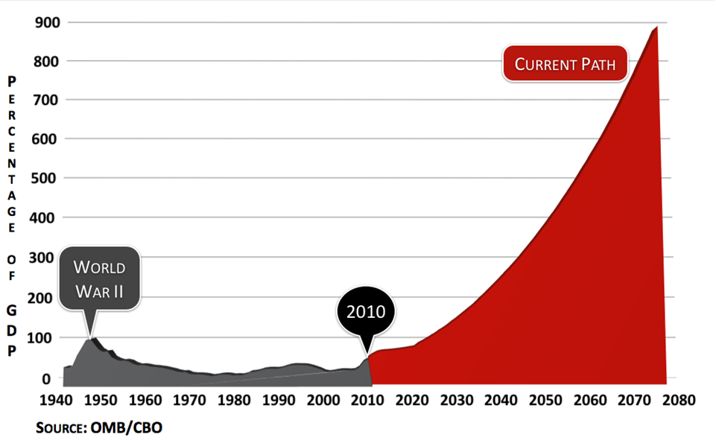
CRUSHING BURDEN OF DEBT
(U.S. DEBT HELD BY PUBLIC AS A SHARE OF ECONOMY)

Slide 3
What Drives Our Debt?
(Government Spending as Share of Economy)

Slide 4
TRUST FUNDS NOT ENTITLEMENTS
According to the 2012 Medicare Trustees Report, Medicare will go bankrupt in 2024.
If Congress lets Medicare go bankrupt in 2024, the federal government may be forced to implement an immediate 26 percent benefit cut for seniors or a 47 percent tax increase on workers.
Likewise, the 2012 Social Security Trustees Report projects that Social Security will run out of money in 2033. According to the 2011 Social Security Trustees Report, Social Security has been running permanent deficits since 2010.
Any deficit to Social Security could result in an immediate loss in benefits to nearly 14 million of the 56 million Americans who were on Social Security in 2009.

Slide 5
THE NEED FOR REFORM
According to a study by the Urban Institute, the average couple retiring in 2011, with both spouses having worked and paid taxes their entire careers, would have paid a total of $149,000 in Medicare taxes.
However, they are expected to consume an average of $351,000 in medical services in their retirement years. A $202,000 gap that would need to be funded by higher taxes on fewer workers.
With more than 70 million Baby Boomers starting to enter the program at a rate of 10,000 a day, Medicare is clearly not sustainable on its current path.
House Republicans laid out a responsible path for keeping Medicare and Social Security solvent for current and future generations in the Ryan budget.

Slide 6
Health Care Costs are the Primary Driver of the Debt
(Government Spending as a Share of Economy)

Slide 7
The Cost of Waiting – The Fiscal Gap
(Unfunded Promises in Trillions of Dollars)
Source: Government Accountability Office/HBC

Slide 9
Who Owns Our Debt?
(Debt Held by Public, 1970 -2011)

Slide 10
Can we tax our way to prosperity?
“You know the phrase they always use? Obama and Biden want to raise taxes by a trillion dollars. Guess what? Yes, we do, in one regard. We want to let that trillion dollar tax cut expire so the middle class doesn’t have to bear the burden of all that money going to the super wealthy. That’s not a tax raiser. That’s called fairness where I come from.”
- Vice President Joe Biden

Slide 11
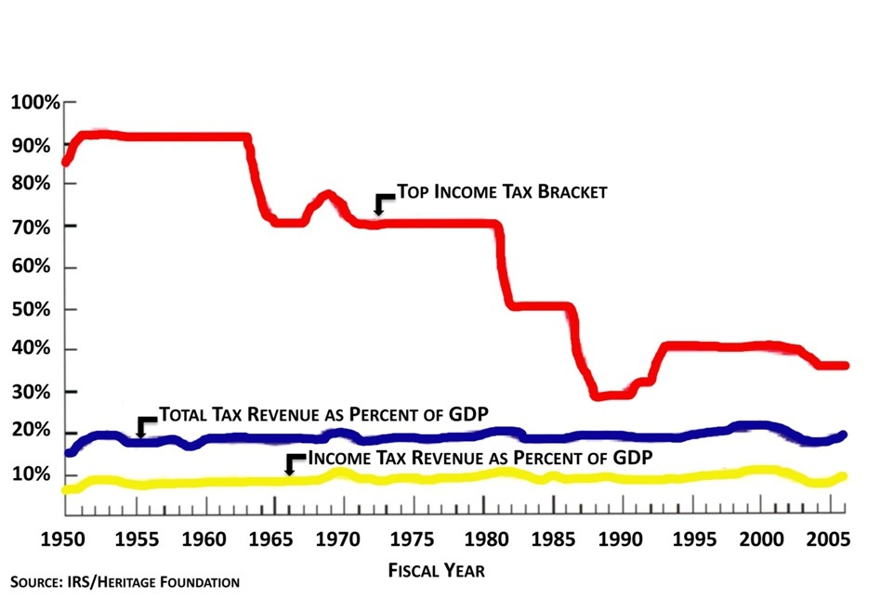
INCREASING TAX RATES DOES NOT INCREASE TAX REVENUE

Slide 12
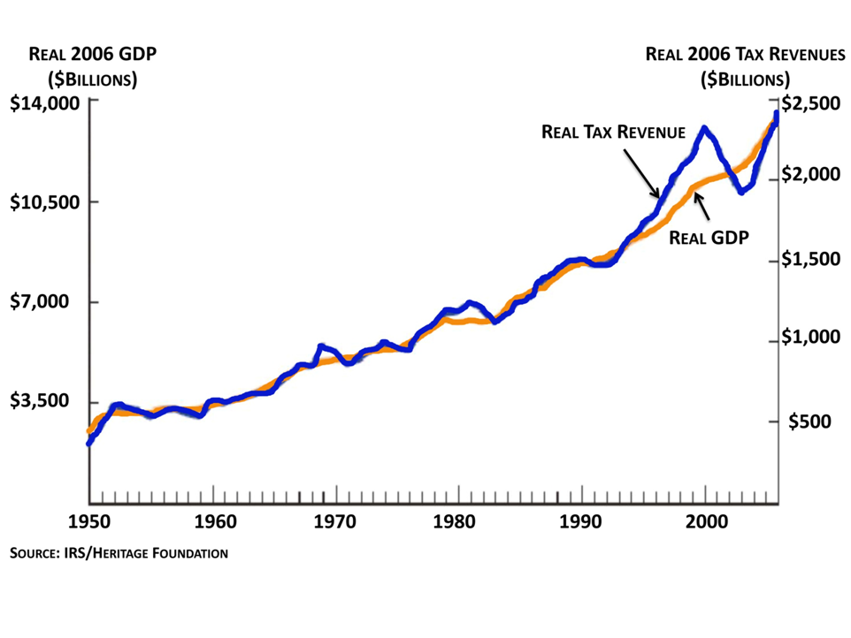
TAX REVENUES ARE HIGHLY CORRELATED WITH GDP

Slide 16
We can not spend our way to prosperity
“Governments don't reduce deficits by raising taxes on the people; governments reduce deficits by controlling spending and stimulating new wealth.” - President Ronald Reagan

Slide 17
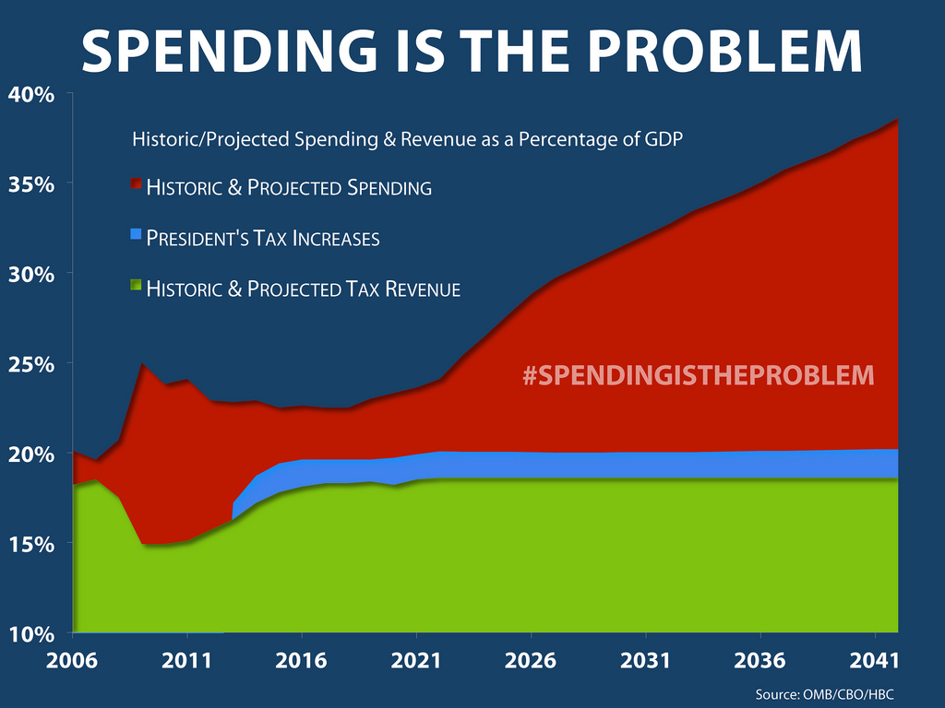

Slide 18
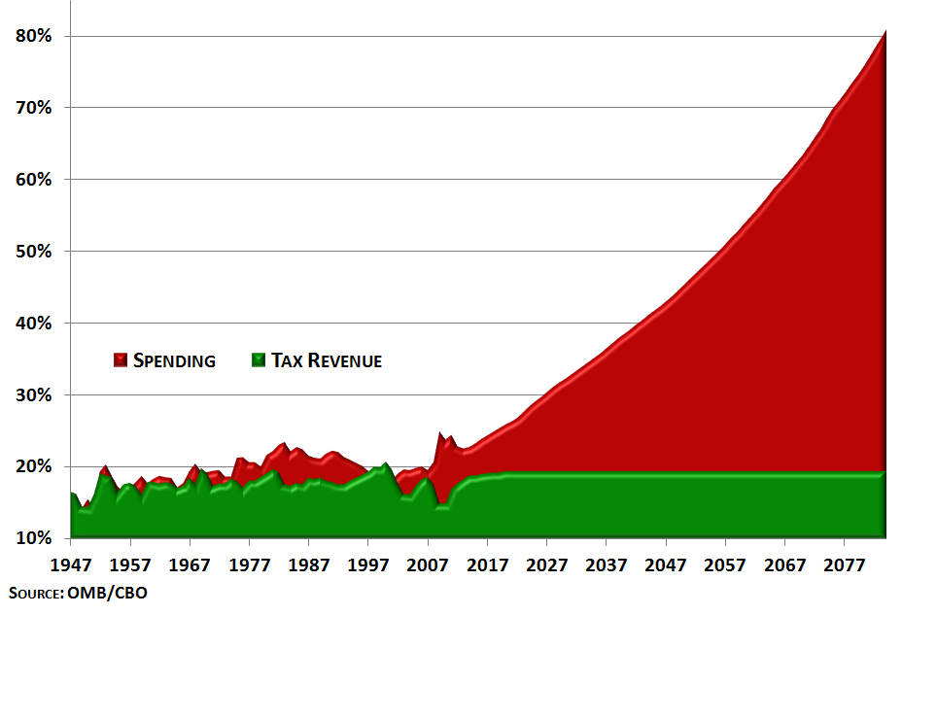
WE ARE IN A SPENDING-DRIVEN DEBT CRISIS
(AS A SHARE OF ECONOMY)

Slide 19
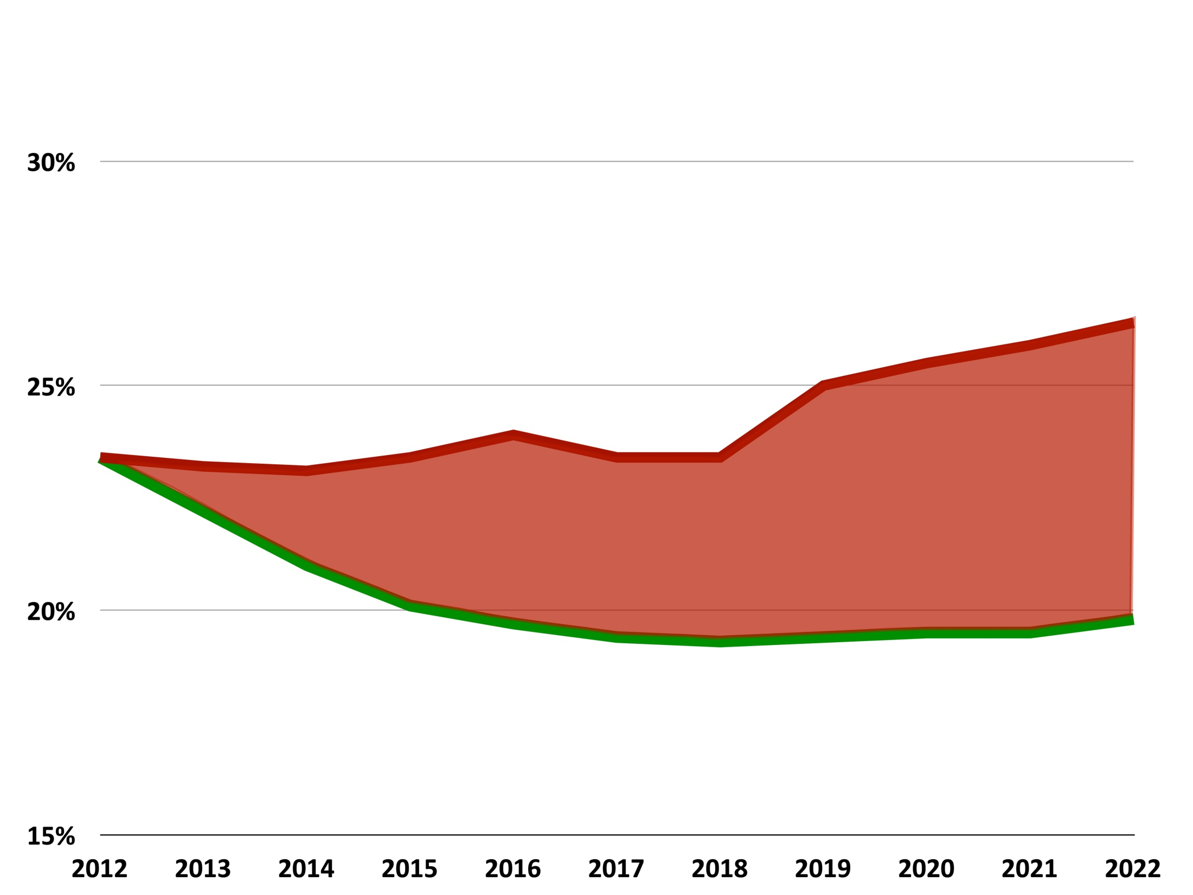
Government Spending
(as a Share of Economy)
President’s Budget
$5.3 Trillion
Path to Prosperity
Source: CBO/HBC

Slide 20
A Choice of Two Futures
(Debt as a Share of Economy)

Slide 21
The Budget Control Act
On August 2, 2011, President Obama signed into law the Budget Control Act (BCA) of 2011.
The BCA increases our nation’s debt limit while imposing a series of measures to limit spending and decrease our national debt.
The first installment of $900 billion is directly tied to $900 billion in caps on discretionary savings.
The second installment is linked to the Joint Select Committee (JSC), also known as the “Super Committee”, which is charged with finding an additional $1.5 trillion in savings over the next decade.
If the Super Committee fails to identify savings or if Congress fails to approve the Super Committee’s recommendation , automatic across-the-board cuts, known as a “sequestration”, will impact both defense and non-defense programs on January 2, 2013.

Slide 22
Republican Spending Cuts versus
President’s Spending Spree
Discretionary Spending Cuts Relative To House-Passed Budget, FY2012-2021

Slide 23
HOW DID WE GET HERE?
Debt Ceiling
  Budget Control Act (BCA)
  Super Committee Failure
Sequester

Slide 24
SEQUESTER
If takes effect on January 2, 2013 the defense budget would cut an additional $55 billion per year from the levels established in the BCA resulting in an additional $492 billion in cuts.
This would leave our military with the smallest ground force since 1940, smallest naval fleet since 1915 and the smallest tactical fighter force in the history of the Air Force.
Medicare could see $16.4 billion in annual cuts leading to the elimination of 496,000 jobs in 2013.
62,000 physicians may be forced to close their offices.

Slide 25
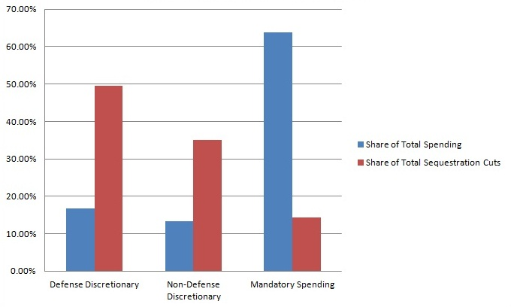
SEQUESTER CUTS ARE UNBALANCED
Source: CBO/HBC

Slide 26
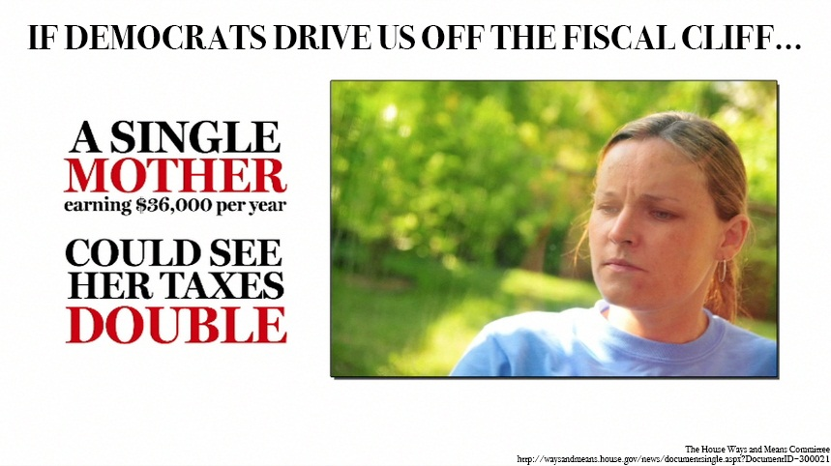

Slide 27
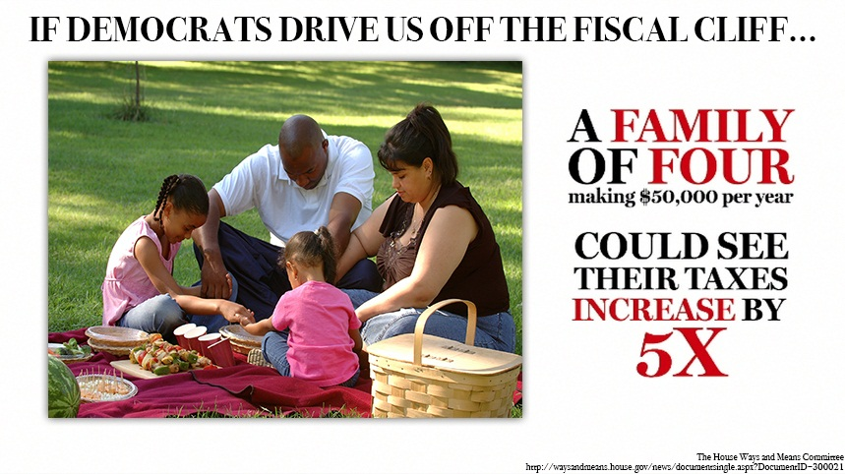

Slide 28
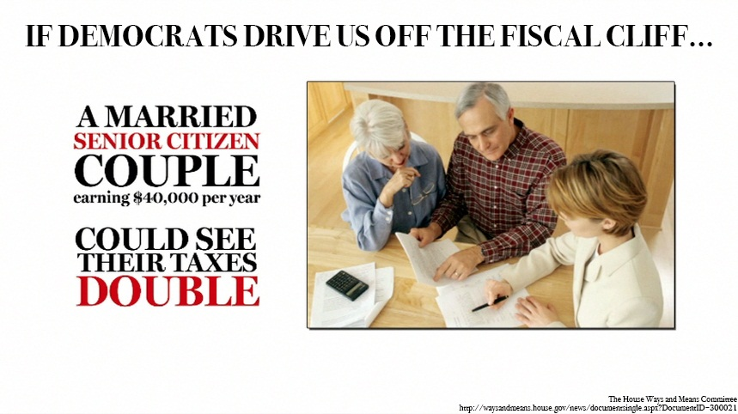

Slide 29
What are House Republicans doing to avoid the fiscal cliff?

Slide 30
Sequester Reconciliation Act of 2012
(H.R. 5652)
H.R. 5652 would provide mandatory spending reductions in order to replace automatic cuts to discretionary spending (primarily from defense accounts) in 2013 under the Budget Control Act and to reduce the deficit.
The savings generated from these reforms to mandatory programs would first be used to offset the approximately $78 billion cost of replacing the automatic across-the-board discretionary spending cuts that are scheduled to occur under sequestration.
The $78 billion amount reflects the remainder of the FY 2013 discretionary sequester after accounting for lowering the FY 2013 discretionary cap from $1.047 to $1.028 as provided for in the House-approved Budget Resolution. The additional savings achieved through reconciliation beyond the $78 billion (over $180 billion in the next ten years) would further reduce the deficit.
Passed the House by a margin of 218-199 votes on May 10, 2012. Awaiting action in the Senate.

Slide 31
National Security and Jobs Protection Act (H.R. 6365)
H.R. 6365 would repeal the across-the-board defense and non-defense discretionary spending cuts scheduled to occur on January 2, 2013, upon the enactment of H.R. 5652,the Sequester Replacement Reconciliation Act of 2012, or any legislation that offsets the automatic sequester with equal or greater spending reductions over the next five years.
This legislation would ensure that if any legislation to replace the sequester with alternative spending reductions were enacted, the sequester would be shut off. In the event that the sequestration is replaced, the bill would lower the discretionary spending cap for FY 2013 from $1.047 trillion to $1.028 trillion.
Passed the House with bipartisan support by a margin of 223-196 votes on September 19, 2012. Awaiting action in the Senate.

Slide 32
Pathway to Job Creation through a Simpler, Fairer Tax Code Act of 2012
(H.R. 6169)
H.R. 6169 would provide an expedited pathway to pro-growth tax reform in 2013.
H.R.6169 would require the House and Senate to consider tax reform legislation according to an expedited timeline.
Passed the House by a margin of 232-189 votes on August 2, 2012. Awaiting action in the Senate.

Slide 33
Job Protection and Recession Prevention Act of 2012 (H.R. 8)
H.R. 8 would provide a one-year extension of all current individual tax rates, as well as the15 percent top rate on capital gains and dividends.
The proposal would also extend for one year the estate tax rates at their current levels, the $1,000 child tax credit, marriage penalty relief and certain educational tax credits.
The bill would also provide higher small business expensing limits for one year and would repeal the personal exemption phase out and the “Pease” limitations in 2013.
Finally, the bill would provide a two-year AMT patch, which would be adjusted for inflation.
Coupled with H.R. 6169, H.R. 8 will ensure that individual tax rates will not increase while comprehensive, pro-growth tax reform is crafter under expedited procedures in 2013.
Passed the House with bipartisan support by a margin of 256-171 votes on August 1, 2012. Awaiting action in the Senate.

Slide 34
Stay informed throughout the debate
Website: WWW.Blackburn.House.Gov
Email: Marsha.Blackburn@Mail.House.Gov
Facebook: Facebook.com/MarshaBlackburn
Twitter: @MarshaBlackburn

