Slide 1
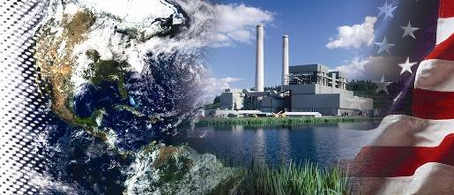
Cost and Performance Baseline for Fossil Energy Plants – Volume 3
Low Rank Coal and Natural Gas to Electricity
U.S. Department of Energy
National Energy Technology Laboratory
July 2011

Slide 2
Disclaimer
This presentation was prepared as an account of work sponsored by an agency of the United States Government. Neither the United States Government nor any agency thereof, nor any of their employees, makes any warranty, express or implied, or assumes any legal liability or responsibility for the accuracy, completeness, or usefulness of any information, apparatus, product, or process disclosed, or represents that its use would not infringe privately owned rights. Reference therein to any specific commercial product, process, or service by trade name, trademark, manufacturer, or otherwise does not necessarily constitute or imply its endorsement, recommendation, or favoring by the United States Government or any agency thereof. The views and opinions of authors expressed therein do not necessarily state or reflect those of the United States Government or any agency thereof.

Slide 3

Project Objectives
  Primary Goal - Complete a comprehensive systems study that estimates performance and cost of state-of-the-art fossil-based electric generating technologies utilizing low-rank coals (PRB and lignite) as well as natural gas at western U.S. ambient conditions equipped with and without carbon capture and sequestration (CCS)
Project Objectives
  Complete cost and performance estimates for fossil-based electric generating technologies with and without CCS
    Oxygen-blown IGCC
    PC and CFBC
    NGCC
  Create baseline of present state-of-the-art such that benefits of advanced technologies can be quantified

Slide 4
Project Overview
Study Matrix
Plant Type | ST Cond. (psig/°F/°F) | GT | Gasifier/ Boiler | PRB | NDL | Acid Gas Removal/ CO₂ Separation / Sulfur Recovery | CO₂ Capture Target
IGCC | 1800/1050/1050 (non-CO₂ capture cases) 1800/1000/1000 (CO₂ capture cases) | F Class | CoP E-Gas | √ | -- | MDEA/ - / Claus | --
 |  |  |  |  |  | Selexol / Selexol / Claus | 90%
 |  |  | TRIG | √ | -- | Sulfinol-M / - / Claus | --
 |  |  |  |  |  | Selexol / Selexol / Claus | 83%
 |  |  | Shell | √ | √ | Sulfinol-M / - / Claus | --
 |  |  |  |  |  | Selexol / Selexol / Claus | 90%
 |  |  | Siemens | √ | √ | Sulfinol-M / - / Claus | --
 |  |  |  |  |  | Selexol / Selexol / Claus | 90%
PC | 3500/1100/1100 | N/A | Supercritical | √ | √ | SDA / - / - | --
 |  |  |  |  |  | SDA / Econamine / - | 90%
 | 4000/1200/1200 |  | Ultra-Supercritical | √ | √ | SDA / - / - | --
 |  |  |  |  |  | SDA / Econamine / - | 90%
CFBC | 3500/1100/1100 | N/A | Supercritical | √ | √ | In-Bed Limestone / - / - | --
 |  |  |  |  |  | In-Bed Limestone / Econamine / - | 90%
NGCC | 2400/1050/1050 | F Class | HRSG | √ | √ | NA | --
 |  |  |  |  |  | - / Econamine / - | 90%

Slide 5
Design Basis
Coal Types
As-Received Ultimate Analysis (weight %)
 | Rosebud PRB | ND Lignite
Moisture | 25.77 | 36.08
Carbon | 50.07 | 39.55
Hydrogen | 3.38 | 2.74
Nitrogen | 0.71 | 0.63
Chlorine | 0.01 | 0.00
Sulfur | 0.73 | 0.63
Ash | 8.19 | 9.86
Oxygen (by difference) | 11.14 | 10.51
HHV (Btu/lb) | 8,564 | 6,617
As-Fed Moisture Content (weight %)
Slurry Gasifier, PC, CFBC | N/A | N/A
Transport Gasifier | 18% | N/A
Dry Feed Gasifier | 6% | 12%

Slide 6
Design Basis
Ambient Conditions
 | Rosebud PRB | ND Lignite
Elevation, m (ft) | 1,036 (3,400) | 579 (1,900)
Barometric Pressure, MPa, (psia) | 0.09 (13.0) | 0.10 (13.8)
Design Temperature, Dry Bulb, ºC (ºF) | 5.6 (42) | 4.4 (40)
Design Temperature, Wet Bulb, ºC (ºF) | 2.8 (37) | 2.2 (36)
Design Relative Humidity, % | 62 | 68
Cooling/Make-up Water Source | Assume limited water availability, 50% condenser cooling load to air cooled condenser, 50% and all auxiliary cooling to wet cooling tower (municipal/ground water mix)

Slide 7
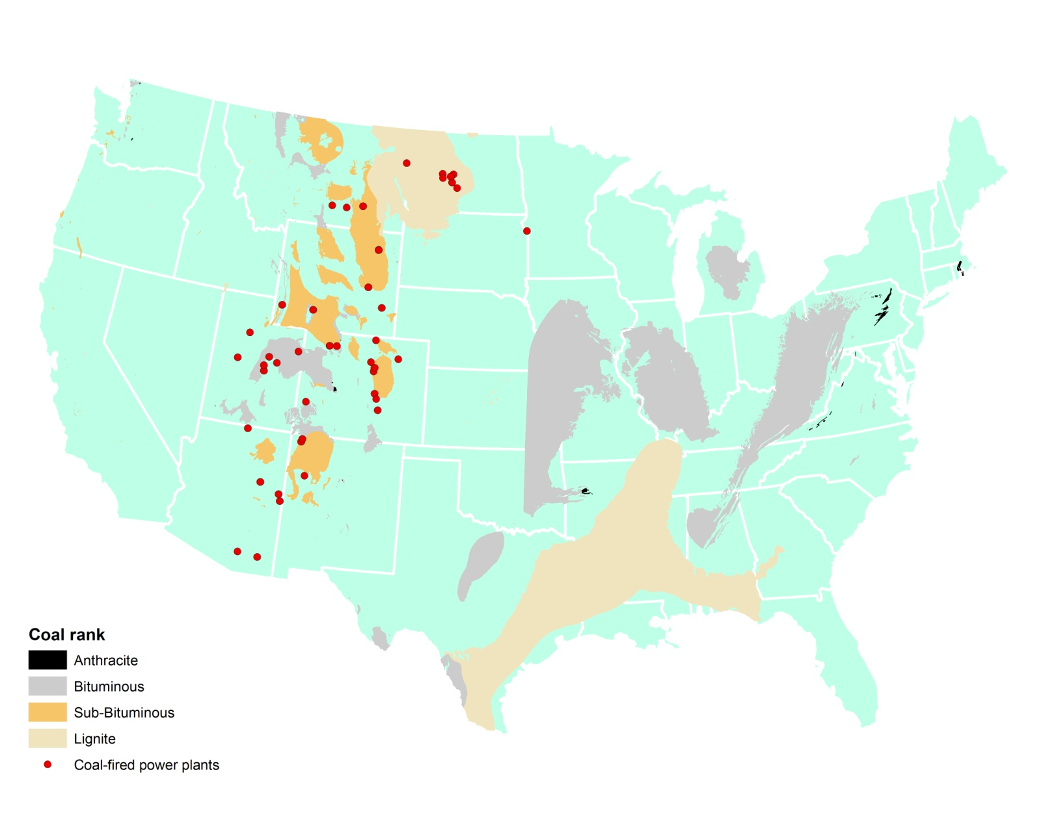

Design Basis
Coal Fields/Power Plants
Western Coal Study
Bituminous Coal Study
0’ ASL
 | Low Point | High Point | Mean Elevation
AZ | 70’ | 12,633’ | 4,100’
CO | 3,315’ | 14,440’ | 6,800’
MT | 1,800’ | 12,799’ | 3,400’
ND | 750’ | 3,506’ | 1,900’
NM | 2,842’ | 13,161’ | 5,700’
UT | 2,000’ | 13,528’ | 6,100’
WY | 3,099’ | 13,804’ | 6,700’
Source: Carpenter, A. and Provorse, C., The World Almanac of the USA, World Almanac Books, 1996

Slide 8
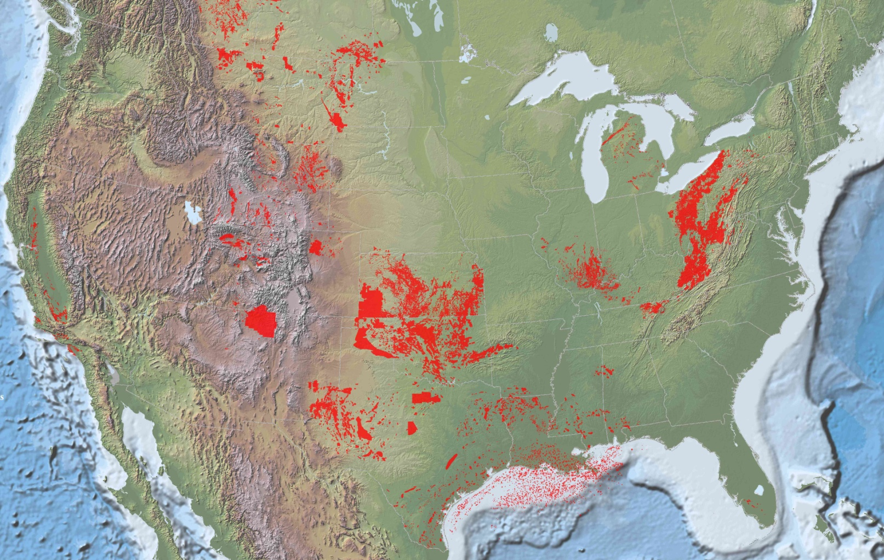
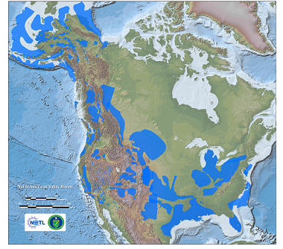
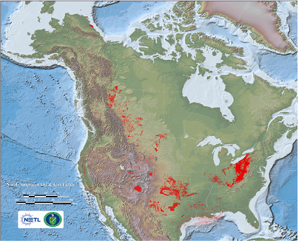
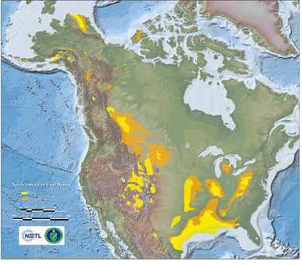
Design Basis
Geologic Sequestration Opportunities
U.S. Emissions ~ 6 GT CO₂/yr all sources
Western Coal Study
Bituminous Coal Study
Saline Formations
North American CO₂ Storage Potential
(Giga Tons)
Oil and Gas Fields
Unmineable Coal Seams
Sink Type | Low | High
Saline Formations | 969 | 3,223
Unmineable Coal Seams | 70 | 97
Oil and Gas Fields | 82 | 83
Hundreds of Years of Storage Potential
Conservative Resource Assessment
Available at http://www.netl.doe.gov/publications/carbon_seq/refshelf.html

Slide 9
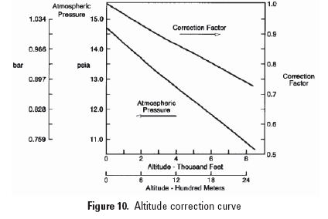
Design Basis
Impact of Altitude on GT Output
North Dakota
Montana
While lower GT output results, the heat rate is largely unaffected
Source: GE Power Systems, GE Gas Turbine Performance Characteristics, GER-3567H (10/00)

Slide 10
Design Basis
Environmental Targets
 | IGCC | PC |  | CFBC |  | NGCC
SO₂ | 0.0128 lb/MMBtu | 0.132 lb/MMBtu |  | 0.132 lb/MMBtu |  | Negligible
NOx | 15 ppmv (dry) @ 15% O₂ | 0.07 lb/MMBtu |  | 0.07 lb/MMBtu |  | 2.5 ppmv (dry) @ 15% O₂
PM | 0.0071 lb/MMBtu | 0.013 lb/MMBtu |  | 0.013 lb/MMBtu |  | N/A
Hg | > 90% capture | PRB | LIG | PRB | LIG | N/A
 |  | 0.6 lb/TBtu | 1.1 lb/TBtu | 3.0 lb/TBtu | 4.8 lb/TBtu
Notes:
Targets vs actual emissions. (CFBC)
Removal efficiencies confirmed to achieve targets

Slide 11
Design Basis
Sequestration Assumptions
Plant Gate CO₂ Pressure (psia) | 2,215
Wellhead CO₂ Pressure (psia) | 1,515
Inlet Temp (°F) | 79
Maximum N₂ Concentration (ppmv) | <300
Maximum O₂ Concentration (ppmv) | <40
Maximum Ar Concentration (ppmv) | <10
Pipeline Length (miles) | 50
Formation Depth (ft) | 4,055
Formation Permeability (millidarcy) | 22
Formation Pressure (psig) | 1,220

Slide 12
Design Basis
Other Assumptions
Coal drying processes
  Dry-feed entrained flow gasifiers – WTA process
  Transport gasifier – indirectly heated fluidized bed
  Slurry-feed gasifier, PC & CFBC – no drying
Nitrogen dilution was used to the maximum extent possible in all IGCC cases and air extraction from the turbine was integrated into the ASU MAC, where applicable
Capacity Factor assumed to equal Availability
  IGCC capacity factor = 80% w/ no spare gasifier
  PC and CFBC capacity factor = 85%

Slide 13
Economic Assumptions
First Year of Capital Expenditure 2007
Effective Levelization Period (Years) 35 (PC & IGCC)
33 (NGCC)
 | 5 Year Construction Period |  | 3 Year Construction Period
 | High Risk | Low Risk | High Risk | Low Risk
Capital Charge Factor | 12.4% | 11.6% | 11.1% | 10.5%
Dollars 2007
PRB Coal ($/MMBtu) 0.89
ND Lignite ($/MMBtu) 0.83
Natural Gas ($/MMBtu) 7.13
Capacity Factor
IGCC 80
PC/NGCC 85
Notes:
No fancy economic tricks employed.
Showing that assumptions are ‘in-line’ with what makes sense and what studies have reported.
Further detailed assumptions are available and a detailed list can be provided for each case. (I will have a list case by case assumptions on hand or will take peoples information and send them the details).
Grassroots plant unless noted otherwise

Slide 14
Capital Cost Levels and their Elements

Slide 15
Technical Merit
TECHNOLOGY
“Early commercial deployment” of technologies for fossil-based electricity generation
  All components commercially available today
  “Next-of-a-kind” application, contingencies and financial risk assigned as appropriate
  Design basis appropriate to Western United States
    Montana PRB
    North Dakota Lignite
PROJECT
Technology vendor input for all major systems
Detailed Aspen Plus process simulations
Interactions with experts in the field
  Technology developers – process input
  WorleyParsons – EPC firm for capital/operating cost estimates

Slide 16
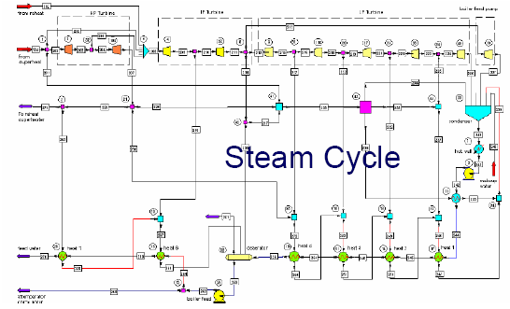
Technical Approach - Overview
1. Extensive Process Simulation (ASPEN)
All major chemical processes and equipment are simulated
Detailed mass and energy balances
Performance calculations (auxiliary power, gross/net power output)
2. Cost Estimation
Inputs from process simulation (Flow Rates/Gas Composition/Pressure/Temp.)
Sources for cost estimation
  WorleyParsons
  Vendor sources where available
Follow DOE Analysis Guidelines

Slide 17
Technical Approach - Project Methodology
Process configurations & modeled results subject to vendor review
  Gasification cases sent individually to specific technology vendors/developers (CoP, Shell, Siemens, SoCo) for iterative review
    Facility Design
      Gasification block I/O
      Facility integration
    Performance Results
    Economic Results
    Technology Description
  Combustion cases sent to two combustion technology vendors (B&W, F-W)
  “Low Rank” NGCC cases based on in-house adjustments for ambient conditions using vendor performance estimates at ISO conditions

Slide 18
Technical Approach
Project Methodology (cont.)
Segmented Peer Review
  Design basis and Consolidated Combustion Report externally reviewed by industry experts
    EPRI
    EPC firm
    Electric utility industry
    Coal industry
    Academia
    Independent consultants
  Previous external review of Bituminous IGCC and NGCC at sea-level viewed as sufficient for the low-rank analyses
Performed sensitivity studies of select system parameters
  Varied economic parameters (on-stream factor, fuel price)
Notes:
Check if siemens ct sens is in report, reflect here

Slide 19
Technical Approach
Systems Analyses Categorization
STUDY CATEGORY
Ι
ΙΙ
ΙΙΙ
Order of Magnitude Estimate (+/- >50% Accuracy)
Very little project-specific definition
Rough scaling of previous related but dissimilar analyses
“Back-of-the-envelope” analyses
Concept Screening (+/- 50% Accuracy)
Preliminary mass and energy balances
Modeling and simulation of major unit operations
Factored estimate based on previous similar analyses
Budget Estimate (+30% / -15% Accuracy)
Thorough mass and energy balances
Detailed process and economic modeling
Estimate based on vendor quotes, third-party EPC firms

Slide 20
IGCC, PC, CFB, NGCC
Power Plants
Current State-of-the-Art

Slide 21
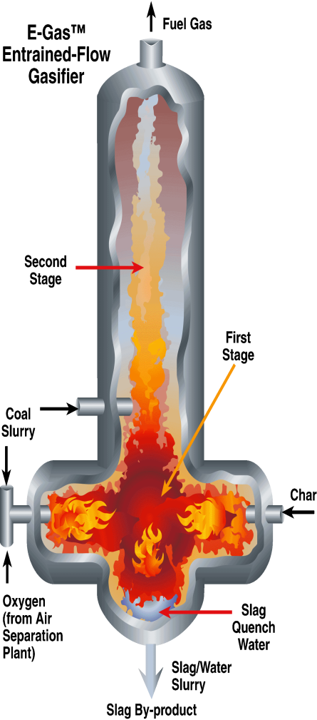
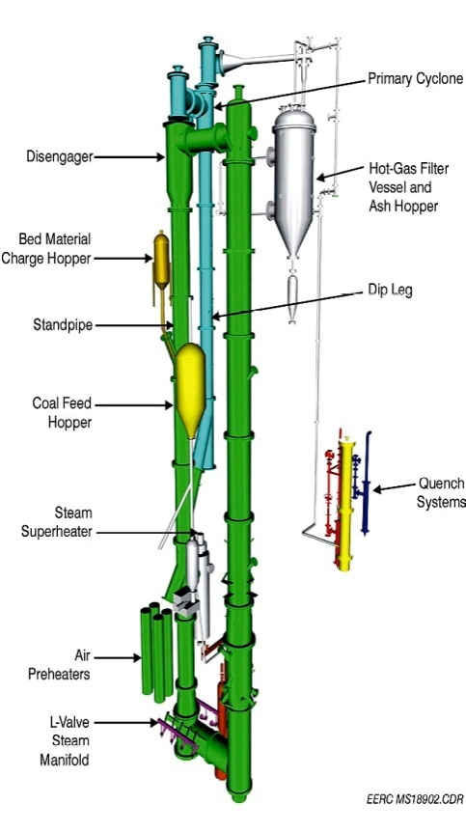
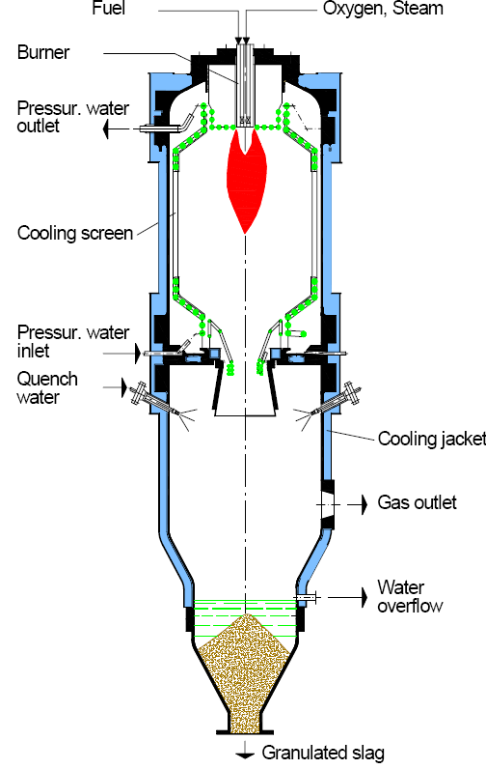
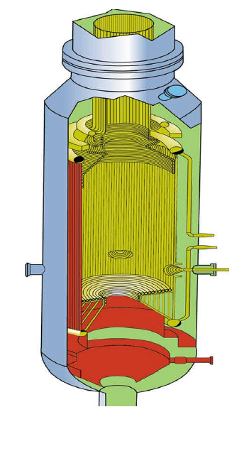
Gasifiers
ConocoPhillips
E-Gas
Southern Company
TRIG
Shell
SCGP
Siemens
(GSP/Noell)
Fuel Gas
HP
Steam
O₂
Dry Coal
Slag

Slide 22
SOA Technology
IGCC without CCS
Emission Controls:
PM: Water scrubbing and/or candle filters
NOx: LNB, N₂ dilution
Sulfur: Sulfinol or MDEA and Claus plant with tail gas recycle
Hg: Activated carbon beds
Advanced F-Class Turbine: 232 MWe – ISO conditions
Steam Conditions: 1800 psig/1050°F/1050°F
~
HRSG
Combined Cycle

Slide 23
SOA Technology
IGCC with CCS
Green Blocks Indicate Unit Operations Added for CO₂ Capture Case
Emission Controls:
PM: Water scrubbing and/or candle filters
NOx: LNB, N₂ dilution
AGR: Selexol and Claus plant with tail gas recycle
Hg: Activated carbon beds
Advanced F-Class Turbine: 232 MWe – ISO Conditions
Steam Conditions: 1800 psig/1000°F/1000°F
~
HRSG
Combined Cycle

Slide 24
Water-Gas Shift Reactor System
General Design:
Sour Gas Shift Catalyst
Up to 99% CO Conversion
Multiple Stages with Intercooling
H₂O:CO Adjusted for Carbon Removal while Maintaining Minimum Outlet Ratio (H₂O to dry gas)
Overall ΔP ~ 30 psia
Steam
Steam
H₂O/CO Ratio
1.6 – 2.0
760-880ºF
400ºF
Gas Cooling
& Knockout
600psia
550ºF
Steam as % of Main Steam Enthalpy
0 – 27%
H₂O + CO CO₂ + H₂
Notes:
¹ Recovered from Heat Integration
Shift steam generated from syngas cooling, etc. heat recovery – not necessarily from ST extraction; ratio to main steam as an indicator

Slide 25
SOA Technology
Pulverized Coal Power Plant
Green Blocks Indicate Unit Operations Added for CO₂ Capture Case
PM Control: Baghouse
NOx Control: LNB + OFA + SCR
Sulfur Control: SDA
Mercury Control: Co-benefit capture + ACI trim
Steam Conditions (SC): 3500 psig/1100°F/1100°F
Steam Conditions (USC): 4000 psig/1200°F/1200°F

Slide 26
SOA Technology
Circulating Fluidized Bed
Green Blocks Indicate Unit Operations Added for CO₂ Capture Case
PM Control: Baghouse
NOx Control: SNCR
Sulfur Control: In-bed Limestone Injection
Mercury Control: Co-benefit capture
Steam Conditions (SC): 3500 psig/1100°F/1100°F

Slide 27
SOA Technology
Natural Gas Combined Cycle
Green Blocks Indicate Unit Operations Added for CO₂ Capture Case
Natural Gas
Cooling Water
HRSG
Direct
Contact
Cooler
Air
Combustion Turbine
Blower
Reboiler Steam
MEA
Stack
Condensate Return
CO₂
2200 psig
CO₂
Compressor
NOx Control: LNB + SCR to maintain 2.5 ppmvd @ 15% O₂
Steam Conditions: 2400 psig/1050°F/1050°F
Notes:
Challenge: Large volume of dilute flue gas (12.8 Mol % CO2) containing low levels of SO2, NOx and Particulates.
Sox control to 10 ppm for CO2 Capture Cases (Uses a polishing unit)

Slide 28
Plant Efficiency, Montana Site
Notes:
The NGCC with no CO₂ capture has the highest net efficiency of the technologies modeled in this study with an efficiency of 50.6 percent at the North Dakota site, slightly higher than the 50.5 percent efficiency at the higher elevation Montana site.
The NGCC cases with CO₂ capture results in the highest efficiency (43.0 percent for MT site, 42.9 percent for ND site) among all of the capture technologies.
The trend for energy efficiency among the IGCC non-capture cases at the MT site is as follows: the dry-fed Shell gasifier (42.0 percent), the lower temperature dry fed TRIG gasifier (39.9 percent), the dry-fed Siemens gasifier without high temperature syngas coolers (37.9 percent), and the slurry-fed, two-stage CoP gasifier (36.7 percent).
When CO₂ capture is added to the IGCC cases, the efficiency of the different configurations begin to converge, as a larger portion of the auxiliaries is used for the common CO₂ capture and compression processes. The gasifier attributes that contribute to a high efficiency, such as dry feed or high temperature heat recovery with no quench, are negated by the need for shift steam in capture cases. The Montana site cases range from 30.4 percent for CoP to 32.1 percent for Shell, with TRIG at 31.8 percent and Siemens at 30.6 percent overall net plant efficiency.
SC PC without CO₂ capture has an efficiency of 38.7 and 37.5 percent for the Montana and North Dakota cases, respectively. CFB with similar steam conditions follow the same trends, but are slightly more efficient at 38.9 and 38.0 percent efficiency, respectively. As steam conditions become more aggressive, the USC PC cases have even higher efficiencies of 39.9 and 38.8 percent, respectively.
The relative efficiency penalty for adding CO₂ capture to the IGCC cases is 21.2 percent on average, the relative penalty for combustion cases is 30.3 percent, and the relative penalty for NGCC is 15.1 percent.
The addition of CO₂ capture to the combustion cases has the highest relative efficiency penalties out of all the cases studied. This is primarily because the low partial pressure of CO₂ in the flue gas (FG) from a combustion plant requires a chemical absorption process rather than physical absorption. For chemical absorption processes, the regeneration requirements are more energy intensive. The relative efficiency impact on a NGCC CO₂ capture configuration is less because of the lower carbon intensity of natural gas relative to coal, which more than offsets the reduced driving force for CO₂ seapartion due to the lower partial pressure of CO₂ in the flue gas.

Slide 29
Plant Efficiency, North Dakota Site
Notes:
The North Dakota site lignite IGCC cases have slightly lower efficiency than the MT (PRB) site counterparts, mainly due to the lower rank coal. The non-capture Shell case decreases from 42.0 to 41.8 percent efficiency, and the Siemens case decreases from 37.9 to 37.6 percent efficiency. The CO₂ capture Shell case decreases from 32.1 to 31.7 percent efficiency, and the Siemens case decreases from 30.6 to 30.0 percent efficiency.

Slide 30
Plant Cost, Montana Site
Notes:
Among the non-capture cases at the Montana site, NGCC has the lowest TOC at $817/kW followed by the combustion cases with an average cost of $2,352/kW and IGCC with an average cost of $2,935/kW. At the North Dakota site, NGCC has the lowest TOC at $782/kW (which is lower than at the Montana site due to increased output) followed by PC with an average cost of $2,536/kW and IGCC with an average cost of $3,166/kW, using the lower rank coal.
Among the capture cases at the Montana site, NGCC has the lowest TOC of $1,607kW followed by PC with an average cost of $4,018/kW and IGCC with an average cost of $4,028/kW. At the North Dakota site, NGCC again has the lowest TOC, $1,548/kW, followed by PC with an average cost of $4,340/kW and IGCC with an average cost of $4,404/kW.
The average non-capture IGCC cost is 25 percent greater than the average PC cost. The process contingency for the IGCC non-capture cases ranges from $56-83/kW, while there is minimal process contingency for the SC PC and NGCC non-capture cases. The differential between IGCC and PC is reduced to 22 percent when the IGCC process contingency is eliminated.
The average CO₂ capture IGCC cost is roughly equivalent to or slightly greater than the average PC cost. The process contingencies are universally higher for the more complex, less commercially mature CO₂ capture processes and plant configurations: the IGCC capture cases process contingency ranges from $135-164/kW, the PC cases from $107-154/kW, CFB cases $233-251/kW, and $168-174/kW for the NGCC cases.

Slide 31
Plant Cost, North Dakota Site

Slide 32
Cost of Electricity, Montana Site
Notes:
In non-capture cases, at the Montana site, the combustion cases have the lowest COE (average 60.5 mills/kWh), followed by NGCC (64.4 mills/kWh) and IGCC (average 80.8 mills/kWh). At the North Dakota site, the SC PC plant has the lowest COE (61.5 mills/kWh, all combustion cases average 64.7 mills/kWh), followed by NGCC (63.6 mills/kWh) and IGCC (average 85.4 mills/kWh).
In capture cases, at the Montana site, NGCC plants have the lowest COE (92.9 mills/kWh), followed by the combustion cases (average 107.7 mills/kWh) and IGCC (average 114.7 mills/kWh), although the TRIG case (105.2 mills/kWh), with an 83% CO₂ capture efficiency, is less expensive than the PC technologies. At the North Dakota site, NGCC plants have the lowest COE (91.4 mills/kWh), followed by the combustion cases (average 115.6 mills/kWh) and IGCC (average 122.8 mills/kWh).
The capital cost component of COE is between 61 and 66 percent in all IGCC and PC cases. It represents only 18 percent of COE in the NGCC non-capture cases and 26 percent in the CO₂ capture cases mainly because NGCC cases use a cleaner and less carbon intensive but more expensive fuel.
The fuel component of COE ranges from 7-14 percent for the PC and IGCC cases. The fuel component is 75 percent of the total in the NGCC non-capture cases and 61 percent in the CO₂ capture cases.
CO₂ TS&M is estimated to add 3 to 6 mills/kWh to the COE, which is less than 6 percent of the total for all capture cases.

Slide 33
Cost of Electricity, North Dakota Site

Slide 34
Environmental Performance Comparison
IGCC, PC, CFB, and NGCC

Slide 35
Criteria Pollutant Emissions, Montana Site
Notes:
Low NOx burners (LNB) with overfire air and selective catalytic reduction in the PC cases and low bed temperature and selective non-catalytic reduction in the CFB cases achieve the 0.07 lb/MMBtu NOx emission limit. A NOx emissions limit of 15 ppmv was achieved in the IGCC cases using LNBs and syngas dilution to the combustion turbine. NGCC emissions were limited using dry LNB and an SCR to achieve 2.5 ppmv. For these concentration based emissions limits, the resulting emissions on a lb/MMBtu basis for the coal-based systems vary slightly because of the variable coal feed rates and flue gas volumes generated among cases.
A dry FGD with baghouse in PC cases and cyclones and a baghouse in the CFB cases were able to achieve the 0.013 lb/MMBtu PM emission limit. A combination of cyclones, candle filters, and scrubbers were assumed to achieve the IGCC particulate limit of 0.0071 lb/MMBtu.
Sulfur emissions are uniformly low and vary with coal type and technology type. The AGR in the IGCC cases removes upwards of 99 percent of the sulfur as H₂S, which is then recovered in the Claus plant as elemental sulfur. In-bed limestone injection in the CFB cases is assumed to have an SO₂ removal efficiency of 94 percent while the spray dryer absorbers used in the PC cases is assumed to have a removal efficiency of 93 percent. While PRB and lignite coals have the similar sulfur content on an as-received basis, more lignite coal is required to generate the same amount of electricity because of its lower heating value. As a consequence, more SO₂ is emitted at a constant capture efficiency in the lignite coal cases.
In combustion-based CO₂ capture cases the sulfur concentration is reduced even further to maintain the performance of the amine-based solvents through the use of a dry polishing scrubber ahead of the absorber.

Slide 36
Criteria Pollutant Emissions, ND Site

Slide 37
CO₂ Emissions, Montana Site
Notes:
In cases with no CO₂ capture, NGCC emits 56 percent less CO₂ than the lowest PC case and 54 percent less CO₂ than the lowest IGCC case per unit of net output comparing each respective site. The NGCC CO₂ emissions reflect the lower carbon intensity of natural gas relative to coal and the higher cycle efficiency of NGCC relative to IGCC and PC. Based on the fuel compositions used in this study, natural gas contains 41 lb carbon/MMBtu and the PRB and ND lignite coals contain 59 lb/MMBtu of heat input.
The CO₂ reduction goal in this study was a nominal 90 percent, which is achieved for all cases except the TRIG IGCC, which remove 83% of the CO₂, in part due to the high cold gas efficiency and high methane concentration. The result is that the controlled CO₂ emissions follow the same trend as the uncontrolled cases, i.e., the NGCC case emits less CO₂ than the IGCC cases, which emit less than the PC cases.
Among the non-capture coal cases the highest efficiency cases have the lowest emissions, after accounting for the carbon intensity of the fuels. The range of emissions rates for the CO₂ capture cases is tightened after 90% of the carbon is captured and sequestered.

Slide 38
CO₂ Emissions, North Dakota Site

Slide 39
Highlights

Slide 40
CO₂ Avoided Cost, Montana Site
Notes:
In non-capture cases, at the Montana site, the combustion cases have the lowest COE (average 60.5 mills/kWh), followed by NGCC (64.4 mills/kWh) and IGCC (average 80.8 mills/kWh). At the North Dakota site, the SC PC plant has the lowest COE (61.5 mills/kWh, all combustion cases average 64.7 mills/kWh), followed by NGCC (63.6 mills/kWh) and IGCC (average 85.4 mills/kWh).
In capture cases, at the Montana site, NGCC plants have the lowest COE (92.9 mills/kWh), followed by the combustion cases (average 107.7 mills/kWh) and IGCC (average 114.7 mills/kWh), although the TRIG case (105.2 mills/kWh), with an 83% CO₂ capture efficiency, is less expensive than the PC technologies. At the North Dakota site, NGCC plants have the lowest COE (91.4 mills/kWh), followed by the combustion cases (average 115.6 mills/kWh) and IGCC (average 122.8 mills/kWh).
The capital cost component of COE is between 61 and 66 percent in all IGCC and PC cases. It represents only 18 percent of COE in the NGCC non-capture cases and 26 percent in the CO₂ capture cases mainly because NGCC cases use a cleaner and less carbon intensive but more expensive fuel.
The fuel component of COE ranges from 7-14 percent for the PC and IGCC cases. The fuel component is 75 percent of the total in the NGCC non-capture cases and 61 percent in the CO₂ capture cases.
CO₂ TS&M is estimated to add 3 to 6 mills/kWh to the COE, which is less than 6 percent of the total for all capture cases.

Slide 41
CO₂ Avoided Cost, North Dakota Site

Slide 42
Natural Gas Price Sensitivity, Montana Site
Notes:
The solid line is the COE of NGCC as a function of natural gas cost, the higher green line representing the CO₂ capture case and the lower blue line representing the non-capture case. For comparision, the lowest COE configuration was selected to represent each technology type: TRIG for PRB IGCC cases, Shell for Lignite IGCC cases, and SC PC for the PC cases. The points on the line represent the natural gas cost that would be required to make the COE of NGCC equal to the other technologies at a varied coal costs. For each coal type, associated with each site location, a range of coal price scenarios are plotted representing the base coal cost ± 25 percent. This translates to data points at [$0.67, $0.89, and $1.11/MMBtu] for the Montana PRB coal costs and [$0.62, $0.83, and $1.03/MMBtu] for the North Dakota lignite coal costs. As an example, at a PRB coal cost of $0.67/MMBtu (25% less than the base cost), the non-capture IGCC becomes competitive with NGCC at a natural gas price of $7.69/MMBtu resulting in a COE of 102.8 mills/kWh.
At higher elevations, PC cases become more attractive, in part because there is no combustion turbine and thus no derate due to lower ambient pressures. For the non-capture scenario, the SC PC cases are the most cost competitive, requiring a natural gas price of $5.92/MMBtu for NGCC to generate power below the Montana PRB SC PC electricity cost of 57.8 mills/kWh assuming the base coal cost. For the lower elevation North Dakota site, NGCC becomes competitive at $6.36/MMBtu, resulting in a COE of 62.2 mills/kWh.
For the CO₂ capture configurations using the base costs, NGCC is the lowest cost option due to the low capital cost component of the COE. For the CO₂ capture configurations at the Montana site, the compact, high efficiency TRIG IGCC case results in a lower cost of electricity than the SC PC case, and beats the NGCC electrical generation cost when natural gas is above $7.97, compared to the base case PRB costs. The Montana PRB CO₂ capture SC PC case requires a natural gas price of $8.23/MMBtu to be competitive with the NGCC CO₂ capture case.

Slide 43
Natural Gas Price Sensitivity, ND Site

Slide 44
Capacity Factor Sensitivity, Montana Site
Notes:
The baseline CF is 80 percent for IGCC cases with no spare gasifier and is 85 percent for PC and NGCC cases. The curves for the IGCC cases assume that the CF could be extended to 90 percent with no spare gasifier. Similarly, the PC and NGCC curves assume that the CF could reach 90 percent with no additional capital equipment.
Technologies with high capital cost (PC and IGCC with CO₂ capture) show a greater increase in COE with decreased CF. Conversely, NGCC with no CO₂ capture is relatively flat because the COE is dominated by fuel costs, which decrease as the CF decreases. Conclusions that can be drawn from this sensitivity include:
For the Montana site, at a CF below 70 percent, NGCC has the lowest COE out of the non-capture cases. Above this threshold, the TRIG IGCC configuration has the lowest COE.
NGCC with CO₂ capture is the most attractive CO₂ capture option and can be even less expensive than some of the non-capture configurations, depending on the CF. At a CF below 40 percent, the NGCC CO₂ capture cases become just as costly as the IGCC non-capture running at the base load (80 percent CF) further illustrating the relatively small impact of CF on NGCC COE.

Slide 45
Capacity Factor Sensitivity, ND Site
Notes:
For the North Dakota site, at a CF below 85 percent, NGCC has the lowest COE out of the non-capture cases. Above this threshold, the SC PC configuration has the lowest COE.

Slide 46
Carbon Emission Price Sensitivity, Montana
Notes:
Note, repasted, the previous numbers were $/ short ton, now everything is in $/metric tonne
At the baseline study conditions any cost applied to carbon emissions favors NGCC technology. While PC and NGCC with no capture start at essentially equivalent COEs, they diverge rapidly as the CO₂ emission cost increases. The lower carbon intensity of natural gas relative to coal and the greater efficiency of the NGCC technology account for this effect.
The SC PC and IGCC curves are nearly parallel indicating that the CO₂ emission price impacts the two technologies nearly equally. As the CO₂ emission price increases from zero, the two technologies gradually converge due to the slightly lower efficiency of SC PC relative to the IGCC.
For the coal-based technologies, adding CO₂ capture becomes the favored configuration compared to SC PC with no capture at an emission price above approximately $70/tonne at both sites.
The intersection of the capture and non-capture curves for a given technology gives the cost of CO₂ avoided for that technology. For example, the cost of CO₂ avoided is $68/tonne for SC PC and $89/tonne for NGCC at the Montana site, and $70/tonne and $87/tonne for the North Dakota site.

Slide 47
Carbon Emission Price Sensitivity, ND

Slide 48
Tech Parity for Varying CO2 and NG Cost
Notes:
The relationship between technologies and CO₂ emission pricing can also be considered in a “phase diagram” type plot
The lines in the plot represent cost parity between different pairs of technologies, combining the CO₂ emissions price and natural gas price sensitivities to determine the lowest cost generating option at all combinations of these economic parameters. The darker lines represent the Montana site cases and the lighter lines represent the North Dakota site cases.
The lowest cost technology selection for the given CO₂ emission and natural gas price follows the same trend for both the Montana and North Dakota site: NGCC dominates at low natural gas prices. The PC cases are the next attractive technology once natural gas prices exceed the colored horizontal lines. The black vertical lines demarcate the economic conditions where including CO₂ capture to the base plant configuration results in the lowest overall COE. The slopes of the lines are a function of the relative CO₂ intensities of the technologies as well as the natural gas cases sensitivity to fuel price.
When the parity charts are overlayed, it becomes apparent that the NGCC cases occupy a larger area as the lowest cost generating option at the North Dakota site, due in part to the reduced combustion turbine derate at lower elevation. The vertical black break even lines for the Montana site occur at slightly higher CO₂ emissions prices compared to the North Dakota site.

Slide 49
NETL Viewpoint
Most up-to-date performance and costs available in public literature to date
Establishes baseline performance and cost estimates for current state of technology
Improved efficiencies and reduced costs are required to improve competitiveness of advanced coal-based systems
  In today’s market and regulatory environment
  Also in a carbon constrained scenario
Fossil Energy RD&D aimed at improving performance and cost of clean coal power systems including development of new approaches to capture and sequester greenhouse gases

Slide 50
Key Findings
Utilizing western coals close to their source of origin (e.g., high elevation, limited water availability) can result in technology selection factors very different than the same plant at an alternate location, i.e., one size does not fit all
Even with low rank coals, IGCC technologies take less of an efficiency hit when adding CCS compared to combustion technologies
Using COE as the metric for comparison, there is no clear advantage for either IGCC or combustion plants fueled by low rank coal equipped with CCS

Slide 51
Overall Accomplishments
Twenty-eight techno-economic systems analyses completed
Three additional technologies (CFBC, TRIG and Siemens) added to NETL OPPA modeling library
First public study with results directly applicable to western coal states, fills a previous void
Significantly improved OPPA/vendor relationships that are expected to provide added credibility to these studies as well as provide future opportunities for collaborative work

Slide 52
Lessons Learned
Do not initially rule out technologies that intuitively seem non-competitive, e.g., slurry fed IGCC with PRB
  Introduction of water (slurry + coal moisture) into the gasifier appears preferable to introduction of MP steam upstream of the WGS reactors
Substantial vendor involvement adds significant technical credibility with the trade-off of uncertain and likely schedule delays
Learning associated with the execution of multiple “atypical” systems studies can result in unanticipated additional iterations of systems engineering
  Learning on later cases requires revision to previously completed early cases

Slide 53
Backup Slides

Slide 54
IGCC Summary Table

Slide 55
Combustion Summary Table

Slide 56
NGCC Summary Table

