Slide 1
Compliance, Safety, Accountability (CSA) Small Business Administration February 2012

Slide 2
CSA – Three Major Elements
New Safety Management System (SMS)
Better targets carriers for Agency interventions
Utilizes a relative threshold to identify carriers for interventions
Broader array of interventions
Includes warning letters, focused investigations, etc. to augment the Full Compliance Review
Planned revisions to Safety Fitness Determination (SFD) Rule
To incorporate on-road performance into SFD methodology

Slide 3
New Safety Measurement System
Replaces the SafeStat system as the FMCSA tool to identify carriers for intervention
Reviews regulatory compliance and identifies unsafe carrier and driver behaviors that lead to crashes
Uses all safety-based roadside inspection violations
~3.5 million inspections per year
~33% are violation-free inspections
Measures carriers based on a relative threshold

Slide 4
New Prioritization and Status System
OLD
Safety Evaluation Areas (SEAs)
NEW
Behavior Analysis and Safety
Improvement Categories (BASICs)
Unsafe
Driving
Fatigued
Driving
(HOS)
Driver
Accident
Crash
Indicator
Driver Fitness
SafeStat
SMS
Safety
Management
Cargo-
Related
Controlled
Substances/
Alcohol
Vehicle
Vehicle
Maintenance
Notes:
4

Slide 5
SMS Implementation Status
Fully implemented in December 2010
Used to prioritize enforcement resources
Identifies “high-risk” carriers per Congressional mandate
Influences roadside Inspection Selection System (ISS)
Results are available on a public website
5 of 7 BASICs viewable
DataQs program available to challenge inspection, violation, and crash data

Slide 6
DataQs
More than 27 million crash and inspection records have been submitted to FMCSA since 2004, less than 0.5% of which received a Request for Data Review (RDR)
63% of RDRs resulted in a modification of the record
SMS rollout in December 2010 - increased number of RDRs
DataQs RDRs | 2009 | 2010 | 2011
Crash | 3,636 | 5,531 | 5,558
Inspection | 11,909 | 27,144 | 34,082
Notes:
We have 23 different RDR types related to inspections, crashes, Compliance Reviews, operating authority, household goods (HHG), and drivers.
Carrier Information Requests include the Inspection Report Requests.
Other (3%) includes 2 HHG types, MCS150, RR, operating authority, safety audit, insurance information, Notice of Claim (NOC)/ Notice of Violation (NOV), interstate carrier (no USDOT #), and others.

Slide 7
Efforts to Improve Data Quality
Evaluate completeness, timeliness, accuracy, and consistency of State-reported data monthly
Continuing work with Commercial Vehicle Safety Alliance (CVSA) to establish policies for consistency
Modifying roadside inspection software (ASPEN) in line with CVSA recommendations
Developed improved DataQs users guide in conjunction with States

Slide 8
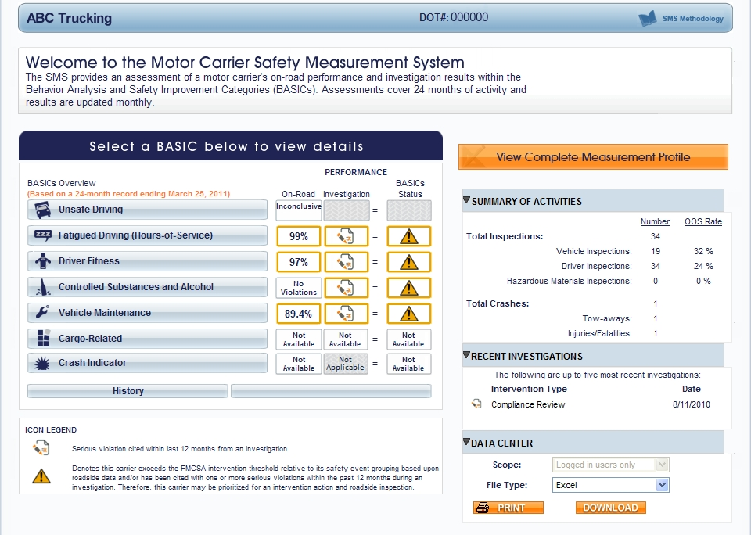
Carrier Measurement: SMS Results

Slide 9
Public Use of SMS Data
What are the limitations with SMS?

Slide 10
Public Use of SMS Data (cont.)
SMS is not a safety rating
Informed, current, and comprehensive picture of a motor carrier safety and compliance standing is provided by:
Official safety rating on Safety and Fitness Electronic Records (SAFER )
Authority and insurance status on Licensing and Insurance (L&I) website
Intervention and priority status on SMS
Outreach and education with shippers and other stakeholders is underway

Slide 11
What Analysis Has Been Performed on SMS?
Agency and independent (University of Michigan Transportation Research Institute [UMTRI]) analyses show that the SMS is an effective tool for identifying high-risk motor carriers
A particularly strong association exists between crashes and high scores in the Unsafe Driving and Fatigued Driving (Hours-of-Service) BASICs
Unsafe Driving BASIC consists of observed violations

Slide 12
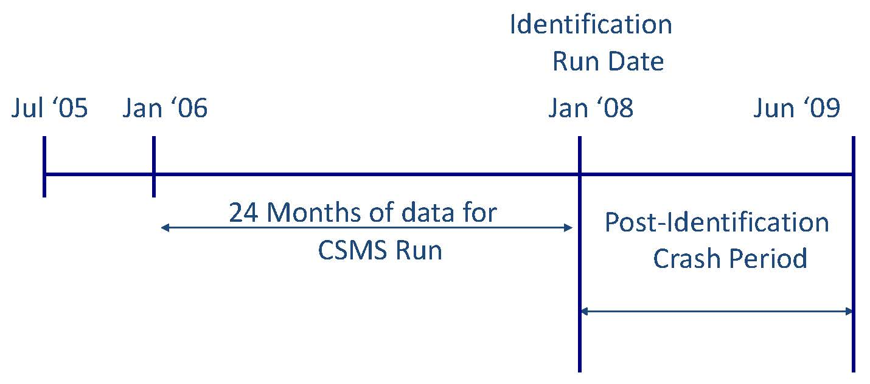
FMCSA Effectiveness Testing
Notes:
12

Slide 13
Unsafe Driving BASIC

Slide 14
Fatigued Driving BASIC

Slide 15
A Look at Some Numbers
Category | Approximate Number | Percentage of Uploaded Crashes
Carriers listed as active | 750K | 100%
Carriers with recent activity “pulse” in last three years | 525K | 100%
Carriers with insufficient data | 325K | 8%
Carriers with sufficient data to be assessed in at least one BASIC | 200K | 92%
Carriers with sufficient negative information to have a percentile assigned | 92K | 83%
Carriers with at least one BASIC above FMCSA intervention threshold | 50K | 45%

Slide 16
How Thresholds Were Identified
Analysis and effectiveness studies
Using improved SMS, goal to identify carriers with both:
Crash rate higher than the population average; and
Known on-road compliance issues
Thresholds identify comparable number of carriers as (~50k) compared to SafeStat (~51k)
BASIC | General | HM | Passenger
Unsafe Driving, Fatigued Driving (HOS), Crash Indicator | 65% | 60% | 50%
Driver Fitness, Vehicle Maintenance, Controlled Substances/Alcohol, Cargo-Related | 80% | 75% | 65%

Slide 17
UMTRI Analysis – Carriers Exceeding Thresholds
18-Month Crash Rates for Carriers: February 2008–July 2009
(Excludes carriers categorized as “test” carriers in CSA Op Model Test)
BASIC Threshold Exceeded | Carriers | Crash Rate per 100 PU | Ratio to Not Identified
Unsafe Driving | 9,245 | 7.44 | 3.56
Fatigued Driving | 17,959 | 6.24 | 2.99
Driver Fitness | 3,981 | 3.04 | 1.46
Controlled Substances/Alcohol | 1,013 | 6.55 | 3.14
Vehicle Maintenance | 18,700 | 4.87 | 2.33
Improper Loading/Cargo Securement | 9,409 | 3.97 | 1.9
Crash Indicator | 5,077 | 7.32 | 3.51
Exceeded Any BASIC | 44,881 | 4.94 | 2.37
Exceeded No BASICs | 428,966 | 2.09 | 1
All Carriers | 473,847 | 3.15 | 1.51

Slide 18
Small Business Impacts Compared to Prior System
Power Unit Group | SAFESTAT: % of Carriers with 1 or more SEAs “deficient” (Aug 2010) | SMS: % of Carriers with 1 or more BASICs above threshold (Jan 2012)
0< PU<=5 | 7.10% | 7.40%
5<PU<=15 | 22.20% | 20.90%
15<PU<=50 | 29.40% | 27.00%
Total % of carriers w/deficient SEA or BASIC above threshold | 10.10% | 10.20%

Slide 19
Drivers – CSA /PSP
SMS incorporates driver behaviors into BASICs
FMCSA does not formally “rate” drivers
Investigators address driver violations during carrier investigations
SMS data feeds into drivers’ Pre-Employment Screening Program (PSP) records. PSP:
Is a Congressionally-mandated program
Provides perspective motor carriers with driver inspection, crash, and violation history upon driver release

Slide 20
SMS Spring/Summer Enhancements
SMS Package #1 – Carrier Preview will be available
Hazardous Materials (HM) BASIC
Vehicle Maintenance
Moving cargo-related violations into vehicle
Intermodal Equipment Providers (IEP)
Aligning SMS with IEP regulation
Elimination of vehicle violations from Level 3 (driver-only) inspections
Redefining which carriers are subject to HM and Passenger Carrier intervention thresholds
ISS Modifications
Meaningful safety-based red-lights
Reprioritization of BASICs

Slide 21
CSA – Intervention Tools
Broader array of interventions to augment the Full Compliance Review
Reaches more carriers
Improves efficiency of investigations
Identifies root causes and corrective actions

Slide 22
CSA - Intervention Tools
OLD
NEW
Full Compliance Review is single tool despite specific type or scope of problem
Efficient and effective intervention tools reach more carriers and influence safety compliance earlier
Automated Warning Letters
Broader investigation types
Offsite Investigations
Focused Onsite Investigations
Comprehensive Onsite Investigations
Use of Safety Management Cycle
Investigators determine “why” violations are occurring

Slide 23
New Intervention Tools Implementation Status
Focused and comprehensive investigations now implemented in all states
Includes application of safety management cycle
UMTRI test evaluation: 20% fewer carriers had safety problems after Focused Onsite Investigations compared to Compliance Reviews
Offsite investigations implemented in 10 states
Further deployment will occur with IT enhancements
Automated warning letters implemented in all states
51k letters sent to date
UMTRI test evaluation: 83% carriers improved within 12 months of receiving a Warning Letter

Slide 24
New Safety Fitness Determination (SFD) Process and Status
CURRENT
One of three safety ratings issued following a Compliance Review
Satisfactory, Conditional, Unsatisfactory
Rating is snapshot based on date of most recent Compliance Review
NEW SAFETY FITNESS REGULATIONS TO BE PROPOSED WOULD
Incorporate on-road safety performance
Allow for proposed downgrade in formal SFD based on monthly update of measurement system
Continue to include major safety violations found as part of investigations
Notice of Proposed Rulemaking scheduled for 2012

