Slide 1

Sampling front-ends Chips for Pico-second Timing with Micro-Channel Plate devices
Jean-Francois Genat
University of Chicago
Research Techniques Seminar
Fermilab, Dec. 15th 2009

Slide 2
With help from
John T. Anderson, Mircea Bogdan, Dominique Breton, Gary Drake, Eric Delagnes,
Henry J. Frisch, Herve Grabas, Mary K. Heintz, Edward May, Samuel Meehan,
Eric Oberla, Larry L. Ruckman, Fukun Tang, Gary S. Varner, Jaroslav Va’Vra
and many others…
Jean-Francois Genat, Fermilab December 15th 2009

Slide 3
Introduction
Micro-Channel Plates The fastest devices to date
timing in the pico-second range
Fast Timing: Deep sub-micron CMOS technologies Pulse sampling at 1-10 GHz
large front-end at affordable power, room and cost
- Micro-channel Plate signals
Associated signal processing for pico-second timing
A 130nm CMOS sampling-digitizing ASIC
Jean-Francois Genat, Fermilab December 15th 2009

Slide 4
Outline
Applications of Pico-second Timing
Micro-Channel Plate devices
Pico-second electronics and Waveform analysis
Sampling Electronics
Pico-second timing SCA in 130nm CMOS technology
Perspective
Jean-Francois Genat, Fermilab December 15th 2009

Slide 5
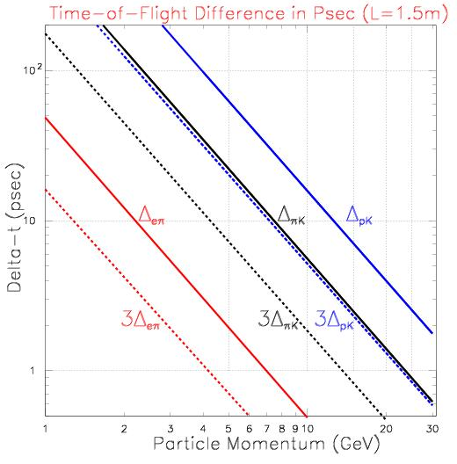
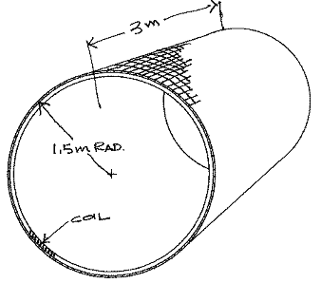
10-100 Picosecond Time of Flight applications at HEP Colliders
Particle identification
1-100ps Time of Flight
Non-TOF
TOF
Henry Frisch
Jean-Francois Genat, Fermilab December 15th 2009

Slide 6
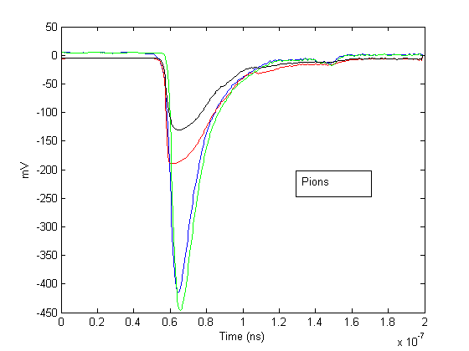
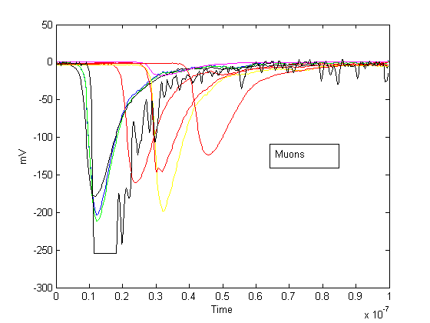
Particle ID from Waveform analysis
Response to Pions to Muons
10ns
10ns
Data from the Hadron Tile Calorimeter at LHC-ATLAS
Pion signals have shorter lifetime: shorter signals and faster rise-time
Sampled Waveform needed
Jean-Francois Genat, Fermilab December 15th 2009

Slide 7
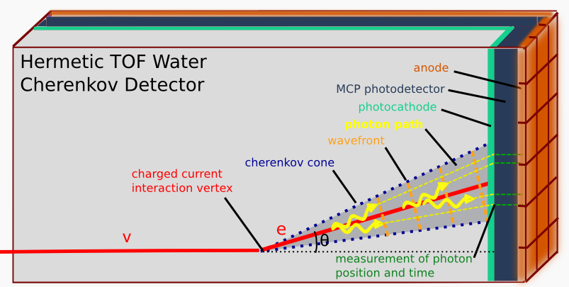
Lepton Flavor Physics
Constantinos Melachrinos
(idea of Howard Nicholson)
Henry Frisch
Example: Deep Underground Science and Engineering Laboratory (DUSEL) detector
Double β decay, Solar neutrinos, Gravitational waves
100% coverage and 3D photon vertex reconstruction.
Need for >10,000 square meters at 100 ps resolution
Jean-Francois Genat, Fermilab December 15th 2009

Slide 8
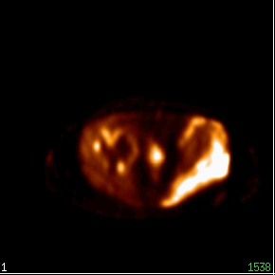
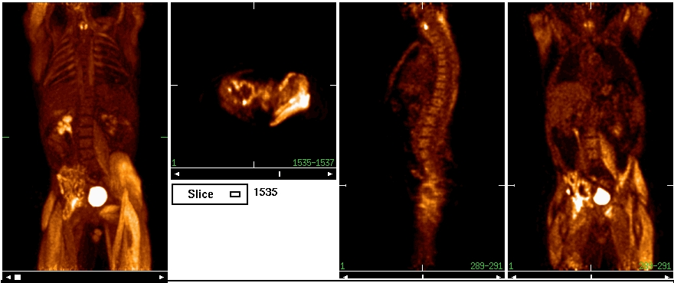
10-100 Picosecond Time of Flight applications
Medical Imaging
100ps Time of Flight:
Positron Emission Tomography [4]
Non-TOF
TOF
TOF
JoelΔx = c Δt/2
Δt=50ps, Δx=7.5mm
arp
Joel Karp
Jean-Francois Genat, Fermilab December 15th 2009

Slide 9
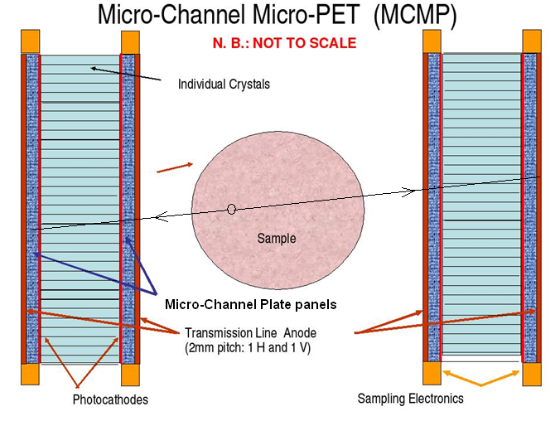
A possible TOF PET detector
Non-TOF
TOF
Henry Frisch
Jean-Francois Genat, Fermilab December 15th 2009

Slide 10
Outline
Applications of Pico-second Timing
Micro-Channel Plate devices
Pico-second electronics and Waveform analysis
Sampling Electronics
Pico-second timing SCA in 130nm CMOS technology
Perspective
Jean-Francois Genat, Fermilab December 15th 2009

Slide 11
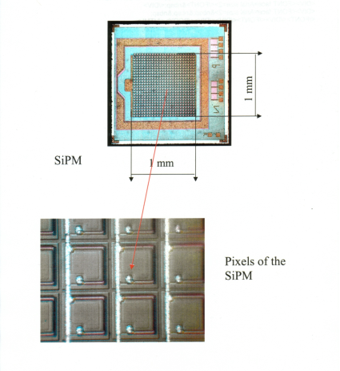
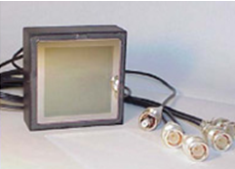
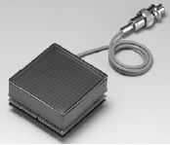
Fast timing-Imaging Devices
Multi-anodes PMTs Silicon-PMTs [10] Micro-Channel Plates [1]
Dynodes Quenched Geiger in Silicon Micro-Pores
Quantum Eff. 30% 90% 30%
Collection Eff. 90% 70% 70%
Rise-time 0.5-1ns 250ps 50-500ps
Timing resolution (1PE) 150ps 100ps 20-30ps
Pixel size 2x2mm² 50x50μm² 1.5x1.5mm²
Dark counts 1-10Hz 1-10MHz/pixel 1Hz-1 kHz/cm²
Dead time 5ns 100-500ns 1μs
Magnetic field no yes 15kG
Radiation hardness 1kRad=noisex10 good (a-Si, Al₂O₃)
Jean-Francois Genat, Fermilab December 15th 2009

Slide 12
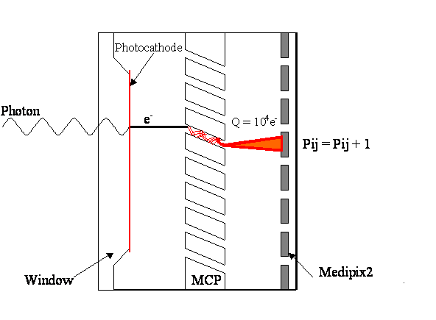
Timing (and Imaging) Devices
Micro-Channel Plate Detectors [1-3]
J. Vallerga
Segmented Anodes
anodes
Timing Resolution: Single Photo-electronTime Transit Spread:
The thinner the device, the better the Timing resolution
Aspect ratio (pore length/pore diameter) critical
Jean-Francois Genat, Fermilab December 15th 2009

Slide 13
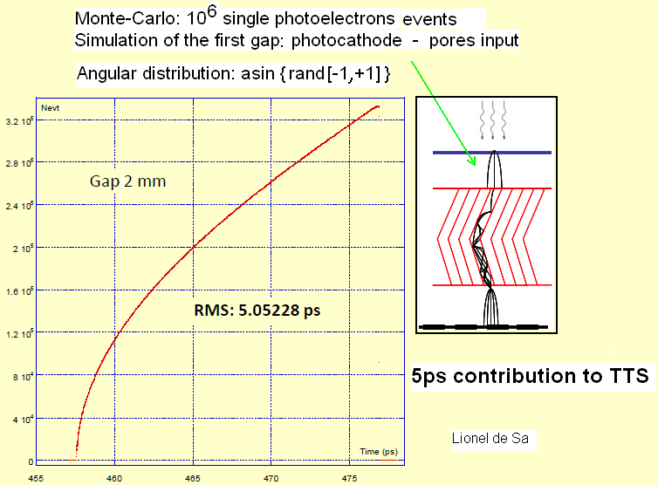
MCP Device Simulations: first gap
(20-30ps total measured)
Full device simulations:
Valentin Ivanov
Zeke Insepov
Jean-Francois Genat, Fermilab December 15th 2009

Slide 14
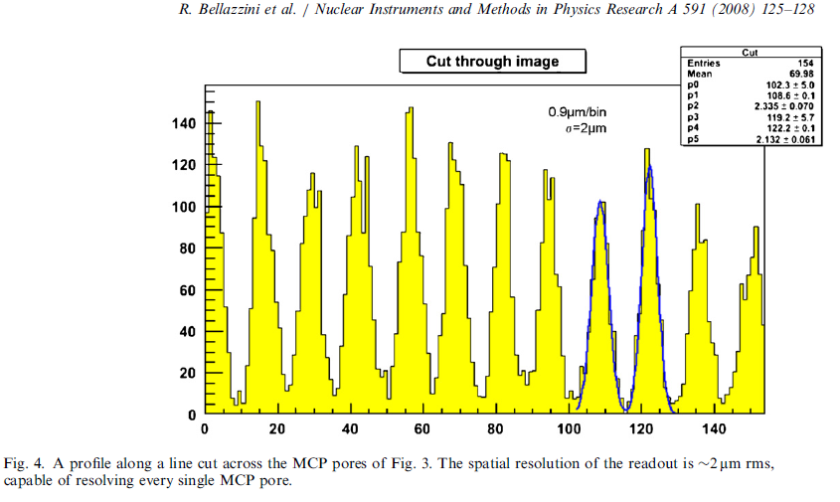
Two-micron space resolution using analog charge division technique
High precision
analog measurements.
But
integration time= 200ns !
Vernier Anodes
geometry
Jean-Francois Genat, Fermilab December 15th 2009

Slide 15
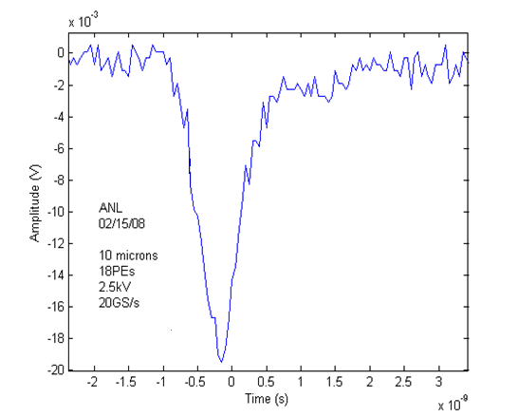
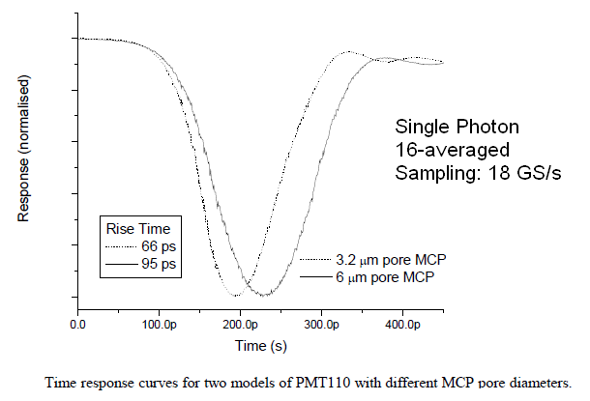
Micro-Channel Plate signals
TTS= 10ps
2” x 2” imaging MCP (BURLE/PHOTONIS)
From Photek Data taken at Argonne
11 mm diameter Micro-Channel Plate signal 2” x 2” Micro-Channel Plate signal
Signal full bandwidth: 10 GHz Signal full bandwidth: 2 GHz
Typical Timing resolution:
Single Photoelectron Time Transit Spread: 10ps 30ps
Jean-Francois Genat, Fermilab December 15th 2009

Slide 16
Timing resolution [5]
Single
Threshold
Time spread proportional to 1/rise-time and noise
Jean-Francois Genat, Fermilab December 15th 2009

Slide 17
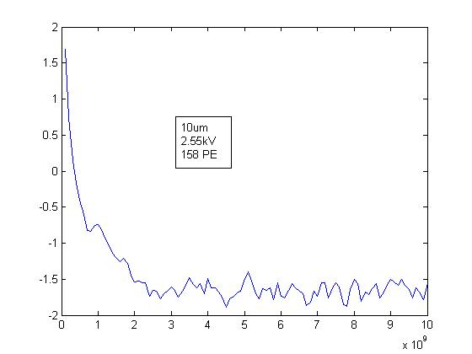
MCP Signal in the frequency domain
Fourier spectrum of a
2”x 2” MCP signal
Noise as small as possible
2 GHz
Slope as steep as possible
Jean-Francois Genat, Fermilab December 15th 2009

Slide 18
Pico-second timing with delay lines:
2D position + time
Delay lines readout and pulse sampling provide
  - Fast timing (2-10ps)
  - One dimension with delay lines readout 100mm- 1mm
  Transverse dimension can be obtained from centroids
  Less electronics channels for large area sensors
Pico-second electronics
t₁, a₁
t₂, a₂
Pico-second electronics
½ (t₁+ t₂) = time
v(t₁-t₂) = longitudinal position
Σ α_{i} a_{i} / Σ α_{i} = transverse position
Jean-Francois Genat, Fermilab December 15th 2009

Slide 19
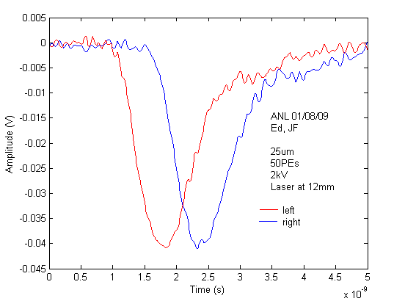
Delay Line readout
Position resolution by fast timing
50 PEs
Oscilloscope
TDS6154C
Tektronix
25 μm pore MCP signal at the output of a ceramic transmission line
Laser 408nm, 50Ω, no amplification
Jean-Francois Genat, Fermilab December 15th 2009

Slide 20
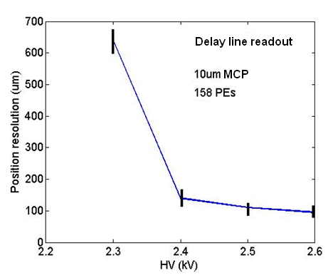
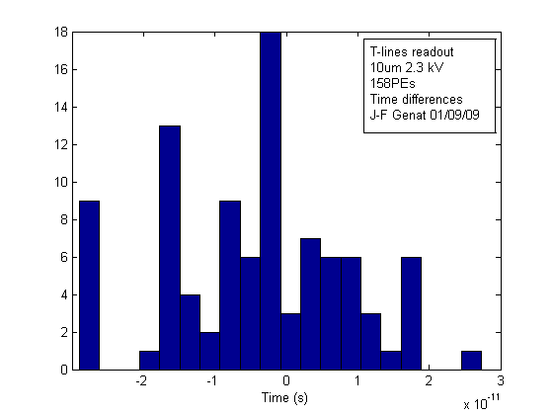
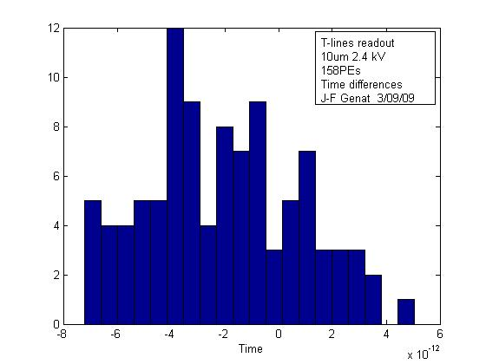
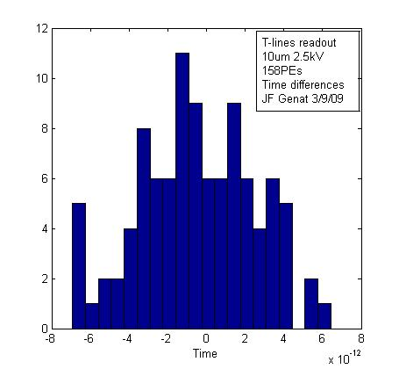
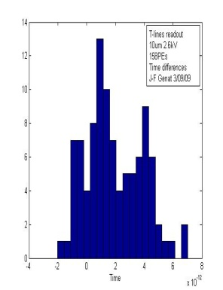
Delay Line readout Position resolution
158 PEs
HV 2.3 kV 2.4 kV 2.5 kV 2.6 kV
Std time diff 12.8ps 2.8ps 2.2 ps 1.95 ps
Std position 640μm 140μm 110μm 97μm
Oscilloscope
TDS6154C
Tektronix
Jean-Francois Genat, Fermilab December 15th 2009

Slide 21
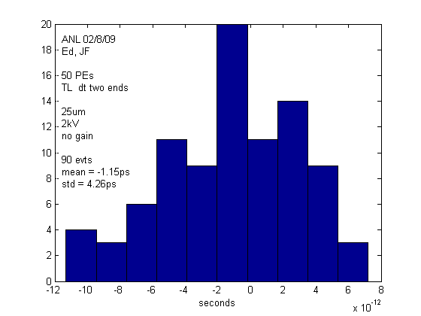
Delay Line readout Position resolution
With Edward May and Eugene Yurtsev (Argonne)
Jean-Francois Genat, Fermilab December 15th 2009

Slide 22
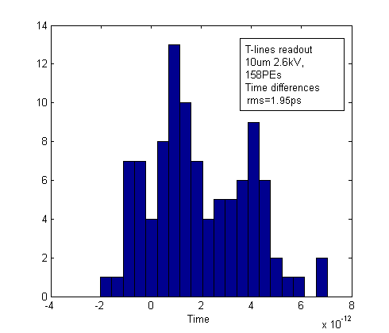
Delay Line readout Position resolution
158 Photo-Electrons
Position resolution (velocity=8.25ps/mm) : 50PEs 4.26ps 213μm
158PEs 1.95ps 97μm
Jean-Francois Genat, Fermilab December 15th 2009

Slide 23
Outline
Applications of Pico-second Timing
Micro-Channel Plate devices
Pico-second electronics and Waveform analysis
Sampling Electronics
Pico-second timing SCA in 130nm CMOS technology
Perspective
Jean-Francois Genat, Fermilab December 15th 2009

Slide 24
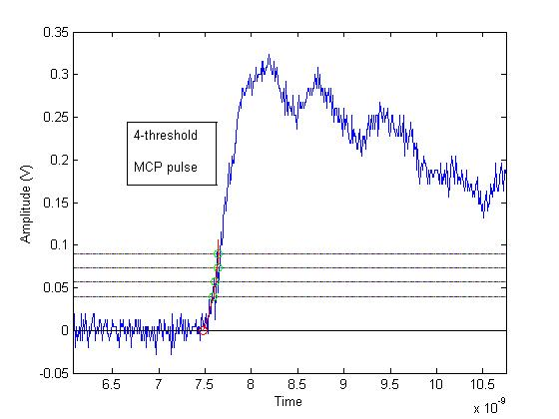
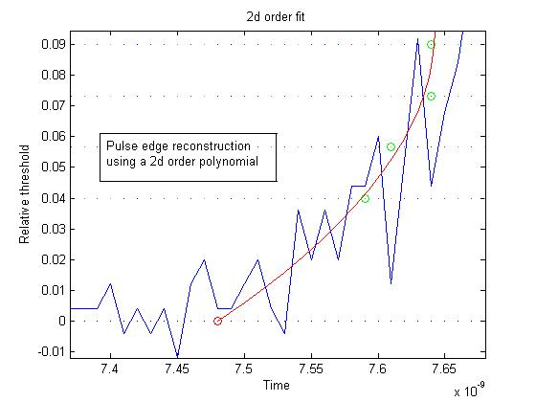
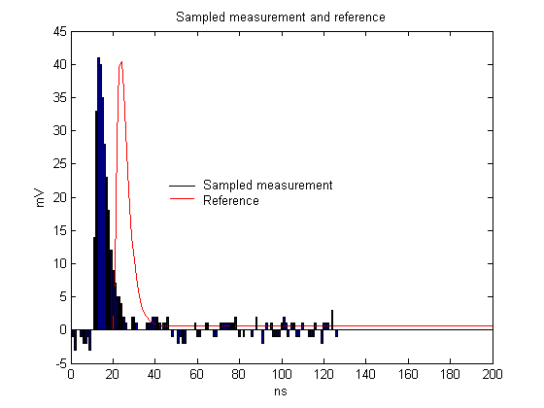
Timing techniques
ANALOG
Multi-threshold
Constant-fraction
Constant fraction
Leading
edge
Extrapolated time
Leading edge errors
Pulse sampling and Waveform analysis
DIGITAL
Sample, digitize,
Fit to the known waveform
Jean-Francois Genat, Fermilab December 15th 2009

Slide 25
Constant fraction [6]
Constant-fraction
Constant fraction
Leading
edge
Leading edge errors
Measure pulse amplitude: threshold at a given fraction a delayed version of the pulse
3-parameter (at least !) technique
- Absolute Threshold
- Fraction threshold
- Delay
Analog delay difficult to integrate (cable in most implementations)
Jean-Francois Genat, Fermilab December 15th 2009

Slide 26
Multi-threshold
Multi-threshold: sample several times over thresholds
Best results:
- Number of thresholds 4-8
- Thresholds values equally spaced
- Order of the fit: 2d order optimum
Extrapolated time
Jean-Francois Genat, Fermilab December 15th 2009

Slide 27
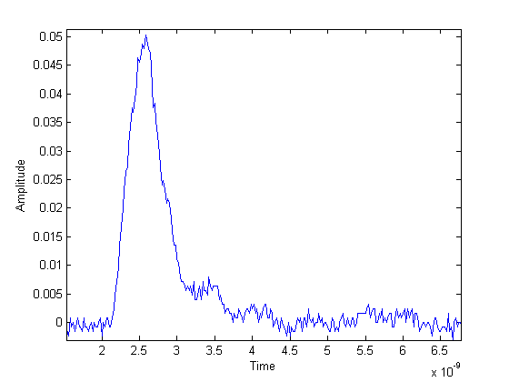
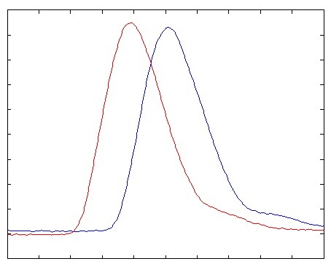
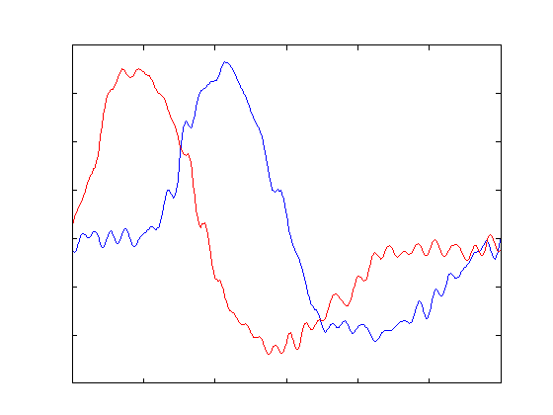
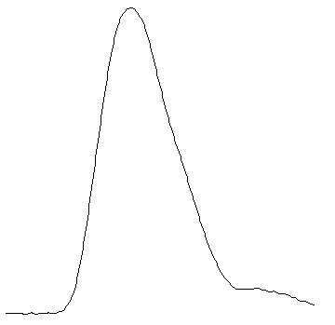
Digital Waveform Analysis
Fit to waveform
and derivative
templates
Psec Timing
and Charge
Jean-Francois Genat, Fermilab December 15th 2009

Slide 28
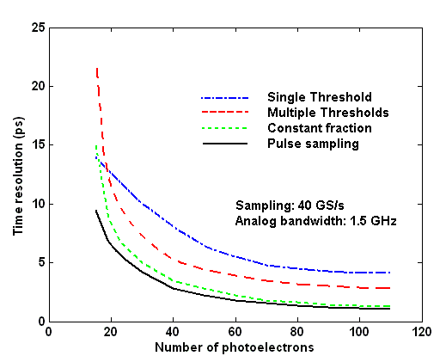
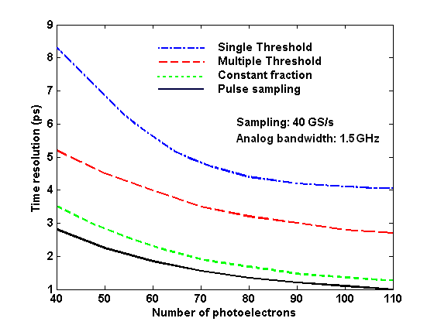
Methods compared (simulation) [11]
zoom
Time resolution vs Number of photo-electrons
Jean-Francois Genat, Fermilab December 15th 2009

Slide 29
Picosecond Digital Electronics for
Micro-Channel Plate Detectors
Store the full detector information as with a digital oscilloscope:
- Quantization noise (LSB/√12) << Detector + electronics noise
Sampling frequency > 2 x full Analog Bandwidth (Shannon-Nyquist)
Ideal approach:
Digitize on the fly, if the two above conditions can be fulfilled.
If not, loss of precision due to A/D conversion and/or loss of timing information
Fourier spectrum of a
2”x 2” MCP signal
Noise as small as possible
2 GHz
Slope as steep as possible
Jean-Francois Genat, Fermilab December 15th 2009

Slide 30
Picosecond Digital Electronics for
Micro-Channel Plate Detectors
A/D state of the art:
8-bit 1GS/s
10-bit 300 MS/s
16-bit 160 MS/s
Need at least 5 GS/s sampling rate, 10-12bit
There is no !
Fast analog storage
and slower digitization, if rate allows, or dead-time acceptable
Apply the best timing algorithm suited to the detector, get the charge for free … !
Jean-Francois Genat, Fermilab December 15th 2009

Slide 31
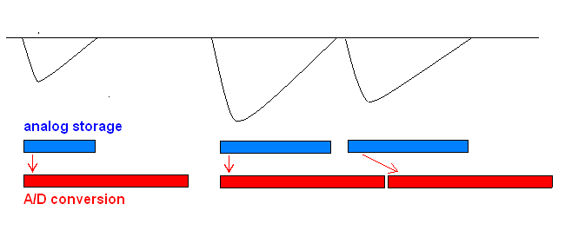
Fast analog storage [7-9]
Example:
Analog ADC
5 GS/s analog storage, 8-ch 12-bit 80 MS/s (AD9222-80)
Ok up to 2% occupancy
- Internal Analog buffer or
- Use other channels on-chip with a fast input multiplexer
Jean-Francois Genat, Fermilab December 15th 2009

Slide 32
Sampled Micro-Channel Plate signals
Assume: a typical noise at 1mV (detector+system)
LSB set to 1mV for a 1V dynamic range (quantization noise 300μV),
50-200ps rise-time
Fast timing:
10 bit, 2.5-10 GHz full analog bandwidth > 5-20 GS/s sampling rate
Readout electronics
Deep sub-micron CMOS ASICs: faster: larger analog bandwidth, sampling rate
improved radiation hardness
cheap, 1-10$/ch
less dynamic range
Jean-Francois Genat, Fermilab December 15th 2009

Slide 33
Outline
Applications of Pico-second Timing
Micro-Channel Plate devices
Pico-second electronics and Waveform analysis
Sampling Electronics
Pico-second timing SCA in 130nm CMOS technology
Perspective
Jean-Francois Genat, Fermilab December 15th 2009

Slide 34
Fast Sampling Electronics
Integration in custom ASIC for large scale detectors ~ 10⁴⁻⁶ channels,
Self or external trigger,
Low power,
Full digital (serial) interface,
High reliability and availability,
Low cost.
Jean-Francois Genat, Fermilab December 15th 2009

Slide 35
Sampling Chips
Sampling Bandwidth Dyn. range Depth PLL ADC Trigger Techno
GS/s GHz bits bits
G. Varner (Hawaii) [9] 6 1.0 10 1024 no 12 experience .25μm
S. Ritt (PSI) [8] 6 .8 11.5 256 3.9ps no no .25μm
D. Breton/E. Delagnes 2.5 .5 13.4 250 20ps no no .35μm
(Orsay/Saclay) [7]
ASIC Deep Sub-Micron ( < .13μm ) CMOS processes allow today:
Sampling: 10-20 GHz
Bandwidth: > 1.5 GHz
Dyn. Range: 10bit
Jean-Francois Genat, Fermilab December 15th 2009

Slide 36
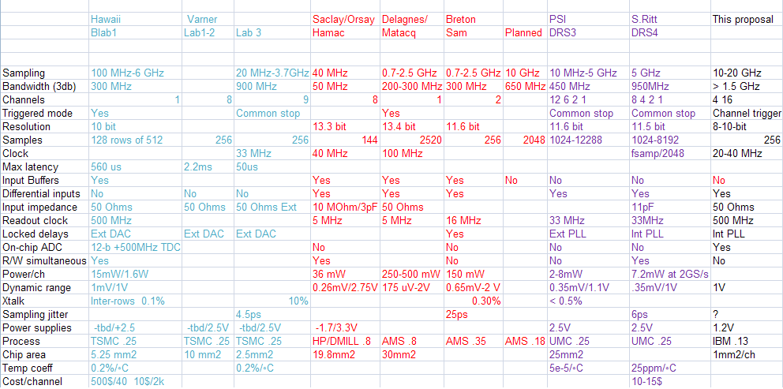
Sampling Chips Survey
Trade-off between analog resolution (10-14-bit) and timing (sampling rate 20 MHz-6 GHz)
Our proposal: 130nm CMOS: optimize for timing resolution
Jean-Francois Genat, Fermilab December 15th 2009

Slide 37
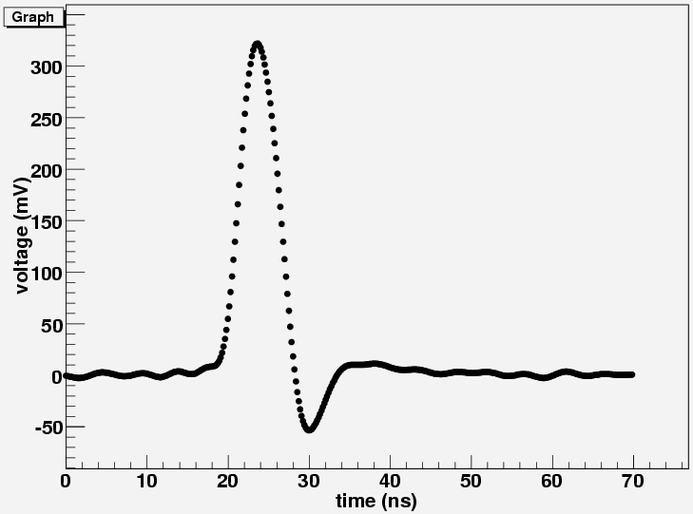
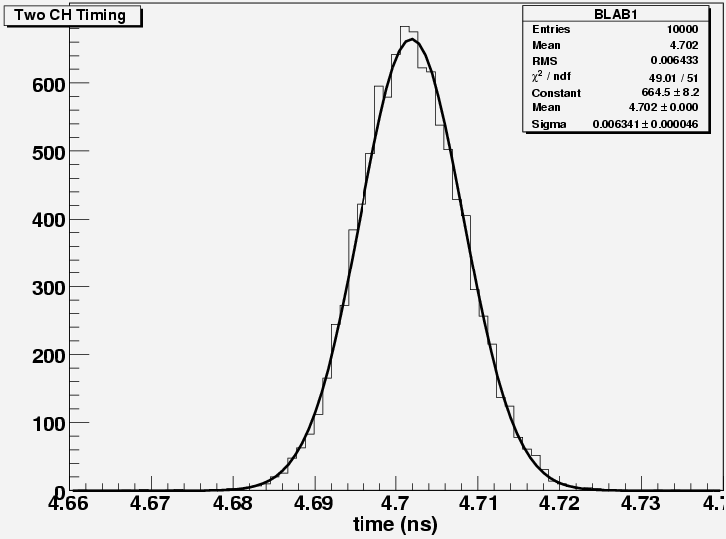
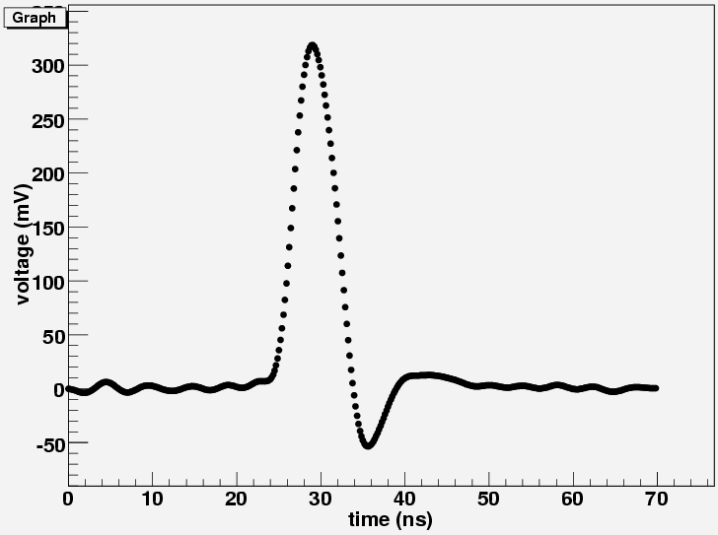
Existing ASICs: Labrador 3 [9]
Gary Varner
U-Hawaii
CH1
6.4 ps RMS
(4.5ps single)
CH2
250nm CMOS
After timing calibration
Jean-Francois Genat, Fermilab December 15th 2009

Slide 38
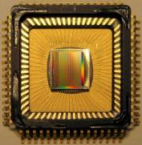
Waveform Digitizing Chip DRS4 [8]
Stefan Ritt
Paul Scherrer Institute
Switzerland
UMC 0.25 μm rad. hard
9 chn. each 1024 bins,
cascadable up to 8192
Sampling speed
0.2 … 5 GS/s
Bandwidth 950 MHz
17.5 mW/chn @ 2.5V
On-chip PLL stabilization
Readout speed using
ext. ADC: 30 ns * n_{samples}
SNR: 69 dB calibrated
Aperture jitter:
4 ps at 5 GS/s calibrated
No
No
250nm CMOS
Jean-Francois Genat, Fermilab December 15th 2009

Slide 39
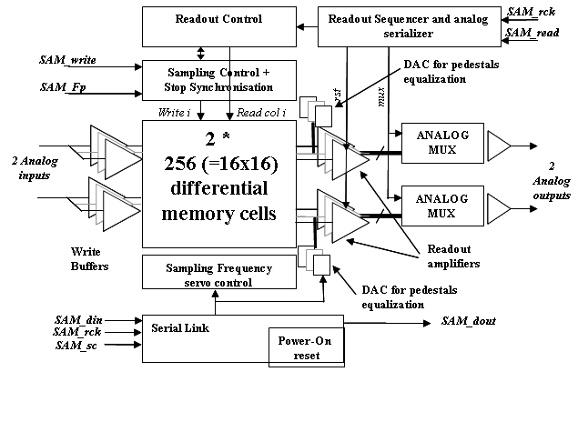
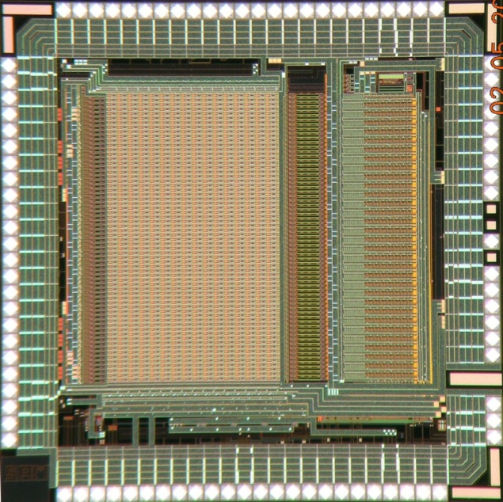
The SAM (Swift Analog Memory) ASIC [7]
D. Breton/E. Delagnes
Orsay/Saclay
2 differential channels
256 cells/channel
BW > 450 MHz
Sampling Freq 400MHz->3.2GHz
High Readout Speed > 16 MHz
Smart Read pointer
Few external signals
Many modes configurable by a serial link.
Auto-configuration @ power on
AMS 0.35 µm => low cost for medium size prod
NIM A, Volume 567, Issue 1, p. 21-26, 2006
6000 ASICs manufactured, tested and delivered in Q2 2007
Jean-Francois Genat, Fermilab December 15th 2009

Slide 40
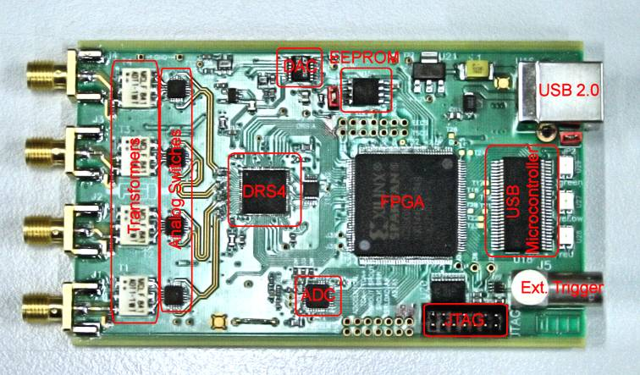
Sampling-Digitizing card using a CMOS ASIC
S. Ritt
PSI, Switzerland
All these chips require a control FPGA for, at least, fine timing calibration purposes
Jean-Francois Genat, Fermilab December 15th 2009

Slide 41
Outline
Applications of Pico-second Timing
Micro-Channel Plate devices
Pico-second electronics and Waveform analysis
Sampling Electronics
Pico-second timing SCA in 130nm CMOS technology
Perspective
Jean-Francois Genat, Fermilab December 15th 2009

Slide 42
130nm CMOS Sampling ASIC
130nm CMOS is the best trade-off today between speed and dynamic range
This chip is developed by U-Chicago and U-Hawaii
It includes
- 4 channels of full sampling (256 cells)
- 1 channel of sampling cell to observe the sampling window
Test structures:
- Sampling cell,
- ADC Comparator,
- Ring Oscillator
Jean-Francois Genat, Fermilab December 15th 2009

Slide 43
Sampling ASIC
Prototype chip in 130nm CMOS technology (IBM 8RF-DM)
4-channel sampling, >10-15GSa/s
1-2 GHz analog bandwidth, 50 Ohms
40-80 MHz clock
256 cells (<100ps/cell, 12.5-25ns range)
Free running delays (no PLL)
Sampling window 500ps-2ns
Dynamic range .8V
Crosstalk <1%
On-chip parallel 12-bit ADC (2 μs min conversion time)
Free running delays (No PLL)
Linearity < 1% on the full dynamic range
Read clock up to 50 MHz (one cell/period, 22 μs total readout time)
One reference channel (sampling window)
1.2V power supply
Power < 40 mW/channel
Process IBM 8RF-DM (130nm CMOS)
4 x 4 mm²
Chicago-Hawai’i
Sent July 2009, received Oct 21st
Jean-Francois Genat, Fermilab December 15th 2009

Slide 44
Block diagram
Clock
Timing Generator
Ch 0
Channel # 0 (256 sampling caps + 12-b ADC)
Read
control
Ch 1
Analog in
Ch 2
Ch 3
Channel # 3
Digital
out
Calibration
Channel #4 (Sampling window)
Read
Jean-Francois Genat, Fermilab December 15th 2009

Slide 45
Sequence of operations
-1 Write: The timing generator runs continuously, outputs clock phases 100ps spaced.
Each phase closes a write switch during one sampling window.
40 MHz Clk
100ps
A/D converters
Analog
inputs
Digital
output
Mux
-2 A/D conversion after a trigger that opens all the write switches
and starts all A/D conversions in parallel
Data available after 2 μs (2GHz counters)
-3 Read occurs after conversion (data can still be taken as in Phase 1)
Jean-Francois Genat, Fermilab December 15th 2009

Slide 46
10 GS/s Timing Generator
100ps step delays
Delay control voltages
40 MHz clock
256 cells
100ps 100ps 100ps
Sampling window
control voltage
To switched capacitor array
Inverters delays used as time reference to be adjusted off-line for pico-second timing
Jean-Francois Genat, Fermilab December 15th 2009

Slide 47
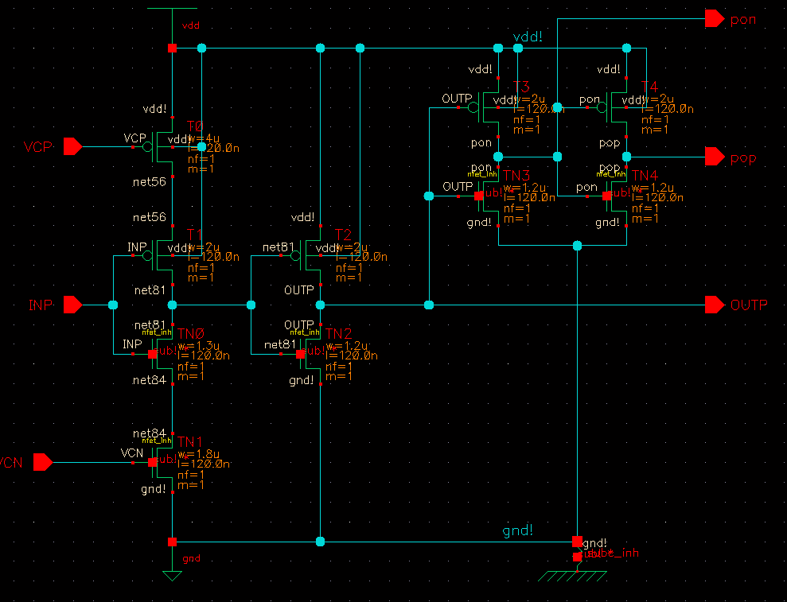
Timing Generator
Voltage Controlled Delay Cell
- 256 voltage controlled delay cells of 100-200ps
- 20-40 MHz clock propagated
Voltage Controlled Delay Cell
Test structure:
Ring Oscillator: Two delay cells + inverter
Jean-Francois Genat, Fermilab December 15th 2009

Slide 48
Sampling Cell
wr
rd
R_{in}
V_{in}
C_{in}
V_{out}
V_{in}
C_{storage}
Principle
wr
V_{in}
C_{in}
“Write” state 3 dB analog bandwidth is 1/(2πR_{in}C_{storage})
“Sampling window” Number of switches closed x sampling period
Thermal kT/C switching noise = 250μV = one 12-bit ADC count
Trade-off analog bandwidth - kT/C noise
Jean-Francois Genat, Fermilab December 15th 2009

Slide 49
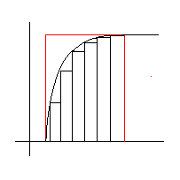
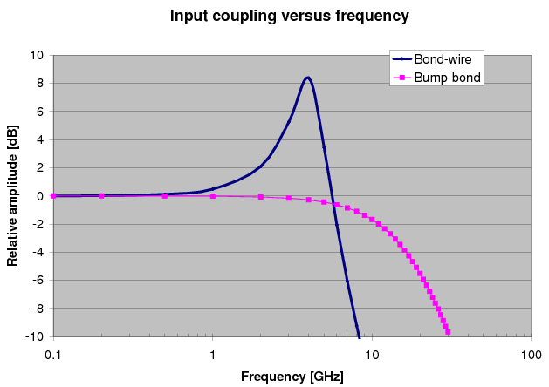
Analog bandwidth and Sampling window
On chip:
R_{in} is the resistance of the
closed write switch
R_{in}
V_{in}
C_{store}
Sampling window
Sampling window = Number of switches closed at a time x sampling period
Sampling Window₁₀₋₃ = -log(10⁻³) x rise-time / 2.2= 1/ 3 dB Analog Bandwidth
In practice, R_{in} and C_{store} are minimum, but limited by the stray capacitor of the switch, the leakage current of the switch in the open state, and kT/C noise.
R_{in} =1.5kΩ, C_{store}= 70 fF
3dB Analog Bandwidth = 2 π R_{in}C _{store}= 1.5 GHz
Sampling window ₁₀₋₃ > 625ps = 7 samples at 10 GS/s
Gary Varner
Off chip:
Inductance of the wire bonds and pad capacitance: Bump-bonding
Jean-Francois Genat, Fermilab December 15th 2009

Slide 50
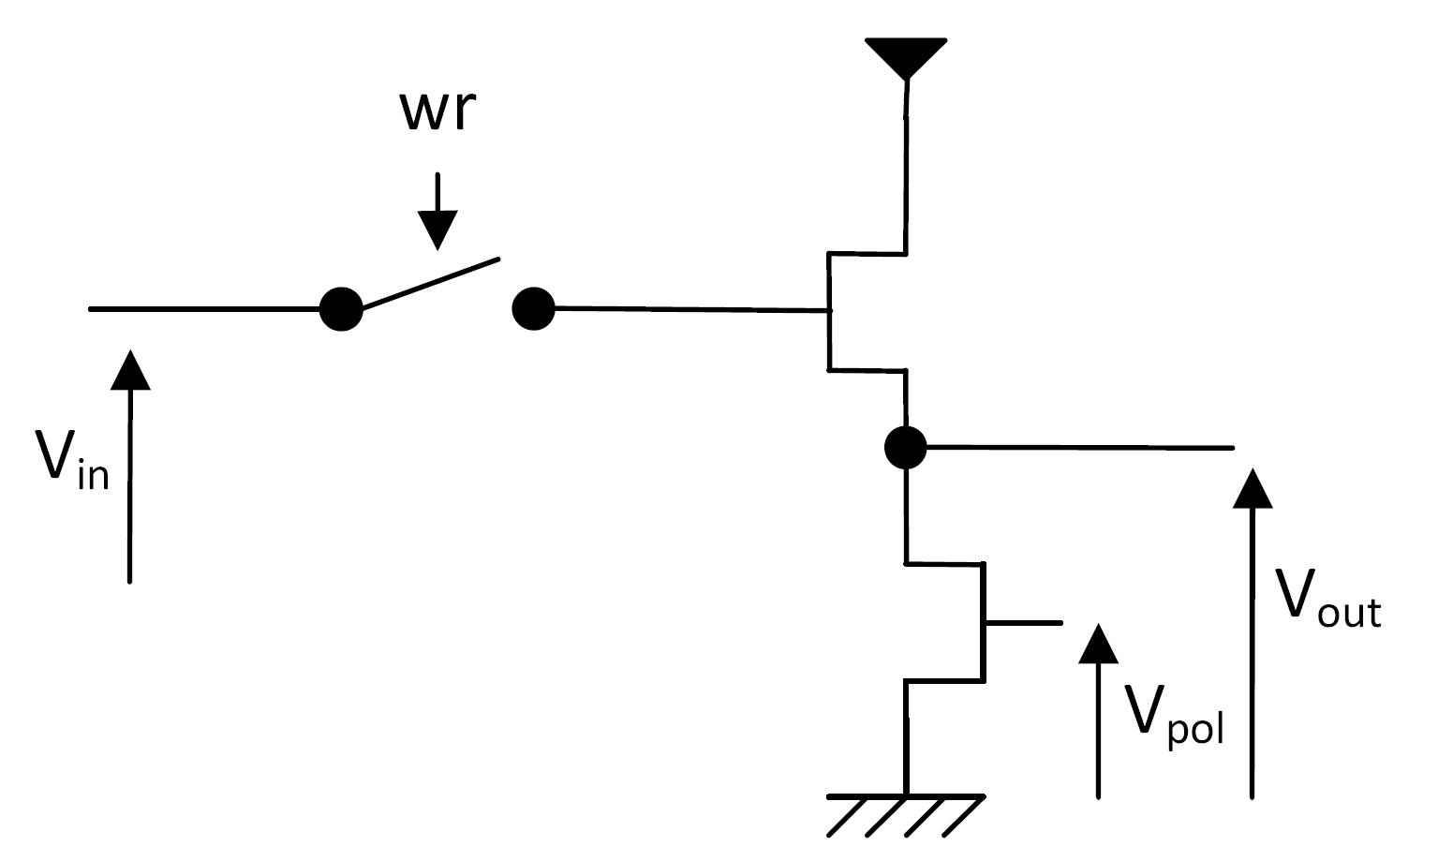
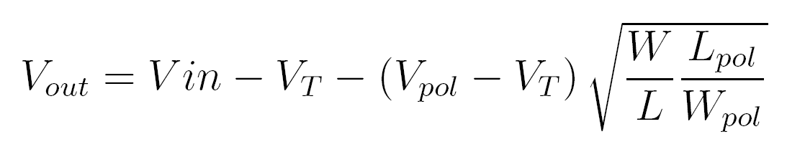
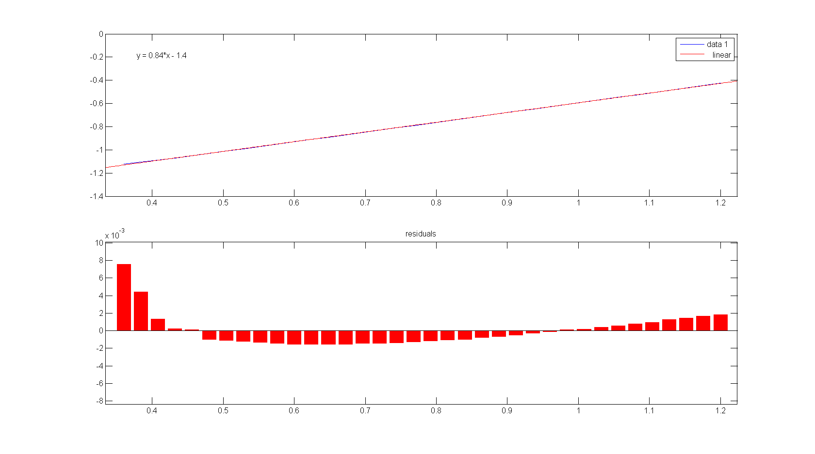
Sampling cell design
Need a voltage buffer to read
the small storage capacitor (70fF)
The gate of the source follower
transistor is part of the storage
capacitor (40+30fF)
Non-linearity < 8/1000
Jean-Francois Genat, Fermilab December 15th 2009

Slide 51
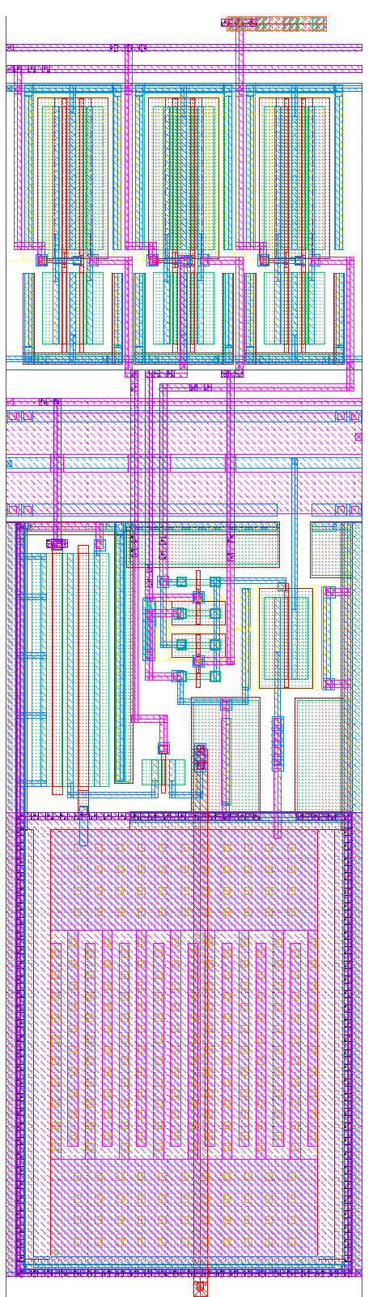

Sampling Cell
Input switch
Storage capacitance & Nfet
Output switch
²
Current source
Multiplexer
Sampling Capacitance 70fF
Switch resistance: 1.5kΩ
Analog bandwidth 1.5GHz
Layout
Jean-Francois Genat, Fermilab December 15th 2009

Slide 52
ADC
Wilkinson:
All cells digitized in one conversion cycle
- Ramp generator
Comparators
Counter
Clocked by the ring oscillator at 1-2 GHz
Jean-Francois Genat, Fermilab December 15th 2009

Slide 53



Layout
One sampling cell
One channel
CMOS 130nm IBM 4 x 4 mm²
Jean-Francois Genat, Fermilab December 15th 2009

Slide 54


Pictures
Received October 21st 2009
Die to be bump-bonded on PCB
Jean-Francois Genat, Fermilab December 15th 2009

Slide 55

Tests
- First tests of packaged chips (presented here)
- DC power vs biases,
- Sampling cell response vs input
- ADC’s comparator
    - Leakages (voltage droop)
- Digital Readout
Fine tests to come… (chip is just being bump-bonded to PCB)
  Analog bandwidth
  Resolution, signal-to-noise
  Sampling cell response vs sampling window
  Crosstalkk
  Max sampling rate
  Full ADC
  Linearities, dynamic range, readout speed
Jean-Francois Genat, Fermilab December 15th 2009
Notes:
55

Slide 56


Tests: Sampling cell
Measurements Simulation/Measurements
DC response ok, except a saturation for voltage inputs > 750 mV
Very close to simulation
Jean-Francois Genat, Fermilab December 15th 2009

Slide 57
Tests: Sampling cell Leakages
1 - input LOW, write switch CLOSED
2 - input HI, switch CLOSED
3 - input HI, switch OPEN
4 - input LOW, switch OPEN
Leakage current is 7 pA
Much smaller than in simulation
1
2
3
4
Write switch Read switch
Jean-Francois Genat, Fermilab December 15th 2009

Slide 58

Tests: Ring Oscillator
- Measured up to 1.5 GHz
- Observation limited by the12 bit down-counter
- Can presumably run faster internally
Jean-Francois Genat, Fermilab December 15th 2009

Slide 59
Tests: Digital readout
Token passing readout to multiplex the 1024 data words onto the output bus
.
Jean-Francois Genat, Fermilab December 15th 2009

Slide 60
Tests Summary
  Test structures measured as expected from simulations in terms of:
  - Dynamic range:
  Sampling cell runs ok within 0-700mV as simulated
  - Speed:
  Ring Oscillator up to 1.5 GHz
  - Readout logic ok
  One problem with I/O pads:
  DC path to ground through protection diodes, but I/O’s can be easily overdriven.
  Full sampling channels have still to be measured
Jean-Francois Genat, Fermilab December 15th 2009

Slide 61
Next Design
Measure and fully understand the first version
Test with actual MCP signals for pico-second timing
Include:
- Input trigger discriminator
- Phase lock (Temperature, voltage supply, process)
- Increase the dynamic range to 1V
- Improve the analog bandwidth to 2GHz
- Increase the sampling rate up to 20 GS/s
- Improve the readout frequency to 8 x 40 = 320 MHz
130nm CMOS runs at MOSIS: Feb 1st, May 10th
Jean-Francois Genat, Fermilab December 15th 2009

Slide 62
20 GHz Timing generator [12]
50ps step delays
40-160 MHz Clock in
0ps
32-64 cells
200ps 200ps 200ps 200ps
250ps
300ps
350ps
To switched capacitor array
Jean-Francois Genat, Fermilab December 15th 2009

Slide 63
Outline
Applications of Pico-second Timing
Micro-Channel Plate devices
Pico-second electronics and Waveform analysis
Sampling Electronics
Pico-second timing SCA in 130nm CMOS technology
Perspective
Jean-Francois Genat, Fermilab December 15th 2009

Slide 64
Perspective
The 4-channel 130nm CMOS ASIC:
First tests ok, more test results to come shortly…
Next chip : Upgrade with channel discriminator, internal PLL, improve analog bandwidth, sample rate, multi-gain input stages ?
Other ASIC design at the University of Chicago:
An integrated Front-End for the Hadron Tile Calorimeter upgrade at ATLAS
Include: 3-gain input stage, Integrator, 12-bit ADC
130nm CMOS OK for these designs so far
Latest technologies (90nm) are faster , but need multi-gain due to the reduced voltage supply range, SiGe is an option (1/f noise, speed)
Multi-gain (QIE-like) switched capacitor arrays ?
Control FPGA in 3D integration technology ?
Jean-Francois Genat, Fermilab December 15th 2009

Slide 65
References
[1] J.L. Wiza. Micro-channel Plate Detectors. Nucl. Instr. Meth. 162 (1979) 587-601.
[2] K. Inami, N. Kishimoto, Y. Enari, M. Nagamine, and T. Ohshima. Timing properties of MCP-PMT. Nucl. Instr. Meth. A560 (2006) 303-308., K. Inami. Timing properties of MCP-PMTs. Proceedings of Science. International Workshop on new Photon-Detectors, June 27-29 (2007). Kobe University, Japan.
[3] J. Va’vra, J. Benitez, J. Coleman, D. W. G. Leith, G. Mazaher, B. Ratcliff and J. Schwiening. A 30 ps Timing Resolution for Single Photons with Multi-pixel Burle MCP-PMT. Nucl. Instr. Meth. A572 (2007) 459-462.
[4] H. Kim et al. Electronics Developments for Fast Timing PET Detectors. Symposium on Radiation and Measurements Applications. June 2-5 (2008), Berkeley CA, USA.
[5] An extensive list of references on timing measurements can be found in: A.Mantyniemi, MS Thesis, Univ. of Oulu, 2004; ISBN 951-42-7460-I; ISBN 951-42-7460-X;
[6] S. Cova et al. Constant Fraction Circuits for Picosecond Photon Timing with Micro-channel Plate Photomultipliers. Review of Scientific Instruments, 64-1 (1993) 118-124.
[7] E. Delagnes, Y. Degerli, P. Goret, P. Nayman, F. Toussenel, and P. Vincent. SAM : A new GHz sampling ASIC for the HESS-II Front-End. Cerenkov Workshop (2005), and NIM A, Volume 567, Issue 1, p. 21-26, 2006
[8] S. Ritt. Design and Performance of the 5 GHz Waveform Digitizer Chip DRS3. Nuclear Instruments and Methods, (2007).
[9] G. Varner, L.L. Ruckman, A. Wong. The First version Buffered Large Analog Bandwidth (BLAB1) ASIC for high Luminosity Colliders and Extensive Radio Neutrino Detectors. Nucl. Inst. Meth. A591 (2008) 534.
[10] G.Bondarenko, B. Dolgoshein et al. Limited Geiger Mode Silicon Photodiodes with very high Gain. Nuclear Physics B, 61B (1998) 347-352.
[11] J-F Genat , G. Varner, F. Tang and H. Frisch. Signal Processing for Pico-second Resolution Timing Measurements. Nuclear Instruments and Methods, (2009).
[12] J. Christiansen . An Integrated CMOS 0.15 ns Digital. Timing Generator for TDC's and Clock Distribution. Systems, IEEE Trans. Nucl. Sci., Vol. 42, No4 (1995), p. 753
Jean-Francois Genat, Fermilab December 15th 2009

Slide 66
Thanks for your attention !
Jean-Francois Genat, Fermilab December 15th 2009

