Slide 1
Surface Ship Sustainment
RDML Jim Shannon
Deputy Commander for Surface Warfare
NAVSEA 21

Slide 2
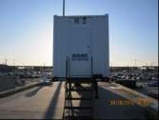
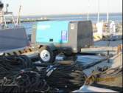
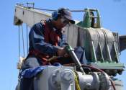
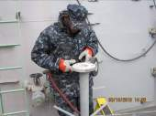
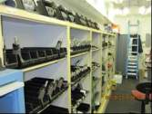
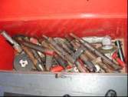
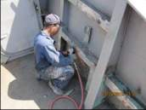
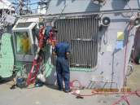
  One year ago, the SEA 21 message was
  about the maintenance community culture
“Changing surface maintenance culture, on the waterfront, one ship at a time”
The Surface Maintenance Engineering Planning Program (SURFMEPP) is the NAVSEA “brain trust” defining and defending maintenance requirements based on technical underpinning and objective quality evidence.

Slide 3
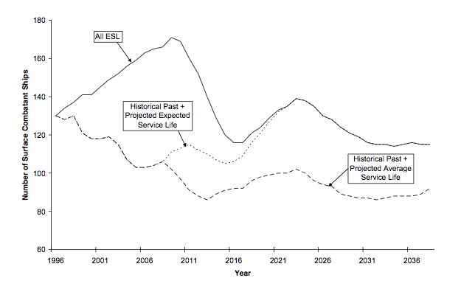
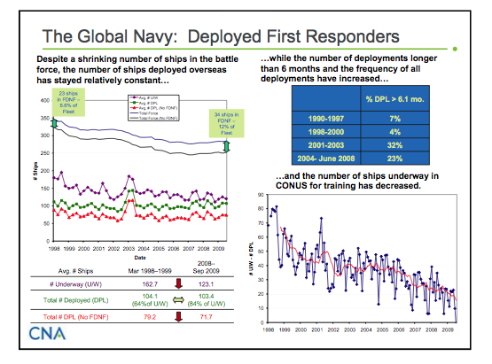
  And the DoN concern for Surface
  Maintenance was about achieving ESL
But there are multiple views of ship life¹
ESL (Expected Service Life) {supports 30 year shipbuilding plan}
ASL (Actual Service Life)
OSL (Operational Service Life) {ASL + 0.25(TOOC)}
Assessed age {INSURV assessment}
DSL (Design Service Life)
Economic Life {Commercial Engineering Assessment}
²
Meeting projected service life still vital and maintenance community working hand-in-hand to implement tools and processes to achieve
¹ “SHIP Service Life and Naval Force Structure”, ASNE paper, 23-25 Sep. 2008 by Koenig, Nalchajian, and Hootman
² “The Navy at a Tipping Point: Maritime Dominance at Stake?, Center Naval Analysis Paper, March 2010, by Whiteneck, Price, Jenkins, Swartz

Slide 4
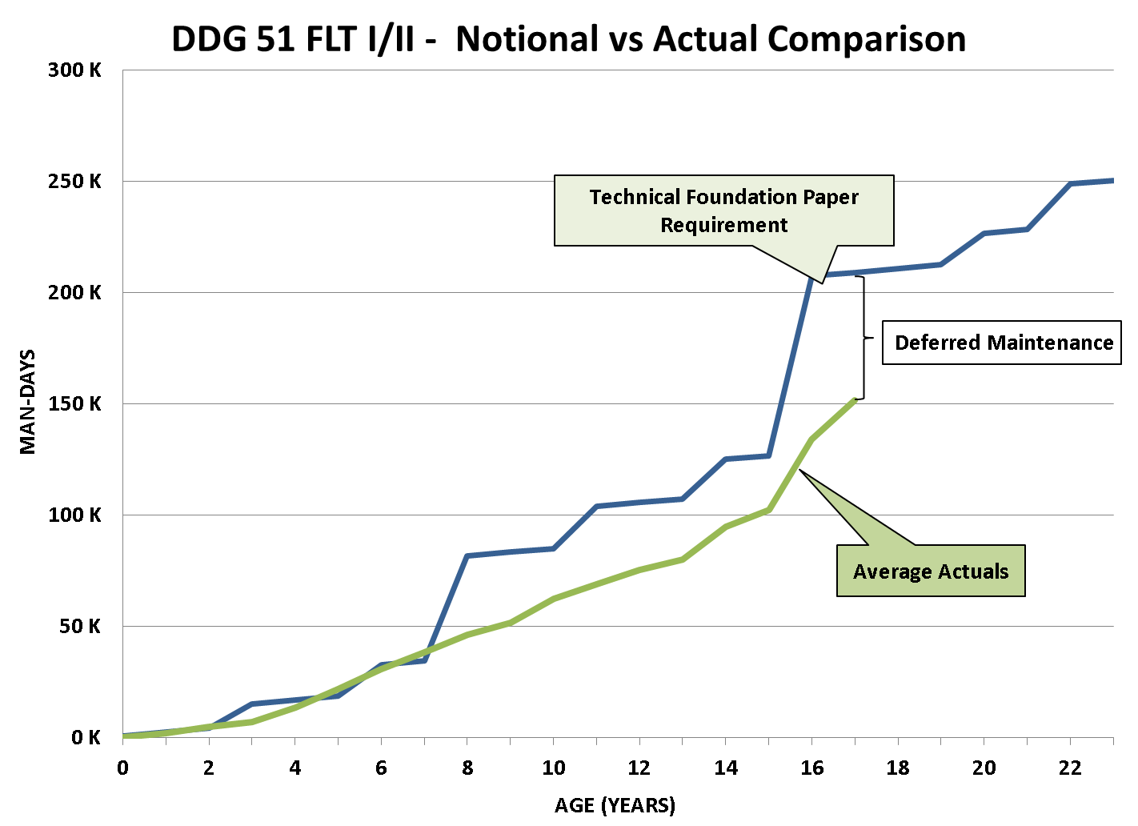
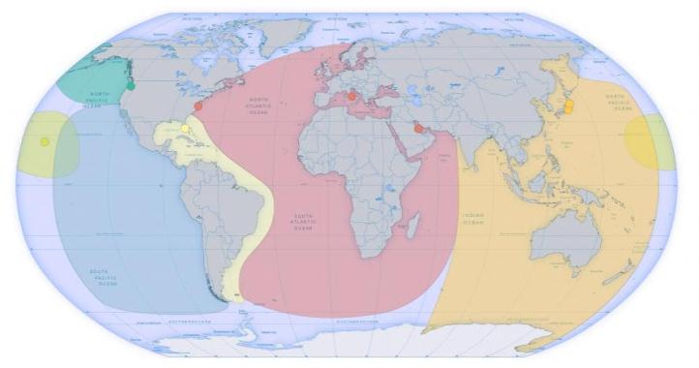
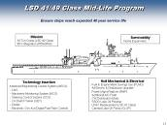
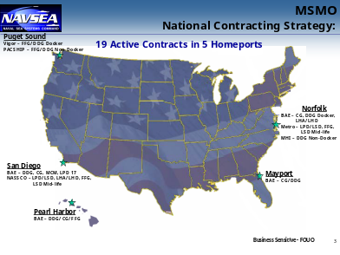
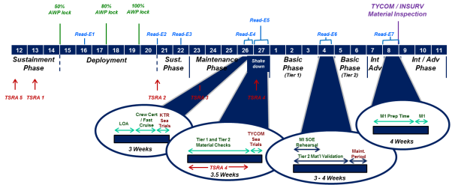
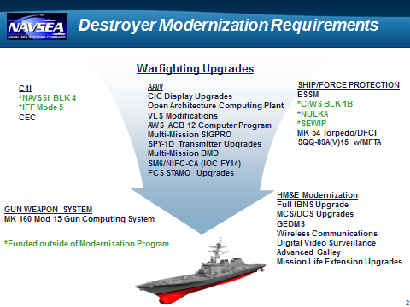
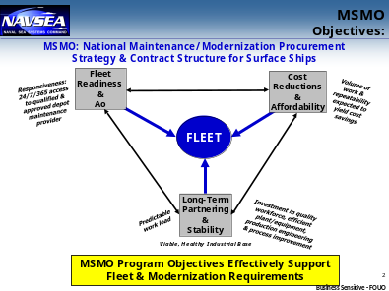
The Surface Maintenance Problem Requires Knowing the Constant …
Class Maintenance Plans (CMPs)
Technically validated documentation of detailed maintenance requirements for each ship class
Technical Foundation Paper
Class-specific document provides a foundation for all maintenance requirements across an entire class
Identify maintenance required to meet the expected service life (ESL)
Lays out a notional long range maintenance schedule that includes man-days, availability periodicity, and availability duration for depot level maintenance
… and understanding the variables
Operational Requirement
Modernization Strategy
Contracting Strategy
Ship Service Life is a variable

Slide 5
Pre - Avail Planning matters most
If Key Contractor Milestones are missed,
Navy Costs (Schedule & Dollars) increase.
Note impact of late definitization:
KTR-related events impacted
EQUIPMENT
PEOPLE
SCHEDULE INTEGRATION
Determine Critical Path
Pier Assignments
Submit Schedule
Schedule Training
IPTD
Subcontractor Purchase Orders
Review Rental/Tool Req
Review Specs
Facility Services
SUPSHIP Assign’t
ID Facility Support
ID Supervision
Dock Availability
Manpower Loading Forecasts
Conduct Model Reviews
Conduct Ship Checks
Resource Load Schedule
Develop Lead Sheet
Review Lessons Learned
A-360
A-240
A-155
A-35
Avail
A-360 Establish Avail NMD
A-240
80% D-Level Package
A-92 Publish Package
A-155
80% D-Level Package
A-78 Submit Proposal
A-35
Definitize
A-30 Trade Level Planning
OQE
Prefab Packages
Worst Case:
Availability compromised
before it begins
Prelim Schedule
Spec Development
LLTM
TIP
Sourcing and Est. Delivery Dates
METHODS
MATERIALS
Better Planning Enables Better Cost/Schedule Performance

Slide 6
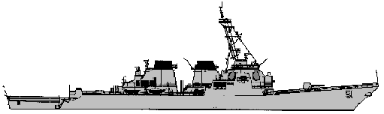
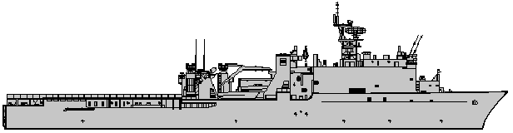

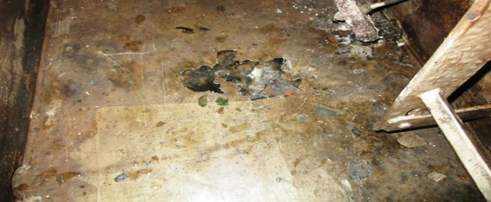
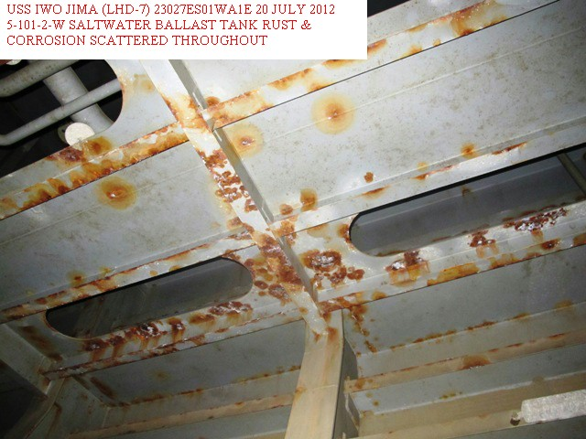
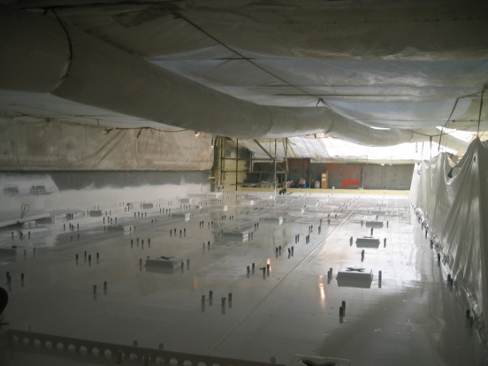
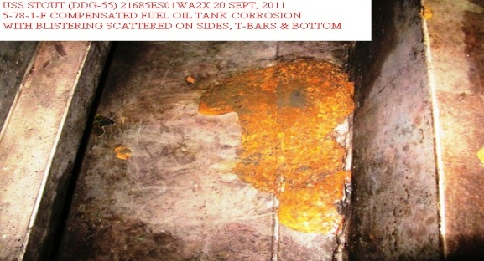
Insufficient Planning Leads to
Deferrals & Risk
IDENTIFIED TANKS (COND 3 and COND 4) GIVEN DFS TO SUPPORT BMD MISSION. REPAIRS DEFERRED.
RESULTED IN :
INCREASE IN TANK INTERNAL DEGRADATION
FUTURE AVAIL CHANGED TO DOCKING AVAIL TO SUPPORT TANK REPAIRS
INCREASED FUTURE AVAIL COST OF AT LEAST $1.7M TO SUPPORT DOCKING REQUIREMENTS
ASSESSMENTS AND MAINTENANCE DEFERRED THROUGHOUT MULTIPLE FRP CYCLES.
RESULTED IN :
MULTIPLE AVAIL EXTENSIONS DUE TO GROWTH/NEW WORK (AVAIL NOW 18+ MONTHS)
INCREMENTAL DISCOVERY DURING AVAIL (1,600+ RCCs)
INCREASED AVAIL COSTS (219% G/NW)
LOSS OF OPERATIONAL AVAILABILITY (6 MONTH EXTENSION TO AVAIL)
AVAILS CANX TO INCREASE OPERATIONAL SCHEDULE.
RESULTED IN :
TANKS NOT ASSESSED SINCE COMMISSIONING
119 TANKS IN UNKNOWN STATUS
25 TANKS REQUIRING 100% RECOAT
POSSIBILITY OF AVAIL EXTENSION AND LOST Ao
POSSIBILITY OF INCREASED AVAIL COSTS DUE TO MANDATORY DOCKING WORK
DDG TANK PICTURE ; COND 3 TANK
PLACE HOLDER
DDG TANK PICTURE ; COND 4 TANK
LSD WELL DECK REPAIRS
LHD TANK PICTURE ; COND 3 TANK
Uncontrolled Deferral of Assessments and Repairs (most prevalent pre-2008) results in degraded systems and unplanned funding needs

Slide 7
We can’t affect what we haven’t measured
Actual MDYS invested almost equal TFP Notional;
Is this good or not?
SRA1-1
SRA1-2
DSRA1
SRA2-1
SRA2-2
Unexecuted Assessments/
Unknown Deferrals build backlog that cannot be re-programmed
There were no TFPs for SRA 1-1 or SRA 1-2
Improved fidelity enables impact analysis

Slide 8
SURFMEPP developed maintenance requirements based on disciplined engineering processes
SURFMEPP CONTINUOUSLY MONITORING BAWP EXECUTION
C+140
UPLOAD BAWP TO RMAIS
A-470
50% OF BAWP TASKS SCREENED
A-410
100% OF BAWP TASKS SCREENED
A-360
TYCOM ASSUME AWP
CANCELLATION, DEFERRAL, NOTIFICATION SYSTEM (CDNS) – CONTINUOUS DEFERRAL REVIEW FROM E2E
SEA 05 TECHNICAL ENDORSEMENT
Directed assessments
Directed maintenance
Underpinned by CMP tasks
SEA05 SDM INTERFACE TECHNICAL
ADJUDICATION
OPNAV N43 FISCAL ACCEPTANCE
OPNAV 4700 Note changed
Increases start in POM13
CNO Avails not flatlined
A-240
TYCOM SUBMITS 1ST DEFERRAL LETTER
A-177
DEVELOP DISPOSITION LETTER
A-120
TYCOM SUBMITS 2ND DEFERRAL LETTER
A-71
DEVELOP DISPOSITION LETTER
A-155
NMD REVIEW
SURFMEPP CONTINUOUSLY DOCUMENTING DEFERRALS
Focus now is on process compliance

Slide 9
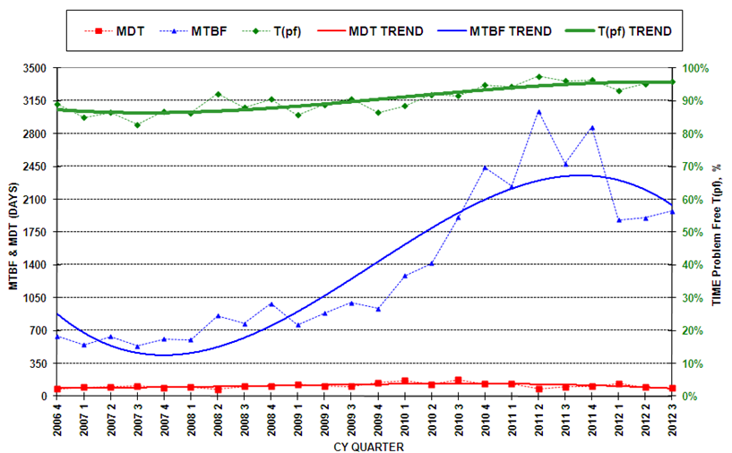
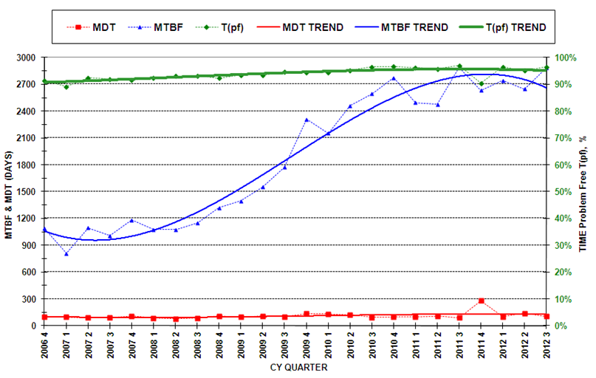
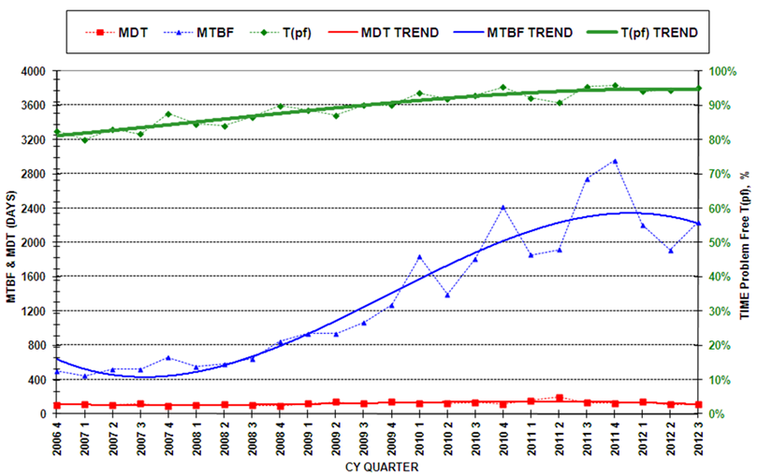
A disciplined engineering process leads to improved readiness and more service life
CG 47 class
DDG 51class
The administrative, logistical, and physical time to repair a failure (MDT), continues to decrease.
There is an overall positive trend in equipment being free of mission limiting maintenance.
Analysis underway to determine specific factors that have contributed to increased readiness.
FFG 7 class
Reference: NSWC Corona Division MRDB data rolled up as of 9/30/12

Slide 10
Governance is key
Total
Operational
Cost
Mission Effectiveness
Systems Effectiveness
System/Subsystem/Component Performance
Manning
Mission
Training
SPM(Ship Platform Mgr / TYCOM Maint Officer
Regional Maint Commander / Private Yard
Repair
Modernization
Maintenance
Cost Estimates
Availability Planning
System Analysis
Ship/ Port Engineer
“Collaborate or Perish!” (Bratton & Tumin)

Slide 11
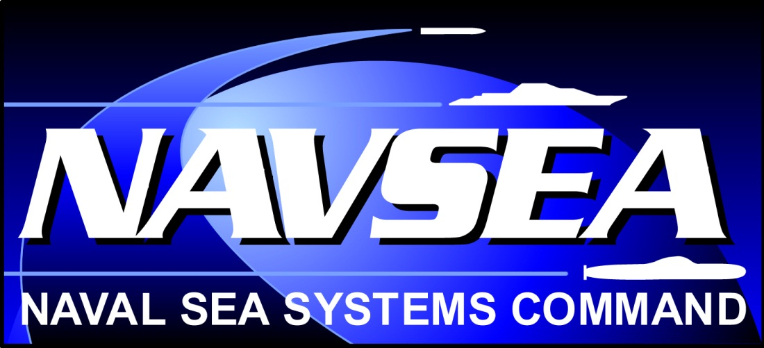

Slide 12
BACKUP

Slide 13
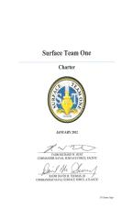
Surface Team One (ST1)
C2 Based on Carrier Team One and Submarine Team One
Governance Council
The unifying mechanism for achieving a coherent, comprehensive and whole Surface Navy Maintenance, Modernization & Sustainment Program
FFC N43
CNSL
CNSP
CPF N43
Executive Steering Committee (ESC)
Co-Chairs: NAVSEA21 / CNRMC
Fleet and TYCOM Members
CPF N43B | CNSP N43 | CNSL N43 | FFC N43B
OPNAV and SYSCOM Members
OPNAV N431 | PEO C4I
SEA21A | PEO IWS
SEA05D | PMS400F
SEA04RM | PMS470
OPNAV N95 | OPNAV N96
SURFMEPP
Charter signed, Feb, 2012
VADM Hunt & RADM Thomas
Knowledge Sharing Networks (KSNs)
Cross-functional collaboration to globally address the needs of both Fleets & TYCOMs
LESSONS LEARNED | Engineering | METRICS | QUALITY | PLANNING
C5I | BAWP / AWP | MODERNIZATION | CORROSION CONTROL | ASSESSMENTS
13

Slide 14
ST1 Priorities & Actions
Complete CNO Availabilities
on-time, at cost, to quality
  Focused Execution of Advanced Planning
  Ensure Flag-Level Involvement at key decision points
  Better Control of Growth and New Work
  Manage within Budget / Schedule Controls
  Strategic Modernization & Maintenance integration
  Establish Effective C2 and Define Positional Authority
Decrease CASREP(s) / FTA(s)
PRIORITIES
TACTICAL
Integrated Project Team Development (IPTD) RMC Policy Standardization (RPS) Workforce Development (WFD) | Cost Engineering & Analysis CE&A) Total Ship Readiness Assessment TSRA) Quality Assurance Initiative Implementation “Find, Fix, Train”
OPERATIONAL
End to End (E2E) Policy/Process Oversight Review Joint Fleet Maintenance Manual Update Develop actionable/credible Surface Ship Maintenance & Modernization Metrics Coordination of Afloat Training Group (ATG) / Surface Force Readiness Manual (SFRM) / Total Ship Readiness Assessment (TSRA) Activities National Contracts Governance RMC Resourcing IMA Reestablishment
STRATEGIC
Mayport ARG, Rota FDNF Laydown PC / MCM Bahrain Support
Increase Shipboard Technical Expertise
Assure Quality Oversight
  Integration of Surface Ship Maintenance & Modernization Planning & Execution
  SWE Tasking SI-1.2: Execute Surface Maintenance Initiatives to finish CNO Avails on time (“27 in 12”)
14
14

Slide 15
ST1 KSN Accomplishments to date
LESSONS LEARNED | Engineering | METRICS | QUALITY | PLANNING
Executed 6 LLCs, including 46 ships & 7 ship classes since April 2012 Integrated Project Team Development (IPTD) | 244 TSRA(s) conducted to date 169 were held in FY-12 15 new NAVSEA Standard Items, 1 Update TSRA full-up FY13 | “27 in 12” E2E Deep Dive 32 Attributes 200 Metrics in review on each Availability Maintenance & Modernization ‘Common Operating Picture’ (COP) | 52 EPCP(s), 31 MST(s) 2 New NAVSEA Standard Items, 1 Update 3 SOP(s) 4 JFMM Inputs 1 of 11 Role Based Desk Guide Inputs | Flag Level Review 116 Action Items: 25 - General 40 - East Coast 51 - West Coast
C5I | BAWP / AWP | MODERNIZATION | CORROSION CONTROL | ASSESSMENTS
Ranked SWE "head hurter” list for impact Conduct 3-4 Pre-Assessments per Availability (FY11/FY12) Conduct 9-10 ALO Assessments per Availability Add EXCOMM Assessments as Pilot Program (FY11/FY12) Conduct LOGSAT, MAMSAT, PUBSAT, TESAT on all Avails | 75 BAWPs delivered (33 LANT / 22 PAC / 20 FDNF) 54 BAWP transitioned to AWPs 6 BAWP ships currently in execution 8 BAWP ships completed avails (1 completed close-out) Intake and Uptake Preservation Handbook in-development | Strategic Maintenance & Modernization Plan | 15 ASLP Surveys 7 closed-out reviews 5 Classes, 108 Ships have initial baseline surveys completed by close of FY 17 10 of "27 in 12" Ships receiving FY 12 CCAT Support Increase of Corrosion-related 2 Kilos containing Block 10 "C“ CCAT assisted Sailors with more corrosion jobs in first half of FY 12 than all of FY 11 > 1K jobs, compared to 855 FY 11 | Identified 150+ assessments & grouped into 8 "clusters" by functional area, 4 with highest potential for improved synergy Evaluated qualitative ROI for 150+ assessments, 30% have low ROI. Executing adjudication process for further analysis. 1 New NAVSEA Standard Item
15
  Drive Surface Ship Availabilities to consistently achieve Schedule, Quality, Cost Goals

Slide 16
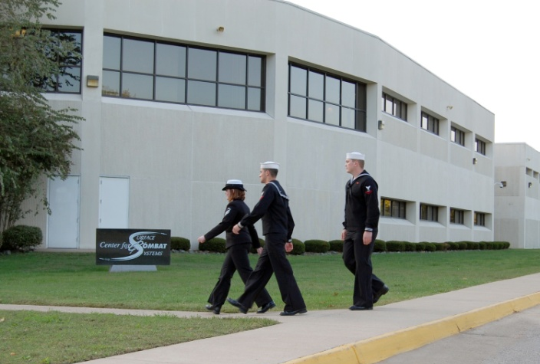
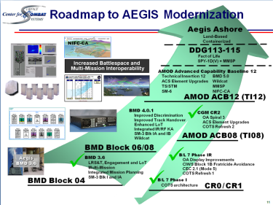
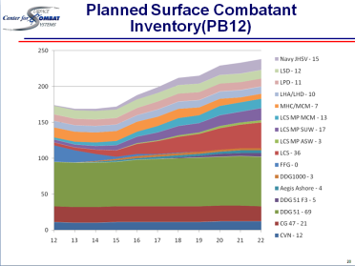
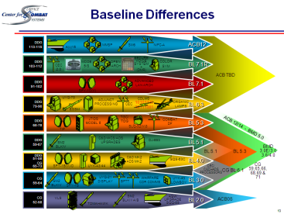
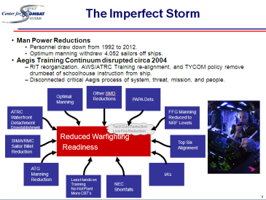
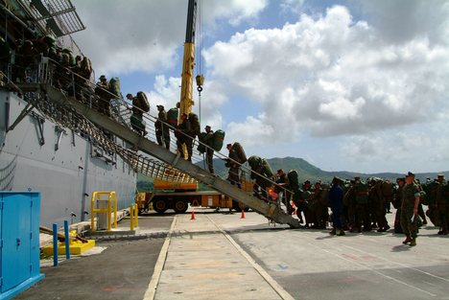
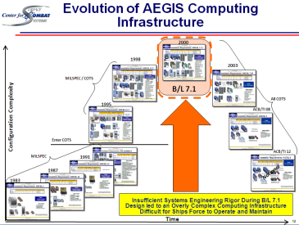
we must continue to address other factors affecting surface ship readiness
School
Houses
AMOD
Complexities
Complexities
Solutions
Fleet
NEW CONSTRUCTION
Embedded Trainers

