Slide 1
Meeting Logistics
Listen only mode
Group login – number attending in Q & A box
Questions
Q & A box
Open lines periodically
F5 full screen
Will be recorded – Webinar, PowerPoint, and FAQ’s will be available after the week of October 1

Slide 2
Lean Six Sigma (LSS)
Agreements Improvement Project
Phase 1

Slide 3
Agenda
Overview of the LSS Process
General System Changes
Outgoing Agreements
Screens/Data Entry/Policies
Incoming Agreement
Screens/Data Entry/Policies
Supporting documentation/training materials
Future Changes (integrated and time permitting)

Slide 4
General Changes
Tooltips – scroll over
Calendars
Reordering tabs
Turning On/Off fields
Auto propagating of data
Agreement Number autogeneration
ADODR = “ARS PI”

Slide 5
General Changes
Added “Go To” features
Upload capabilities
E-Green – Office File
SEB-102 (Ethics requirements)
All changes will be made in Work, Active, History, Status, Reporting forms, prints, and query fields
Removed LOI

Slide 6
Outgoing Agreements

Slide 7
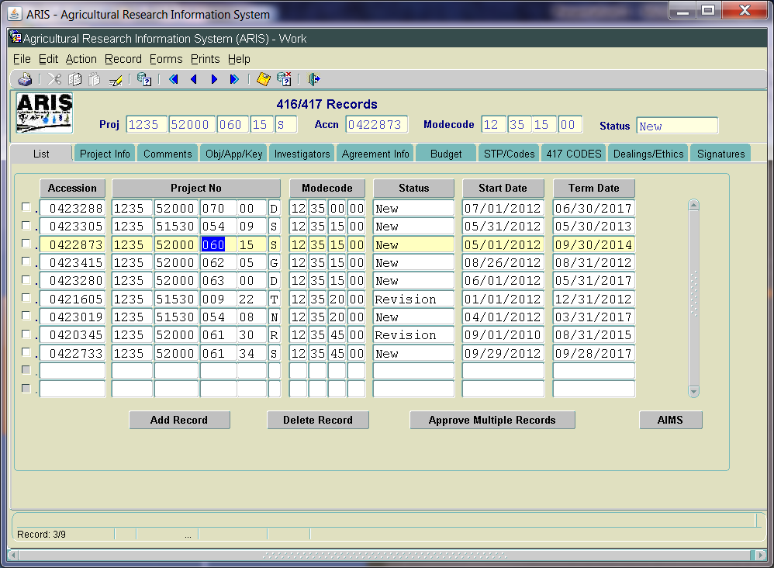
Outgoing – List Screen
Tab Moved

Slide 8
Outgoing – List Screen
Agreement Info tab moved to allow for identification of related inhouse project earlier
Added AIMS button to go directly to AIMS screens from List screen
Multiple ways to enter AIMS from ARIS
Modified buttons to “Add Record”, “Delete Record”, “Approve Multiple Records”

Slide 9
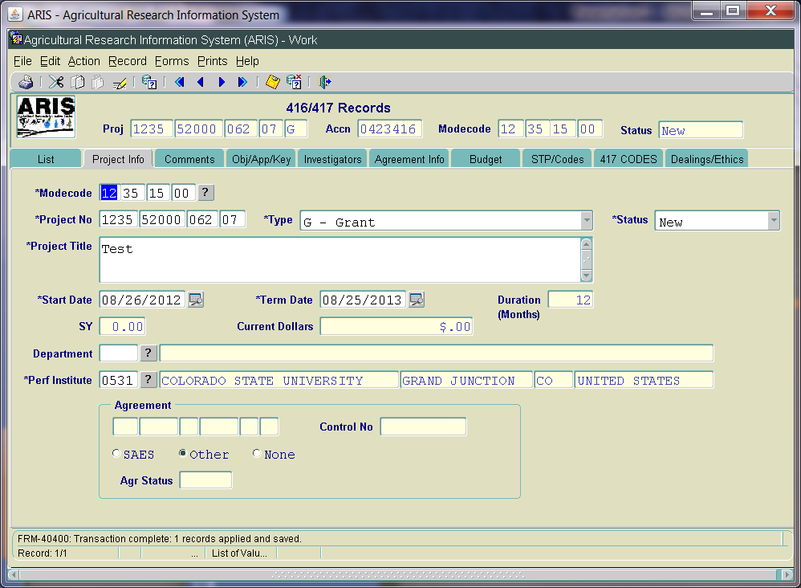
Outgoing – Project Info Screen
Agreement Types added; matches AIMS

Slide 10
Outgoing – Project Info Screen
Calendars added to select start/term dates
Agreement # field:
autogenerated at the time AIMS is added for outgoing agreements;
nonmodifiable;
Foreign determination based on recipient table designation of domestic or international
Sequential numbering within location; starts new each FY
Conversion of existing data – agreement #s for existing agreements will auto populate

Slide 11
Outgoing – Project Info Screen
Outgoing Agreement types added:
Outgoing Interagency (O);
Assistance Type Cooperative Agreement (ATCA) (A);
Standard Cooperative Agreement (B)
Grant (G) – modified in AIMS – was “Project Grant”
Agreement types in ARIS = AIMS types
Will auto propagate to AIMS from ARIS
Can only be modified in ARIS
Notes:
-

Slide 12
Outgoing – Project Info Screen
Project Title - upper/lower case entry
Slightly increased size to 148 characters (from 140)
Tooltip added for Agreement type
Tooltip added for SAES, Other, or None
Modified label to “Performing Institute”
Removed “Award Date” field
Notes:
-

Slide 13
Outgoing – Agreement Number
Autogeneration when AIMS record is created
Agr No. Part 1: 58; 59; or 60 – based on agr type
Agr No. Part 2: Location Code
Agr No. Part 3: Last Digit of FY (FY indicator)
Agr No. Part 4: Sequential number w/in the location & FY
Agr No. Part 5: Foreign indicator – from recipient table
Agr No. Part 6: MOU or NFCA indicator from Agr Type
Notes:
-

Slide 14
Outgoing – Comments Screen
Changed heading to “Internal Comments” – indicates only used for internal purposes; not on executed agreement sent to cooperator
Comments required for all work record transactions

Slide 15
Outgoing – Obj/App/Key Screen
Thesaurus – shut off for all agreements
No other changes

Slide 16
Outgoing – Investigator Screen
Capability to add SY time is removed
Default is 0.00 for reports and prints
No other changes

Slide 17
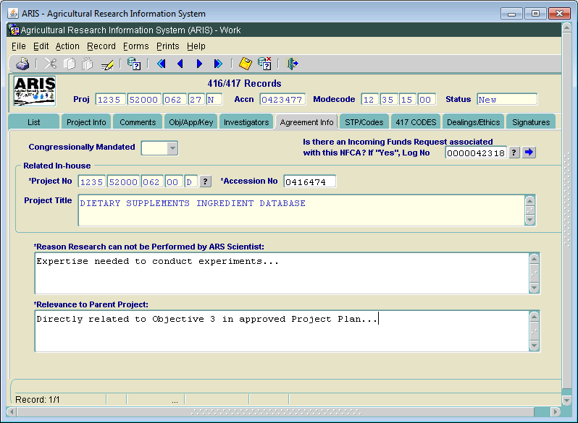
Outgoing -Agreement Info Screen

Slide 18
Outgoing - Agreement Info Screen
Congressionally Mandated – yellowed out
For NFCAs only, added Log No. field to connect to associated Incoming Agreement, if applicable
Added Tooltip for “Reason Research Cannot be Performed by ARS Scientist”
“Provide specific expertise and/or experience the cooperator will provide towards the project’s overall objectives”
Multi Year section (3 fields) removed

Slide 19
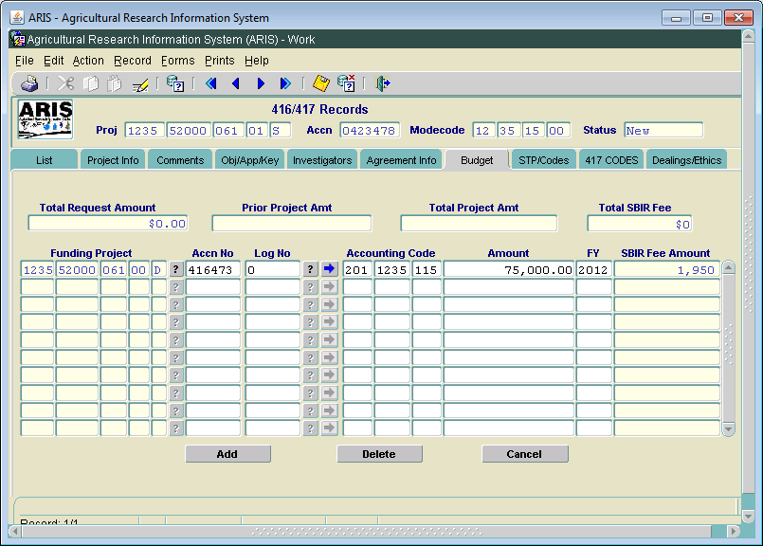
Outgoing - Budget Screen

Slide 20
Outgoing - Budget Screen
Defaulting in Accession # and/or Log # when funding project selected
Warning messages added for incoming funds scenarios, when used to fund outgoing agreement
Added capability to link to funding project - “go to arrow”
Added validation between accounting code and project type
For new “outgoing interagency” agreements – SBIR will not be assessed at this time

Slide 21
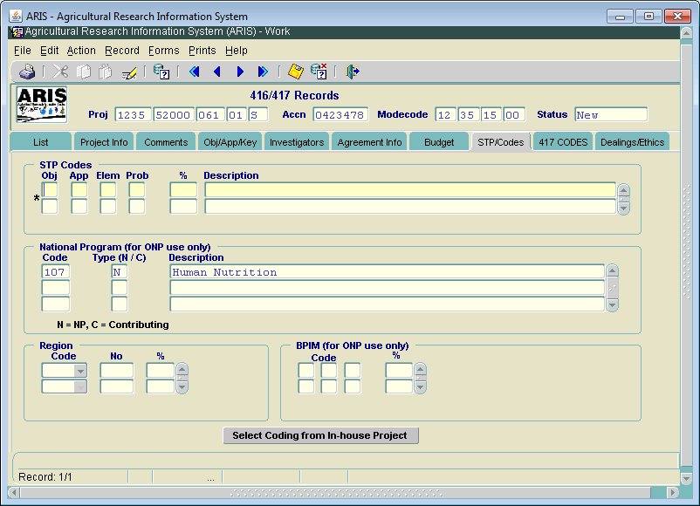
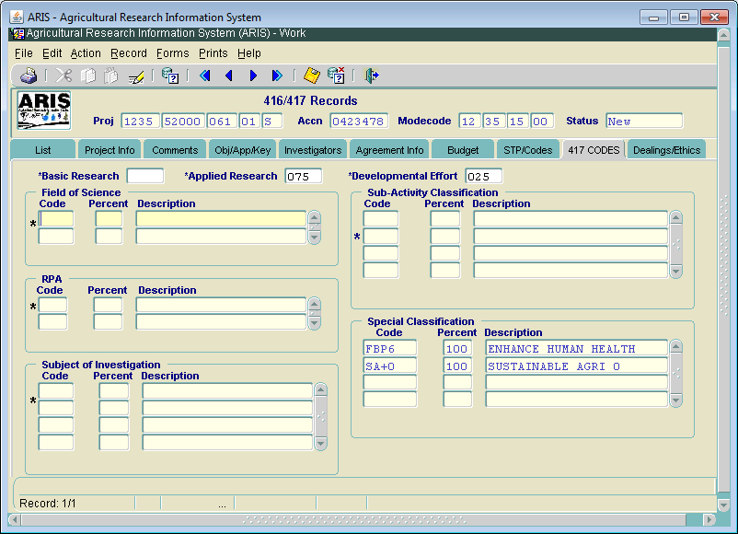
Outgoing - STP/Codes Screens
Notes:
-

Slide 22
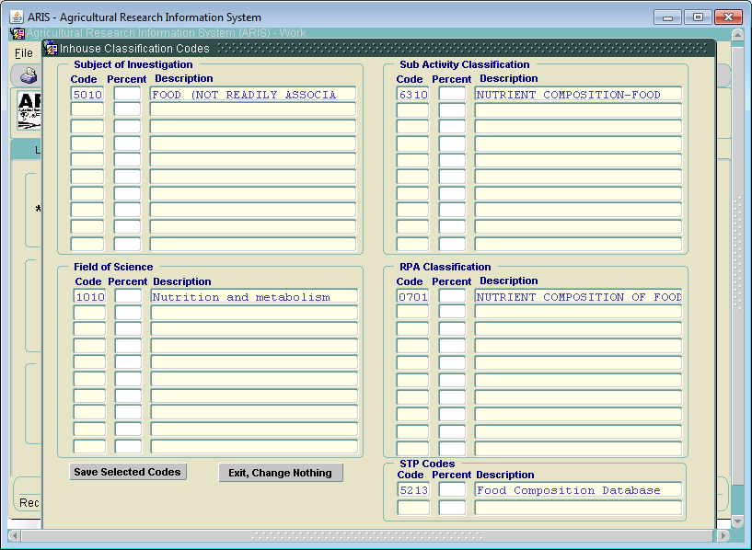
Outgoing - Selecting Codes Screen

Slide 23
Outgoing - Selecting Codes Screen
Selection of coding is based on related inhouse codes (similar to incoming record coding process)
Basic/Applied/Developmental – auto propagate
Special codes – auto propagate (only FBP and SA)
National Program (NP) – auto propagate
Enter percentages for all other coding, as applicable
Totals must = 100% for each category
Once saved, codes are inserted in coding screens
Modifications/deletions/additions then occur on the regular Coding screen(s)

Slide 24
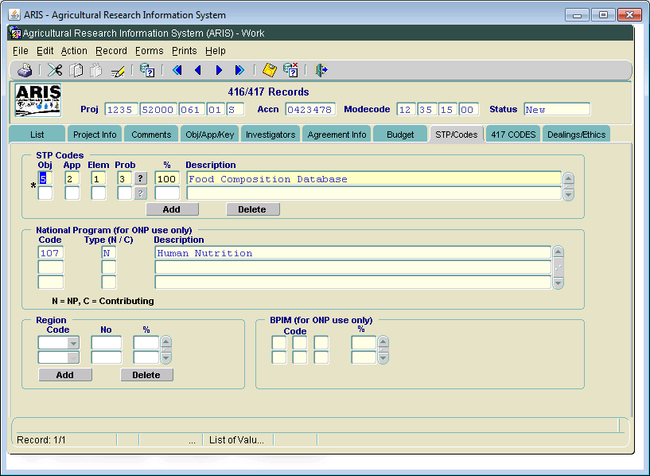
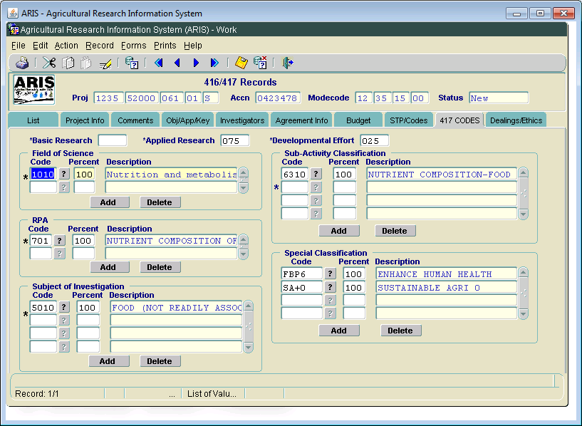
Outgoing - Selected Coding

Slide 25
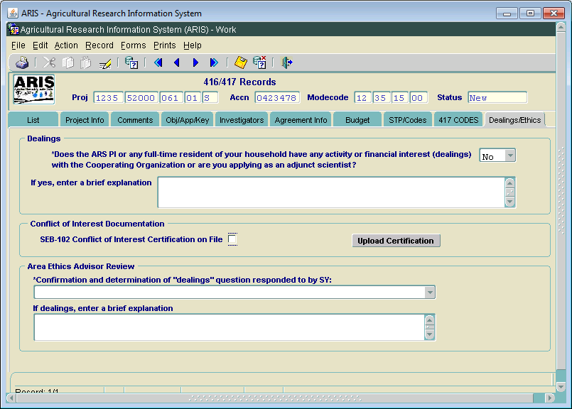
Outgoing - Dealings/Ethics Screen

Slide 26
Outgoing - Dealings/Ethics Screen
Reworded Financial Dealings question
Reworded label for “Area Ethics Advisor Review”
Added Conflict of Interest Documentation section
SEB-102 Certification required
Upload Certification form
Required at RL level or initial level of entry
Not required for Outgoing Interagency Agreements
Area Ethics Advisor/Area Office will review to ensure conformity

Slide 27
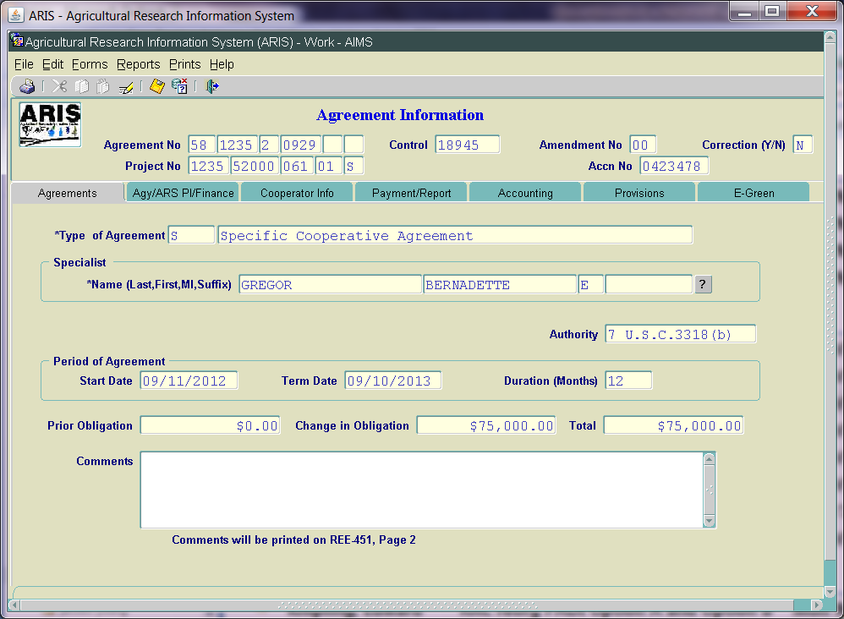
Outgoing - AIMS–Agreements Screen
Agreement number auto generated on AIMS first entry
Type of Agreement – auto populated from ARIS
Nonmodifiable
Added note below Comments field

Slide 28
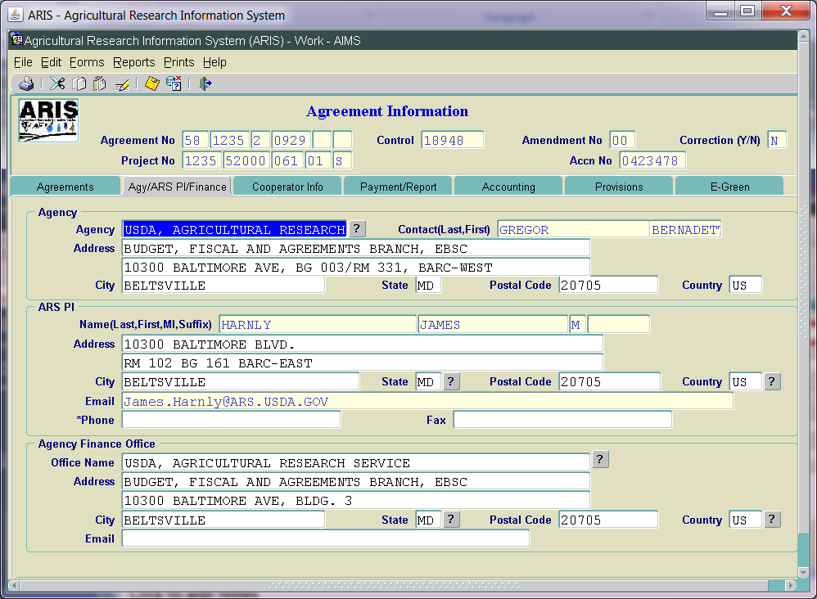
Outgoing - Agy/ARSPI/Finance Screen
ARS PI – phone number required at All levels
ARS PI – email address auto populates from Delegation of Authority table
Not modifiable on screen

Slide 29
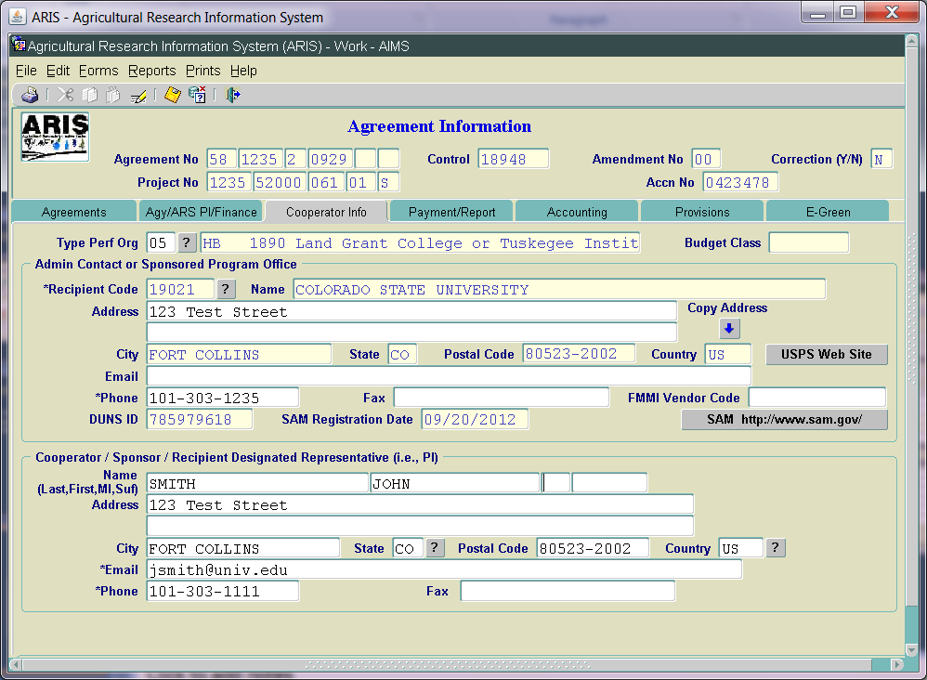
Outgoing - Cooperator Info Screen

Slide 30
Outgoing - Cooperator Info Screen
Admin Contact or Sponsored Program Office
Zip +4 required for all domestic agreements
USPS Website link added
SAM link added
DUNS ID – auto propagates
SAM Registration Date – auto propagates
DUNS Parent ID removed
DUNS Confidence Level removed
Phone # required at ADO level
Email Address required at ADO level
Cooperator/Sponsor/Recipient Designated Rep (i.e. PI)
Email address required at ADO level
Phone # required at ADO level

Slide 31
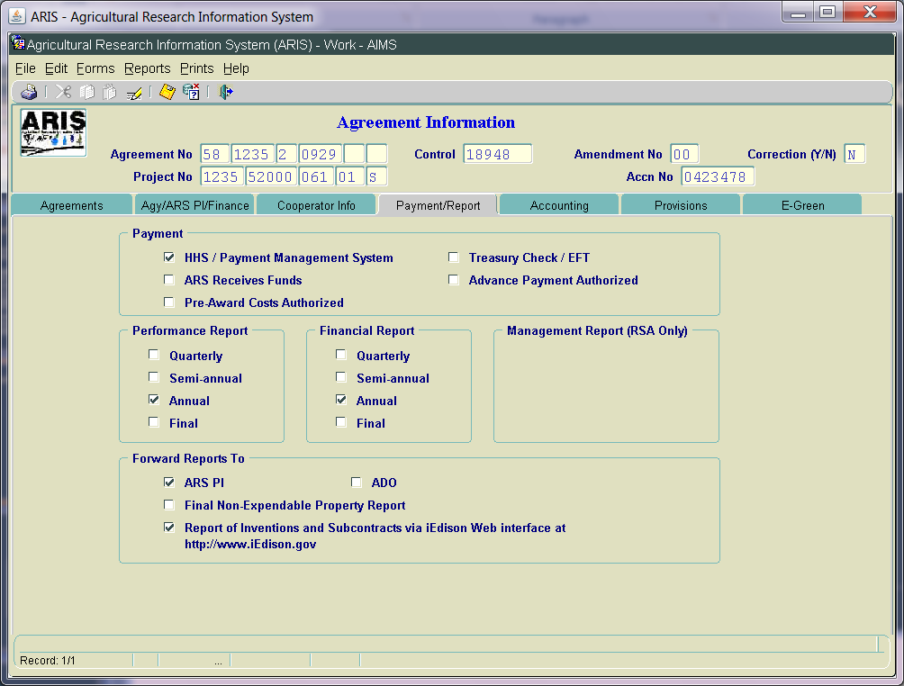
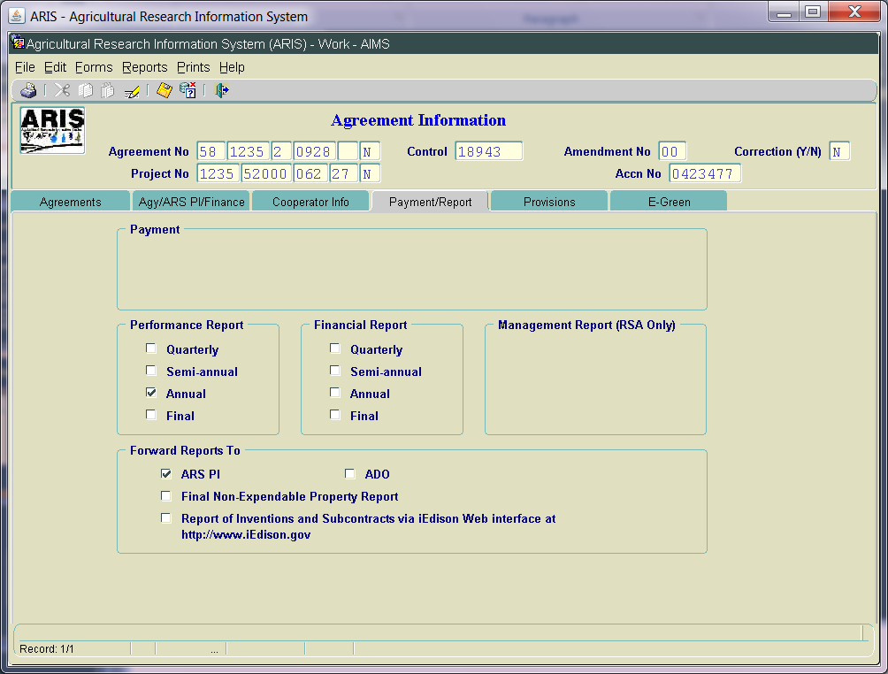
Outgoing - Payment/Report Screen

Slide 32
Outgoing - Payment/Report Screen
Label changes –
“Forward Reports To”
“Report of Inventions and Subcontracts”
Added check box for Final Non-Expendable Property Report
Turn off Management Reports for all Non RSAs
Turn off Payment Section for NFCAs and MOUs

Slide 33
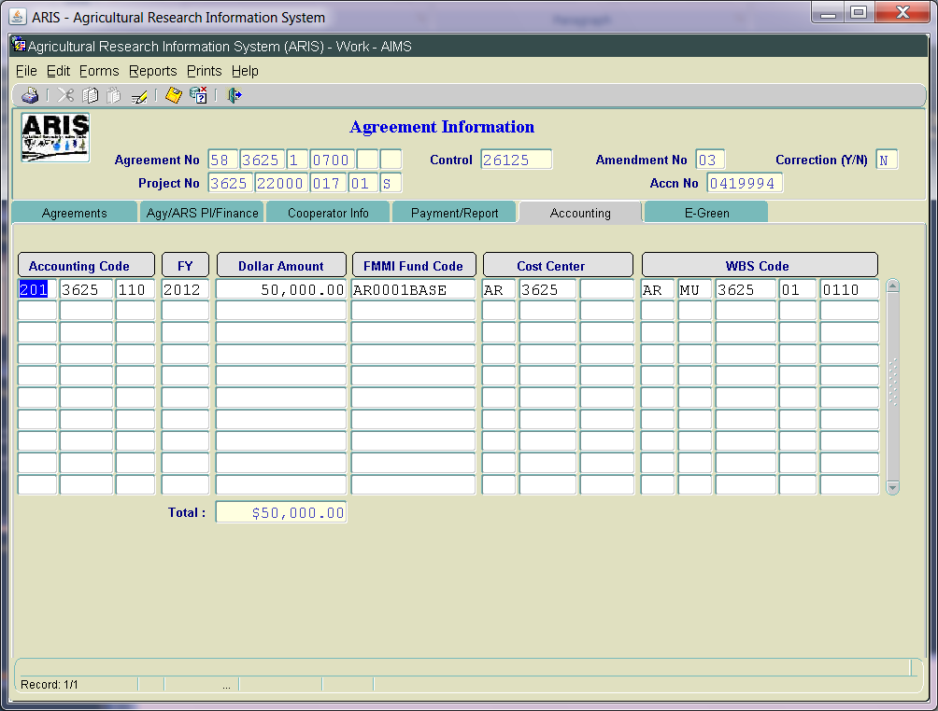
Outgoing - Accounting Screen
Data is system generated based on outgoing agreement budget data in ARIS
Notes:
-

Slide 34
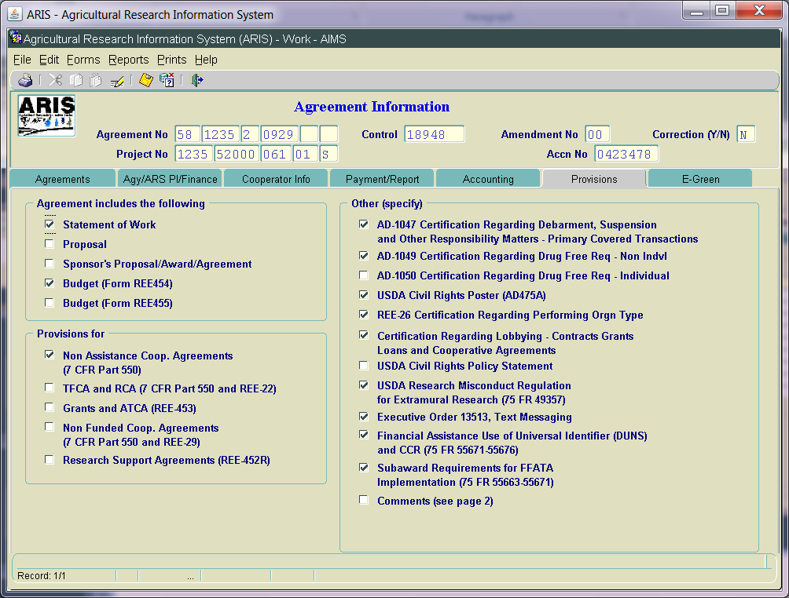
Outgoing - Provisions Screen

Slide 35
Outgoing - Provisions Screen
Agreement includes the following:
“Sponsor’s Proposal/Award/Agreement”
Other (specify):
Hide Attachment A for all Non RSAs
Added - Executive Order 13513, Text Messaging
Added - USDA Research Misconduct Regulation for Extramural Research (75 FR49357)
Added - USDA Civil Rights Policy Statement
Added - Financial Assistance use of Universal Identifier (DUNS) and CCR (75 R 55671-55676)
Added - Sub-award Requirements for FFATA Implementation (75 FR 55663-55671)

Slide 36
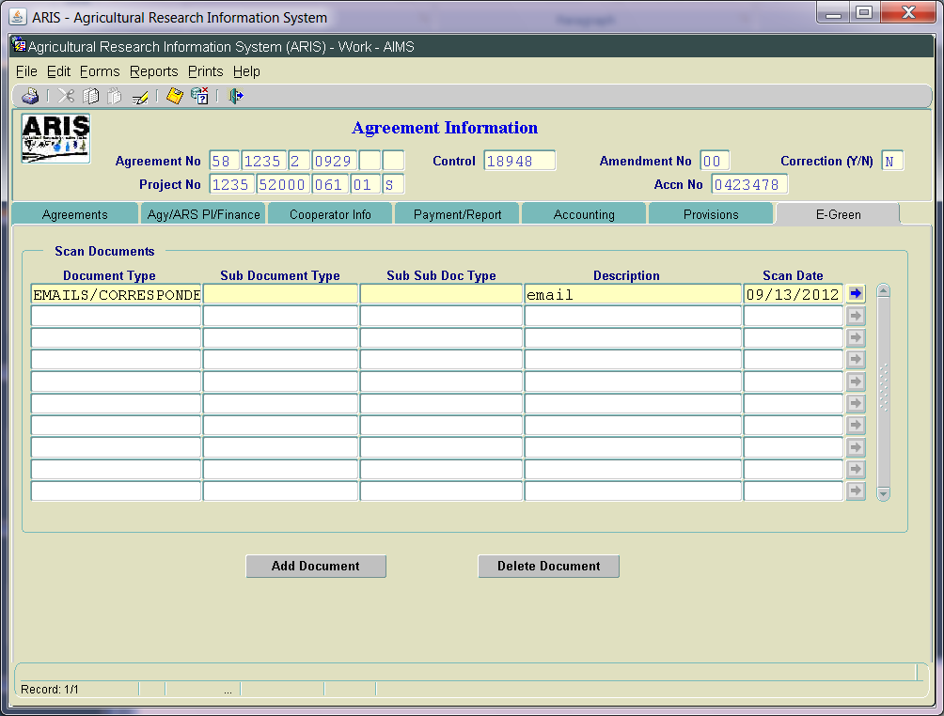
Outgoing - E-Green Screen
E-green now available in Work file
All levels can Add
All levels can View
Only the level that adds the document can delete, other than ADO
Added additional options in document type and sub doc type
Notes:
-

Slide 37
Outgoing – SOW Screens
Added Accession number in header
No other changes
NOTE: Incoming Agr Log No field – only for incoming agreements
No changes to “Parties Agree to” Screen
Notes:
-

Slide 38
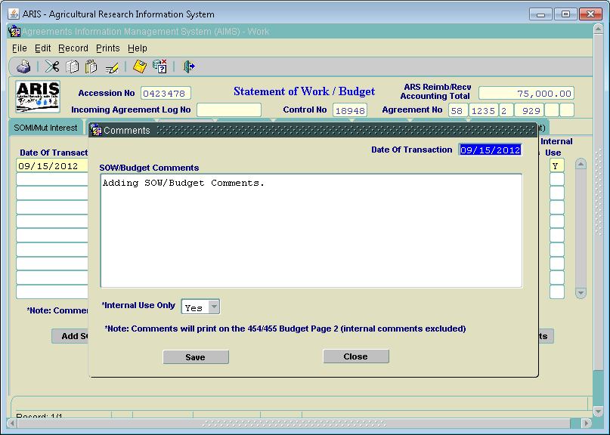
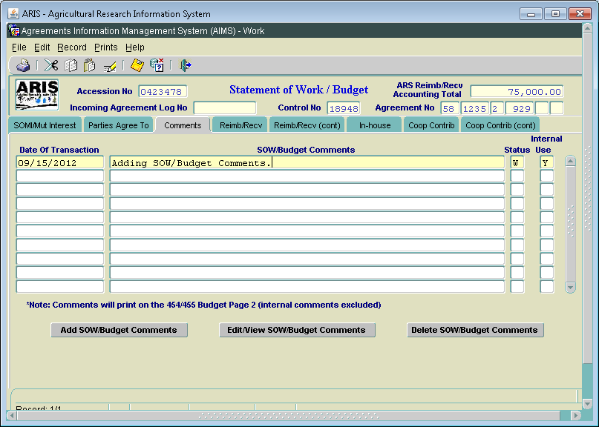
Outgoing - SOW/Budget Comments Screen

Slide 39
Outgoing - SOW/Budget Comments Screen
Changed label to “SOW/Budget Comments”
Added check box to indicate Internal Use Only
Required to answer Yes or No
If Yes is selected, comments WILL NOT print on the 454/455
Added Note: Comments will Print on the 454/455 Budget Page 2 (if check box = No)

Slide 40
Outgoing - Budget Screens
No changes at this time
Future phase:
Increase size of description fields
Consolidate screens
Standardize all screens
Redesign for better viewing

Slide 41
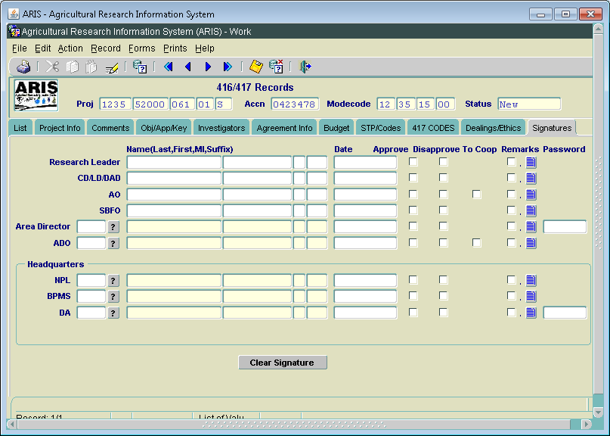
Outgoing - Signature Screen
Modified label – ABFO to SBFO
Removed NPL2 and 3

Slide 42
Questions on Outgoing Agreements
Notes:
-

Slide 43
Incoming Agreements
(Incoming Funds Records)
Notes:
-

Slide 44
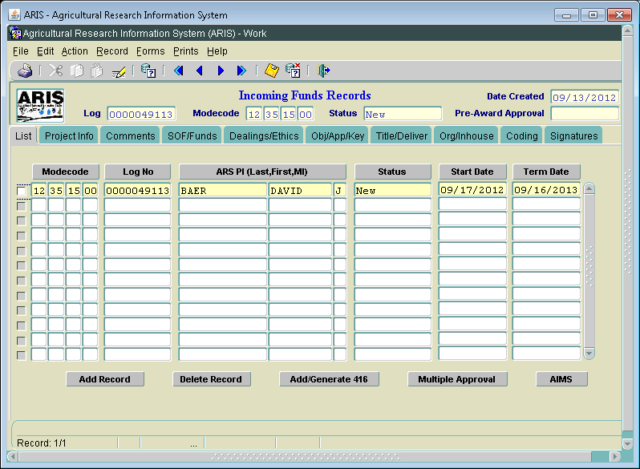
Incoming – List Screen

Slide 45
Incoming – List Screen
Modified ARIS to say “Incoming Funds Records”
AIMS entry is the actual “agreement”
Added “go to” AIMS button
Modified labels:
Add Record
Delete Record
Add/Generate 416
Notes:
-

Slide 46
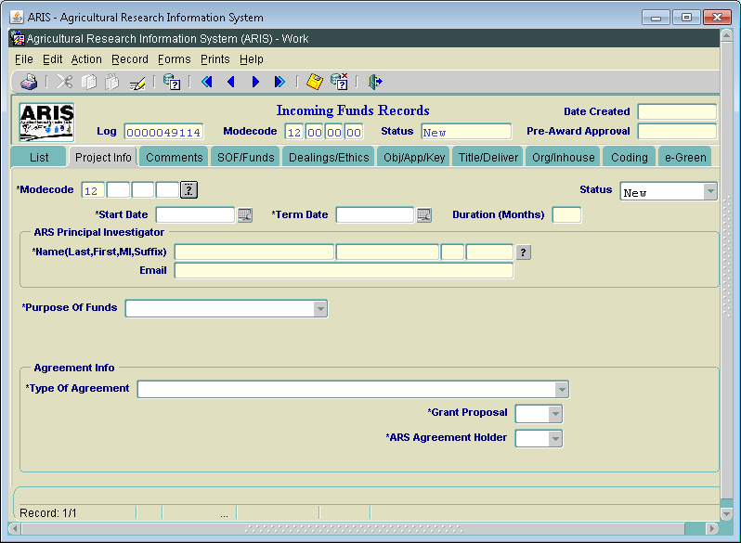
Incoming – Project Info Screen
Notes:
-

Slide 47
Incoming – Project Info Screen
New field added in header – Pre-Award Approval
System generated
First time through Approval date
Never changes; nonmodifiable
Changed “Contact” to “ARS Principal Investigator”
Formerly “Contact” or “ADODR”
Uniform through all agreements
Removed “Contact Type” and “Phone Number” fields
Added ARS PI Email – auto inserted when ARS PI is selected from the LOV (now uses the Delegation of Authority Table)
Message displayed if ARS PI training has not been done

Slide 48
Incoming – Project Info Screen
Purpose of Funds field – moved up on screen
Purpose of Funds field– used to turn on and off fields appropriate for the selection
Gifts
Services Only
Research (under/over $25K, No Funds)
Award Date removed
Notes:
-

Slide 49
Incoming – Project Info Screen
Added two Agreement types:
Interagency Reimbursable Agreements (IRA) (I)
Material Transfer Research Agreement (MTRA) (H)
CRADA (C) – formerly “Trust” when 416 added; will now be shown as “C” on 416 and Incoming Funds Record
Grant Proposal fields – turned off for Gifts and Services Only
If Grant Proposal = Yes, Grant Awarded field is activated

Slide 50
Incoming – Primary Agreement Holder
Label changes:
ARS Primary Agreement Holder - now ARS Agreement Holder
Primary Agreement Log Number – now ARS Agreement Holder Log No.
Primary Agreement Proposed Total Funds – now ARS Proposed Total Funding
If ARS Agreement Holder = No, added “go to” arrow that will connect with the Active file - Agreement Holder (log)
If ARS Agreement Holder = No, ARS Proposed Total Funding field is turned off

Slide 51
Incoming – Primary Agreement Holder
Tooltips added:
ARS Agreement Holder: “Select Yes if this Unit is responsible for executing the actual agreement with the cooperator”
ARS Proposed Total Funding: “Enter the total amount of funding all ARS locations are proposed to receive”

Slide 52
Incoming – Agreement Number
Autogeneration:
Research < = or >$25,000 – upon entry of AIMS
Services Only – on saving of Proj Info screen
Gifts - no Agreement Number
No Funds to ARS - no Agreement Number
If ARS Agreement Holder = No, once the ARS Agreement Holder has generated their Agreement Number, it will be auto inserted into the ARS Agreement Holder = No project, as long as the Log No. is listed on the Incoming Funds Record

Slide 53
Incoming – Agreement Number
Agr No. Part 1: 58; 59; or 60 – based on agr type
Agr No. Part 2: Location Code
Agr No. Part 3: Last Digit of FY (FY indicator)
Agr No. Part 4: Sequential number w/in the location & FY
Agr No. Part 5: Foreign indicator – from recipient table
Agr No. Part 6: N/A for incoming
If Start Date (FY) and/or agreement type changes, system auto updates agreement number and displays message

Slide 54
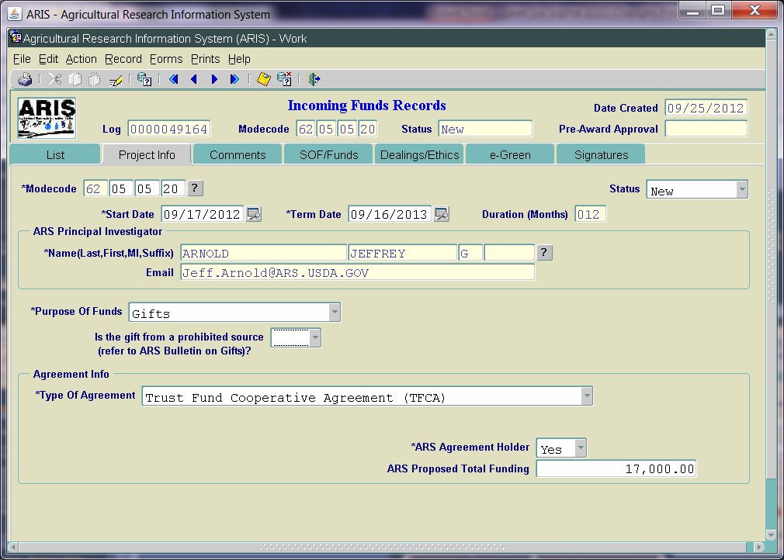
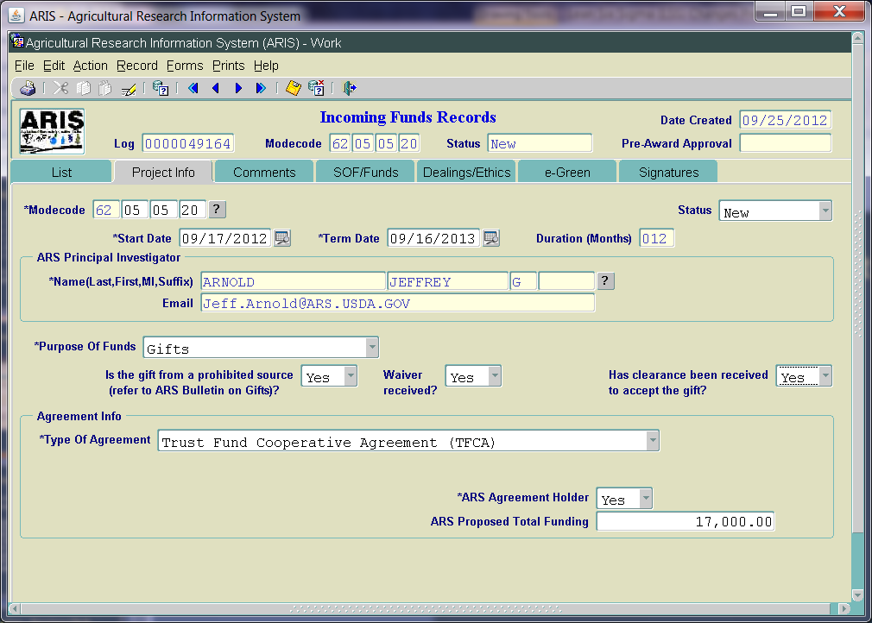
Incoming - Gifts

Slide 55
Incoming - Gifts
No Agreement Number for Gifts
Type of Agreement = Trust; system auto inserts
Added:
“Is the gift from a prohibited source…”; If yes, message displayed “You must have a waiver from the Agency Administrator to accept a gift from a prohibited source”
Waiver (Yes/No) field added; if waiver = No, cannot approve until =Yes
“Has clearance been received to accept the gift?” - Yes/No option; if No, cannot approve until =Yes
E-Green Tab added

Slide 56
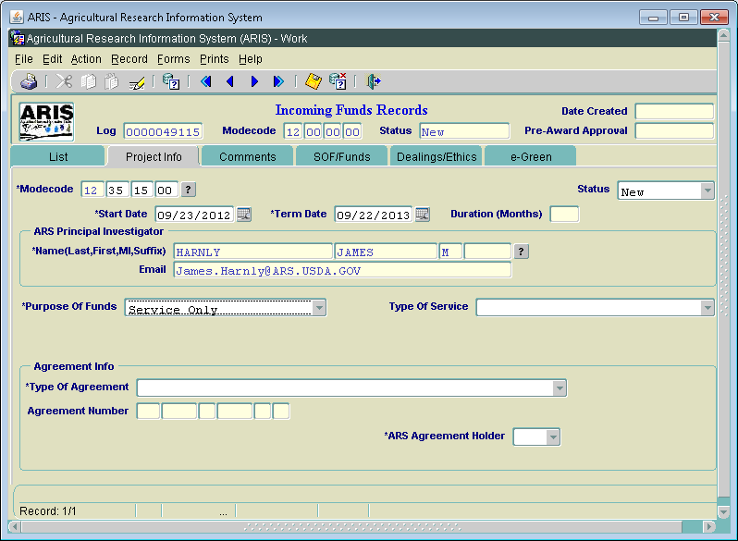
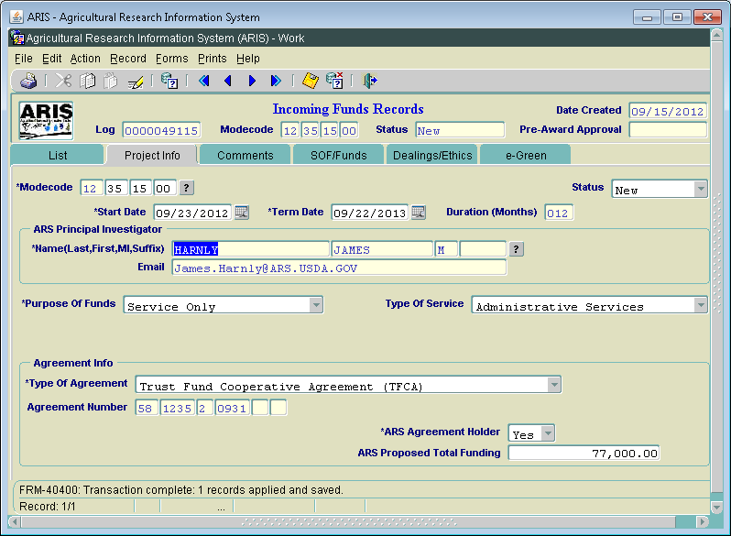
Incoming – Services Only

Slide 57
Incoming – Services Only
Agreement No. will autogenerate upon saving of Proj Info screen
Type of Service: Added Recycling/Rebate
E-Green Tab added
Notes:
-

Slide 58
Incoming – Comments Screen
Modified label to: “Internal Comments”
Comments required for all Work records

Slide 59
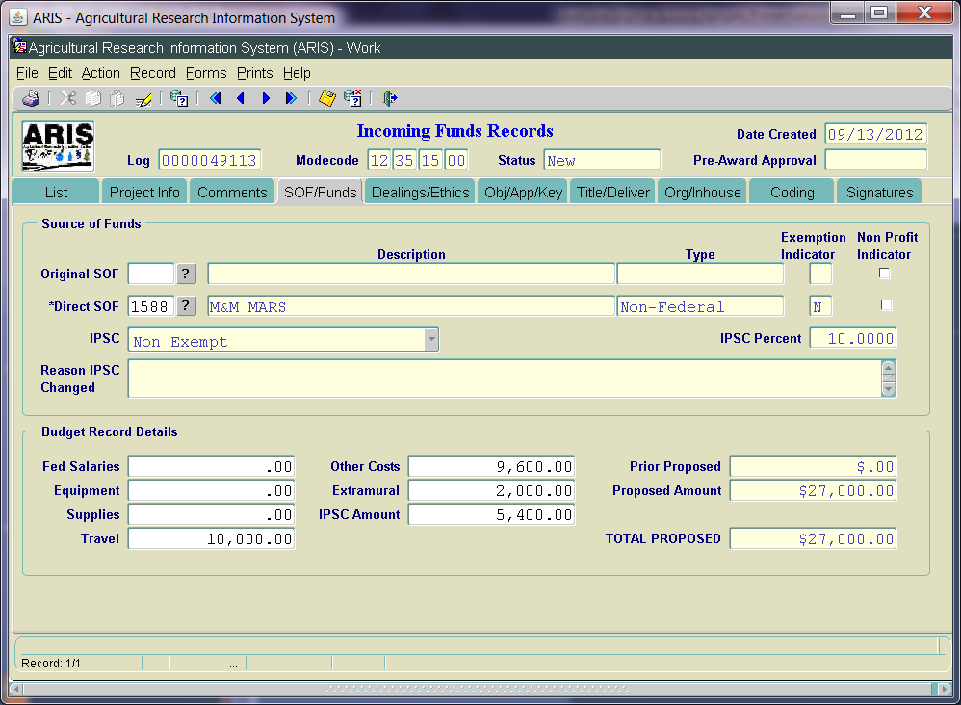
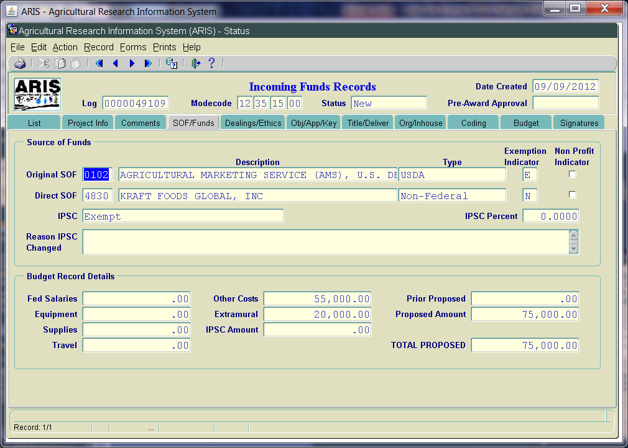
Incoming – SOF/Funds Screen

Slide 60
Incoming – SOF/Funds Screen IPSC
IPSC section modified based on revised P&P329.5
IPSC is based on the Original Source of Funds (OSOF), effective October 1
IPSC not charged on agreements less than or equal to $10,000 (effective October 1)
Added Exemption Indicator, Non Profit Indicator, and IPSC Percent
Added IPSC amount in “Budget Record Details”
Waivers no longer requested; strictly based on SOF Reference Table (Exempt or Non Exempt)
Reason IPSC Changed – BPMS only
Notes:
-

Slide 61
Incoming- SOF/Funds Screen
“How Funds to be Used” – now “Budget Record Details”
Only funding that the Unit is getting should be entered here (future Tooltip will be added when new proposal screen added – Phase 2)
Replaced “RSA” with “Extramural”
If funds entered in “Extramural”, must match extramural total on the Org/Inhouse screen
Added IPSC Amount

Slide 62
Incoming- SOF/Funds Screen
IPSC Calculation:
Based on IPSC percent for SOF (shown on screen)
Calculated as 10% (or 20%) of total proposed funding
If IPSC is “Exempt”, no funding can be added in the IPSC field
If IPSC is “Non Exempt”, enter the calculated amount
If not correctly calculated, system will display message indicating not correct, and display the correct amount
Only a warning message, will still allow processing

Slide 63
Incoming – SOF/Funds Screen
Removed fields:
Requesting Waiver; Why Waiver Requested; Waiver Approved by BPMS, Reason Waiver Denied
Cat 1 or 4 Salaries
ARS FTE
Total Proposed Amt has increased from <= $5,000…

Slide 64
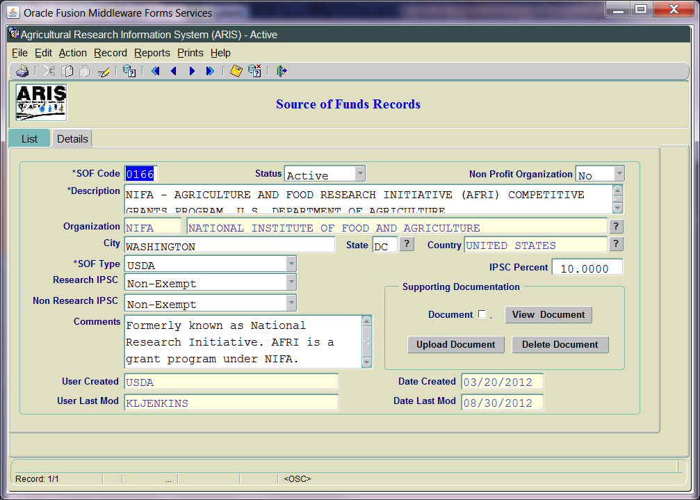
New SOF Reference Table

Slide 65
New SOF Reference Table
Added “Organization” – high level
Modified “waived” to “exempt”
Added Supporting Documentation – to support Exemption policy
Added City, State, Country
Exempt list also posted on EAD Website
In process of “cleaning up” data

Slide 66
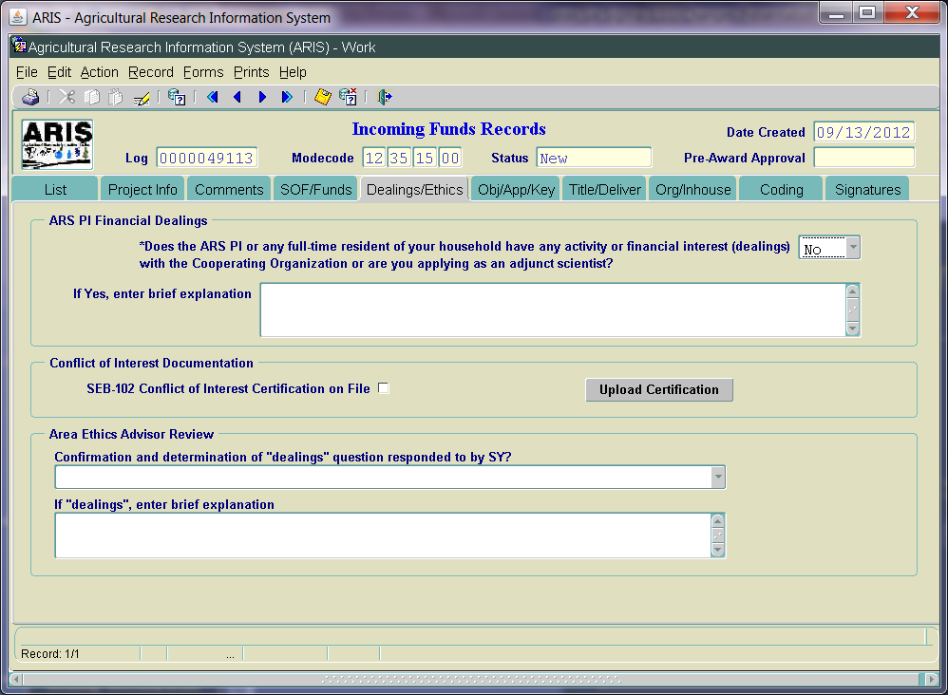
Incoming - Dealings/Ethics Screen

Slide 67
Incoming- Dealings/Ethics Screen
Reworded Financial Dealings question
Reworded label for “Area Ethics Advisor Review”
Added Conflict of Interest Documentation section
SEB-102 Certification required
Upload Certification form
Required at RL level or initial level of entry at point of award (when entering AIMS)
Not required for Interagency Agreements, Services Only, Gifts, or No Funds to ARS
Area Ethics Advisor/Area Office will review to ensure conformity
Removed Area Director Only questions

Slide 68
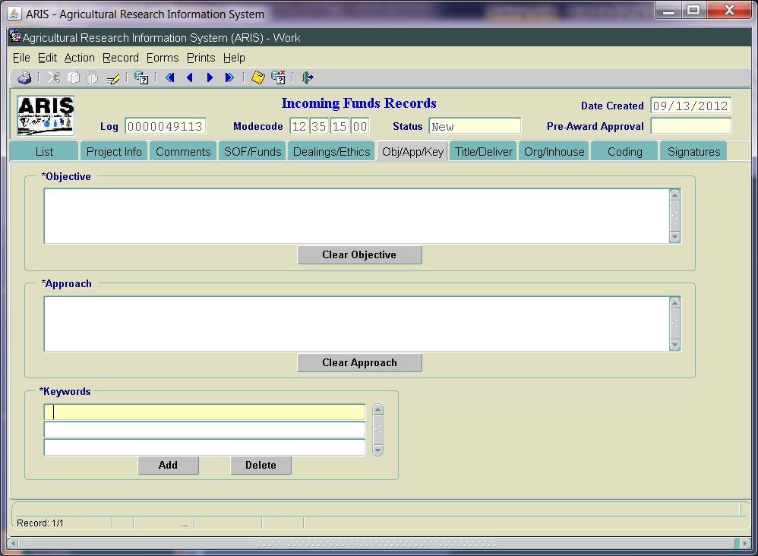
Incoming – Obj/App/Key Screen
No changes

Slide 69
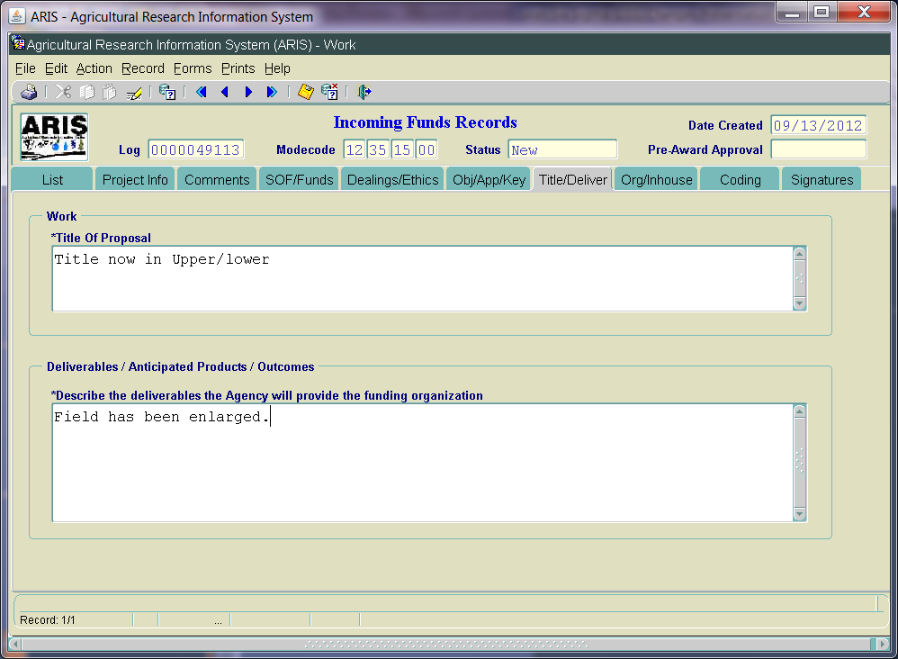
Incoming -Title/Deliverables Screen
Changed Title field to be Upper/lower case
Increased length of Title field to 148 characters
Deliverables label changed to “Deliverables/Anticipated Products/Outcomes
Increased size of Deliverables field to unlimited
Notes:
-

Slide 70
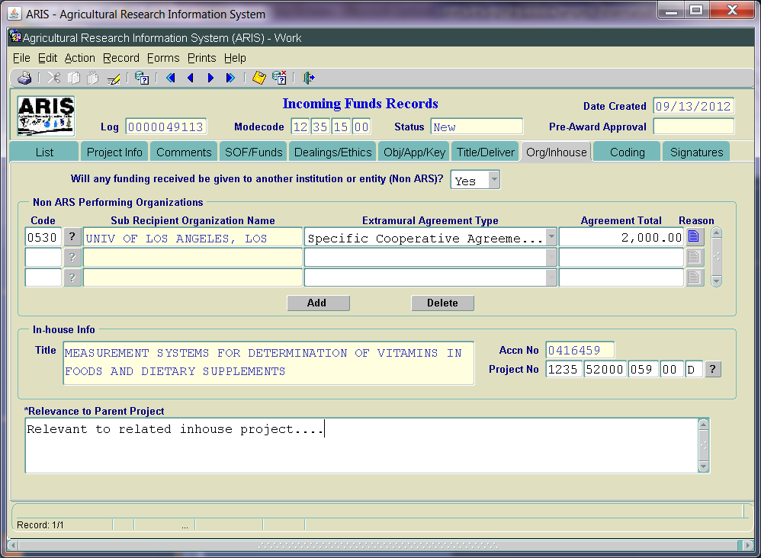
Incoming - Org/Inhouse Screen

Slide 71
Incoming - Org/Inhouse Screen
Work to be Performed” – changed to “Will any funding received be given to another institution or entity (Non ARS)?
Select Yes/No
If Yes, the Non ARS Performing Organization section is activated
Added additional agreement types in LOV
Agreement total will be validated against Extramural amount in Budget Record Details section
Modified “Description” to “Sub Recipient Organization Name”
Removed “Is the proposed research directed related to the Inhouse project of SY” questions

Slide 72
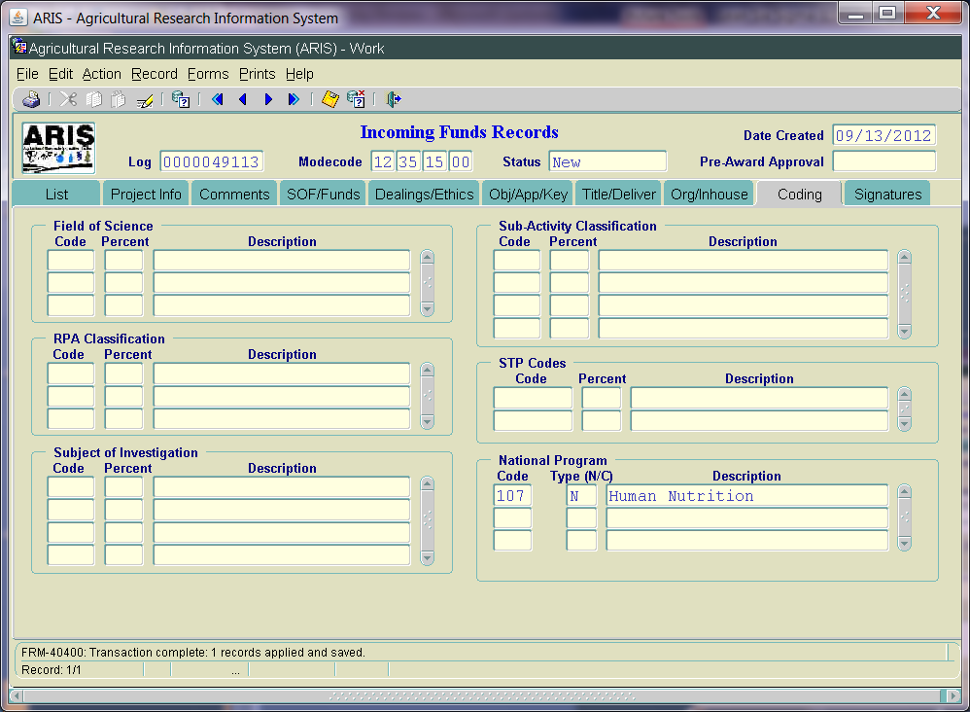
Incoming – Coding Screen
Coding is no longer required on initial entry
NP code auto propagates
Upon award notification, coding will be required on Incoming Funds Record if under $25,000 or on 416/417 if over $25,000
Notes:
-

Slide 73
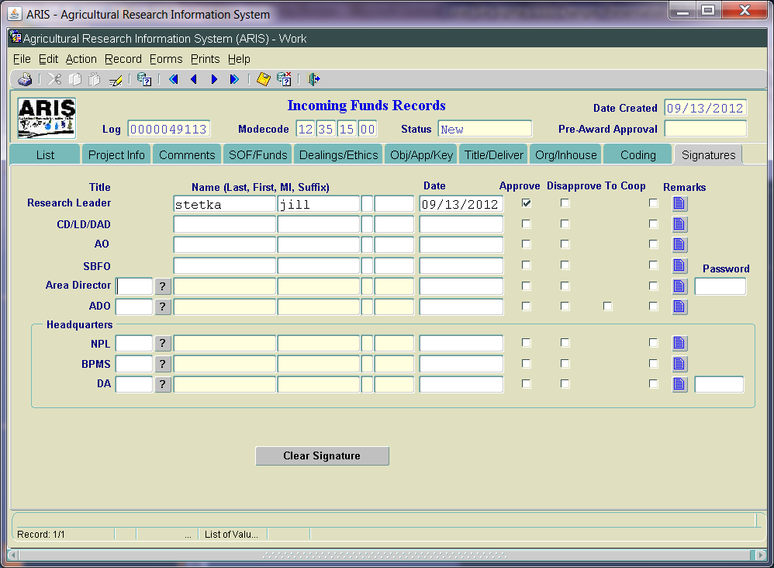
Incoming – Signature Screen
Modified label – ABFO to SBFO
Removed NPL2 and 3

Slide 74
Incoming – Award / Post-Award
Award Process for Agreements w/o 416/417
Create Work Record of Incoming Funds Record
Modify Comments
Add Coding
Upload SEB-102 (if applicable)
Add AIMS Data (if applicable)
Make any other necessary changes
Approve

Slide 75
Incoming – Award / Post-Award
Award Process for Agreements w/ 416/417
Create Work record of Incoming Funds Record
Generate 416
Add Comments on 416
Add Coding on 416
Upload SEB-102 (if applicable)
Add AIMS data (if applicable)
Approve
NOTE: 416/417 must be entered prior to entering AIMS. If attempt is made to enter AIMS first, error will be displayed

Slide 76
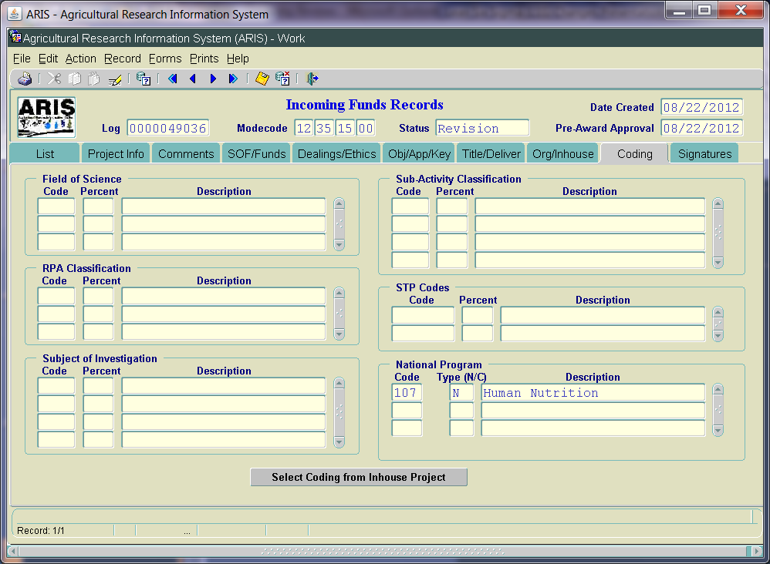
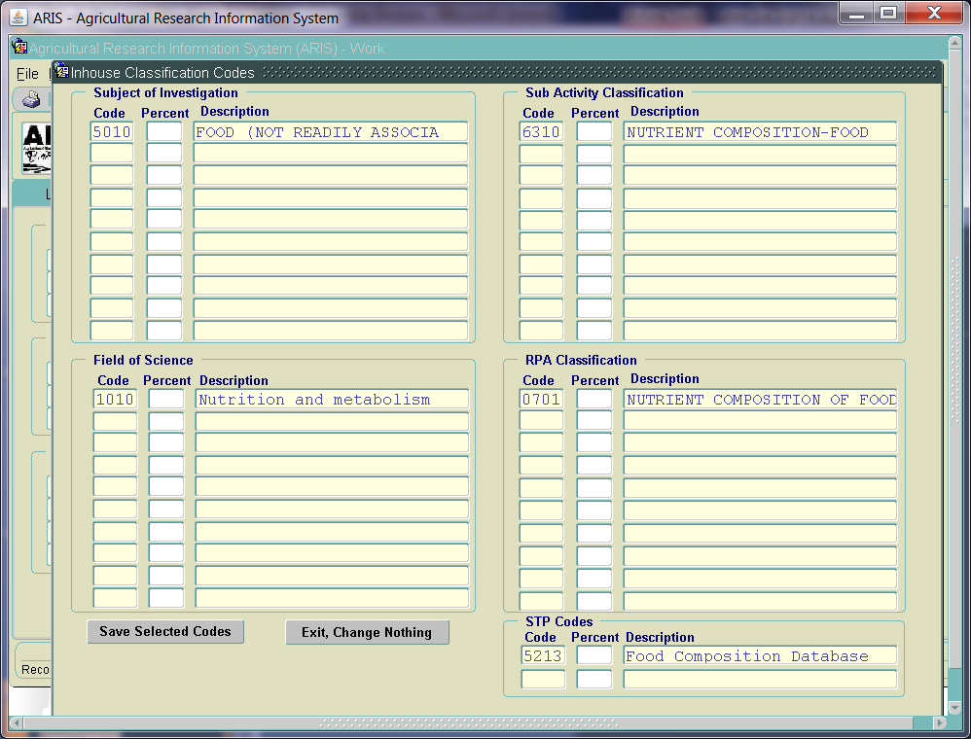
Incoming – Generating 416 and Adding Coding
Notes:
-

Slide 77
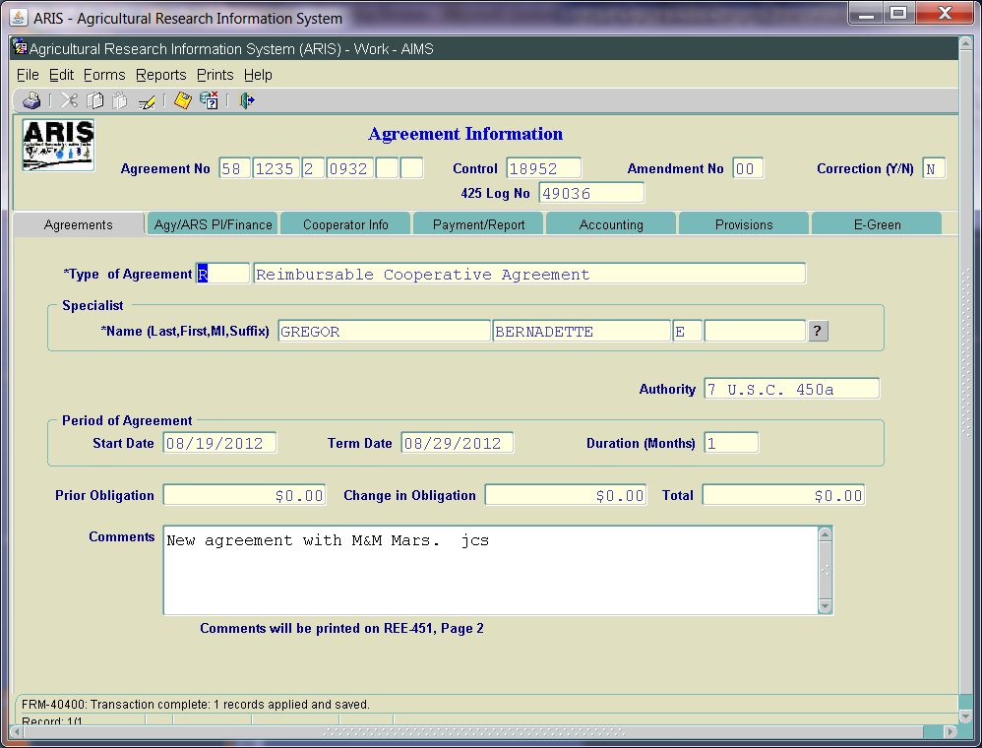
Incoming – Agreement Screen
Agreement number auto generated on AIMS first entry
Type of Agreement – auto populated from ARIS
Nonmodifiable
Added note below Comments field

Slide 78
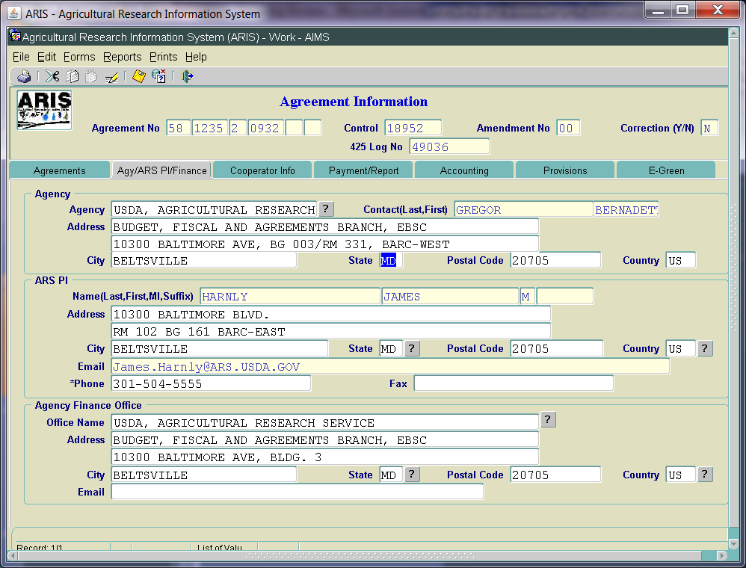
Incoming – Agy/ARS PI Screen
ARS PI – phone number required at All levels
ARS PI – email address auto populates from Delegation of Authority table
Not modifiable on screen

Slide 79
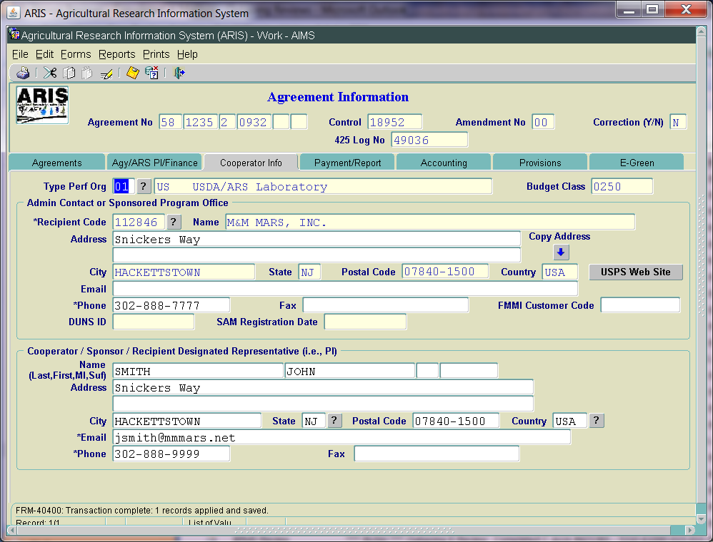
Incoming – Cooperator Info Screen

Slide 80
Incoming – Cooperator Info Screen
Admin Contact or Sponsored Program Office
Perf Org Type auto inserts - “01 USDA/ARS Laboratory”
Zip +4 required for all domestic agreements
USPS Website link added
SAM link added
DUNS ID – auto propagates
SAMS Registration Date – auto propagates
DUNS Parent ID removed
DUNS Confidence Level removed
Phone # required at ADO level
Email Address required at ADO level
Cooperator/Sponsor/Recipient Designated Rep
Email address required at ADO level
Phone # required at ADO level

Slide 81
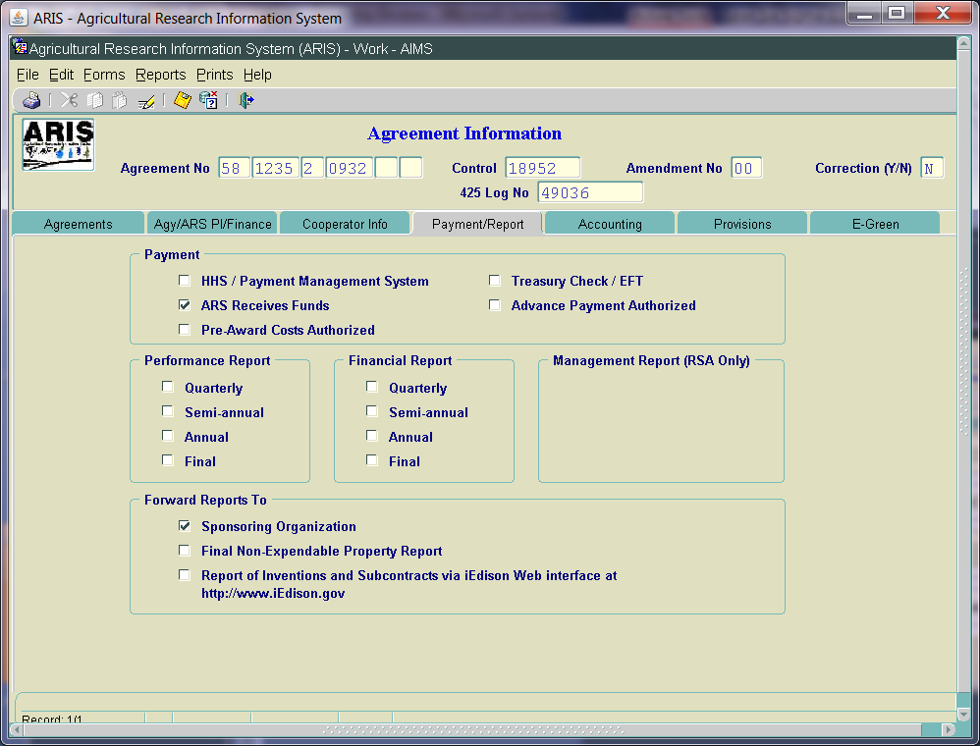
Incoming – Payment/Report Screen
Label changes –
“Forward Reports To”
“Report of Inventions and Subcontracts”
Added check box for Final Non-Expendable Property Report
Turn off Management Reports for all Non RSAs

Slide 82
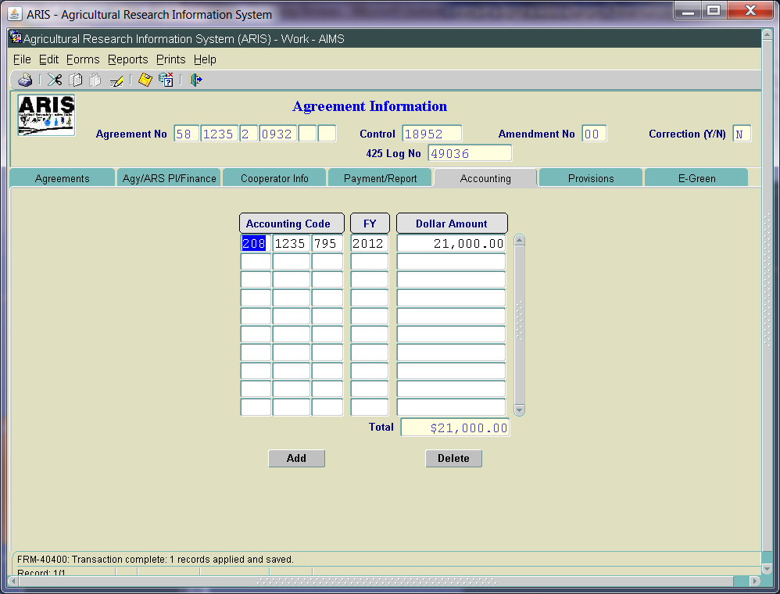
Incoming – Accounting Screen
No changes

Slide 83
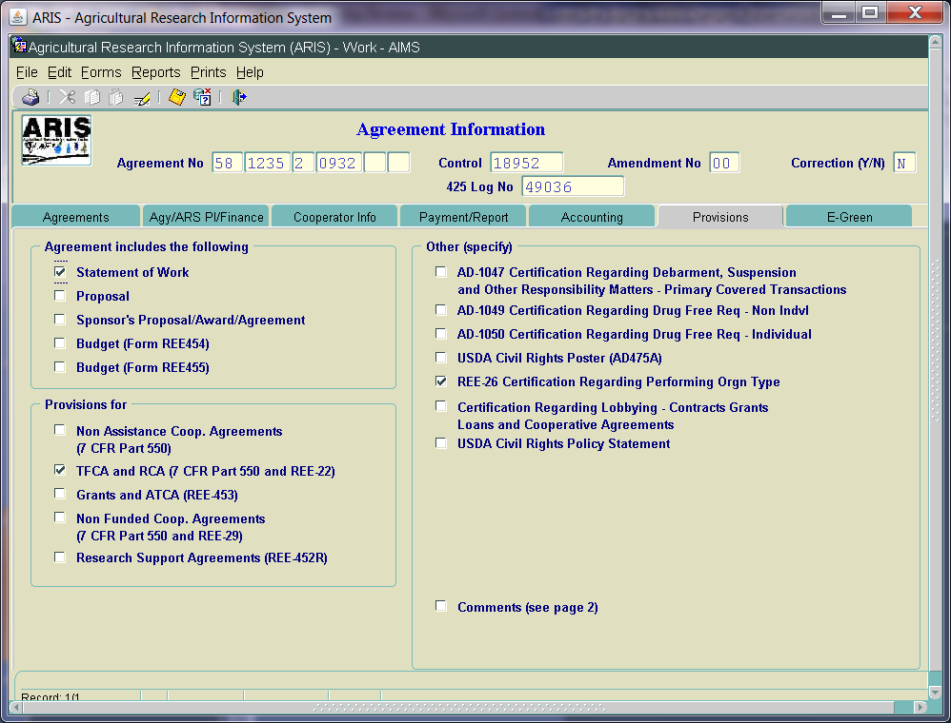
Incoming – Provisions Screen
In “Agreement includes the following” section:
“Sponsor’s Proposal/ Award/Agreement” label modified
In “Other (specify)” section:
Hide Attachment A for all Non RSAs
Added “USDA Civil Rights Policy Statement”

Slide 84
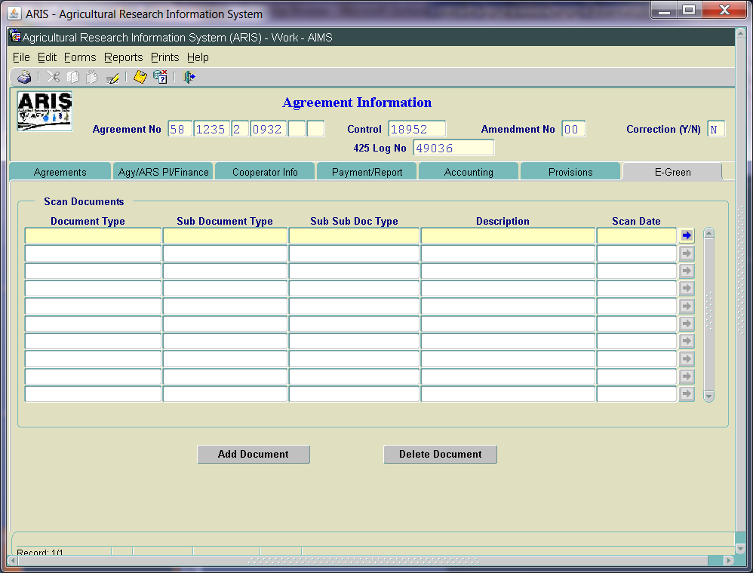
Incoming – E-Green Screen
E-green now available in Work file
All levels can Add
All levels can View
Only the level that adds the document can delete, other than ADO
Added additional options in document type and sub doc type

Slide 85
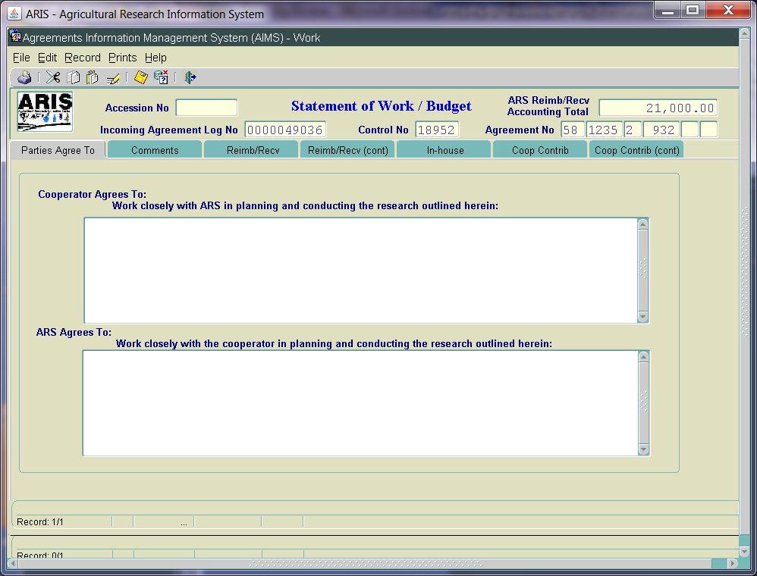
Incoming – SOW Screens
Added Accession number in header
SOMI/Mutual Benefits not required for RCA, TFCA, or IRA
No other changes
No changes to “Parties Agree to” Screen

Slide 86
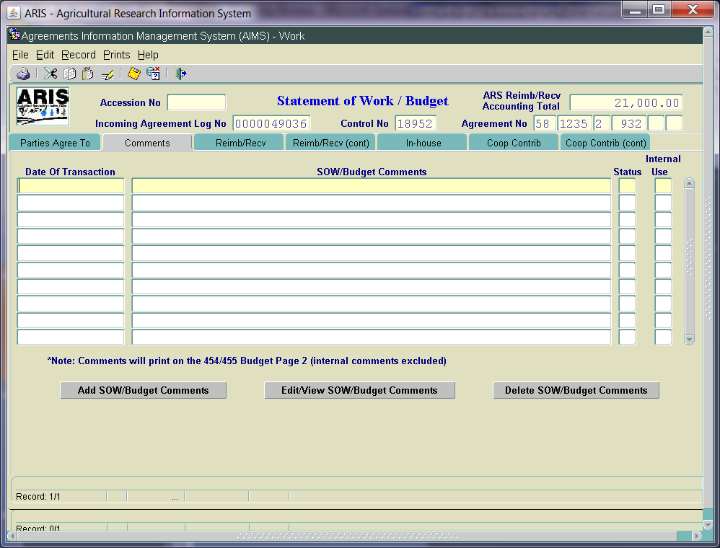
Incoming – SOW/Budget Comments
Changed label to “SOW/Budget Comments”
Added check box to indicate Internal Use Only
Required to answer Yes/No
If Yes is selected, comments WILL NOT print on the 454/455
Added Note: Comments will Print on the 454/455 Budget Page 2 (if check box = No)

Slide 87
Incoming – Budget Screens
No changes at this time
Future phase:
Increase size of description fields
Consolidate screens
Standardize all screens
Redesign for better viewing

Slide 88
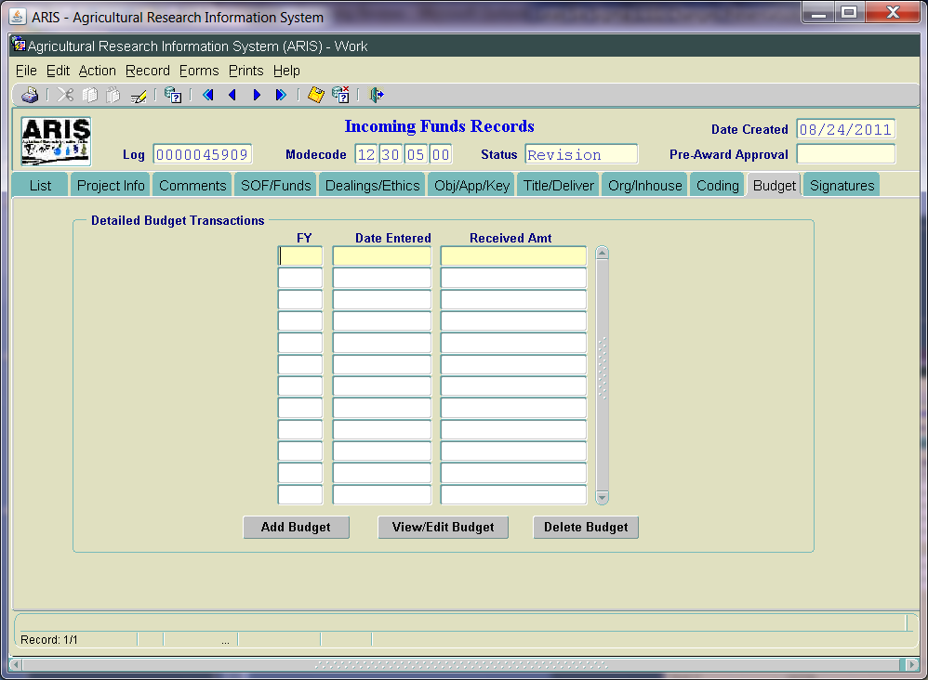
Incoming – Posting Screen (ARIS)
No changes at this time

Slide 89
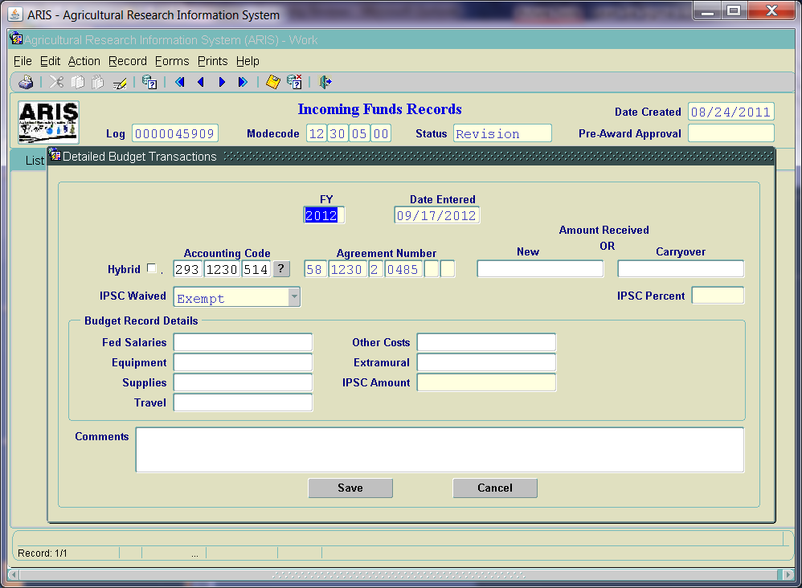
Incoming – Posting Screen

Slide 90
Incoming – Budget Screen
Removed - Fund Authorization field
Modified funding fields to correspond to Budget Record Details format
Added IPSC field – generated from IPSC % and amount of new funds posted
IPSC % and Amount – modifiable by BPMS
LOV added for Accounting Codes selection; can still manually enter

Slide 91
Incoming – Requirements
Gifts
ARIS to Dealings or E-Green screen
Services Only
ARIS to Dealings or E-Green screen
No Funds to ARS
ARIS – All screens; No AIMS
Research <= or > $25,000 (CRADA, MTRA, IRA, RCA, TFCA)
ARIS and AIMS – all screens
TFCA/RCA/IRA – SOMI/Mut Benefits removed

Slide 92
Additional Documentation
ARIS Online Manual – Chapter 4C
ARIS Online Manual – Chapter 4D
Powerpoint Presentation – recorded
Interagency Agreement Training – EAD website
P&P 321.1 will be revised
IPSC P&P329.5 updated – effective October 1, 2012
Bulletin – 12-220.0 (Gifts)

Slide 93
Future Phases
Phase 2:
Streamlining approval process/chain
Email notifications
Addition of Proposal screen for Incoming Agreements
Modification to Work Record Creation
Budget Screen modifications
Modifying ADO Disapproval Transaction levels

Slide 94
Questions on Incoming Agreements ??

