Slide 1

What’s New in
in 2012?

Slide 2

Google Drive

Slide 3
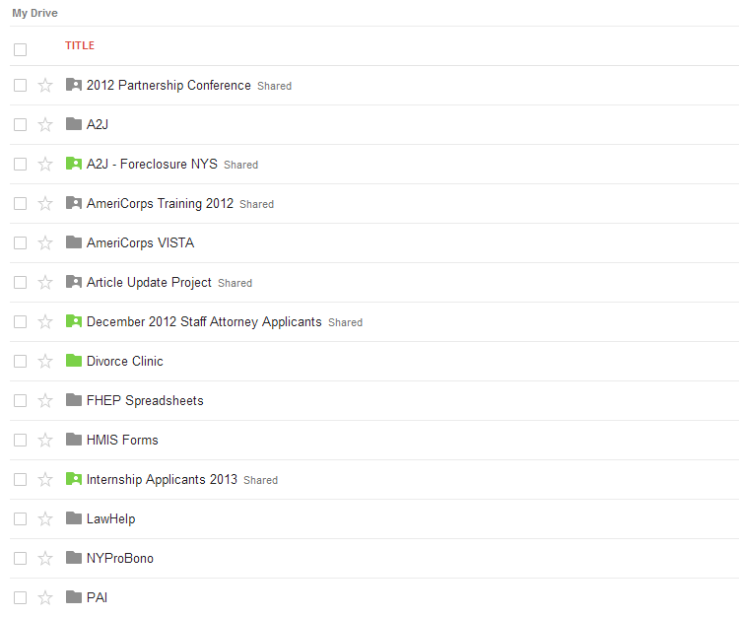
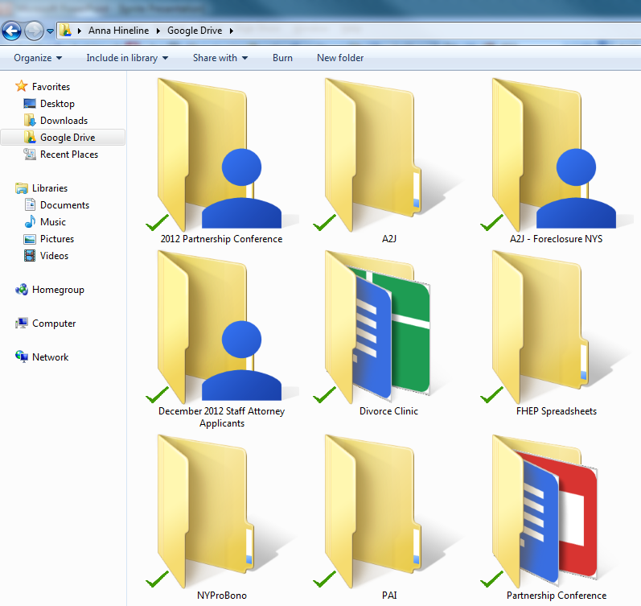

Slide 4
Collaboration

Slide 5
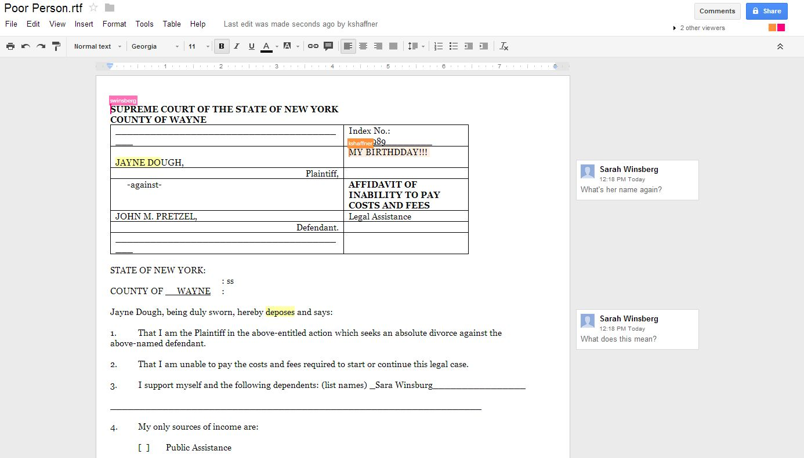

Slide 6
File Formats

Slide 7
.JPEG
.AI
.SVG
.TXT
.DXF
.CSS
. AVI
.DOC
.PSD
.PDF
.XLS
.WPD
.ZIP

Slide 8

Google⁺

Slide 9
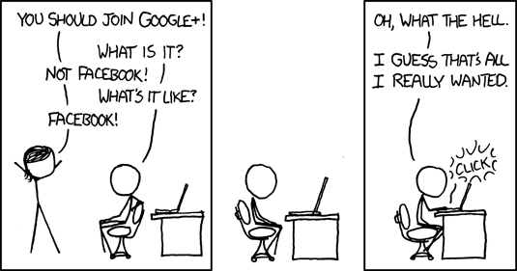
XKCD

Slide 10
Hangouts

Slide 11
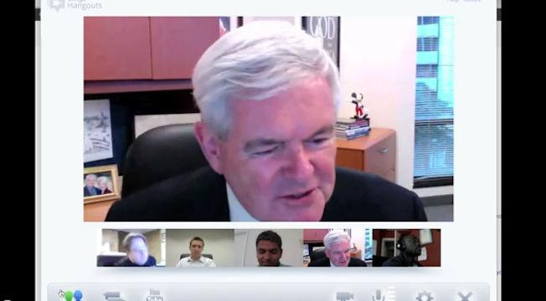

Slide 12
Communities

Slide 13
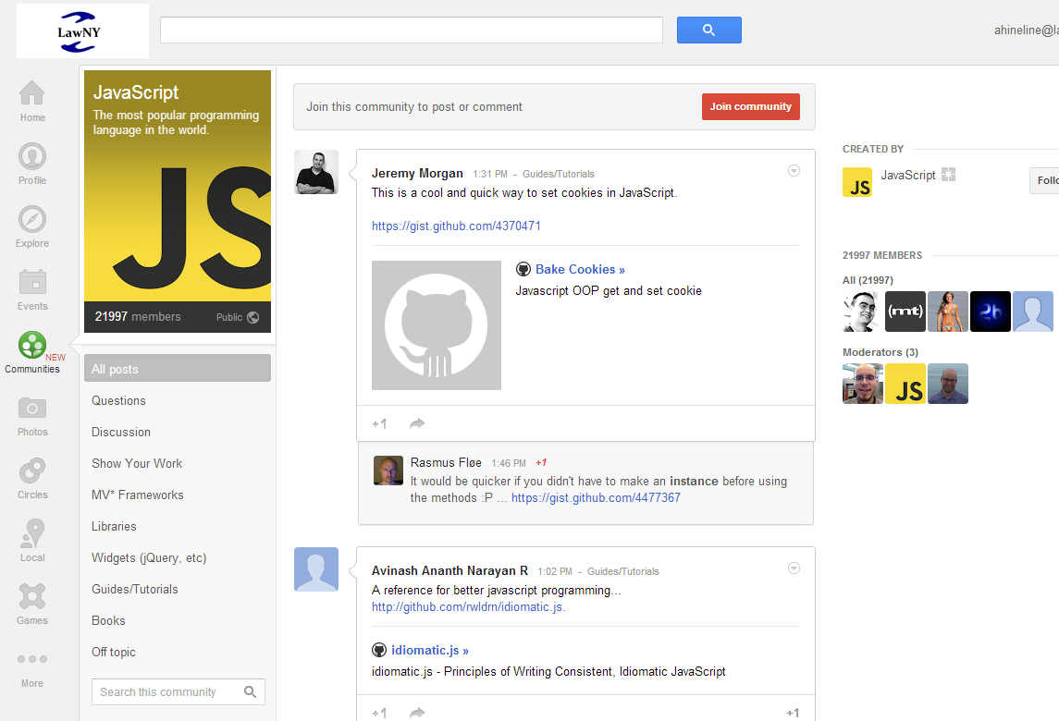

Slide 14

Administrative

Slide 15
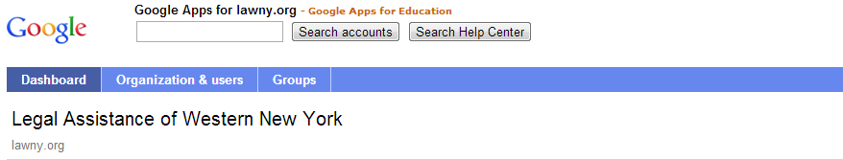
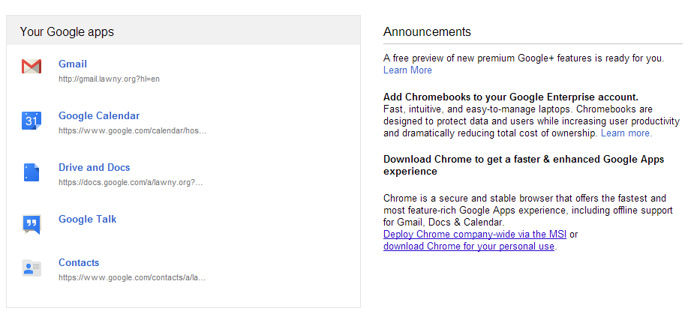

Slide 16
Email Settings

Slide 17
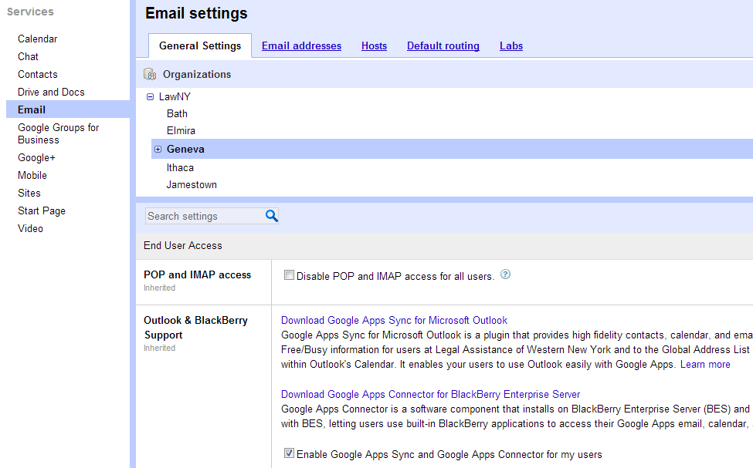

Slide 18
Mobile Controls

Slide 19
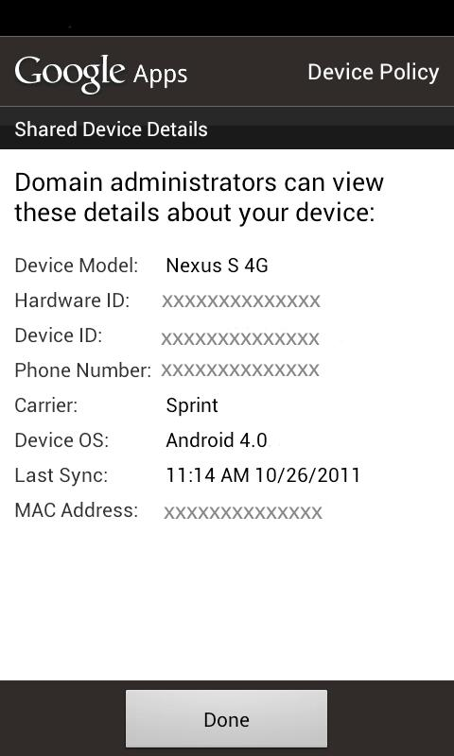
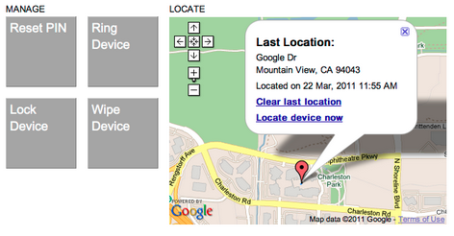

Slide 20


Anna Hineline
Legal Assistance of Western New York, Inc.®
ahineline@lawny.org

