Slide 1
Treasury Lessons Learned Overview September 25, 2012
Purposes of the presentation:
Discuss approaches for enterprise initiatives
Discuss impact of emerging IT trends across Treasury

Slide 2
Approaches for Enterprise Initiatives
Prioritize evaluation of enterprise initiatives
Identify business cases for enterprise initiatives
Document in Bureau CXO performance plans
Measure progress in Deputy Secretary Bureau stat sessions
Consistently communicate goals externally to OMB and GAO
Review alignment with government wide initiatives such as: DCCI, Digital/Mobile Strategy, Cloud Computing, Shared Services, IPv6, HSPD-12, Sustainability, Strategic Sourcing
Re-use data regularly collected whenever possible to track progress
CPIC reporting for cost accounting
Cyber/EA reporting for system accounting
Telecommunication costs can fluctuate dependent on:
Communication channels (mobile, remote, WIFI)
Number security approaches (PIV, PIV-I, derived credentials, RSA)
Distance between users and IT services
Amount of data transferred
Technology changes to impact “virtualization” scope
“Big Data” clusters not likely to be virtualized
Increase in thin clients will lead to more virtual desktop infrastructure

Slide 3
Fiscal IT Project Lessons Learned Overview September 25, 2012
Purposes of the presentation:
Shared Service Strategy
Bureau of the Fiscal Service Priorities & Investment Spending
Fiscal IT Project Background
Fiscal IT Project Lessons Learned

Slide 4
Shared Service Strategy
Shared Infrastructure Services
Network Management (TNet)
Identity and Access Management (IDAM)
Public Key Infrastructure (PKI)
Shared Business Services
Administrative Resource Center (ARC): Financial Management, Human Resources, Investment Accounting, Procurement, IT, Travel Services
HR Connect (HRC): HR Systems

Slide 5
Bureau of the Fiscal Service Priorities
FY 2013 Priorities
Consolidation Activities
Operating under a combined budget structure
Continue to position the organization for change
Increase number of electronic transactions
Reduce improper payments
Improve effectiveness of debt collection activities
Streamline government-wide accounting and reporting

Slide 6
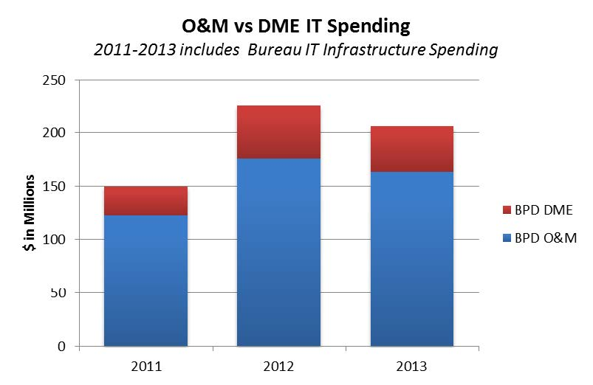
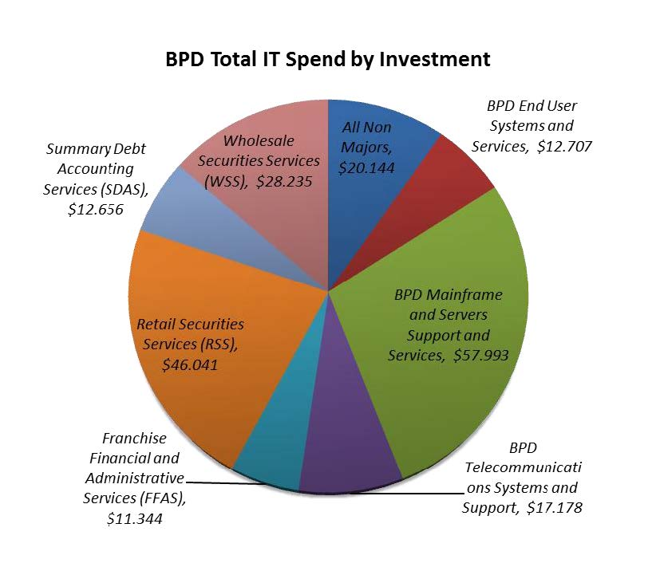
Bureau of the Fiscal Service Investment Spending

Slide 7
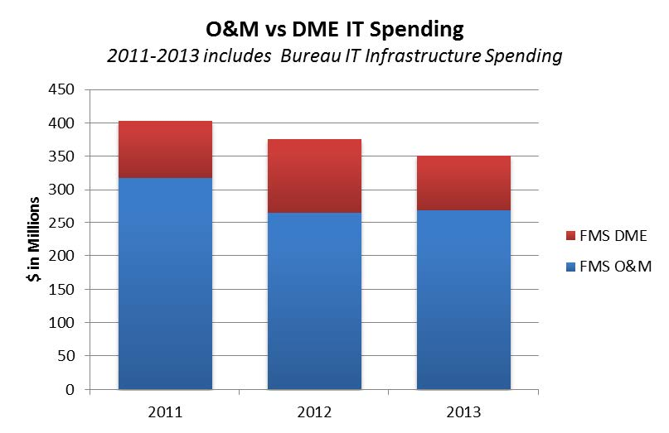
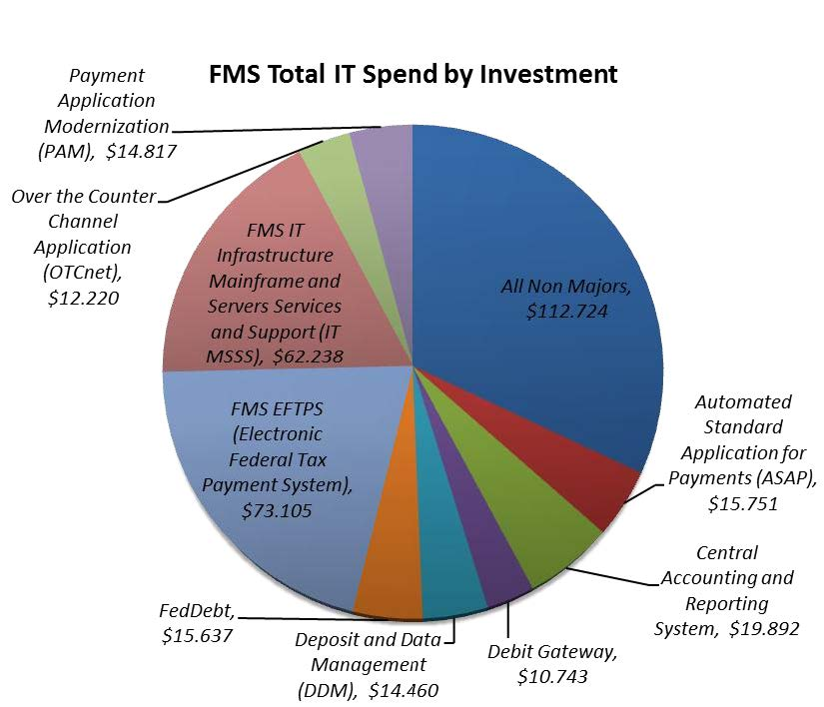
Bureau of the Fiscal Service Investment Spending

Slide 8
Fiscal IT Project Background
Project Announcement
December 9, 2009
Project Objectives
Consolidate Data Centers
Create Single Corporate Governing Body
In-Source Select Contractor Functions
Consolidate Application Development Methodologies and Infrastructure
Data Center Closure Dates
Contingency Automated Processing Site (CAPS): 7/29/11
Philadelphia Regional Operations Center (PROC): 8/30/11
Hyattsville Regional Operations Center (HROC): 1/31/12
Reorganizations
Public Debt OIT Phase I: September 25, 2011
Impacted Employees: 139 FMS / 9 Public Debt
Transferred Employees: 99 FMS / 7 Public Debt
FMS Enterprise Business Information & Security Services (EBISS): May 1, 2012
Public Debt OIT Phase II: May 7, 2012

Slide 9
Fiscal IT Project Background
Contract Services
Enterprise Professional Services – 60 Contractors for Infrastructure Support
Service Management Contract – 7 Contractors for IT Service Management
Governance Structure
Fiscal IT Security Program
Technical Architecture Review Board (TARB)
Capital Planning and Investment Control (CPIC)
Project Management Methodology
Total Economic Impact (TEI) Methodology
Application Development Methodologies
Project Estimated Savings

Slide 10
Fiscal IT Project Lessons Learned
Governance
Convergence of IT Governance
Program Area Project Prioritization
Technical Architecture Review Board (TARB)
Business Case Analyses (BCAs)
Communication
Stakeholder Analysis
Development of Communication Plan
External Communications with Federal Program Agencies (FPAs)
Internal Communications with Functional Areas
Fiscal IT Web Site

Slide 11
Fiscal IT Project Lessons Learned
Project Planning & Management
Joint CIO Decision Making
Project Plans & Dashboards
Project Organization (Committees & Project Sponsors)
Risk Register
Technical Infrastructure Status Meetings
Data Center Closure
Contractor In-Sourcing
Common Services
Inventory & Asset Management
Human Capital
Managing Organizational Change
Employee Impact & Considerations
Reorganizations

